Slide 1

House Facility Searching System
EPPS 6354

Slide 2



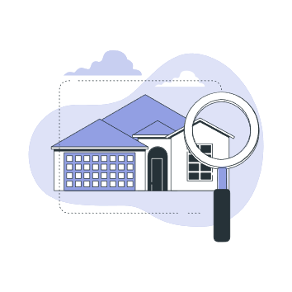

Slide 3
Contents
Purpose
Workflow
Data Design
Schema
Applications

Slide 4
Purpose
This project provides an application for users who wants to buy a house. The users can not only find a house but also the facilities around the house, such as schools, hospital, stores, gyms, etc. It can help users to find the dream house faster.

Slide 5
Workflow
Create database use PjAdmin4 and SQL
Extract the database from PjAdmin4 with DB browser
Put the data into Shiny app folders
Use Shiny app to implement applications with R

Slide 6
Data Design
Data is collected from redfin and data.World
The house data covers some attributes, such as number of bedrooms and bathrooms, price, address, longitude, latitude, etc.
The facility data covers the school, hospital, store, gym, etc.

Slide 7
Primary Key & Schema
The tables are:
house(with primary key: MLS)
hospital(with primary key: name)
store(with primary key: longitude, latitude)
school(with primary key: school_id )
student(with primary key: school_id )
staff(with primary key: school_id)

Slide 8
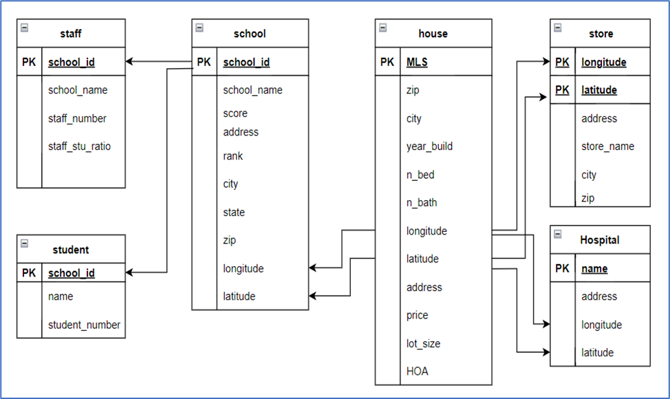

Slide 9
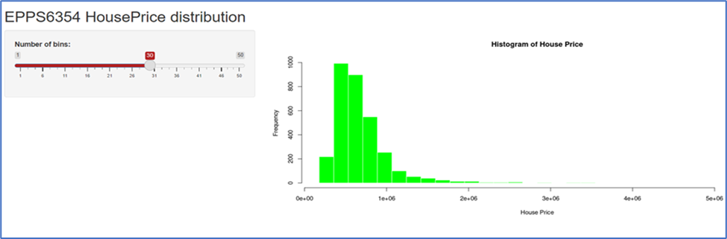
Applications

Slide 10
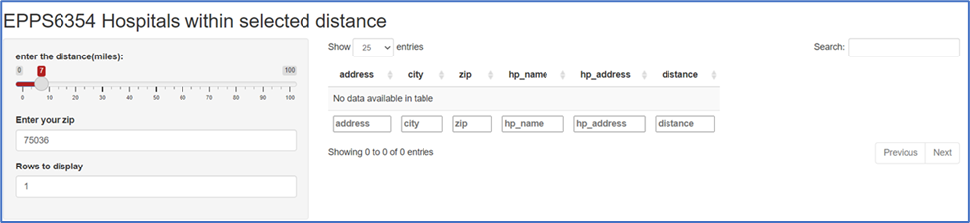

Slide 11
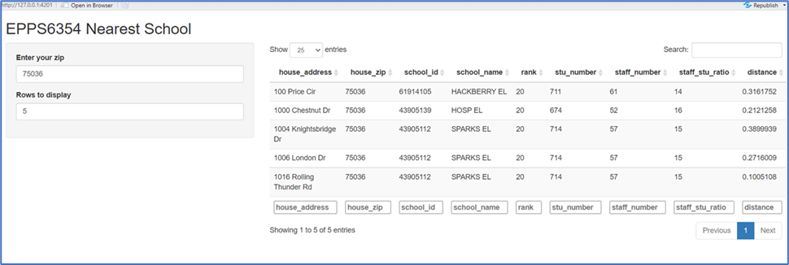

Slide 12
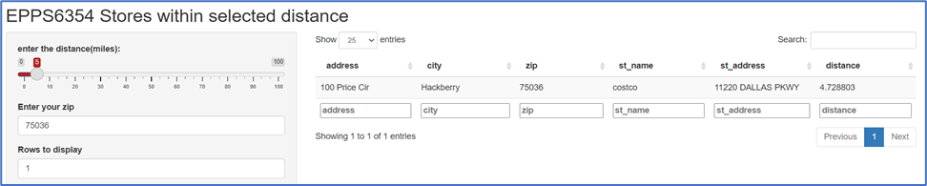

Slide 13
Shiny app link
https://xiaoyanhouston2.shinyapps.io/house_store/
https://xiaoyanhouston2.shinyapps.io/houseprice_frequency/
https://xiaoyanhouston2.shinyapps.io/house_hospital/
https://xiaoyanhouston2.shinyapps.io/house_school/

Slide 14
Thank You!

