Slide 1
House Searching System
Xiaoyan Zhang

Slide 2
Contents
Purpose
Data Design
Schema
Methods

Slide 3
Purpose
This project provides an application for users who wants to buy a house. The users can not only find a house but also the facilities around the house, such as schools, banks, stores, gyms, etc. It can help users to find the dream house more faster.

Slide 4
Data Design
Data will be collected on redfin and data. World
The house data covers some attributes, such as number of bedroom and bathroom, price, address, longitude, latitude, etc.
The facilities data covers the school, bank, store, gym, etc.

Slide 5
Primary Key
The tables are:
property(with primary key: ID)
listing(with primary key: id, MLS_id)
store(with primary key: id, name)
school(with primary key: id )
Record(with primary key: year, id )
Facility(with primary key: id , name )

Slide 6
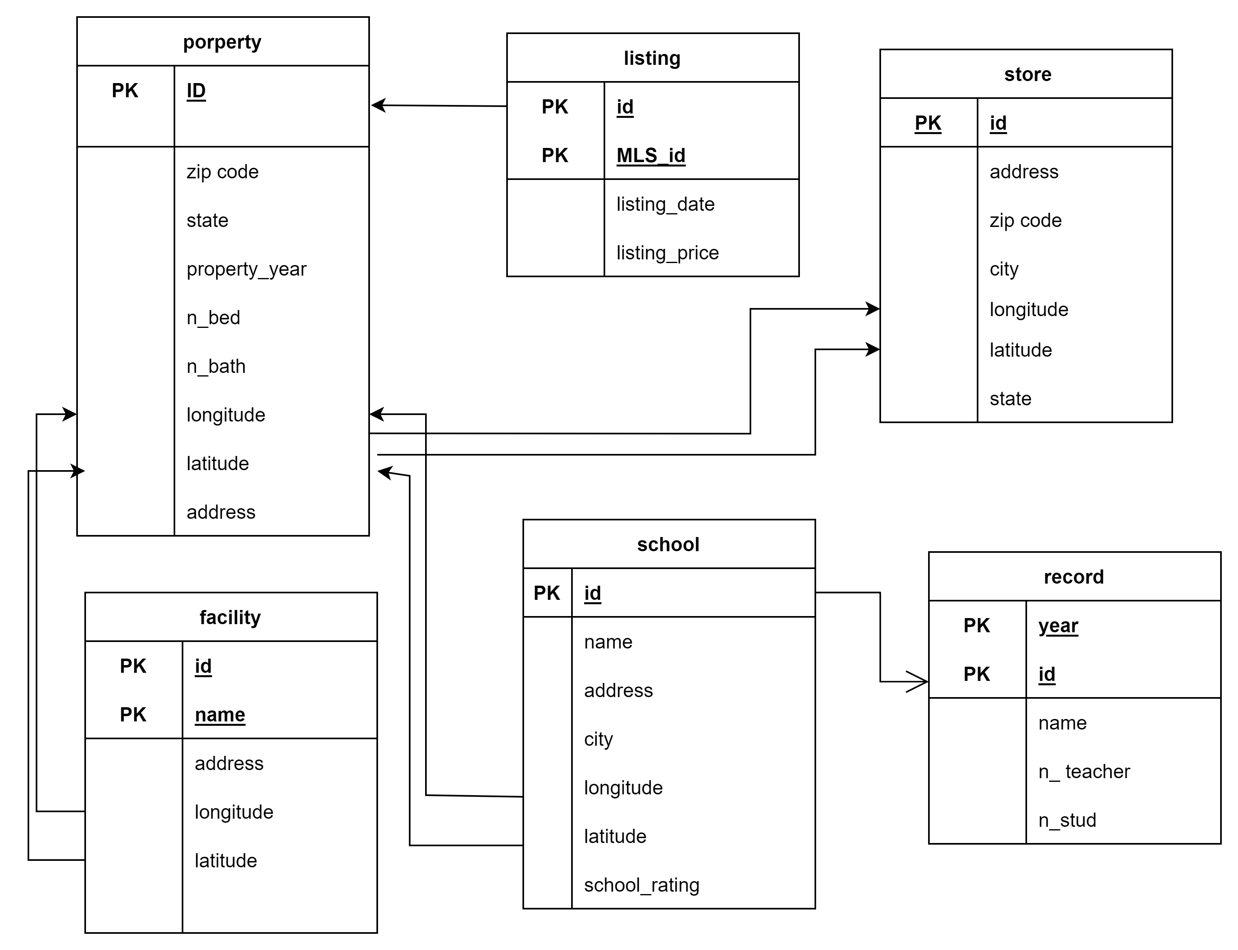

Slide 7
Analysis
House price distribution
Check school rating around each house
Check the distance distribution between house and store.
Use spatial join to find number of stores around each house within n miles.

