Slide 1
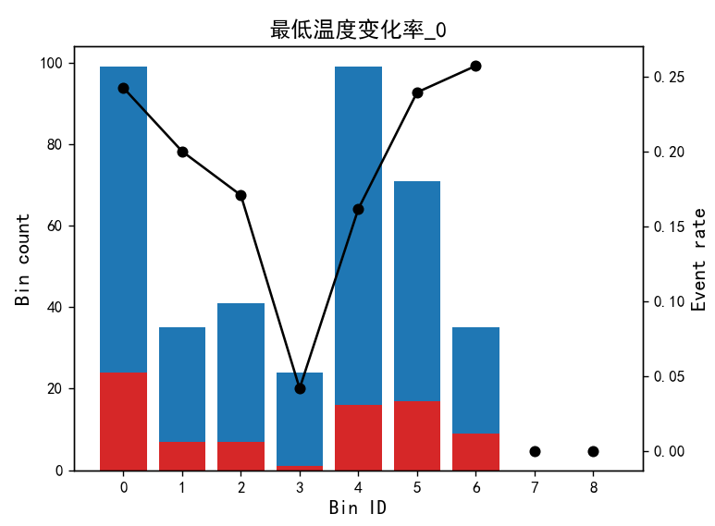
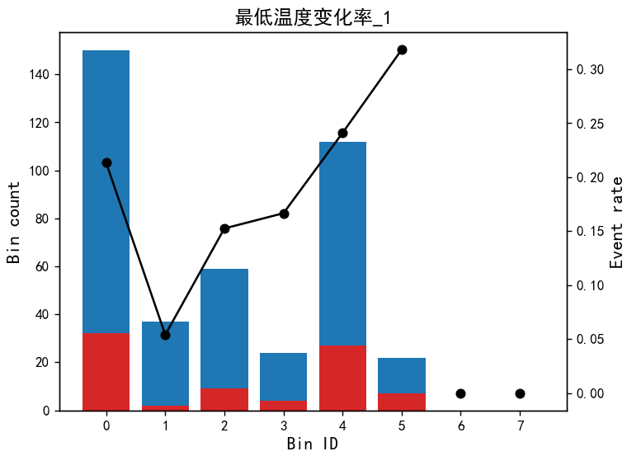
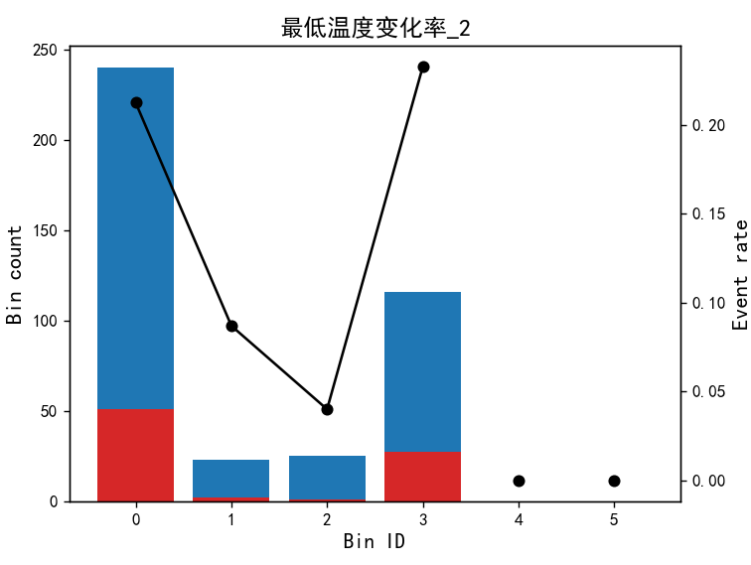
分箱阈值: [0.7582795 0.85373431 0.95778897 0.96032894 1.25594306 2.5893631 ]
=== 变量: 最低温度变化率_0 ===
Bin Count Count (%) Event rate EEF
0 (-inf, 0.76) 99 0.245050 0.242424 323.714844
1 [0.76, 0.85) 35 0.086634 0.200000 324.064917
2 [0.85, 0.96) 41 0.101485 0.170732 308.762792
3 [0.96, 0.96) 24 0.059406 0.041667 322.840980
4 [0.96, 1.26) 99 0.245050 0.161616 317.124838
5 [1.26, 2.59) 71 0.175743 0.239437 315.075103
6 [2.59, inf) 35 0.086634 0.257143 320.294949
分箱阈值: [0.33676302 0.36553687 0.40514623 0.41603236 0.93280786]
=== 变量: 最低温度变化率_1 ===
Bin Count Count (%) Event rate EEF
0 (-inf, 0.34) 150 0.371287 0.213333 320.316109
1 [0.34, 0.37) 37 0.091584 0.054054 296.327116
2 [0.37, 0.41) 59 0.146040 0.152542 315.188017
3 [0.41, 0.42) 24 0.059406 0.166667 324.623393
4 [0.42, 0.93) 112 0.277228 0.241071 323.118493
5 [0.93, inf) 22 0.054455 0.318182 326.621309
分箱阈值: [0.42381787 0.43155469 0.45278631]
=== 变量: 最低温度变化率_2 ===
Bin Count Count (%) Event rate EEF
0 (-inf, 0.42) 240 0.594059 0.212500 319.244350
1 [0.42, 0.43) 23 0.056931 0.086957 319.882148
2 [0.43, 0.45) 25 0.061881 0.040000 298.115738
3 [0.45, inf) 116 0.287129 0.232759 321.936958

Slide 2
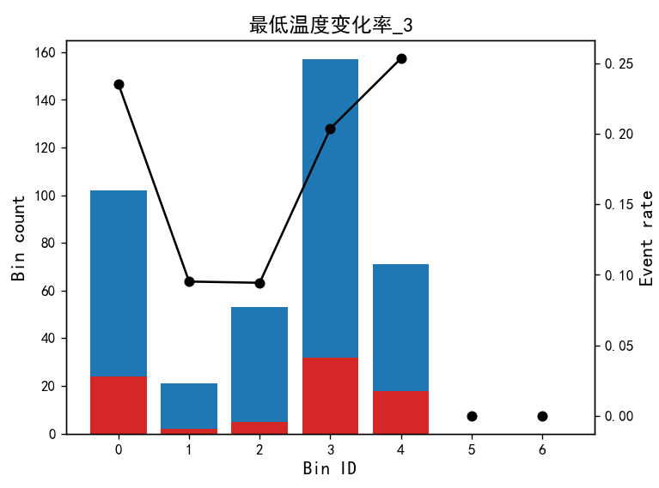
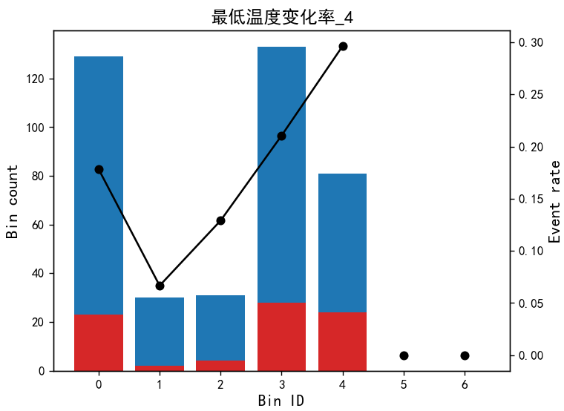
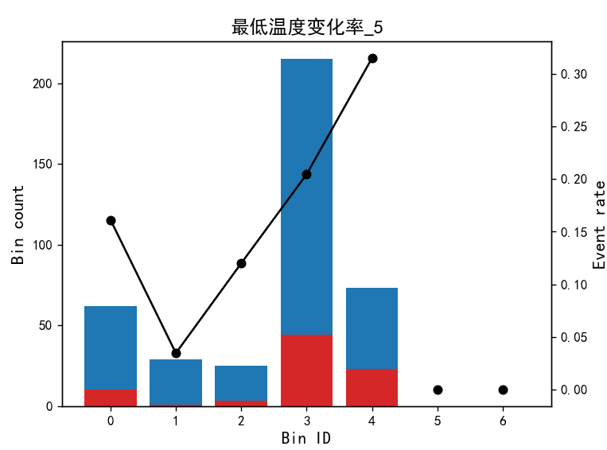
分箱阈值: [0.35076125 0.35561687 0.38551535 0.52372617]
=== 变量: 最低温度变化率_3 ===
Bin Count Count (%) Event rate EEF
0 (-inf, 0.35) 102 0.252475 0.235294 317.296625
1 [0.35, 0.36) 21 0.051980 0.095238 308.606679
2 [0.36, 0.39) 53 0.131188 0.094340 312.013280
3 [0.39, 0.52) 157 0.388614 0.203822 320.375214
4 [0.52, inf) 71 0.175743 0.253521 325.252191
分箱阈值: [0.41579415 0.42869654 0.43703449 0.56089675]
=== 变量: 最低温度变化率_4 ===
Bin Count Count (%) Event rate EEF
0 (-inf, 0.42) 129 0.319307 0.178295 309.421986
1 [0.42, 0.43) 30 0.074257 0.066667 315.528008
2 [0.43, 0.44) 31 0.076733 0.129032 314.662801
3 [0.44, 0.56) 133 0.329208 0.210526 323.929222
4 [0.56, inf) 81 0.200495 0.296296 327.840792
分箱阈值: [0.35307498 0.38436994 0.39095132 0.55303106]
=== 变量: 最低温度变化率_5 ===
Bin Count Count (%) Event rate EEF
0 (-inf, 0.35) 62 0.153465 0.161290 307.201090
1 [0.35, 0.38) 29 0.071782 0.034483 289.550367
2 [0.38, 0.39) 25 0.061881 0.120000 315.438414
3 [0.39, 0.55) 215 0.532178 0.204651 321.689583
4 [0.55, inf) 73 0.180693 0.315068 332.614592

Slide 3
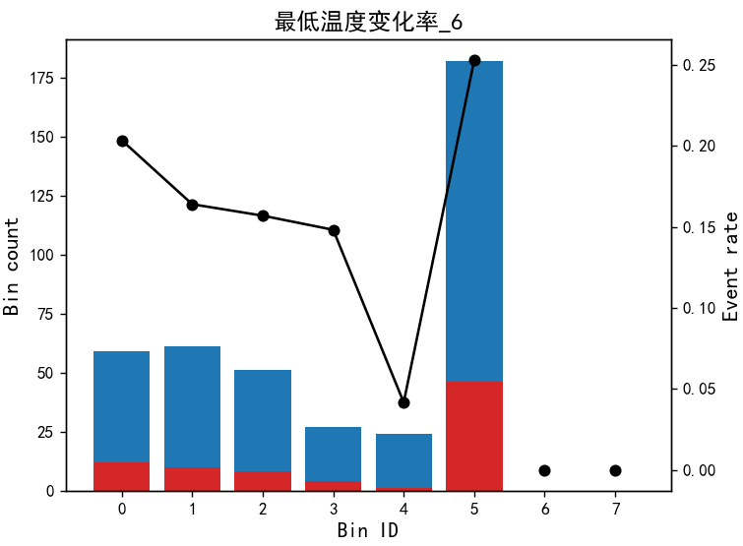
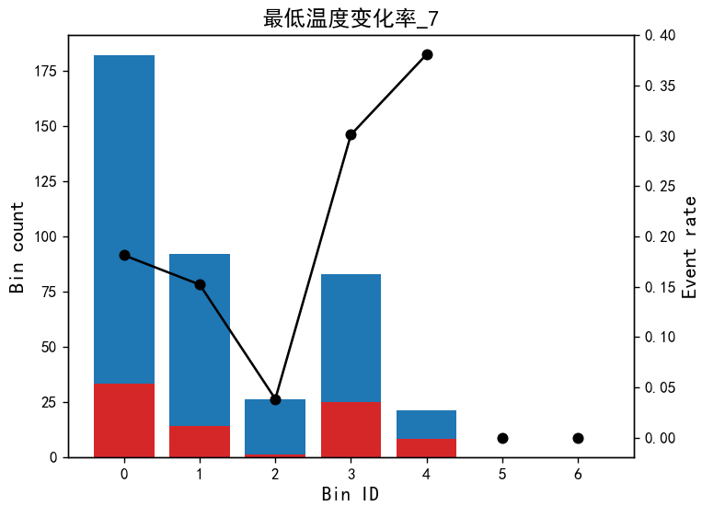
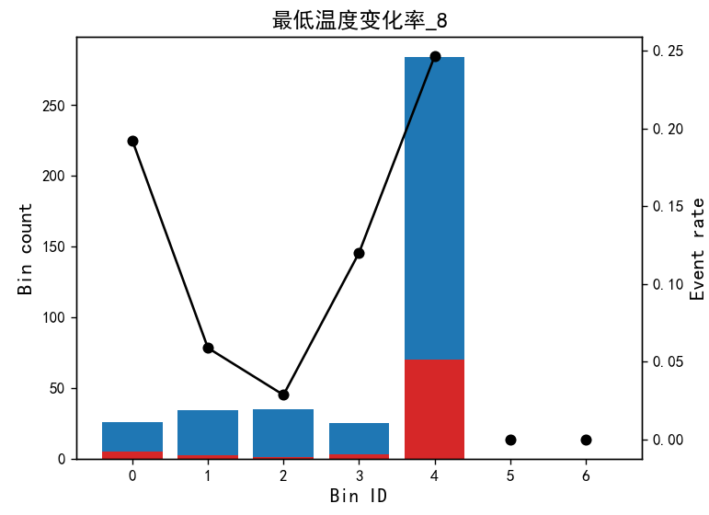
分箱阈值: [0.3875349 0.43811837 0.48210064 0.50500476 0.5184955 ]
=== 变量: 最低温度变化率_6 ===
Bin Count Count (%) Event rate EEF
0 (-inf, 0.39) 59 0.146040 0.203390 315.125808
1 [0.39, 0.44) 61 0.150990 0.163934 310.360971
2 [0.44, 0.48) 51 0.126238 0.156863 304.516859
3 [0.48, 0.51) 27 0.066832 0.148148 311.954119
4 [0.51, 0.52) 24 0.059406 0.041667 317.128309
5 [0.52, inf) 182 0.450495 0.252747 327.938856
箱阈值: [0.46382686 0.53619179 0.56374538 0.6950841 ]
=== 变量: 最低温度变化率_7 ===
Bin Count Count (%) Event rate EEF
0 (-inf, 0.46) 182 0.450495 0.181319 311.976790
1 [0.46, 0.54) 92 0.227723 0.152174 314.333089
2 [0.54, 0.56) 26 0.064356 0.038462 321.493796
3 [0.56, 0.70) 83 0.205446 0.301205 335.375666
4 [0.70, inf) 21 0.051980 0.380952 327.622620
=== 变量: 最低温度变化率_8 ===
Bin Count Count (%) Event rate EEF
0 (-inf, 0.32) 26 0.064356 0.192308 306.149530
1 [0.32, 0.36) 34 0.084158 0.058824 299.844730
2 [0.36, 0.40) 35 0.086634 0.028571 305.592999
3 [0.40, 0.42) 25 0.061881 0.120000 316.233471
4 [0.42, inf) 284 0.702970 0.246479 324.004626

Slide 4
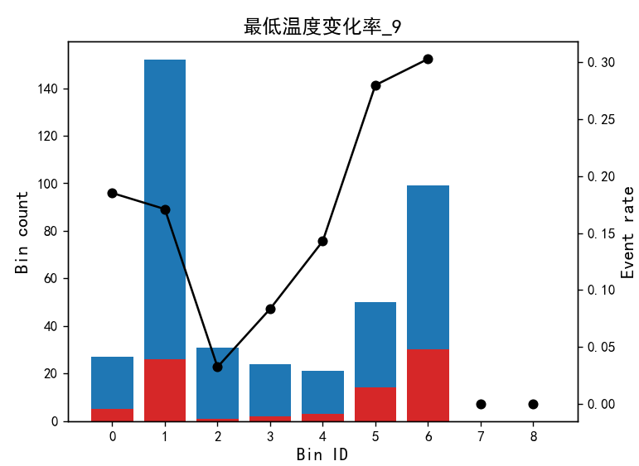
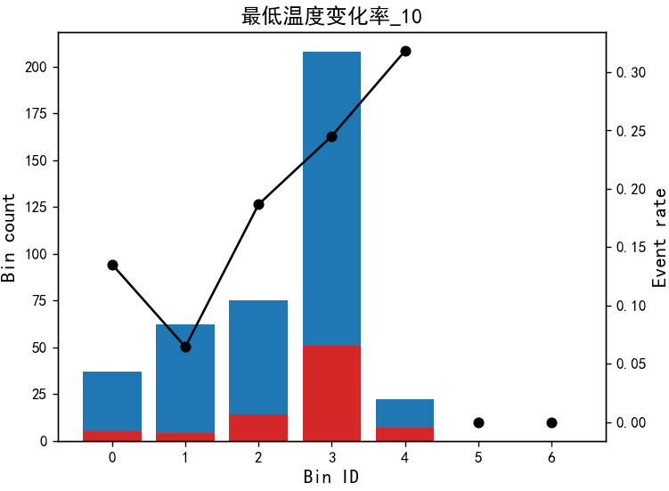
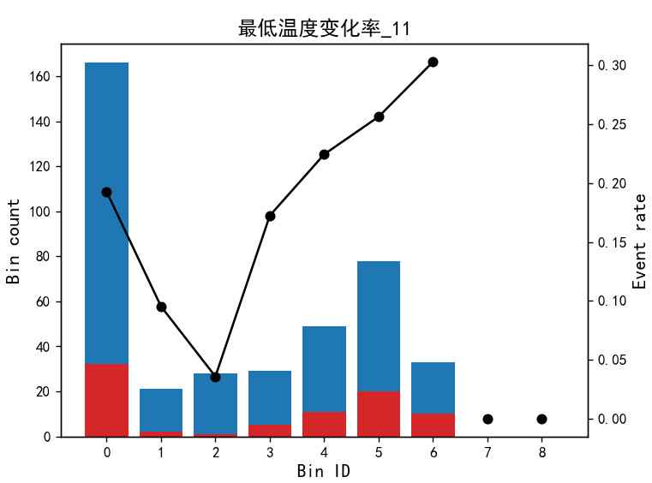
分箱阈值: [0.33806533 0.41924013 0.4852508 0.50864455 0.5370369 0.56015256 0.61876202]
=== 变量: 最低温度变化率_9 ===
Bin Count Count (%) Event rate EEF
0 (-inf, 0.34) 27 0.066832 0.185185 317.449902
1 [0.34, 0.42) 76 0.188119 0.171053 307.333521
2 [0.42, 0.49) 76 0.188119 0.171053 309.108199
3 [0.49, 0.51) 31 0.076733 0.032258 302.669020
4 [0.51, 0.54) 24 0.059406 0.083333 313.984920
5 [0.54, 0.56) 21 0.051980 0.142857 306.024843
6 [0.56, 0.62) 50 0.123762 0.280000 329.202153
7 [0.62, inf) 99 0.245050 0.303030 338.866554
分箱阈值: [0.37604782 0.44002137 0.49932158 0.78693575]
=== 变量: 最低温度变化率_10 ===
Bin Count Count (%) Event rate EEF
0 (-inf, 0.38) 37 0.091584 0.135135 319.549375
1 [0.38, 0.44) 62 0.153465 0.064516 305.664544
2 [0.44, 0.50) 75 0.185644 0.186667 309.327828
3 [0.50, 0.79) 208 0.514851 0.245192 325.492163
4 [0.79, inf) 22 0.054455 0.318182 322.592201
分箱阈值: [0.52112699 0.53844202 0.5567514 0.58299881 0.65234733 0.80594659]
=== 变量: 最低温度变化率_11 ===
Bin Count Count (%) Event rate EEF
0 (-inf, 0.52) 166 0.410891 0.192771 312.348359
1 [0.52, 0.54) 21 0.051980 0.095238 303.243602
2 [0.54, 0.56) 28 0.069307 0.035714 288.712606
3 [0.56, 0.58) 29 0.071782 0.172414 318.683742
4 [0.58, 0.65) 49 0.121287 0.224490 334.451921
5 [0.65, 0.81) 78 0.193069 0.256410 328.298276
6 [0.81, inf) 33 0.081683 0.303030 340.435746

Slide 5
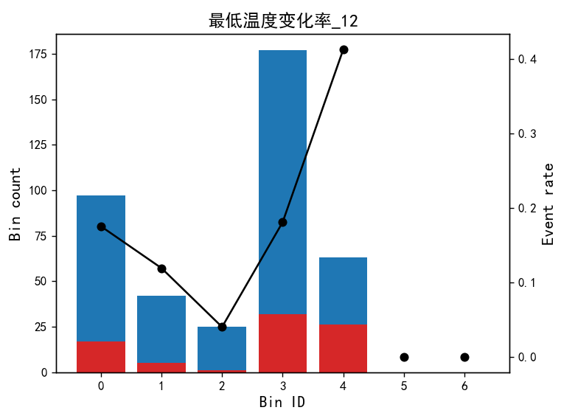
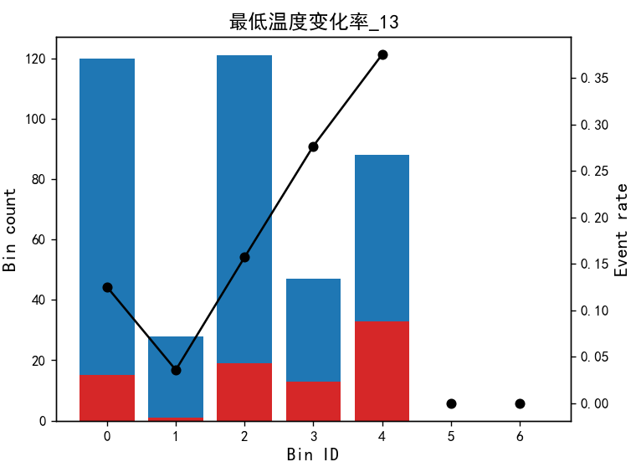
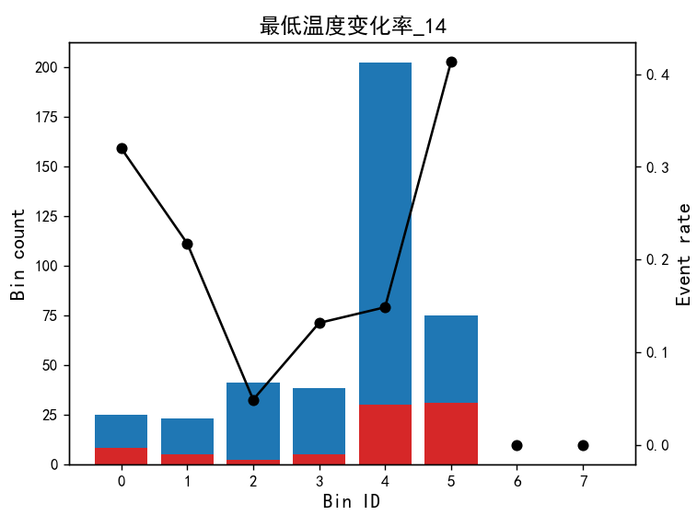
分箱阈值: [0.49219993 0.52884454 0.54437602 0.75900352]
=== 变量: 最低温度变化率_12 ===
Bin Count Count (%) Event rate EEF
0 (-inf, 0.49) 97 0.240099 0.175258 311.824892
1 [0.49, 0.53) 42 0.103960 0.119048 300.662845
2 [0.53, 0.54) 25 0.061881 0.040000 286.170258
3 [0.54, 0.76) 177 0.438119 0.180791 319.564490
4 [0.76, inf) 63 0.155941 0.412698 352.087123
分箱阈值: [0.53065088 0.55867875 0.69642958 0.75759211]
=== 变量: 最低温度变化率_13 ===
Bin Count Count (%) Event rate EEF
0 (-inf, 0.53) 120 0.297030 0.125000 305.854791
1 [0.53, 0.56) 28 0.069307 0.035714 284.979735
2 [0.56, 0.70) 121 0.299505 0.157025 316.744054
3 [0.70, 0.76) 47 0.116337 0.276596 332.128744
4 [0.76, inf) 88 0.217822 0.375000 342.675285
分箱阈值: [0.43048207 0.47175983 0.51512653 0.55845565 0.8125082 ]
=== 变量: 最低温度变化率_14 ===
Bin Count Count (%) Event rate EEF
0 (-inf, 0.43) 25 0.061881 0.320000 315.913488
1 [0.43, 0.47) 23 0.056931 0.217391 318.828099
2 [0.47, 0.52) 41 0.101485 0.048780 296.861173
3 [0.52, 0.56) 38 0.094059 0.131579 303.402108
4 [0.56, 0.81) 202 0.500000 0.148515 315.090244
5 [0.81, inf) 75 0.185644 0.413333 349.250841

Slide 6
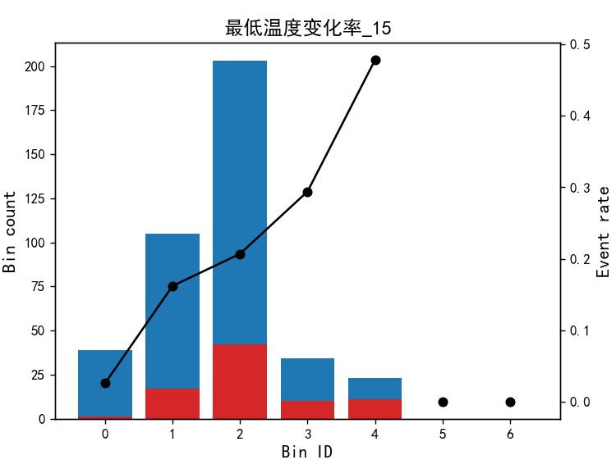
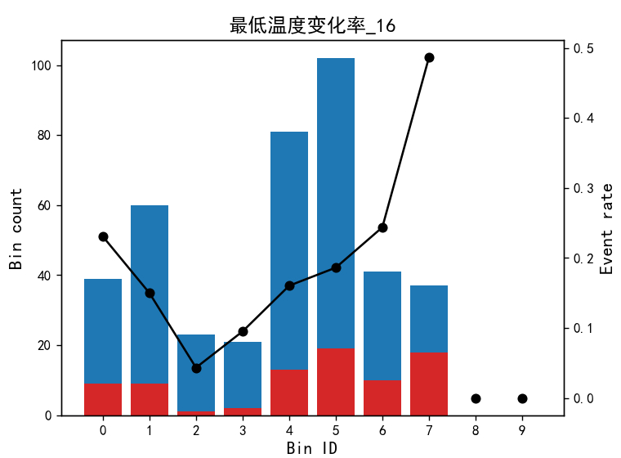
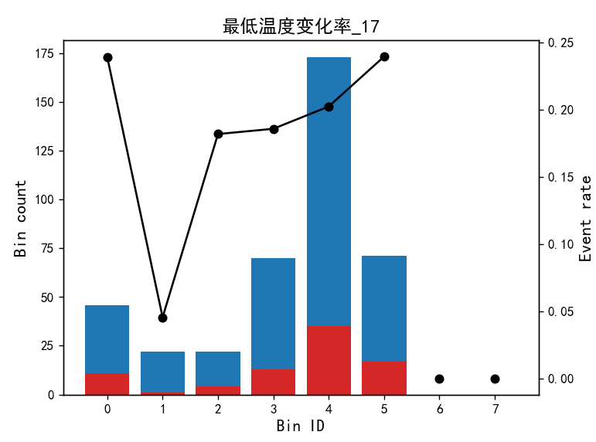
分箱阈值: [0.4560096 0.5974361 0.86528474 0.97099236]
=== 变量: 最低温度变化率_15 ===
Bin Count Count (%) Event rate EEF
0 (-inf, 0.46) 39 0.096535 0.025641 302.392971
1 [0.46, 0.60) 105 0.259901 0.161905 310.701086
2 [0.60, 0.87) 203 0.502475 0.206897 319.152558
3 [0.87, 0.97) 34 0.084158 0.294118 338.271436
4 [0.97, inf) 23 0.056931 0.478261 350.755483
分箱阈值: [0.46223243 0.54290989 0.567065 0.59307685 0.66753438 0.82626283 0.92734343]
=== 变量: 最低温度变化率_16 ===
Bin Count Count (%) Event rate EEF
0 (-inf, 0.46) 39 0.096535 0.230769 316.070163
1 [0.46, 0.54) 60 0.148515 0.150000 306.111027
2 [0.54, 0.57) 23 0.056931 0.043478 290.214471
3 [0.57, 0.59) 21 0.051980 0.095238 317.303007
4 [0.59, 0.67) 81 0.200495 0.160494 310.670623
5 [0.67, 0.83) 102 0.252475 0.186275 319.785765
6 [0.83, 0.93) 41 0.101485 0.243902 330.809431
7 [0.93, inf) 37 0.091584 0.486486 362.058509
分箱阈值: [0.46329425 0.51090112 0.53690037 0.6164965 0.8779043 ]
=== 变量: 最低温度变化率_17 ===
Bin Count Count (%) Event rate EEF
0 (-inf, 0.46) 46 0.113861 0.239130 315.244478
1 [0.46, 0.51) 22 0.054455 0.045455 302.457269
2 [0.51, 0.54) 22 0.054455 0.181818 310.937603
3 [0.54, 0.62) 70 0.173267 0.185714 307.404184
4 [0.62, 0.88) 173 0.428218 0.202312 318.464448
5 [0.88, inf) 71 0.175743 0.239437 340.351245

Slide 8
