Slide 1











Link 1
Link 0
lane group 1
:
1
lane group 2
:
2
Link 2
lane groups 3
:

Slide 2
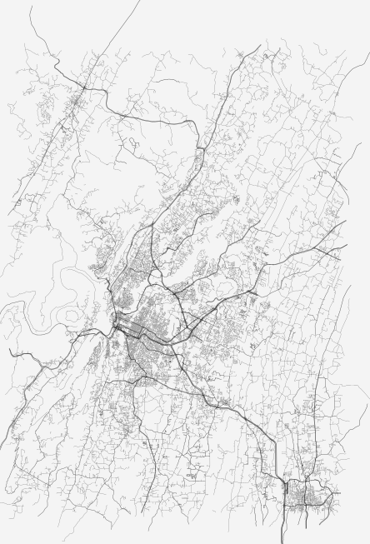
relative sources and sinks
subnetwork A
subnetwork B

Slide 4
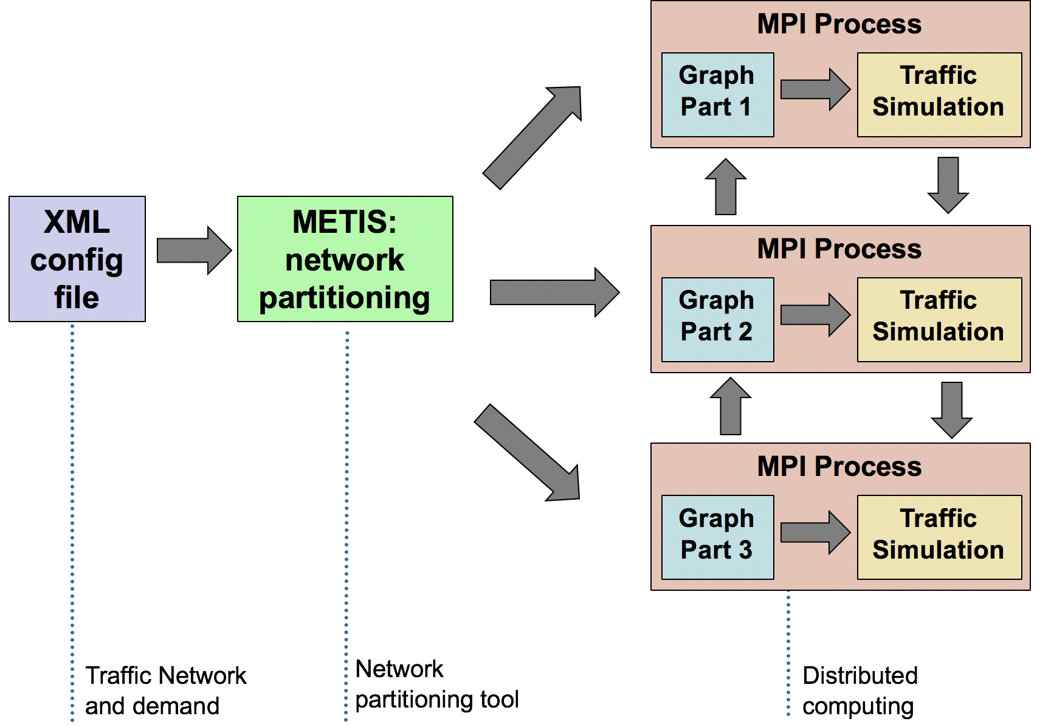
Parallelization Strategy: Network Partitioning

Slide 5
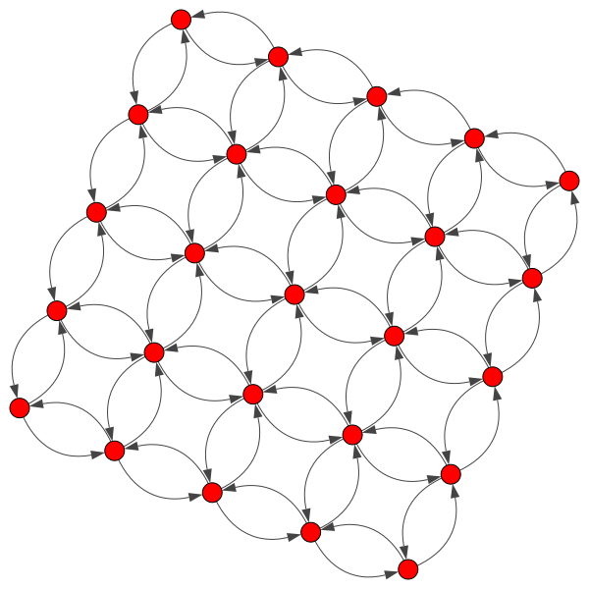
Results: Parallel simulation attains considerable speed up
Run on a synthetic grid-like network with 62500 nodes, 170000 Links, and 12500 origin-destination pairs.
Parallel simulation on 1024 cores:
  475 speed up compared to serial simulation
  Time reduction from 8245 seconds to 17 seconds

Slide 6
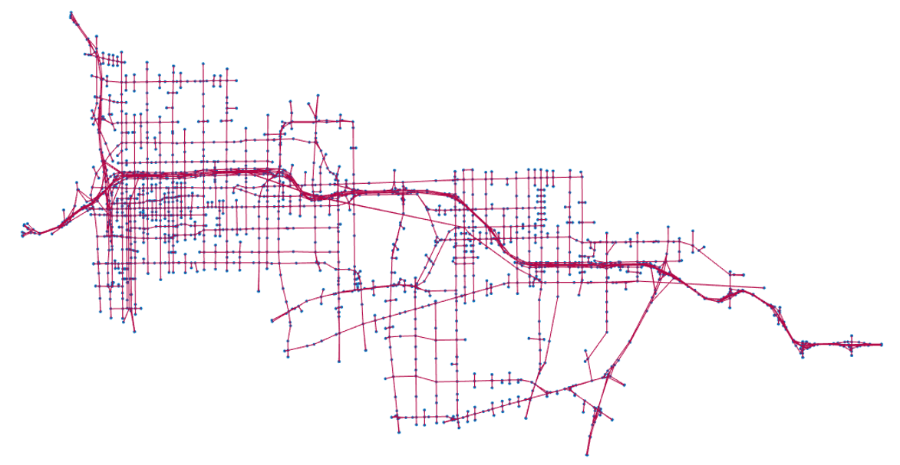
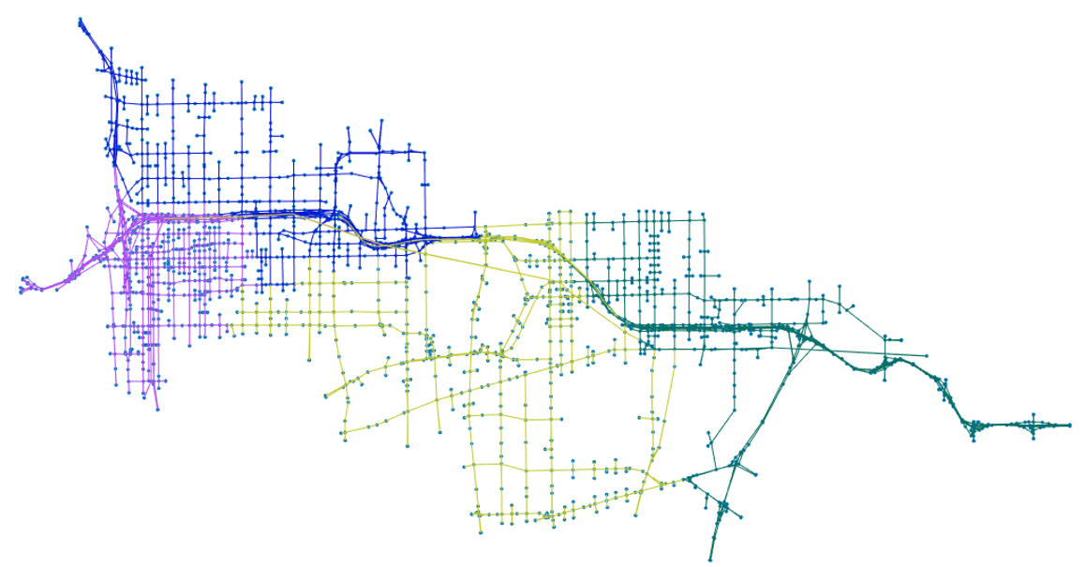

Base network
Subnetworks
MPI graph
communicator
run
METIS
N1
N4
N1
N4
N2
N3
N2
N3
Subnetwork files
N1
...
N4

