Slide 1
The Effect of Growth Factor Concentration on Gene Expression
Presentation of Data

Slide 2
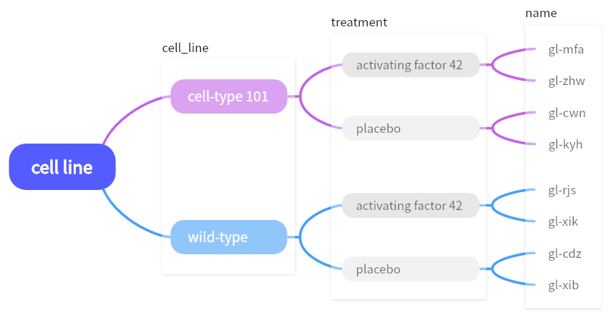
Presentation of Data
The experimental data consists of four variables: "cell_line", "treatment", "name", "conc", and "gene_expression".
"cell_line": Two types of cell lines, referred to as cell type and wild type.
"treatment": Two groups, designated as the activating factor group and the placebo group.
"name": Each activation factor group or placebo group contains two subgroups represented by different names.
"conc": Represents the concentration of growth factors, with concentrations ranging from 0 to 10 in increments of 1 for each subgroup.
"gene_expression": The values of gene expression as the concentration varies within each subgroup.
First, let's use a mind map to understand the structure of the entire experimental data.

Slide 3
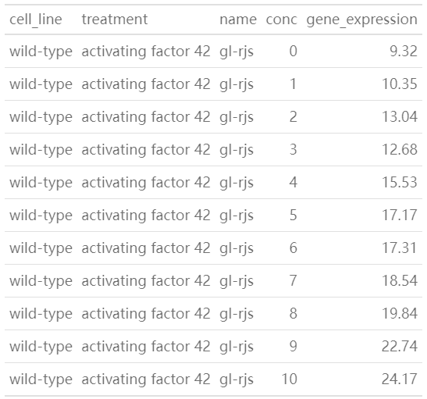
Presentation of Data
Next, let's select a subset of the total experimental data to gain a more direct understanding of the data.
The table on the left displays the data for the subgroup named "gl-rjs" within the activating factor group in the "wild-type" cell line.
The concentration of growth factors varies from 0 to 10 in increments of 1, corresponding to gene expression values ranging from 9.32 to 24.17.

Slide 4
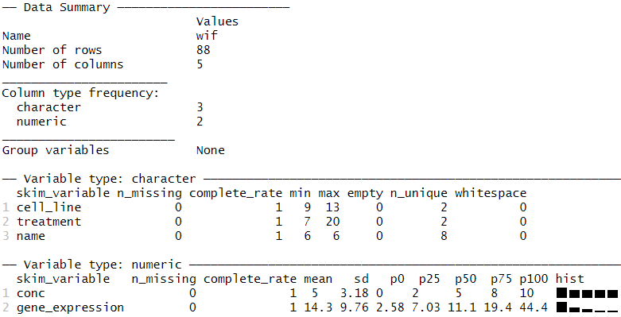
Presentation of Data
Then, let’s look at the data summary.
As mentioned earlier, the data consists of 5 variables, with "cell_line", "treatment", and "name" being character variables, while "conc" and "gene_expression" are numeric variables.
For the numeric variables, the mean gene expression value is 14.3, with a standard deviation of 9.76. The minimum gene expression value is 2.58, with a maximum of 44.4.

Slide 5
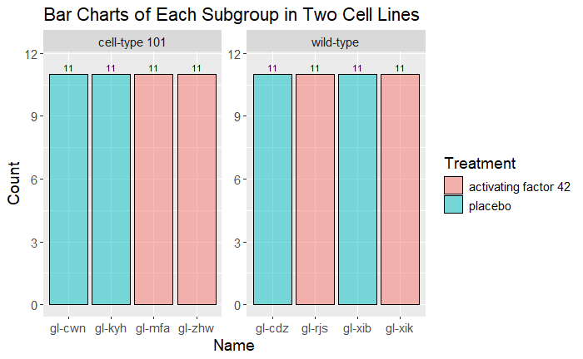
Presentation of Data
Let's look at the bar charts of the subgroups for two different cell lines.
For each subgroup, the concentration of growth factors varies from 0 to 10 in increments of 1, resulting in 11 observations per subgroup.
With a total of 8 subgroups, there are 88 observations in total.

Slide 6
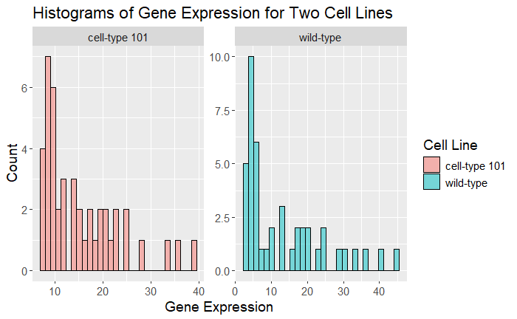
Presentation of Data
Regarding the values of gene expression, histograms provide the most intuitive observation.
It can be observed that in the histograms of the two cell lines, the distribution of gene expression is unimodal and right-skewed.

Slide 7
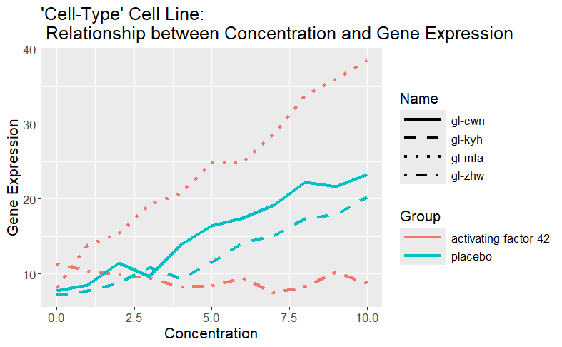
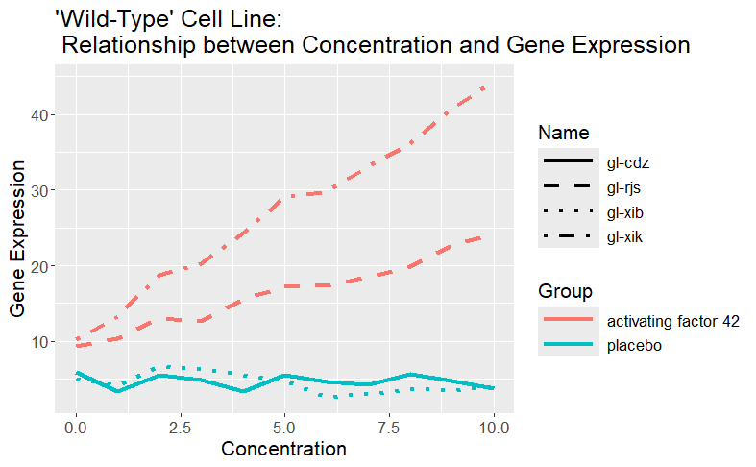
Presentation of Data
These two plots illustrate the relationship between concentration and gene expression for the “cell-type" and “wild-type" cell lines, respectively.
The plot displays lines representing the trend of gene expression values with varying concentrations of growth factors.
The lines are differentiated by treatment groups, indicated by different colors, and by subgroup names, denoted by different line types.
The x-axis represents the concentration of growth factors, while the y-axis represents gene expression values.
Each line represents a different combination of the treatment and subgroup within the cell line.

Slide 8
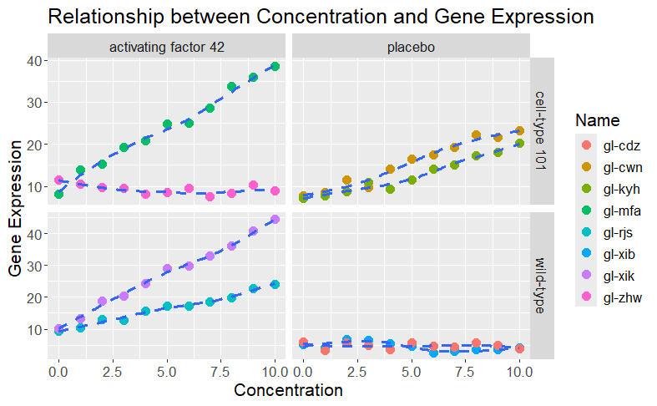
Presentation of Data
The left plot illustrates the trend of gene expression values varying with the concentration of growth factors.
The graph is divided into two panels corresponding to different combinations of "cell_line" and "treatment".
Each point represents an observation, with the x-axis denoting the concentration of growth factors and the y-axis denoting the gene expression value.
The color of the points represents the names of different subgroups.
Additionally, the plot includes fitted curves, which are fit to the data of each group and displayed as dashed lines.

Slide 9
Thank you!

