Slide 1
Configurable Robotic Platform Client Meeting
ESE Robot Team
Liwen Chang
Chien-An Chen
Shunji Cheng
Xiaoyi Ge
Tongkai Shao
2016.1.19

Slide 2
Outline - Review
Robot Overview
Project Motivation and Goals
Basic Requirements
Key Goals
Key Stakeholders

Slide 3
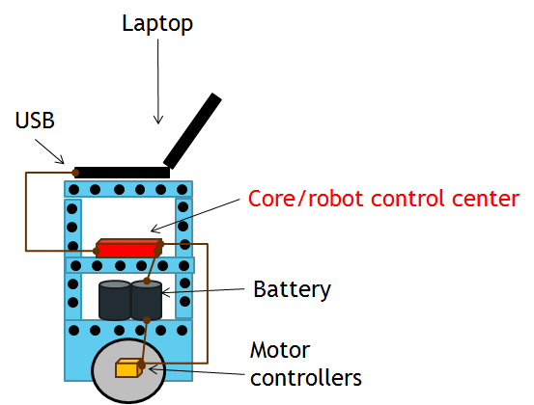
Robot Overview

Slide 4
Project Motivation and Goals - Review
Engineers and researchers are often forced to use robots that are not designed specifically for their research, test, and/or development purposes. Their needs often include:
development of special control and/or access to control software
development, test, and experimentation of application level software
ability to easily add new hardware elements physically, electrically, and software for test and experimentation
easy access to system hardware and power
The goal of this project is to build a general purpose, mobile robot, designed to meet these needs of engineers and researchers in industry, government, and academia.
What kinds of functions we have to provide and satisfy the “general purpose”: Sensors, I/O, Motors ... etc.

Slide 5
Basic Requirements Review – 1
A. Laptop gives real-time commands to robot?
B. Other relation between laptop and robot?
Design an “open” robotic platform that supports the following needs:
enable a developer to use their own laptop (Mac or Window) to connect to the robot via USB
provide simple communication protocol vis-à-vis an open API accessible from their own laptop
the laptop will be used to develop applications that will use the robot
the robot will provide basic services such as motion, basic collision detection, error management and others TBD
the API will allow programmers to access to the robots services
What’s the definition of “basic”?

Slide 6
Basic Requirements Review – 2
Current prototype platform:
provides “hard points” to mount sensors, actuators, and various other hardware
provides access to 12V/60A deep charge marine battery power
two high power drive motors and motor control hardware
What is needed:
control-communication hardware
control software
API
basic collision detection system
power monitoring
comprehensive demo
APIs should support programmers using Java and C.
What’s the C.C.H?
Laptop
What’s the C.S? On robot or PC?
Mount Points
What’s the demo detail?
Power
Propulsion

Slide 7
Basic Requirements Review – 3
You can use the 300 SCR facility as a test environment
carpeting/linoleum floor, crossing thresholds (elevator, break area), fit through doors and passageways,…
Demo is TBD:
telepresence? office service? remote semi-autonomous control?
should illustrate all basic features of the system
transit
We will need comprehensive developers documentation.
What kinds of documentation do we have to provide for client?

Slide 8
Key Goals Review
High priority goals:
control-communication hardware & associated control system software
basic collision detection system
API supporting Java
basic demo illustrating basic features above
Secondary goals:
power monitoring
support for C API
comprehensive demo illustrating a couple of different applications, a laptop swap to a second application
Two libraries for both Java and C?

Slide 9
Key Stakeholders Review
Me – I will…
approve designs, procurement choices, demo, test plans and acceptance
designed, built, and will modify the prototype platform as necessary
Mentor’s contact information:
Set up routine meeting:
Schedule:

Slide 10
Thank you!

