Slide 1
Team Robot Project Presentation 2016/2/2
ESE Robot Team
Liwen Chang
Chien-An Chen
Shunji Cheng
Xiaoyi Ge
Tongkai Shao

Slide 2
Outline
Business goals
Stakeholders
System overview
High-level requirements
Business constraints
Technical constraints
Quality attributes

Slide 3
Business Goal
From client:
“The goal is to build a general purpose, mobile robot, designed to meet needs of engineers and researchers in industry, government, and academia.”

Slide 4
Stakeholders
Tony (Client)
Dan (Consultant)
Robot Team (us)
Users

Slide 5
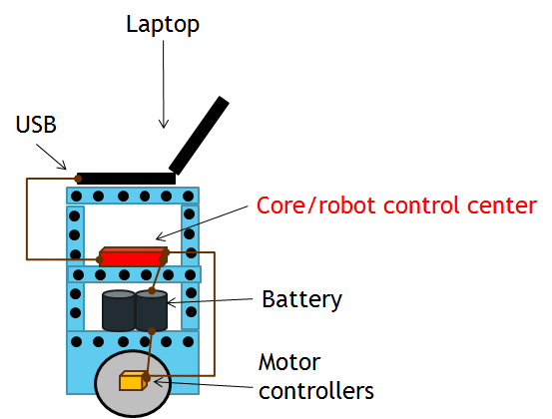
System overview

Slide 6
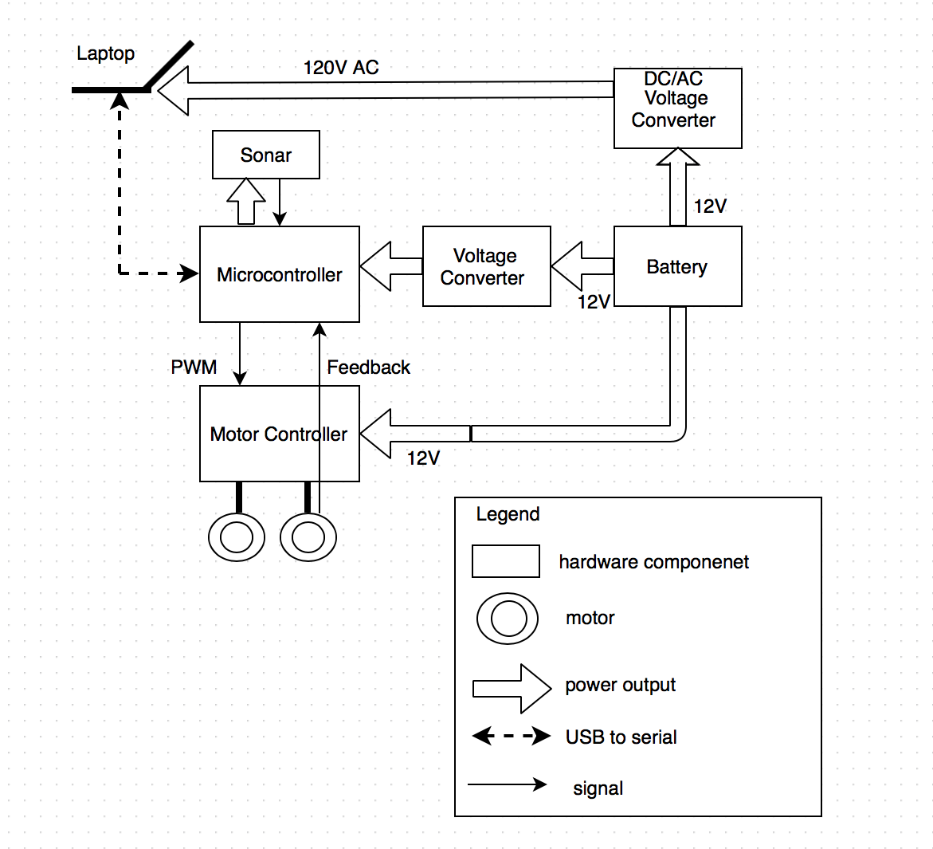
System overview (Cont.)

Slide 7
High-level Requirements
The system shall enable a developer to use their own laptop to connect (and make commands) to the robot.
The system shall provide simple communication protocol between laptop and robot platform.
The system shall provide API which allows programmers to access to the robot services.

Slide 8
High-level Requirements (Cont.)
The system shall provide the basic robot motion control.
The system shall have the basic collision detection function.
The system shall have the ability of error management.

Slide 9
High-level Requirements (Cont.)
The system shall support power monitoring.
The team shall prepare a comprehensive demo.
The team shall provide a complete system test plan, user guide and API documentation.

Slide 10
Business Constraint
Budget is about $500.
Deliver before the end of summer semester.

Slide 11
Technical Constraints
Use sonar sensor for collision detection.
Use two high power drive motors and existing motor control hardware for robot propulsion.
Use a 12V/60A deep marine battery as power supply.

Slide 12
Technical Constraints (Cont.)
Use Tony’s existing robot platform as a development foundation.
Use USB as connection between laptop and robot.
The API shall support Java.

Slide 13
Quality attributes
a. Safety - if unsafe, just stop [NO.1]
b. Availability - stable connection between laptop and robot
c. Reliability - cannot miss operations; follow the command correctly
d. Performance - constant latency between laptop and robot
Notes:
Test the API to judge the Quality Attributes
Online Documentation
Stress Test - full speed / people walking

Slide 14
Thank you!

