Slide 1

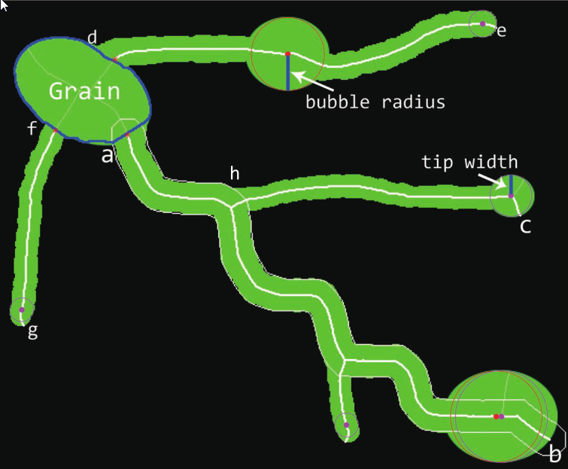
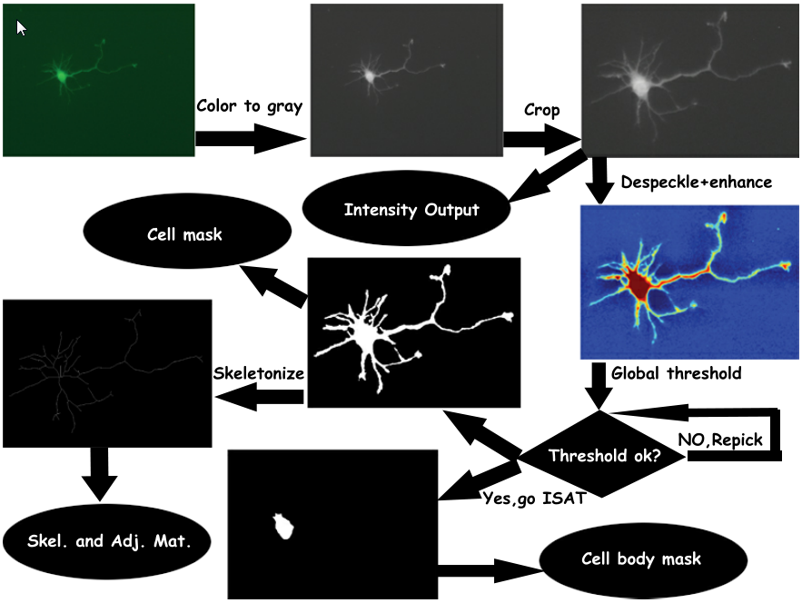
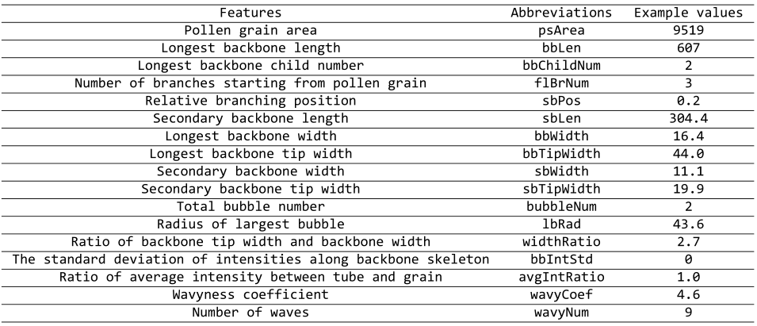
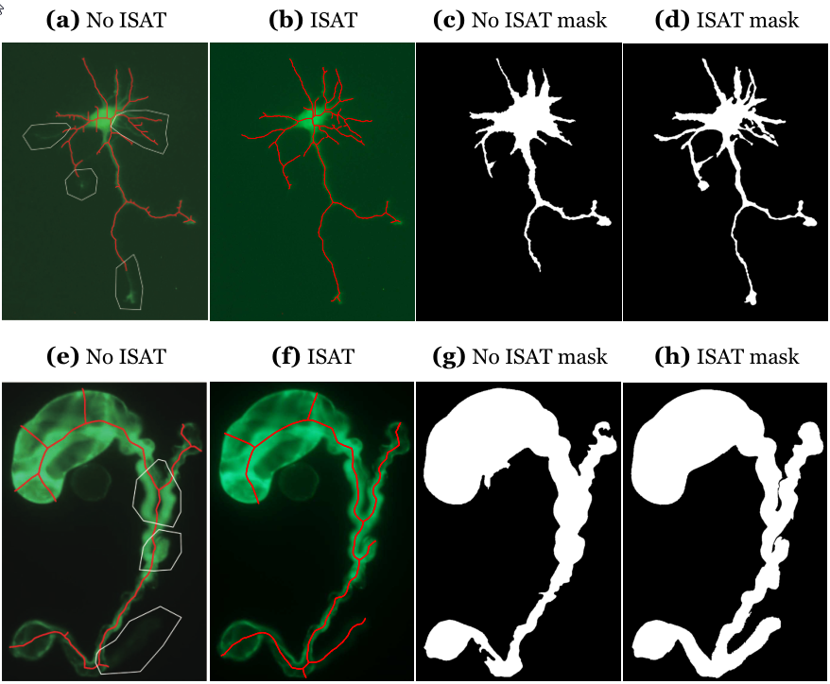
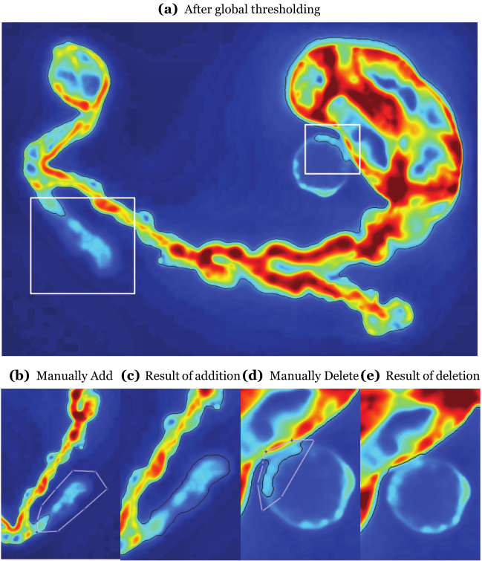
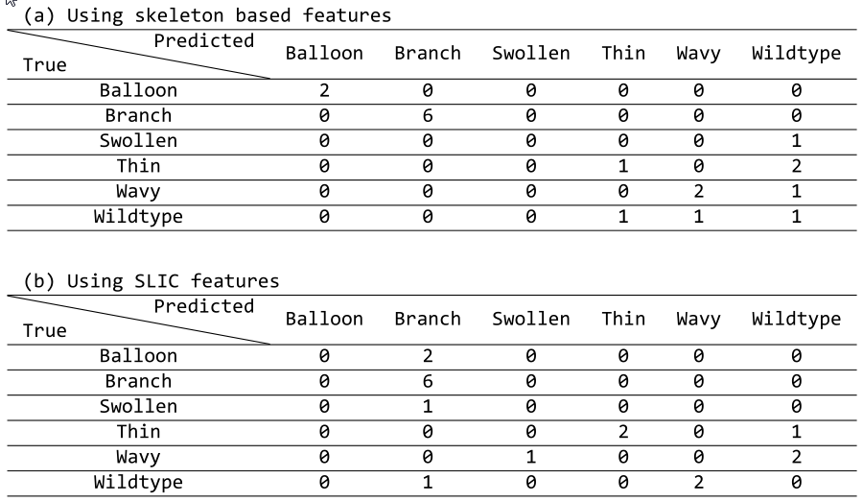
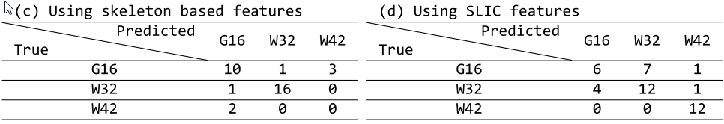
branMorph: An image skeletonization based tool for branching cell morphology analysis
Chaofeng Wang, Haikuan Liu, Caiping Gui, Dong Zhang, Weihua Tang, Axel Mosig
Department of Biophysics
CAS-MPG Partner Institute and Key Laboratory for Computational Biology,
Shanghai Institute for Biological Sciences, Shanghai, China
Introduction
The biological morphology, consisting of shape, color, structure or pattern, has always been an indispensable research object in biological science domain. We devised a computational tool to model and quantify morphological features from sets of cell fluorescence images, which in here, contain pollen tube images and neuron images. A skeletonization based model is proposed to account for the cell morphologies which are shown in Tip-growth cells (TGCs) like pollen tubes and neurons.
Workflow
Skeleton based features
The workflow is demonstrated using a neuron image (kindly provided by Dr. Zhi Yang from ION).The four intermediate outputs: intensity image, cell mask, cell body mask and skeleton image are represented in black ellipses. These outputs are used to perform feature extraction later on. Adj.Mat. is short for adjacency matrix.
After segmentation and skeletonization, the features are extracted along the skeleton. A simulated branching cell is demonstrated below.
ISAT
Obtaining a proper segmentation is essentially important to feature abstraction. Automatically or manually global thresholding, and image enhancement are usually implemented for such sake. However, from a generality perspective, images having debris or non-interesting cells, complicated by uneven illumination, cause global thresholding to fail. The Interactive Segmentation Aid Tool (ISAT) provided by us could easily facilitate the human intervention in an aim of suppressing subjectivity and tediousness in this process to an extent as possbile as it can.
Validation in classification
We applied the skeleton based features to classification to validates its adequacy to distinguish the different phenotypes observable in our data set based on the first two principal components. To further support this on a more quantitative basis, we examined the cross-validation performance of a random forest classifier. We used 100,000 trees and Leave-One-Out-Cross-Validation (LOOCV) strategy to train and validate the classifier. The SLIC features by Murphy et al are used for comparison, and the confusion matrices are shown. Data used in images (a,b) are pollen tubes grouped by morphology by experts, images (c,d) grouped by genes (genes causing different morphs, to be published.)
(a) is a rotated pollen image in pseudo-color, white boxes showing the problems.
Specifying a region for addition/deletion (white ROI in a and d), ISAT gives a satisfactory result (black ROI in c and e).
Images a, c, e, g: global thresholding with a carefully chosen threshold.
Images b, d, f, h: ISAT.
Conclusion
The skeleton features provide a new way to quantify the morphology of branching cells (or TGCs), and can be used in clustering and classifying high-throughput image morphology data provided that the image quality is consistent.
For lab images bothered by serious noises and pollutants, ISAT provides an easy and effective solution to segmentation.
Questions and suggestions to owen263@gmail.com, 2012 Aug 3rd.

