Slide 1

Vectorization of plug and play diffusion priors
Presenter: Xiaoyu Qiu

Slide 2
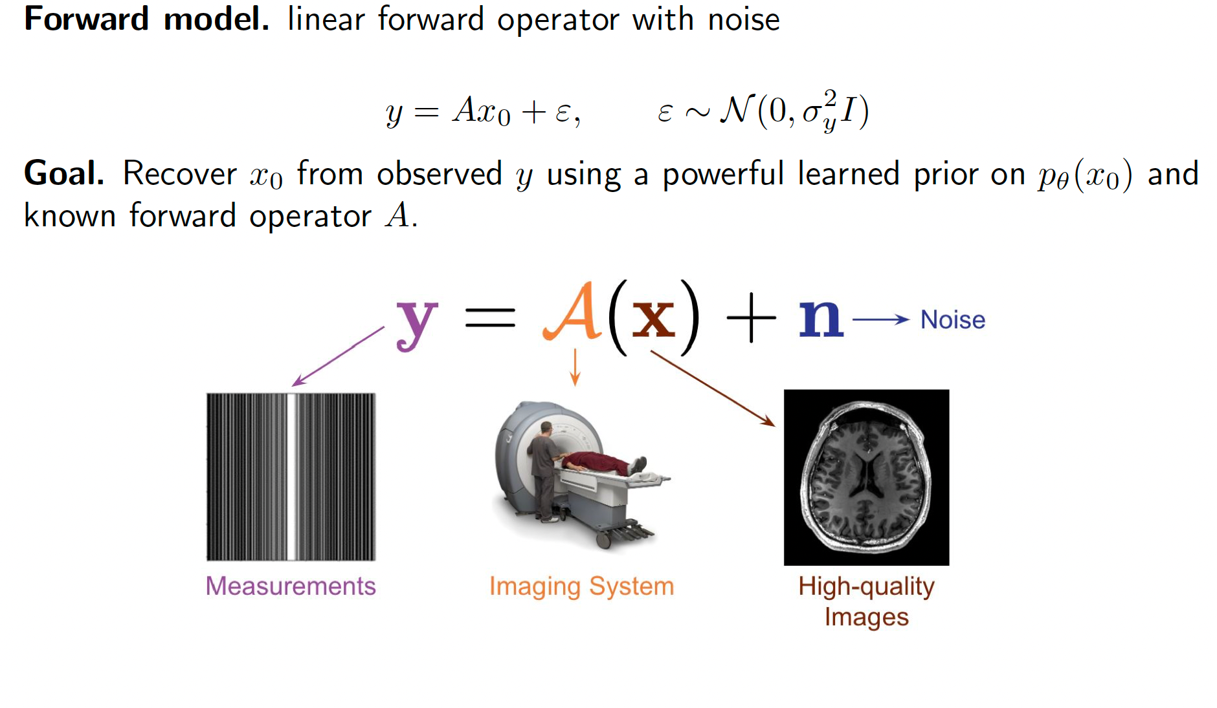
Background

Slide 3
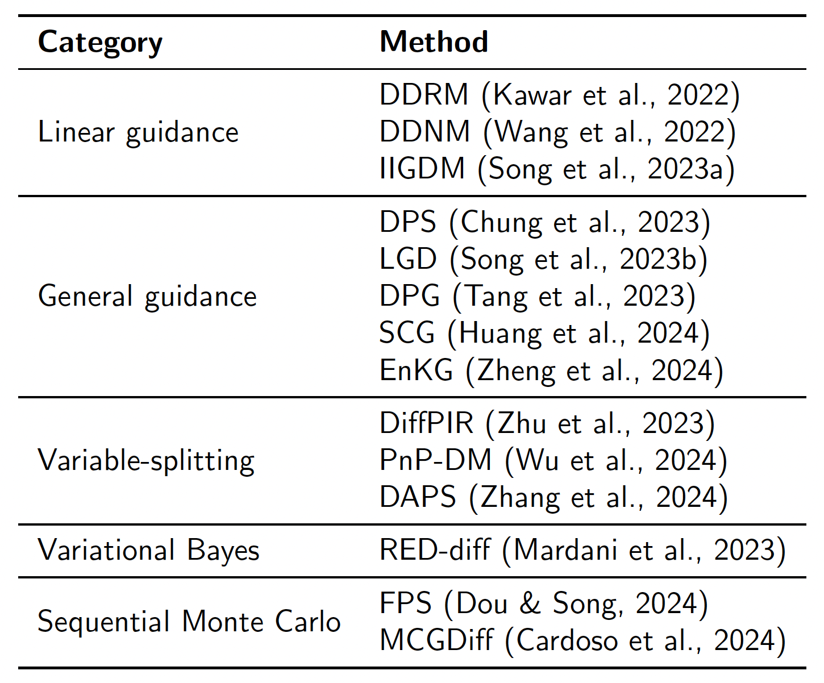
background
Input: a trained diffusion model prior, given operator A, measurement y
Target: reconstruct x
There are many methods proposed

Slide 4
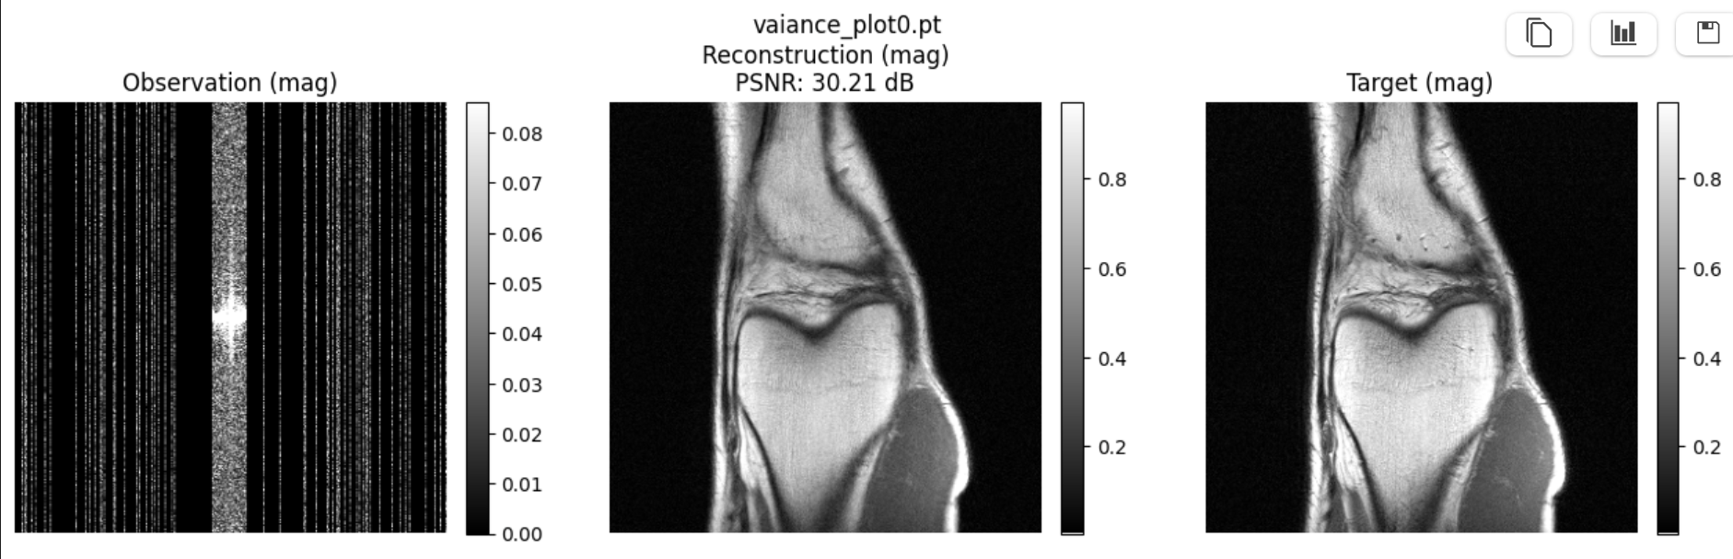
Example – DAPS
- Thanks to my collaborator Zhanhao Liu

Slide 5
motivation
Solution
Released code only supports image
I don’t have experience in image data
Limited access to GPU
I need to work on the project
Small dimension vector data toy setting to speed up
Rewrote and adapted several Plug-and-Play Diffusion methods into vector format

Slide 6
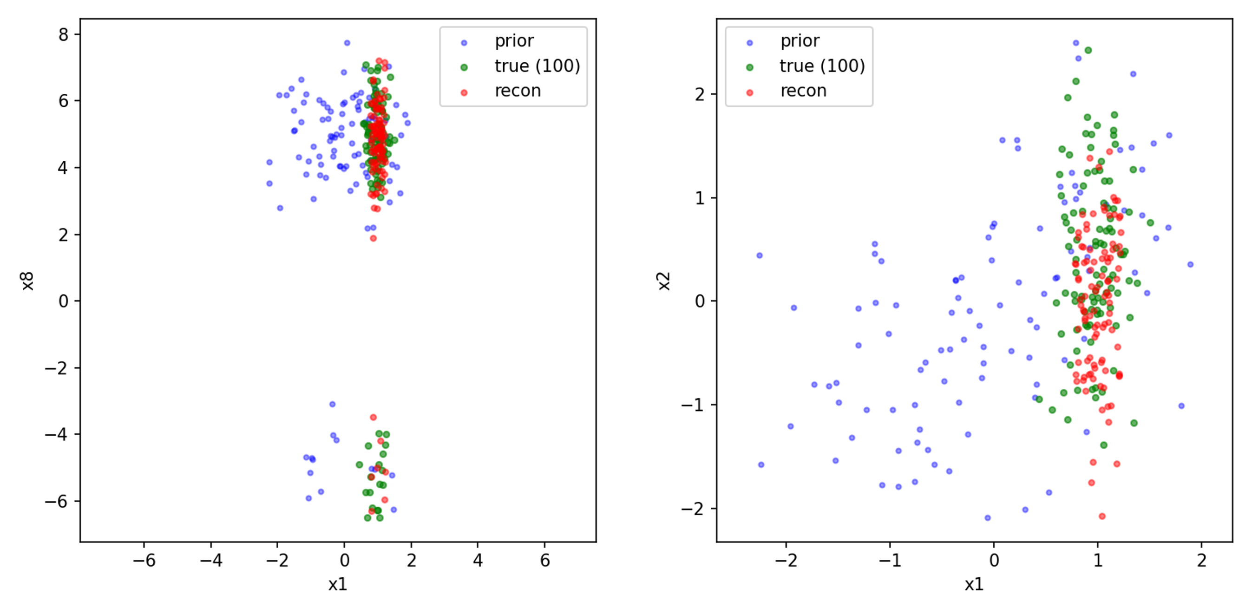
Progress 1: reproduce the expected result

Slide 7
motivation2
Solution
Wrap vector data (or other type in the future) into pseudo images
-- Modularize the code
It cannot guarantee that the adapted code keeps everything the same.
It’s also not possible to rewrite all the methods.
There would also be format other than vector.

Slide 8
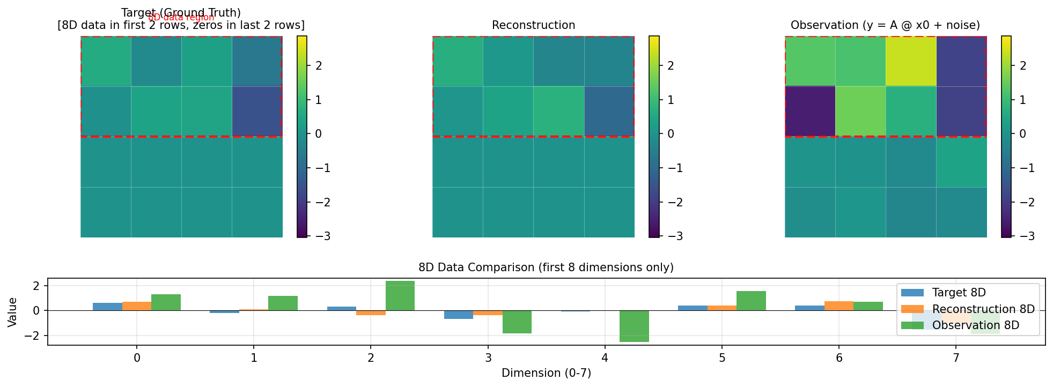
Progress2: expected result in pseudo image

Slide 9
Ambitious impact dreaming
Make it easy to use for statisticians and advertising these methods to stats field
(e.g. imputation on missing data with a known prior)
Investigate the underlying structure of true image (natural image, medical image) comparing with tabular (numerical) data based pseudo image

