Slide 1
Monthly Report
2018-06-20

Slide 2
Outline
Overview of project progress
Work Done Last Month
Work Arrangement Next Month
Questions

Slide 3
Ⅰ Overview of project progress
Our focus has gradually shifted from product design to UI design and technology development.
Recently completed work on time:
Q2 M2 Complete the prototype design of the Yuudee2 product
Q2 M3 A2 The CTO builds the technical framework according to the prototype of the product
Q2 M4 Cohort Product Development
Q2 M6 Meeting Open Source Contractual Requirement
Q2 M7 Communication and Branding
Q2 M8 Product Design
Q2 M9 Testing
Work done ahead of time:
Q3 M1 Complete all the drawing pictures
Q3 M3 Complete the PRD of Yuudee2
Work in progress:
Q2 M5 Development and Integration(of data collection/analytics tools/PIADS)
Q3 M4 The main function of Android client development is completed, and user research is conducted
Delayed work:
Q2 M3 A1 product manager and UI discuss the interface design style of the whole product and start interface design(2018.05->2018.06)
Q1 M5 A2 upload symbol sets(2018.06->2018.07)
Notes:
We are going to develop the backend and the android client.

Slide 4
Ⅱ Work Done Last Month
1, product design: data statistics module design(Q2M8), test scale design(Q2M5); writing product requirements documents(Q3M3), review and update PRD
2, UI design(Q2M3A1)
3, the first draft of technical architecture(Q2M3A2)
4, draw training pictures and research(Q3M1)
5 , communication(Q2M7)

Slide 5
1、product design - PRD
We organized our colleagues in the product and technical departments to review the PRD, and it was updated to the 4th version.
It is expected that the revised version will be used in developing in the end of this month.

Slide 6
1、product design - data module
The statistical indicators of the app and backend management system are summed up, and the corresponding product design work has been completed:
(1) app statistics are divided into two major modules: user learning files (cumulative values and trend graphs) and training effects (the relationship between scale scores and learning duration/testing progress);
(2) admin statistics are divided into three major modules: platform user data (cumulative values and trends, user details), training method effectiveness analysis, courseware difficulty statistic

Slide 7
1、 product design – test scale
The current scale consists of two parts:
Part 1: assess the improvement in Chinese language complexity and grammatical correctness: PCDI vocabulary and sentence scales;
Part 2: assess the improvement in autism symptoms: Brunei, Denver, ABC , Krishna, PAIDS (currently not confirmed/completed)

Slide 8
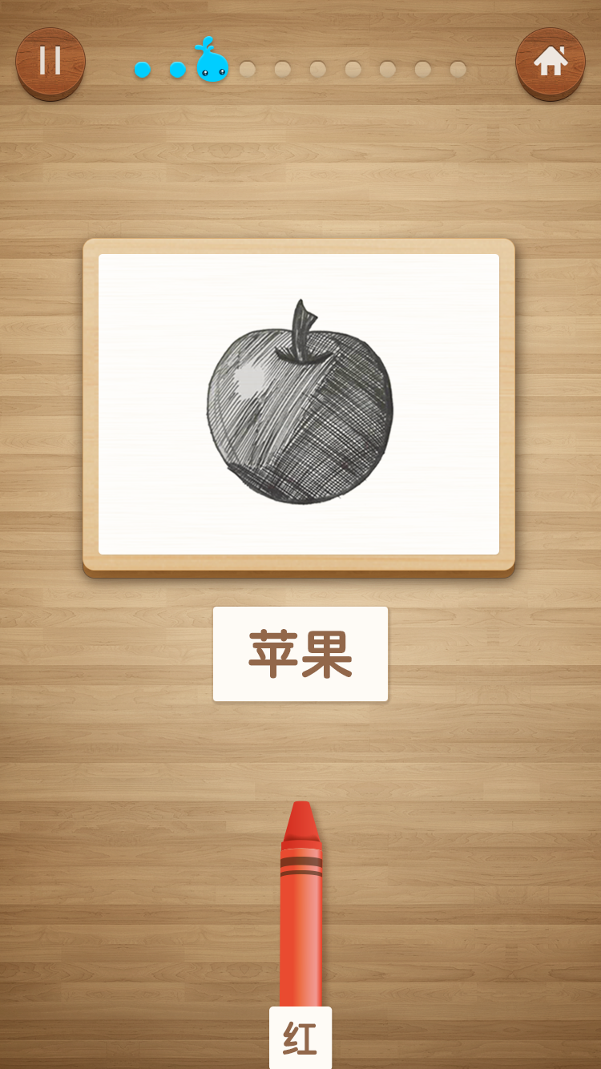
2、UI design
At present, the UI design has completed the main visual design, and left pages are expected to be completed by the end of this month.

Slide 9
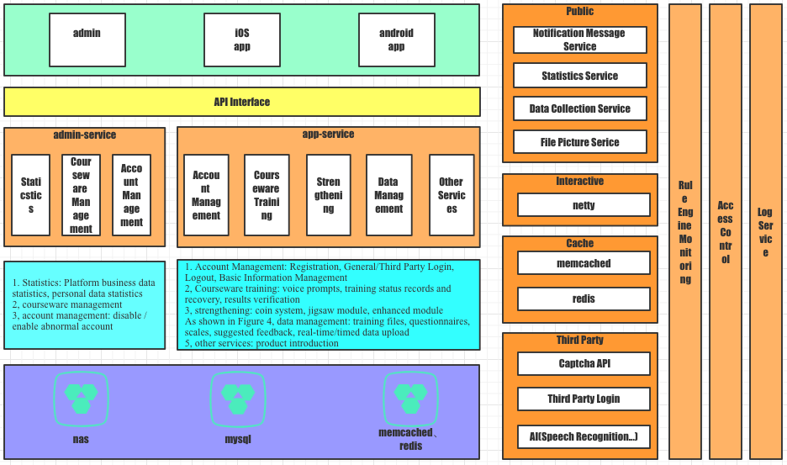
3、Technical Architecture Draft 1
1, Based on the current product requirements document, the server-side technical architecture was given, using the classic MVC model, open source database and cache services, and the service module in back-end code is divided based on product modules.
2. The server will provide services to the client in the form of restful api; the client supports online and offline use, and when connecting to the network, it can send usage data to the server.

Slide 10
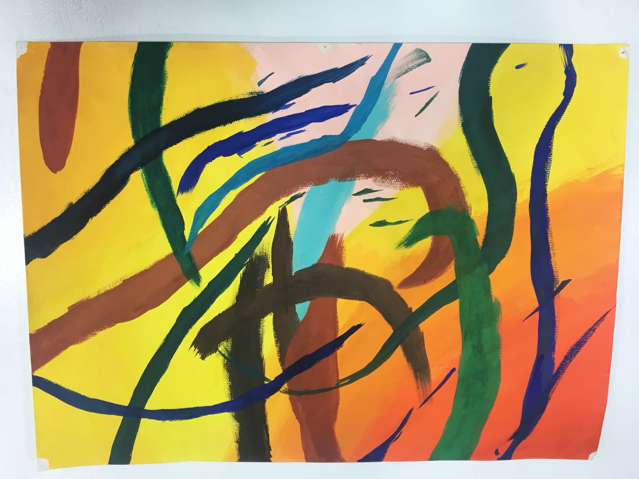
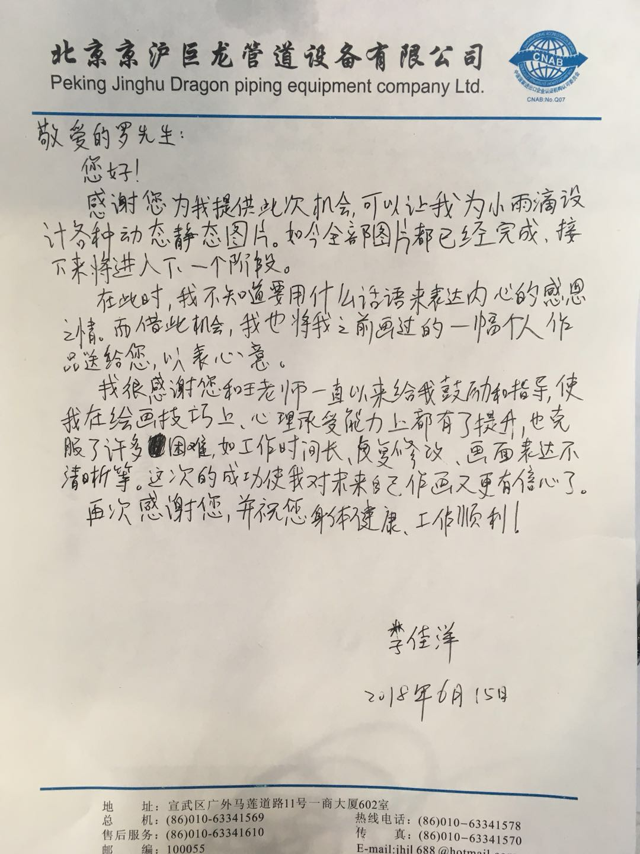
4、drawing/processing/research training pictures
Training pictures were drawn by an autistic youth called Li Jiayang.
More than 200 prototypes of hand-drawn pictures have been completed. It is expected that the pictures will be scanned and processed by the end of the month.

Slide 11
5 , communication
We posted a blog called “let love continue to melt the autistic” on our official website: http://www.xiaoyudi.org/?p=2225
It tells the story of a young people with autism overcoming lots of difficulties to draw yuudee2 training pictures.
We hope that more Chinese autistic families will see this story and get some faith from that. Meanwhile, we hope more autistic families get knowledge of yuudee2.
The difference between this APP and other types of AAC lies in the desire to achieve goals that children can use themselves and without the assistance of professionals through： a. Content selection and organization through the APP itself b. Interaction design c. Evaluation and feedback system. We believe that it will be a milestone in AAC field if our automatic training method works well.
Notes:
We posted a blog called “let love continue to melt the autistic” on our official website.

Slide 12
Ⅲ Work Arrangement Next Month
1、Q3 M4 The main function of Android client development is completed, and user research is conducted(2018.07)
2、Q3 M2 Complete the recording of this app(2018.07)
3、Q2 M5 Development and Integration(of data collection/analytics tools/PIADS)(2018.07)
4、Q2 M3 A1 product manager and UI discuss the interface design style of the whole product and start interface design(2018.05->2018.06)
5、Q1 M5 A2 upload symbol sets(2018.07)
6、Q2 M7 A2 1 blog post at the end of quarter(2018.06)

Slide 13
Ⅳ Questions
1, Is there any format requirement for symbol sets while uploading to UNICEF? Is there a document?
2. Is there any format requirement for real-time data uploading to the official website of UNICEF? Is there a document?
3. We have done a lot of work, but we have not found a Chinese version of the PIADS scale. Finally, we designed a scale based on the opinions of experts. Do you see any problems with this approach?

Slide 14
Thanks!

