Slide 1

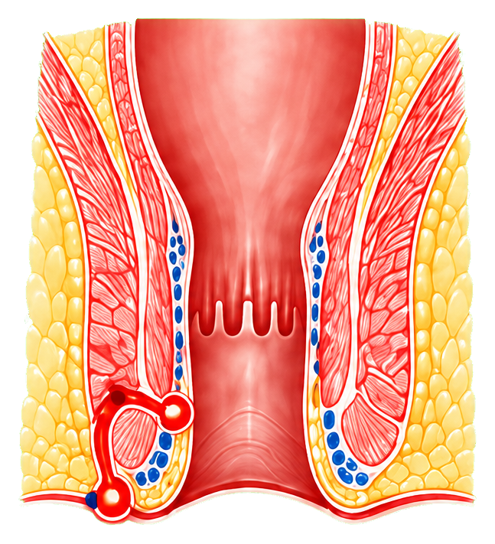
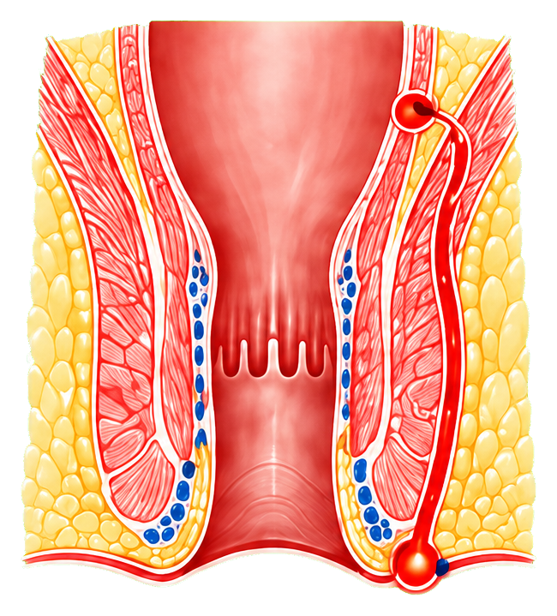














02
病例特点与临床护理难点
CASE PROFILE & CLINICAL NURSING CHALLENGES
1
复杂性肛瘘难治与复发风险并存
Complex anal fistula is characterized by treatment difficulty and a high risk of recurrence
低位肛瘘
高位肛瘘
Low anal fistula
High anal fistula
肛瘘是肛管或直肠与肛周皮肤之间形成的异常感染性管道，
内口
瘘管复杂
感染迁延
是结直肠肛门外科常见疾病之一。
内口
（高位）
Anal fistula is an abnormal infectious tract connecting the anal canal
（低位）
Internal
Complex fistula tract
Persistent infection
or rectum with the perianal skin and is one of the common anorectal
Internal
opening
surgical diseases.
opening
(high)
(low)
瘘管
复杂性肛瘘因瘘管走行复杂或内口位置较高，术后复发风险
（深部，
复杂性肛瘘
显著高于单纯性肛瘘。
瘘管
跨括约肌）
（浅部）
Fistula tract
Complex anal fistula has a significantly higher postoperative recurrence
Fistula tract
(deep,
Complex anal fistula
risk than simple anal fistula because of its complicated tract pattern or
(superficial)
transsphincteric)
high internal opening.
外口
外口
创面难愈
反复发作可导致创面迁延不愈，严重影响患者生活质量。
（肛周皮肤）
（肛周皮肤）
External
External
Repeated recurrence may lead to prolonged wound non-healing and
opening
opening
Delayed wound healing
substantially impair quality of life.
(perianal skin)
(perianal skin)
2
本例围手术期护理面临多重风险叠加
This case involved overlapping perioperative nursing risks.
急性淋巴细胞白血病异基因造血干细胞移植术后，感染防控要求更高。
感染控制
After allogeneic hematopoietic stem cell transplantation for acute lymphoblastic leukemia,
Infection control
stricter infection prevention and surveillance are required.
复发预防
引流通畅
合并2型糖尿病，围手术期血糖波动明显，影响创面修复。
Recurrence
Drainage
Comorbid type 2 diabetes caused marked perioperative glycemic fluctuation, which may
prevention
maintenance
affect wound healing.
围手术期护理核心
疼痛管理
Core perioperative
功能保护
血小板减少及凝血相关指标异常，需警惕出血风险。
Pain management
nursing priorities
Functional protection
Thrombocytopenia and coagulation-related abnormalities require close attention
to bleeding risk.
因此，本例护理难点不在于单一创面换药，而在于如何同时兼顾感染控制、挂线引流、疼痛缓解、血糖管理、出血防护及创面修复。
Therefore, the nursing challenge in this case was not limited to local dressing change, but lay in simultaneously coordinating infection control, seton drainage,
pain relief, glycemic management, bleeding precautions, and wound healing.

