Slide 1
INFO 6215 · MIDTERM PRESENTATION
SummerNest
Verified summer sublets for students moving between Seattle and the Bay Area.
TEAM
DATE
Xiaoyu Wang & Aurora Ouyang
October 30, 2026

Slide 2
SummerNest PRODUCT
XIAOYU WANG & AURORA OUYANG
Moving for an internship? Finding a room is the hard part.
We watched a classmate look for a summer sublet in another city. They spent hours in Facebook groups and on RedNote, scrolling past the wrong dates and guessing which rooms were real.
PAIN 1
PAIN 2
PAIN 3
Scams and fake listings
Can't see the room before paying
Dates rarely line up
SummerNest: every room verified, every search filtered by your dates.

Slide 3
SummerNest PRODUCT
XIAOYU WANG & AURORA OUYANG
Two customers, often the same person
 | Interns moving to a new city Renters · need a room | Students leaving for the summer Hosts · have an empty room
JOB | A room near my internship, for exactly my dates | Cover my rent while I'm away
PAINS | Scams and fake listings Can't see the room before paying | Paying rent on an empty room Not knowing who moves in
GAINS | Housing locked in before day one | Deal done in days, not weeks
VALUE | Verified rooms that match your dates, from anywhere. | Fill your room with a verified intern whose dates match.
Leave Seattle → intern in SF
Has a room to fill in Seattle and needs one in SF. One sign-up adds both supply and demand, which helps with the cold start.

Slide 4
SummerNest PRODUCT
XIAOYU WANG & AURORA OUYANG
Free boards have no trust. Trusted options cost too much.
✓ yes ~ partly ✕ no |  | VERIFIED IDENTITY | DATE MATCHING | CLOSE TO YOUR WORK | BUILT FOR 2 TO 4 MONTHS | LOW COST | OPEN TO ANY STUDENT INTERN | ENGLISH & INTERNATIONAL
FREE BOARDS | Facebook groups, Craigslist | ✕ | ✕ | ~ | ~ | ✓ | ✓ | ✓
 | RedNote | ✕ | ✕ | ~ | ~ | ✓ | ✓ | ~
PAID STAYS | Airbnb (monthly) | ✓ | ✓ | ✓ | ✕ | ✕ | ✓ | ✓
 | Furnished Finder | ✓ | ~ | ~ | ✓ | ~ | ✓ | ✓
 | Extended-stay hotels | ✓ | ✓ | ~ | ✓ | ✕ | ✓ | ✓
INSTITUTIONAL | Company-provided housing | ✓ | ✓ | ✓ | ✓ | ✓ | ✕ | ✓
 | University summer housing | ✓ | ~ | ✕ | ✓ | ~ | ✕ | ✓
PERSONAL | Friends and alumni | ✓ | ✕ | ✕ | ~ | ✓ | ✕ | ~
 | SummerNest | ✓ | ✓ | ✓ | ✓ | ✓ | ~ | ✓
What the table doesn't show: free boards already have the users, and Airbnb has years of trust and reviews. Kopa, a verified medium-term housing marketplace, has shut down. SummerNest is ~ on "any student intern" because launch covers 6 schools.
Verified like Airbnb, at student-to-student rent, for students moving between Seattle and the Bay Area.
Source: Kopa (kopa.co).

Slide 5
SummerNest BUSINESS CASE
XIAOYU WANG & AURORA OUYANG
Post free. Pay $29 a year to see and chat.
Renter
needs a room
FREE
Search by city and dates
FREE
Preview: summary, cover photo, Room verified ✓
$29 / year
Unlock all photos, details and chat
→
→
Host
has a room
FREE
List the room
FREE
Verify: ID photo in the room + 5 room photos
$29 / year
“You have 3 messages.” Join to reply
→
→
One $29 covers both roles. Supply is free to create; people pay once they want something.
WHAT USERS PAY ELSEWHERE
$0 Facebook, RedNote
$29 / yr SummerNest
$199 / yr Furnished Finder, per listing
~$700 Airbnb host fee, 3 months
Sources: Furnished Finder 2026 pricing; Airbnb host-only fee (~15.5%) on a $1,500/month room.

Slide 6
SummerNest BUSINESS CASE
XIAOYU WANG & AURORA OUYANG
Year 1 P&L: 800 members, break-even at 14%
PERIOD summer 2027 · LAUNCH 6 schools in Seattle and the SF Bay Area · PRICE free to post, $29 a year to unlock · TEAM founders unpaid
REVENUE FUNNEL
P&L
Students at 6 launch schools Seattle 53.8k · SF Bay Area 94.3k | 148,100
Do a summer internship 30% · EST. NACE: 67% of seniors intern during college | 44,430
Relocate to another city 40% · EST. | 17,772
Sign up with school email, free 15% · EST. | 2,666
Buy a $29 membership 30% · EST. | 800
Revenue | 800 × $29 | $23,200
Payment processing | 2.9% + $0.30 per charge | ($913)
Customer support | $1 per member · EST. | ($800)
Gross profit | 93% margin | $21,487
Campus ambassadors | 6 × $500 · EST. | ($3,000)
Social ads | EST. | ($3,000)
Hosting and software | ~$175 / month · EST. | ($2,100)
Legal review of terms | one time · EST. | ($2,000)
Operating profit | 49% margin | $11,387
376 members
Break-even, or 14.1% of sign-ups paying
$7.50
CAC, marketing ÷ paid members
11 of 30 (37%)
said they would pay $29 in our survey. We plan on 30%, below what people told us.
Sources: 2023 to 2025 enrollment reports (UW, Northeastern, SF State, USF, UC Berkeley, Stanford); NACE 2024 Student Survey; Stripe pricing; SummerNest team survey, Oct. 2026. EST. = team estimate.

Slide 7
SummerNest BUSINESS CASE
XIAOYU WANG & AURORA OUYANG
Three things that could kill this
RANKED BY impact on the P&L × how little evidence we have
R1 · WILLINGNESS TO PAY
R2 · LIQUIDITY
R3 · CHEAP REACH
Users will pay $29 when Facebook and RedNote are free
Each city has enough verified rooms for the right dates
We can reach relocating interns in a 4-month window
Assumed: 30% of sign-ups pay
Assumed: 40% of members both list and rent
Assumed: 15% sign up, $7.50 CAC
30% pay | +$11,387
15% pay | +$644
14.1% pay, break-even | $0
5% pay | −$6,528
A member with no match gets nothing for $29 and won’t recommend us
Overlap should grow supply with demand. Untested
One city pair keeps supply concentrated
Students need us once or twice in college, so lifetime value is about $29
One search season a year: a failed channel costs a full year
Biggest driver of profit
Only stated evidence so far: 11 of 30
MVP TEST Fake-door “Unlock for $29” button
MVP TEST 30 verified rooms per city before renters; date-match rate
MVP TEST Two campus ambassadors with unique sign-up links
Sources: Kopa (kopa.co); Ries, Eric. The Lean Startup, 2011, ch. 5, on leap-of-faith assumptions.

Slide 8
SummerNest MVP
XIAOYU WANG & AURORA OUYANG
Our MVP: six must-haves, each tied to a risk
MUST-HAVE high importance + low or medium build cost
 | MUST-HAVE | DETAILS | WHY | RISK
1 | Room verification | ID photo in the room + 5 room photos, reviewed by hand | Stops scams, the #1 pain | R1
2 | Free listing | City, dates, rent, photos; “also looking in ___” | Builds supply, measures overlap | R2
3 | Date search | Free preview: cover photo + Verified ✓ | Matches internship dates | R2
4 | $29 / year membership | Unlocks all photos, details, chat | Our only revenue | R1
5 | Member chat | Members only; hosts join to reply | What users pay for | R1
6 | .edu sign-up | 6 schools in Seattle and the Bay Area | Verifies students for free | R3
WIZARD OF OZ
FAKE DOOR
Users see a working web app. Behind it, we review every room by hand.
“Unlock for $29” records the click. No real payments in this class project.
Source: Ries, Eric. The Lean Startup, 2011, ch. 6, on MVPs.

Slide 9
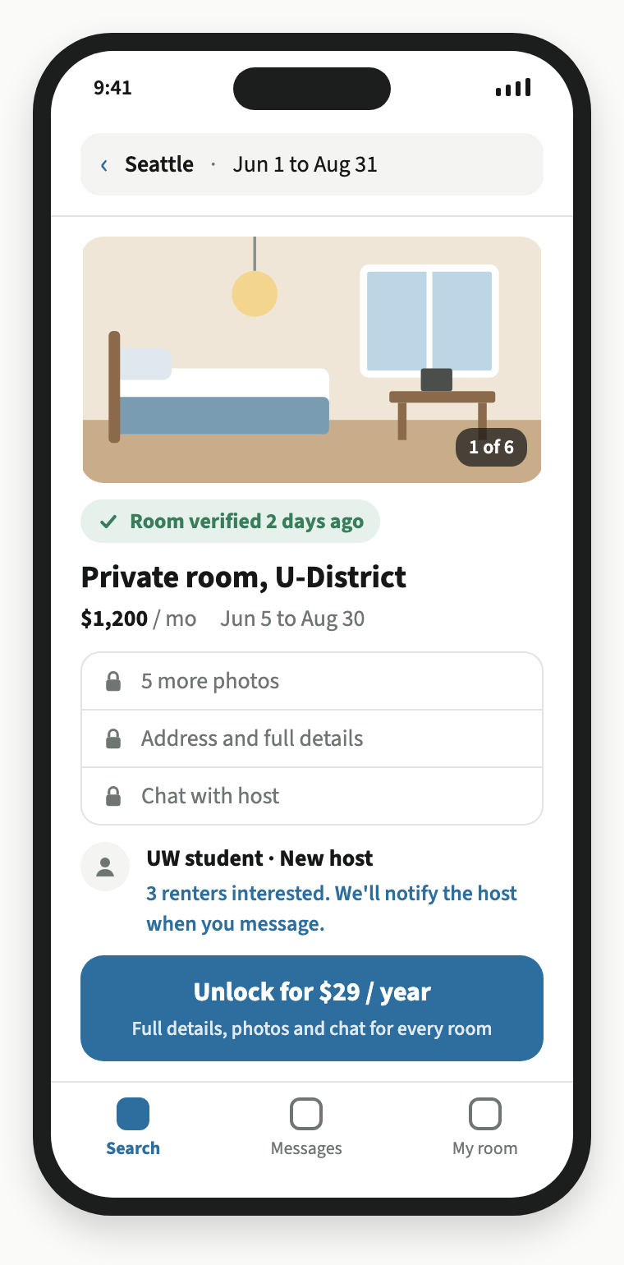
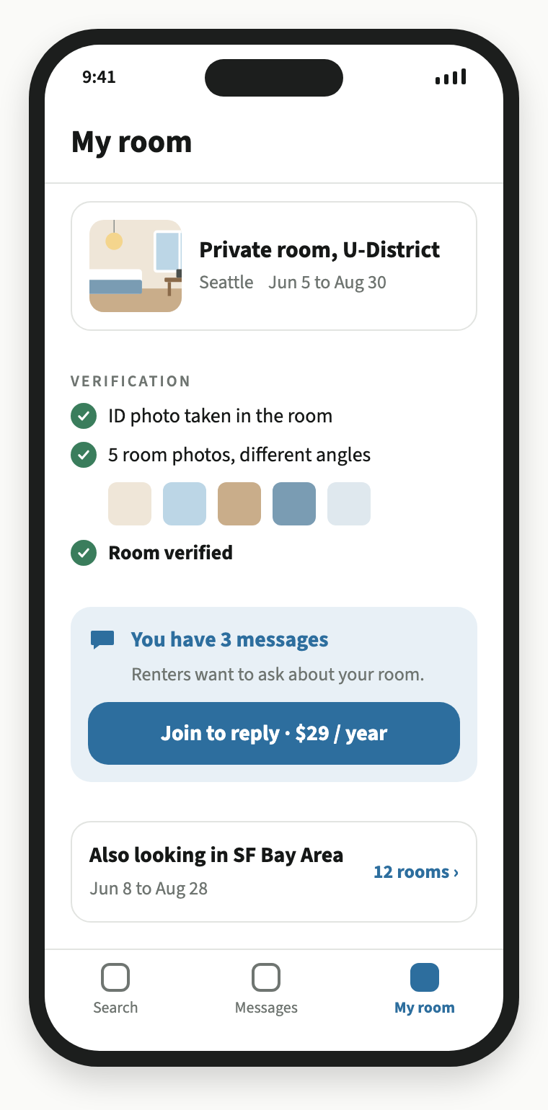
SummerNest MVP
XIAOYU WANG & AURORA OUYANG
See the room before you pay
Renters see proof for free
One cover photo and the verified badge answer “is this room real?”
Hosts pay when renters are waiting
Listing and verification stay free, so supply isn’t blocked.
A clear fallback
If under 10% of hosts with messages join, replies become free.
NEXT Launch in January 2027 and test whether 15% of verified users click “Unlock.”
RENTER
HOST

Slide 10
SUMMERNEST
Thank you
Questions?
TEAM
COURSE
Xiaoyu Wang & Aurora Ouyang
INFO 6215 · Fall 2026
AI use: “Create the class presentation slides for SummerNest, a verified sublet marketplace for interns” prompt. Claude, Opus 5.5 version, Anthropic, 27 Oct. 2026, claude.ai.

