Slide 1
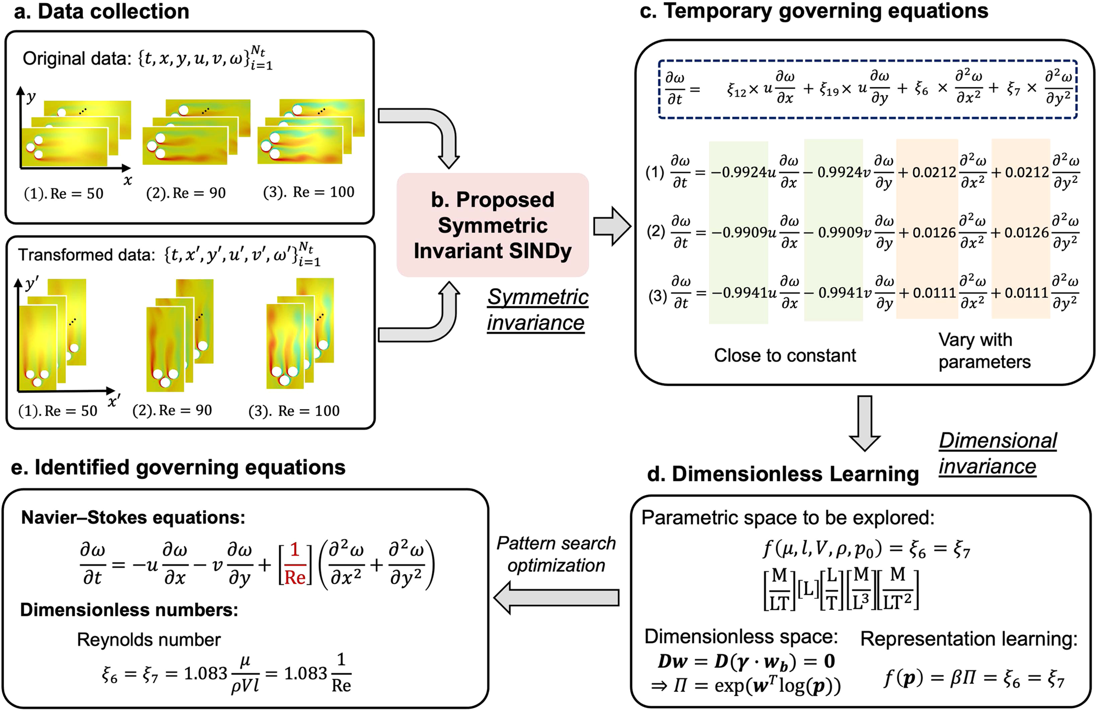
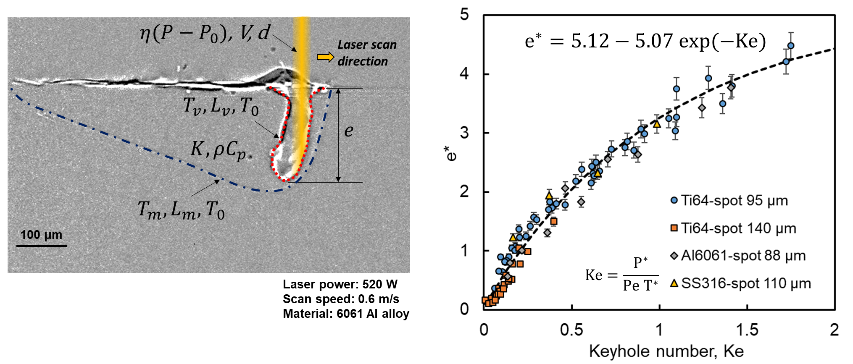
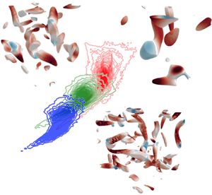
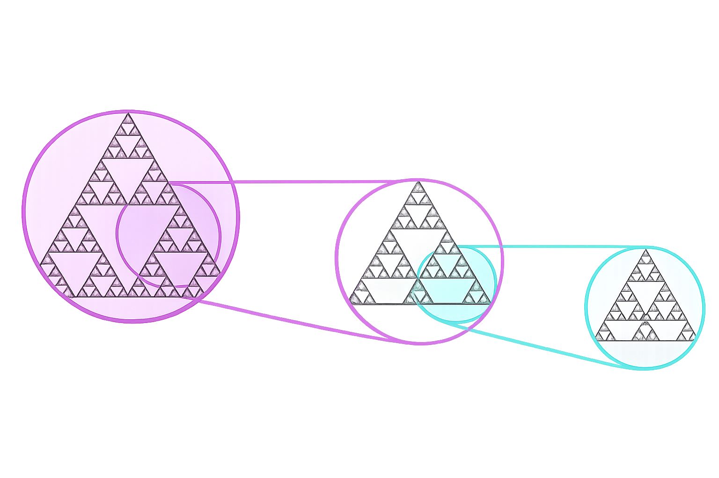
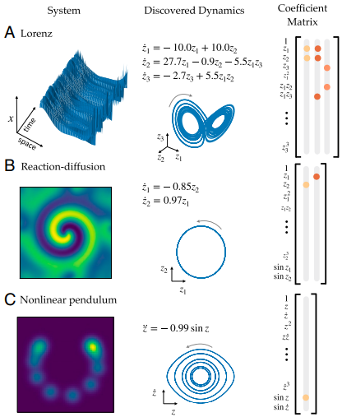

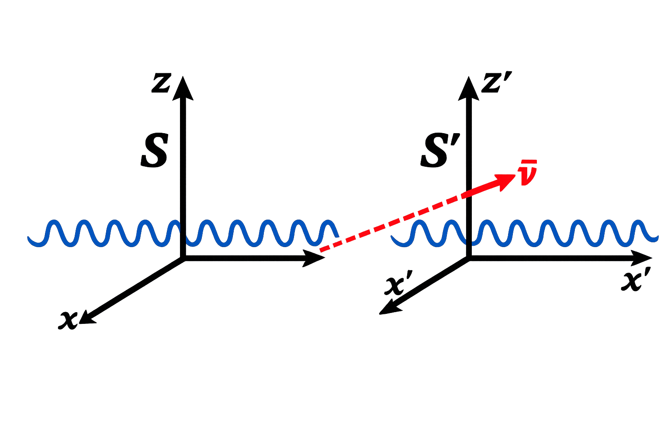
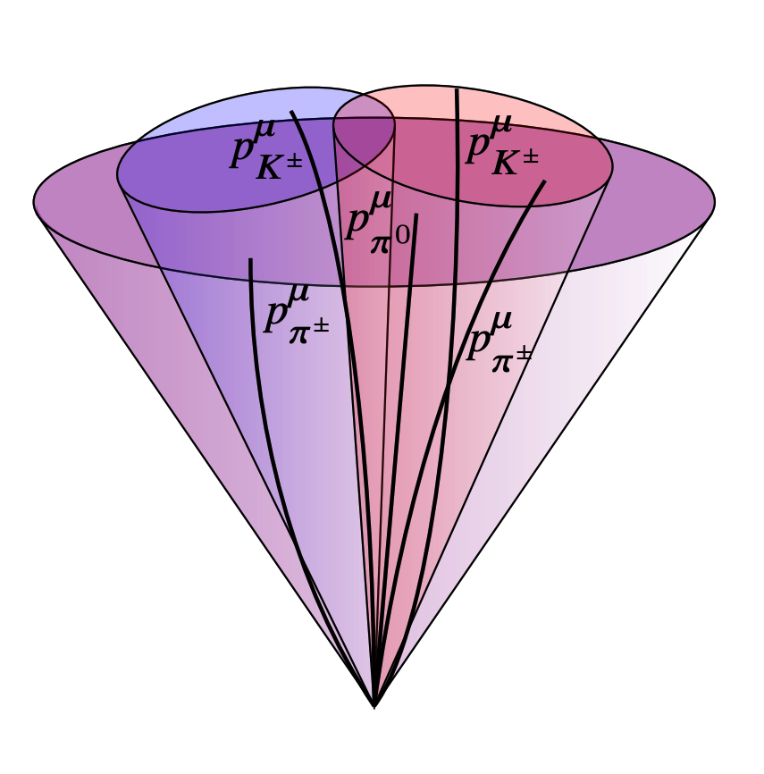
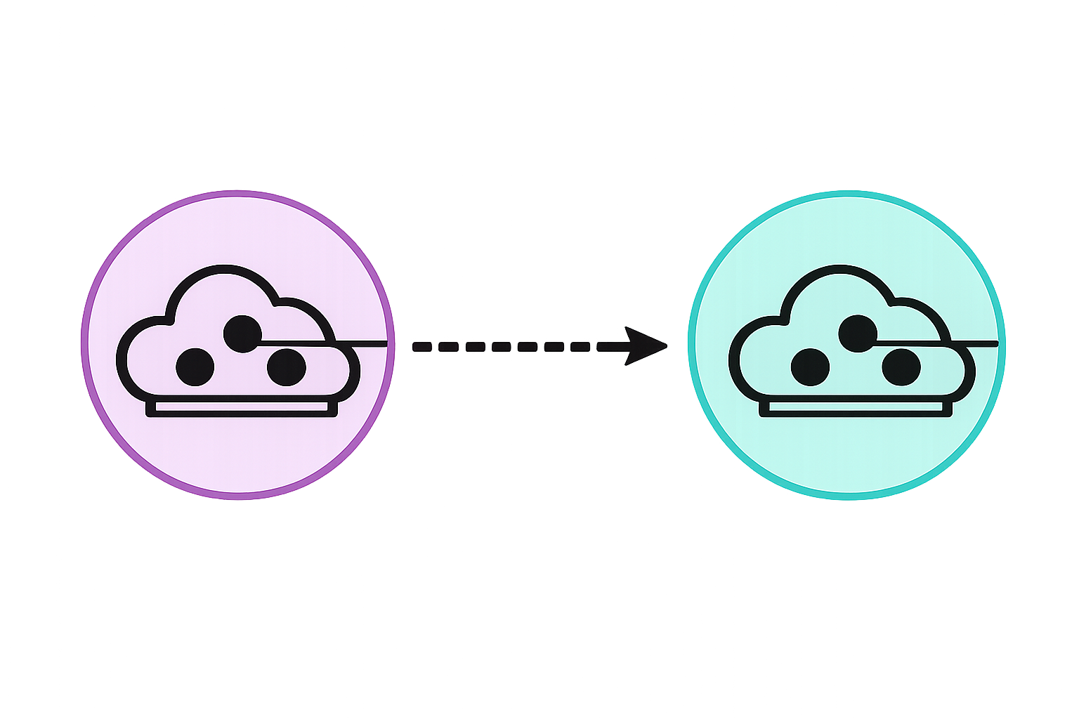
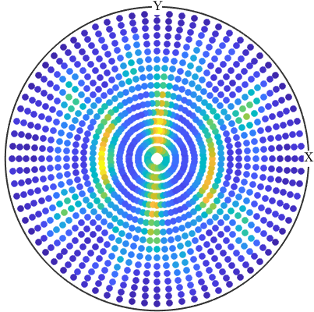
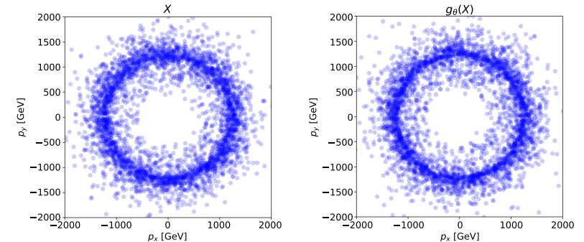
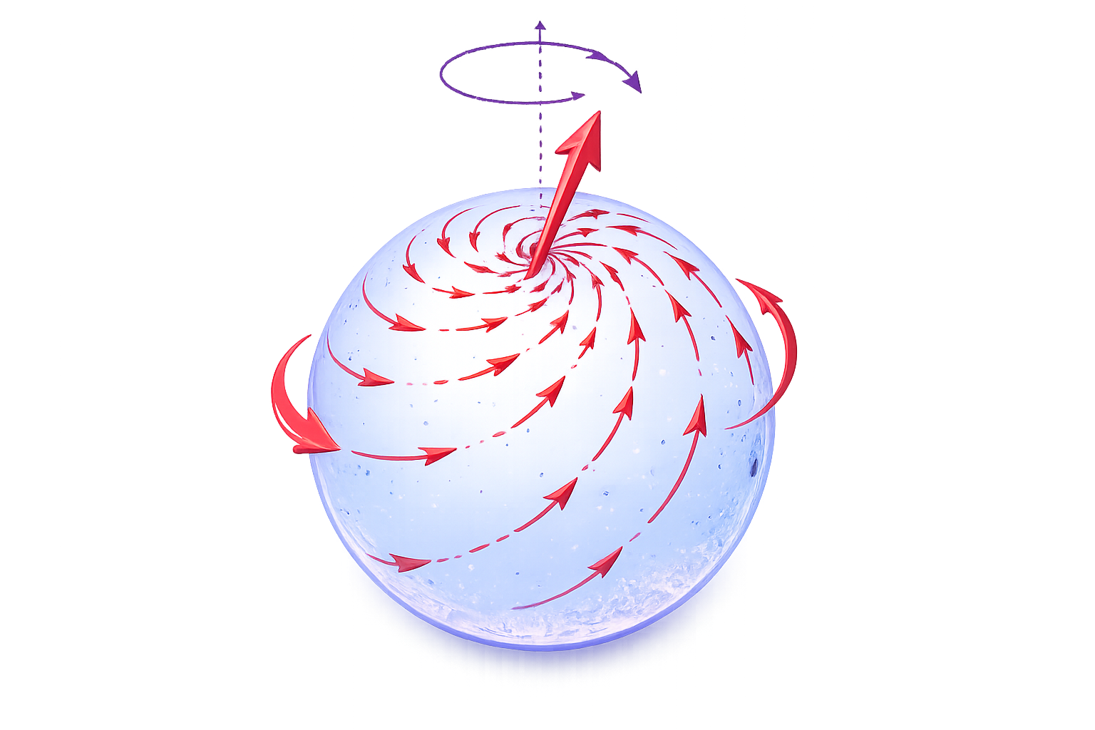
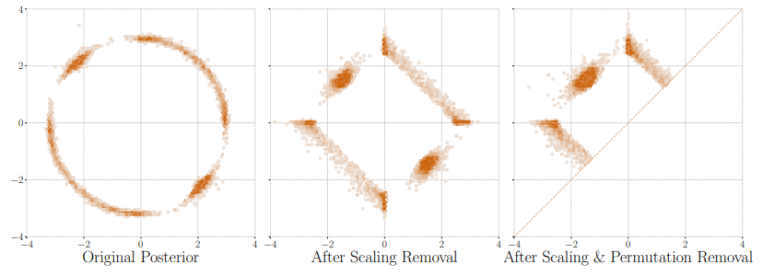




Research Directions and Applications
Scaling Laws in Engineering
Data-driven Discovery of Governing Equation
Z. Gan, Nature Comm., 2021
Discover Symmetries from Data
PyDimension
Laser-based manufacturing
Symmetry-aware equation discovery
Scaling Symmetry
Boost Symmetry
X. Xie, Nature Comm., 2022
$$f\left(λx\right)=λ^{−a}f(x)$$
$$f\left(x−vt\right)=f(x)$$
Coordinates discovery
Fluid Mechanics
K. Fukami, J Fluid Mechanics, 2024
K. Champion, PNAS, 2019
Ecosystem
OpenSymmetry
Theoretical Physics
Translational Symmetry
Other
Symmetries
Symmetry-aware AI
Particle physics
A. Bogatskiy, ICML, 2020
$$f\left(x+a\right)=f(x)$$
Rotational Symmetry
Large Hadron Collider (LHC)
Symmetry-aware exploration
$$f\left(Rx\right)=f(x)$$
K. Desai, Phys. Rev. D, 2022
O. Laurent, ICLR, 2024

Slide 3
Governing Committee
Co-Chairs
PI Gan, Co-PI: Wei
OSE Mentor
J. Zhang
(Microsoft, Senior Software Engineer)
Technical Integration Committee
Lead: PI Gan;
Advisor: Dr. X. Xie (Meta, independent contributor)
Community Engagement Committee
Lead: Co-PI Wei
Advisor: Prof. A. Ciampagila (independent contributor)
Steward the cross-simulator API, schema, and parity suite;
Ensure technical consistency across engines and testbeds.
Lead outreach, onboarding, workshops, and hackathons;
support broader participation and community growth.
Policy & Partnership Committee
Lead: PI Gan
Advisors: Dr. Z. Ren (Brookhaven National Laboratory)
Operations & Sustainability Committee
Lead: Co-PI Wei
Advisor: Dr. A. Kashtelyan(U.S. Army TDAC)
Liaise with agencies, municipalities, and industry partners;
Ensure alignment with priorities, goals, and pathways.
Oversee releases, CI/CD pipelines, security plan, and long-term sustainability (governance charter, roadmap, metrics).

Slide 4
Physics from symmetry
As far as I see, all a priori statements in physics have their origin in symmetry – Hermann Weyl
The truth always turns out to be simpler than you thought – Richard P. Feynman
The most beautiful thing in physics is when something incomprehensible, suddenly becomes comprehensible, because of a deep explanation.
There is presently NO theory that is able to derive the constants of nature. These constants need to be extracted from experiments

Slide 5
Special relativity: the velocity of light has the same value in all inertial frames of reference, which are frames moving with constant velocity relative to each other and physics is the same in all inertial frames of reference.
The set of all transformations permitted by these symmetry constrains is called the Poincaré group.
Lagrangian must be invariant (= does not change) under any transformation of the Poincaré group
Symmetry breaking and a special way to break symmetries called the Higgs mechanism, which enables us to describe particles with mass.
Noether’s theorem reveals a deep connection between symmetries and conserved quantities.
The standard model uses quantum field theory to describe the behavior of all known elementary particles.

Slide 6
Elementary Particles
Bosons (integer spin, mostly 1)
For the forces of nature
1. Electromagnetic interactions – massless photons – need charge: electric charge
2. Weak force – massive W+, W-, Z- bosons – need charge: isospin (all fermions have )
3. Strong force – massless gluons – need charge: color
4. Gravity – (maybe) gravitons
Higgs boson (spin 0)
Fermions (half-integer spin)– Pauli’s exclusion principle
Responsible for matter
Atoms consist of electrons (are leptons), protons (consist of quarks), and neutrons (consist of quarks) (all fermions)

Slide 7
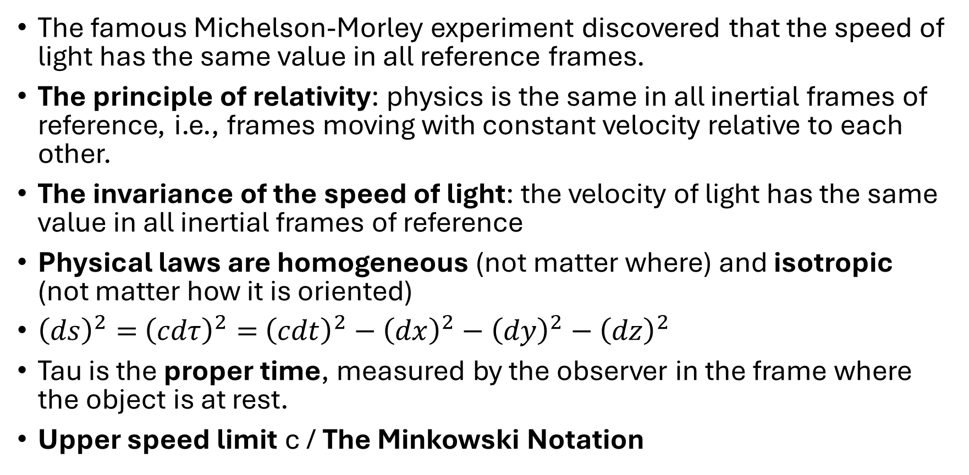
2. Special relativity
The famous Michelson-Morley experiment discovered that the speed of light has the same value in all reference frames.
The principle of relativity: physics is the same in all inertial frames of reference, i.e., frames moving with constant velocity relative to each other.
The invariance of the speed of light: the velocity of light has the same value in all inertial frames of reference
Physical laws are homogeneous (not matter where) and isotropic (not matter how it is oriented)
${\left(ds\right)}^{2}=$ ${\left(cdτ\right)}^{2}=$ ${\left(cdt\right)}^{2}−{\left(dx\right)}^{2}−{\left(dy\right)}^{2}−{\left(dz\right)}^{2}$
Tau is the proper time, measured by the observer in the frame where the object is at rest.
Upper speed limit c / The Minkowski Notation

Slide 8
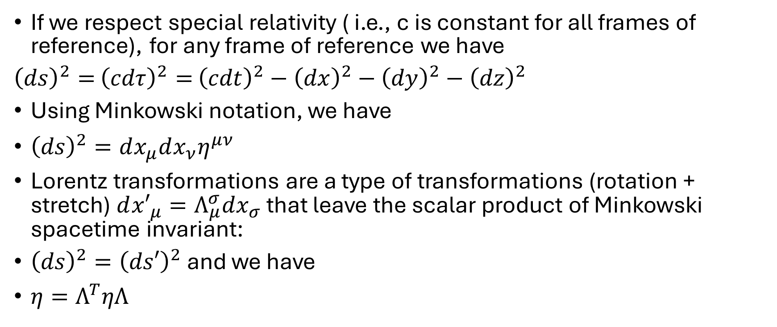
Special relativity to Minkowski notation to Lorenz transformations
If we respect special relativity ( i.e., c is constant for all frames of reference), for any frame of reference we have
${\left(ds\right)}^{2}=$ ${\left(cdτ\right)}^{2}=$ ${\left(cdt\right)}^{2}−{\left(dx\right)}^{2}−{\left(dy\right)}^{2}−{\left(dz\right)}^{2}$
Using Minkowski notation, we have
${\left(ds\right)}^{2}=dx_{μ}dx_{ν}η^{μν}$
Lorentz transformations are a type of transformations (rotation + stretch) $d{x′}_{μ}=Λ_{μ}^{σ}dx_{σ}$ that leave the scalar product of Minkowski spacetime invariant:
${\left(ds\right)}^{2}={\left(ds′\right)}^{2}$ and we have
$η=Λ^{T}ηΛ$

Slide 9
We call something invariant/symmetry, if it doesn’t change under transformations
Covariance means something takes the same form (but can have different parameters)
All physical laws must be covariant under Lorentz transformations

Slide 10
Part II symmetry tools: Lie Group Theory
‘Numbers measure size, groups measure symmetry’ – Mark A. Armstrong
The Poincaré group is the Lorentz group (rotation and stretch) plus translations

