Slide 1
基于似然比的异常检测
—吴博文
2012/02/05
Notes:
Likelihood Ratios for Out-of-Distribution Detection，NIPS2019，google.

Slide 2
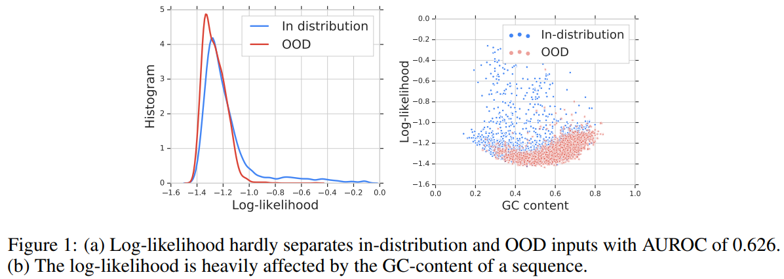
问题陈述
细菌检测对败血症等传染疾病的诊断与治疗以及食源性病原体的鉴定起着关键作用。尽管使用一种基于细菌种类进行训练的神经网络分类器可以达到很高的精度，但针对细菌检测的模型部署仍具有挑战：因为现实的数据在不断地发展变化，并且不可避免地包含以往训练数据中未曾出现的基因组。
常见的异常检测算法的缺点：

Slide 3






异常检测的似然比
High level idea
假设每个样本x由两部分组成，即 ：
(1) a background component characterized by population level background statistics
(2) a semantic component characterized by patterns specific to the in-distribution data.
似然函数
假设背景和语义成分是独立生成的，则生成样本的似然比有以下分解：
似然比函数
Assume that is a model trained using in-distribution data, and is a background model that captures general background statistics.
Notes:
For example, images can be modeled as backgrounds plus objects; genomes can be modeled as background sequences plus motifs.

Slide 4
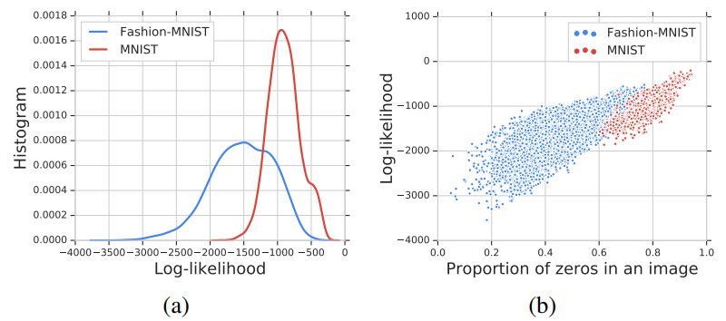
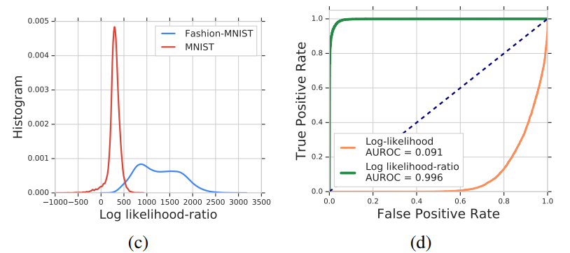
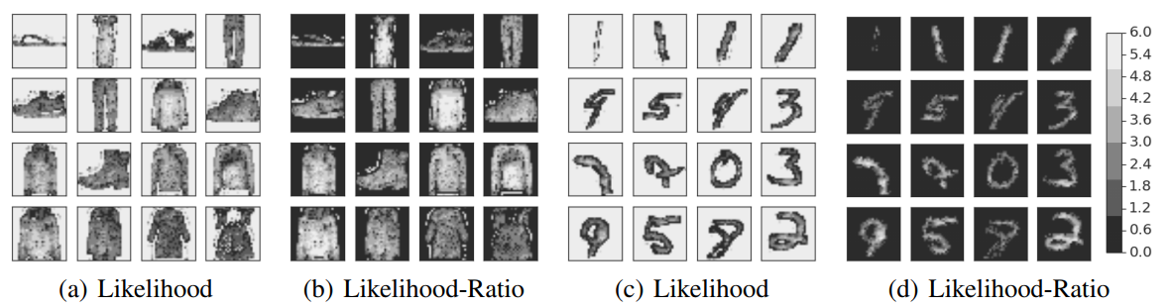
实验结果
图像数据
Notes:
For example, images can be modeled as backgrounds plus objects; genomes can be modeled as background sequences plus motifs.

Slide 5
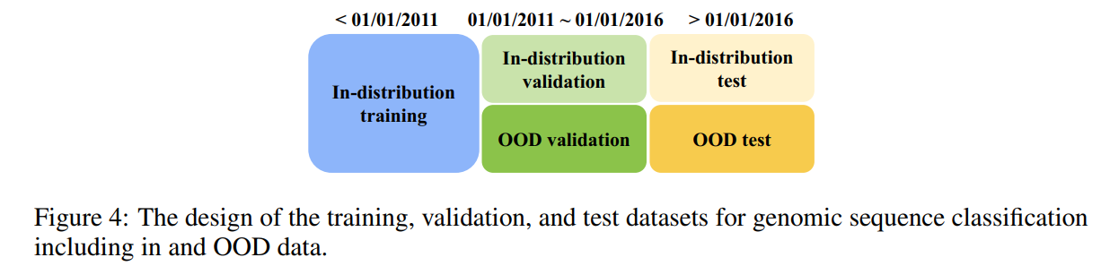
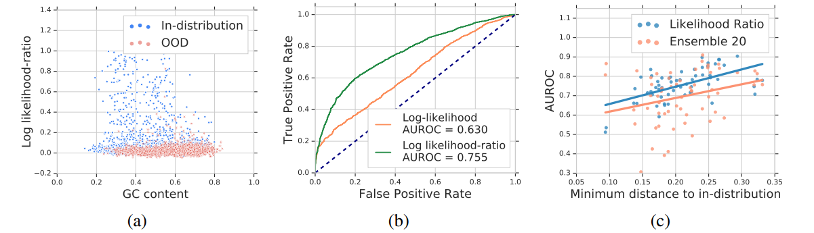
实验结果
细菌数据
Notes:
For example, images can be modeled as backgrounds plus objects; genomes can be modeled as background sequences plus motifs.

Slide 6
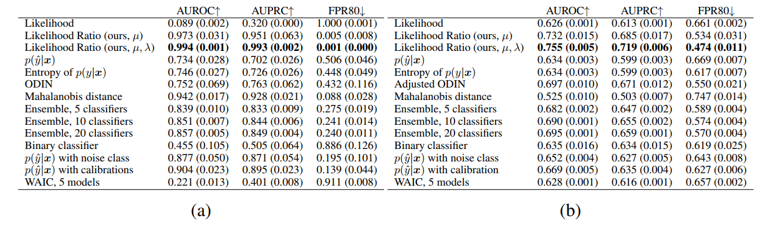
实验结果
评估度量
Notes:
For example, images can be modeled as backgrounds plus objects; genomes can be modeled as background sequences plus motifs.

