Slide 1
Hashing and Natural Parallism
Companion slides for
The Art of Multiprocessor Programming
by Maurice Herlihy & Nir Shavit

Slide 2
Code
Please review the code for the presented data structures from Chapter 13 of the textbook
Art of Multiprocessor Programming© Herlihy-Shavit 2007

Slide 3
Linked Lists
We looked at a number of ways to make highly-concurrent list-based Sets:
  Fine-grained locks
  Optimistic synchronization
  Lazy synchronization
  Lock-free synchronization
What’s missing?
Art of Multiprocessor Programming© Herlihy-Shavit 2007

Slide 4
Linear-Time Set Methods
Problem is
  add(), remove(), contains()
  Take time linear in set size
We want
  Constant-time methods
  (at least, on average)
Art of Multiprocessor Programming© Herlihy-Shavit 2007

Slide 5
Hashing
Hash function
  h: items → integers
Uniformly distributed
  Different item most likely have different hash values
Java hashCode() method
Art of Multiprocessor Programming© Herlihy-Shavit 2007

Slide 6
Sequential Hash Map
0
16
1
9
buckets
2
3
2 Items
h(k) = k mod 4
Art of Multiprocessor Programming© Herlihy-Shavit 2007
Notes:
What’s an extensible hash table? We’re looking at closed addressing table. Here’s the most popular implementation. The table is implemented as an array of buckets, each pointing to a constant size list of elements. Where the number of buckets is a power of two, and the hash function maps an item to the respective bucket of key modulo size.
Seven is inserted to bucket 3,…
As items are added, the total itemcount increases, and when it passes a certain threshold the table is extended.

Slide 7
Add an Item
0
16
1
9
2
3
7
3 Items
h(k) = k mod 4
Art of Multiprocessor Programming© Herlihy-Shavit 2007

Slide 8
Add Another: Collision
0
16
4
1
9
2
3
7
4 Items
h(k) = k mod 4
Art of Multiprocessor Programming© Herlihy-Shavit 2007

Slide 9
More Collisions
0
16
4
1
9
2
3
7
15
5 Items
h(k) = k mod 4
Art of Multiprocessor Programming© Herlihy-Shavit 2007

Slide 10
More Collisions
0
16
4
1
9
2
3
7
15
5 Items
Problem:
buckets getting too long
h(k) = k mod 4
Art of Multiprocessor Programming© Herlihy-Shavit 2007

Slide 11
Resizing
0
16
4
1
9
2
3
7
15
4
5 Items
5
h(k) = k mod 8
6
7
Grow the array
Art of Multiprocessor Programming© Herlihy-Shavit 2007
Notes:
To extend the table one allocates a new bucket array and redistributes the items using the new hash function, which now uses the new size.

Slide 12
Resizing
0
16
4
1
9
Adjust hash function
2
3
7
15
4
5 Items
5
h(k) = k mod 8
6
7
Art of Multiprocessor Programming© Herlihy-Shavit 2007
Notes:
To extend the table one allocates a new bucket array and redistributes the items using the new hash function, which now uses the new size.

Slide 13
Resizing
0
16
4
h(4) = 0 mod 8
1
9
2
3
7
15
4
5
h(k) = k mod 8
6
7
Art of Multiprocessor Programming© Herlihy-Shavit 2007
Notes:
The four must move the bucket four, and 7 and 15 must moveto bucket 7.

Slide 14
Resizing
0
16
h(4) = 4 mod 8
1
9
2
3
7
15
4
4
5
h(k) = k mod 8
6
7
Art of Multiprocessor Programming© Herlihy-Shavit 2007

Slide 15
Resizing
0
16
h(15) = 7 mod 8
1
9
2
3
7
15
4
4
5
h(k) = k mod 8
6
7
Art of Multiprocessor Programming© Herlihy-Shavit 2007

Slide 16
Resizing
0
16
h(15) = 7 mod 8
1
9
2
3
4
4
5
h(k) = k mod 8
6
7
7
15
Art of Multiprocessor Programming© Herlihy-Shavit 2007

Slide 17
Hash Sets
Implement a Set object
  Collection of items, no duplicates
  add(), remove(), contains() methods
  You know the drill …
Art of Multiprocessor Programming© Herlihy-Shavit 2007

Slide 18
Simple Hash Set
public class SimpleHashSet {
protected LockFreeList[] table;
public SimpleHashSet(int capacity) {
table = new LockFreeList[capacity];
for (int i = 0; i < capacity; i++)
table[i] = new LockFreeList();
}
…
Art of Multiprocessor Programming© Herlihy-Shavit 2007

Slide 19
Fields
public class SimpleHashSet {
protected LockFreeList[] table;
public SimpleHashSet(int capacity) {
table = new LockFreeList[capacity];
for (int i = 0; i < capacity; i++)
table[i] = new LockFreeList();
}
…
Array of lock-free lists
Art of Multiprocessor Programming© Herlihy-Shavit 2007

Slide 20
Constructor
public class SimpleHashSet {
protected LockFreeList[] table;
public SimpleHashSet(int capacity) {
table = new LockFreeList[capacity];
for (int i = 0; i < capacity; i++)
table[i] = new LockFreeList();
}
…
Initial size
Art of Multiprocessor Programming© Herlihy-Shavit 2007

Slide 21
Constructor
public class SimpleHashSet {
protected LockFreeList[] table;
public SimpleHashSet(int capacity) {
table = new LockFreeList[capacity];
for (int i = 0; i < capacity; i++)
table[i] = new LockFreeList();
}
…
Allocate memory
Art of Multiprocessor Programming© Herlihy-Shavit 2007

Slide 22
Constructor
public class SimpleHashSet {
protected LockFreeList[] table;
public SimpleHashSet(int capacity) {
table = new LockFreeList[capacity];
for (int i = 0; i < capacity; i++)
table[i] = new LockFreeList();
}
…
Initialization
Art of Multiprocessor Programming© Herlihy-Shavit 2007

Slide 23
Add Method
public boolean add(Object key) {
int hash =
key.hashCode() % table.length;
return table[hash].add(key);
}
Art of Multiprocessor Programming© Herlihy-Shavit 2007

Slide 24
Add Method
public boolean add(Object key) {
int hash =
key.hashCode() % table.length;
return table[hash].add(key);
}
Use object hash code to pick a bucket
Art of Multiprocessor Programming© Herlihy-Shavit 2007

Slide 25
Add Method
public boolean add(Object key) {
int hash =
key.hashCode() % table.length;
return table[hash].add(key);
}
Call bucket’s add() method
Art of Multiprocessor Programming© Herlihy-Shavit 2007

Slide 26
No Brainer?
We just saw a
  Simple
  Lock-free
  Concurrent hash-based set implementation
What’s not to like?
Art of Multiprocessor Programming© Herlihy-Shavit 2007

Slide 27
No Brainer?
We just saw a
  Simple
  Lock-free
  Concurrent hash-based set implementation
What’s not to like?
We don’t know how to resize …
Art of Multiprocessor Programming© Herlihy-Shavit 2007

Slide 28
Is Resizing Necessary?
Constant-time method calls require
  Constant-length buckets
  Table size proportional to set size
  As set grows, must be able to resize
Art of Multiprocessor Programming© Herlihy-Shavit 2007

Slide 29
Set Method Mix
Typical load
  90% contains()
  9% add ()
  1% remove()
Growing is important
Shrinking not so much
Art of Multiprocessor Programming© Herlihy-Shavit 2007

Slide 30
When to Resize?
Many reasonable policies. Here’s one.
Pick a threshold on num of items in a bucket
Global threshold
  When ≥ ¼ buckets exceed this value
Bucket threshold
  When any bucket exceeds this value
Art of Multiprocessor Programming© Herlihy-Shavit 2007
Notes:
Java: .75 load factor threshold

Slide 31
Coarse-Grained Locking
Good parts
  Simple
  Hard to mess up
Bad parts
  Sequential bottleneck
Art of Multiprocessor Programming© Herlihy-Shavit 2007

Slide 32
Fine-grained Locking
0
4
8
1
9
17
2
3
7
11
Each lock associated with one bucket
Art of Multiprocessor Programming© Herlihy-Shavit 2007

Slide 33
Resize This
Make sure table reference didn’t change between resize decision and lock acquisition
0
4
8
1
9
17
2
3
7
11
Acquire locks in ascending order
Art of Multiprocessor Programming© Herlihy-Shavit 2007

Slide 34
Resize This
0
4
8
0
1
9
17
1
2
2
3
7
11
3
4
Allocate new super-sized table
5
6
7
Art of Multiprocessor Programming© Herlihy-Shavit 2007

Slide 35
Resize This
0
4
8
0
8
1
9
17
1
9
17
2
2
3
7
11
3
11
4
4
5
6
7
7
Art of Multiprocessor Programming© Herlihy-Shavit 2007
Notes:
Dashed lines?

Slide 36
Resize This
0
8
0
1
9
17
1
2
2
3
11
3
4
4
5
6
7
7
Art of Multiprocessor Programming© Herlihy-Shavit 2007

Slide 37
Resize This
Striped Locks: each lock now associated with two buckets
0
8
0
1
9
17
1
2
2
3
11
3
4
4
5
6
7
7
Art of Multiprocessor Programming© Herlihy-Shavit 2007
Notes:
Seems one lock to sequentialize resizes might be a good idea .. somebody else having the lock already … don’t do anything
Yossi: why not a single lock? If someone have the first lock in the array we block as well…

Slide 38
Observations
We grow the table, but not locks
  Resizing lock array is tricky …
We use sequential lists
  Not LockFreeList lists
  If we’re locking anyway, why pay?
Art of Multiprocessor Programming© Herlihy-Shavit 2007
Notes:
tricky: need to communicate that waiting threads need to recompute the bucket .. with interrupts … disable old locks..

Slide 39
Fine-Grained Hash Set
public class FGHashSet {
protected RangeLock[] lock;
protected List[] table;
public FGHashSet(int capacity) {
table = new List[capacity];
lock = new RangeLock[capacity];
for (int i = 0; i < capacity; i++) {
lock[i] = new RangeLock();
table[i] = new LinkedList();
}} …
Art of Multiprocessor Programming© Herlihy-Shavit 2007

Slide 40
Fine-Grained Hash Set
public class FGHashSet {
protected RangeLock[] lock;
protected List[] table;
public FGHashSet(int capacity) {
table = new List[capacity];
lock = new RangeLock[capacity];
for (int i = 0; i < capacity; i++) {
lock[i] = new RangeLock();
table[i] = new LinkedList();
}} …
Array of locks
Art of Multiprocessor Programming© Herlihy-Shavit 2007

Slide 41
Fine-Grained Hash Set
public class FGHashSet {
protected RangeLock[] lock;
protected List[] table;
public FGHashSet(int capacity) {
table = new List[capacity];
lock = new RangeLock[capacity];
for (int i = 0; i < capacity; i++) {
lock[i] = new RangeLock();
table[i] = new LinkedList();
}} …
Array of buckets
Art of Multiprocessor Programming© Herlihy-Shavit 2007

Slide 42
Fine-Grained Hash Set
Initially same number of locks and buckets
public class FGHashSet {
protected RangeLock[] lock;
protected List[] table;
public FGHashSet(int capacity) {
table = new List[capacity];
lock = new RangeLock[capacity];
for (int i = 0; i < capacity; i++) {
lock[i] = new RangeLock();
table[i] = new LinkedList();
}} …
Art of Multiprocessor Programming© Herlihy-Shavit 2007

Slide 43
The add() method
public boolean add(Object key) {
int keyHash
= key.hashCode() % lock.length;
synchronized (lock[keyHash]) {
int tabHash = key.hashCode() %
table.length;
return table[tabHash].add(key);
}
}
Art of Multiprocessor Programming© Herlihy-Shavit 2007

Slide 44
Fine-Grained Locking
public boolean add(Object key) {
int keyHash
= key.hashCode() % lock.length;
synchronized (lock[keyHash]) {
int tabHash = key.hashCode() %
table.length;
return table[tabHash].add(key);
}
}
Which lock?
Art of Multiprocessor Programming© Herlihy-Shavit 2007

Slide 45
The add() method
public boolean add(Object key) {
int keyHash
= key.hashCode() % lock.length;
synchronized (lock[keyHash]) {
int tabHash = key.hashCode() %
table.length;
return table[tabHash].add(key);
}
}
Acquire the lock
Art of Multiprocessor Programming© Herlihy-Shavit 2007

Slide 46
Fine-Grained Locking
public boolean add(Object key) {
int keyHash
= key.hashCode() % lock.length;
synchronized (lock[keyHash]) {
int tabHash = key.hashCode() %
table.length;
return table[tabHash].add(key);
}
}
Which bucket?
Art of Multiprocessor Programming© Herlihy-Shavit 2007

Slide 47
The add() method
public boolean add(Object key) {
int keyHash
= key.hashCode() % lock.length;
synchronized (lock[keyHash]) {
int tabHash = key.hashCode() %
table.length;
return table[tabHash].add(key);
}
}
Call that bucket’s add() method
Art of Multiprocessor Programming© Herlihy-Shavit 2007

Slide 48
Fine-Grained Locking
private void resize(int depth,
List[] oldTab) {
synchronized (lock[depth]) {
if (oldTab == this.table){
int next = depth + 1;
if (next < lock.length)
resize (next, oldTab);
else
sequentialResize();
}}}
resize() calls resize(0,this.table)
Art of Multiprocessor Programming© Herlihy-Shavit 2007

Slide 49
Fine-Grained Locking
private void resize(int depth,
List[] oldTab) {
synchronized (lock[depth]) {
if (oldTab == this.table){
int next = depth + 1;
if (next < lock.length)
resize (next, oldTab);
else
sequentialResize();
}}}
Acquire next lock
Art of Multiprocessor Programming© Herlihy-Shavit 2007

Slide 50
Fine-Grained Locking
private void resize(int depth,
List[] oldTab) {
synchronized (lock[depth]) {
if (oldTab == this.table) {
int next = depth + 1;
if (next < lock.length)
resize (next, oldTab);
else
sequentialResize();
}}}
Check that no one else has resized
Art of Multiprocessor Programming© Herlihy-Shavit 2007

Slide 51
Fine-Grained Locking
private void resize(int depth,
List[] oldTab) {
synchronized (lock[depth]) {
if (oldTab == this.table){
int next = depth + 1;
if (next < lock.length)
resize (next, oldTab);
else
sequentialResize();
}}}
Recursively acquire next lock
Art of Multiprocessor Programming© Herlihy-Shavit 2007

Slide 52
Fine-Grained Locking
private void resize(int depth,
List[] oldTab) {
synchronized (lock[depth]) {
if (oldTab == this.table){
int next = depth + 1;
if (next < lock.length)
resize (next, oldTab);
else
sequentialResize();
}}}
Locks acquired, do the work
Art of Multiprocessor Programming© Herlihy-Shavit 2007

Slide 53
Fine-Grained Locks
We can resize the table
But not the locks
Debatable whether method calls are constant-time in presence of contention …
Art of Multiprocessor Programming© Herlihy-Shavit 2007
Notes:
- debatable ... high contention: we need to wait - well but we have constant time in case of low contention!

Slide 54
Insight
The contains() method
  Does not modify any fields
  Why should concurrent contains() calls conflict?
Art of Multiprocessor Programming© Herlihy-Shavit 2007

Slide 55
Read/Write Locks
public interface ReadWriteLock {
Lock readLock();
Lock writeLock();
}
Art of Multiprocessor Programming© Herlihy-Shavit 2007

Slide 56
Read/Write Locks
public interface ReadWriteLock {
Lock readLock();
Lock writeLock();
}
Returns associated read lock
Art of Multiprocessor Programming© Herlihy-Shavit 2007

Slide 57
Read/Write Locks
public interface ReadWriteLock {
Lock readLock();
Lock writeLock();
}
Returns associated read lock
Returns associated write lock
Art of Multiprocessor Programming© Herlihy-Shavit 2007

Slide 58
Lock Safety Properties
No thread may acquire the write lock
  while any thread holds the write lock
  or the read lock.
No thread may acquire the read lock
  while any thread holds the write lock.
Concurrent read locks OK
Art of Multiprocessor Programming© Herlihy-Shavit 2007

Slide 59
Read/Write Lock
Satisfies safety properties
  If readers > 0 then writer == false
  If writer = true then readers == 0
Liveness?
  Lots of readers …
  Writers locked out?
Art of Multiprocessor Programming© Herlihy-Shavit 2007

Slide 60
FIFO R/W Lock
As soon as a writer requests a lock
No more readers accepted
Current readers “drain” from lock
Writer gets in
Art of Multiprocessor Programming© Herlihy-Shavit 2007

Slide 61
The Story So Far
Resizing the hash table is the hard part
Fine-grained locks
  Striped locks cover a range (not resized)
Read/Write locks
  FIFO property tricky
Art of Multiprocessor Programming© Herlihy-Shavit 2007
Notes:
Yossi: why tricky? (because they don’t know much)

Slide 62
Optimistic Synchronization
If the contains() method
  Scans without locking
If it finds the key
  OK to return true
  Actually requires a proof ….
What if it doesn’t find the key?
Art of Multiprocessor Programming© Herlihy-Shavit 2007

Slide 63
Optimistic Synchronization
If it doesn’t find the key
  May be victim of resizing
Must try again
  Getting a read lock this time
Makes sense if
  Keys are present
  Resizes are rare
Art of Multiprocessor Programming© Herlihy-Shavit 2007
Notes:
Yossi: makes sense if most of the time you look for something that is likely to be in the set.

Slide 64
Stop The World Resizing
The resizing we have seen up till now stops all concurrent operations
Can we design a resize operation that will be incremental
Need to avoid locking the table
A lock-free table with incremental resizing
Art of Multiprocessor Programming© Herlihy-Shavit 2007

Slide 65
Lock-Free Resizing Problem
0
4
8
1
9
2
3
7
15
Art of Multiprocessor Programming© Herlihy-Shavit 2007
Notes:
Add 12 to bucket 0 and decide to extend.
Double the table
Try to move 4

Slide 66
Lock-Free Resizing Problem
0
4
8
12
1
9
Need to extend table
2
3
7
15
Art of Multiprocessor Programming© Herlihy-Shavit 2007
Notes:
Add 12 to bucket 0 and decide to extend.
Double the table
Try to move 4

Slide 67
Lock-Free Resizing Problem
4
4
8
12
0
12
1
9
Need to extend table
2
3
7
15
4
5
6
7
Art of Multiprocessor Programming© Herlihy-Shavit 2007
Notes:
Add 12 to bucket 0 and decide to extend.
Double the table
Try to move 4

Slide 68
Lock-Free Resizing Problem
0
4
8
12
1
9
2
3
7
15
4
4
12
5
6
7
Art of Multiprocessor Programming© Herlihy-Shavit 2007
Notes:
Add 12 to bucket 0 and decide to extend.
Double the table
Try to move 4

Slide 69
Lock-Free Resizing Problem
0
4
8
12
1
9
to remove and
then add even a
single item single
location CAS
not enough
2
3
7
15
4
4
12
5
6
We need a new idea…
7
Art of Multiprocessor Programming© Herlihy-Shavit 2007
Notes:
Moving items, it doesn’t matter if its one or many, from one bucket to the other, cannot be done efficiently using CAS operations. If you first remove it from the old bucket and only then put it in the new bucket then concurrent threads might not find it. If you first copy it and then remove it from the old bucket that you got a copy management problem, it’s not clear how to manage the inconsistencies.
Building an efficient double-compare-and-swap using primitives existing on today’s machines is also unknown.
So we need a new idea.
Yossi: what copy-management problem? Each thread knows which entries it needs to remove.

Slide 70
Don’t move the items
Move the buckets instead
Keep all items in a single lock-free list
Buckets become “shortcut pointers” into the list
16
4
9
7
15
0
1
2
3
Art of Multiprocessor Programming© Herlihy-Shavit 2007
Notes:
Since moving items among buckets is what’s hard, our idea was not to move them. Instead, were gonna flip the idea of bucket-based hashing on its head. We’re gonna keep the items fixed and move the buckets. As you can see from the picture, we’re gonna keep the items in an ordered linked list, which will be implemented using Michael’s technique.
Even though all the items are gonna be reachable from the top bucket, the additional buckets are going to be shortcuts that will allow us to reach items in constant time.

Slide 71
Recursive Split Ordering
0
4
2
6
1
5
3
7
0
Art of Multiprocessor Programming© Herlihy-Shavit 2007
Notes:
Let’s look at a simple example, Suppose the items 0 through 7 need to be hashed into the table. If we have one bucket, it can only point to the head of the list. Once we have another bucket, we expect it to split the list in 2, and with 4 buckets, each of the two new buckets will recursively split each of those halfs, so that in the end, there are only a constant number of items between any two bucket pointers.
In order to allow us to redirect the bucket pointers in this recursive manner, we haveto insert the items in such a special order, and order that allows to trecursively split buckets.
What is this magical order?

Slide 72
Recursive Split Ordering
1/2
0
4
2
6
1
5
3
7
0
1
Art of Multiprocessor Programming© Herlihy-Shavit 2007
Notes:
Let’s look at a simple example, Suppose the items 0 through 7 need to be hashed into the table. If we have one bucket, it can only point to the head of the list. Once we have another bucket, we expect it to split the list in 2, and with 4 buckets, each of the two new buckets will recursively split each of those halfs, so that in the end, there are only a constant number of items between any two bucket pointers.
In order to allow us to redirect the bucket pointers in this recursive manner, we haveto insert the items in such a special order, and order that allows to trecursively split buckets.
What is this magical order?

Slide 73
Recursive Split Ordering
1/4
1/2
3/4
0
4
2
6
1
5
3
7
0
1
2
3
Art of Multiprocessor Programming© Herlihy-Shavit 2007
Notes:
Let’s look at a simple example, Suppose the items 0 through 7 need to be hashed into the table. If we have one bucket, it can only point to the head of the list. Once we have another bucket, we expect it to split the list in 2, and with 4 buckets, each of the two new buckets will recursively split each of those halfs, so that in the end, there are only a constant number of items between any two bucket pointers.
In order to allow us to redirect the bucket pointers in this recursive manner, we haveto insert the items in such a special order, and order that allows to trecursively split buckets.
What is this magical order?

Slide 74
Recursive Split Ordering
1/4
1/2
3/4
0
4
2
6
1
5
3
7
0
1
2
3
List entries sorted in order that allows recursive splitting. How?
Art of Multiprocessor Programming© Herlihy-Shavit 2007
Notes:
Let’s look at a simple example, Suppose the items 0 through 7 need to be hashed into the table. If we have one bucket, it can only point to the head of the list. Once we have another bucket, we expect it to split the list in 2, and with 4 buckets, each of the two new buckets will recursively split each of those halfs, so that in the end, there are only a constant number of items between any two bucket pointers.
In order to allow us to redirect the bucket pointers in this recursive manner, we haveto insert the items in such a special order, and order that allows to trecursively split buckets.
What is this magical order?

Slide 75
Recursive Split Ordering
0
4
2
6
1
5
3
7
0
Art of Multiprocessor Programming© Herlihy-Shavit 2007
Notes:
Let’s look at a simple example, Suppose the items 0 through 7 need to be hashed into the table. If we have one bucket, it can only point to the head of the list. Once we have another bucket, we expect it to split the list in 2, and with 4 buckets, each of the two new buckets will recursively split each of those halfs, so that in the end, there are only a constant number of items between any two bucket pointers.
In order to allow us to redirect the bucket pointers in this recursive manner, we haveto insert the items in such a special order, and order that allows to trecursively split buckets.
What is this magical order?

Slide 76
Recursive Split Ordering
LSB 0
LSB 1
0
4
2
6
1
5
3
7
0
1
LSB = Least significant Bit
Art of Multiprocessor Programming© Herlihy-Shavit 2007
Notes:
Let’s look at a simple example, Suppose the items 0 through 7 need to be hashed into the table. If we have one bucket, it can only point to the head of the list. Once we have another bucket, we expect it to split the list in 2, and with 4 buckets, each of the two new buckets will recursively split each of those halfs, so that in the end, there are only a constant number of items between any two bucket pointers.
In order to allow us to redirect the bucket pointers in this recursive manner, we have to insert the items in such a special order, and order that allows to recursively split buckets.
What is this magical order?

Slide 77
Recursive Split Ordering
LSB 00
LSB 10
LSB 01
LSB 11
0
4
2
6
1
5
3
7
0
1
2
3
Art of Multiprocessor Programming© Herlihy-Shavit 2007
Notes:
Let’s look at a simple example, Suppose the items 0 through 7 need to be hashed into the table. If we have one bucket, it can only point to the head of the list. Once we have another bucket, we expect it to split the list in 2, and with 4 buckets, each of the two new buckets will recursively split each of those halfs, so that in the end, there are only a constant number of items between any two bucket pointers.
In order to allow us to redirect the bucket pointers in this recursive manner, we haveto insert the items in such a special order, and order that allows to trecursively split buckets.
What is this magical order?

Slide 78
Split-Order
If the table size is 2^{i},
  Bucket b contains keys k
    k = b (mod 2^{i})
  bucket index consists of key's i LSBs
Art of Multiprocessor Programming© Herlihy-Shavit 2007

Slide 79
When Table Splits
Some keys stay
  b = k mod(2^{i+1})
Some move
  b+2^{i} = k mod(2^{i+1})
Determined by (i+1)^{st} bit
  Counting backwards
Key must be accessible from both
  Keys that will move must come later
Art of Multiprocessor Programming© Herlihy-Shavit 2007

Slide 80
A Bit of Magic
Real keys:
0
4
2
6
1
5
3
7
Art of Multiprocessor Programming© Herlihy-Shavit 2007
Notes:
Here are the real keys in the list. And here are their indeces in the list. We need to map the real keys to the split-order. How do we do that? Look at the binary representation of the real keys. And look at the binary representations of the desired indeces. Magically, but not surprisingly, the map simply needs to reverse the order of the bits. That is, the split-order according to which any two keys should be inserted into the list is given by comparing the binary reveresed representations of the keys.

Slide 81
A Bit of Magic
Real keys:
0
4
2
6
1
5
3
7
Real key 1 is in the 4th location
Split-order:
0
1
2
3
4
5
6
7
Art of Multiprocessor Programming© Herlihy-Shavit 2007
Notes:
Here are the real keys in the list. And here are their indexes in the list. We need to map the real keys to the split-order. How do we do that? Look at the binary representation of the real keys. And look at the binary representations of the desired indexes. Magically, but not surprisingly, the map simply needs to reverse the order of the bits. That is, the split-order according to which any two keys should be inserted into the list is given by comparing the binary reveresed representations of the keys.

Slide 82
A Bit of Magic
Real keys:
0
4
2
6
1
5
3
7
000
100
010
110
001
101
011
111
Real key 1 is in 4th location
Split-order:
0
1
2
3
4
5
6
7
000
001
010
011
100
101
110
111
Art of Multiprocessor Programming© Herlihy-Shavit 2007
Notes:
Here are the real keys in the list. And here are their indexes in the list. We need to map the real keys to the split-order. How do we do that? Look at the binary representation of the real keys. And look at the binary representations of the desired indexes. Magically, but not surprisingly, the map simply needs to reverse the order of the bits. That is, the split-order according to which any two keys should be inserted into the list is given by comparing the binary reveresed representations of the keys.

Slide 83
A Bit of Magic
Real keys:
000
100
010
110
001
101
011
111
Split-order:
000
001
010
011
100
101
110
111
Art of Multiprocessor Programming© Herlihy-Shavit 2007
Notes:
So if you have, two keys – a and b, a precedes b if and only if the bit-reversed value of a is smaller than the bit-reversed value of b.

Slide 84
A Bit of Magic
Real keys:
000
100
010
110
001
101
011
111
Split-order:
000
001
010
011
100
101
110
111
Just reverse the order of the key bits
Art of Multiprocessor Programming© Herlihy-Shavit 2007
Notes:
So if you have, two keys – a and b, a precedes b if and only if the bit-reversed value of a is smaller than the bit-reversed value of b.

Slide 85
Split Ordered Hashing
Order according to reversed bits
000
001
010
011
100
101
110
111
0
4
2
6
1
5
3
7
0
1
2
3
Art of Multiprocessor Programming© Herlihy-Shavit 2007
Notes:
Let’s look at a simple example, Suppose the items 0 through 7 need to be hashed into the table. If we have one bucket, it can only point to the head of the list. Once we have another bucket, we expect it to split the list in 2, and with 4 buckets, each of the two new buckets will recursively split each of those halfs, so that in the end, there are only a constant number of items between any two bucket pointers.
In order to allow us to redirect the bucket pointers in this recursive manner, we haveto insert the items in such a special order, and order that allows to trecursively split buckets.
What is this magical order?

Slide 86
Parent Always Provides a Short Cut
0
4
2
6
1
5
3
7
0
search
1
2
3
Art of Multiprocessor Programming© Herlihy-Shavit 2007

Slide 87
Sentinel Nodes
16
4
9
7
15
0
1
2
3
Problem: how to remove a node pointed by 2 sources using CAS
Art of Multiprocessor Programming© Herlihy-Shavit 2007
Notes:
There are a few other technical details. If you notice, in our implementations have two incoming pointers. This complicated deletions using CAS since we must keep track of how many pointer there are to a given node. To avoid this problem we had logical dummy nodes, one per bucket. That is, as if each bucket points to a dummy and not to a real item in the list and the dummy nodes are never deletes. In reality we need only and additional 4 bytes for the array entries.

Slide 88
Sentinel Nodes
0
16
4
1
9
3
7
15
0
1
2
3
Solution: use a Sentinel node for each bucket
Art of Multiprocessor Programming© Herlihy-Shavit 2007

Slide 89
Sentinel vs Regular Keys
Want sentinel key for i ordered
  before all keys that hash to bucket i
  after all keys that hash to bucket (i-1)
Art of Multiprocessor Programming© Herlihy-Shavit 2007

Slide 90
Splitting a Bucket
We can now split a bucket
In a lock-free manner
Using two CAS() calls ...
Art of Multiprocessor Programming© Herlihy-Shavit 2007

Slide 91
Initialization of Buckets
0
16
4
1
9
7
15
0
1
Art of Multiprocessor Programming© Herlihy-Shavit 2007
Notes:
When we allocate a new block of buckets they’re uninitialized, and the work of initializing a bucket and redirecting it’s pointer is done incrementally. Buckets are initialized when they are first accessed. This is important in realtime applications since it means that there is no prolonged resized phase.
explain

Slide 92
Initialization of Buckets
0
16
4
1
9
7
15
0
3
1
2
3
3 in list but not connected to bucket yet
Need to initialize bucket 3 to split bucket 1
Now 3 points to sentinel – bucket has been split
Art of Multiprocessor Programming© Herlihy-Shavit 2007
Notes:
When we allocate a new block of buckets they’re uninitialized, and the work of initializing a bucket and redirecting it’s pointer is done incrementally. Buckets are initialized when they are first accessed. This is important in realtime applications since it means that there is no prolonged resized phase.
explain

Slide 93
Adding 10
10
= 2 mod 4
0
16
4
1
9
3
7
0
2
2
1
2
3
Must initialize bucket 2
Then can add 10
Art of Multiprocessor Programming© Herlihy-Shavit 2007
Notes:
When we allocate a new block of buckets they’re uninitialized, and the work of initializing a bucket and redirecting it’s pointer is done incrementally. Buckets are initialized when they are first accessed. This is important in realtime applications since it means that there is no prolonged resized phase.
explain

Slide 94
Recursive Initialization
To add 7 to the list
7
= 3 mod 4
0
8
12
1
3
= 1 mod 2
0
But EXPECTED depth is constant
1
Could be log n depth
2
Must initialize bucket 1
3
Must initialize bucket 3
Art of Multiprocessor Programming© Herlihy-Shavit 2007
Notes:
When we allocate a new block of buckets they’re uninitialized, and the work of initializing a bucket and redirecting it’s pointer is done incrementally. Buckets are initialized when they are first accessed. This is important in realtime applications since it means that there is no prolonged resized phase.
Explain
Yossi: we can’t pospone initializing bucket 1 because 7 is 1 modulo 2, and someone may look for 7 thinking that there are only 2 buckets.

Slide 95
Lock-Free List
int makeRegularKey(int key) {
return reverse(key | 0x80000000);
}
int makeSentinelKey(int key) {
return reverse(key);
}
Art of Multiprocessor Programming© Herlihy-Shavit 2007

Slide 96
Lock-Free List
int makeRegularKey(int key) {
return reverse(key | 0x80000000);
}
int makeSentinelKey(int key) {
return reverse(key);
}
Regular key: set high-order bit to 1 and reverse
Art of Multiprocessor Programming© Herlihy-Shavit 2007

Slide 97
Lock-Free List
int makeRegularKey(int key) {
return reverse(key | 0x80000000);
}
int makeSentinelKey(int key) {
return reverse(key);
}
Sentinel key: simply reverse (high-order bit is 0)
Art of Multiprocessor Programming© Herlihy-Shavit 2007

Slide 98
Main List
Lock-Free List from earlier class
With some minor variations
Art of Multiprocessor Programming© Herlihy-Shavit 2007

Slide 99
Lock-Free List
public class LockFreeList {
public boolean add(Object object,
int key) {...}
public boolean remove(int k) {...}
public boolean contains(int k) {...}
public
LockFreeList(LockFreeList parent,
int key) {...};
}
Art of Multiprocessor Programming© Herlihy-Shavit 2007

Slide 100
Lock-Free List
public class LockFreeList {
public boolean add(Object object,
int key) {...}
public boolean remove(int k) {...}
public boolean contains(int k) {...}
public
LockFreeList(LockFreeList parent,
int key) {...};
}
Change: add takes key argument
Art of Multiprocessor Programming© Herlihy-Shavit 2007

Slide 101
Lock-Free List
Inserts sentinel with key if not already present …
public class LockFreeList {
public boolean add(Object object,
int key) {...}
public boolean remove(int k) {...}
public boolean contains(int k) {...}
public
LockFreeList(LockFreeList parent,
int key) {...};
}
Art of Multiprocessor Programming© Herlihy-Shavit 2007

Slide 102
Lock-Free List
… returns new list starting with sentinel (shares with parent)
public class LockFreeList {
public boolean add(Object object,
int key) {...}
public boolean remove(int k) {...}
public boolean contains(int k) {...}
public
LockFreeList(LockFreeList parent,
int key) {...};
}
Art of Multiprocessor Programming© Herlihy-Shavit 2007

Slide 103
Split-Ordered Set: Fields
public class SOSet {
protected LockFreeList[] table;
protected AtomicInteger tableSize;
protected AtomicInteger setSize;
public SOSet(int capacity) {
table = new LockFreeList[capacity];
table[0] = new LockFreeList();
tableSize = new AtomicInteger(2);
setSize = new AtomicInteger(0);
}
Art of Multiprocessor Programming© Herlihy-Shavit 2007

Slide 104
Fields
public class SOSet {
protected LockFreeList[] table;
protected AtomicInteger tableSize;
protected AtomicInteger setSize;
public SOSet(int capacity) {
table = new LockFreeList[capacity];
table[0] = new LockFreeList();
tableSize = new AtomicInteger(2);
setSize = new AtomicInteger(0);
}
For simplicity treat table as big array …
Art of Multiprocessor Programming© Herlihy-Shavit 2007

Slide 105
Fields
public class SOSet {
protected LockFreeList[] table;
protected AtomicInteger tableSize;
protected AtomicInteger setSize;
public SOSet(int capacity) {
table = new LockFreeList[capacity];
table[0] = new LockFreeList();
tableSize = new AtomicInteger(2);
setSize = new AtomicInteger(0);
}
In practice, want something that grows dynamically
Art of Multiprocessor Programming© Herlihy-Shavit 2007

Slide 106
Fields
public class SOSet {
protected LockFreeList[] table;
protected AtomicInteger tableSize;
protected AtomicInteger setSize;
public SOSet(int capacity) {
table = new LockFreeList[capacity];
table[0] = new LockFreeList();
tableSize = new AtomicInteger(2);
setSize = new AtomicInteger(0);
}
How much of table array are we actually using?
Art of Multiprocessor Programming© Herlihy-Shavit 2007

Slide 107
Fields
public class SOSet {
protected LockFreeList[] table;
protected AtomicInteger tableSize;
protected AtomicInteger setSize;
public SOSet(int capacity) {
table = new LockFreeList[capacity];
table[0] = new LockFreeList();
tableSize = new AtomicInteger(2);
setSize = new AtomicInteger(0);
}
Track set size so we know when to resize
Art of Multiprocessor Programming© Herlihy-Shavit 2007

Slide 108
Fields
Initially use 1 bucket and size is zero
public class SOSet {
protected LockFreeList[] table;
protected AtomicInteger tableSize;
protected AtomicInteger setSize;
public SOSet(int capacity) {
table = new LockFreeList[capacity];
table[0] = new LockFreeList();
tableSize = new AtomicInteger(1);
setSize = new AtomicInteger(0);
}
Art of Multiprocessor Programming© Herlihy-Shavit 2007

Slide 109
Add() Method
public boolean add(Object object) {
int hash = object.hashCode();
int bucket = hash % tableSize.get();
int key = makeRegularKey(hash);
LockFreeList list
= getBucketList(bucket);
if (!list.add(object, key))
return false;
resizeCheck();
return true;
}
Art of Multiprocessor Programming© Herlihy-Shavit 2007

Slide 110
Add() Method
public boolean add(Object object) {
int hash = object.hashCode();
int bucket = hash % tableSize.get();
int key = makeRegularKey(hash);
LockFreeList list
= getBucketList(bucket);
if (!list.add(object, key))
return false;
resizeCheck();
return true;
}
Pick a bucket
Art of Multiprocessor Programming© Herlihy-Shavit 2007

Slide 111
Add() Method
public boolean add(Object object) {
int hash = object.hashCode();
int bucket = hash % tableSize.get();
int key = makeRegularKey(hash);
LockFreeList list
= getBucketList(bucket);
if (!list.add(object, key))
return false;
resizeCheck();
return true;
}
Non-Sentinel split-ordered key
Art of Multiprocessor Programming© Herlihy-Shavit 2007

Slide 112
Add() Method
public boolean add(Object object) {
int hash = object.hashCode();
int bucket = hash % tableSize.get();
int key = makeRegularKey(hash);
LockFreeList list
= getBucketList(bucket);
if (!list.add(object, key))
return false;
resizeCheck();
return true;
}
Get pointer to bucket’s sentinel, initializing if necessary
Art of Multiprocessor Programming© Herlihy-Shavit 2007

Slide 113
Add() Method
Call bucket’s add() method with reversed key
public boolean add(Object object) {
int hash = object.hashCode();
int bucket = hash % tableSize.get();
int key = makeRegularKey(hash);
LockFreeList list
= getBucketList(bucket);
if (!list.add(object, key))
return false;
resizeCheck();
return true;
}
Art of Multiprocessor Programming© Herlihy-Shavit 2007

Slide 114
Add() Method
No change? We’re done.
public boolean add(Object object) {
int hash = object.hashCode();
int bucket = hash % tableSize.get();
int key = makeRegularKey(hash);
LockFreeList list
= getBucketList(bucket);
if (!list.add(object, key))
return false;
resizeCheck();
return true;
}
Art of Multiprocessor Programming© Herlihy-Shavit 2007

Slide 115
Add() Method
Time to resize?
public boolean add(Object object) {
int hash = object.hashCode();
int bucket = hash % tableSize.get();
int key = makeRegularKey(hash);
LockFreeList list
= getBucketList(bucket);
if (!list.add(object, key))
return false;
resizeCheck();
return true;
}
Art of Multiprocessor Programming© Herlihy-Shavit 2007

Slide 116
Resize
Divide set size by total number of buckets
If quotient exceeds threshold
  Double tableSize field
  Up to fixed limit
Art of Multiprocessor Programming© Herlihy-Shavit 2007

Slide 117
Initialize Buckets
Buckets originally null
If you find one, initialize it
Go to bucket’s parent
  Earlier nearby bucket
  Recursively initialize if necessary
Constant expected work
Art of Multiprocessor Programming© Herlihy-Shavit 2007
Notes:
MENTION PARENT PROVIDES SHORT CUT

Slide 118
Recall: Recursive Initialization
To add 7 to the list
7
= 3 mod 4
0
8
12
1
3
= 1 mod 2
0
But EXPECTED depth is constant
1
Could be log n depth
2
Must initialize bucket 1
3
Must initialize bucket 3
Art of Multiprocessor Programming© Herlihy-Shavit 2007
Notes:
When we allocate a new block of buckets they’re uninitialized, and the work of initializing a bucket and redirecting it’s pointer is done incrementally. Buckets are initialized when they are first accessed. This is important in realtime applications since it means that there is no prolonged resized phase.
explain

Slide 119
Initialize Bucket
void initializeBucket(int bucket) {
int parent = getParent(bucket);
if (table[parent] == null)
initializeBucket(parent);
int key = makeSentinelKey(bucket);
LockFreeList list =
new LockFreeList(table[parent],
key);
}
Art of Multiprocessor Programming© Herlihy-Shavit 2007

Slide 120
Initialize Bucket
void initializeBucket(int bucket) {
int parent = getParent(bucket);
if (table[parent] == null)
initializeBucket(parent);
int key = makeSentinelKey(bucket);
LockFreeList list =
new LockFreeList(table[parent],
key);
}
Find parent, recursively initialize if needed
Art of Multiprocessor Programming© Herlihy-Shavit 2007

Slide 121
Initialize Bucket
void initializeBucket(int bucket) {
int parent = getParent(bucket);
if (table[parent] == null)
initializeBucket(parent);
int key = makeSentinelKey(bucket);
LockFreeList list =
new LockFreeList(table[parent],
key);
}
Prepare key for new sentinel
Art of Multiprocessor Programming© Herlihy-Shavit 2007

Slide 122
Initialize Bucket
void initializeBucket(int bucket) {
int parent = getParent(bucket);
if (table[parent] == null)
initializeBucket(parent);
int key = makeSentinelKey(bucket);
LockFreeList list =
new LockFreeList(table[parent],
key);
}
Insert sentinel if not present, and get back reference to rest of list
Art of Multiprocessor Programming© Herlihy-Shavit 2007

Slide 123
Correctness
Linearizable concurrent set implementation
Theorem: O(1) expected time
  No more than O(1) items expected between two dummy nodes on average
  Lazy initialization causes at most O(1) expected recursion depth in initializeBucket()
Art of Multiprocessor Programming© Herlihy-Shavit 2007
Notes:
What we showed is that we implemented a linearizable set and that the expected number items in any bucket is constant.
Lazy initialization can happen recursively. You can a chain of upto log n recursive initialization, but that’s the worst case. As we showed, the expected length of such a sequence is constant

Slide 124
Empirical Evaluation
On a 30-processor Sun Enterprise 3000
Lock-Free vs. fine-grained (Lea) optimistic
In a non-multiprogrammed environment
10⁶ operations: 88% contains(), 10% add(), 2% remove()
Art of Multiprocessor Programming© Herlihy-Shavit 2007

Slide 125
Work = 0
ops/time
lock-free
locking
threads
Art of Multiprocessor Programming© Herlihy-Shavit 2007
(2)

Slide 126
Work = 500
ops/time
lock-free
locking
threads
Art of Multiprocessor Programming© Herlihy-Shavit 2007
(2)

Slide 127
Expected Bucket Length
ops/time
lock-free
Load factor
locking
64 threads
Art of Multiprocessor Programming© Herlihy-Shavit 2007
(2)
Notes:
Load factor is the capacity of the individual buckets
Yossi: how did you measure expected bucket length?

Slide 128
Varying The Mix
ops/time
lock-free
locking
More reads
More updates
64 threads
Art of Multiprocessor Programming© Herlihy-Shavit 2007
(2)

Slide 129
Summary
Concurrent resizing is tricky
Lock-based
  Fine-grained
  Read/write locks
  Optimistic
Lock-free
  Builds on lock-free list
Art of Multiprocessor Programming© Herlihy-Shavit 2007

Slide 130
Additional Performance
The effects of the choice of locking granularity
The effects of bucket size
Art of Multiprocessor Programming© Herlihy-Shavit 2007

Slide 131
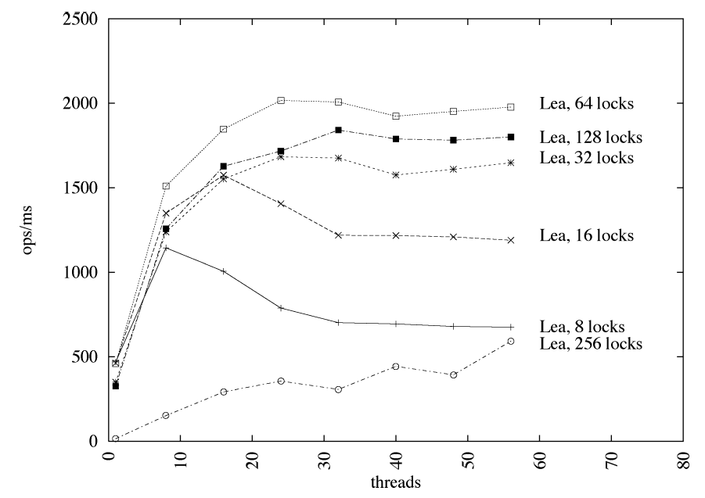
Number of Fine-Grain Locks
Art of Multiprocessor Programming© Herlihy-Shavit 2007
Notes:
mention that we have 10% add and 2% remove .. constant increase … more locks is more overhead in resize ; but more locks provide more parallelism of the other ops

Slide 132
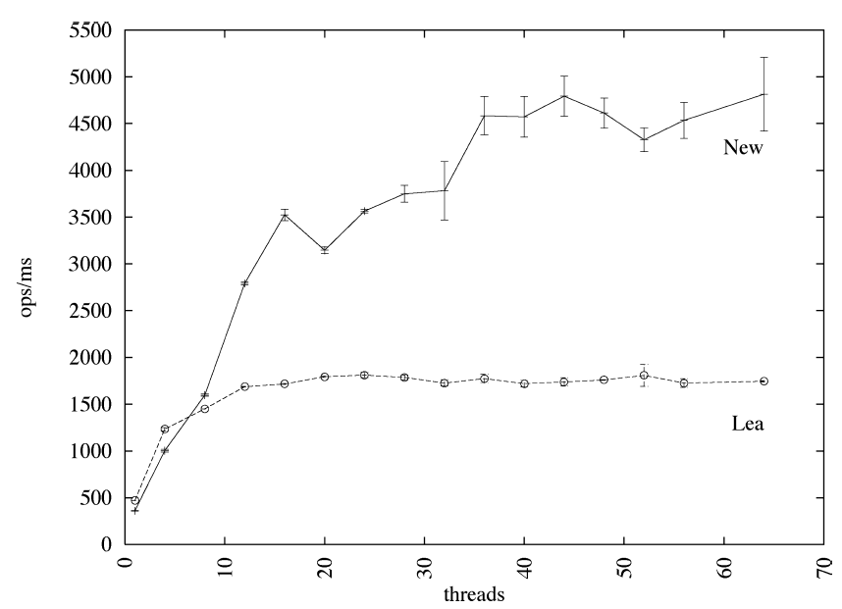
Lock-free vs Locks
Art of Multiprocessor Programming© Herlihy-Shavit 2007
Notes:
Load factor = 3 ( 3 nodes per bucket)
Lock free .. scales better.. but has greater variance

Slide 133
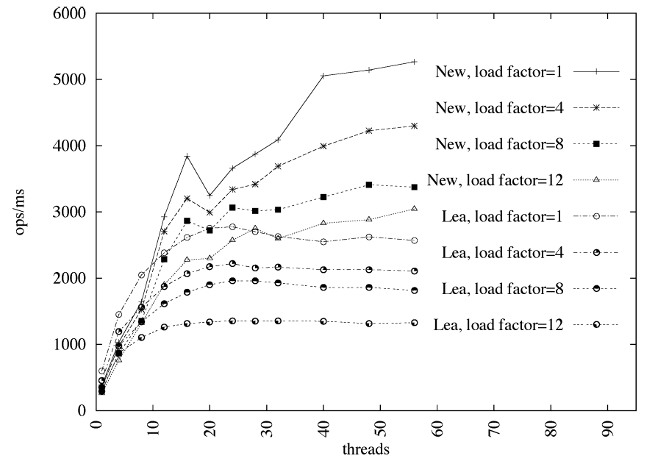
Hash Table Load Factor
(load factor = nodes per bucket)
Art of Multiprocessor Programming© Herlihy-Shavit 2007

Slide 134
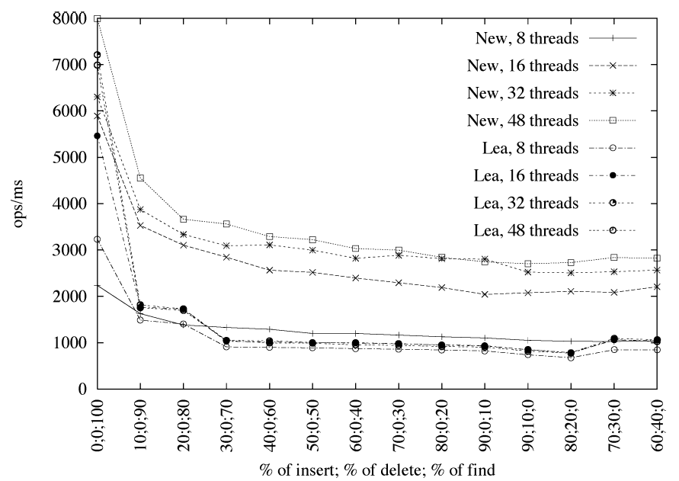
Varying Operations
Art of Multiprocessor Programming© Herlihy-Shavit 2007

Slide 135
This work is licensed under a Creative Commons Attribution-ShareAlike 2.5 License.
You are free:
  to Share — to copy, distribute and transmit the work
  to Remix — to adapt the work
Under the following conditions:
  Attribution. You must attribute the work to “The Art of Multiprocessor Programming” (but not in any way that suggests that the authors endorse you or your use of the work).
  Share Alike. If you alter, transform, or build upon this work, you may distribute the resulting work only under the same, similar or a compatible license.
For any reuse or distribution, you must make clear to others the license terms of this work. The best way to do this is with a link to
  http://creativecommons.org/licenses/by-sa/3.0/.
Any of the above conditions can be waived if you get permission from the copyright holder.
Nothing in this license impairs or restricts the author's moral rights.
Art of Multiprocessor Programming© Herlihy-Shavit 2007

