Slide 1

Transactional Memory
Companion slides for
The Art of Multiprocessor Programming
by Maurice Herlihy & Nir Shavit

Slide 2
From the New York Times …
SAN FRANCISCO, May 7. 2004 - Intel said on Friday that it was scrapping its development of two microprocessors, a move that is a shift in the company's business strategy….

Slide 3
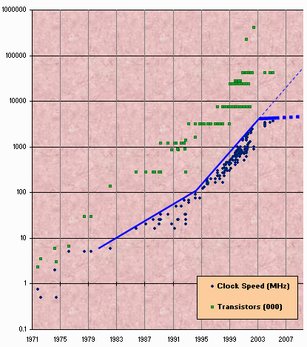
Moore’s Law
Transistor count still rising
Clock speed flattening sharply
(hat tip: Simon Peyton-Jones)

Slide 4
Multicore Architetures
“Learn how the multi-core processor architecture plays a central role in Intel's platform approach. ….”
“AMD is leading the industry to multi-core technology for the x86 based computing market …”
“Sun's multicore strategy centers around multi-threaded software. ... “

Slide 5
Why do we care?
Time no longer cures software bloat
When you double your path length
  You can’t just wait 6 months
  Your software must somehow exploit twice as much concurrency

Slide 6
The Problem
Cannot exploit cheap threads
Today’s Software
  Non-scalable methodologies
Today’s Hardware
  Poor support for scalable synchronization

Slide 7
Locking

Slide 8
Coarse-Grained Locking
Easily made correct …
But not scalable.

Slide 9
Fine-Grained Locking
Here comes trouble …

Slide 10
Why Locking Doesn’t Scale
Not Robust
Relies on conventions
Hard to Use
  Conservative
  Deadlocks
  Lost wake-ups
Not Composable

Slide 11
Locks are not Robust
If a thread holding
a lock is delayed …
No one else can make progress

Slide 12
Why Locking Doesn’t Scale
Not Robust
Relies on conventions
Hard to Use
  Conservative
  Deadlocks
  Lost wake-ups
Not Composable

Slide 13
Locking Relies on Conventions
Relation between
  Lock bit and object bits
  Exists only in programmer’s mind
Actual comment from Linux Kernel
(hat tip: Bradley Kuszmaul)
  /*
  * When a locked buffer is visible to the I/O layer
  * BH_Launder is set. This means before unlocking
  * we must clear BH_Launder,mb() on alpha and then
  * clear BH_Lock, so no reader can see BH_Launder set
  * on an unlocked buffer and then risk to deadlock.
  */

Slide 14
Why Locking Doesn’t Scale
Not Robust
Relies on conventions
Hard to Use
  Conservative
  Deadlocks
  Lost wake-ups
Not Composable

Slide 15
Sadistic Homework
enq(x)
Double-ended queue
enq(y)
No interference if ends “far enough” apart

Slide 16
Sadistic Homework
enq(x)
Double-ended queue
enq(y)
Interference OK if ends “close enough” together

Slide 17
Sadistic Homework
deq()
Double-ended queue
deq()

Make sure suspended dequeuers awake as needed

Slide 18
You Try It …
One lock?
  Too Conservative
Locks at each end?
  Deadlock, too complicated, etc
Waking blocked dequeuers?
  Harder that it looks

Slide 19
Actual Solution
Clean solution would be a publishable result
[Michael & Scott, PODC 96]
What good is a methodology where solutions to such elementary problems are hard enough to be publishable?

Slide 20
In Search of the Lost Wake-Up
Waiting thread doesn’t realize when to wake up
It’s a real problem in big systems
  “Calling pthread_cond_signal() or pthread_cond_broadcast() when the thread does not hold the mutex lock associated with the condition can lead to lost wake-up bugs.”
from Google™ search for “lost wake-up”

Slide 21
Why Locking Doesn’t Scale
Not Robust
Relies on conventions
Hard to Use
  Conservative
  Deadlocks
  Lost wake-ups
Not Composable

Slide 22
Locks do not compose
lock T₁
Hash Table
lock T1
Must lock T₁
before adding
item
add(T₁, item)
item
Move from T₁ to T₂
lock T₁
lock T1
lock T₂
lock T2
delete(T₁, item)
add(T₂, item)
Must lock T₂
before deleting
from T₁
item
item
Exposing lock internals breaks abstraction

Slide 23
Monitor Wait and Signal
Empty
zzz
buffer
Yes!
If buffer is empty,
wait for item to show up

Slide 24
Wait and Signal do not Compose
empty
Wait for either?
empty
zzz…

Slide 25
The Transactional Manifesto
What we do now is inadequate to meet the multicore challenge
Research Agenda
  Replace locking with a transactional API
  Design languages to support this model
  Implement the run-time to be fast enough

Slide 26
Transactions
Atomic
  Commit: takes effect
  Abort: effects rolled back
    Usually retried
Linearizable
  Appear to happen in one-at-a-time order

Slide 27
Sadistic Homework Revisited
Public void LeftEnq(item x) {
Qnode q = new Qnode(x);
q.left = this.left;
this.left.right = q;
this.left = q;
}
Write sequential Code
(1)

Slide 28
Sadistic Homework Revisited
Public void LeftEnq(item x) {
atomic {
Qnode q = new Qnode(x);
q.left = this.left;
this.left.right = q;
this.left = q;
}
}
(1)

Slide 29
Sadistic Homework Revisited
Public void LeftEnq(item x) {
atomic {
Qnode q = new Qnode(x);
q.left = this.left;
this.left.right = q;
this.left = q;
}
}
Enclose in atomic block
(1)

Slide 30
Warning
Not always this simple
  Conditional waits
  Enhanced concurrency
  Overlapping locks
But often it is
  Works for sadistic homework

Slide 31
Composition
Public void Transfer(Queue q1, q2)
{
atomic {
Item x = q1.deq();
q2.enq(x);
}
}
Trivial or what?
(1)

Slide 32
Wake-ups: lost and found
Public item LeftDeq() {
atomic {
if (this.left == null)
retry;
…
}
}
Roll back transaction and restart when something changes
(1)

Slide 33
OrElse Composition
atomic {
x = q1.deq();
} orElse {
x = q2.deq();
}
Run 1st method. If it retries …
Run 2nd method. If it retries …
Entire statement retries

Slide 34
Related Work: Hardware
First wave
  Herlihy&Moss 93, Stone et al. 93
Second wave
  Rajwar&Goodman 02, Martinez&Torellas 02, Oplinger&Lam 02, TCC 04, VTM 05, …

Slide 35
Hardware Overview
Exploit Cache coherence protocols
Already do almost what we need
  Invalidation
  Consistency checking
Exploit Speculative execution
  Branch prediction = optimistic synch!

Slide 36
HW Transactional Memory
read
active
T
caches
Interconnect
memory

Slide 37
Transactional Memory
read
active
active
T
T
caches
memory

Slide 38
Transactional Memory
active
committed
active
T
T
caches
memory

Slide 39
Transactional Memory
write
committed
active
T
D
caches
memory

Slide 40
Rewind
write
aborted
active
active
T
T
D
caches
memory

Slide 41
Transaction Commit
At commit point
  If no cache conflicts, we win.
Mark transactional entries
  Read-only: valid
  Modified: dirty (eventually written back)
That’s all, folks!
  Except for a few details …

Slide 42
Not all Skittles and Beer
Limits to
  Transactional cache size
  Scheduling quantum
Transaction cannot commit if it is
  Too big
  Too slow
  Actual limits platform-dependent

Slide 43
Some Approaches
Trap to software if hardware fails
  “Hybrid” approach
Use locks if speculation fails
  Lock elision
“Virtualize” transactional memory
  VTM, UTM, etc…

Slide 44
Related Work: Software
DSTM [PODC 03]
  Sun Microsystems, Java library
FSTM, OSTM [OOPSLA 03]
  Cambridge University, Java extension
STM Haskell [PPoPP 05]
  Microsoft Research
SXM [TBA]
  Microsoft Research, C# library

Slide 45
Hardware versus Software
Do we need hardware at all?
  Like virtual memory, probably need HW for performance
Do we need software?
  Policy issues don’t make sense for hardware

Slide 46
We Don’t have Language Support (Yet)
Review a typical STM library

Slide 47
Goals of DSTM2 Project
World Domination
  Decent API
  Encourage experimentation
    No one agrees on anything yet
  Capture mind-share
    For example, ScM projects
    Released under BSD-style license
    See Sun download page

Slide 48
Why It’s Hard
Not just a collection of useful objects and methods
Effect of transactional synchronization is pervasive
  How classes are defined
  Control flow: commit & abort
  Exception handling, etc

Slide 49
Rules
Provide Java Library
  Usable by anyone
  No language/compiler extensions
Users don’t need to master complicated 3rd-party tools
  Weavers, etc.
  OK to use such tools internally

Slide 50
This Talk
How to Implement an STM
Review: DSTM
DSTM2 API
DSTM2 engine room
Reflections on life …

Slide 51
We Got Issues, Right Here in River City …
Consistent versus inconsistent views
Visible versus invisible reads
Blocking versus non-blocking progress
Engine-room issues …

Slide 52
Do Orphan (Zombie) Transactions Always See Consistent States?
Yes!
  Invariants observed (no surprises)
  Expensive (maybe)
No!
  Who cares about surprises?
    Divide by zero, infinite loops, et cetera …
    Use exception/interrupt handlers?
  More efficient (maybe)

Slide 53
Read Synchronization
Visible (mark objects)
  Consistent views
  Strong contention management
  Quick validation
  Slower overall (maybe)

Slide 54
Read Synchronization
Invisible (no footprint)
  Inconsistent views
  Weaker contention management
  Slow validation
  Faster overall (maybe)

Slide 55
Recovery
Undo logs
  Update in place
  Reads are fast
  Rolling back wedged transaction complex
Redo logs
  Apply changes on commit
  Reads require look-aside
  Rolling back wedged transaction easy

Slide 56
Other Sectarian Differences
Levels of indirection
Compatibility with HTM
Contention management policies
There’s lots more …

Slide 57
What is to be done?
Need an agnostic STM
Allow users to install (almost) any STM algorithm or policy
Contenders on common platform
Low barrier-to-entry for people who want to do STM research

Slide 58
Backstory
DSTM [PODC 2003]
  Intended to support fine-grained concurrency in data structures
  No ambitions of world domination
SXM
  C#
  Atomic factories
    (must program in MSIL)

Slide 59
What should be customizable?
Event handlers
  Voting on validation
  Commit, abort cleanup
Contention management policies
  Who aborts, waits for whom
Atomic objects
  Data layout
  Algorithms

Slide 60
What should be customizable?
Event handlers
  Voting on validation
  Commit, abort cleanup
Contention management policies
  Who aborts, waits for whom
Atomic objects
  Data layout
  Algorithms
Focus of talk

Slide 61
Atomic Classes in DSTM2
@atomic
public interface Node {
int getItem();
void setItem(int value);
Node getNext();
void setNext(Node value);
}

Slide 62
Atomic Classes in DSTM2
@atomic
public interface Node {
int getItem();
void setItem(int value);
Node getNext();
void setNext(Node value);
}
Atomic class defined via stylized interface

Slide 63
Atomic Classes in DSTM2
@atomic
public interface Node {
int getItem();
void setItem(int value);
Node getNext();
void setNext(Node value);
}
Declare “atomic” attribute

Slide 64
Atomic Classes in DSTM2
@atomic
public interface Node {
int getItem();
void setItem(int value);
Node getNext();
void setNext(Node value);
}
Property: matching getter & setter

Slide 65
Atomic Classes in DSTM2
@atomic
public interface Node {
int getItem();
void setItem(int value);
Node getNext();
void setNext(Node value);
}
Property types: must be scalar or @atomic

Slide 66
Atomic objects are made by Factories
Factory<Node> factory
= new AtomicFactory<Node>(
adapter,
Node.class
);

Slide 67
Atomic objects are made by Factories
Factory<Node> factory
= new AtomicFactory<Node>(
adapter,
Node.class
);
User-defined implementation
(more later)

Slide 68
Atomic objects are made by Factories
Factory<Node> factory
= new AtomicFactory<Node>(
adapter,
Node.class
);
Run-time class of @atomic interface

Slide 69
Transactional Node Factory
Node node = factory.create();

Slide 70
Transactional Node Factory
Node node = factory.create();
Returns transactionally-synchronized object of anonymous class implementing Node

Slide 71
Transactional Code
public boolean insert(int v) {
…
} else {
Node newNode = factory.create(v);
newNode.setNext(prevNode.getNext());
prevNode.setNext(newNode);
return true;
}
}

Slide 72
Transactional Code
public boolean insert(int v) {
…
} else {
Node newNode = factory.create(v);
newNode.setNext(prevNode.getNext());
prevNode.setNext(newNode);
return true;
}
}
Almost like sequential code, except for getter/setter syntax …

Slide 73
User-defined Factories
Factories are magic
  Input: interface
  Output: transactional class
Reflection can parse interface
  But can’t generate code
C# beats Java here
  Reflection.Emit …

Slide 74
Rethinking DSTM
Use BCEL
  Byte-Code Engineering Library
  Not for wimps
  Or our users, come to think of it …
Provides ability to outwit Java type system
Use as “glue” between factories and user code
Software Transactional Memory

Slide 75
Adapters
Adapters allow users to program factories in Java
makeGetter()
  defines getters
makeSetter()
  defines setters

Slide 76
Create a Getter Proxy
public <V> Adapter.Setter<V>
makeSetter(String methodName,
Class<V> _class) {
…
}

Slide 77
DSTM2 Code
public <V> Adapter.Setter<V>
makeSetter(String methodName,
Class<V> _class) {
…
}
Type of virtual field

Slide 78
DSTM2 Code
public <V> Adapter.Setter<V>
makeSetter(String methodName,
Class<V> _class) {
…
}
Method Name

Slide 79
DSTM2 Code
public <V> Adapter.Setter<V>
makeSetter(String methodName,
Class<V> _class) {
…
}
Run-time class info

Slide 80
2-Phase Locking Adapter
public class Adapter<T> implements
dstm2.factory.Adapter<T> {
T version;
Lock lock;
boolean firstTime;

Slide 81
2-Phase Locking Adapter
public class Adapter<T> implements
dstm2.factory.Adapter<T> {
T version;
Lock lock;
boolean firstTime;
Recoverable object version
(initialized by call to a sequential Factory)

Slide 82
2-Phase Locking Adapter
public class Adapter<T> implements
dstm2.factory.Adapter<T> {
T version;
Lock lock;
boolean firstTime;
Two-phase lock

Slide 83
2-Phase Locking Adapter
public class Adapter<T> implements
dstm2.factory.Adapter<T> {
T version;
Lock lock;
boolean firstTime;
First access?

Slide 84
Getter Code (simplified)
return new Adapter.Getter<V>() {
public V call() {
lock.lock();
if (firstTime) {
version.backup();
firstTime = false;
}

Slide 85
Getter Code (simplified)
return new Adapter.Getter<V>() {
public V call() {
lock.lock();
if (firstTime) {
version.backup();
firstTime = false;
}
Factory creates a proxy for each getter

Slide 86
MakeGetter()
return new Adapter.Getter<V>() {
public V call() {
lock.lock();
if (firstTime) {
version.backup();
firstTime = false;
}
Getter proxy calls this code

Slide 87
Getter Code (simplified)
return new Adapter.Getter<V>() {
public V call() {
lock.lock();
if (firstTime) {
version.backup();
firstTime = false;
}
Lock object & make backup

Slide 88
DSTM2 Code
onCommitOnce(new Runnable() {
public void run() {
lock.unlock();
}
});

Slide 89
DSTM2 Code
onCommitOnce(new Runnable() {
public void run() {
lock.unlock();
}
});
Register handler for commit (& abort)

Slide 90
Experiments So Far
Lists, SkipLists, RBTrees, OO7J
Adapters
  “shadow copy”
    Short critical sections (like HTM)
    Backup
  “obstruction-free”
    Uses CAS & indirection
    No critical sections

Slide 91
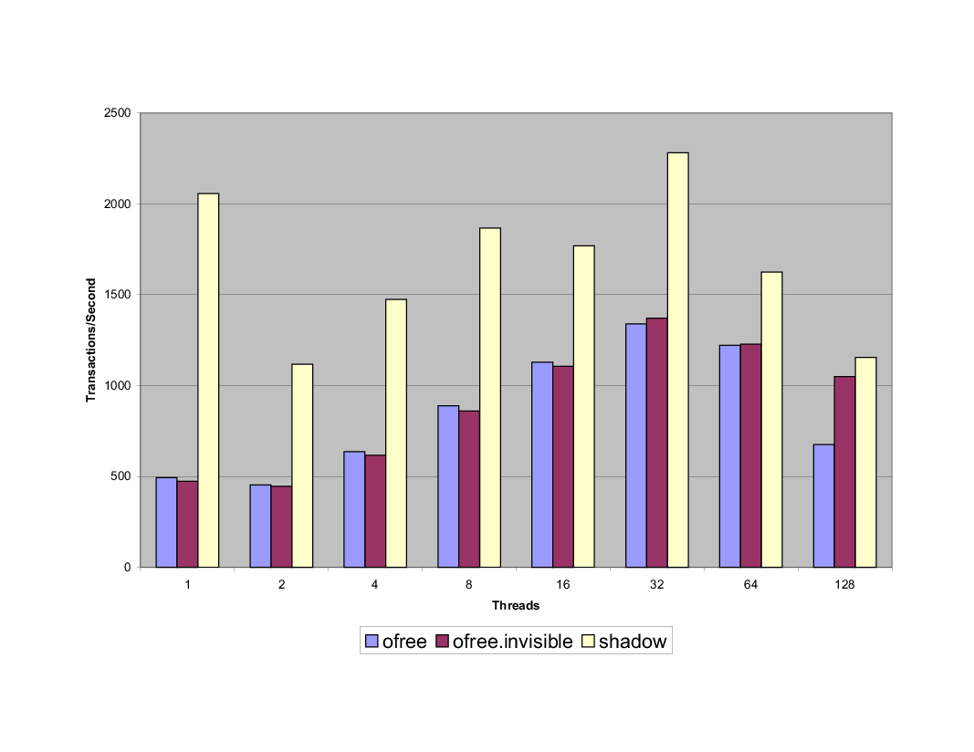
List, 100% updates

Slide 92
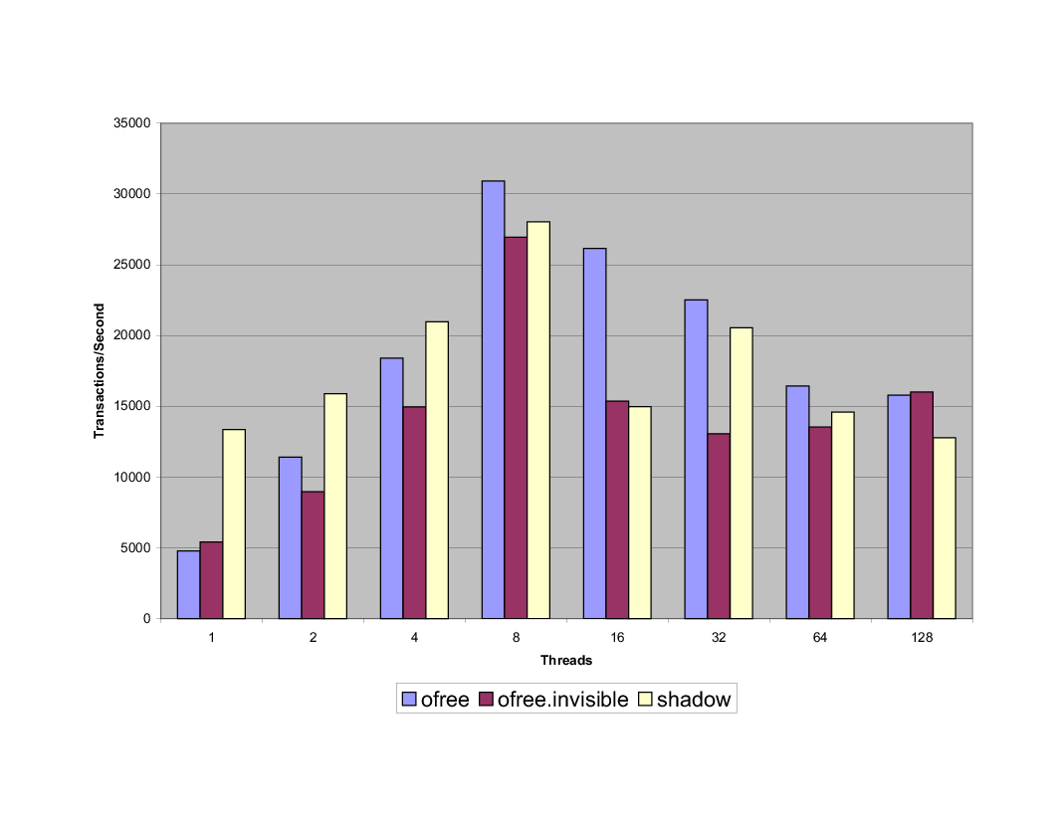
Skip-List, No Updates

Slide 93
So Many Features, So Little Time
Conditional waiting
  Retry()
  Essential for real applications
Nested transactions
  Closed
  Open (be afraid, very afraid!)
Irrevocable actions (I/O …)

Slide 94
My Research Program
Building a next-generation STM system in C#
  Configurable like DSTM2
  Integrate with DB transaction systems
Building a compiler front-end
  Non-local optimizations

Slide 95
Perfect Opportunity for …
Honors Thesis
Summer employment (UTRA)
ScM thesis
Interested?
  Talk to Me or Tom Doeppner

Slide 96
Next Semester: CS275
Learn how to come up-to-speed on a research area
Exact area doesn’t matter (much)
  Skill is fungible
You are always going to need this skill
  So start now!

Slide 97
Class Methodology
Recent conference proceedings
  Indicate which topics are hot
  Even if the papers themselves are
    Incremental
    Cryptic
    Or worse!
Even the worst papers
  Have to cite the best

Slide 98
Detective Work
Start with a recently published paper
  So we know someone cares
Skim through it & primary citations
  Which citations seem important?
Identify area’s primary paper
  The one to read if you read only one
  First? Best improvement? Best written?

Slide 99
Presentations
Form team of 2 or 3 people
Pick recent paper
Perform “due diligence” on area
Identify one paper that everyone else
  Must read first
  Must submit evaluation
Give presentation
Repeat as needed …

Slide 100
Penultimate Slide

Slide 101
I, for one, Welcome our new Multicore Overlords …
Multicore architectures force us to rethink how we do synchronization
Standard locking model won’t work
Transactional model might
  Software
  Hardware
A full-employment act!

Slide 102
This work is licensed under a Creative Commons Attribution-ShareAlike 2.5 License.
You are free:
  to Share — to copy, distribute and transmit the work
  to Remix — to adapt the work
Under the following conditions:
  Attribution. You must attribute the work to “The Art of Multiprocessor Programming” (but not in any way that suggests that the authors endorse you or your use of the work).
  Share Alike. If you alter, transform, or build upon this work, you may distribute the resulting work only under the same, similar or a compatible license.
For any reuse or distribution, you must make clear to others the license terms of this work. The best way to do this is with a link to
  http://creativecommons.org/licenses/by-sa/3.0/.
Any of the above conditions can be waived if you get permission from the copyright holder.
Nothing in this license impairs or restricts the author's moral rights.

