Slide 1
Principles of Distributed Database Systems
M. Tamer Özsu
Patrick Valduriez

Slide 2
Outline
Introduction
Distributed and Parallel Database Design
Distributed Data Control
Distributed Query Processing
Distributed Transaction Processing
Data Replication
Database Integration – Multidatabase Systems
Parallel Database Systems
Peer-to-Peer Data Management
Big Data Processing
NoSQL, NewSQL and Polystores
Web Data Management

Slide 3
Outline
Introduction
What is a distributed DBMS
History
Distributed DBMS promises
Design issues
Distributed DBMS architecture

Slide 4
Distributed Computing
A number of autonomous processing elements (not necessarily homogeneous) that are interconnected by a computer network and that cooperate in performing their assigned tasks.
What is being distributed?
Processing logic
Function
Data
Control

Slide 5
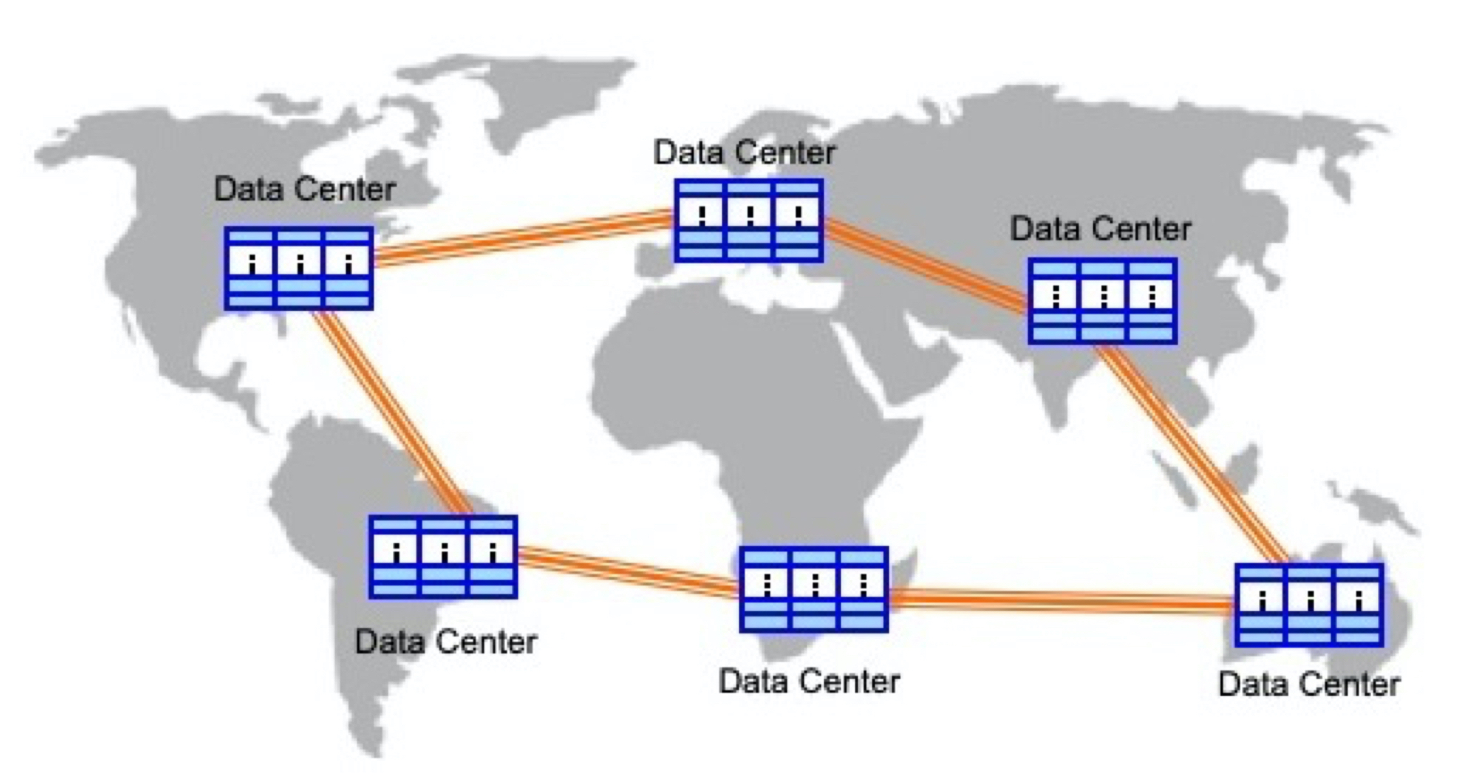
Current Distribution – Geographically Distributed Data Centers

Slide 6
What is a Distributed Database System?
A distributed database is a collection of multiple, logically interrelated databases distributed over a computer network
A distributed database management system (Distributed DBMS) is the software that manages the DDB and provides an access mechanism that makes this distribution transparent to the users

Slide 7
What is not a DDBS?
A timesharing computer system
A loosely or tightly coupled multiprocessor system
A database system which resides at one of the nodes of a network of computers - this is a centralized database on a network node

Slide 8
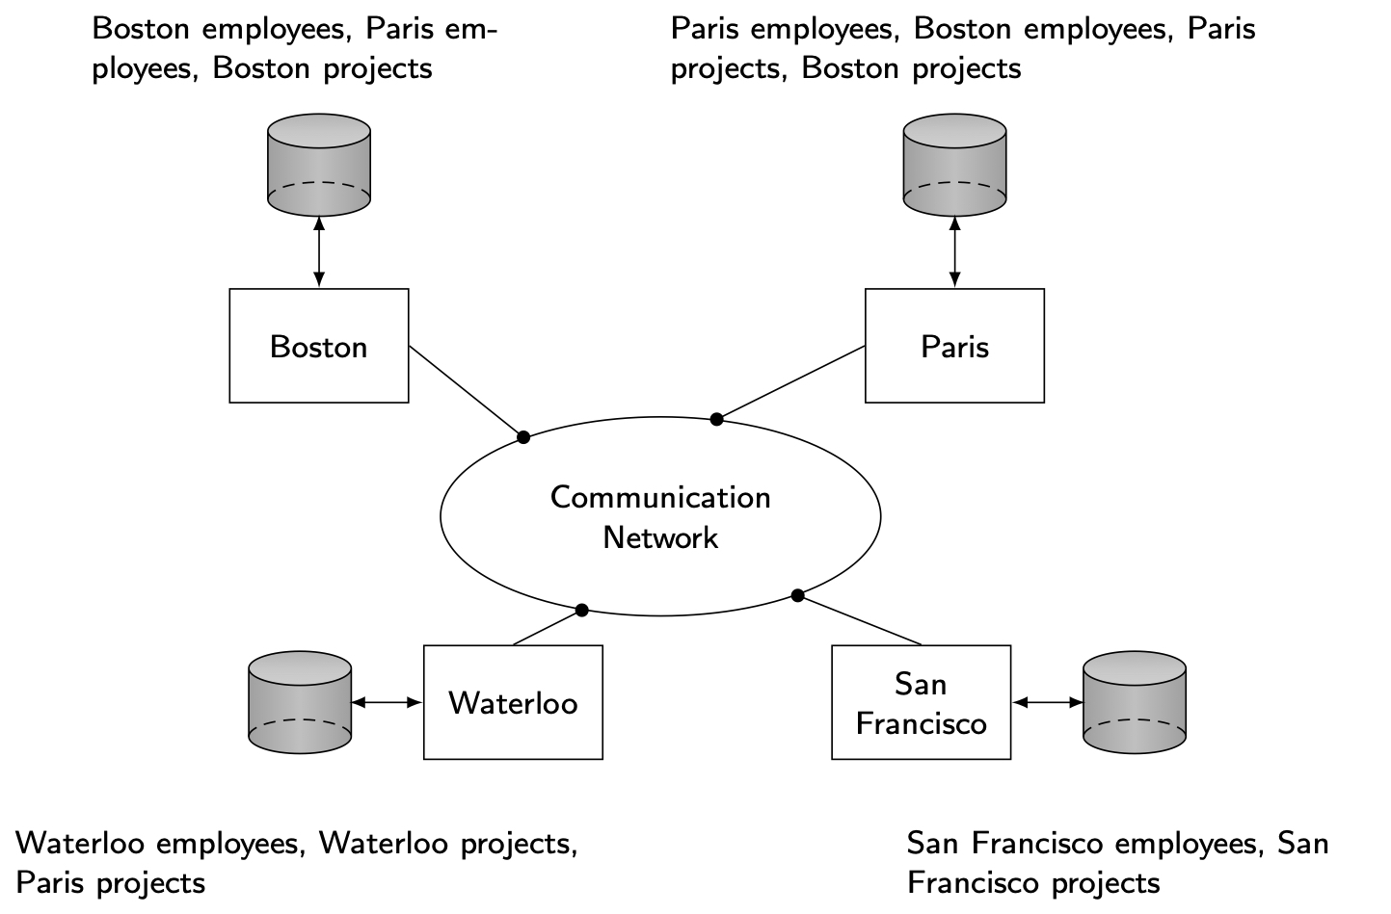
Distributed DBMS Environment

Slide 9
Implicit Assumptions
Data stored at a number of sites → each site logically consists of a single processor
Processors at different sites are interconnected by a computer network → not a multiprocessor system
Parallel database systems
Distributed database is a database, not a collection of files → data logically related as exhibited in the users’ access patterns
Relational data model
Distributed DBMS is a full-fledged DBMS
Not remote file system, not a TP system

Slide 10
Important Point
Logically integrated
but
Physically distributed

Slide 11
Outline
Introduction
What is a distributed DBMS
History
Distributed DBMS promises
Design issues
Distributed DBMS architecture

Slide 12
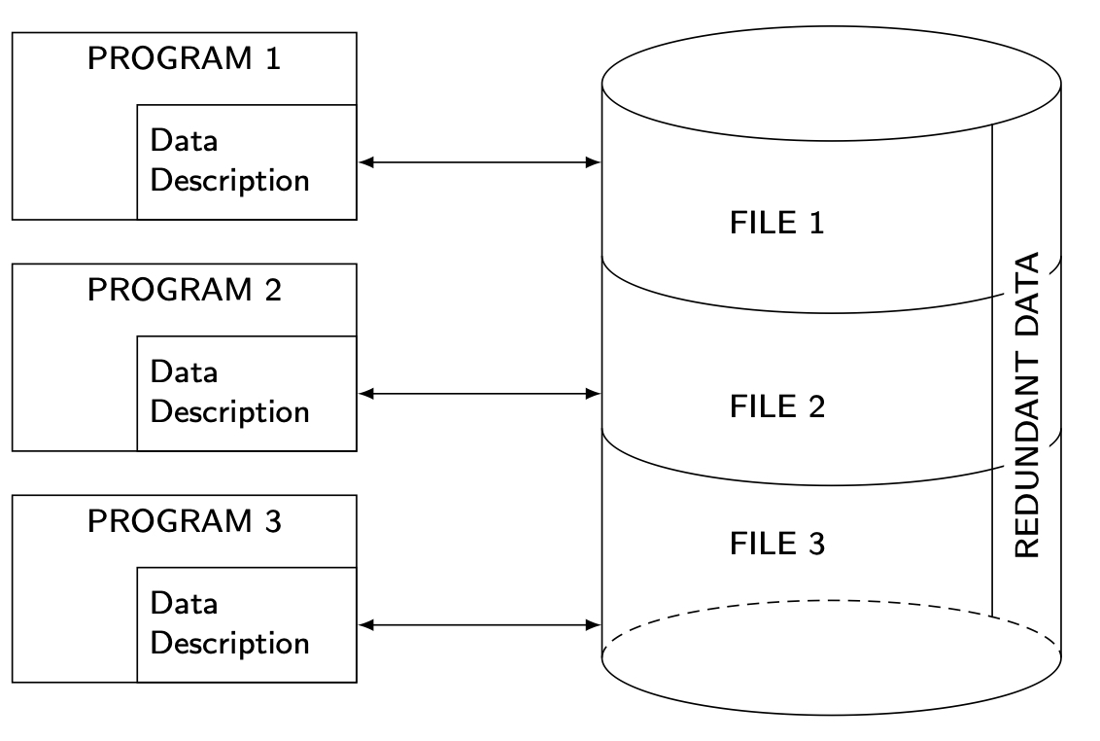
History – File Systems

Slide 13
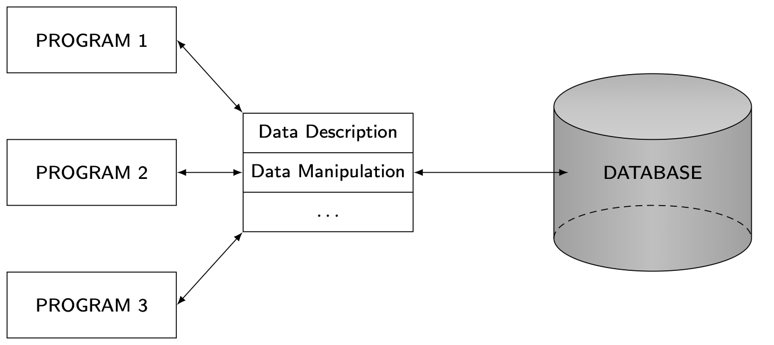
History – Database Management

Slide 14
History – Early Distribution
Peer-to-Peer (P2P)

Slide 15
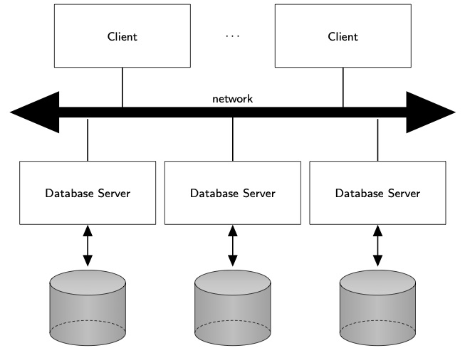
History – Client/Server

Slide 16
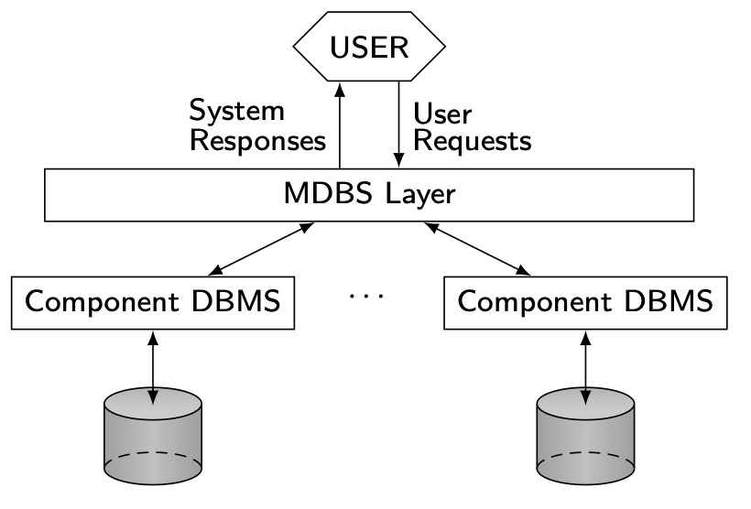
History – Data Integration

Slide 17
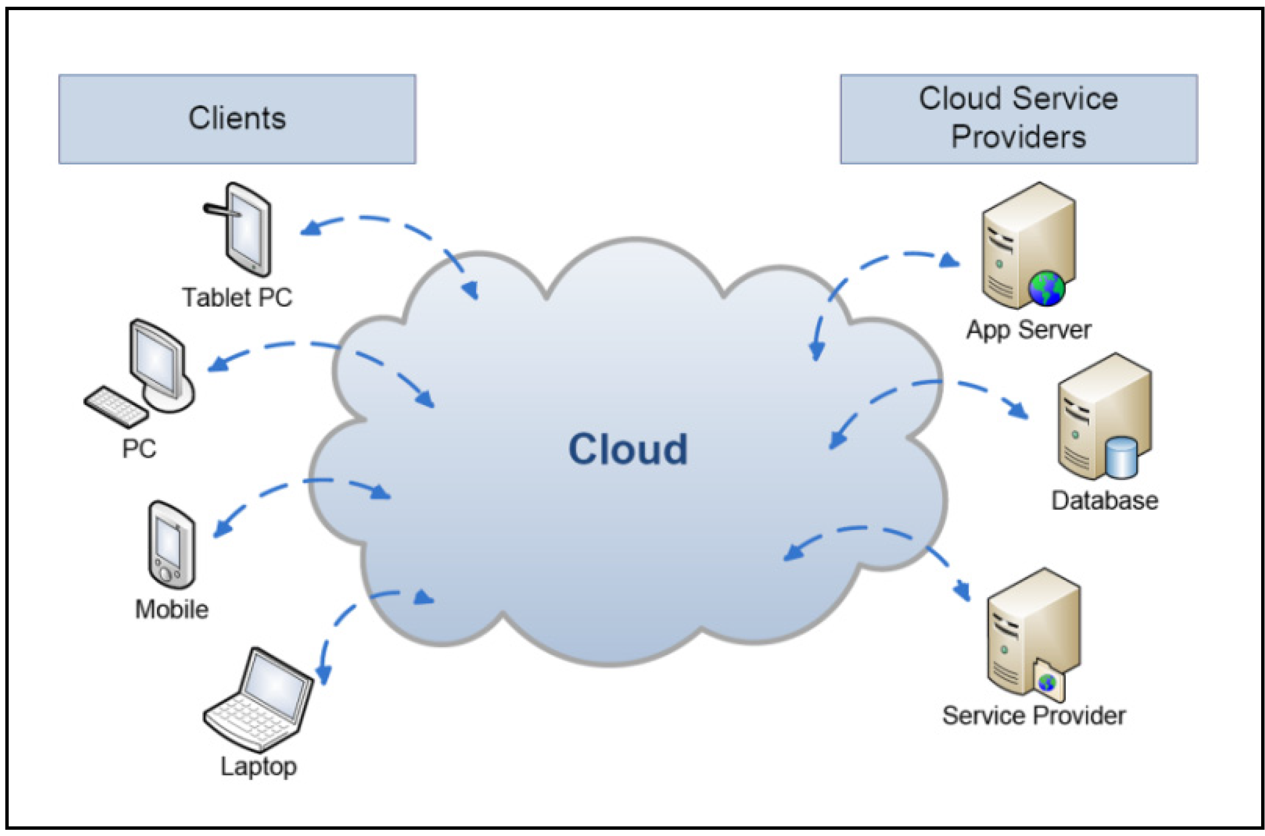
History – Cloud Computing
On-demand, reliable services provided over the Internet in a cost-efficient manner
Cost savings: no need to maintain dedicated compute power
Elasticity: better adaptivity to changing workload

Slide 18
Data Delivery Alternatives
Delivery modes
Pull-only
Push-only
Hybrid
Frequency
Periodic
Conditional
Ad-hoc or irregular
Communication Methods
Unicast
One-to-many
Note: not all combinations make sense

Slide 19
Outline
Introduction
What is a distributed DBMS
History
Distributed DBMS promises
Design issues
Distributed DBMS architecture

Slide 20
Distributed DBMS Promises
Transparent management of distributed, fragmented, and replicated data
Improved reliability/availability through distributed transactions
Improved performance
Easier and more economical system expansion

Slide 21
Transparency
Transparency is the separation of the higher-level semantics of a system from the lower level implementation issues.
Fundamental issue is to provide
data independence
in the distributed environment
Network (distribution) transparency
Replication transparency
Fragmentation transparency
horizontal fragmentation: selection
vertical fragmentation: projection
hybrid

Slide 22
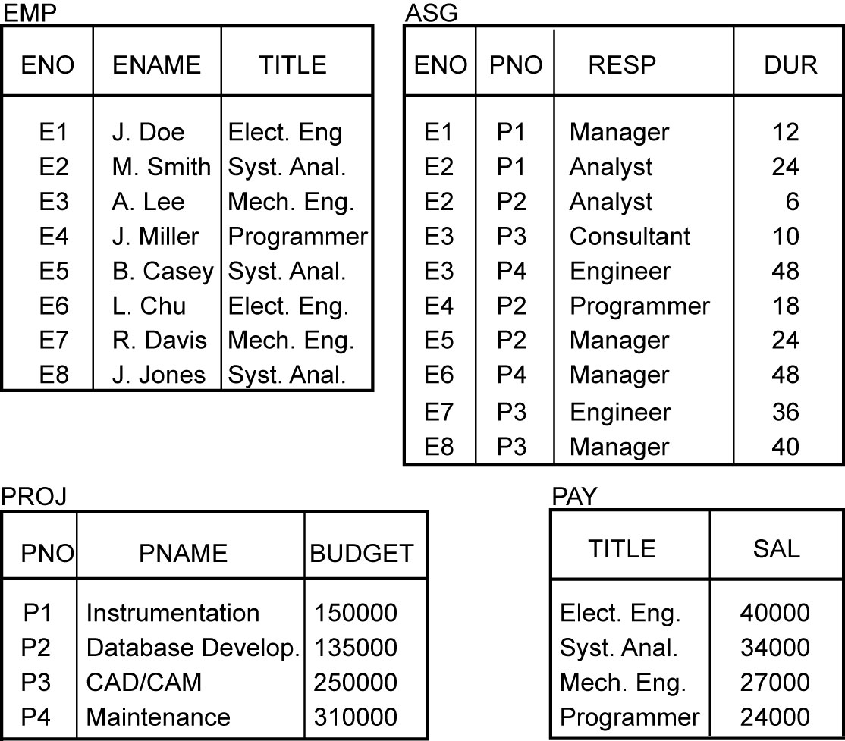
Example

Slide 23
Transparent Access
Tokyo
SELECT ENAME,SAL
FROM EMP,ASG,PAY
WHERE DUR > 12
AND EMP.ENO = ASG.ENO
AND PAY.TITLE = EMP.TITLE
Boston
Paris
Paris projects
Paris employees
Paris assignments
Boston employees
Communication
Network
Boston projects
Boston employees
Boston assignments
Montreal
New
York
Montreal projects
Paris projects
New York projects
with budget > 200000
Montreal employees
Montreal assignments
Boston projects
New York employees
New York projects
New York assignments
Notes:
Animated slide

Slide 24
Distributed Database - User View
Distributed Database

Slide 25
Distributed DBMS - Reality
User
Query
DBMS
Software
User
Application
DBMS
Software
DBMS
Software
Communication
Subsystem
User
Application
DBMS
Software
User
Query
DBMS
Software
User
Query

Slide 26
Types of Transparency
Data independence
Network transparency (or distribution transparency)
Location transparency
Fragmentation transparency
Fragmentation transparency
Replication transparency

Slide 27
Reliability Through Transactions
Replicated components and data should make distributed DBMS more reliable.
Distributed transactions provide
Concurrency transparency
Failure atomicity
Distributed transaction support requires implementation of
Distributed concurrency control protocols
Commit protocols
Data replication
Great for read-intensive workloads, problematic for updates
Replication protocols

Slide 28
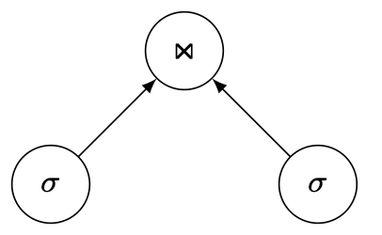
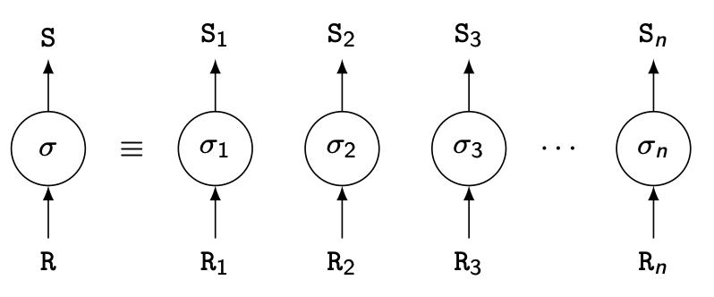
Potentially Improved Performance
Proximity of data to its points of use
Requires some support for fragmentation and replication
Parallelism in execution
Inter-query parallelism
Intra-query parallelism

Slide 29
Scalability
Issue is database scaling and workload scaling
Adding processing and storage power
Scale-out: add more servers
Scale-up: increase the capacity of one server → has limits

Slide 30
Outline
Introduction
What is a distributed DBMS
History
Distributed DBMS promises
Design issues
Distributed DBMS architecture

Slide 31
Distributed DBMS Issues
Distributed database design
How to distribute the database
Replicated & non-replicated database distribution
A related problem in directory management
Distributed query processing
Convert user transactions to data manipulation instructions
Optimization problem
min{cost = data transmission + local processing}
General formulation is NP-hard

Slide 32
Distributed DBMS Issues
Distributed concurrency control
Synchronization of concurrent accesses
Consistency and isolation of transactions' effects
Deadlock management
Reliability
How to make the system resilient to failures
Atomicity and durability

Slide 33
Distributed DBMS Issues
Replication
Mutual consistency
Freshness of copies
Eager vs lazy
Centralized vs distributed
Parallel DBMS
Objectives: high scalability and performance
Not geo-distributed
Cluster computing

Slide 34
Related Issues
Alternative distribution approaches
Modern P2P
World Wide Web (WWW or Web)
Big data processing
4V: volume, variety, velocity, veracity
MapReduce & Spark
Stream data
Graph analytics
NoSQL
NewSQL
Polystores

Slide 35
Outline
Introduction
What is a distributed DBMS
History
Distributed DBMS promises
Design issues
Distributed DBMS architecture

Slide 36
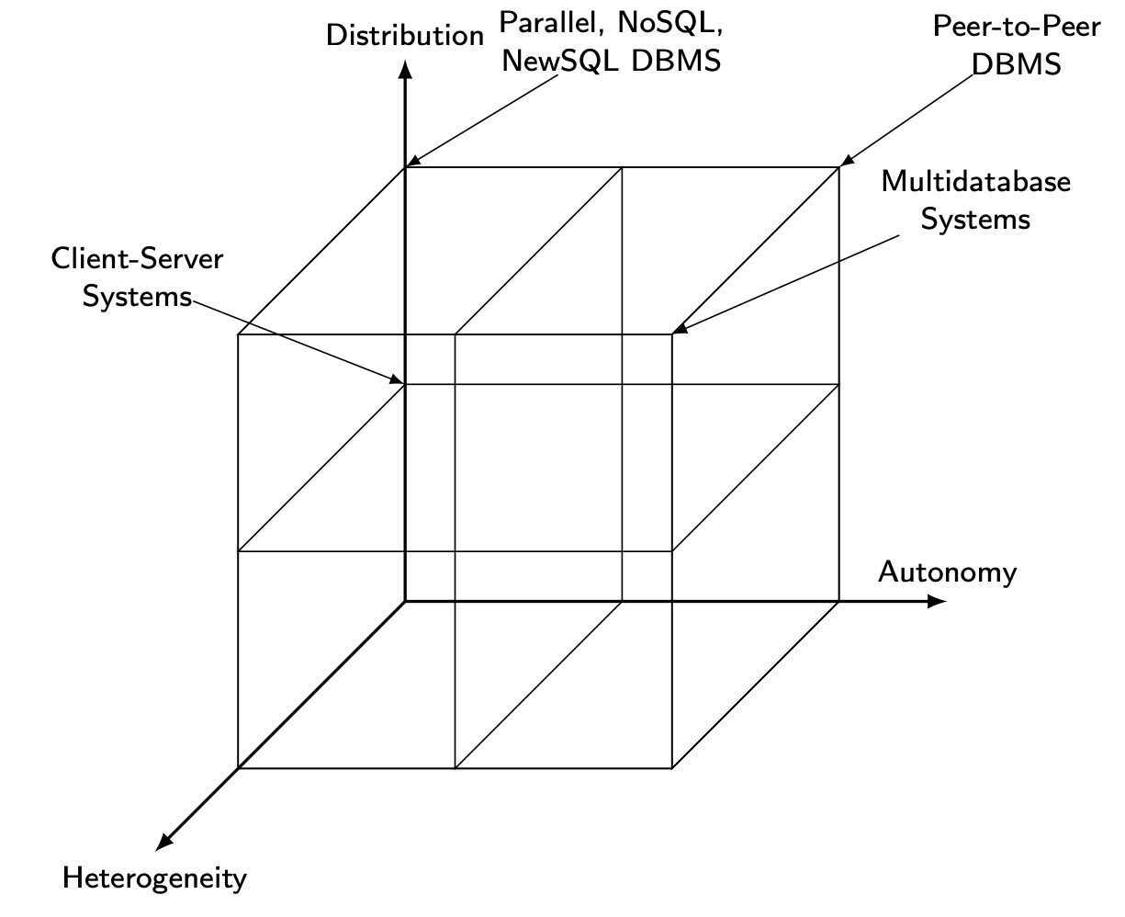
DBMS Implementation Alternatives

Slide 37
Dimensions of the Problem
Distribution
Whether the components of the system are located on the same machine or not
Heterogeneity
Various levels (hardware, communications, operating system)
DBMS important one
data model, query language,transaction management algorithms
Autonomy
Not well understood and most troublesome
Various versions
Design autonomy: Ability of a component DBMS to decide on issues related to its own design.
Communication autonomy: Ability of a component DBMS to decide whether and how to communicate with other DBMSs.
Execution autonomy: Ability of a component DBMS to execute local operations in any manner it wants to.

Slide 38
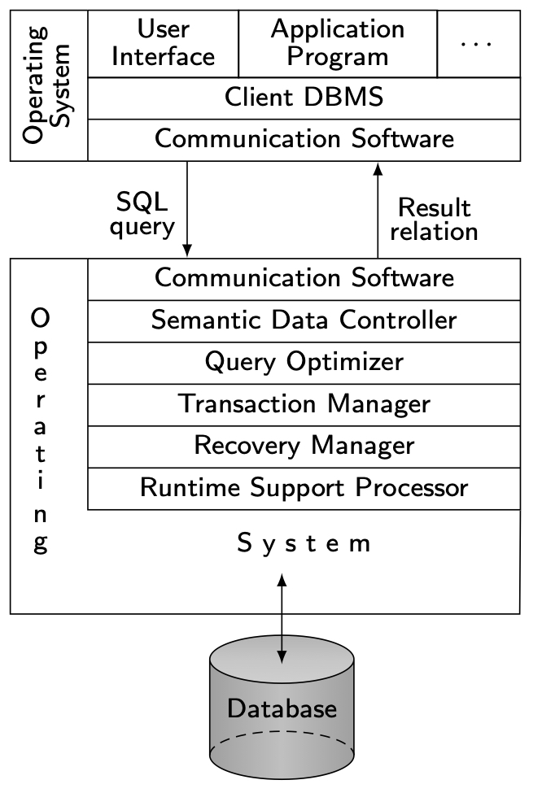
Client/Server Architecture

Slide 39
Advantages of Client-Server Architectures
More efficient division of labor
Horizontal and vertical scaling of resources
Better price/performance on client machines
Ability to use familiar tools on client machines
Client access to remote data (via standards)
Full DBMS functionality provided to client workstations
Overall better system price/performance

Slide 40
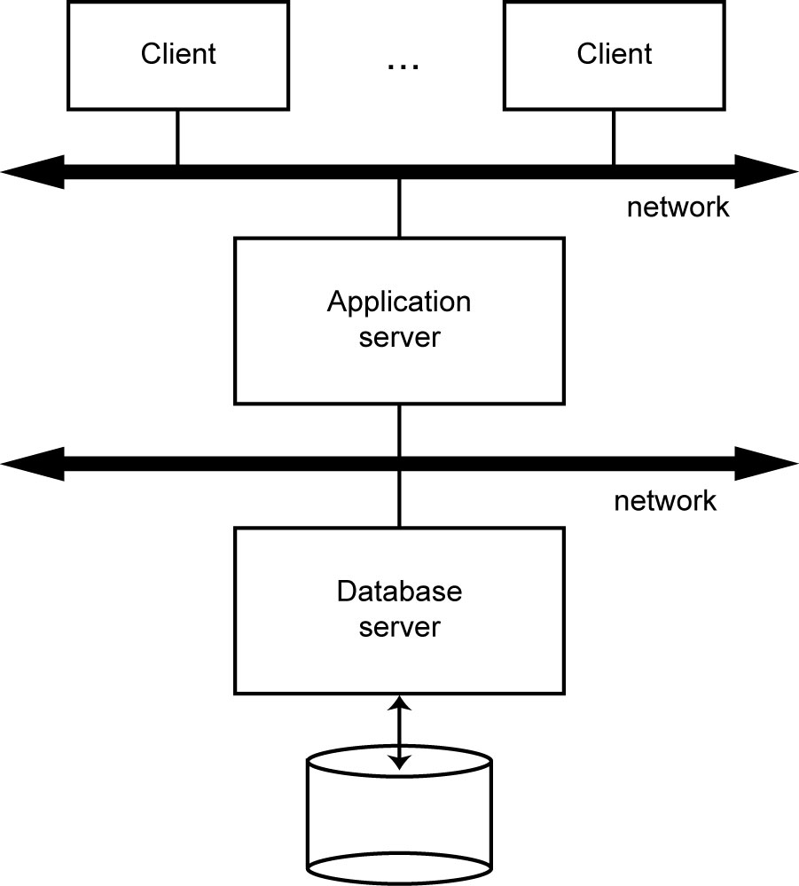
Database Server

Slide 41
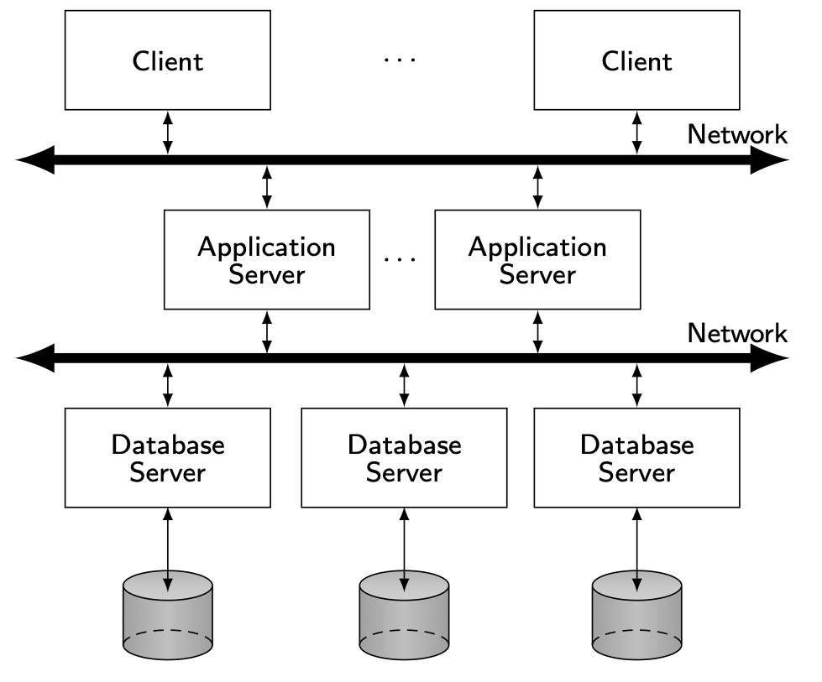
Distributed Database Servers

Slide 42
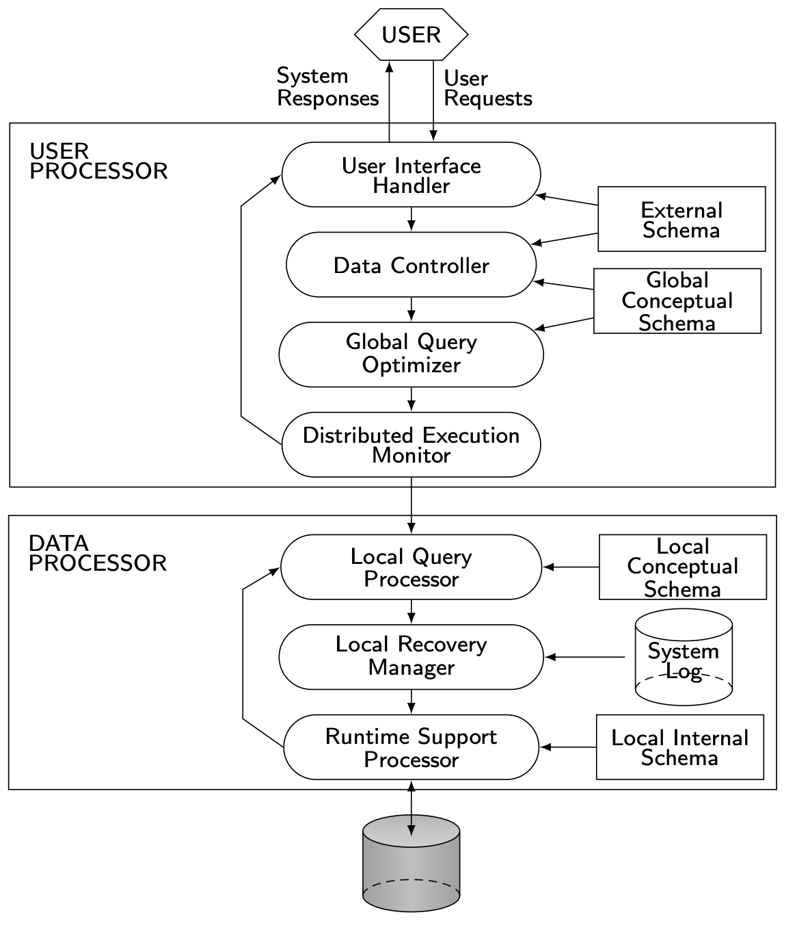
Peer-to-Peer Component Architecture

Slide 43
MDBS Components & Execution

Slide 44
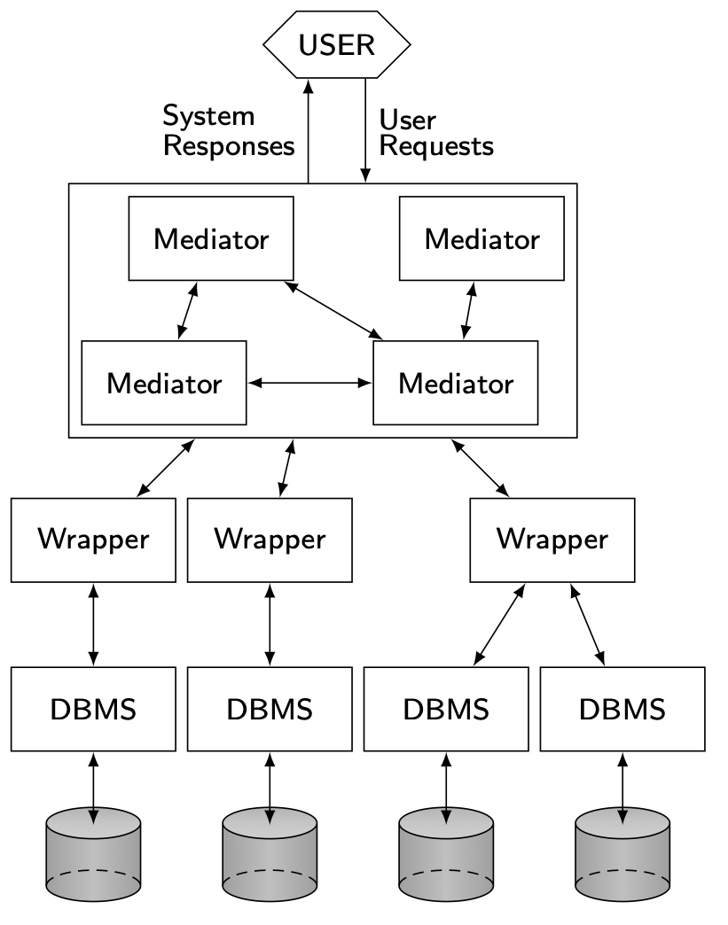
Mediator/Wrapper Architecture

Slide 45
Cloud Computing
On-demand, reliable services provided over the Internet in a cost-efficient manner
IaaS – Infrastructure-as-a-Service
PaaS – Platform-as-a-Service
SaaS – Software-as-a-Service
DaaS – Database-as-a-Service

Slide 46
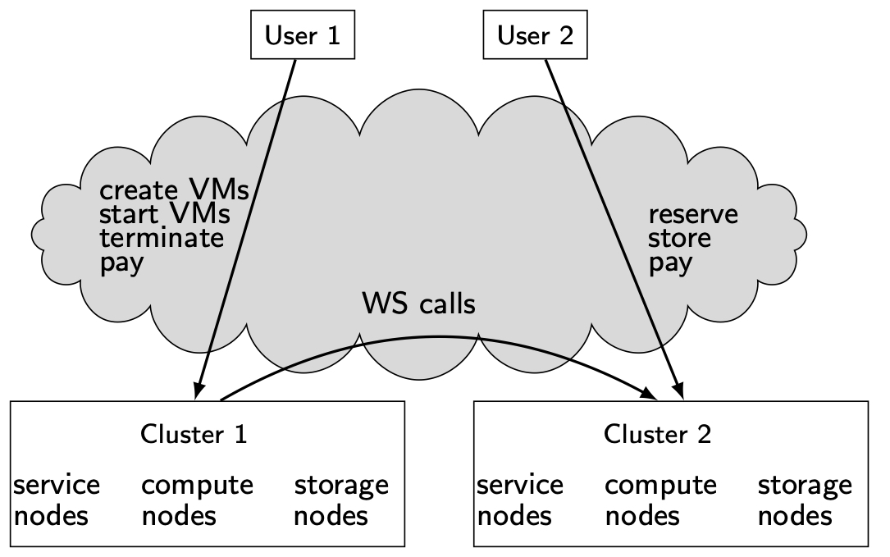
Simplified Cloud Architecture

