Slide 1
Principles of Distributed Database Systems
M. Tamer Özsu
Patrick Valduriez

Slide 2
Outline
Introduction
Distributed and Parallel Database Design
Distributed Data Control
Distributed Query Processing
Distributed Transaction Processing
Data Replication
Database Integration – Multidatabase Systems
Parallel Database Systems
Peer-to-Peer Data Management
Big Data Processing
NoSQL, NewSQL and Polystores
Web Data Management

Slide 3
Outline
NoSQL, NewSQL and Polystores
Motivations
NoSQL systems
NewSQL systems
Polystores

Slide 4
Motivations
Trends
Big data
Unstructured data
Data interconnexion
Hyperlinks, tags, blogs, etc.
Very high scalability
Data size, numbers of users
Limits of relational DBMSs (SQL)
Need for skilled DBA and well-defined schemas
SQL and complex tuning
Hard to make updates scalable
Parallel RDBMS use a shared-disk for OLTP
The CAP theorem

Slide 5
The CAP Theorem
Polemical topic
“A database can't provide consistency AND availability during a network partition”
Argument used by NoSQL to justify their lack of ACID properties
But has nothing to do with scalability
Two different points of view
Relational databases
Consistency is essential
ACID transactions
Distributed systems
Service availability is essential
Inconsistency tolerated by the user, e.g. web cache

Slide 6
What is the CAP Theorem?
The desirable properties of a distributed system
Consistency: all nodes see the same data values at the same time
Availability: all requests get an answer
Partition tolerance: the system keeps functioning in case of network failure
History
At the PODC 2000 conference, Brewer (UC Berkeley) conjectures that one can have only two properties at the same time
In 2002, Gilbert and Lynch (MIT) prove the conjecture, which becomes a theorem

Slide 7
Strong vs Eventual Consistency
Strong consistency (ACID)
All nodes see the same data values at the same time
Eventual consistency
Some nodes may see different data values at the same time
But if we stop injecting updates, the system reaches strong consistency
Illustration with symmetric, asynchronous replication in databases
Notes:
Différents niveaux de cohérence

Slide 8

Symmetric, Asynchronous Replication
Client
Client
AP ok
C non ok
DB1
DB2
But we have eventual consistency
After reconnection (and resolution of update conflicts), consistency can be obtained

Slide 9
Outline
NoSQL, NewSQL and Polystores
Motivations
NoSQL systems
NewSQL systems
Polystores

Slide 10
NoSQL (Not Only SQL): definition
Specific DBMS: for web-based data
Specialized data model
Key-value, table, document, graph
Trade relational DBMS properties
Full SQL, ACID transactions, data independence
For
Simplicity (schema, basic API)
Scalability and performance
Flexibility for the programmer (integration with programming language)
NB: SQL is just a language and has nothing to do with the story

Slide 11
NoSQL Approaches
Characterized by the data model, in increasing order of complexity:
Key-value: DynamoDB
Tabular: Bigtable
Document: MongoDB
Graph: Neo4J
Multimodel: OrientDB
What about object DBMS or XML DBMS?
Were there much before NoSQL
Sometimes presented as NoSQL
But not really scalable

Slide 12
Key-value Stores
Simple (key, value) data model
Key = unique id
Value = a text, a binary data, structured data, etc.
Simple queries
Put (key, value)
Inserts a (key, value) pair
Value = get (key)
Returns the value associated with key
{(key, value)} = get_range (key1, key2)
Returns the data whose key is in interval [key1, key2]

Slide 13
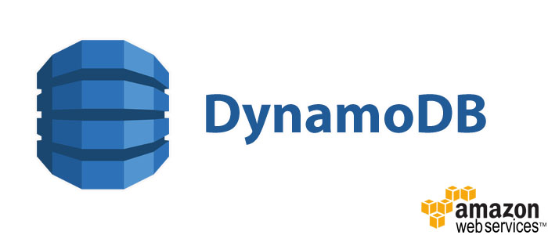
Amazon DynamoDB
Major service of AWS for data storage
E.g. product lists, shopping carts, user preferences
Data model (key, structured value)
Partitioning on the key and secondary indices on attributes
Simple queries on key and attributes
Flexible: no schema to be defined (but automatically inferred)
Consistency
Eventual consistent reads (default)
Strong consistent reads
Atomic updates with atomic counters
High availability and fault-tolerance
Synchronous replication between data centers
Integration with other AWS services
Identity control and access
MapReduce
Redshift data warehouse

Slide 14
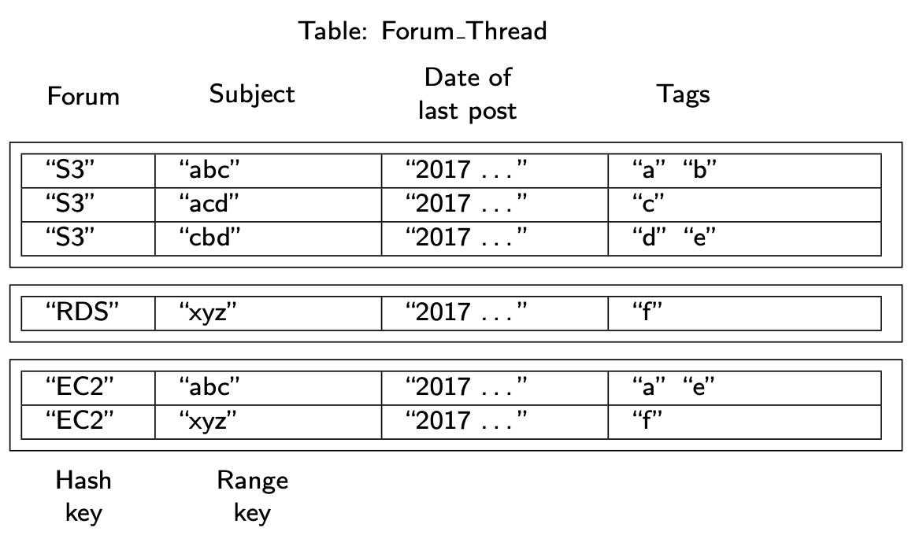
DynamoDB – data model
Table (items)
Item (key, attributes)
2 types of primary (unique) keys
Hash (1 attribute)
Hash & range (2 attributes)
Attributes of the form "name":"value"
Type of value: scalar, set, or JSON
Java API with methods
Add, update, delete item
GetItem: returns an item by primary key in a table
BatchGetItem: returns the items of same primary key in multiple tables
Scan : returns all items
Query
Range on hash & range key
Access on indexed attribute
GetItem (Forum="EC2", Subject="xyz")
Query (Forum="S3", Subject > "ac")

Slide 15
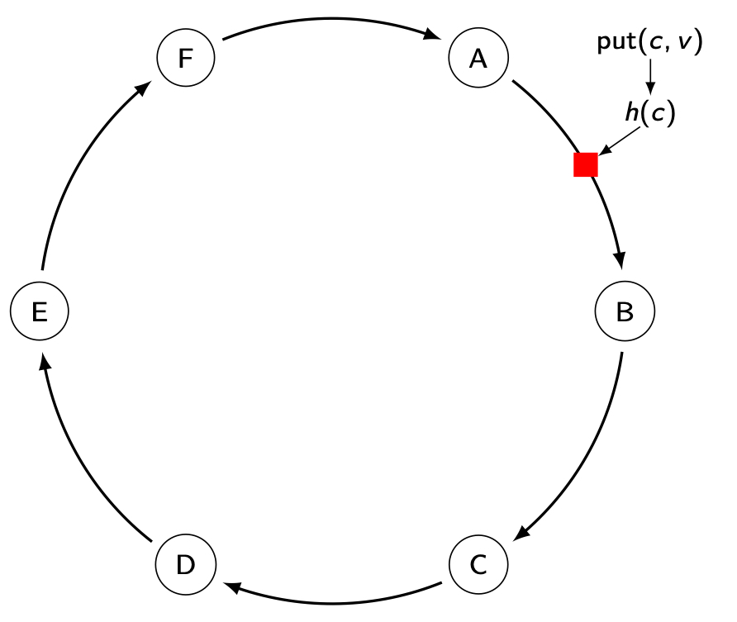
DynamoDB - data partitioning
Consistent hashing: the interval of hash values is treated as a ring
Advantage: if a node fails, its successor takes over its data
No impact on other nodes
Data is replicated on next nodes
Node B is responsible for the hash value interval (A,B]. Thus, item (c,v) is assigned to node B

Slide 16
Document Stores
Main applications
Document systems
Content Management Systems
Catalogs
Personalization
Analysis of messages (tweets, etc.) in real time
Etc.

Slide 17
Data Models for Documents
Documents
Hierarchical structure, with nesting of elements
Weak structuring, with "similar" elements
Base types: text, but also integer, real, date, etc.
Two main data models
XML (eXtensible Markup Language): W3C standard (1998) for exchanging data on the Web
Complex and heavy
JSON (JavaScript Object Notation) by Douglas Crockford (2005) for exchanging data JavaScript
Simple and light

Slide 18

MongoDB
Objective: performance and scalability
A document is a collection of (key, typed value) with a unique key (generated by MongoDB)
Data model and query language based on JSON
Binary JSON (BSON): more compact
No schema, no join, no complex transaction
Shared-nothing cluster architecture
Secondary indices
Integration with MapReduce & Spark

Slide 19
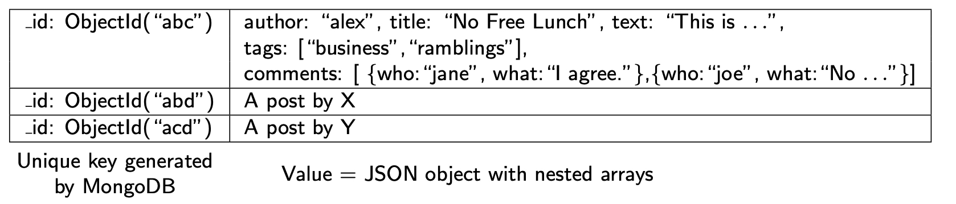
A MongoDB Collection (posts)

Slide 20
MongoDB – query language
Expression of the form
db.nomBD.function (JSON expression)
Update examples
db.posts.insert({author:’alex’, title:’No Free Lunch’})
db.posts.update({author:’alex’, {$set:{age:30}})
db.posts.update({author:’alex’, {$push:{tags:’music’}})
Select examples
db.posts.find({author:"alex"})
All posts from Alex
db.posts.find({comments.who:"jane"})
All posts commented by Jane

Slide 21
MongoDB - architecture

Slide 22
Main NoSQL JSON DBMSs
Vendor | Product | Langages | Comments
Apache | CouchDB | JavaScript | Open source (Apache)
Couchbase Inc. | Couchbase | N1QL | Open source (Apache)
djondb.com | djondb | JSON
ejdb.org | EJDB | Mongo-DB like | Open source (LGPL)
linkedin | Espresso | JSON
MarkLogic | Marklogic server | JSON | Integration with Hadoop
Mongodb.com | MongoDB | Ext. JSON
zorba.io | Zorba | JSONiq | Open source (Apache)

Slide 23
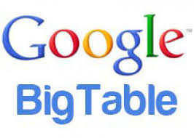
Tabular Stores: BigTable
Database storage system for a shared-nothing cluster
Uses GFS to store structured data, with fault-tolerance and availability
Used by popular Google applications
Google Earth, Google Analytics, Google+, etc.
The basis for popular Open Source implementations
Hadoop Hbase on top of HDFS (Apache & Yahoo)
Specific data model that combines aspects of row-store and column-store DBMS
Rows with multi-valued, timestamped attributes
Dynamic partitioning of tables for scalability

Slide 24
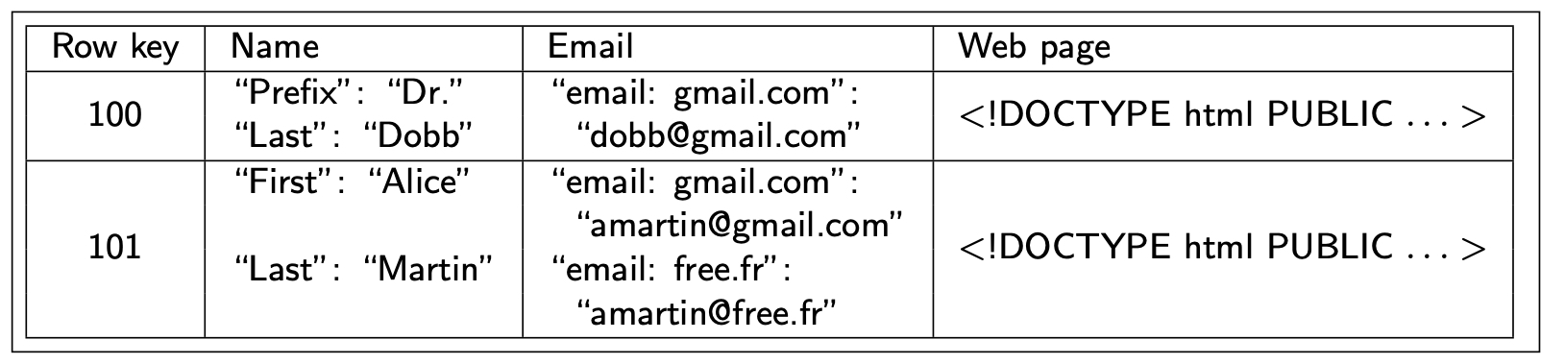
A BigTable Row
Column family = a kind of multi-valued attribute
Set of columns (of the same type), each identified by a key
Column key = attribute value, but used as a name e.g. gmail.com, free.fr
Unit of access control and compression

Slide 25
BigTable API
No such thing as SQL
Basic API for defining and manipulating tables, within a programming language such as C++
No impedance mismatch
Various operators to write and update values, and to iterate over subsets of data, produced by a scan operator
Various ways to restrict the rows, columns and timestamps produced by a scan, as in relational select, but no complex operator such as join or union
Transactional atomicity for single row updates only

Slide 26
Dynamic Range Partitioning
Range partitioning of a table on the row key
Tablet = a partition (shard) corresponding to a row range
Partitioning is dynamic, starting with one tablet (the entire table range) which is subsequently split into multiple tablets as the table grows
Metadata table itself partitioned in metadata tablets, with a single root tablet stored at a master server, similar to GFS’s master
Implementation techniques
Compression of column families
Grouping of column families with high locality of access
Aggressive caching of metadata information by clients

Slide 27
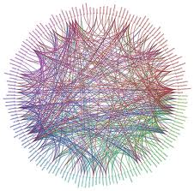
Graph DBMS
Database graphs
Very big: billions of nodes and links
Many: millions of graphs
Main applications
Social networks
Recommendation, sharing, sentiment analysis
Master data management
Reference business objects, data governance
Fraud detection in real time
E-commerce, insurance, etc.
Enterprise networks
Impact analysis, QoS
Identity management
Group management, provenance

Slide 28
Graph Partitioning
Objective: get balanced partitions
NP-hard problem: no optimal algorithm
Solutions: approximate, heuristics, based on the graph topology
See Chapter 10 for details on graph partitioning

Slide 29
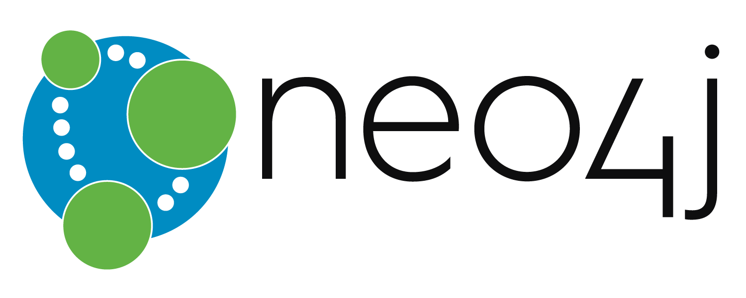
Neo4J
Direct support of graphs
Data model, API, query language
Implemented by linked lists on disk
Optimized for graph processing
Transactions
Implemented on SN cluster
Asymmetric replication
But no graph partitioning
Planned for a future version

Slide 30
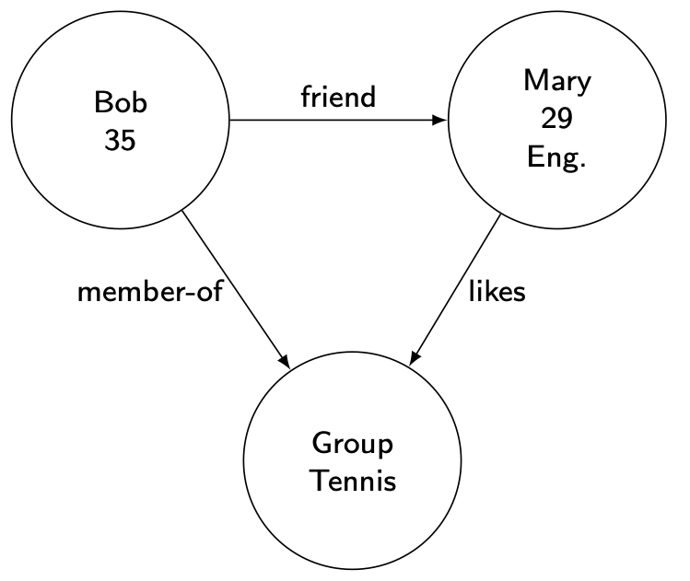
Neo4J – data model
Nodes
Links between nodes
Properties on nodes and links
A Neo transaction
NeoService neo = … // factory
Transaction tx = neo.beginTx();
Node n1 = neo.CreateNode();
n1.setProperty("name", "Bob");
n1.setProperty("age", 35);
Node n2 = neo.createNode();
n2.setProperty("name", "Mary");
n1.setProperty("age", 29);
n1.setProperty("job", "engineer");
n1.createRelationshipTo(n2, RelTypes.friend);
tx.Commit();

Slide 31
Neo4J - languages
Java API (navigational)
Cypher query language
Queries and updates with graph traversals
Support of SparQL for RDF data
Example Cypher query that returns the (indirect) friends of Bob whose name starts with "M"
MATCH bob-[:friend]->()-[:friend]->follower
WHERE bob.name=''Bob'' AND follower.name =~ ''M.*''
RETURN bob, follower.name

Slide 32
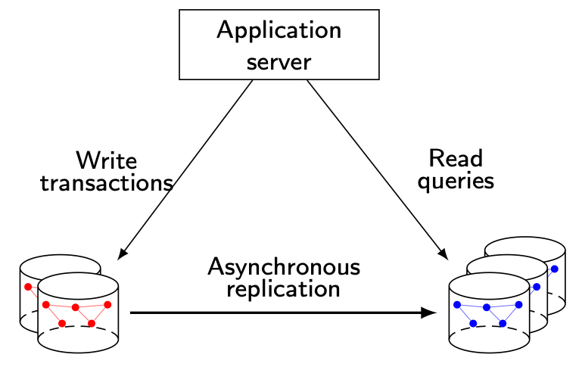
Neo4J – architecture

Slide 33
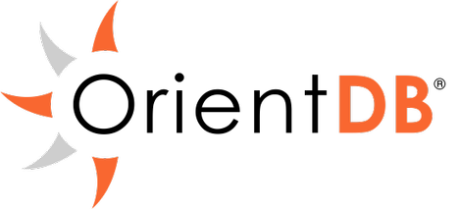
Multimodel Stores: OrientDB
Integration of key-value, document and graph
Extension of an objet model, with direct connections between objects/nodes
SQL extended with graph traversals
Distributed architecture
Graph partitioning in a cluster
Symmetric replication between data centers
ACID transactions
Web technologies: JSON, REST
Notes:
Other NoSQL multimodel system: ArangoDB in Germany

Slide 34
Main NoSQL Systems
Vendor | Product | Category | Comments
Amazon | DynamoDB | KV | Proprietary
Apache | Cassandra Accumulo | KV Tabular | Open source, Orig. Facebook Open source, Orig. NSA
Couchbase | Couchbase | KV, document | Origin: MemBase
Google | Bigtable | Tabular | Proprietary, patents
FaceBook | RocksDB | KV | Open source
Hadoop | Hbase | Tabular | Open source, Orig. Yahoo
LinkedIn | Voldemort Expresso | KV Document | Open source ACID transactions
10gen | MongoDB | Document | Open source
Oracle | NoSQL | KV | Based on BerkeleyDB
OrientDB | OrientDB | Graph, KV, document | Open source, ACID transactions
Neo4J.org | Neo4J | Graph | Open source, ACID transactions
Ubuntu | CouchDB | Document | Open source

Slide 35
Outline
NoSQL, NewSQL and Polystores
Motivations
NoSQL systems
NewSQL systems
Polystores

Slide 36
NewSQL
Pros NoSQL
Scalability
Often by relaxing strong consistency
Performance
Practical APIs for programming
Pros Relational
Strong consistency
Transactions
Standard SQL
Makes it easy for tool vendors (BI, analytics, …)
NewSQL = NoSQL/relational hybrid

Slide 37

Google F1
F1 inspired by the term hybrid filial 1 in genetics
For the AdWords killer app
More than 100 Terabytes, 100K requests per sec
Scalability problem with the MySQL / cluster solution
Objective
"F1 combines high availability, the scalability of NoSQL systems like Bigtable, and the consistency and usability of traditional SQL databases."
Geographic distribution of the data centers
Synchronous replication between data centers for high availability
Sharding and parallel processing within data center

Slide 38
Google F1
Based on Spanner, a large scale distributed system
Synchronous replication between data centers with Paxos
Load balancing between F1 servers
Favor the geographical zone of the client
Different levels of consistency
ACID transactions
Snapshot (read only) transactions
Based on data versioning
Optimistic transactions (read without locking, then write)
Validation phase to detect conflicts and abort conflicting transactions
Two interfaces
SQL
NoSQL key-value interface
Hierarchical relational storage
Precomputed joins

Slide 39

LeanXcale
SQL/JSON DBMS
Access from a JDBC driver
Key-value store (KiVi)
Dual SQL/KV interface over relational data with efficiency, elasticity, high availability, indexing, …
Fast, parallel data ingestion
Polystore access: HDFS, NoSQL, …
OLAP parallel processing
Based on the Apache Calcite optimizer
Extensive push down of operators to KiVi
Ultra-scalable transaction processing

Slide 40
Distributed Architecture

Slide 41




Transaction Processing
Traditional approach
Processes &
commits
transactions
in parallel
Single-node bottleneck
Provides a consistent
view
vs
Time
Time

Slide 42
Main NewSQL systems
Vendor | Product | Objective | Comment
Clustrix Inc., San Francisco | Clustrix | Analytics and transactional | First version out in 2006
CockroachDB Labs, NY | CockroachDB | Transactional | By ex-googlers. Open source inspired by F1, based on RocksDB
Google | F1/Spanner | Transactional | Proprietary
SAP | HANA | Analytics | In-memory, column-oriented
MemSQL Inc. | MemSQL | Analytics | In-memory, column/row-oriented, compatible with MySQL
LeanXcale, Madrid | LeanXcale | Analytics and transactional | Based on Apache Derby and Hbase Multistore access (KV, Hadoop, CEP, etc.)
NuoDB, Cambridge | NuoDB | Analytics and transactionall | Solution cloud (Amazon)
GitHub | TiDB | Transactional | Open source inspired by Google F1
VoltDB Inc. | VoltDB | Analytics and transactional | Open source and proprietary versions In-memory

Slide 43
Which Data Store for What?
Category | Systems | Requirements
Key-value | DynamoDB, SimpleDB, Cassandra | Access by key Flexibility (no schema) Very high scalability and performance
Document | MongoDB, CouchDB, Expresso | Web content management Flexibility (no schema) Limited transactions
Tabular | BigTable, Hbase, Accumulo | Very big collections Scalability and high availability
Graph | Neo4J, Sparcity, Titan | Efficient storage and management of large graphs
Multimodel | OrientDB, ArangoDB | Integrated key-value, document and graph management
NewSQL | Google F1, CockroachDB, VoltDB | ACID transactions , flexibility and scalability SQL and key-value access

Slide 44
Outline
NoSQL, NewSQL and Polystores
Motivations
NoSQL systems
NewSQL systems
Polystores

Slide 45
Polystores
Also called Multistores
Provide integrated access to multiple cloud data stores such as NoSQL, HDFS and RDBMS
Great for integrating structured (relational) data and big data
Much more difficult than distributed databases
A major area of research & development

Slide 46
Differences with Distributed Databases
Multidatabase systems
A few databases (e.g. less than 10)
Corporate DBs
Powerful queries (with updates and transactions)
Web data integration systems
Many data sources (e.g. 1000’s)
DBs or files behind a web server
Simple queries (read-only)
Mediator/wrapper architecture
In the cloud, more opportunities for an efficient multistore architecture
No restriction to where mediator and wrapper components need be installed

Slide 47
Classification of Polystores
We divide polystores based on the level of coupling with the underlying data stores
Loosely-coupled
Tightly-coupled
Hybrid

Slide 48
Loosely-coupled Polystores
Reminiscent of multidatabase systems
Mediator-wrapper architecture
Deal with autonomous data stores
One common interface to all data stores
Common interface translated to local API
Examples
BigIntegrator (Uppsala University)
Forward (UC San Diego)
QoX (HP Labs)

Slide 49
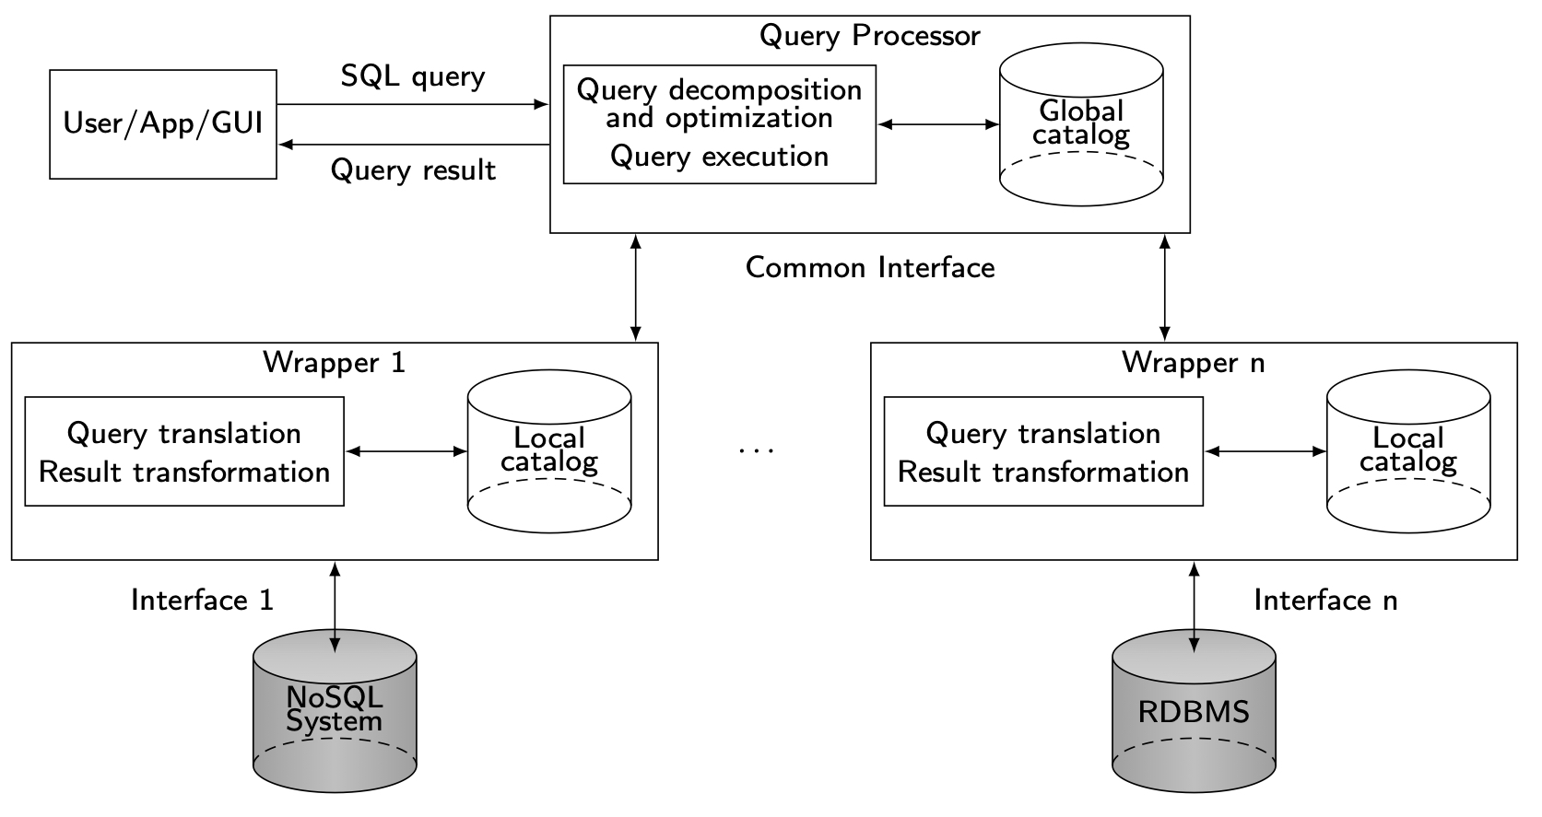
Architecture

Slide 50
Big Integrator
Combines Bigtable data stores in the cloud and relational data stores
SQL-like queries
Google Query Language (GQL)
No join, only basic select predicates
Query processing mechanism based on plugins
Absorber and finalizer
Uses Local As View approach
To define the global schema of the Bigtable and relational data sources as flat relational tables

Slide 51
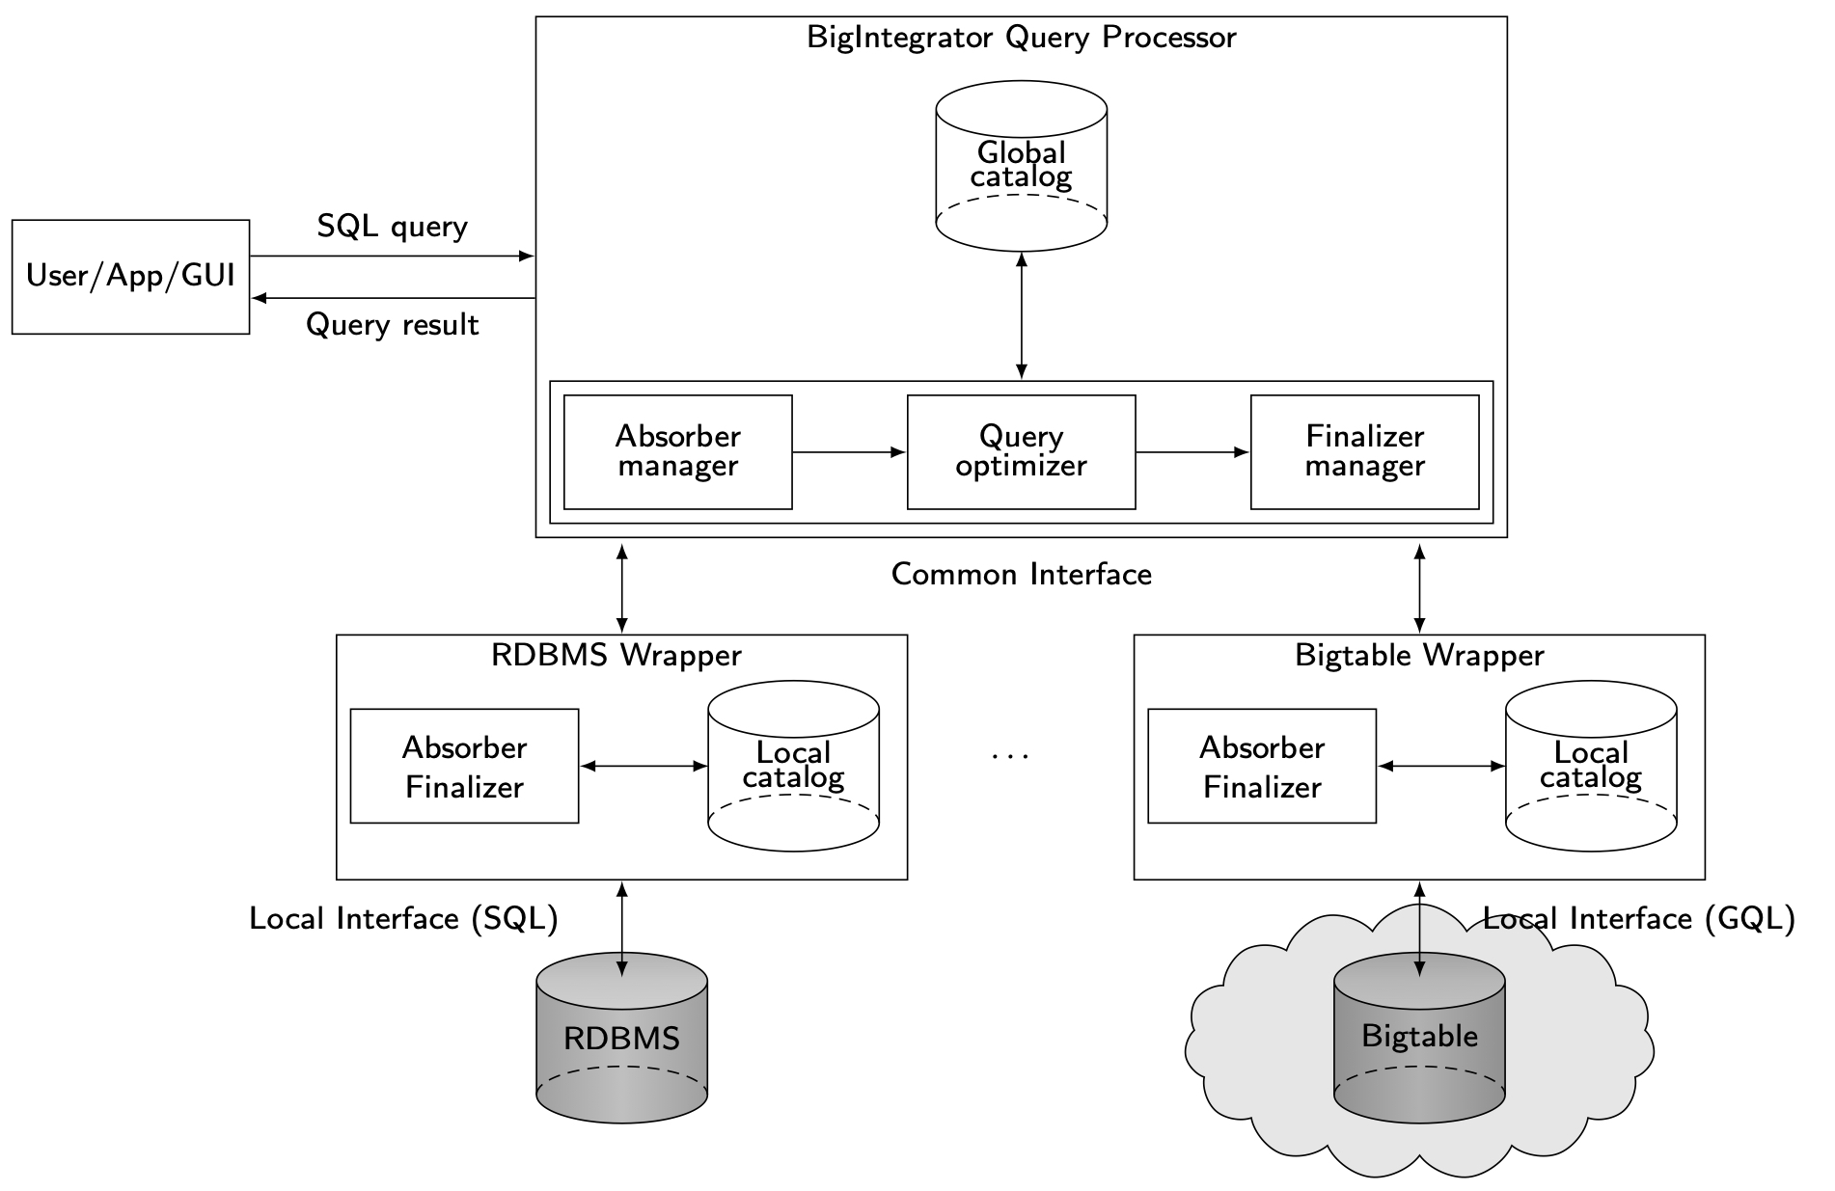
Big Integrator Architecture

Slide 52
Forward
Supports SQL++
SQL-like language
Semi-structured data model
Extends JSON and relational data models
Rich web development frameworks
Integrate visualization components (e.g., Google Maps)
Global As View approach for the global schema
Each data source (SQL or NoSQL) appears to the user as an SQL++ virtual view, defined over SQL++ collections
Architecture
Query processor
Performs SQL++ query decomposition
Cost based optimization
One wrapper per data store

Slide 53
QoX
Integrates data from relational databases and various execution engines (MapReduce or ETL)
Relational data model
SQL-like language
Queries are analytical data-driven workflows (or dataflows)
QoX optimizer
Integrates the back-end ETL pipeline and the front-end query operations into a single analytics pipeline
Evaluates alternative execution plans, estimates theirs costs and generates executable code

Slide 54
Tightly-coupled Polystores
Use the local interfaces of the data stores
Use a single query language for data integration in the query processor
Allow data movement across data stores
Optimize queries using materialized views or indexes
Examples
Polybase (Microsoft Research, Madison)
HadoopDB (Yale Univ. & Brown Univ.)
Estocada (Inria)

Slide 55
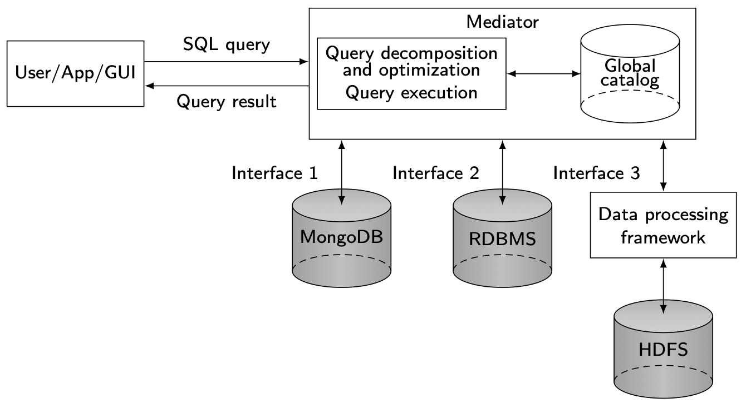
Architecture

Slide 56
Polybase
Feature of the SQL Server Parallel Data Warehouse (PDW) to query and integrate HDFS through SQL
HDFS data can be referenced in Polybase as external tables
Using the PDW query optimizer, SQL operators on HDFS data are translated into MapReduce jobs to be executed directly on the Hadoop cluster

Slide 57
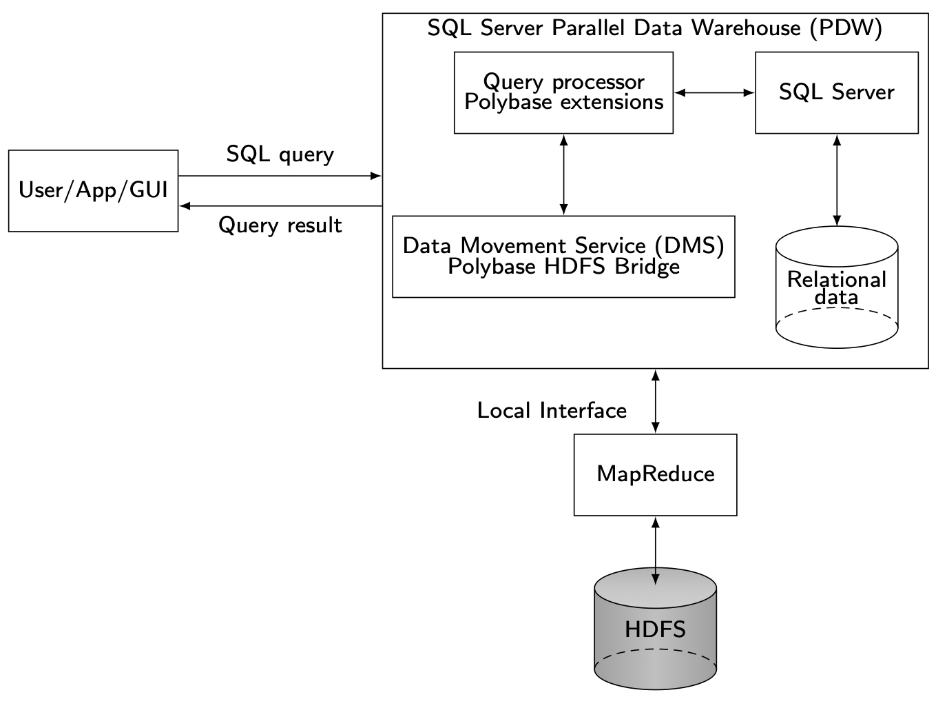
Polybase Architecture

Slide 58
HadoopDB
Tightly couples the Hadoop framework, including MapReduce and HDFS, with multiple single-node RDBMS (e.g. PostgreSQL or MySQL) deployed across a cluster
Extends the Hadoop architecture with four components
Database connector
Catalog
Data loader
SQL-MapReduce-SQL (SMS) planner

Slide 59
Estocada
Self-tuning polystore
Automatic data distribution and partitioning across the different data stores
Each data partition is internally described as a materialized view over one or several data collection
Query processor
Deals with single model queries only, each expressed in the query language of the corresponding data source
To integrate various data sources, one would need a common data model and language on top of Estocada
Query processing involves view-based query rewriting and cost-based optimization

Slide 60
Hybrid Polystores
Support data source autonomy as in loosely-coupled systems
Exploit the local data source interface as in tightly-coupled systems
Examples
SparkSQL (Databricks & UC Berkeley)
CloudMdsQL (Inria & LeanXcale)
BigDaWG (MIT, U. Chicago & Intel)

Slide 61
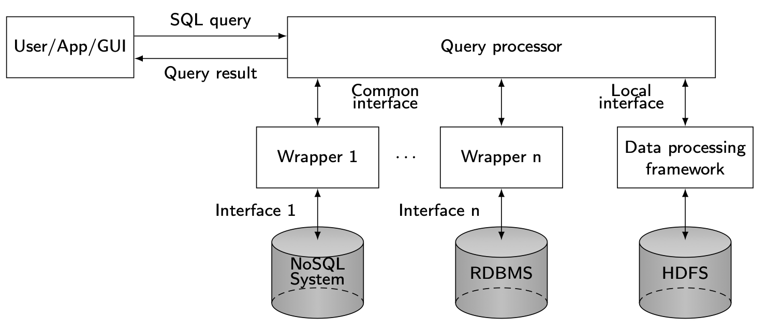
Architecture

Slide 62
SparkSQL
Runs as a library on top of Spark
The query processor
Directly accesses the Spark engine through the Spark Java interface
Accesses external data sources (e.g. an RDBMS or a key-value store) through the Spark SQL common interface supported by wrappers (JDBC drivers)
Extensible query optimizer
In-memory caching using columnar storage

Slide 63
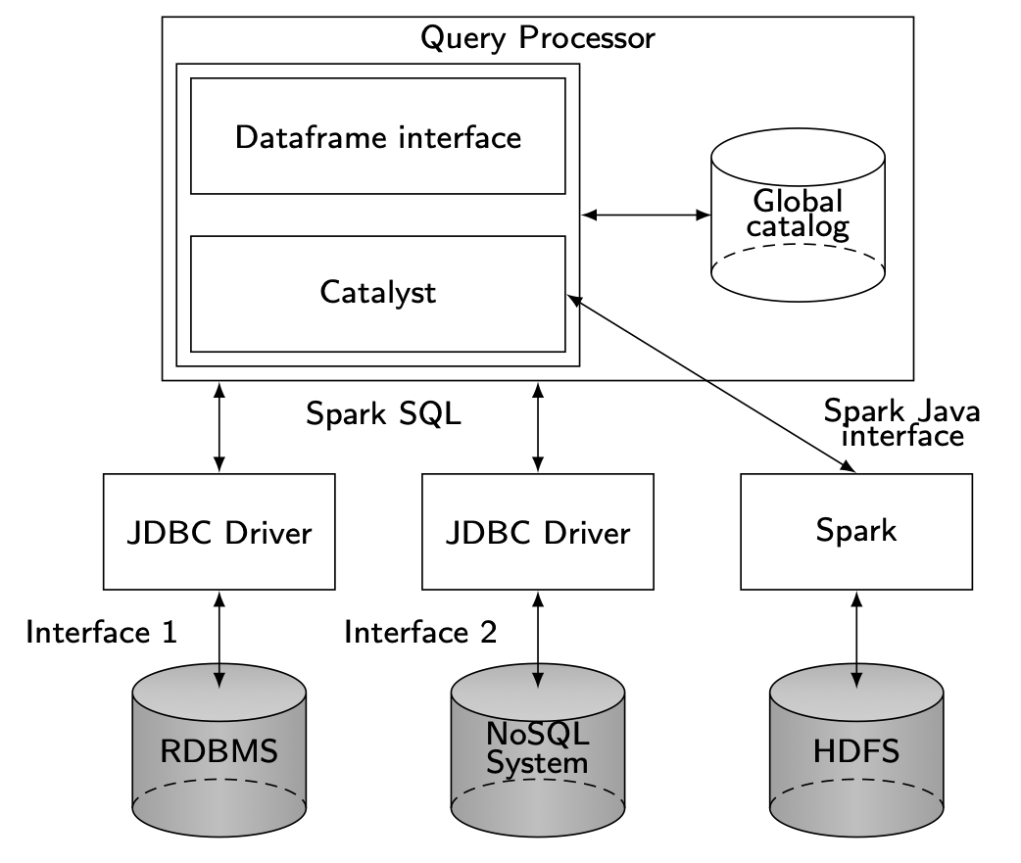
SparkSQL Architecture

Slide 64
CloudMdsQL
JSON-based data model
With rich data types
To allow computing on typed values
No global schema and schema mappings to define
Functional-style SQL
Can represent all query building blocks as functions
A function can be expressed in one of the DB languages
Function results can be used as input to subsequent functions
Fully distributed architecture exploited by the query processor
Select pushdown and bind join optimization
Operator ordering
Reducing data transfers between nodes

Slide 65
CloudMdsQL Example
A query that integrates data from:
DB1 – relational (MonetDB)
DB2 – document (MongoDB)
π
x, z
/* Integration query */
SELECT T1.x, T2.z
FROM T1 JOIN T2
ON T1.x = T2.x
/* SQL sub-query */
T1(x int, y int)@DB1 =
( SELECT x, y FROM A )
/* Native sub-query */
T2(x int, z string)@DB2 =
{*
db.B.find( {$lt: {x, 10}}, {x:1, z:1, _id:0} )
*}
@CloudMdsQL
π
x, y
A
T1@DB1
(MonetDB)
N
x, z
T2@DB2
(MongoDB)

Slide 66
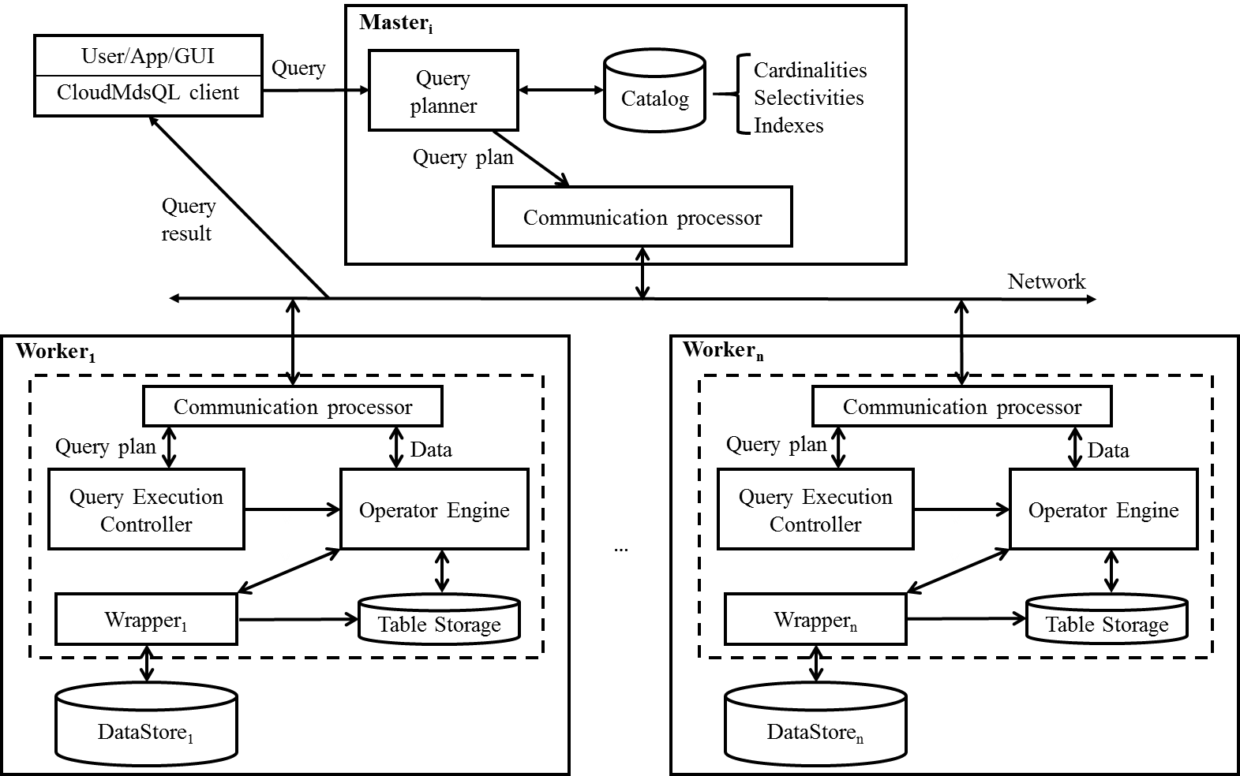
CloudMdsQL Distributed Query Engine

Slide 67
MFR Statement
Sequence of Map/Filter/Reduce operations on datasets for big data frameworks (e.g. Spark)
Example: count the words that contain the string ‘cloud’
A dataset is an abstration for a set of tuples, a Spark RDD
Consists of key-value tuples
Processed by MFR operations
Dataset
SCAN(TEXT,’words.txt’)
.MAP(KEY,1)
.FILTER( KEY LIKE ‘%cloud%’ )
.REDUCE (SUM)

Slide 68
MFR Example
Query: retrieve data from RDBMS and HDFS
/* Integration subquery*/
SELECT title, kw, count FROM T1 JOIN T2 ON T1.kw = T2.word
WHERE T1.kw LIKE '%cloud%'
/* SQL subquery */
T1(title string, kw string)@rdbms = ( SELECT title, kw FROM tbl )
/* MFR subquery */
T2(word string, count int)@hdfs = {*
SCAN(TEXT,'words.txt’)
.MAP(KEY,1)
.REDUCE(SUM)
.PROJECT(KEY,VALUE) *}

Slide 69
BigDAWG
No common data model and language
Key abstraction: island of information
A collection of data stores accessed with a single query language
Examples of islands: relational, array, NoSQL, DSMS
Within an island, there is loose-coupling of the data stores, which need to provide a wrapper island language to their native one
Query processing within an island using distributed techniques
Function shipping
Data shipping

Slide 70
Comparisons: functionality
Polystore | Objective | Data model | Query language | Data stores
Loosely-coupled
BigIntegrator | Querying relational and cloud data | Relational | SQL-like | BigTable,RDBMS
Forward | Unyfing relational and NoSQL | JSON-based | SQL++ | RDBMS, NoSQL
QoX | Analytic data flows | Graph | XML based | RDBMS, ETL
Tightly-coupled
Polybase | Querying Hadoop from RDBMS | Relational | SQL | HDFS, RDBMS
HadoopDB | Querying RDBMS from Hadoop | Relational | SQL-live (HiveQL) | HDFS, RDBMS
Estocada | Self-tuning | No common model | Native QL | RDBMS, NoSQL
Hybrid
SparkSQL | SQL on top of Spark | Nested | SQL-like | HDFS, RDBMS
BigDAWG | Unifying relational and NoSQL | No common model | Island query languages | RDBMS, NoSQL, Array DBMS, DSMSs
CloudMdsQL | Querying relational and NoSQL | JSON-based | SQL-like with native subqueries | RDBMS, NoSQL, HDFS

Slide 71
Comparisons: implementation techniques
Polystore | Objective | Data model | Query language | Data stores
Loosely-coupled
BigIntegrator | Importer,absorber, finalizer | LAV | Access filters | Heuristics
Forward | Query processor | GAV | Data store capabilities | Cost-based
QoX | Dataflow engine | No | Data/function shipping | Cost-based
Tightly-coupled
Polybase | HDFS bridge | GAV | Query splitting | Cost-based
HadoopDB | SMS planer, db conector | GAV | Query splitting | Heuristics
Estocada | Storage advisor | Materialzed views | Query rewriting | Cost-based
Hybrid
SparkSQL | Dataframes | Nested | In-memory caching | Cost-based
BigDAWG | Island query | GAV within islands | Function/datashipping | Heuristics
CloudMdsQL | Query planner | No | Bind join | Cost-based

Slide 72
Conclusions for Polystores
The ability to integrate relational data (stored in RDBMS) with other kinds of data stores
The growing importance of accessing HDFS within Hadoop
Most systems provide a relational/ SQL-like abstraction
QoX has a more general graph abstraction to capture analytic dataflows
BigDAWG allows the data stores to be directly accessed with their native (or island) languages

