Slide 1
Principles of Distributed Database Systems
M. Tamer Özsu
Patrick Valduriez

Slide 2
Outline
Introduction
Distributed and parallel database design
Distributed data control
Distributed Query Processing
Distributed Transaction Processing
Data Replication
Database Integration – Multidatabase Systems
Parallel Database Systems
Peer-to-Peer Data Management
Big Data Processing
NoSQL, NewSQL and Polystores
Web Data Management

Slide 3
Outline
Distributed Query Processing
Query Decomposition and Localization
Join Ordering
Distributed Query Optimization
Adaptive Query Processing

Slide 4
Query Processing in a DDBMS
High level user query
Query
Processor
Low-level data manipulation
commands for D-DBMS

Slide 5
Query Processing Components
Query language
SQL: “intergalactic dataspeak”
Query execution
The steps that one goes through in executing high-level (declarative) user queries.
Query optimization
How do we determine the “best” execution plan?
We assume a homogeneous D-DBMS

Slide 6
Selecting Alternatives
SELECT ENAME
FROM EMP NATURAL JOIN ASG
WHERE RESP = "Manager"
Strategy 1
Π_{ENAME}(σ_{RESP=“Manager”∧EMP.ENO=ASG.ENO}(EMP×ASG))
Strategy 2
Π _{ENAME}(EMP ⋈_{ENO} (σ_{RESP=“Manager”} (ASG))
Strategy 2 avoids Cartesian product, so may be “better”

Slide 7
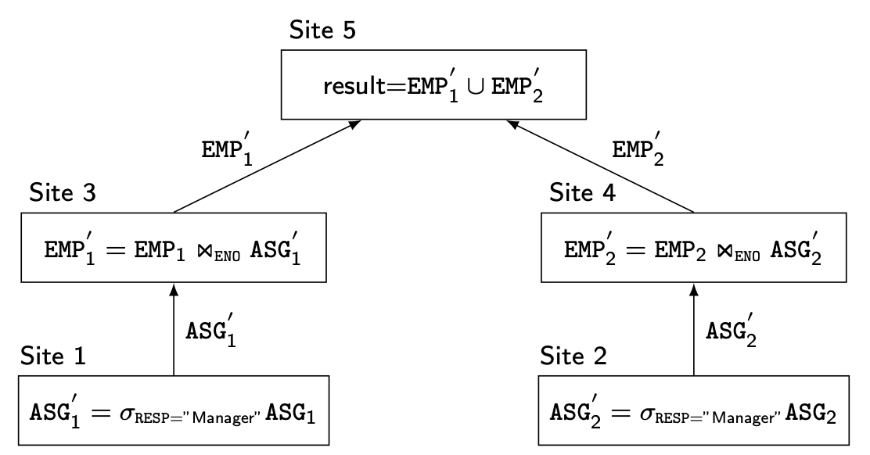
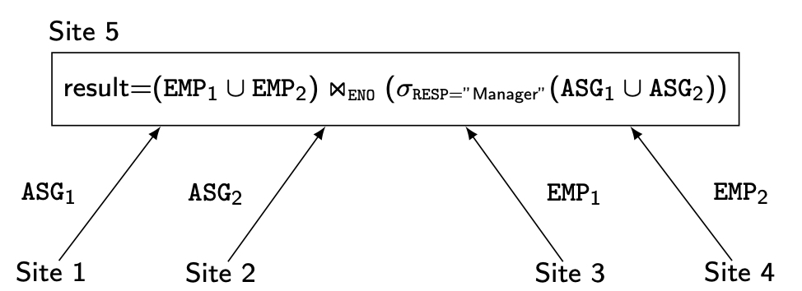
What is the Problem?
Site 1
Site 2
Site 3
Site 4
Site 5
ASG₁=σ_{ENO≤“E3”}(ASG)
ASG₂= σ_{ENO>“E3”}(ASG)
EMP₁= σ_{ENO≤“E3”}(EMP)
EMP₂= σ_{ENO>“E3”}(EMP)
Result

Slide 8
Cost of Alternatives
Assume
size(EMP) = 400, size(ASG) = 1000
tuple access cost = 1 unit; tuple transfer cost = 10 units
Strategy 1
produce ASG': (10+10) ∗ tuple access cost 20
transfer ASG' to the sites of EMP: (10+10) ∗ tuple transfer cost 200
produce EMP': (10+10) ∗ tuple access cost ∗ 2 40
transfer EMP' to result site: (10+10) ∗ tuple transfer cost 200
Total Cost 460
Strategy 2
transfer EMP to site 5: 400 ∗ tuple transfer cost 4,000
transfer ASG to site 5: 1000 ∗ tuple transfer cost 10,000
produce ASG': 1000 ∗ tuple access cost 1,000
join EMP and ASG': 400 ∗ 20 ∗ tuple access cost 8,000
Total Cost 23,000

Slide 9
Query Optimization Objectives
Minimize a cost function
I/O cost + CPU cost + communication cost
These might have different weights in different distributed environments
Wide area networks
Communication cost may dominate or vary much
Bandwidth
Speed
Protocol overhead
Local area networks
Communication cost not that dominant,so total cost function should be considered
Can also maximize throughput

Slide 10
Complexity of Relational Operations
Operation
Complexity
Select
Project
O(n)
Assume
Relations of cardinality n
Sequential scan
(without duplicate elimination)
Project
(with duplicate elimination)
O(n ∗ log n)
Group
Join
Semi-join
O(n ∗ log n)
Division
Set Operators
Cartesian Product
O(n²)

Slide 11
Types Of Optimizers
Exhaustive search
Cost-based
Optimal
Combinatorial complexity in the number of relations
Heuristics
Not optimal
Regroup common sub-expressions
Perform selection, projection first
Replace a join by a series of semijoins
Reorder operations to reduce intermediate relation size
Optimize individual operations

Slide 12
Optimization Granularity
Single query at a time
Cannot use common intermediate results
Multiple queries at a time
Efficient if many similar queries
Decision space is much larger

Slide 13
Optimization Timing
Static
Compilation ➔ optimize prior to the execution
Difficult to estimate the size of the intermediate results⇒error propagation
Can amortize over many executions
Dynamic
Run time optimization
Exact information on the intermediate relation sizes
Have to reoptimize for multiple executions
Hybrid
Compile using a static algorithm
If the error in estimate sizes > threshold, reoptimize at run time

Slide 14
Statistics
Relation
Cardinality
Size of a tuple
Fraction of tuples participating in a join with another relation
Attribute
Cardinality of domain
Actual number of distinct values
Simplifying assumptions
Independence between different attribute values
Uniform distribution of attribute values within their domain

Slide 15
Optimization Decision Sites
Centralized
Single site determines the “best” schedule
Simple
Need knowledge about the entire distributed database
Distributed
Cooperation among sites to determine the schedule
Need only local information
Cost of cooperation
Hybrid
One site determines the global schedule
Each site optimizes the local subqueries

Slide 16
Network Topology
Wide area networks (WAN) – point-to-point
Characteristics
Relatively low bandwidth (compared to local CPU/IO)
High protocol overhead
Communication cost may dominate; ignore all other cost factors
Global schedule to minimize communication cost
Local schedules according to centralized query optimization
Local area networks (LAN)
Communication cost not that dominant
Total cost function should be considered
Broadcasting can be exploited (joins)
Special algorithms exist for star networks

Slide 17
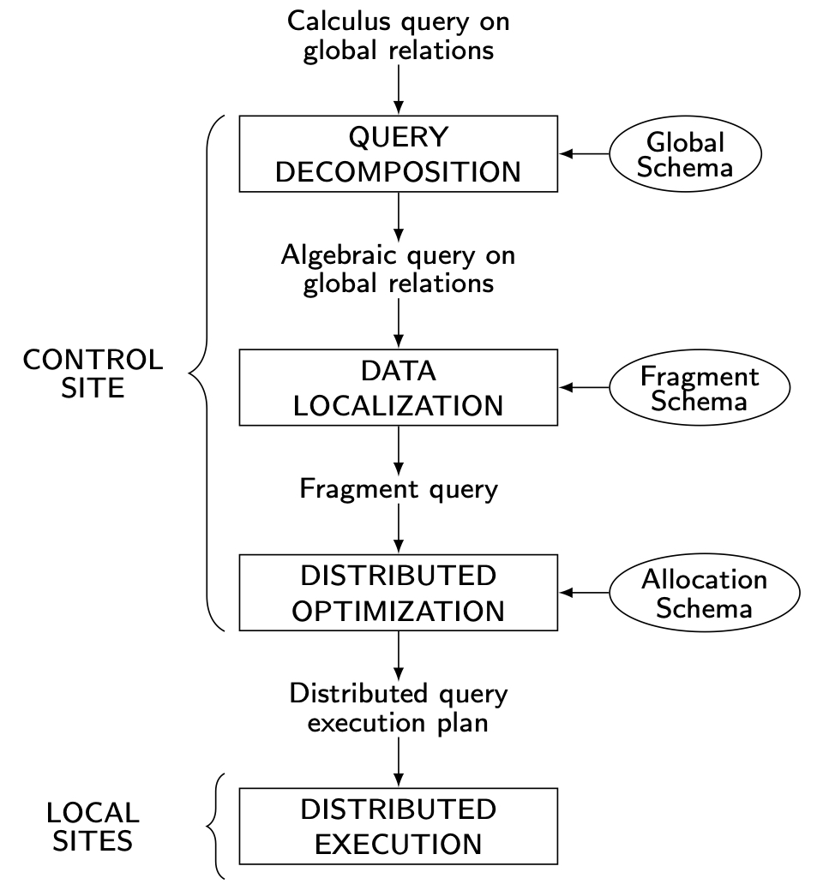
Distributed Query Processing Methodology

Slide 18
Outline
Distributed Query Processing
Query Decomposition and Localization
Distributed Query Optimization
Join Ordering
Adaptive Query Processing

Slide 19
Step 1 – Query Decomposition
Same as centralized query processing
Input : Calculus query on global relations
Normalization
Manipulate query quantifiers and qualification
Analysis
Detect and reject “incorrect” queries
Simplification
Eliminate redundant predicates
Restructuring
Calculus query ➔ algebraic query
Use transformation rules

Slide 20
Step 2 – Data Localization
Input: Algebraic query on distributed relations
Determine which fragments are involved
Localization program
Substitute for each global query its materialization program
Optimize

Slide 21
Example
Assume
EMP is fragmented as follows:
EMP₁= σ_{ENO≤“E3”}(EMP)
EMP₂= σ_{“E3”<ENO≤“E6”}(EMP)
EMP₃= σ_{ENO≥“E6”}(EMP)
ASG fragmented as follows:
ASG₁= σ_{ENO≤“E3”}(ASG)
ASG₂= σ_{ENO>“E3”}(ASG)
In any query
Replace EMP by (EMP₁ ∪ EMP₂ ∪ EMP₃)
Replace ASG by (ASG₁ ∪ ASG₂)

Slide 22
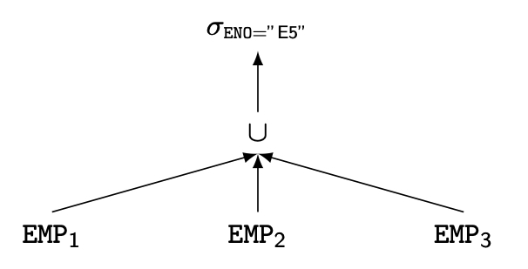
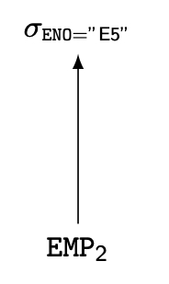
Reduction for PHF
Reduction with selection
Relation R and F_{R}={R₁, R₂, …, R_{w}} where R_{j}=σ_{pj}(R)
σ_{pi}(R_{j})=∅ if ∀x in R: ¬(p_{i}(x)∧ p_{j}(x))
SELECT *
FROM EMP
WHERE ENO="E5"

Slide 23
Reduction for PHF
Reduction with join
Possible if fragmentation is done on join attribute
Distribute join over union
(R₁∪ R₂)⋈S ⇔ (R₁⋈S) ∪ (R₂⋈S)
Given R_{i} =σ_{pi}(R) and R_{j} = σ_{pj}(R)
R_{i} ⋈R_{j} =∅ if ∀x in R_{i}, ∀y in R_{j}: ¬(p_{i}(x)∧ p_{j}(y))

Slide 24
Reduction for PHF
Assume EMP is fragmented as before and
ASG₁: σ_{ENO ≤ "E3"}(ASG)
ASG₂: σ_{ENO > "E3"}(ASG)
Consider the query
SELECT *
FROM EMP
NATURAL JOIN ASG
Distribute join over unions
Apply the reduction rule
▷◁ _{ENO}
∪
∪
EMP₁
EMP₂
EMP₃
ASG₁
ASG₂
∪
▷◁ _{ENO}
▷◁ _{ENO}
▷◁ _{ENO}
EMP₁
ASG₁
EMP₂
ASG₂
EMP₃
ASG₂

Slide 25
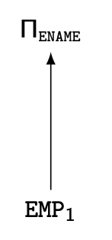
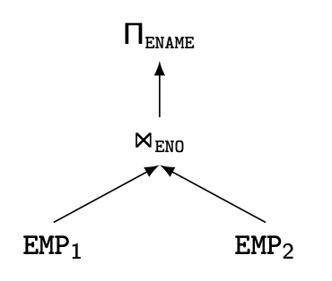
Reduction for VF
Find useless (not empty) intermediate relations
Relation R defined over attributes A = {A₁, ..., A_{n}} vertically fragmented as R_{i} =Π_{A'}(R) where A'⊆ A:
Π_{D,K}(R_{i}) is useless if the set of projection attributes D is not in A'
Example: EMP₁=Π_{ENO,ENAME} (EMP); EMP₂=Π_{ENO,TITLE} (EMP)
SELECT ENAME
FROM EMP

Slide 26
Reduction for DHF
Rule :
Distribute joins over unions
Apply the join reduction for horizontal fragmentation
Example
ASG₁: ASG ⋉_{ENO} EMP₁
ASG₂: ASG ⋉_{ENO} EMP₂
EMP₁: σ_{TITLE=“Programmer”} (EMP)
EMP₂: σ_{TITLE=“Programmer”} (EMP)
Query
SELECT *
FROM EMP NATURAL JOIN ASG
WHERE EMP.TITLE = "Mech. Eng."

Slide 27
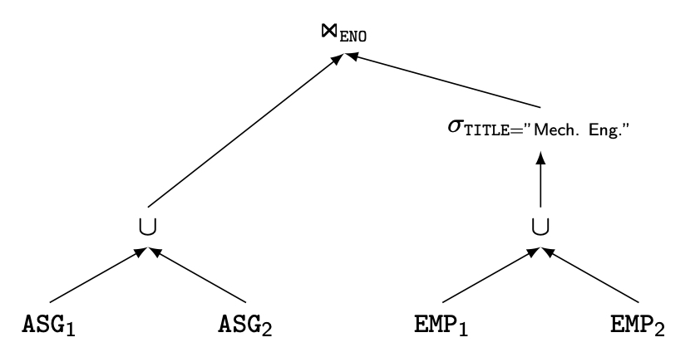
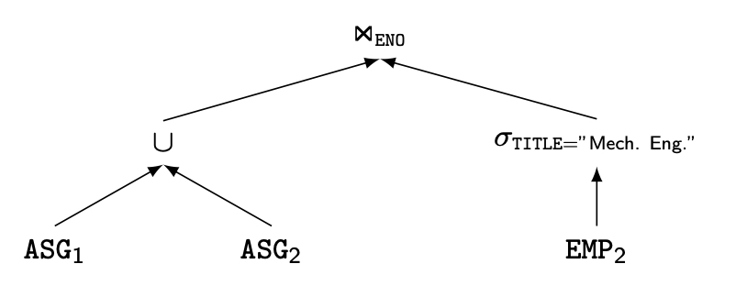
Reduction for DHF
Generic query
Selections first

Slide 28
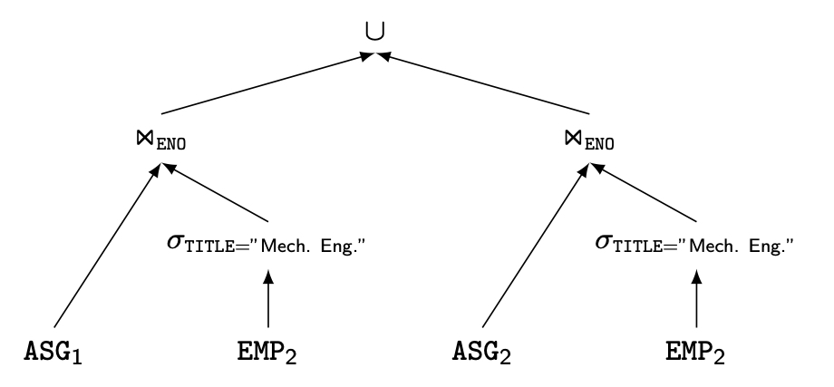
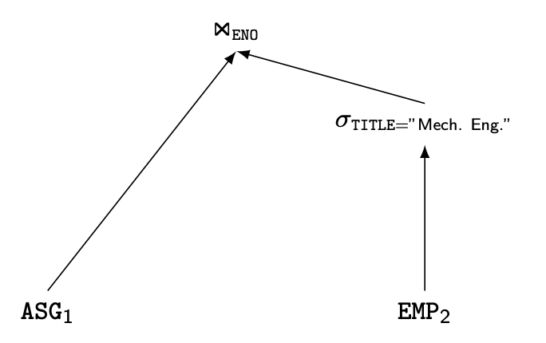
Reduction for DHF
Joins over unions
Elimination of the empty
intermediate relations
(left sub-tree)

Slide 29
Reduction for Hybrid Fragmentation
Combine the rules already specified:
Remove empty relations generated by contradicting selections on horizontal fragments;
Remove useless relations generated by projections on vertical fragments;
Distribute joins over unions in order to isolate and remove useless joins.

Slide 30
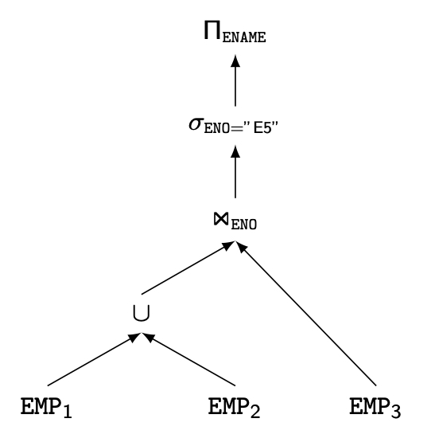
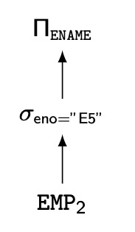
Reduction for HF
Example
Consider the following hybrid fragmentation:
EMP₁= σ_{ENO≤"E4"} (Π_{ENO,ENAME} (EMP))
EMP₂= σ_{ENO>"E4"} (Π_{ENO,ENAME} (EMP))
EMP₃= σ_{ENO,TITLE} (EMP)
and the query
SELECT ENAME
FROM EMP
WHERE ENO="E5"
⇒

Slide 31
Outline
Distributed Query Processing
Query Decomposition and Localization
Distributed Query Optimization
Join Ordering
Adaptive Query Processing

Slide 32
Step 3 – Global Query Optimization
Input: Fragment query
Find the best (not necessarily optimal) global schedule
Minimize a cost function
Distributed join processing
Bushy vs. linear trees
Which relation to ship where?
Ship-whole vs ship-as-needed
Decide on the use of semijoins
Semijoin saves on communication at the expense of more local processing
Join methods
Nested loop, merge join or hash join

Slide 33
Query Optimization Process
Input Query
Search Space
Generation
Transformation
Rules
Equivalent QEP
Search
Strategy
Cost Model
Best QEP

Slide 34
Components
Search space
The set of equivalent algebra expressions (query trees)
Cost model
I/O cost + CPU cost + communication cost
These might have different weights in different distributed environments (LAN vs WAN)
Can also maximize throughput
Search algorithm
How do we move inside the solution space?
Exhaustive search, heuristic algorithms (iterative improvement, simulated annealing, genetic,…)

Slide 35
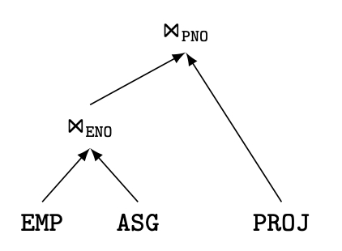
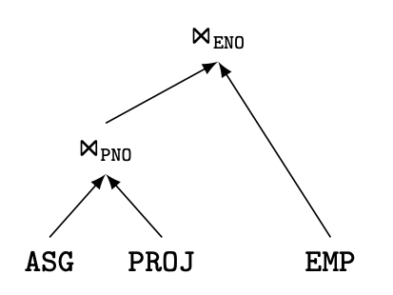
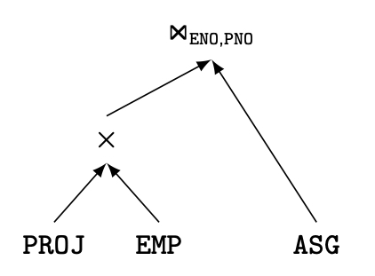
Join Trees
Characterize the search space for optimization
For N relations, there are O(N!) equivalent join trees that can be obtained by applying commutativity and associativity rules
SELECT ENAME,RESP
FROM EMP
NATURAL JOIN ASG
NATURAL JOIN PROJ

Slide 36
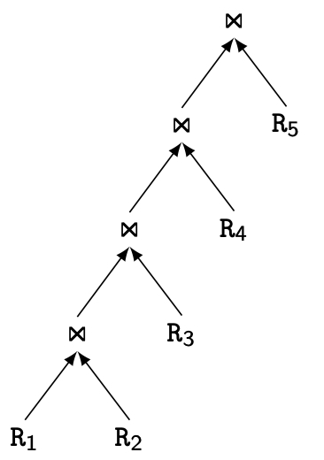
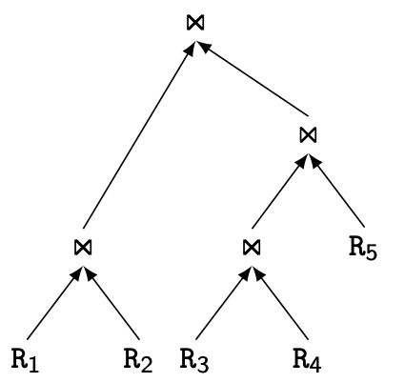
Join Trees
Two major shapes
Linear versus bushy trees
Linear Join Tree
Bushy Join Tree

Slide 37
Search Strategy
How to “move” in the search space
Deterministic
Start from base relations and build plans by adding one relation at each step
Dynamic programming: breadth-first
Greedy: depth-first
Randomized
Search for optimalities around a particular starting point
Trade optimization time for execution time
Better when > 10 relations
Simulated annealing
Iterative improvement

Slide 38
Search Strategies
Deterministic
⋈
⋈
⋈
R₄
⋈
⋈
R₃
⋈
R₃
R₁
R₂
R₁
R₂
R₁
R₂
Randomized
⋈
⋈
⋈
R₃
⋈
R₂
R₁
R₂
R₁
R₃

Slide 39
Outline
Distributed Query Processing
Query Decomposition and Localization
Distributed Query Optimization
Join Ordering
Adaptive Query Processing

Slide 40
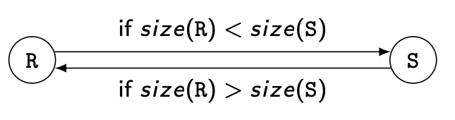
Join Ordering
Multiple relations more difficult because too many alternatives.
Compute the cost of all alternatives and select the best one.
Necessary to compute the size of intermediate relations which is difficult.
Use heuristics

Slide 41
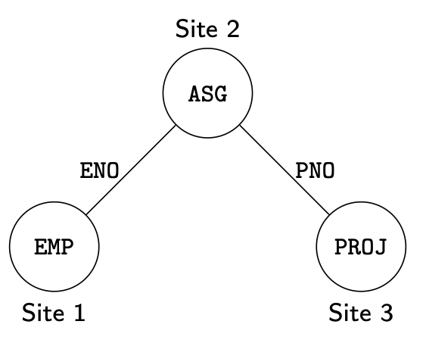
Join Ordering – Example
Consider
PROJ ⋈_{PNO} ASG ⋈_{ENO} EMP

Slide 42
Join Ordering – Example
Execution alternatives
1. EMP→ Site 2 2. ASG → Site 1
Site 2 computes EMP'=EMP ⋈ ASG Site 1 computes EMP'=EMP ⋈ ASG
EMP'→ Site 3 EMP' → Site 3
Site 3 computes EMP' ⋈ PROJ Site 3 computes EMP’ ⋈ PROJ
3. ASG → Site 3 4. PROJ → Site 2
Site 3 computes ASG'=ASG ⋈ PROJ Site 2 computes PROJ'=PROJ ⋈ ASG
ASG' → Site 1 PROJ' → Site 1
Site 1 computes ASG' ▷◁ EMP Site 1 computes PROJ' ⋈ EMP
5. EMP → Site 2
PROJ → Site 2
Site 2 computes EMP ⋈ PROJ ⋈ ASG

Slide 43
Semijoin-based Ordering
Consider the join of two relations:
R[A] (located at site 1)
S[A](located at site 2)
Alternatives:
Do the join R ⋈_{A}S
Perform one of the semijoin equivalents
R ⋈_{A}S ⇔ (R ⋉_{A}S) ⋈_{A}S
⇔ R ⋈_{A} (S ⋉_{A} R)
⇔ (R ⋉_{A} S) ⋈_{A} (S ⋉_{A} R)

Slide 44
Semijoin-based Ordering
Perform the join
Send R to Site 2
Site 2 computes R ⋈_{A} S
Consider semijoin (R ⋉_{A}S) ⋈_{A}S
S' = Π_{A}(S)
S' → Site 1
Site 1 computes R' = R ⋉_{A}S'
R'→ Site 2
Site 2 computes R' ⋈_{A}S
Semijoin is better if
size(Π_{A}(S)) + size(R ⋉_{A}S)) < size(R)

Slide 45
Full Reducer
Optimal semijoin program that reduces each relation more than others
How to find the full reducer?
Enumeration of all possible semijoin programs and select the one that has best size reduction
Problem
For cyclic queries, no full reducers can be found
For tree queries, full reducers exist but the number of candidate semijoin programs is exponential in the number of relations
For chained queries, where relations can be ordered so that each relation joins only with the next relation, polynomial algorithms exist

Slide 46
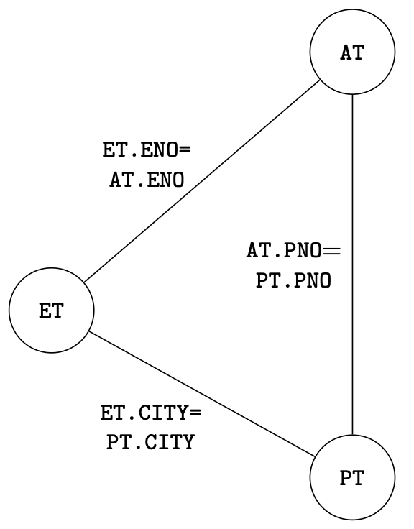
Full Reducer – Example
Consider
ET (ENO, ENAME, TITLE, CITY)
AT (ENO, PNO, RESP, DUR, CITY)
PT (PNO, PNAME, BUDGET, CITY)
And the cyclic query
SELECT ENAME, PNAME
FROM ET NATURAL JOIN AT
NATURAL JOIN PT
NATURAL JOIN ET

Slide 47
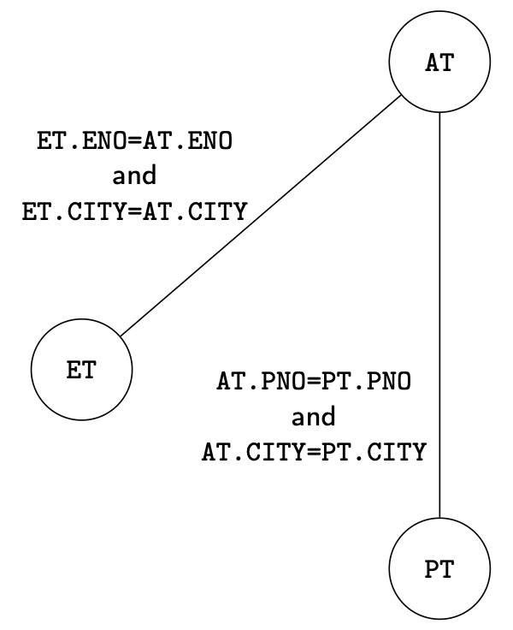
Full Reducer – example
Solution: transform the cyclic query into a tree
Remove one arc of the cyclic graph
Add appropriate predicates to other arcs such that the removed predicate is preserved by transitivity

Slide 48
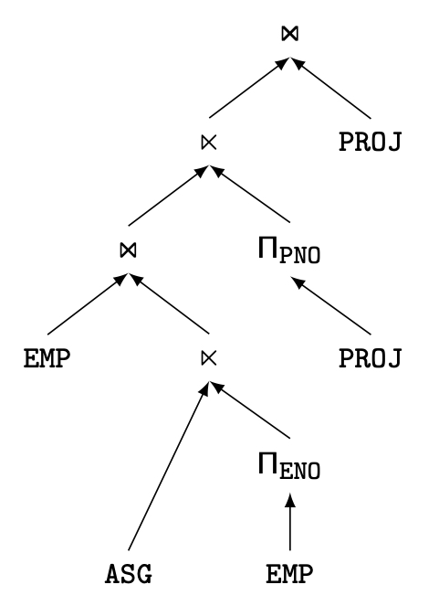
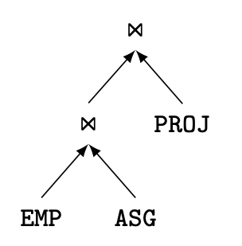
Join versus Semijoin-based Ordering
Semijoin-based induces more operators, but possibly on smaller operands

Slide 49
Distributed Cost Model
Cost functions
Total Time (or Total Cost)
Reduce each cost (in terms of time) component individually
Do as little of each cost component as possible
Optimizes resource utilization and increases system throughput
Response Time
Do as many things as possible in parallel
May increase total time because of increased total activity

Slide 50
Total Time
Total time = CPU cost + I/O cost + com. Cost
The summation of all cost factors
CPU cost = unit instruction cost ∗ no.of instructions
I/O cost = unit disk I/O cost ∗ no. of disk I/Os
com. cost = message initiation + transmission

Slide 51
Response Time
Response time = CPU time + I/O time + com. time
Must consider parallel execution
CPU time = unit instruction time * no. of seq instructions
I/O time = unit I/O time * no. of seq I/Os
com. time = unit msg initiation time * no. of seq msgs
+ unit transmission time * no. of seq bytes

Slide 52
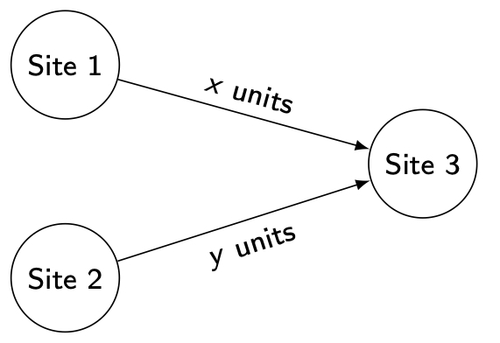
Example
Consider communication cost only
Total time = 2 × msg initialization time + unit transmission time * (x+y)
Response time = max {time to send x from 1 to 3, time to send y from 2 to 3}

Slide 53
Database Statistics
Primary cost factor: size of intermediate relations
Need to estimate their sizes
Make them precise ⇒ more costly to maintain
Simplifying assumption: uniform distribution of attribute values in a relation

Slide 54
Statistics
For each relation R[A₁, A₂, …, A_{n}] fragmented as R₁, …, R_{r}
length of each attribute: length(A_{i})
the number of distinct values for each attribute in each fragment: card(Π_{Ai}R_{j})
maximum and minimum values in the domain of each attribute: min(A_{i}), max(A_{i})
the cardinalities of each domain: card(dom[A_{i}])
The cardinalities of each fragment: card(R_{j})
Selectivity factor of each operator on relations
See centralized query optimization statistics

Slide 55
Distributed Query Optimization
Dynamic approach
Distributed INGRES
No static cost estimation, only runtime cost information
Static approach
System R*
Static cost model
Hybrid approach
2-step

Slide 56
Dynamic Approach
Execute all monorelation queries (e.g., selection, projection)
Reduce the multirelation query to produce irreducible subqueries q₁→ q₂ → … → q_{n} such that there is only one relation between q_{i} and q_{i+1}
Choose q_{i} involving the smallest fragments to execute (call MRQ')
Find the best execution strategy for MRQ'
Determine processing site
Determine fragments to move
Repeat 3 and 4

Slide 57
Static Approach
Cost function includes local processing as well as transmission
Considers only joins
“Exhaustive” search
Compilation

Slide 58
Static Approach – Performing Joins
Ship whole
Larger data transfer
Smaller number of messages
Better if relations are small
Fetch as needed
Number of messages = O(cardinality of external relation)
Data transfer per message is minimal
Better if relations are large and the selectivity is good

Slide 59
Static Approach – Vertical Partitioning & Joins
1. Move outer relation tuples to the site of the inner relation
(a) Retrieve outer tuples
(b) Send them to the inner relation site
(c) Join them as they arrive
Total Cost = cost(retrieving qualified outer tuples)
+ no. of outer tuples fetched * cost(retrieving qualified inner tuples)
+ msg. cost * (no. outer tuples fetched * avg. outer tuple size)/msg. size

Slide 60
Static Approach – Vertical Partitioning & Joins
2. Move inner relation to the site of outer relation
Cannot join as they arrive; they need to be stored
Total cost = cost (retrieving qualified outer tuples)
+ no. of outer tuples fetched * cost(retrieving matching inner tuples from temporary storage)
+ cost(retrieving qualified inner tuples)
+ cost(storing all qualified inner tuples in temporary storage)
+ msg. cost * no. of inner tuples fetched * avg. inner tuple size/msg. size

Slide 61
Static Approach – Vertical Partitioning & Joins
3. Move both inner and outer relations to another site
Total cost = cost(retrieving qualified outer tuples)
+ cost(retrieving qualified inner tuples)
+ cost(storing inner tuples in storage)
+ msg. cost ⋅ (no. of outer tuples fetched * avg. outer tuple size)/msg. size
+ msg. cost * (no. of inner tuples fetched * avg. inner tuple size)/msg. size
+ no. of outer tuples fetched * cost(retrieving inner tuples from temporary storage)

Slide 62
Static Approach – Vertical Partitioning & Joins
4. Fetch inner tuples as needed
(a) Retrieve qualified tuples at outer relation site
(b) Send request containing join column value(s) for outer tuples to inner relation site
(c) Retrieve matching inner tuples at inner relation site
(d) Send the matching inner tuples to outer relation site
(e) Join as they arrive
Total Cost = cost(retrieving qualified outer tuples)
+ msg. cost * (no. of outer tuples fetched)
+ no. of outer tuples fetched * no. of inner tuples fetched * avg. inner tuple size * (msg. cost / msg. size)
+ no. of outer tuples fetched * cost(retrieving matching inner tuples for one outer value)

Slide 63
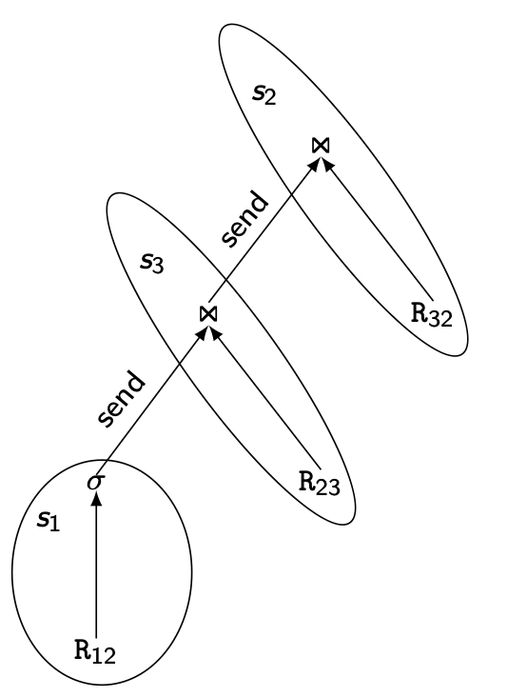
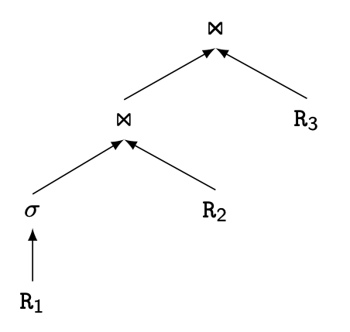
2-Step Optimization
At compile time, generate a static plan with operation ordering and access methods only
At startup time, carry out site and copy selection and allocate operations to sites
Static plan
Runtime plan

Slide 64
2-Step – Problem Definition
Given
A set of sites S = {s₁, s₂, …,s_{n}} with the load of each site
A query Q ={q₁, q₂, q₃, q₄} such that each subquery q_{i} is the maximum processing unit that accesses one relation and communicates with its neighboring queries
For each q_{i} in Q, a feasible allocation set of sites S_{q}={s₁, s₂, …,s_{k}} where each site stores a copy of the relation in q_{i}
The objective is to find an optimal allocation of Q to S such that
The load unbalance of S is minimized
The total communication cost is minimized

Slide 65
2-Step Algorithm
For each q in Q compute load (S_{q})
While Q not empty do
Select subquery a with least allocation flexibility
Select best site b for a (with least load and best benefit)
Remove a from Q and recompute loads if needed

Slide 66
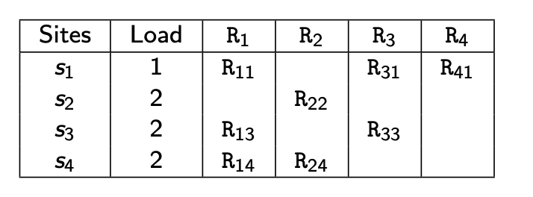
2-Step Algorithm Example
Let Q = {q₁, q₂, q₃, q₄} where q₁ is associated with R₁, q₂ is associated with R₂ joined with the result of q₁, etc.
Iteration 1: select q₄, allocate to s₁, set load(s₁)=2
Iteration 2: select q₂, allocate to s₂, set load(s₂)=3
Iteration 3: select q₃, allocate to s₁, set load(s₁) =3
Iteration 4: select q₁, allocate to s₃ or s₄
Note: if in iteration 2, q₂ were allocated to s₄, this would have produced
a better plan. So hybrid optimization can still miss optimal plans

Slide 67
Outline
Distributed Query Processing
Query Decomposition and Localization
Distributed Query Optimization
Join Ordering
Adaptive Query Processing

Slide 68
Adaptive Query Processing - Motivations
Assumptions underlying query optimization
The optimizer has sufficient knowledge about runtime
Cost information
Runtime conditions remain stable during query execution
Appropriate for systems with few data sources in a controlled environment
Inappropriate for changing environments with large numbers of data sources and unpredictable runtime conditions

Slide 69
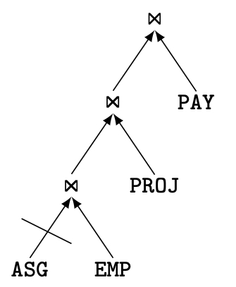
Example: QEP with Blocked Operator
Assume ASG, EMP, PROJ and PAY each at a different site
If ASG site is down, the entire pipeline is blocked
However, with some reorganization, the join of EMP and PAY could be done while waiting for ASG

Slide 70
Adaptive Query Processing – Definition
A query processing is adaptive if it receives information from the execution environment and determines its behavior accordingly
Feed-back loop between optimizer and runtime environment
Communication of runtime information between DDBMS components
Additional components
Monitoring, assessment, reaction
Embedded in control operators of QEP
Tradeoff between reactiveness and overhead of adaptation

Slide 71
Adaptive Components
Monitoring parameters (collected by sensors in QEP)
Memory size
Data arrival rates
Actual statistics
Operator execution cost
Network throughput
Adaptive reactions
Change schedule
Replace an operator by an equivalent one
Modify the behavior of an operator
Data repartitioning

Slide 72
Eddy Approach
Query compilation: produces a tuple ⟨D, P, C, Eddy⟩
D: set of data sources (e.g. relations)
P: set of predicates
C: ordering constraints to be followed at runtime
Eddy: n-ary operator between D and P
Query execution: operator ordering on a tuple basis using Eddy
On-the-fly tuple routing to operators based on cost and selectivity
Change of join ordering during execution
Requires symmetric join algorithms such as Ripple joins

Slide 73
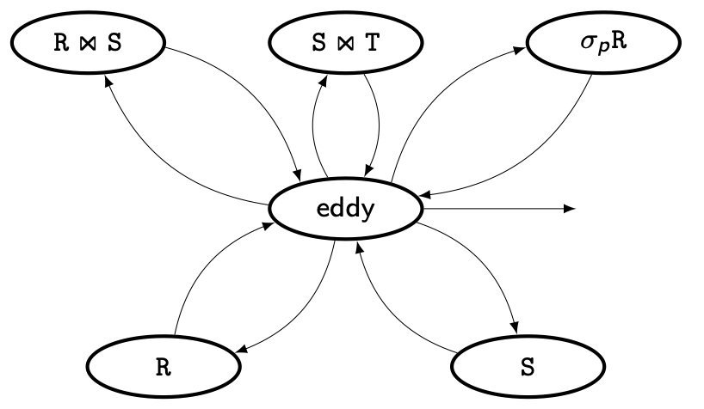
QEP with Eddy
D= {R, S, T}
P = {σ_{P} (R), R ⋈₁ S, S ⋈₂ T)
C = {S < T} where < imposes S tuples to probe T tuples using an index on join attribute
Access to T is wrapped by ⋈

