Slide 1
Principles of Distributed Database Systems
M. Tamer Özsu
Patrick Valduriez

Slide 2
Outline
Introduction
Distributed and parallel database design
Distributed data control
Distributed Transaction Processing
Data Replication
Database Integration – Multidatabase Systems
Parallel Database Systems
Peer-to-Peer Data Management
Big Data Processing
NoSQL, NewSQL and Polystores
Web Data Management

Slide 3
Outline
Distributed Transaction Processing
Distributed Concurrency Control
Distributed Reliability

Slide 4
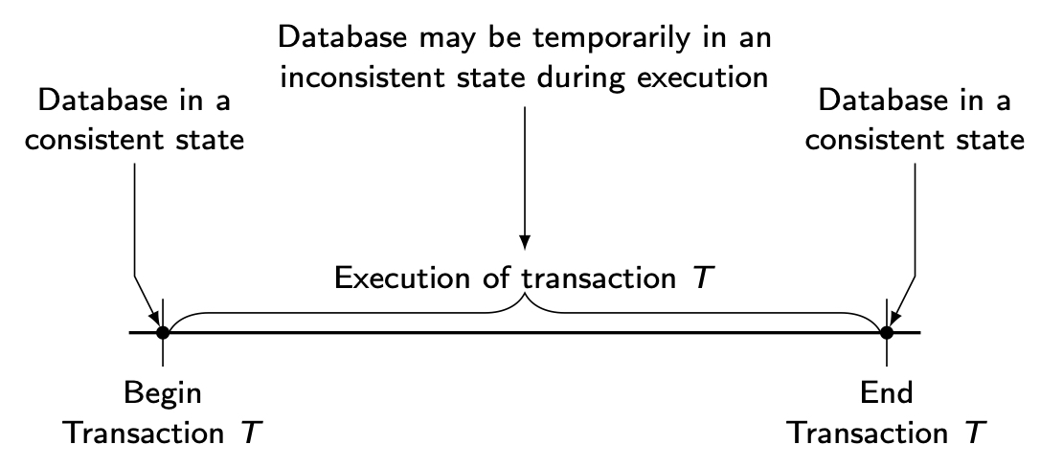
Transaction
A transaction is a collection of actions that make consistent transformations of system states while preserving system consistency.
concurrency transparency
failure transparency

Slide 5
Transaction Characterization
Begin_transaction
…
Read
Read
…
Write
Read
…
Commit
Read set (RS)
The set of data items that are read by a transaction
Write set (WS)
The set of data items whose values are changed by this transaction
Base set (BS)
RS ∪ WS

Slide 6
Principles of Transactions
ATOMICITY
all or nothing
CONSISTENCY
no violation of integrity constraints
ISOLATION
concurrent changes invisible ⇒ serializable
DURABILITY
committed updates persist

Slide 7
Transactions Provide…
Atomic and reliable execution in the presence of failures
Correct execution in the presence of multiple user accesses
Correct management of replicas (if they support it)

Slide 8
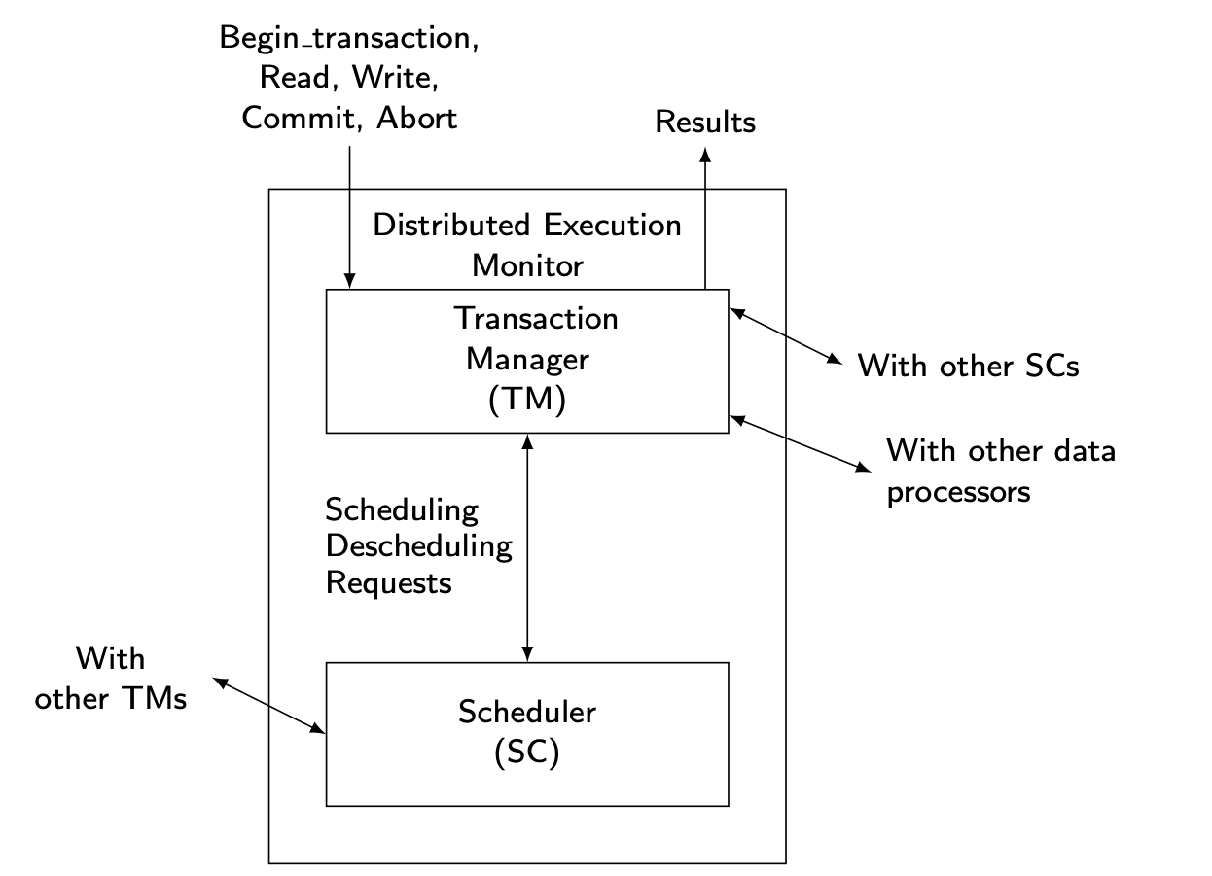
Distributed TM Architecture

Slide 9
Outline
Distributed Transaction Processing
Distributed Concurrency Control
Distributed Reliability

Slide 10
Concurrency Control
The problem of synchronizing concurrent transactions such that the consistency of the database is maintained while, at the same time, maximum degree of concurrency is achieved.
Enforce isolation property
Anomalies:
Lost updates
The effects of some transactions are not reflected on the database.
Inconsistent retrievals
A transaction, if it reads the same data item more than once, should always read the same value.

Slide 11
Serializability in Distributed DBMS
Two histories have to be considered:
local histories
global history
For global transactions (i.e., global history) to be serializable, two conditions are necessary:
Each local history should be serializable → local serializability
Two conflicting operations should be in the same relative order in all of the local histories where they appear together → global serializability

Slide 12
Global Non-serializability
T₁: Read(x) T₂: Read(x)
x ←x-100 Read(y)
Write(x) Commit
Read(y)
y ←y+100
Write(y)
Commit
x stored at Site 1, y stored at Site 2
LH₁, LH₂ are individually serializable (in fact serial), but the two transactions are not globally serializable.
LH₁={R₁(x),W₁(x), R₂(x)}
LH₂={R₂(y), R₁(y),W₁(y)}

Slide 13
Concurrency Control Algorithms
Pessimistic
Two-Phase Locking-based (2PL)
Centralized (primary site) 2PL
Primary copy 2PL
Distributed 2PL
Timestamp Ordering (TO)
Basic TO
Multiversion TO
Conservative TO
Optimistic
Locking-based
Timestamp ordering-based

Slide 14
Locking-Based Algorithms
Transactions indicate their intentions by requesting locks from the scheduler (called lock manager).
Locks are either read lock (rl) [also called shared lock] or write lock (wl) [also called exclusive lock]
Read locks and write locks conflict (because Read and Write operations are incompatible
rl wl
rl yes no
wl no no
Locking works nicely to allow concurrent processing of transactions.

Slide 15
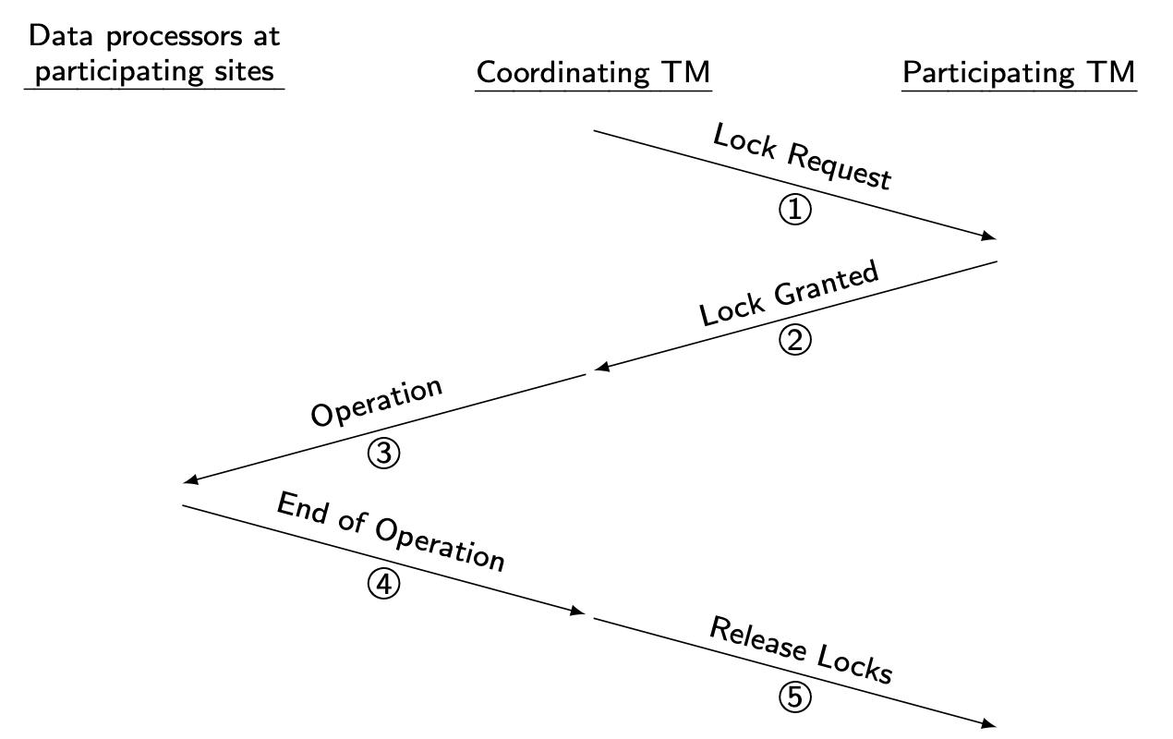
Centralized 2PL
There is only one 2PL scheduler in the distributed system.
Lock requests are issued to the central scheduler.

Slide 16
Distributed 2PL
2PL schedulers are placed at each site. Each scheduler handles lock requests for data at that site.
A transaction may read any of the replicated copies of item x, by obtaining a read lock on one of the copies of x. Writing into x requires obtaining write locks for all copies of x.

Slide 17
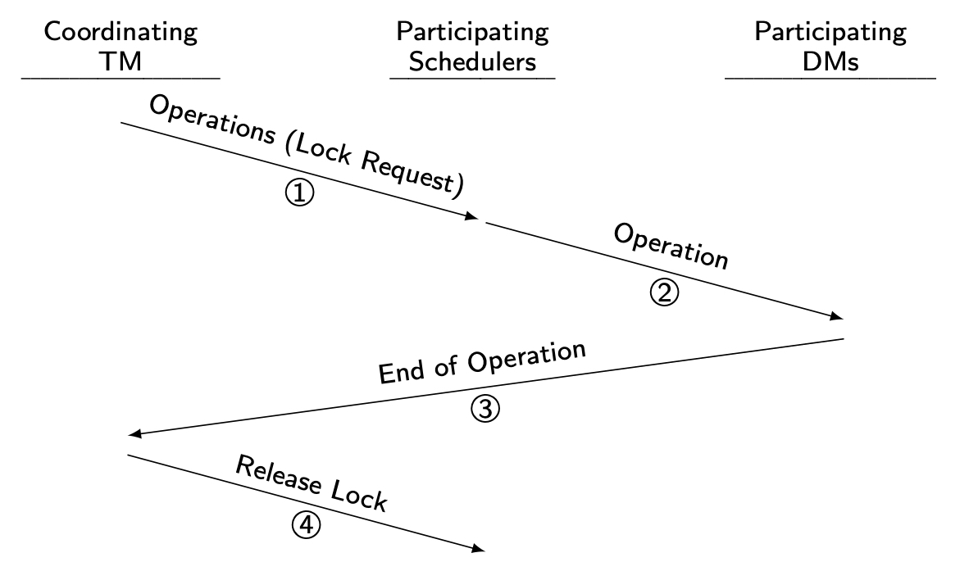
Distributed 2PL Execution

Slide 18
Deadlock
A transaction is deadlocked if it is blocked and will remain blocked until there is intervention.
Locking-based CC algorithms may cause deadlocks.
TO-based algorithms that involve waiting may cause deadlocks.
Wait-for graph
If transaction T_{i} waits for another transaction T_{j} to release a lock on an entity, then T_{i} → T_{j} in WFG.
T_{i}
T_{j}

Slide 19
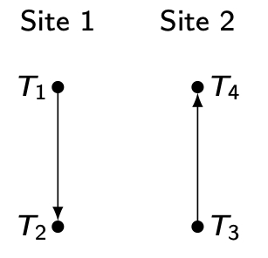
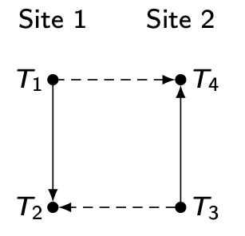
Local versus Global WFG
T₁ and T₂ run at site 1, T₃ and T₄ run at site 2.
T₃ waits for a lock held by T₄ which waits for a lock held by T₁ which waits for a lock held by T₂ which, in turn, waits for a lock held by T₃.
Local WFG
Global WFG

Slide 20
Deadlock Detection
Transactions are allowed to wait freely.
Wait-for graphs and cycles.
Topologies for deadlock detection algorithms
Centralized
Distributed
Hierarchical

Slide 21
Centralized Deadlock Detection
One site is designated as the deadlock detector for the system. Each scheduler periodically sends its local WFG to the central site which merges them to a global WFG to determine cycles.
How often to transmit?
Too often ⇒ higher communication cost but lower delays due to undetected deadlocks
Too late ⇒ higher delays due to deadlocks, but lower communication cost
Would be a reasonable choice if the concurrency control algorithm is also centralized.
Proposed for Distributed INGRES

Slide 22
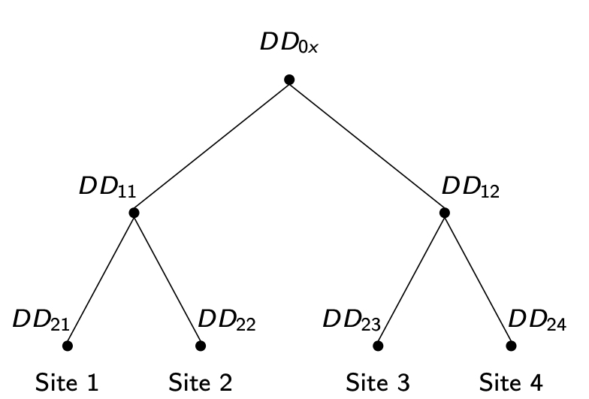
Hierarchical Deadlock Detection
Build a hierarchy of detectors

Slide 23
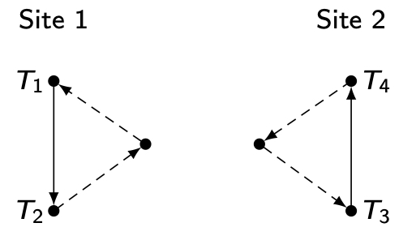
Distributed Deadlock Detection
Sites cooperate in detection of deadlocks.
One example:
Form local WFGs at each modified as follows:
Potential deadlock cycles from other sites are added as edges
Join these with regular edges
Pass these local WFGs to other sites
Each local deadlock detector:
looks for a cycle that does not involve the external edge. If it exists, there is a local deadlock which can be handled locally.
looks for a cycle involving the external edge. If it exists, it indicates a potential global deadlock. Pass on the information to the next site.

Slide 24
Timestamp Ordering
Transaction (T_{i}) is assigned a globally unique timestamp ts(T_{i}).
Transaction manager attaches the timestamp to all operations issued by the transaction.
Each data item is assigned a write timestamp (wts) and a read timestamp (rts):
rts(x) = largest timestamp of any read on x
wts(x) = largest timestamp of any read on x
Conflicting operations are resolved by timestamp order.
Basic T/O:
for R_{i}(x) for W_{i}(x)
if ts(T_{i}) < wts(x) if ts(T_{i}) < rts(x) and ts(T_{i}) < wts(x)
then reject R_{i}(x) then reject W_{i}(x)
else accept R_{i}(x) else accept W_{i}(x)
rts(x) ← ts(T_{i}) wts(x) ← ts(T_{i})

Slide 25
Basic Timestamp Ordering
Two conflicting operations O_{ij} of T_{i} and O_{kl} of T_{k} → O_{ij} executed before O_{kl} iff ts(T_{i}) < ts(T_{k}).
T_{i} is called older transaction
T_{k} is called younger transaction
for R_{i}(x) for W_{i}(x)
if ts(T_{i}) < wts(x) if ts(T_{i}) < rts(x) and ts(T_{i}) < wts(x)
then reject R_{i}(x) then reject W_{i}(x)
else accept R_{i}(x) else accept W_{i}(x)
rts(x) ← ts(T_{i}) wts(x) ← ts(T_{i})

Slide 26
Conservative Timestamp Ordering
Basic timestamp ordering tries to execute an operation as soon as it receives it
progressive
too many restarts since there is no delaying
Conservative timestamping delays each operation until there is an assurance that it will not be restarted
Assurance?
No other operation with a smaller timestamp can arrive at the scheduler
Note that the delay may result in the formation of deadlocks

Slide 27
Multiversion Concurrency Control (MVCC)
Do not modify the values in the database, create new values.
Typically timestamp-based implementation
ts(T_{i}) < ts(x_{r}) < ts(T_{j})
Implemented in a number of systems: IBM DB2, Oracle, SQL Server, SAP HANA, BerkeleyDB, PostgreSQL

Slide 28
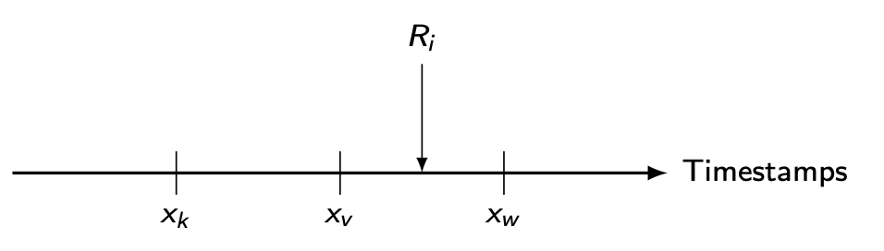
MVCC Reads
A R_{i}(x) is translated into a read on one version of x.
Find a version of x (say x_{v}) such that ts(x_{v}) is the largest timestamp less than ts(T_{i}).

Slide 29
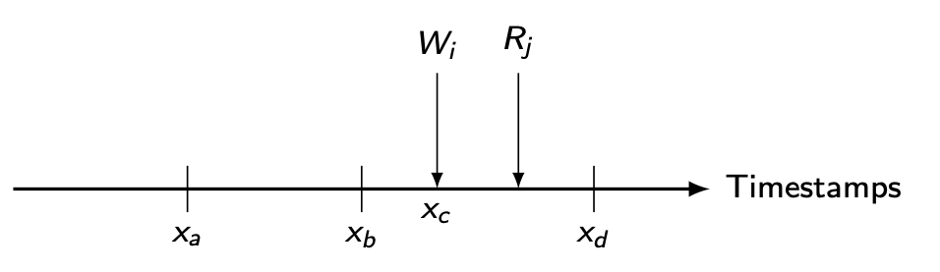
MVCC Writes
A W_{i}(x) is translated into W_{i}(x_{w}) and accepted if the scheduler has not yet processed any R_{j}(x_{r}) such that
ts(T_{i}) < ts(x_{r}) < ts(T_{j})

Slide 30
Optimistic Concurrency Control Algorithms
Pessimistic execution
Validate
Read
Compute
Write
Optimistic execution
Read
Compute
Validate
Write

Slide 31
Optimistic Concurrency Control Algorithms
Transaction execution model: divide into subtransactions each of which execute at a site
T_{ij}: transaction T_{i} that executes at site j
Transactions run independently at each site until they reach the end of their read phases
All subtransactions are assigned a timestamp at the end of their read phase
Validation test performed during validation phase. If one fails, all rejected.

Slide 32
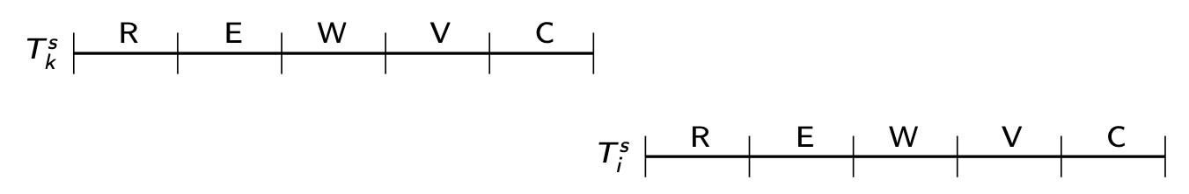
Optimistic CC Validation Test
If all transactions T_{k} where ts(T_{k}) < ts(T_{ij}) have completed their write phase before T_{ij} has started its read phase, then validation succeeds
Transaction executions in serial order

Slide 33
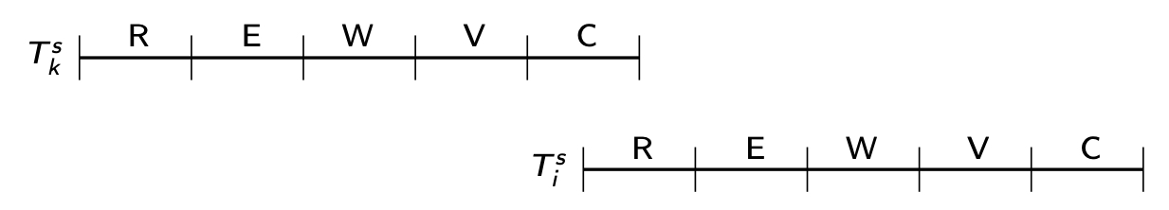
Optimistic CC Validation Test
If there is any transaction T_{k} such that ts(T_{k})<ts(T_{ij}) and which completes its write phase while T_{ij} is in its read phase, then validation succeeds if WS(T_{k}) ∩ RS(T_{ij}) = Ø
Read and write phases overlap, but T_{ij} does not read data items written by T_{k}

Slide 34
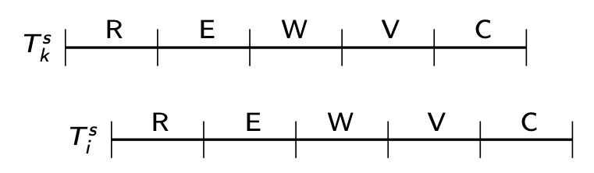
Optimistic CC Validation Test
If there is any transaction T_{k} such that ts(T_{k})< ts(T_{ij}) and which completes its read phase before T_{ij} completes its read phase, then validation succeeds if
WS(T_{k}) ∩ RS(T_{ij}) = Ø and WS(T_{k}) ∩ WS(T_{ij}) = Ø
They overlap, but don't access any common data items.

Slide 35
Snapshot Isolation (SI)
Each transaction “sees” a consistent snapshot of the database when it starts and R/W this snapshot
Repeatable reads, but not serializable isolation
Read-only transactions proceed without significant synchronization overhead
Centralized SI-based CC
T_{i} starts, obtains a begin timestamp ts_{b}(T_{i})
T_{i} ready to commit, obtains a commit timestamp ts_{c}(T_{i}) that is greater than any of the existing ts_{b} or ts_{c}
T_{i} commits if no other T_{j} such that tsc(T_{i}) [ts_{b}(T_{i}), ts_{c}(T_{i})]; otherwise aborted (first committer wins)
When T_{i} commits, changes visible to all T_{k} where ts_{b}(T_{k})> ts_{c}(T_{i})

Slide 36
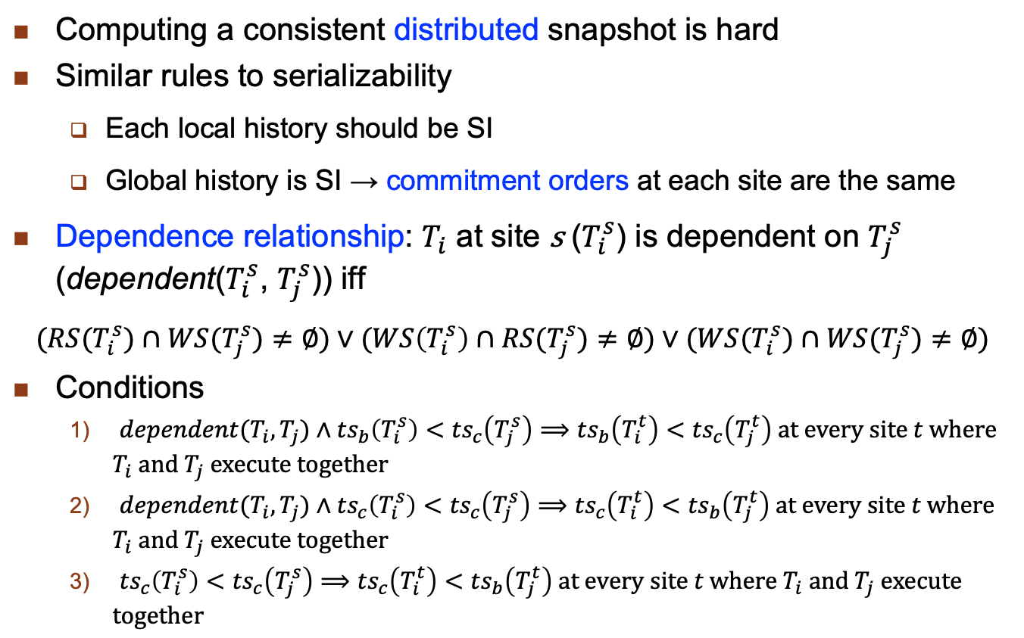
Distributed CC with SI
Computing a consistent distributed snapshot is hard
Similar rules to serializability
Each local history should be SI
Global history is SI → commitment orders at each site are the same
Dependence relationship: $T_{i}$ at site s ($T_{i}^{s}$) is dependent on $T_{j}^{s}$ (dependent($T_{i}^{s}$, $T_{j}^{s}$)) iff
$$(RS(T_{i}^{s})∩WS(T_{j}^{s})≠∅)∨(WS\left(T_{i}^{s}\right)∩RS(T_{j}^{s})≠∅)∨(WS(T_{i}^{s})∩WS(T_{j}^{s})≠∅)$$
Conditions
$dependent(T_{i},T_{j})∧{ts}_{b}\left(T_{i}^{s}\right)<{ts}_{c}\left(T_{j}^{s}\right)⟹{ts}_{b}\left(T_{i}^{t}\right)<{ts}_{c}\left(T_{j}^{t}\right) \text{at} \text{every} \text{site} t \text{where} T_{i} \text{and} T_{j} \text{execute} \text{together}$
$dependent(T_{i},T_{j})∧{ts}_{c}\left(T_{i}^{s}\right)<{ts}_{c}\left(T_{j}^{s}\right)⟹{ts}_{c}\left(T_{i}^{t}\right)<{ts}_{b}\left(T_{j}^{t}\right) \text{at} \text{every} \text{site} t \text{where} T_{i} \text{and} T_{j} \text{execute} \text{together}$
${ts}_{c}\left(T_{i}^{s}\right)<{ts}_{c}\left(T_{j}^{s}\right)⟹{ts}_{c}\left(T_{i}^{t}\right)<{ts}_{b}\left(T_{j}^{t}\right) \text{at} \text{every} \text{site} t \text{where} T_{i} \text{and} T_{j} \text{execute} \text{together}$

Slide 37
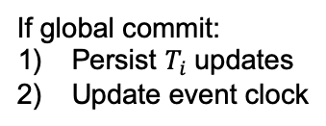

Distributed CC with SI – Executing $T_{i}$
Coordinating TM
Each site s
Asks concurrent transactions,event clock
Local set of concurrent tx
Compiled global concurrent tx set
Check if first 2
Conditions hold
Positive validation/Negative validation
Positive?
Yes
Any neg?
Update event clock:
max(own,coord TM)
Yes, global abort
No
Update event clock:
Max(event clocks of all s)
Global commit,event clock
Wait
If global commit:
Persist $T_{i}$updates
Update event clock

Slide 38
Outline
Distributed Transaction Processing
Distributed Concurrency Control
Distributed Reliability

Slide 39
Reliability
Problem:
How to maintain
atomicity
durability
properties of transactions
Ch.10/39

Slide 40
Types of Failures
Transaction failures
Transaction aborts (unilaterally or due to deadlock)
System (site) failures
Failure of processor, main memory, power supply, …
Main memory contents are lost, but secondary storage contents are safe
Partial vs. total failure
Media failures
Failure of secondary storage devices → stored data is lost
Head crash/controller failure
Communication failures
Lost/undeliverable messages
Network partitioning

Slide 41
Distributed Reliability Protocols
Commit protocols
How to execute commit command for distributed transactions.
Issue: how to ensure atomicity and durability?
Termination protocols
If a failure occurs, how can the remaining operational sites deal with it.
Non-blocking: the occurrence of failures should not force the sites to wait until the failure is repaired to terminate the transaction.
Recovery protocols
When a failure occurs, how do the sites where the failure occurred deal with it.
Independent: a failed site can determine the outcome of a transaction without having to obtain remote information.
Independent recovery ⇒ non-blocking termination

Slide 42
Two-Phase Commit (2PC)
Phase 1 : The coordinator gets the participants ready to write the results into the database
Phase 2 : Everybody writes the results into the database
Coordinator :The process at the site where the transaction originates and which controls the execution
Participant :The process at the other sites that participate in executing the transaction
Global Commit Rule:
The coordinator aborts a transaction if and only if at least one participant votes to abort it.
The coordinator commits a transaction if and only if all of the participants vote to commit it.

Slide 43
State Transitions in 2PC
Coordinator
Participant
COMMIT

Slide 44
Centralized 2PC

Slide 45
2PC Protocol Actions

Slide 46
Linear 2PC
V-C: Vote-Commit, V-A: Vote-Abort, G-C: Global-commit, G-A: Global-abort

Slide 47
Distributed 2PC

Slide 48
Variations of 2PC
To improve performance by
Reduce the number of messages between coordinator & participants
Reduce the number of time logs are written
Presumed Abort 2PC
Participant polls coordinator about transaction’s outcome
No information → abort the transaction
Presumed Commit 2PC
Participant polls coordinator about transaction’s outcome
No information → assume transaction is committed
Not an exact dual of presumed abort 2PC

Slide 49
Site Failures - 2PC Termination
Coordinator
Timeout in INITIAL
Who cares
Timeout in WAIT
Cannot unilaterally commit
Can unilaterally abort
Timeout in ABORT or COMMIT
Stay blocked and wait for the acks

Slide 50
Site Failures - 2PC Termination
Participant
Timeout in INITIAL
Coordinator must have failed in INITIAL state
Unilaterally abort
Timeout in READY
Stay blocked

Slide 51
Site Failures - 2PC Recovery
Coordinator
Failure in INITIAL
Start the commit process upon recovery
Failure in WAIT
Restart the commit process upon recovery
Failure in ABORT or COMMIT
Nothing special if all the acks have been received
Otherwise the termination protocol is involved

Slide 52
Site Failures - 2PC Recovery
Participant
Failure in INITIAL
Unilaterally abort upon recovery
Failure in READY
The coordinator has been informed about the local decision
Treat as timeout in READY state and invoke the termination protocol
Failure in ABORT or COMMIT
Nothing special needs to be done

Slide 53
2PC Recovery Protocols – Additional Cases
Arise due to non-atomicity of log and message send actions
Coordinator site fails after writing “begin_commit” log and before sending “prepare” command
treat it as a failure in WAIT state; send “prepare” command
Participant site fails after writing “ready” record in log but before “vote-commit” is sent
treat it as failure in READY state
alternatively, can send “vote-commit” upon recovery
Participant site fails after writing “abort” record in log but before “vote-abort” is sent
no need to do anything upon recovery

Slide 54
2PC Recovery Protocols – Additional Case
Coordinator site fails after logging its final decision record but before sending its decision to the participants
coordinator treats it as a failure in COMMIT or ABORT state
participants treat it as timeout in the READY state
Participant site fails after writing “abort” or “commit” record in log but before acknowledgement is sent
participant treats it as failure in COMMIT or ABORT state
coordinator will handle it by timeout in COMMIT or ABORT state

Slide 55
Problem With 2PC
Blocking
Ready implies that the participant waits for the coordinator
If coordinator fails, site is blocked until recovery
Blocking reduces availability
Independent recovery is not possible
However, it is known that:
Independent recovery protocols exist only for single site failures; no independent recovery protocol exists which is resilient to multiple-site failures.
So we search for these protocols – 3PC

Slide 56
Three-Phase Commit
3PC is non-blocking.
A commit protocols is non-blocking iff
it is synchronous within one state transition, and
its state transition diagram contains
no state which is “adjacent” to both a commit and an abort state, and
no non-committable state which is “adjacent” to a commit state
Adjacent: possible to go from one stat to another with a single state transition
Committable: all sites have voted to commit a transaction
e.g.: COMMIT state

Slide 57
State Transitions in 3PC
Coordinator
Participant

Slide 58
3PC Protocol Actions

Slide 59
Network Partitioning
Simple partitioning
Only two partitions
Multiple partitioning
More than two partitions
Formal bounds:
There exists no non-blocking protocol that is resilient to a network partition if messages are lost when partition occurs.
There exist non-blocking protocols which are resilient to a single network partition if all undeliverable messages are returned to sender.
There exists no non-blocking protocol which is resilient to a multiple partition.

Slide 60
Independent Recovery Protocols for Network Partitioning
No general solution possible
allow one group to terminate while the other is blocked
improve availability
How to determine which group to proceed?
The group with a majority
How does a group know if it has majority?
Centralized
Whichever partitions contains the central site should terminate the transaction
Voting-based (quorum)

Slide 61
Quorum Protocols
The network partitioning problem is handled by the commit protocol.
Every site is assigned a vote V_{i}.
Total number of votes in the system V
Abort quorum V_{a}, commit quorum V_{c}
V_{a} + V_{c} > V where 0 ≤ V_{a} , V_{c} ≤ V
Before a transaction commits, it must obtain a commit quorum V_{c}
Before a transaction aborts, it must obtain an abort quorum V_{a}

Slide 62
Paxos Consensus Protocol
General problem: how to reach an agreement (consensus) among TMs about the fate of a transaction
2PC and 3PC are special cases
General idea: If a majority reaches a decision, the global decision is reached (like voting)
Roles:
Proposer: recommends a decision
Acceptor: decides whether to accept the proposed decision
Learner: discovers the agreed-upon decision by asking or it is pushed

Slide 63
Paxos & Complications
Naïve Paxos: one proposer
Operates like a 2PC
Complications
Multiple proposers can exist at the same time; acceptor has to choose
Attach a ballot number
Multiple proposals may result in split votes with no majority
Run multiple consensus rounds → performance implication
Choose a leader
Some accepts fail after they accept a decision; the remaining acceptors may not constitute majority
Use ballot numbers

Slide 64
Basic Paxos – No Failures
Proposer (or Leader)
Acceptor
prepare(bal)
Any previous prop?
Ack
No
Record
prepare(bal)
Record Ack
Yes
Ack(bal’,val’)
bal > any bal received?
Yes
Ack from majority?
Record
prepare(bal)
Yes, (nbal,val)
No
Ignore and
Wait
if all are Ack (not with bal’,val’)
then val ← proposer wants &
nbal ← bal
else val ← val’ & nbal ← bal
nbal = ack.bal?
No
Ignore
Yes
Record
accepted(nbal,val)

Slide 65
Basic Paxos with Failures
Some acceptors fail but there is quorum
Not a problem
Enough acceptors fail to eliminate quorum
Run a new ballot
Proposer/leader fails
Choose a new leader and start a new ballot

