Slide 1
Principles of Distributed Database Systems
M. Tamer Özsu
Patrick Valduriez

Slide 2
Outline
Introduction
Distributed and Parallel Database Design
Distributed Data Control
Distributed Query Processing
Distributed Transaction Processing
Data Replication
Database Integration – Multidatabase Systems
Parallel Database Systems
Peer-to-Peer Data Management
Big Data Processing
NoSQL, NewSQL and Polystores
Web Data Management

Slide 3
Outline
Database Integration – Multidatabase Systems
Schema Matching
Schema Integration
Schema Mapping
Query Rewriting
Optimization Issues

Slide 4
Problem Definition
Given existing databases with their Local Conceptual Schemas (LCSs), how to integrate the LCSs into a Global Conceptual Schema (GCS)
GCS is also called mediated schema
Bottom-up design process

Slide 5
Integration Alternatives
Physical integration
Source databases integrated and the integrated database is materialized
Data warehouses
Logical integration
Global conceptual schema is virtual and not materialized
Enterprise Information Integration (EII)

Slide 6
Data Warehouse Approach

Slide 7
Bottom-up Design
GCS (also called mediated schema) is defined first
Map LCSs to this schema
As in data warehouses
GCS is defined as an integration of parts of LCSs
Generate GCS and map LCSs to this GCS

Slide 8
GCS/LCS Relationship
Local-as-view
The GCS definition is assumed to exist, and each LCS is treated as a view definition over it
Global-as-view
The GCS is defined as a set of views over the LCSs

Slide 9
Database Integration Process

Slide 10
Database Integration Issues – Schema Translation
Component database schemas translated to a common intermediate canonical representation
What is the canonical data model?
Relational
Entity-relationship
DIKE
Object-oriented
ARTEMIS
Graph-oriented
DIPE, TranScm, COMA, Cupid
Translation algorithms
These are well-known

Slide 11
Database Integration Issues – Schema Generation
Intermediate schemas are used to create a global conceptual schema
Schema matching
Finding the correspondences between multiple schemas
Schema integration
Creation of the GCS (or mediated schema) using the correspondences
Schema mapping
How to map data from local databases to the GCS
Important: sometimes the GCS is defined first, and schema matching and schema mapping is done against this target GCS

Slide 12
Outline
Database Integration – Multidatabase Systems
Schema Matching
Schema Integration
Schema Mapping
Query Rewriting
Optimization Issues

Slide 13
Running Example
Relational
E-R Model
EMP(ENO, ENAME, TITLE)
PROJ(PNO, PNAME, BUDGET, LOC, CNAME)
ASG(ENO, PNO, RESP, DUR)
PAY(TITLE, SAL)

Slide 14
Schema Matching
Schema heterogeneity
Structural heterogeneity
Type conflicts
Dependency conflicts
Key conflicts
Behavioral conflicts
Semantic heterogeneity
More important and harder to deal with
Synonyms, homonyms, hypernyms
Different ontology
Imprecise wording

Slide 15
Schema Matching (cont’d)
Other complications
Insufficient schema and instance information
Unavailability of schema documentation
Subjectivity of matching
Issues that affect schema matching
Schema versus instance matching
Element versus structure level matching
Matching cardinality

Slide 16
Schema Matching Approaches

Slide 17
Linguistic Schema Matching
Use element names and other textual information (textual descriptions, annotations)
May use external sources (e.g., Thesauri)
〈SC1.element-1 ≈ SC2.element-2, p,s〉
Element-1 in schema SC1 is similar to element-2 in schema SC2 if predicate p holds with a similarity value of s
Schema level
Deal with names of schema elements
Handle cases such as synonyms, homonyms, hypernyms, data type similarities
Instance level
Focus on information retrieval techniques (e.g., word frequencies, key terms)
“Deduce” similarities from these

Slide 18
Linguistic Matchers
Use a set of linguistic (terminological) rules
Basic rules can be hand-crafted or may be discovered from outside sources (e.g., WordNet)
Predicate p and similarity value s
hand-crafted ⇒ specified,
discovered ⇒ may be computed or specified by an expert after discovery
Examples
〈uppercase names ≈ lower case names, true, 1.0〉
〈uppercase names ≈ capitalized names, true, 1.0〉
〈capitalized names ≈ lower case names, true, 1.0〉
〈DB1.ASG ≈ DB2.WORKS_IN, true, 0.8〉

Slide 19
Automatic Discovery of Name Similarities
Affixes
Common prefixes and suffixes between two element name strings
N-grams
Comparing how many substrings of length n are common between the two name strings
Edit distance
Number of character modifications (additions, deletions, insertions) that needs to be performed to convert one string into the other
Soundex code
Phonetic similarity between names based on their soundex codes
Also look at data types
Data type similarity may suggest stronger relationship than the computed similarity using these methods or to differentiate between multiple strings with same value

Slide 20
N-gram Example
3-grams of string “Responsibility” are the following:
Res  sib
ibi  esp
bip  spo
ili  pon
lit  ons
ity  nsi
3-grams of string “Resp” are
Res
esp
3-gram similarity: 2/12 = 0.17

Slide 21
Edit Distance Example
Again consider “Responsibility” and “Resp”
To convert “Responsibility” to “Resp”
Delete characters “o”, “n”, “s”, “i”, “b”, “i”, “l”, “i”, “t”, “y”
To convert “Resp” to “Responsibility”
Add characters “o”, “n”, “s”, “i”, “b”, “i”, “l”, “i”, “t”, “y”
The number of edit operations required is 10
Similarity is 1 − (10/14) = 0.29

Slide 22
Constraint-based Matchers
Data always have constraints – use them
Data type information
Value ranges
…
Examples
RESP and RESPONSIBILITY: n-gram similarity = 0.17, edit distance similarity = 0.19 (low)
If they come from the same domain, this may increase their similarity value
ENO in relational, WORKER.NUMBER and PROJECT.NUMBER in E-R
ENO and WORKER.NUMBER may have type INTEGER while PROJECT.NUMBER may have STRING

Slide 23
Constraint-based Structural Matching
If two schema elements are structurally similar, then there is a higher likelihood that they represent the same concept
Structural similarity:
Same properties (attributes)
“Neighborhood” similarity
Using graph representation
The set of nodes that can be reached within a particular path length from a node are the neighbors of that node
If two concepts (nodes) have similar set of neighbors, they are likely to represent the same concept

Slide 24
Learning-based Schema Matching
Use machine learning techniques to determine schema matches
Classification problem: classify concepts from various schemas into classes according to their similarity. Those that fall into the same class represent similar concepts
Similarity is defined according to features of data instances
Classification is “learned” from a training set

Slide 25
Learning-based Schema Matching

Slide 26
Combined Schema Matching Approaches
Use multiple matchers
Each matcher focuses on one area (name, etc)
Meta-matcher integrates these into one prediction
Integration may be simple (take average of similarity values) or more complex (see Fagin’s work)

Slide 27
Outline
Database Integration – Multidatabase Systems
Schema Matching
Schema Integration
Schema Mapping
Query Rewriting
Optimization Issues

Slide 28
Schema Integration
Use the correspondences to create a GCS
Mainly a manual process, although rules can help

Slide 29
Binary Integration Methods
Stepwise
Pure binary

Slide 30
N-ary Integration Methods
One-pass
Iterative

Slide 31
Outline
Database Integration – Multidatabase Systems
Schema Matching
Schema Integration
Schema Mapping
Query Rewriting
Optimization Issues

Slide 32
Schema Mapping
Mapping data from each local database (source) to GCS (target) while preserving semantic consistency as defined in both source and target.
Data warehouses ⇒ actual translation
Data integration systems ⇒ discover mappings that can be used in the query processing phase
Mapping creation
Mapping maintenance

Slide 33
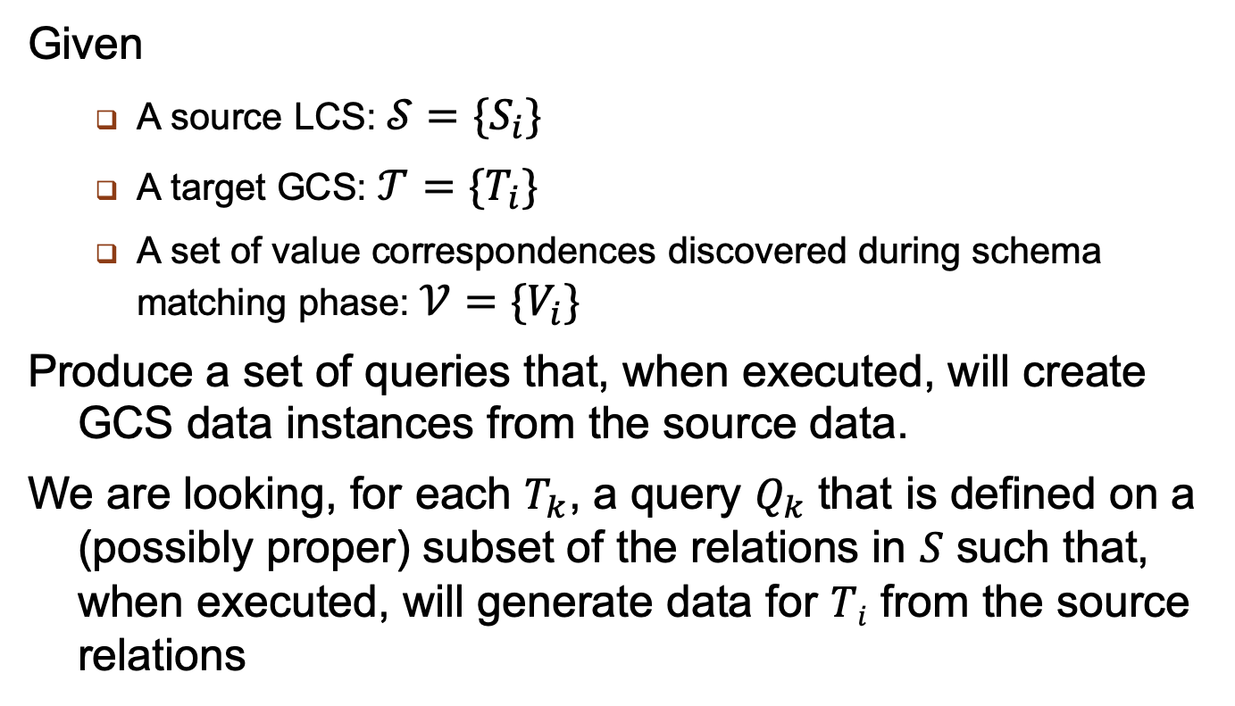
Mapping Creation
Given
A source LCS: $𝒮=\{S_{i}\}$
A target GCS: $𝒯=\{T_{i}\}$
A set of value correspondences discovered during schema matching phase: $𝒱=\{V_{i}\}$
Produce a set of queries that, when executed, will create GCS data instances from the source data.
We are looking, for each $T_{k}$, a query $Q_{k}$ that is defined on a (possibly proper) subset of the relations in $S$ such that, when executed, will generate data for $Ti$ from the source relations

Slide 34
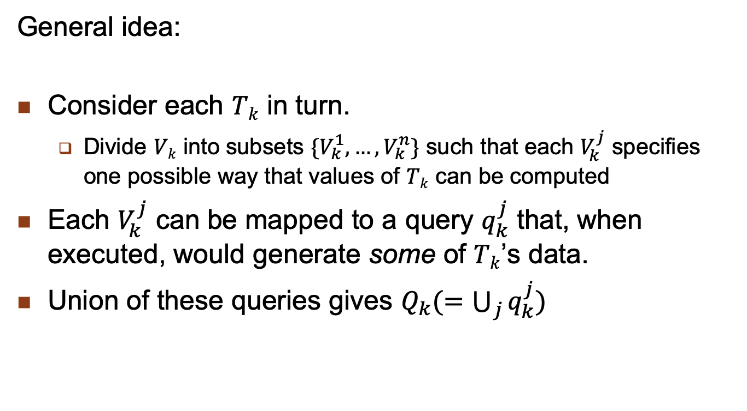
Mapping Creation Algorithm
General idea:
Consider each $Tk$ in turn.
Divide $Vk$ into subsets $\{V_{k}^{1}, …, V_{k}^{n}\}$ such that each $V_{k}^{j}$ specifies one possible way that values of $Tk$ can be computed
Each $V_{k}^{j}$ can be mapped to a query $q_{k}^{j}$ that, when executed, would generate some of $Tk$’s data.
Union of these queries gives $Q_{k}(=\bigcup_{j}{q_{k}^{j})}$

Slide 35
Outline
Database Integration – Multidatabase Systems
Schema Matching
Schema Integration
Schema Mapping
Query Rewriting
Optimization Issues

Slide 36
Multidatabase Query Processing
Mediator/wrapper architecture
MDB query processing architecture
Query rewriting using views
Query optimization and execution
Query translation and execution

Slide 37
Recall Mediator/Wrapper Architecture
Result
Integration
Query
Processing
Global view
Local
Schema
Local
Schema
Local
Schema

Slide 38
Issues in MDB Query Processing
Component DBMSs are autonomous and may range from full-fledge relational DBMS to flat file systems
Different computing capabilities
Prevents uniform treatment of queries across DBMSs
Different processing cost and optimization capabilities
Makes cost modeling difficult
Different data models and query languages
Makes query translation and result integration difficult
Different runtime performance and unpredictable behavior
Makes query execution difficult

Slide 39
Component DBMS Autonomy
Communication autonomy
The ability to terminate services at any time
How to answer queries completely?
Design autonomy
The ability to restrict the availability and accuracy of information needed for query optimization
How to obtain cost information?
Execution autonomy
The ability to execute queries in unpredictable ways
How to adapt to this?

Slide 40
MDB Query Processing Architecture
Global/local correspondences
Allocation and capabilities
Local/DBMS
mappings

Slide 41
Query Rewriting Using Views
Views used to describe the correspondences between global and local relations
Global As View: the global schema is integrated from the local databases and each global relation is a view over the local relations
Local As View: the global schema is defined independently of the local databases and each local relation is a view over the global relations
Query rewriting best done with Datalog, a logic-based language
More expressive power than relational calculus
Inline version of relational domain calculus

Slide 42
Datalog Terminology
Conjunctive (SPJ) query: a rule of the form
Q(T) :- R₁(T₁), … R_{n}(T_{n})
Q(T) : head of the query denoting the result relation
R₁(T₁), … R_{n}(T_{n}): subgoals in the body of the query
R₁, … R_{n}: predicate names corresponding to relation names
T₁, … T_{n}: refer to tuples with variables and constants
Variables correspond to attributes (as in domain calculus)
“-” means unnamed variable
Disjunctive query = n conjunctive queries with same head predicate

Slide 43
Datalog Example
EMP(E#,ENAME,TITLE,CITY) WORKS(E#,P#,RESP,DUR)
SELECT E#, TITLE, P#
FROM EMP NATURAL JOIN WORKS
WHERE TITLE = "Programmer" OR DUR=24
Q(E#,TITLE,P#) :- EMP(E#,ENAME,"Programmer",CITY),
WORKS(E#,P#,RESP,DUR).
Q(E#,TITLE,P#) :- EMP(E#,ENAME,TITLE,CITY),
WORKS(E#,P#,RESP,24).

Slide 44
Rewriting in GAV
Global schema similar to that of homogeneous distributed DBMS
Local relations can be fragments
But no completeness: a tuple in the global relation may not exist in local relations
Yields incomplete answers
And no disjointness: the same tuple may exist in different local databases
Yields duplicate answers
Rewriting (unfolding)
Similar to query modification
Apply view definition rules to the query and produce a union of conjunctive queries, one per rule application
Eliminate redundant queries

Slide 45
GAV Example Schema
Global relations
EMP(E#,ENAME,CITY)
WORKS(E#,P#,TITLE,DUR)
Local relations
EMP1(E#,ENAME,TITLE,CITY)
EMP2(E#,ENAME,TITLE,CITY)
WORKS(E#,P#,DUR)
EMP(E#,ENAME,CITY):- EMP1(E#,ENAME,TITLE,CITY). (d₁)
EMP(E#,ENAME,CITY):- EMP2(E#,ENAME,TITLE,CITY). (d₂)
WORKS(E#,P#,TITLE,DUR):- EMP1(E#,ENAME,TITLE,CITY), WORKS(E#,P#,DUR). (d₃)
WORKS(E#,P#,TITLE,DUR):- EMP2(E#,ENAME,TITLE,CITY), WORKS(E#,P#,DUR). (d₄)

Slide 46
GAV Example Query
Let Q: project for employees in Paris
Q(e,p) :- EMP(e,ENAME,"Paris"),WORKS(e,p,TITLE,DUR).
Unfolding produces Q′
Q′(e,p) :- EMP1(e,ENAME,"Paris"),
WORKS(e,p,TITLE,DUR). (q₁)
Q′(e,p):- EMP2(e,ENAME,"Paris"),
WORKS(e,p,TITLE,DUR). (q₂)
where
q₁ is obtained by applying d₃ only or both d₁ and d₃
In the latter case, there are redundant queries
same for q₂ with d₂ only or both d₂ and d₄

Slide 47
Rewriting in LAV
More difficult than in GAV
No direct correspondence between the terms in GS (EMP, ENAME) and those in the views (EMP1, EMP2, ENAME)
There may be many more views than global relations
Views may contain complex predicates to reflect the content of the local relations
e.g. a view EMP3 for only programmers
Often not possible to find an equivalent rewriting
Best is to find a maximally-contained query which produces a maximum subset of the answer
e.g. EMP3 can only return a subset of the employees

Slide 48
Rewriting Algorithms
The problem to find an equivalent query is NP-complete in the number of views and number of subgoals of the query
Thus, algorithms try to reduce the numbers of rewritings to be considered
Three main algorithms
Bucket
Inverse rule
MiniCon

Slide 49
LAV Example Schema
Local relations
EMP1(E#,ENAME,TITLE,CITY)
EMP2(E#,ENAME,TITLE,CITY)
WORKS1(E#,P#,DUR)
Global relations
EMP(E#,ENAME,CITY)
WORKS(E#,P#,TITLE,DUR)
EMP1(E#,ENAME,TITLE,CITY):- EMP(E#,ENAME,CITY) (d₅)
WORKS(E#,P#,TITLE,DUR).
EMP1(E#,ENAME,TITLE,CITY):- EMP(E#,ENAME,CITY) (d₆) WORKS(E#,P#,TITLE,DUR).
WORKS(E#,P#,DUR):- WORKS(E#,P#,TITLE,DUR). (d₇)

Slide 50
Bucket Algorithm
Considers each predicate of the query Q independently to select only the relevant views
Step 1
Build a bucket b for each subgoal q of Q that is not a comparison predicate
Insert in b the heads of the views which are relevant to answer q
Step 2
For each view V of the Cartesian product of the buckets, produce a conjunctive query
If it is contained in Q, keep it
The rewritten query is a union of conjunctive queries

Slide 51
LAV Example Query
Q(e,p) :- EMP(e,ENAME,"Paris"), WORKS(e,p,TITLE,DUR).
Step1: we obtain 2 buckets (one for each subgoal of Q)
b₁ = {EMP1(E#,ENAME,TITLE′,CITY),
EMP2(E#,ENAME,TITLE′,CITY)}
b₂ = {WORKS1(E#,P#,DUR′)}
(the prime variables (TITLE’ and DUR’) are not useful)
Step2: produces
Q′(e,p) :- EMP1(e,ENAME,TITLE,"Paris"),
WORKS1(e,p,DUR). (q₁)
Q′(e,p) :- EMP2(e,ENAME,TITLE,"Paris"),
WORKS1(e,p,DUR). (q₂)

Slide 52
Outline
Database Integration – Multidatabase Systems
Schema Matching
Schema Integration
Schema Mapping
Query Rewriting
Optimization Issues

Slide 53
Query Optimization and Execution
Takes a query expressed on local relations and produces a distributed QEP to be executed by the wrappers and mediator
Three main problems
Heterogeneous cost modeling
To produce a global cost model from component DBMS
Heterogeneous query optimization
To deal with different query computing capabilities
Adaptive query processing
To deal with strong variations in the execution environment

Slide 54
Heterogeneous Cost Modeling
Goal: determine the cost of executing the subqueries at component DBMS
Three approaches
Black-box: treats each component DBMS as a black-box and determines costs by running test queries
Customized: customizes an initial cost model
Dynamic: monitors the run-time behavior of the component DBMS and dynamically collect cost information

Slide 55
Black-box Approach
Define a logical cost expression
Cost = init cost + cost to find qualifying tuples
+ cost to process selected tuples
The terms will differ much with different DBMS
Run probing queries on component DBMS to compute cost coefficients
Count the numbers of tuples, measure cost, etc.
Special case: sample queries for each class of important queries
Use of classification to identify the classes
Problems
The instantiated cost model (by probing or sampling) may change over time
The logical cost function may not capture important details of component DBMS

Slide 56
Customized Approach
Relies on the wrapper (i.e. developer) to provide cost information to the mediator
Two solutions
Wrapper provides the logic to compute cost estimates
Access_cost = reset + (card-1)*advance
reset = time to initiate the query and receive a first tuple
advance = time to get the next tuple (advance)
card = result cardinality
Hierarchical cost model
Each node associates a query pattern with a cost function
The wrapper developer can give cost information at various levels of details, depending on knowledge of the component DBMS

Slide 57
Hierarchical Cost Model

Slide 58
Dynamic Approach
Deals with execution environment factors which may change
Frequently: load, throughput, network contention, etc.
Slowly: physical data organization, DB schemas, etc.
Two main solutions
Extend the sampling method to consider some new queries as samples and correct the cost model on a regular basis
Use adaptive query processing which computes cost during query execution to make optimization decisions

Slide 59
Heterogeneous Query Optimization
Deals with heterogeneous capabilities of component DBMS
One DBMS may support complex SQL queries while another only simple select on one fixed attribute
Two approaches, depending on the M/W interface level
Query-based
All wrappers support the same query-based interface (e.g. ODBC or SQL/MED) so they appear homogeneous to the mediator
Capabilities not provided by the DBMS must be supported by the wrappers
Operator-based
Wrappers export capabilities as compositions of operators
Specific capabilities are available to mediator
More flexibility in defining the level of M/W interface

Slide 60
Query-based Approach
We can use 2-step query optimization with a heterogeneous cost model
But centralized query optimizers produce left-linear join trees whereas in MDB, we want to push as much processing in the wrappers, i.e. exploit bushy trees
Solution: convert a left-linear join tree into a bushy tree such that
The initial total cost of the QEP is maintained
The response time is improved
Algorithm
Iterative improvement of the initial left-linear tree by moving down subtrees while response time is improved

Slide 61
Operator-based Approach
M/W communication in terms of subplans
Use of planning functions (Garlic)
Extension of cost-based centralized optimizer with new operators
Create temporary relations
Retrieve locally stored data
Push down operators in wrappers
accessPlan and joinPlan rules
Operator nodes annotated with
Location of operands, materialization, etc.

Slide 62
Planning Functions Example
Consider 3 component databases with 2 wrappers:
w₁.db₁: EMP(ENO,ENAME,CITY)
w₁.db₂: ASG(ENO,PNAME,DUR)
w₂.db₃: EMPASG(ENAME,CITY,PNAME,DUR)
Planning functions of w₁
accessPlan(R: rel, A: attlist, P: pred) = scan(R, A, P, db(R))
joinPlan(R₁, R₂: rel, A: attlist, P: joinpred) = join(R₁, R₂, A, P)
condition: db(R₁) ≠ db(R₂)
implemented by w₁
Planning functions of w₂
accessPlan(R: rel, A: attlist, P: pred) = fetch(city=c)
condition: (city=c) included in P
accessPlan(R: rel, A: attlist, P: pred) = scan(R, A, P, db(R))
implemented by w₂

Slide 63
Heterogenous QEP
SELECT ENAME,PNAME,DUR
FROM EMPASG
WHERE CITY = "Paris" AND DUR>24

Slide 64
Query Translation and Execution
Performed by wrappers using the component DBMS
Conversion between common interface of mediator and DBMS-dependent interface
Query translation from wrapper to DBMS
Result format translation from DBMS to wrapper
Wrapper has the local schema exported to the mediator (in common interface) and the mapping to the DBMS schema
Common interface can be query-based (e.g. ODBC or SQL/MED) or operator-based
In addition, wrappers can implement operators not supported by the component DBMS, e.g. join

Slide 65
Wrapper Placement
Depends on the level of autonomy of component DB
Cooperative DB
May place wrapper at component DBMS site
Efficient wrapper-DBMS com.
Uncooperative DB
May place wrapper at mediator
Efficient mediator-wrapper com.
Impact on cost functions

Slide 66
SQL Wrapper for Text Files
Consider EMP (ENO, ENAME, CITY) stored in a Unix text file in componentDB
Each EMP tuple is a line in the file, with attributes separated by “:”
SQL/MED definition of EMP
CREATE FOREIGN TABLE EMP
ENO INTEGER, ENAME VARCHAR(30), CITY CHAR(30)
SERVER componentDB
OPTIONS(Filename ‘/usr/EngDB/emp.txt’, Delimiter ‘:’)
The query
SELECT ENAME FROM EMP
Can be translated by the wrapper using a Unix shell command
cut –d: -f2/ usr/EngDB/emp

Slide 67
Wrapper Management Issues
Wrappers mostly used for read-only queries
Makes query translation and wrapper construction easy
DBMS vendors provide standard wrappers
ODBC, JDBC, ADO, etc.
Updating makes wrapper construction harder
Problem: heterogeneity of integrity constraints
Implicit in some legacy DB
Solution: reverse engineering of legacy DB to identify implicit constraints and translate in validation code in the wrapper
Wrapper maintenance
schema mappings can become invalid as a result of changes in component DB schemas
Use detection and correction, using mapping maintenance techniques

