Slide 1
Principles of Distributed Database Systems
M. Tamer Özsu
Patrick Valduriez

Slide 2
Outline
Introduction
Distributed and Parallel Database Design
Distributed Data Control
Distributed Query Processing
Distributed Transaction Processing
Data Replication
Database Integration – Multidatabase Systems
Parallel Database Systems
Peer-to-Peer Data Management
Big Data Processing
NoSQL, NewSQL and Polystores
Web Data Management

Slide 3
Outline
Parallel Database Systems
Parallel Architectures
Data Placement
Query Processing
Load Balancing and Fault-tolerance
Database Clusters

Slide 4
Objectives of Parallel Systems
High-performance using parallelism
High throughput for OLTP loads
Lots of short transactions, which update a few data
Low response time for OLAP queries
Large queries, which read lots of data
High availability and reliability through data replication and failover
Extensibility and scalability by adding ressources
Processors, memory, disk, network

Slide 5
Extensibility
Ideal: linear speed-up
Linear increase of performance by growing the components
For a fixed database size and load

Slide 6
Speed-up Limits
Hardware/software
As we add more resources, arbitration conflicts increase
E.g. Access to the bus by processors
Application
Only part of a program can be parallelized
Recall: Amdahl's law that gives the maximum speed-up
Seq = fraction of code that cannot be parallelized
Examples
Seq=0, NbProc=4 => speed-up= 4
Seq=30%, NbProc=4 => speed-up= 2,1
Seq=30%, NbProc=8 => speed-up= 2,5
1
Seq +
1 - Seq
NbProc
Notes:
Seq: fraction (pourcentage) de la partie séquentielle

Slide 7
Scalability
Ideal: linear scale-up
Sustained performance for a linear increase of database size and load
By proportional increase of components

Slide 8
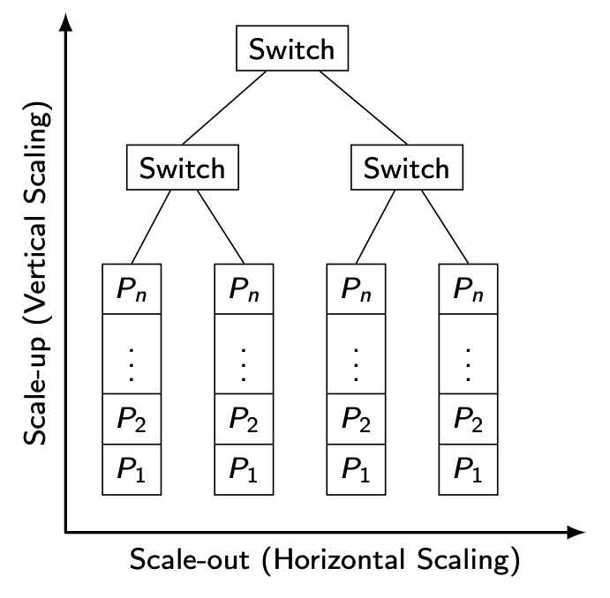
Vertical vs Horizontal Scaleup
Typically in a computer cluster
Notes:
Avec l'arrivée des clusters (ensemble de machines interconnectées pour former une seule machine)

Slide 9
Data-based Parallelism
Inter-query
Different queries on the same data
For concurrent queries
Inter-operation
Different operations of the same query on different data
For complex queries
Intra-operation
The same operation on different data
For large queries
Q₁
…
Q_{n}
R
Op₃
Op₁
Op₂
R
S
Op
…
Op
R₁
R_{n}

Slide 10
Barriers to Parallelism
Startup
The time needed to start a parallel operation may dominate the actual computation time
Interference
When accessing shared resources, each new process slows down the others (hot spot problem)
Skew
The response time of a set of parallel processes is the time of the slowest one
Parallel data management techniques intend to overcome these barriers

Slide 11
Outline
Parallel Database Systems
Parallel Architectures
Data Placement
Query Processing
Load Balancing and Fault-tolerance
Database Clusters

Slide 12
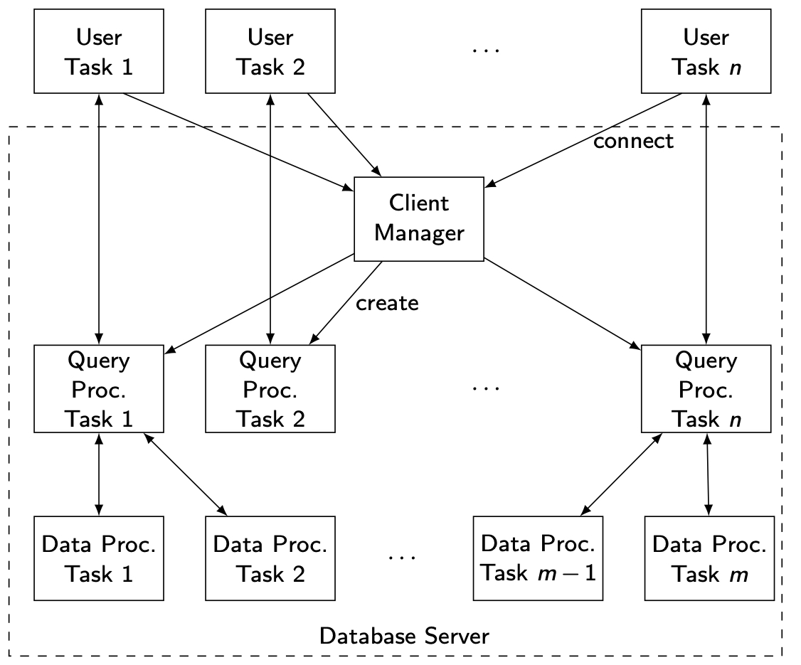
Parallel DBMS – general architecture

Slide 13
Parallel DBMS Functions
Client manager
Support for client interactions and user sessions
Load balancing
Query processor
Compilation and optimization
Catalog and metadata management
Semantic data control
Execution control
Data processor
Execution of DB operations
Transaction management
Data management

Slide 14
Parallel System Architectures
Shared memory (SM)
Uniform Memory Architecture (UMA)
Non-Uniform Memory Architecture (NUMA)
Shared disk (SD)
Shared nothing (SN)

Slide 15
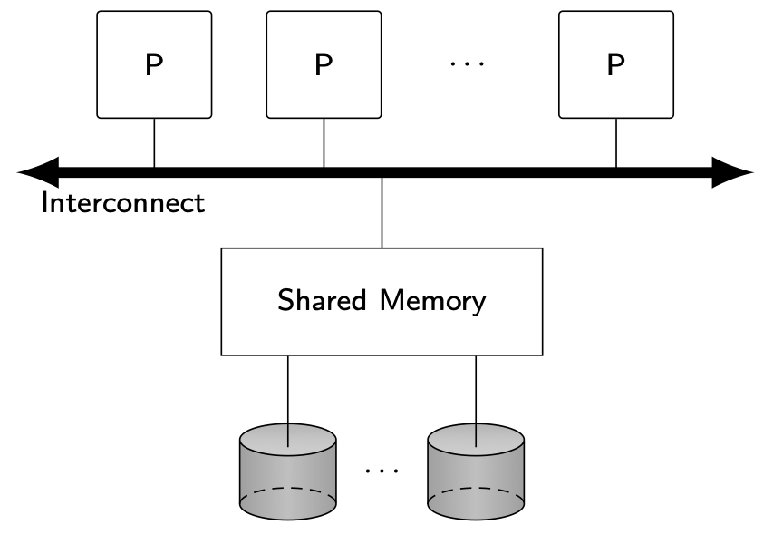
UMA
Physical memory shared by all processors
Symmetric multiprocessor (SMP) or multicore processor
Constant access time
Examples
XPRS, Volcano, DBS3
Assessment
+ Simplicity, load balancing, fast communication
- Network cost, low extensibility

Slide 16
NUMA
Shared-memory vs. distributed memory
Mixes two different aspects : addressing and memory
Addressing: single address space vs multiple address spaces
Physical memory: central vs distributed
NUMA = single address space on distributed physical memory
Eases application portability
Extensibility
The most successful NUMA is Cache Coherent NUMA (CC-NUMA)

Slide 17
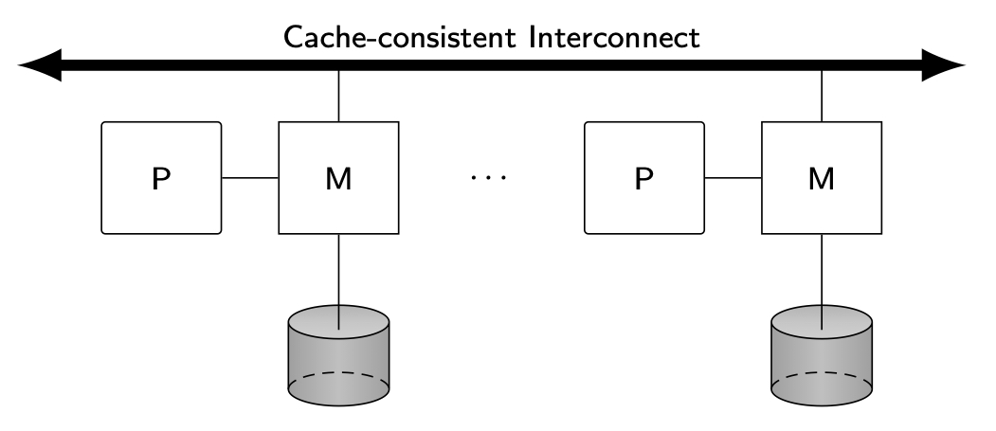
CC-NUMA
Principle
Main memory physically distributed (as in shared-nothing)
However, any processor has access to all other processors’ memories
Cache consistency
Special consistent cache interconnect
Remote memory access very efficient, only a few times (typically between 2 and 3 times) the cost of local access
Exploit Remote Direct Memory Access (RDMA)
Now provided by low latency cluster interconnects such as Infiniband and Myrinet

Slide 18
Storage: DAS vs NAS vs SAN
Application
Application
Application
File System
File System
File System
blocks
DAS
blocks
Storage
NAS
blocks
SAN
Storage
Storage
Direct Attached Storage
Network Attached Storage
Storage Area Network

Slide 19
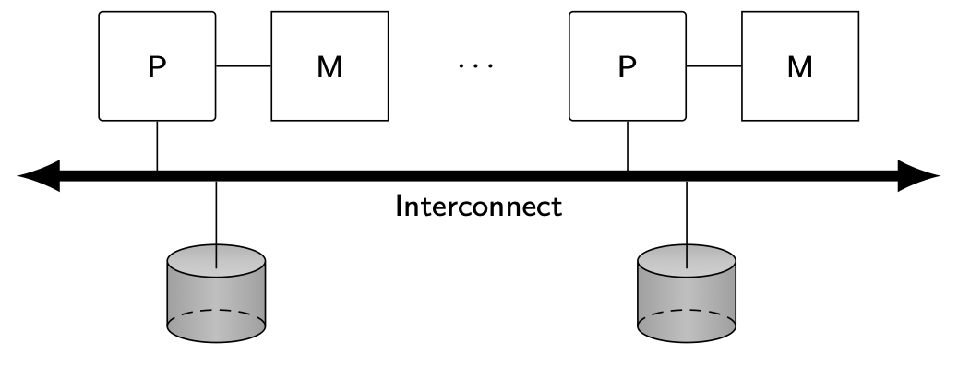
Shared-Disk
Shared disk, private memory
SAN
Cache coherency
Examples
Oracle RAC et Exadata
IBM PowerHA
Assessment
+ Simplicity for admin.
- Network cost (SAN), scalability

Slide 20
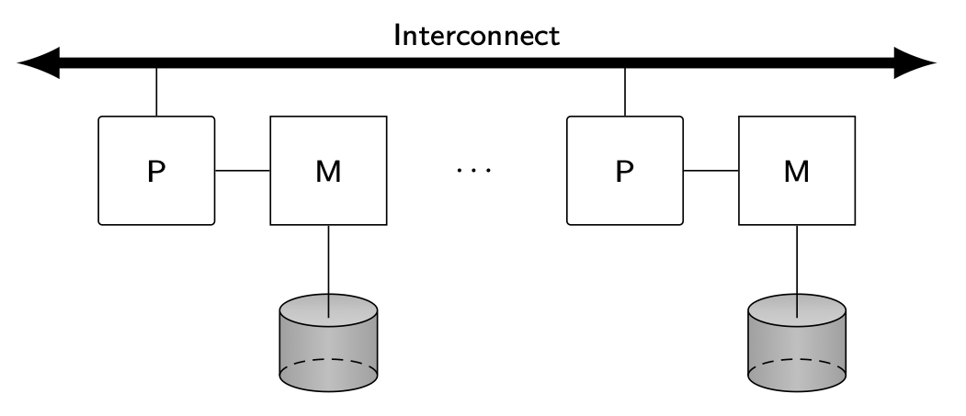
Shared-Nothing
No sharing of either disk or memory
Data partitioning
Examples
DB2 DPF, SQL Server Parallel DW, Teradata, MySQLcluster
NoSQL, NewSQL
Assessment
+ Scalability, cost/performance
- Complex (distributed updates)

Slide 21
Parallel DBMS Techniques
Data placement
Data partitioning
Replication
Parallel query processing
Parallel algorithms for relational operators
Query optimization
Load balancing
Transaction management
Similar to distributed transaction management
But need to scale up to many nodes
Fault-tolerance and failover

Slide 22
Outline
Parallel Database Systems
Parallel Architectures
Data Placement
Query Processing
Load Balancing and Fault-tolerance
Database Clusters

Slide 23
Data Partitioning
Each relation is divided in n partitions (subrelations), where n is a function of relation size and access frequency
Horizontal partitioning (see Chapter 2)
Round-robin
Maps i-th element to node i mod n
Simple but only exact-match queries
Hash
Only exact-match queries but small index
Range
Supports range queries but large index

Slide 24
Partitioning Functions
2
2
4
4
10
12
Hashing
(k,v) assigned to node h(k)
Exact match queries
Problem with skew distribution
Range
(k,v) to the node that holds k's interval
Exact match and range queries
Needs an index on key
1
11
11
13
1
2
2
4
4
10
11
11
12
13

Slide 25
Replicated Data Partitioning
High-availability requires data replication
Simple solution is mirrored disks
Hurts load balancing when one node fails
More elaborate solutions achieve load balancing
Interleaved partitioning (Teradata)
Chained partitioning (Gamma)

Slide 26
Interleaved Partitioning
Node | 1 | 2 | 3 | 4
Primary copy | R₁ | R₂ | R₃ | R₄
Backup copies | R_{2,1} R_{3,1} R_{4,1} | R_{1,1} R_{3,2} R_{4,2} | R_{1,2} R_{2,2} R_{4,3} | R_{1,3} R_{2,3} R_{3,3}

Slide 27
Chained Partitioning
Node | 1 | 2 | 3 | 4
Primary copy | R₁ | R₂ | R₃ | R₄
Backup copies | R₄ R₃ | R₁ R₄ | R₂ R₁ | R₃ R₂

Slide 28
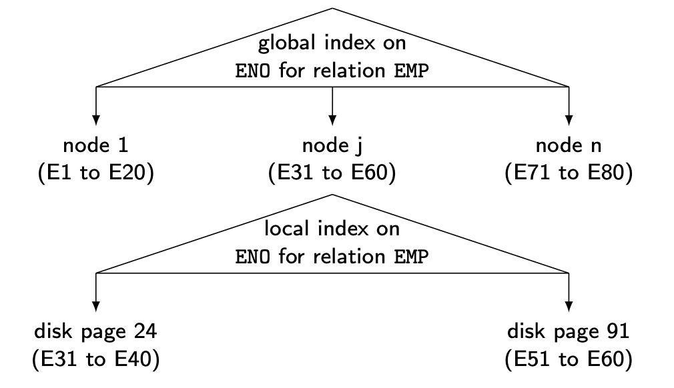
Placement Directory
Performs two functions
F₁ (relname, placement attval) = lognode-id
F₂ (lognode-id) = phynode-id
Global index on placement att. available at each node
In addition, each node has its local index (to access disk pages)

Slide 29
Outline
Parallel Database Systems
Parallel Architectures
Data Placement
Query processing
Load Balancing and Fault-tolerance
Database Clusters

Slide 30
Join Processing
Two basic algorithms for intra-operator parallelism
Parallel nested loop join: no special assumption
Parallel hash join: equijoin
They also apply to other complex operators such as duplicate elimination, union, intersection, etc. with minor adaptation

Slide 31
Parallel Nested Loop Join

Slide 32
Parallel Nested Loop Join - implementation
Two nested loops
One relation is chosen as the inner relation (e.g. R), the other relation as the outer relation (e.g. S)
First phase
Each fragment of R is sent and replicated at each node that contains a fragment of S (there are n such nodes)
Second phase
Each S-node j receives relation R entirely, and locally joins R with its fragment of S
Pipelining
As soon as R tuples are received, they can be processed in pipeline by accessing the S tuples, e.g. through an index

Slide 33
Parallel Hash Join

Slide 34
Parallel Hash Join - implementation
Build phase
Hashes R used as inner relation, on the join attribute
Sends it to the target p nodes that build a hash table for the incoming tuples
Probe phase
Sends S, the outer relation, associatively to the target p nodes
Each target node probes the hash table for each incoming tuple
Pipelining
As soon as the hash tables have been built for R, the S tuples can be sent and processed in pipeline by probing the hash tables

Slide 35
Variants
To exploit large main memories and multicore
Symmetric hash join
The traditional build and probe phases of the basic hash join algorithm are simply interleaved, using two hash tables
When a tuple arrives
It is used to probe the hash table corresponding to the other relation and find matching tuples
Then, it is inserted in its corresponding hash table so that tuplesof the other relation arriving later can be joined
Ripple join
Generalization of the nested loop join algorithm where the roles of inner and outer relation continually alternate during query execution

Slide 36
Parallel Query Optimization
The objective is to select the “best” parallel execution plan for a query using the following components
Search strategy
Dynamic programming for small search space
Randomized for large search space
Search space
Models alternative execution plans as operator trees
Different tree shapes
Cost model (abstraction of execution system)
Physical schema info. (partitioning, indexes, etc.)
Statistics and cost functions

Slide 37
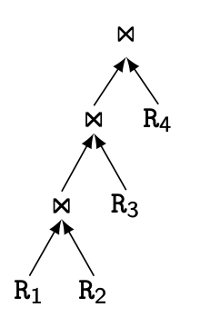
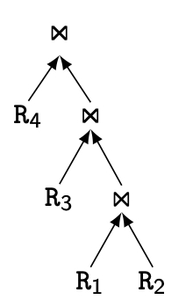
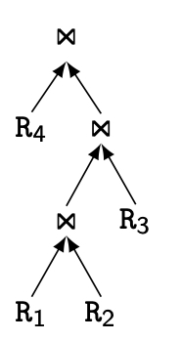
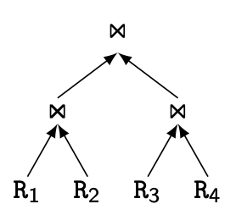
Operator Trees
Left-deep
Right-deep
Zig-zag
Bushy

Slide 38
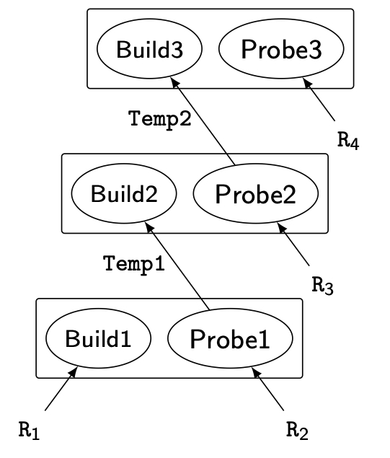
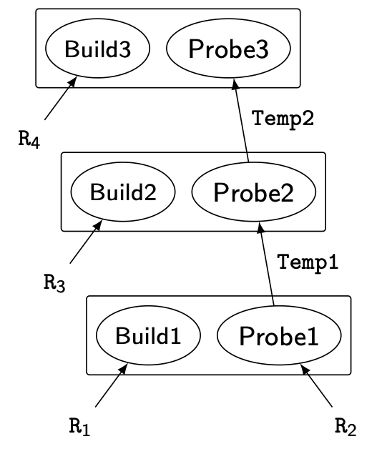
Equivalent Hash-Join Trees with Different Scheduling
No pipeline
Pipeline of R₂, Temp₁ and Temp₂

Slide 39
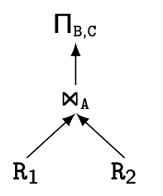
Operator Tree with Exchange Operator

Slide 40
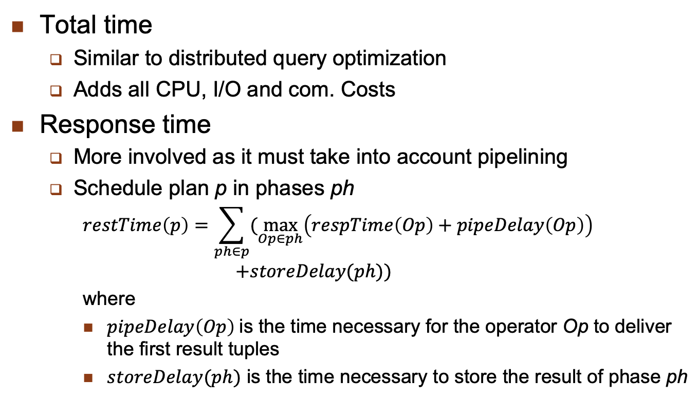
Cost Model
Total time
Similar to distributed query optimization
Adds all CPU, I/O and com. Costs
Response time
More involved as it must take into account pipelining
Schedule plan p in phases ph
$$restTime\left(p\right)=\sum_{ph∈p}{(\max_{Op∈ph}\left(respTime\left(Op\right)+pipeDelay\left(Op\right)\right)}$$
$$+storeDelay(ph))$$
where
$pipeDelay\left(Op\right)$is the time necessary for the operator Op to deliver the first result tuples
$storeDelay(ph)$ is the time necessary to store the result of phase ph

Slide 41
Outline
Parallel Database Systems
Parallel Architectures
Data Placement
Query Processing
Load Balancing and Fault-tolerance
Database Clusters

Slide 42
Load Balancing
Problems arise for intra-operator parallelism with skewed data distributions
Attribute data skew (AVS)
Tuple placement skew (TPS)
Selectivity skew (SS)
Redistribution skew (RS)
Join product skew (JPS)
Solutions
Sophisticated parallel algorithms that deal with skew
Dynamic processor allocation (at execution time)

Slide 43
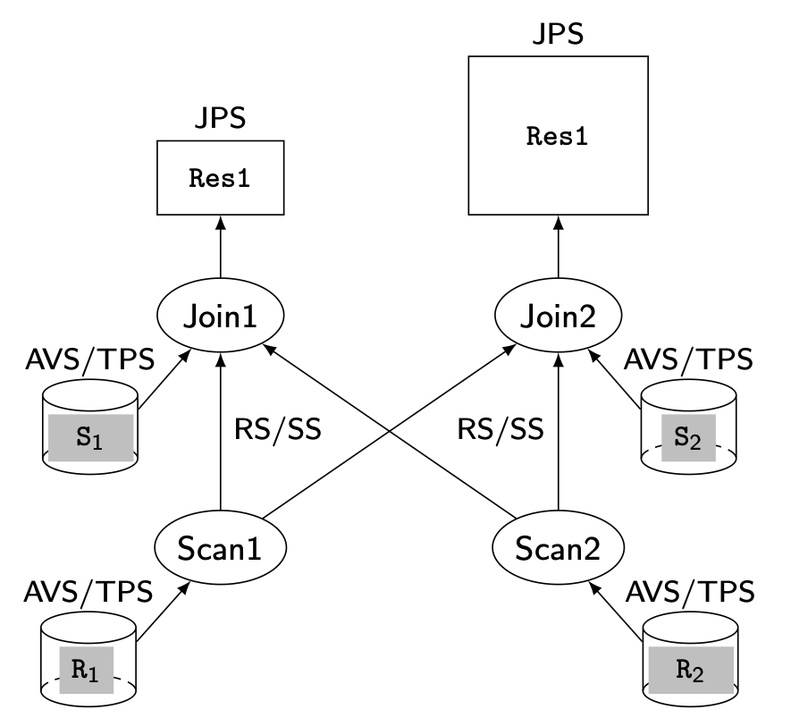
Data Skew Example

Slide 44
Load Balancing
Q₄
Q₃
Q₂
Q₁
Choose the node to execute Q
round robin
The least loaded
Need to get load information
Failover
In case a node N fails, N’s queries are taken over by another node
Requires a copy of N’s data or SD
In case of interference
Data of an overloaded node are replicated to another node
Load balancing
Q₁
Q₂
Q₃
Q₄

Slide 45
Dynamic Processing (DP) Execution Model
A query is decomposed into selfcontained units of sequential processing, each of which can be carried out by any processor
Intuitively, a processor can migrate horizontally (intraoperator parallelism) and vertically (interoperator parallelism) along the query operators
The parallel execution plan as produced by the optimizer includes operator scheduling constraints that express a partial order among the operators of the query

Slide 46
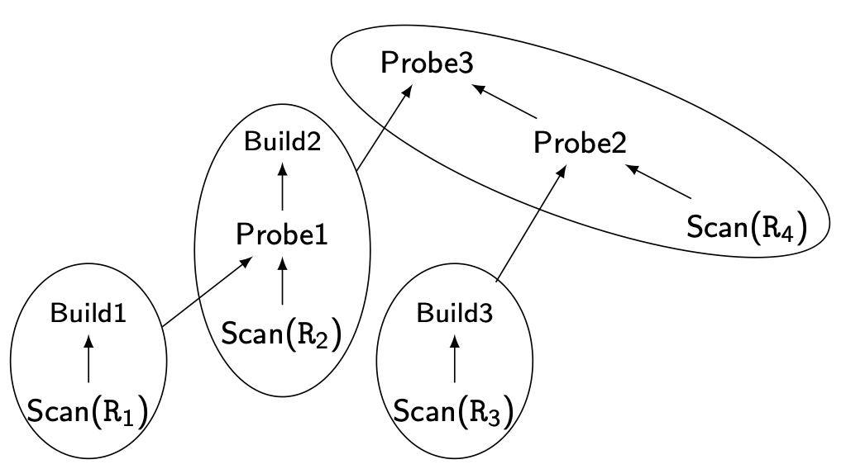
DP Example
Join tree with 4 pipelined chains

Slide 47
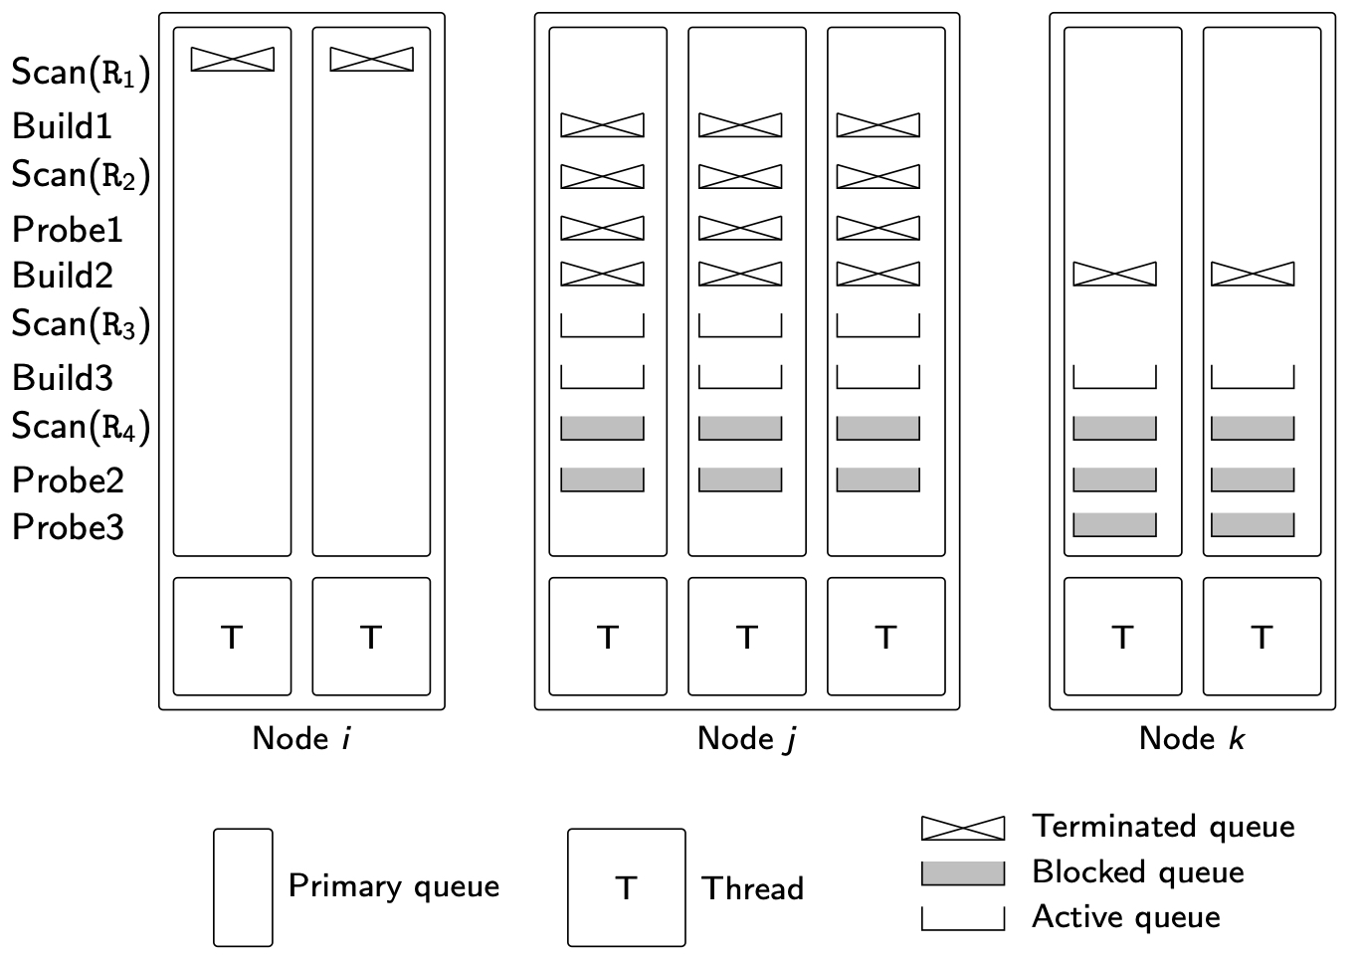
DP Example – snapshot of execution

Slide 48
Replication and Failover
Replication
The basis for fault-tolerance and availability
Failover
On a node failure, another node detects and recovers the node’s tasks
=>
Savepoints for long queries
Client
Node 1
Ping
Node 2
connect1
connect1

Slide 49
Outline
Parallel Database Systems
Parallel Architectures
Data Placement
Query Processing
Load Balancing and Fault-tolerance
Database Clusters

Slide 50
Motivations
Database cluster = cluster of autonomous databases, each managed by an off-the-shelf DBMS
Major difference with a parallel DBMS is the use of a “black-box” DBMS at each node
In general, same DBMS
Since the DBMS source code is not necessarily available and cannot be changed to be “cluster-aware,” parallel data management capabilities must be implemented via middleware
Examples: MySQL or PostgreSQL clusters

Slide 51
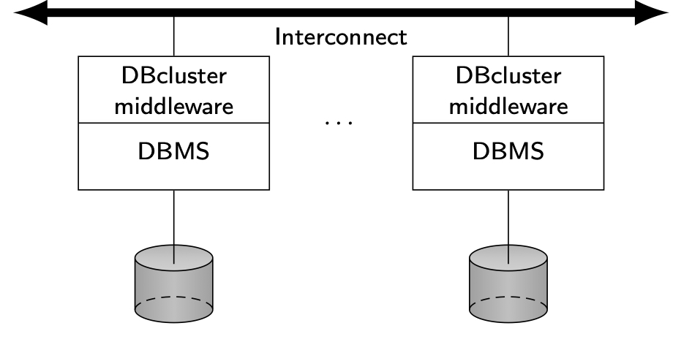
Database Cluster Architecture
Middleware has several software layers
Transaction load balancer, replication manager, query processor, and fault-tolerance manager

Slide 52
Replication
The fast interconnect and communication system can be exploited to support one-copy serializability
Example with Preventive Replication
Uses FIFO reliable multicast (simple and efficient)
Principle
Each incoming transaction T has a chronological timestamp ts(T ) = C, and is multicast to all other nodes where there is a copy.
At each node, a time delay is introduced before starting the execution of T. This delay corresponds to the upper bound of the time needed to multicast a message
When the delay expires, all transactions that may have committed before C are guaranteed to be received and executed before T , following the timestamp order (i.e., total order)

Slide 53
Load Balancing
Query load balancing is easy
Since all copies are mutually consistent, any node that stores a copy of the data, e.g., the least loaded node, can be chosen at runtime by a conventional load balancing strategy
Transaction load balancing
The total cost of transaction execution at all nodes may be high
By relaxing consistency, lazy replication can better reduce transaction execution cost and thus increase performance of both queries and transactions

Slide 54
Query Processing
Interquery parallelism is naturally obtained as a result of load balancing and replication
Useful to increase the throughput of transaction-oriented applications and, to some extent, to reduce the response time of transactions and queries
Intraquery parallelism is essential to further reduce response times of OLAP queries
More difficult than data partitioning because of black-box DBMSs
2 solutions
Physical partitioning
Virtual partitioning

Slide 55
Physical Partitioning
Similar to data partioning in distributed databases (see Chap. 2) except that the objective is to increase intraquery parallelism, not locality of reference
Thus, depending on the query and relation sizes, the degree of partitioning should be much finer
Under uniform data distribution, yields good intraquery parallelism and outperforms interquery parallelism
However, it is static and thus very sensitive to data skew conditions and the variation of query patterns that may require periodic repartitioning

Slide 56
Virtual Partitioning
Uses full replication (each relation is replicated at each node).
Simple virtual partitioning (SVP)
Virtual partitions are dynamically produced for each query and intraquery parallelism is obtained by sending subqueries to different virtual partitions
To produce the different subqueries, the query processor adds predicates to the incoming query in order to restrict access to a subset of a relation, i.e., a virtual partition
Then, each DBMS that receives a subquery is forced to process a different subset of data items
Finally, the partitioned result needs to be combined by an aggregate query

Slide 57
SVP Example
Consider
SELECT PNO, AVG(DUR)
FROM WORKS
WHERE SUM(DUR) > 200
GROUP BY PNO
A generic subquery on a virtual partition is obtained by adding to Q’s where clause the predicate
AND PNO >= ‘P1’ AND PNO < ‘P2’

Slide 58
SVP Example
By binding [‘P1’, ‘P2’] to n subsequent ranges of PNO values, we obtain n subqueries, each for a different node on a different virtual partition of WORKS
The AVG(DUR) operation must be rewritten as SUM(DUR), COUNT(DUR) in the subquery
Finally, to obtain the correct result for AVG(DUR), the composition query must perform
SUM(DUR)/SUM(COUNT(DUR))
over the n partial results

Slide 59
SVP Assessment
Great flexibility for node allocation during query processing since any node can be chosen for executing a subquery
Not all kinds of queries can benefit from SVP
Only queries without subqueries that access a fact table are ok
Queries with a subquery must be converted to have no subquery
Any other queries cannot benefit
Limitations
Determining the best virtual partitioning attributes and value ranges can be difficult
Dependent on the underlying DBMS query capabilities
Solution: Adaptive Virtual Partitioning

