Slide 1
Monoio – Yet Another Rust Async Runtime
@ihciah, @dyxushuai

Slide 2
Index
1. Rust Async Runtime
2. Why Monoio
3. Mini Rust Runtime
4. Monoio Design
5. Problems

Slide 3
Rust Async Runtime

Slide 4
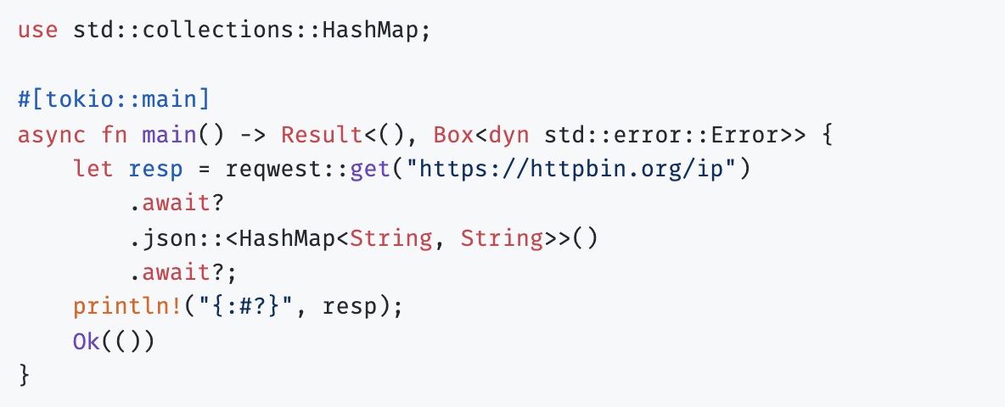
Rust Async Runtime
性能
安全
协作
From reqwest example
Notes:
Just async + await.

Slide 5
What about without
Async Runtime
?

Slide 6
Main loop
listener = bind(..)
mapping = [0 -> listener]
epoll = epoll_create(..)
epoll.register(listener, user_data = 0)
loop {
1. events = epoll.wait()
2. for event in events {
fd = mapping.get(event.user_data)
new_fd = do_syscall(fd) // accept
epoll.register(new_fd , user_data = 1)
mapping.push(1 -> new_fd)
}
}
-> Mio example
Notes:
C/C++/Rust are like.

Slide 7
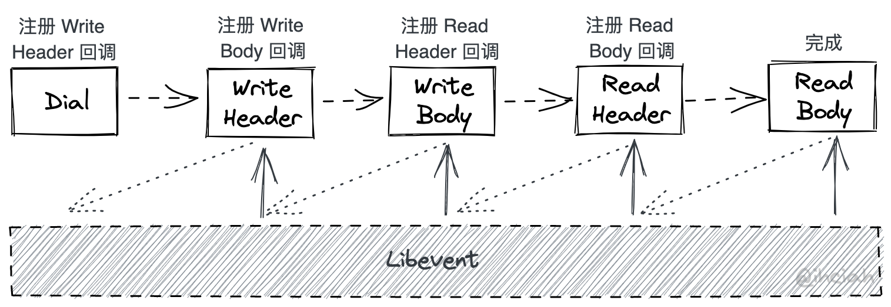
Callback?
Notes:
IO Runtime + User code, how?

Slide 8
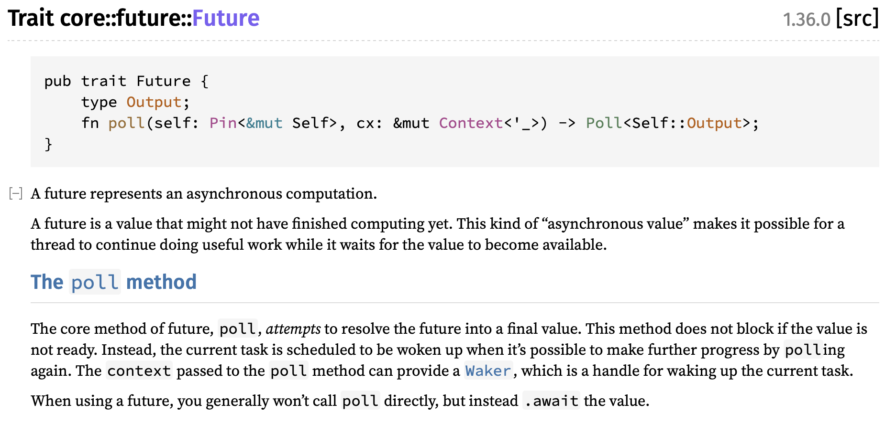
Rust Future
性能
安全
协作
Notes:
Future + Runtime + Generator = We can use async + await!

Slide 9
Why Monoio
Tokio
Tokio-uring
Glommio
Actix-rt
What we need:
Thread per core: tasks do not need Send + Sync
io-uring: fast, low-latency and low-cost

Slide 10
Mini Rust Runtime
Reactor
Executor
Poll
io(read/write/accept/…)
Task
poll_task
io->cx
cx.waker().wake()
Task
RawWakerVTable::wake
Task Queue
https://github.com/ihciah/mini-rust-runtime

Slide 11
Monoio Design
Buffer
Ownership
Across
Threads
Compatible
Notes:
Only 3 designs here

Slide 12
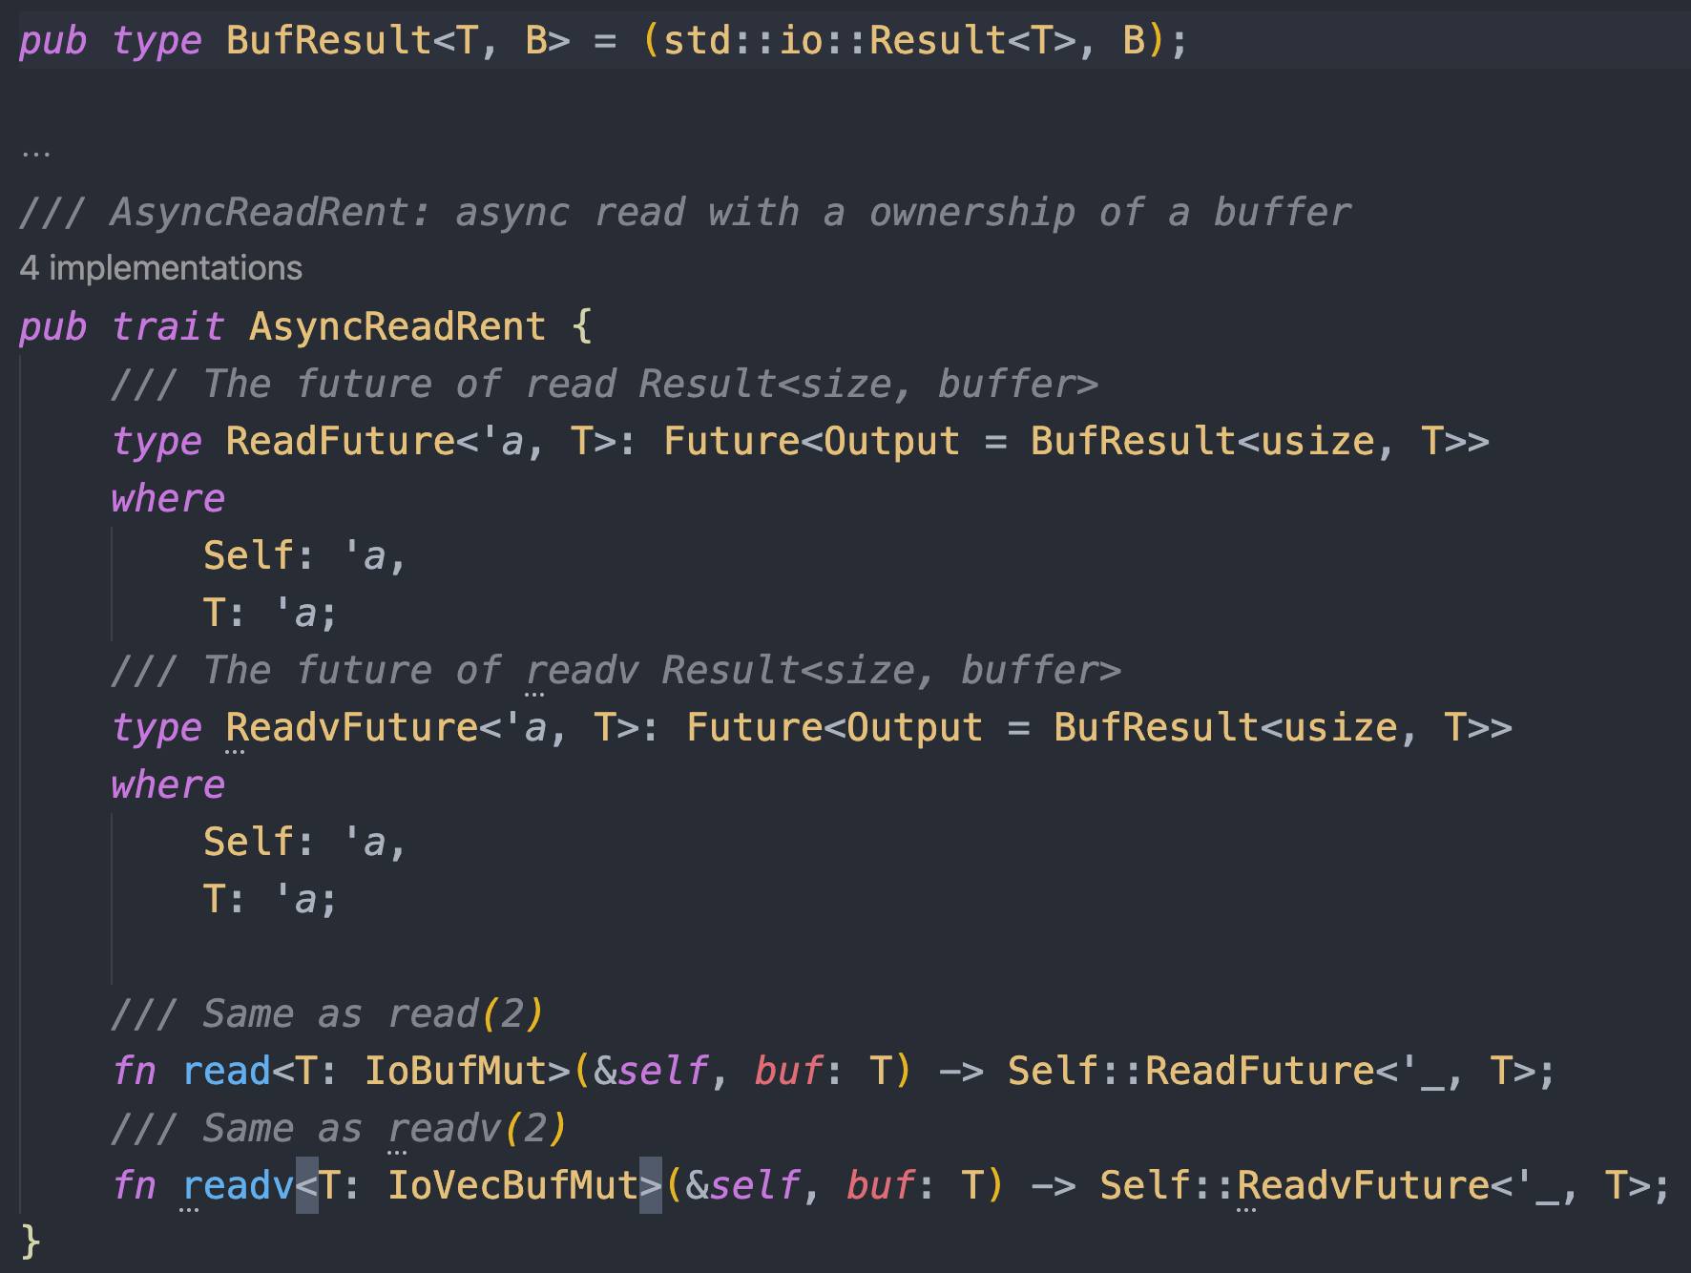
Buffer Ownership
Idea comes from tokio-uring
Notes:
GAT enabled

Slide 13
Buffer Ownership
Slab:
id -> {Buf, Lifecycle}
Push Op
Buf
read
Future
Make progress & wake
CQE
(userdata= id)
Submit_and_wait(1)

Slide 14
Await across threads
Thread id -> { UnparkHandle, Sender<Waker> }
Global Map
Thread id -> { UnparkHandle, Sender<Waker> }
Unpark Handle
Get unpark handle from cache/global
Unpark handle by write to event_fd
Thread-local cache
State
Vtable owner_id
…
Local thread id == owner_id ?
1. Unpark owner thread
2. Send waker to the owner thread
wake_by_val
wake_by_ref
Task

Slide 15
Compatible
Synchronous Syscall & poll-like interface
Asynchronous Syscall & pure async + await interface

Slide 16
End
https://github.com/bytedance/monoio
Welcome contributing!

