Slide 1
op standard library overview
beyond a library

Slide 2
Library or Framework？
c standard library
java collection framework/executor framework
Spring Framework
apache commons
Notes:
https://stackoverflow.com/questions/148747/what-is-the-difference-between-a-framework-and-a-library

Slide 3
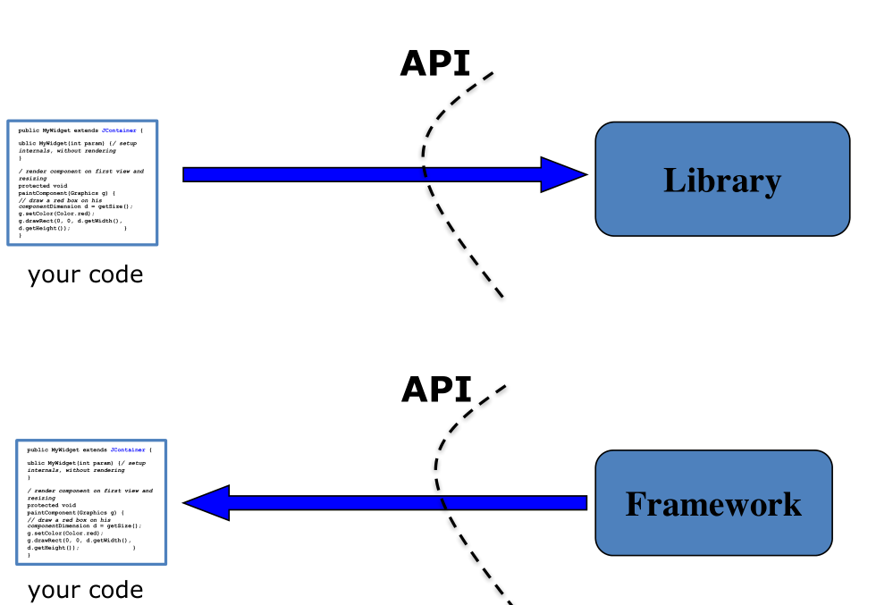

Slide 4
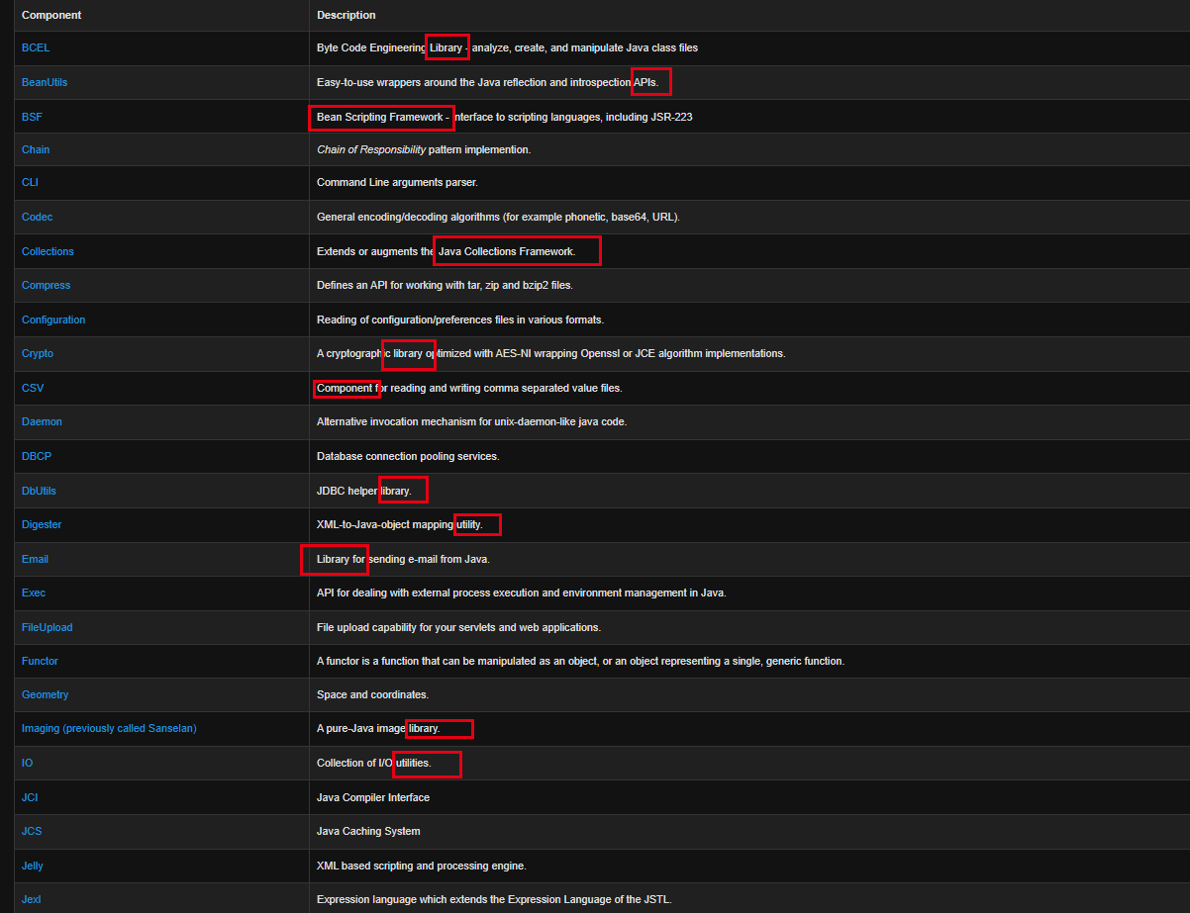

Slide 5
我的所见所闻
utils，common
生成javadoc暴露http接口
kafka clinet对比 https://spring.io/projects/spring-kafka
核心接口和方法作用
参考jcf的文档
代码review
礼物奖励
每一个技术的公有api，功能简介，设计细节，对比其他，优点和缺点，最新版本介绍

Slide 6
common-akka

Slide 7
common-atomikos

Slide 8
common-canal
common-canal-kafka-clients-flat
common-canal-kafka-flat

Slide 9
common-consul

Slide 10
common-csv
https://github.com/robert-bor/CSVeed/wiki/Comparison-of-Java-CSV-libraries

Slide 11
common-ddd
1 注解处理器，新加更多ddd概念。
2

Slide 12
common-delay-queue

Slide 13
common-elasticsearch
1 spring-data-relasticsearch，到底多做了哪些工作，和系统使用区别在哪里？真的区别在哪里？封装了进100个类
2 high，low rest 对比

Slide 14
common-email

Slide 15
common-event-bus
common-event-bus-annotation

Slide 16
common-excel

Slide 17
common-hazelcast

Slide 18
common-httpclientfluent

Slide 19
common-kafka
common-kafka
common-kafka-jedis-deadletter
common-kafka-clients
common-kafka-clients-jedis-deadletter

Slide 20
common-mvc

Slide 21
common-mybatisplus

Slide 22
common-redis

Slide 23
common-utils

Slide 24
改进的地方
1 枚举

Slide 25
未来畅想
1 akka-typed
2 es-high-level-client

