Slide 1
Four-Bit
Wireless Link Estimation
Omprakash Gnawali (USC)
with
Rodrigo Fonseca (UC Berkeley)
Kyle Jamieson (MIT CSAIL)
Philip Levis (Stanford)
HotNets 2007

Slide 2
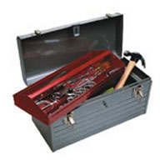
Link Estimation: An Enabler
Tools to improve wireless performance
  Routing: ETX, Geographic, Beacon Vector, ExOR
  Network coding, Packet combining
  SampleRate, Datalink Streaming
Link Estimation a prerequisite for these tools

Slide 3
Link Quality Estimation
Identify good links
ETX: Expected Transmission Count [Mobicom 2003]
A
B
TX
ReTX
1
ETX(L) =
PRR(f) * PRR(b)
ACK

Slide 4
ETX Estimation Example
Beacons
1.0
3.0
1.0
ETX Estimate
(alpha = 0.8)
2.0
1.8
2.04
1.83
t1
t2
t3

Slide 5
State of the Art Today
Not all information used
Coupled designs
MLQI
  Physical layer (LQI)
  Coupled implementation
Network Layer
LE
Link Layer
Physical Layer

Slide 6
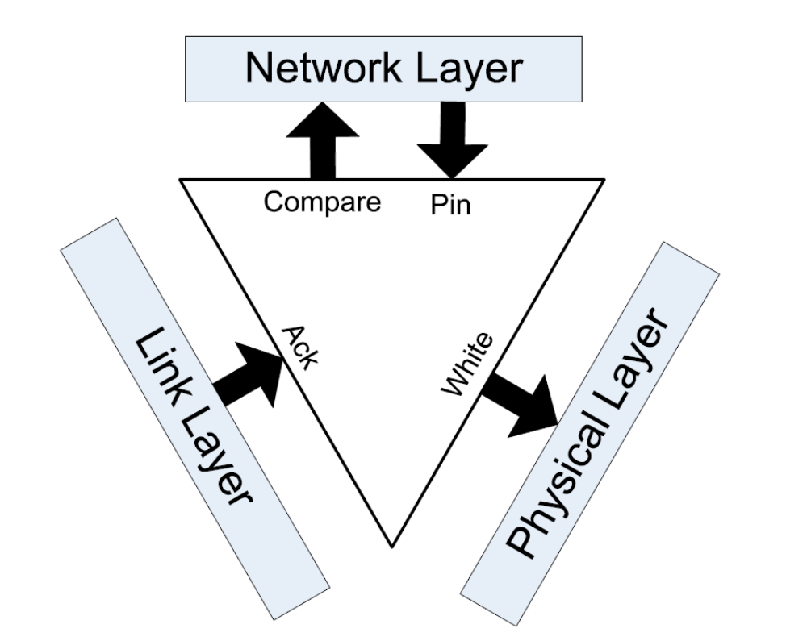
Scope
Identify the information different layers of the stack can provide
Define a narrow interface between the layers and the link estimator
Describe an accurate and efficient estimator implemented using the four bit interface

Slide 7
Layers and Information
Better estimator with information from different layers?
  Physical Layer
    Packet decoding quality
  Link Layer
    Packet Acknowledgements
  Network Layer
    Relative importance of links
Network Layer
LE
Link Layer
Physical Layer

Slide 8
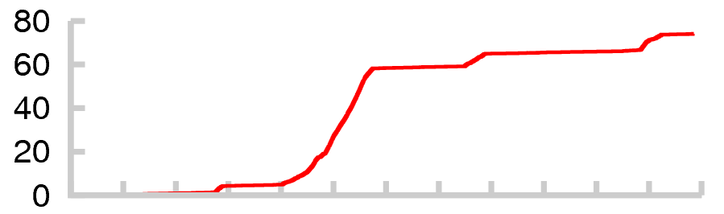
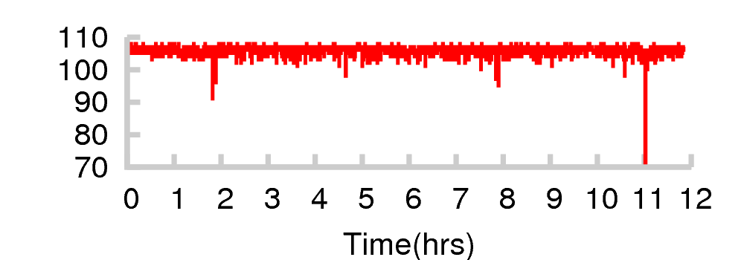
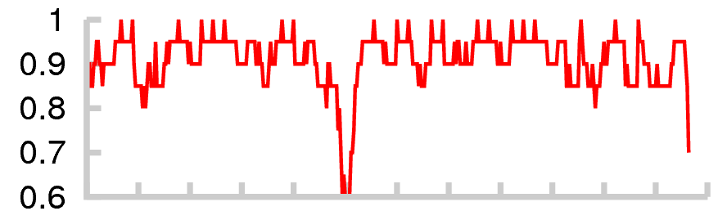
PHY Info Not Sufficient
Unacked
Network Layer
LE
Link Layer
Physical Layer
PRR
Network Layer
LQI
LE
Link Layer
Physical Layer

Slide 9
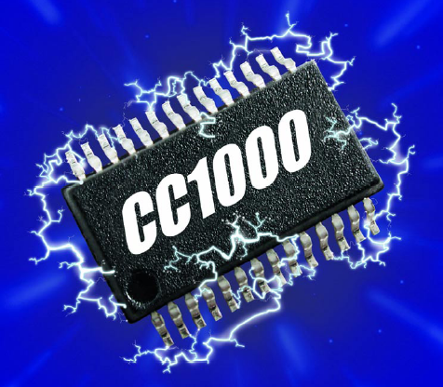
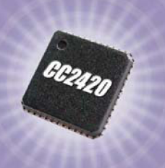
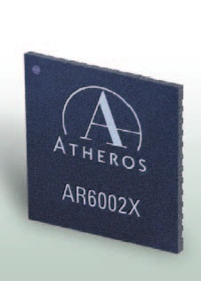
Physical Layer
Network Layer
LE
Link Layer
Physical Layer
Decoding Quality
  Agile
  Free
  Asymmetric (receive) quality
  Radio-specific
Examples
  LQI, RSSI, SNR

Slide 10
Link Layer
Network Layer
LE
Link Layer
Physical Layer
Outcome of unicast packet transmission
Higher quality links
  Successful TX
  Successful ACK reception
Example
  EAR [Mobicom 2006]
A
DATA
ACK
B

Slide 11
Network Layer
Network Layer
LE
Link Layer
Physical Layer
Is a link useful?
Keep useful links in the table
Network layer decides
  Geographic routing
    Geographically diverse links
  Collection
    Link to the parent
    Link on a good path
SRC
A
DST

Slide 12
The Interfaces
Network Layer
LE
Link Layer
Physical Layer

Slide 13
Interface Details
COMPARE
Is this a useful link?
PIN
Keep this link in the table
ACK
A packet transmission on this link was acknowledged
WHITE
Packets on this channel experience few errors

Slide 14
Implementing an Estimator
4B estimator for TinyOS CTP
Tested with CC2420 radio
Using the Four-Bit Interface
  WHITE, COMPARE, PIN bits: state management
  ACK bit – Updates ETX based on transmission outcome

Slide 15
Using ACK
Beacons
1.5
4B ETX
5.0
4.3
3.6
3.1
3.7
1.0
1.25
6
ACK
Received/Acked Packet
Lost/Unacked Packet

Slide 16
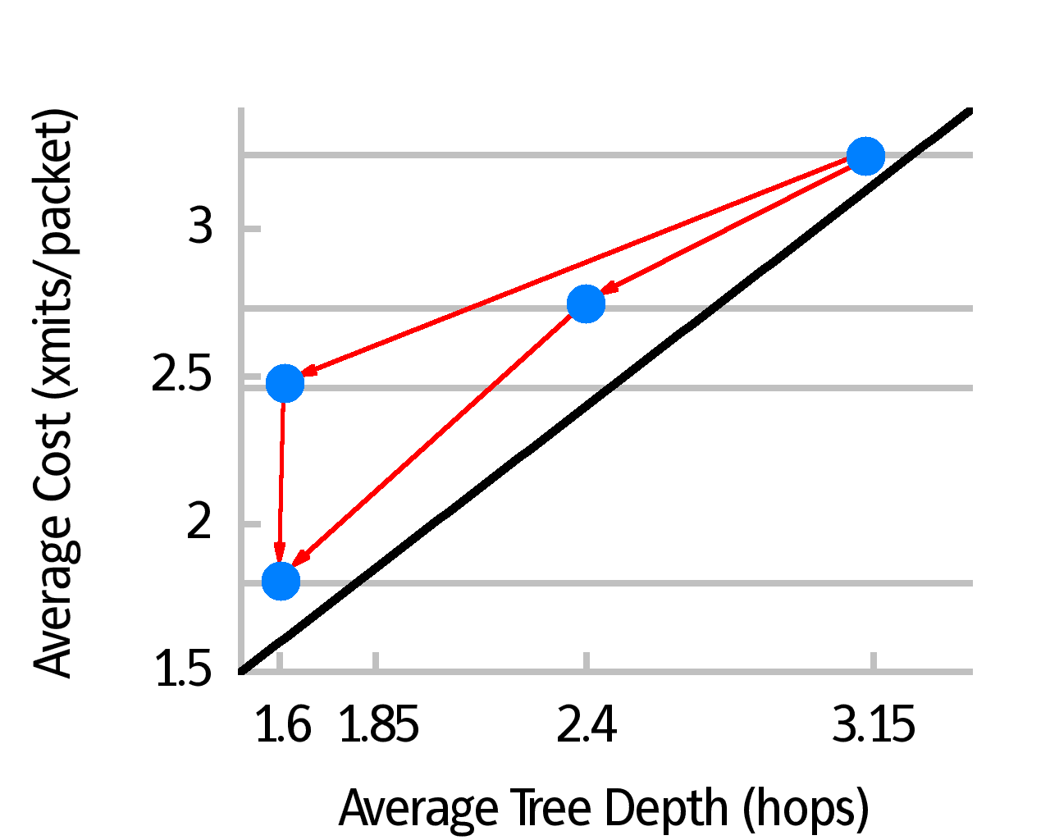
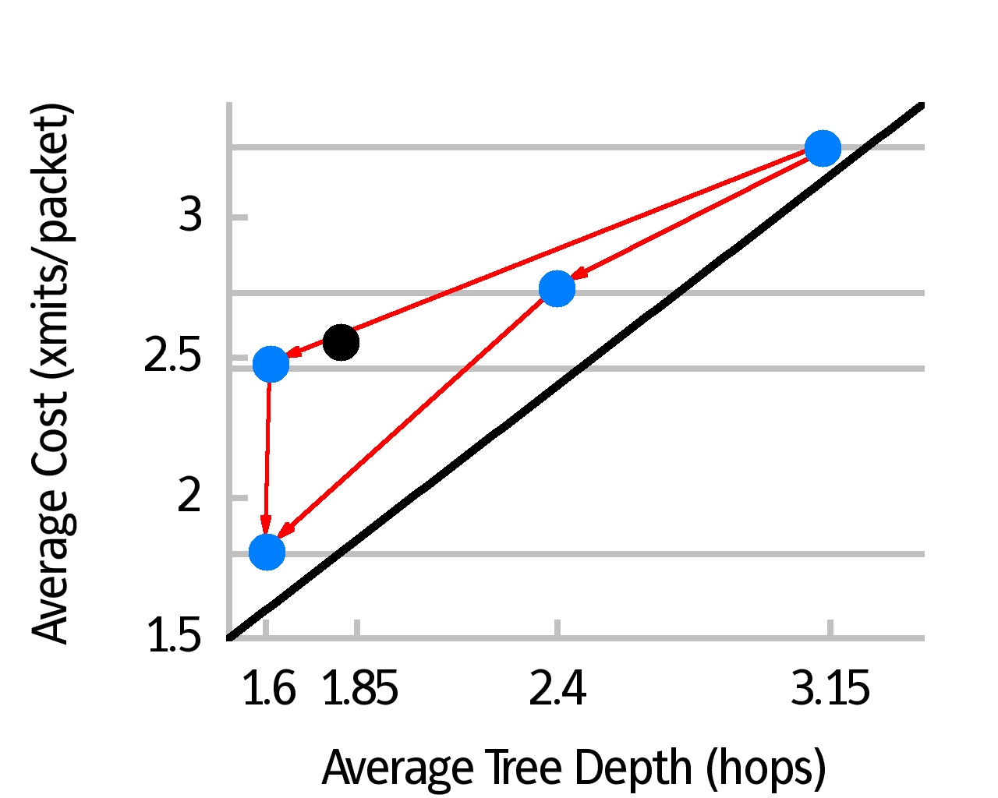
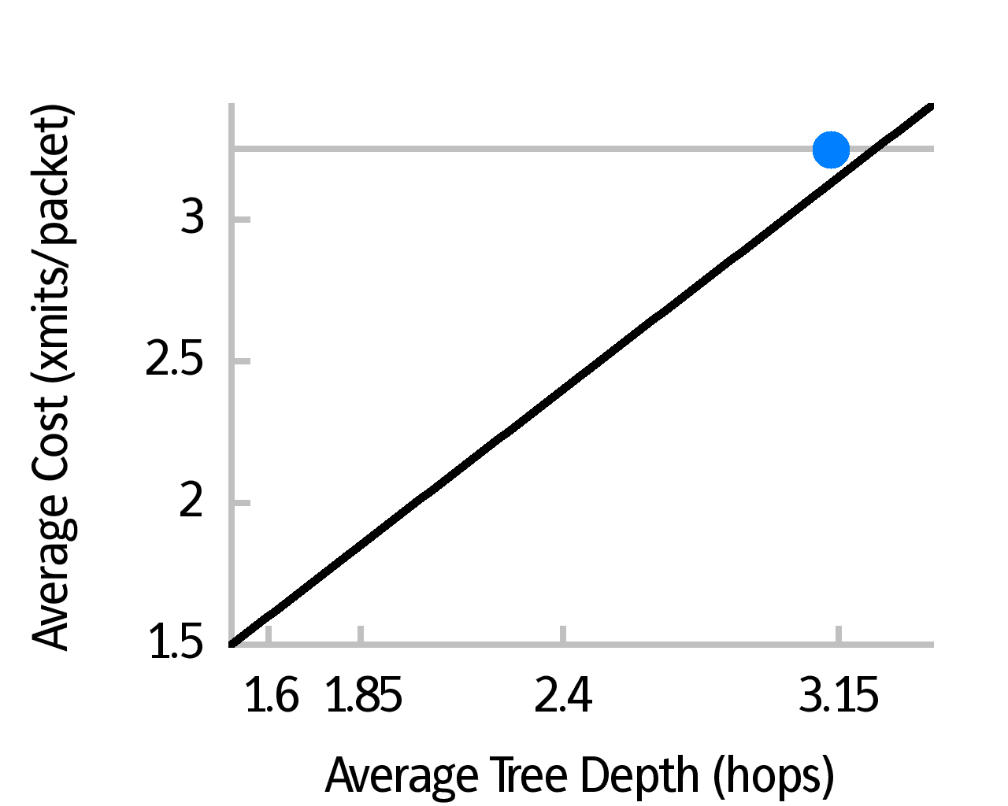
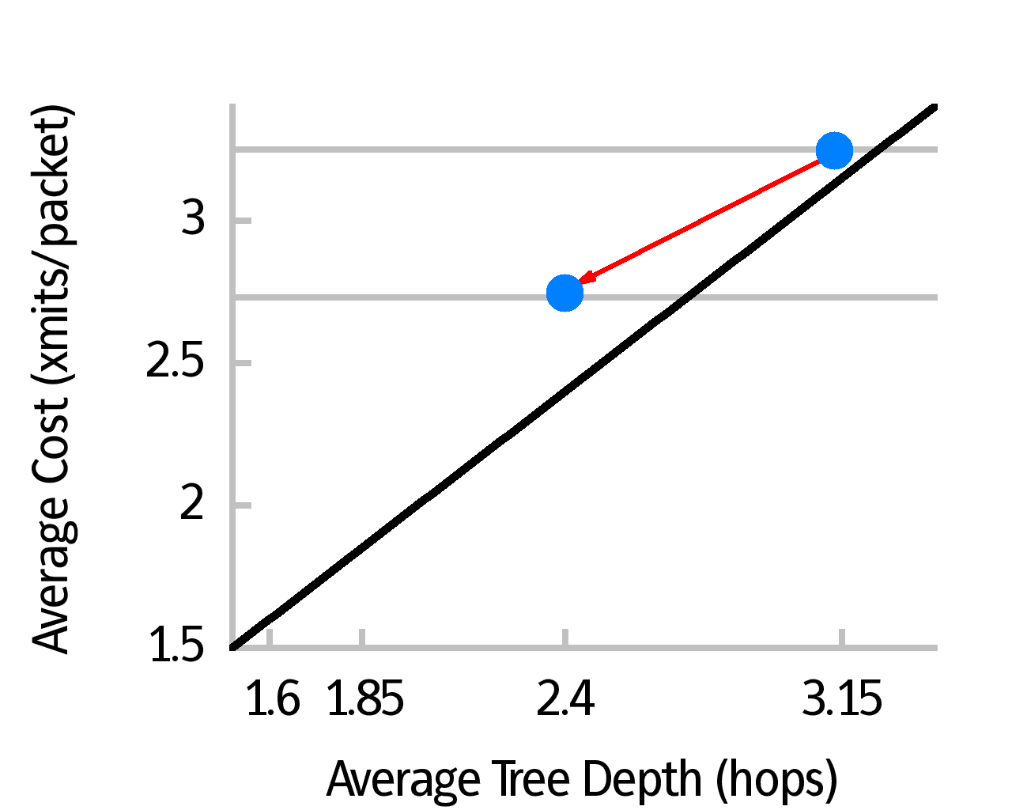
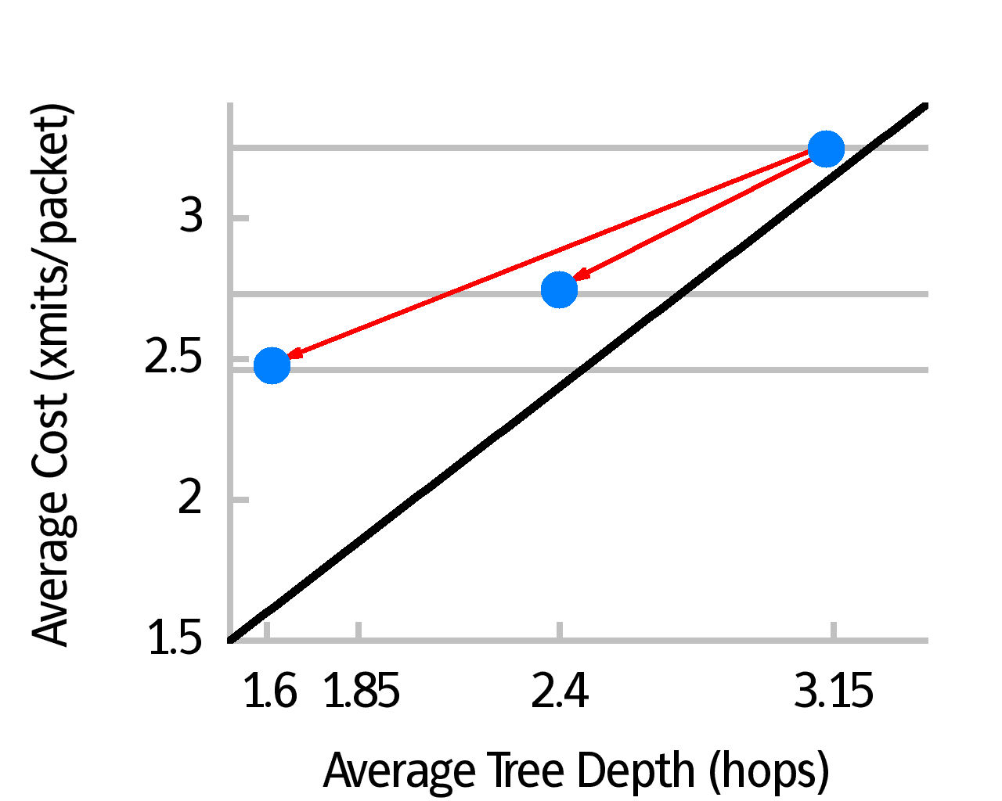
Dissecting the Bits
ETX
ACK
C+W
MLQI
ACK
C+W
4B

Slide 17
Discussion
Applicable to 802.11?
Applicable to all protocols?
Need more than four bits?

