Slide 1
HKU QIDS 2023 Quantitative Investment Competition
Presentation
Yang feifei
PhD Student
Sorbonne université & ESPCI

Slide 2
Round1:
Objectif: Improve the alpha factor by using a tree-based model that combines the other alpha factors to increase correlation with real returns.
Alpha factors
In-day period factor:
10 factors using kline data for each period:
Low2high = low / high
Kmid = (close-open) / open
GK_vol = (1 / 2 * np.log(high / low) ** 2 - (2 * np.log(2) - 1) * np.log(close / open) ** 2)
RS_vol = np.log(high / close) * np.log(high / open) + np.log(low / close) * np.log(low / open)
Day-factors:
30 factors aggregated for each day on 50 periods:
Kline: open, high, low, close, money, volume,vwap
Aggregated factors: Low2high_mean, Kmid_mean, ….., GK_vol_mean, RS_vol_mean
Correlation factors:
corr_ret_vwap = close.diff().corr(vwap)
corr_ret_ksft2= close.diff().corr(ksft2)
corr_ret_GK_vol=close.diff().corr(GK_vol)
corr_ret_RS_vol=close.diff().corr(RS_vol)
corr_vol_vwap =volume.corr(vwap),
corr_vol_ksft2= volume.corr(ksft2),
corr_vol_GK_vol= volume.corr(GK_vol),
corr_vol_RS_vol= volume.corr(RS_vol)
N-days factors:
30+ factors lag/aggregated on N- days:
Return: lag_3, lag_7, lag_14, lag_28, lag_35
N-days std: ret_std_{n}, vol_std_{n}, ta_std_{n}, pe_ttm_std_{n}, f_pe_std_{n}, pb_std_{n}, ps_std_{n}, pcf_std_{n}, turn_std_{n}, vwap_std_{n}
N-days mean: ret_mean_{n}, vol_mean_{n}, ta_mean_{n}, pe_ttm_mean_{n}, f_pe_mean_{n}, pb_mean_{n}, ps_mean_{n}, pcf_mean_{n}, turn_mean_{n}, vwap_mean_{n}
N-days correlation: corr_ret_close_{n}, corr_ret_open_{n}, corr_ret_high_{n} corr_ret_low_{n}, corr_ret_vol_{n}, corr_ret_turn_{n}, corr_ret_ta_{n}, corr_ret_pe_ttm_{n}, corr_ret_pe_{n}, corr_ret_pb_{n}, corr_ret_ps_{n}, corr_ret_pcf_{n}, corr_ret_vwap_{n}
Short/long term: ta_mean_{n1}_{n2}, pe_ttm_mean_{n1}_{n2}, pe_mean_{n1}_{n2}, pb_mean_{n1}_{n2}, ps_mean_{n1}_{n2}, pcf_mean_{n1}_{n2}, turn_mean_{n1}_{n2}, vwap_mean_{n1}_{n2}, money_std_mean_{n1}_{n2}, volume_std_mean_{n1}_{n2}, vwap_std_mean_{n1}_{n2}
…

Slide 3
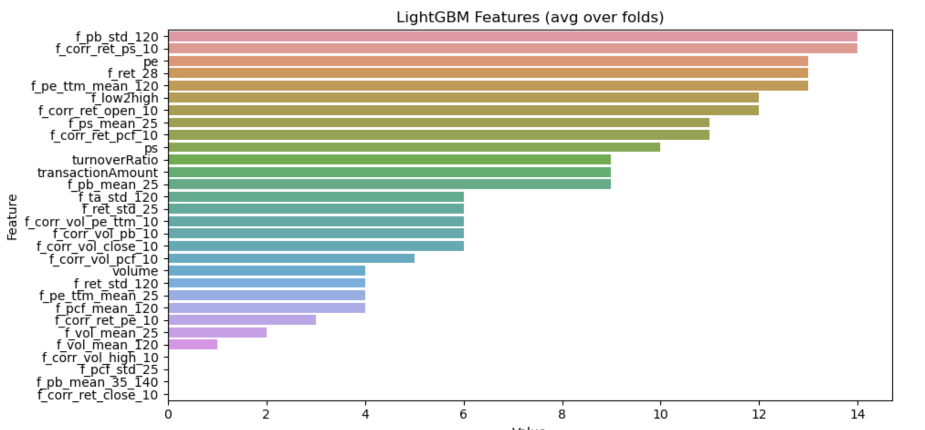
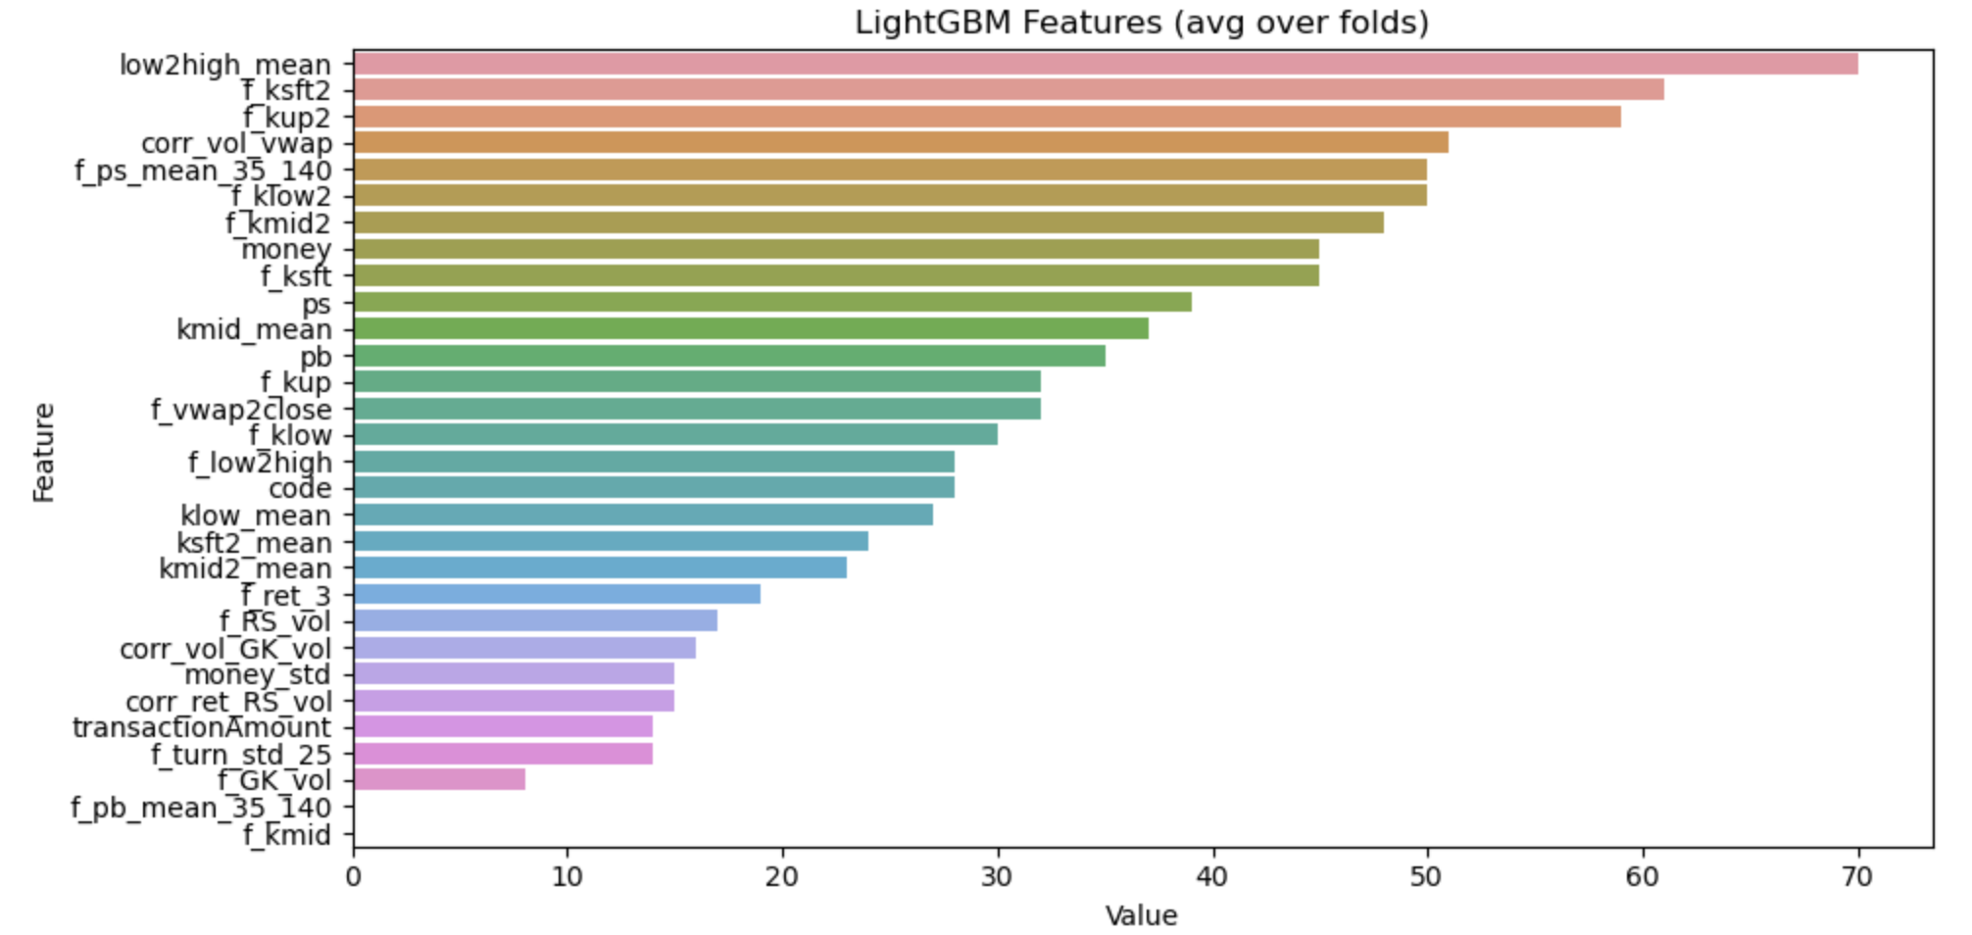
Round1:
Objectif: Improve the alpha factor by using a tree-based model that combines the other alpha factors to increase correlation with real returns.
Model: LightGbm
Model1 - 83 Selected features:
Model2 - 36 Selected features:
Public Score | Private Score
0.07 | 0.083

Slide 4
Round2:
Objectif: build an investment strategy to generate a good perfomance based on the combined factors generated by the ML model
Strategy logic:
Some investment codes displayed a significant correlation with our predicted returns (0.05 – 0.35)
The frequent switching investment codes produce a large transaction fees
The 3 selected investment codes have a low correlation between them
Pooling
54 Investments codes
10 Investments codes
3 Investments codes
Top 10 Corr mean window=267
Find only 3 codes for reducing fee
Low correlation between them

Slide 5
Round2:
Objectif: build an investment strategy to generate a good perfomance based on the combined factors generated by the ML model
Portfolio Allocation & Strategy Capacity:
99% 1st
Trust the model for the decision
To augment capacity, find other group (high corr with target, low corr between them)
1%
2nd
Risk Management:
Tried to filter out signals that fall outside of the 30th and 95th percentiles => Less return, Less drawdown
Need find other way

Slide 6
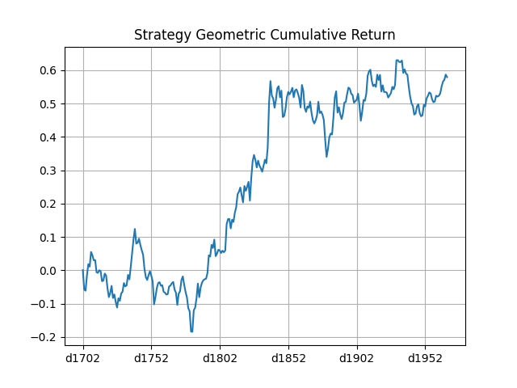
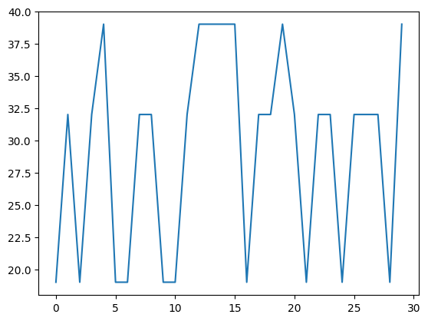
Round2:
Objectif: build an investment strategy to generate a good perfomance based on the combined factors generated by the ML model
Switching investment codes has been limited (4 days holding)
Some drawdowns are significant for some periods.
Indicator | Score
Annualized Return | 53.36%
Annualized Sharpe Ratio | 1.355
Maximum Drawdown | 30.6%
CAPM Alpha P-value | 0.0308
Cumulative return
Decisions sample

