Slide 1
Natural Language Processing
Lecture 5: Applications of NLP

Slide 2
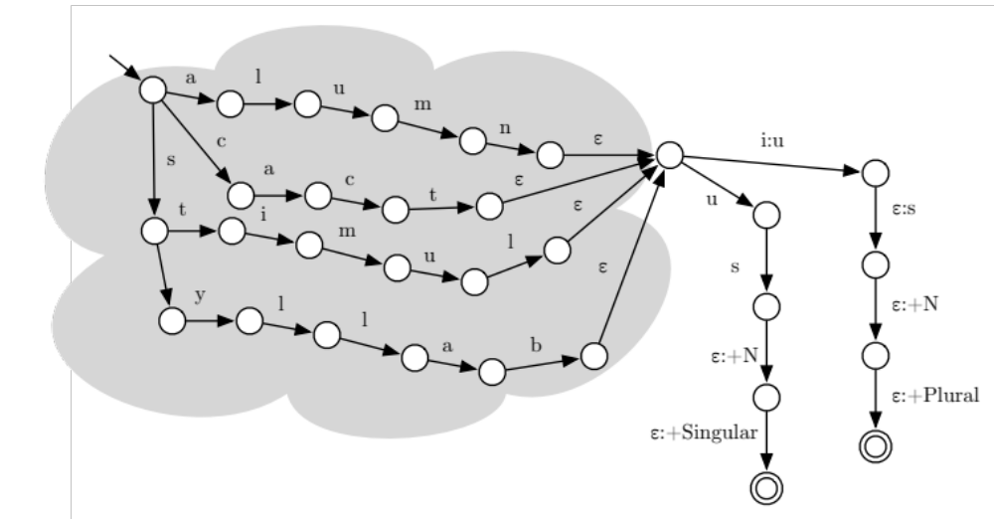

Slide 3
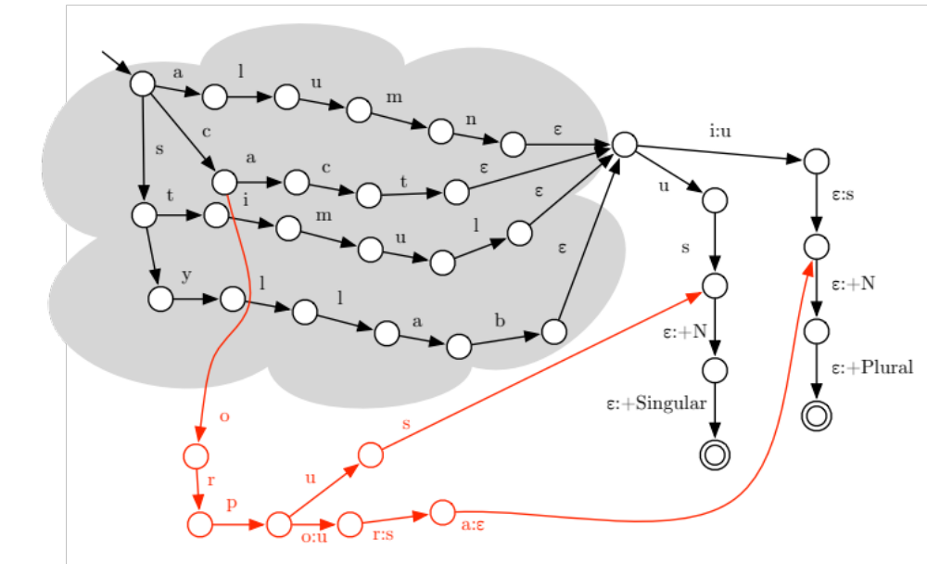

Slide 4
Information Extraction (From 10,000 Feet)
Input: text, empty relational database
Output: populated relational database
State | Party | Candidate | Fraction
FL | D | Edwards | 0.14
FL | D | Clinton | 0.50
FL | D | Obama | 0.33
Senator John Edwards is to drop out of the race to become the Democratic party's presidential candidate after consistently trailing in third place.
In the latest primary, held in Florida yesterday, Edwards gained only 14% of the vote, with Hillary Clinton polling 50% and Barack Obama on 33%. A reported 1.5m voters turned out to vote.

Slide 5
Named Entity Recognition
Senator John Edwards is to drop out of the race to become the Democratic party's presidential candidate after consistently trailing in third place.
In the latest primary, held in Florida yesterday, Edwards gained only 14% of the vote, with Hillary Clinton polling 50% and Barack Obama on 33%. A reported 1.5m voters turned out to vote.

Slide 6
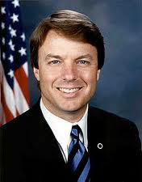
Reference Resolution
Senator John Edwards is to drop out of the race to become the Democratic party's presidential candidate after consistently trailing in third place.
In the latest primary, held in Florida yesterday, Edwards gained only 14% of the vote, with Hillary Clinton polling 50% and Barack Obama on 33%. A reported 1.5m voters turned out to vote.

Slide 7
Coreference Resolution
Senator John Edwards is to drop out of the race to become the Democratic party's presidential candidate after consistently trailing in third place.
In the latest primary, held in Florida yesterday, Edwards gained only 14% of the vote, with Hillary Clinton polling 50% and Barack Obama on 33%. A reported 1.5m voters turned out to vote.

Slide 8
Relation Detection
Senator John Edwards is to drop out of the race to become the Democratic party's presidential candidate after consistently trailing in third place.
In the latest primary, held in Florida yesterday, Edwards gained only 14% of the vote, with Hillary Clinton polling 50% and Barack Obama on 33%. A reported 1.5m voters turned out to vote.
member_of
John Edwards | Democratic party
Hillary Clinton | Democratic party
Barack Obama | Democratic party

Slide 9
NER

Slide 10
Encoding the NER Problem
...
O
O
B-NAT
I-NAT
O
B-PER
O
B-LOC
I-LOC
O
O
O
O
O
O
O
O
O
O
B-GPE
O
O
O
...
...
ravaged
by
Hurricane Katrina
.
Edwards
embraced
New
Orleans
as
a
glaring symbol
of
what
he
described
as
a
Washington
that
didn't
hear
...
With that, Edwards' campaign will end the way it began 13 months ago -- with the candidate pitching in to rebuild lives in a city still ravaged by Hurricane Katrina. Edwards embraced New Orleans as a glaring symbol of what he described as a Washington that didn't hear the cries of the downtrodden.

Slide 11


Evaluating an NER System
Correct named entity tokens
Hypothesized named entity tokens

Slide 12
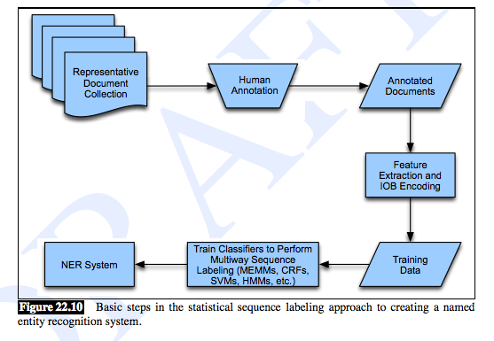
NER System Building Process
Test Data
Evaluate Precision and Recall

Slide 13
Relation Extraction

Slide 14
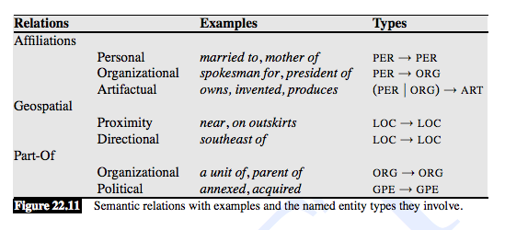
Examples of Relations

Slide 15
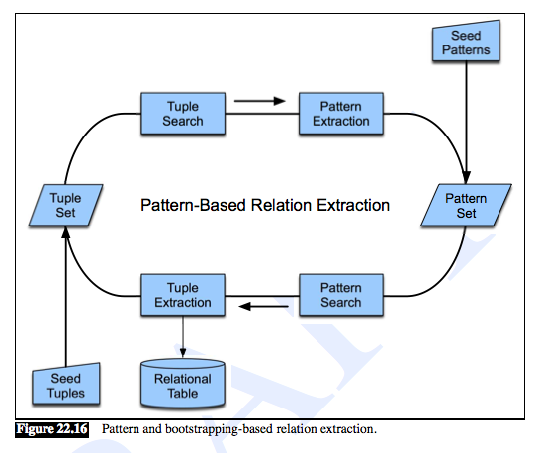
Bootstrapping Relations

Slide 16
Information Retrieval

Slide 17
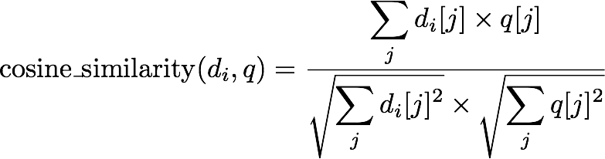

The Vector Space Model
Each document is a |Σ|-dimensional vector di:
Given a query q, represent it in the same way.
Similarity of vectors ⇒ relevance:
Twists: tf-idf

Slide 18
Evaluating Information Retrieval
precision
recall

Slide 19
Question Answering

Slide 20
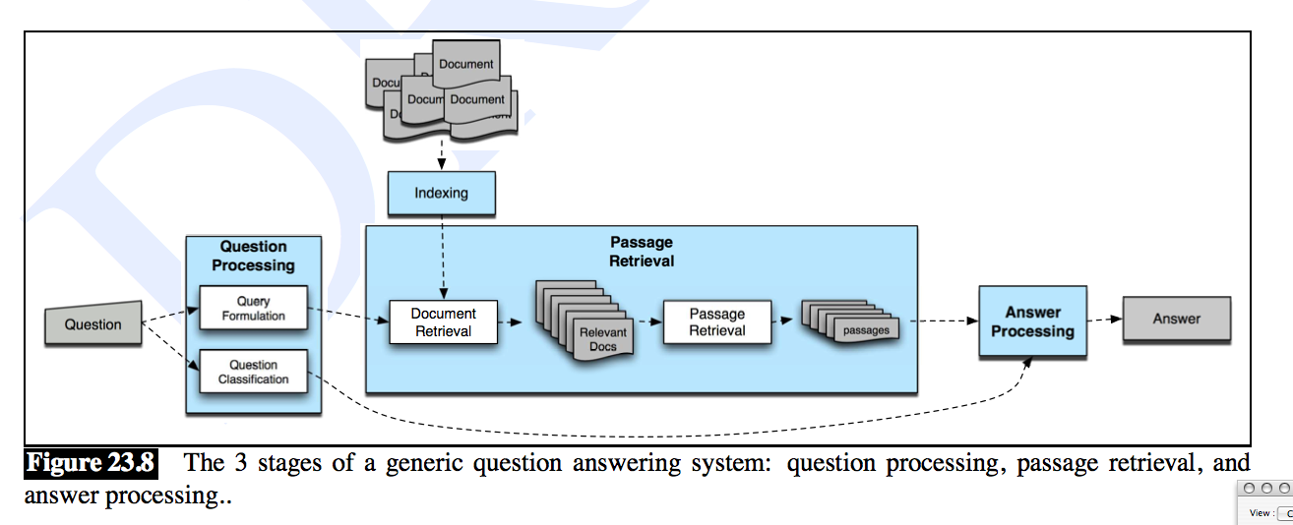
Question Answering Architecture
SLP p. 793

Slide 21
Your Project (Perhaps)
known document
Question
SLP p. 793

Slide 22
Evaluating QA

Slide 23
Some General Tools
Supervised classification
Feature vector representations
Bootstrapping
Evaluation:
  Precision and recall (and their curves)
  Mean reciprocal rank

