Slide 1
Natural Language Processing
Lecture 5: Scripting with Python

Slide 2
Preliminaries
How comfortable is everyone with writing code?
How comfortable is everyone with Python?
Python is a scripting language.
  Why is this good?
  Why is this bad?

Slide 3
Caveats
There are many ways to do the same thing in Python
We will NOT tell you everything
We will also tell you things we find useful for text processing using Python
There are lots of NLP tools to choose from
There are lots of programming languages to choose from
Notes:
-”many ways”: some of you are probably experts already
-You will have to evaluate the NLP tools that you find online
-Python may not be the best language for your project

Slide 4
Outline
Python
  File IO
  Python data types – Lists, dictionaries, tuples
  String operations
  Regular expressions
  Handling Unicode
  Useful packages
Notes:
Python 2.x mostly

Slide 5
Python Scripts

Slide 6
Hello, World!
# comments
print ‘Hello, World!’
Notes:
Comment lines begin with hashes
Strictly speaking, there is no multiline comment

Slide 7
Control flows: for
# comments
for i in range(0,11):
print i,
# tips: xrange is slightly faster
output:
0 1 2 3 4 5 6 7 8 9 10
no curly brackets, python uses indentation for code blocks

Slide 8
Reading files
# comments
inputfile=open(‘myfile.txt’)
for line in inputfile:
print line
inputfile.close()
Notes:
Files are opened to read by default
They can be used as iterators

Slide 9
Python modules
# a module is just a file ending in .py containing
# a set of functions
import os,sys
# comments
Notes:
Import using the import command
You can import more than one module per line, though for style don’t

Slide 10
Python modules
# os.py file in the python “site” path
import os
# def walk(…) in os.py
os.walk
# selective import
from os.path import join
join(“/home”, “usrname”)
# rename for convenience
import os as cats
cats.walk(…)
Notes:
For our purposes a Python module isessentially a python file, ending with .py
You can import specific items out of a module; or import a module and assign it an alias

Slide 11
Iterating a directory
import os,sys
# comments
for path,dirs,files in os.walk(‘/usr’):
print path
print dirs
print files
/usr
['bin', 'include', 'lib', 'libexec', 'local', 'sbin', 'share', 'standalone', 'texbin', 'tibs', 'X11', 'X11R6']
[]
/usr/bin
[]
['2to3', '2to3-', ...

Slide 12
Writing files
# comments
inputfile=open(‘myfile.txt’)
outputfile=open(‘myoutput.txt’,’w’)
for line in inputfile:
outputfile.write(line)
inputfile.close()
outputfile.close()
Notes:
To write: we use the open function, but with a ‘w’ parameter or ‘wb’ for binary mode
What does the script on screen do?

Slide 13
Control flows: if
# comments
for i in range(0,11):
if i%3 == 0:
print 3,
elif i%2 == 0:
print 2,
else:
print 1,
output:
3 1 2 3 2 1 3 1 2 3 2
Notes:
Note the importance of indentation: the indent level determines how the elses attach to ifs

Slide 14
False in Python
Things that are False:
  None
  False (boolean value)
  Zero of any numeric type: 0, 0L, 0.0
  Any empty sequence: ‘ ’, ( ), [ ]
  Any empty mapping: { }
Logical operators: and or not (like English)
© Noah A. Smith 2011

Slide 15
String operations
# comments
i=‘natural’
j=‘language’
k=‘processing’
print i+‘ ’+j+‘ ’+k
Output:
natural language processing

Slide 16
Type conversion
# comments
i=‘1’
j=‘2’
k=‘3’
print int(i)+int(j)+int(k)
output:
6

Slide 17
Important data types in Python
file
bool
int
float
str / unicode (character string)
list
dict
tuples
© Noah A. Smith 2011

Slide 18
List
# comments
strings=[‘natural’,‘language’,‘processing’]
for s in strings:
print s,
print ‘is fun’
output:
natural language processing is fun

Slide 19
Processing characters
# comments
w=‘natural’
for i in range(0,len(w)):
print w[i],
# alternatively
for i in w:
print i,
output:
n a t u r a l

Slide 20
Dictionary
# comments
dictionary = {}
dictionary[‘one’] = 1
dictionary[‘two’] = 2
dictionary[‘three’] = 3
for d in dictionary:
print d+‘ ’+str(dictionary[d]),
output:
three 3 two 2 one 1

Slide 21
Dictionary
# comments
dictionary = {}
dictionary[‘one’] = 1
dictionary[‘two’] = 2
dictionary[‘three’] = 3
word = ‘two’
if word not in dictionary:
dictionary[word] = 0
else:
print dictionary[word]
output: 2

Slide 22
Python functions
def myfunction(a,b =‘world’):
print a+b
return (a, b)
r = myfunction(1,2) # 3
r = myfunction(‘nat’,‘lang’) # natlang
r = myfunction(‘hello’) # helloworld
x, y = myfunction(7, 8) # x=7, y=8
nlp_func = lambda a, b: a+b
nlp_func(‘hello’, ‘world’)
Notes:
Python functions look like this.
Every time a function is called, it has its own variable space.
If a variable cannot be found in its own variable space, it moves up the call stack and search in the variable space until it reaches the global “function”.
No restrictions on the data types
Function arguments can be made optional
Lambda “functions”

Slide 23
Main “function”
# function definitions
# main usually comes at the end
# after the function definitions
if __name__=='__main__':
a = 10
. . .
Notes:
so lets say you have a script that can be run from the command line, or imported by another python file.
How would you distinguish between the two?
The trick is in the __name__ variable, python has a bunch of these variables that contain information about the interpreter’s state.
__name__ is one that stores the name of the caller.

Slide 24
Quick style guide
Use parentheses sparingly
Indent code with 4 spaces
  Never mix tabs and spaces
Imports should be on separate lines
Naming:-
GLOBAL_CONST, global_var, function_name, module_name, ClassName
Ref: http://google-styleguide.googlecode.com/svn/trunk/pyguide.html
http://legacy.python.org/dev/peps/pep-0008/

Slide 25
In a few days Mr. Bingley returned Mr. Bennet's visit, and sat about ten minutes with him in his library. He had entertained hopes of being admitted to a sight of the young ladies, of whose beauty he had heard much; but he saw only the father. The ladies were somewhat more fortunate, for they had the advantage of ascertaining from an upper window that he wore a blue coat, and rode a black horse. An invitation to dinner was soon afterwards dispatched; and already had Mrs. Bennet planned the courses that were to do credit to her housekeeping, when an answer arrived which deferred it all. Mr. Bingley was obliged to be in town the following day, and, consequently, unable to accept the honour of their invitation, etc. Mrs. Bennet was quite disconcerted. She could not imagine what business he could have in town so soon after his arrival in Hertfordshire; and she began to fear that he might be always flying about from one place to another, and never settled at Netherfield as he ought to be. Lady Lucas quieted her fears a little by starting the idea of his being gone to London only to get a large party for the ball; and a report soon followed that Mr. Bingley was to bring twelve ladies and seven gentlemen with him to the assembly. The girls grieved over such a number of ladies, but were comforted the day before the ball by hearing, that instead of twelve he brought only six with him from London--his five sisters and a cousin. And when the party entered the assembly room it consisted of only five altogether--Mr. Bingley, his two sisters, the husband of the eldest, and another young man. Mr. Bingley was good-looking and gentlemanlike; he had a pleasant countenance, and easy, unaffected manners. His sisters were fine women, with an air of decided fashion. His brother-in-law, Mr. Hurst, merely looked the gentleman; but his friend Mr. Darcy soon drew the attention of the room by his fine, tall person, handsome features, noble mien, and the report which was in general circulation within five minutes after his entrance, of his having ten thousand a year. The gentlemen pronounced him to be a fine figure of a man, the ladies declared he was much handsomer than Mr. Bingley, and he was looked at with great admiration for about half the evening, till his manners gave a disgust which turned the tide of his popularity; for he was discovered to be proud; to be above his company, and above being pleased; and not all his large estate in Derbyshire could then save him from having a most forbidding, disagreeable countenance, and being unworthy to be compared with his friend. Mr. Bingley had soon made himself acquainted with all the principal people in the room; he was lively and unreserved, danced every dance, was angry that the ball closed so early, and talked of giving one himself at Netherfield. Such amiable qualities must speak for themselves. What a contrast between him and his friend! Mr. Darcy danced only once with Mrs. Hurst and once with Miss Bingley, declined being introduced to any other lady, and spent the rest of the evening in walking about the room, speaking occasionally to one of his own party. His character was decided. He was the proudest, most disagreeable man in the world, and everybody hoped that he would never come there again. Amongst the most violent against him was Mrs. Bennet, whose dislike of his general behaviour was sharpened into particular resentment by his having slighted one of her daughters.
PYTHON FOR TEXT

Slide 26
How do I?
GET THE WORDS

Slide 27
String operations
# comments
w=‘natural language processing\n’
tokens=w.strip().split()
for t in tokens:
print t
output:
natural
language
processing
Notes:
Language involves text, words
Poor man’s tokenizer
What will go wrong with this? (punctuation; contractions)
We’ll get back to tokenization

Slide 28
String operations
# comments
wlist =[‘natural’,‘language’,‘processing’]
print ‘ ’.join(wlist)
output:
natural language processing

Slide 29
Regular expressions
# matching single character
a # matches ‘a’
abc # matches `abc’
[abc] # matches ‘a’,‘b’ or ‘c’
[a-z] # matches ‘a’, ‘b’, …, or ‘z’
[a-z0-9] # matches any lowercase alphanumerics
[^a-z] # matches anything not in [a-z]
\d # matches digits
\D # matches non digits, i.e [^0-9]
\s # matches whitespaces
\b # matches empty string at beginning or end of word
\w # equivalent to [a-zA-Z0-9]
. # matches any single character
Notes:
Who has not worked with regular expressions before?
See python definition for \b, alphanumeric+underscore

Slide 30
Regular expressions
# matching patterns
fo* # matches ‘f’, ‘fo’, ‘foo’, …
fo+ # matches ‘fo’, ‘foo’, ‘fooo’, …
fo? # matches ‘f’ or ‘fo’
foo|bar # matches ‘foo’ or ‘bar’
fo(o|b)ar # matches ‘fooar’ or ‘fobar’
(foo)+ # matches ‘foo’, ‘foofoo’, …
^foo # matches ‘foo’ at the beginning only
foo$ # matches ‘foo’ at the end only
fo+? # overloaded ?, non-greedy wildcard matching
Notes:
See python definition for \b, alphanumeric+underscore
^ => beginning

Slide 31
Regular expressions
print "Words, words, words.".split()
# ['Words,', 'words,', 'words.']
\W = all characters not in [0-9a-zA-z]
print re.split(r'\W+', 'Words, words, words.')
# ['Words', 'words', 'words', '']
Keep all delimiters too:
print re.split(r’(\W+)', 'Words, words, words.‘)
# ['Words', ', ', 'words', ', ', 'words', '.', '']
Notes:
There is a regular expression split function that is more powerful than the string member function
See python definition for \b, alphanumeric+underscore
^ => beginning

Slide 32
How do I?
FIND ALL THE EMAILS
(or URLS/DATES, PRESIDENTS, ETC.)

Slide 33
Regular expressions
# Let’s find all the presidents in text
line = """President Barack Obama said that
First Lady Michelle Obama said ...
... French President Francois Holland said ...
"""
presRe=re.compile(r'(President( [A-Z][\S]*)+)')
print pres.findall(line)
[('President Barack Obama', ' Obama'), ('President Francois Holland', ' Holland')]
Notes:
Note r operator in front of string of the string: instructs Python to interpret the string as a “raw” string
--The details are complicated; they involve the backslash
--It’s generally a good idea to use raw strings to represent regular expressions
Note the use of parentheses: they subdivide matches in the text

Slide 34
Regular expressions
# regex groups with parentheses
re_email = re.compile(r‘([0-9a-z][\w_\.-]*)\@([0-9a-z][\w_\.-]*)\.([a-z]{2,4})$’)
m = re_email.match(‘johnsmith@cs.cmu.edu’)
print m.group() # johnsmith@cs.cmu.edu
print m.group(1) # johnsmith
print m.group(2) # cs.cmu
print m.group(3) # edu
m = re_email.search(‘my email is johnsmith@cs.cmu.edu’)
print m.span() # (12, 32)
print m.span(1) # (12, 21)
Notes:
Can break this regex up into three parts – the name, domain, and the top level domain
See how the parts have parentheses? They “group” the results into substrings of the match.
The match function starts with the first character in the string; you can use the search function to find a match anywhere in the string.

Slide 35
Regular expressions
# substitutions
print re.sub(r'\s+', ' ', 'a line with space')
# a line with space
re_email = re.compile(r‘([0-9a-z][\w_\.-]*)\@([0-9a-z][\w_\.-]*)\.([a-z]{2,4})$’)
print re_email.sub(r‘shomir@\2.\3', ‘johnsmith@cs.cmu.edu')
# shomir@cs.cmu.edu
Notes:
The regex library also helps us make substitutions in strings.
First example: remove “extra” spaces in a string; note the three parameters to this form of sub
Second example: note the two parameters to this form of sub, as a member function of a compiled regex; note the \2 and \3
That’s all for regexes
For more: see Chapter 2 of the textbook on regular expressions and automata.

Slide 36
BUT THE WORDS ARE ALL MESSED UP

Slide 37
'ascii' codec can't encode character u'\u2019' in position 16: ordinal not in range(128)

Slide 38
Handling Unicode in Python
# processing a utf-8 encoded file
contents = open(‘wiki-article.txt’, ‘r’).read()
u_content = contents.decode(‘utf-8’)
# alternatively
import codecs
contents = codecs.open(‘wiki-article.txt’, ‘r’, ‘utf-8’).read()
# common Unicode symbols: ‘, ’, “, ”, –
# diacritics: á, é, í, ñ
a_content = u_content.encode(‘ascii’, errors=‘ignore’)
# errors = [‘strict’, ‘ignore’, ‘replace’]
Notes:
-Might need to know this for your project, since some of the Wikipedia articles may contain unicode symbols.
-A good practice, shown here: immediately upon reading the contents of a file, decode its character encoding
--utf-8 should work with the Wikipedia articles
--Result is a unicode string
-Alternative, also shown here: use the codecs module: converts unicode to ASCII
--Might not want to do that, because it ignores or drops unicode symbols it can’t convert

Slide 39
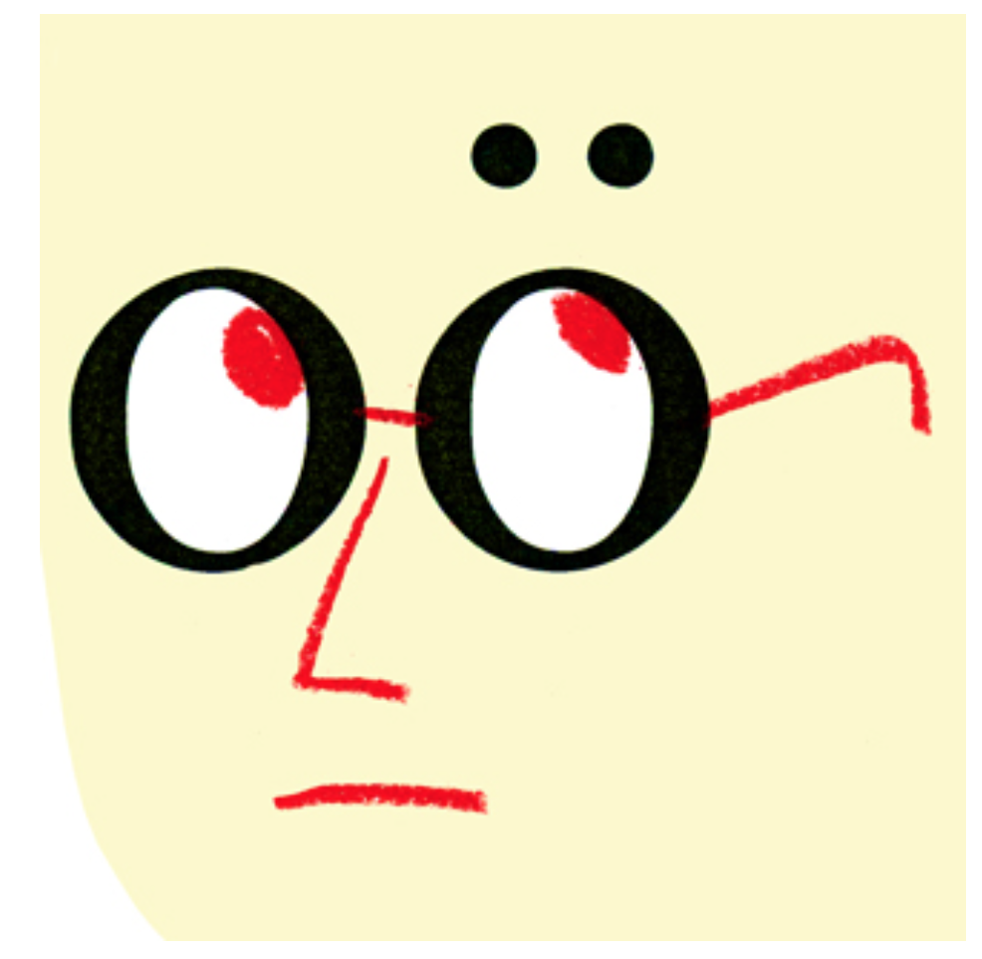
The special tool we use here at The New Yorker for punching out the two dots that we then center carefully over the second vowel in such words as “naïve” and “Laocoön” will be getting a workout this year, as the Democrats coöperate to reëlect the President.
Mary Norris, “The Curse of the Diaeresis,” New Yorker. April 26, 2012
Notes:
Here’s an example string with some extended characters: o’s and i’s with umlats
--Might or might not be represented in unicode

Slide 40
Handling Unicode in Python
# ñ (\u00f1) is also n (\u006e) + ~ (\u0303)
# we need normalization!
# http://en.wikipedia.org/wiki/Unicode_equivalence#Normalization
# coding: utf-8
import unicodedata
n = unicodedata.normalize(‘NFKD’, u‘ñ’) # u'n\u0303‘
# ignore diacritics
unicodedata.normalize('NFKD', u'André').encode('ascii', errors='ignore')
# Andre
__RE_HYPHENS = regex.compile(ur'[\p{Pd}\p{Pc}]+', re.U)
Notes:
A tricky thing about unicode: it is sometimes possible to represent the same character multiple ways
--Those multiple ways might or might not be equivalent
--Problem: strings that look equivalent to a human reader actually aren’t
If you run into a problem where strings that seem like they should be equivalent aren’t: use normalize with the NFKD parameter
--Applies some conventions to the input string that eliminate strange non-equivalence problems
You also might consider discarding diacritics, especially if the input text does not use them uniformly
Hyphens are sometimes a pain: there are about 20 of them in unicode, in varying weights and lengths.
---
[OLD NOTES BELOW]
Thing about unicode is that each character is not necessarily represented with one character.
Can be represented in multiple ways…and they might or might not be equivalent.
Unicode defines things that are equivalent, like the spanish ene, but there are also symbols that look the same but are not considered equivalent, for instance roman numerals IX.
So there are several ways of decomposing and composing them etc, which I am not going to talk about. You probably wont need it for this course, but you might encounter these things in the future, especially when we start working with data from different sources, etc.
Might be useful in job interview too, google, i18n urls, etc.
Need to use a coding: comment in file to signify that this file is in unicode and the interpreter will interpreted it as such.
One thing that I usually do, since I work primarily with English data, is that I just drop all these diacritics stuff that come up once in a while in my data.
See Unicodedata
For example, the name Andre, without normalization, it comes out as Andr, but with normalization, we get Andre, which is closer to the name itself?
The regex library we talked about, re, has rudimentary support for unicode.
Python has a new regex library that is under development, might have been in Python 3, I am not sure, but in Python 2.x its called “regex”.
One of the cool things is that it has support for unicode categories, so in this regex, \p refers to unicode category, and Pd => punctuation dashes, Pc=>punct connector.
Hyphens in html data can be a pain, especially when different editors use different forms of dashes for aesthetic reasons…there are about 20 over different forms defined in the unicode standard.

Slide 41
Handling Unicode in Python
# more un-latin like alphabets?
# arabic? cyrillic? devanagari scripts? chinese, japanese, korean?
import unidecode # http://pypi.python.org/pypi/Unidecode
import unihandecode # http://pypi.python.org/pypi/Unihandecode
print (u"\u5317\u4EB0")
# 北亰
print unidecode(u"\u5317\u4EB0")
# Bei Jing
# transliteration!
# it is an open problem: FSTs? Machine learning?
Notes:
For some languages, there are defined ways to convert from symbols to alphabetical sounds
But for languages like mandarin, these mappings are no where near 1 to 1

Slide 42
How do I?
COUNT STUFF

Slide 43
Python “Counter”
# Counter
from collections import Counter
cnt = Counter()
for word in ['red', 'blue', 'red', 'green', 'blue']:
cnt[word] += 1
print cnt
# Counter({'blue': 2, 'red': 2, 'green': 1})
print cnt + cnt
# Counter({'blue': 4, 'red': 4, 'green': 2})
words = re.findall('\w+ly', open(‘alice.txt’).read().lower())
print Counter(words).most_common(3)
# [('only', 52), ('hastily', 16), ('certainly', 14)]
Notes:
Features*
Essentially a dictionary with numerical values

Slide 44
How do I?
COUNT MORE THAN WORDS

Slide 45
Useful Python modules
import sys, os, datetime, math, string, random import subprocess
import urllib, BeautifulSoup, json, pickle
import re
import collections
import numpy, scipy, pandas, matplotlib, nltk, gensim, networkx
Notes:
Power of Python is that there are libraries for everything
Json, url management, scraping websites, databases, multithreading, etc etc
If you can’t find it in the python standard library, you can probably download it from the python package index.
But today, we are just going to be looking at a few that are useful for nlp applications.

Slide 46
Python for NLP
import nltk
# http://nltk.org/ and http://nltk.org/book/
# natural language toolkit
sentence = "At eight o'clock on Thursday morning Arthur didn't feel very good."
tokens = nltk.word_tokenize(sentence)
print tokens
['At', 'eight', "o'clock", 'on', 'Thursday', 'morning', 'Arthur', 'did', "n't", 'feel', 'very', 'good', '.']
tagged = nltk.pos_tag(tokens)
print tagged[0:6]
[('At', 'IN'), ('eight', 'CD'), ("o'clock", 'JJ'), ('on', 'IN'), ('Thursday', 'NNP'), ('morning', 'NN')]
# tokenization, tagging, parsing, chunking, etc.
Notes:
-NLTK could be really useful for your project
-Remember the word tokenization problem we discussed earlier? Here’s a solution with NLTK
-There are lots of tools in NLTK to do things we haven’t talked about yet

Slide 47
Python for NLP
from nltk.corpus import wordnet
for syn in wordnet.synsets('bank', 'n'):
print syn.name(), syn.definition()
  bank.n.01 sloping land (especially the slope beside a body of water)
  depository_financial_institution.n.01 a financial institution that accepts deposits and channels the money into lending activities
  bank.n.03 a long ridge or pile
  bank.n.04 an arrangement of similar objects in a row or in tiers
  bank.n.05 a supply or stock held in reserve for future use (especially in emergencies)
  …
Notes:
NLTK includes an interface to WordNet: an ontology of words
What’s an ontology? (A description of entities and the relationships between them)
Wordnet organizes words into synsets: each synset expresses a concept
NLTK will tell us definitions of words; we can do NLP on definitions, too.
--Why? More on that later in the semester.

Slide 48
Python for NLP
from nltk.corpus import wordnet
for syn in wordnet.synsets(’bank', 'n'):
print syn.hypernyms()
  [Synset('slope.n.01')]
  [Synset('financial_institution.n.01')]
  [Synset('ridge.n.01')]
  [Synset('array.n.01')]
  [Synset('reserve.n.02')]
  [Synset('funds.n.01')]
  [Synset('slope.n.01')]
  …
Notes:
Wordnet specifies relationships between synsets:
Hypernyms
The hypernym of a synset is another synset whose meaning subsumes it
Think of it as a generality relationship
A synset can have multiple hypernyms
The noun ontology has a unique root hypernym: entity

Slide 49
Python for NLP
from nltk.corpus import wordnet
for syn in wordnet.synsets('bass', 'n'):
print syn.hyponyms()
  []
  [Synset('figured_bass.n.01'), Synset('ground_bass.n.01')]
  []
  [Synset('striped_bass.n.01')]
  [Synset('smallmouth_bass.n.01'), Synset('largemouth_bass.n.01')]
  [Synset('basso_profundo.n.01')]
  [Synset('bass_horn.n.01'), Synset('bass_guitar.n.01'), Synset('bass_fiddle.n.01’)[Synset('freshwater_bass.n.02')]
Notes:
Hyponym of a synset is another synset that’s more specific
A synset can have multiple hyponyms

Slide 50
How do I?
LEARN

Slide 51
Python for Machine Learning
import numpy as np, scipy, matplotlib
# http://www.numpy.org/ <- handle numbers
# http://www.scipy.org/ <- scientific functions
# http://matplotlib.org/ <- plotting
# http://scikit-learn.org/stable/ <- machine learning
a = np.array([1,2,3])
print a[1:3] # matlab style indexing
print np.dot(a, a) # linear algebra functions
# many more implementations for common mathematical
# functions like root finding, FFTs, etc
# matlab-like plotting with matplotlib
Notes:
Who uses Matlab?
Numpy is a little like Matlab; it will let you work with arrays in a mathematically intuitive fashion

Slide 52
Python for Machine Learning
from sklearn import linear_model, datasets
iris = datasets.load_iris()
X=iris.data
Y=iris.target
logreg = linear_model.LogisticRegression()
logreg.fit(X, Y)
# learned parameters:
logreg.coef_
logreg.intercept_
# classification, regression, clustering, dimensionality reduction
Notes:
Machine learning: libraries available for this too
Look into SciKit and sklearn which is part of SciKit

Slide 53
IN PRACTICE

Slide 54
Putting it all together
Example python script to extract features from documents and learn a movie review sentiment classifier, with:
- nltk, re
- numpy
- scikit-learn
- scipy
http://bit.ly/1ncNt85
Notes:
Try this at home: it takes too long to run on my laptop
The script at this URL uses machine learning to classify movie reviews as positive or negative
Download the script
Download and extract the tarfile it mentions in the header

