Slide 1
Natural Language Processing
Lecture 14: Context-Free Recognition

Slide 2
Context-Free Grammars
Using grammars
Recognition
Parsing
Parsing algorithms
Top down
Bottom up
CNF
CKY Algorithm

Slide 3
Context-Free Grammars
Vocabulary of terminal symbols, Σ
Set of nonterminal symbols (a.k.a. variables), N
Special start symbol S ∈ N
Production rules of the form X → α
where
X ∈ N
α ∈ (N ∪ Σ)*

Slide 4
Two Related Problems
Input: sentence w = (w1, ..., wn) and CFG G
Output (recognition): true iff w ∈ Language(G)
Output (parsing): one or more derivations for w, under G

Slide 5
Parsing as Search
S
top-down
bottom-up
w1 ...
... wn

Slide 6
Implementing Recognizers as Search
Agenda = { state0 }
while(Agenda not empty)
s = pop a state from Agenda
if s is a success-state return s // valid parse tree
else if s is not a failure-state:
generate new states from s
push new states onto Agenda
return nil // no parse!

Slide 7
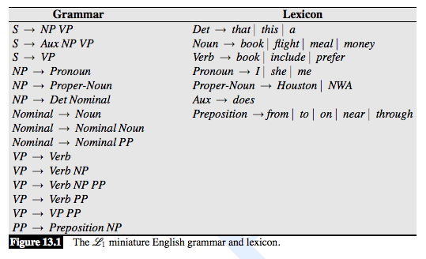
Example Grammar and Lexicon

Slide 8
Recursive Descent (A Top-Down Parser)
Start state: (S, 0)
Scan: From (wj+1 β, j), you can get to (β, j + 1).
Predict: If Z → γ, then from (Z β, j), you can get to (γβ, j).
Final state: (ε, n)

Slide 9
Example Grammar and Lexicon

Slide 10
Shift-Reduce (A Bottom-Up Parser)
Start state: (ε, 0)
Shift: From (α, j), you can get to (α wj+1, j + 1).
Reduce: If Z → γ, then from (αγ, j) you can get to (α Z, j).
Final state: (S, n)

Slide 12
Context-Free Grammars in Chomsky Normal Form
Vocabulary of terminal symbols, Σ
Set of nonterminal symbols (a.k.a. variables), N
Special start symbol S ∈ N
Production rules of the form X → α
where
X ∈ N
α ∈ N,N ∪ Σ

Slide 13
Context-Free Grammars in Chomsky Normal Form
Vocabulary of terminal symbols, Σ
Set of nonterminal symbols (a.k.a. variables), N
Special start symbol S ∈ N
Production rules of the form X → α
where
X ∈ N
α ∈ N,N ∪ Σ

Slide 14
Convert CFGs to CNF
For each rule
X → A B C
Rewrite as
X → A X2
X2 → B C
Introducing a new non-terminal

Slide 15
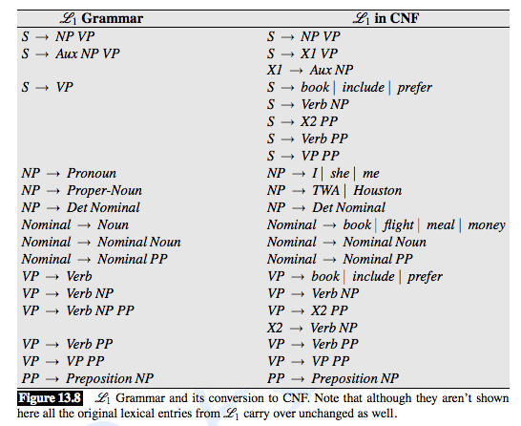

Slide 16
CKY Algorithm: Chart
book
 | this
 |  | flight
 |  |  | through
 |  |  |  | Houston

Slide 17
CKY Algorithm: Chart
 | Noun
book
 | this
 |  | flight
 |  |  | through
 |  |  |  | Houston

Slide 18
CKY Algorithm: Chart
 | Noun, Verb
book
 | this
 |  | flight
 |  |  | through
 |  |  |  | Houston

Slide 19
CKY Algorithm: Chart
 | Noun, Verb
book |  | Det
 | this |  | Noun
 |  | flight |  | Prep
 |  |  | through |  | PNoun
 |  |  |  | Houston

Slide 20
CKY Algorithm: Chart
 | Noun, Verb
book |  | Det
 | this |  | Noun
 |  | flight |  | Prep
 |  |  | through |  | Pnoun, NP
 |  |  |  | Houston

Slide 21
CKY Algorithm: Chart
 | Noun, Verb | -
book |  | Det
 | this |  | Noun
 |  | flight |  | Prep
 |  |  | through |  | PNoun
 |  |  |  | Houston

Slide 22
CKY Algorithm: Chart
 | Noun, Verb | -
book |  | Det | NP
 | this |  | Noun
 |  | flight |  | Prep
 |  |  | through |  | PNoun, NP
 |  |  |  | Houston

Slide 23
CKY Algorithm: Chart
 | Noun, Verb | -
book |  | Det | NP
 | this |  | Noun
 |  | flight |  | Prep
 |  |  | through |  | PNoun, NP
 |  |  |  | Houston

Slide 24
CKY Algorithm: Chart
 | Noun, Verb | -
book |  | Det | NP
 | this |  | Noun | -
 |  | flight |  | Prep
 |  |  | through |  | PNoun, NP
 |  |  |  | Houston

Slide 25
CKY Algorithm: Chart
 | Noun, Verb | -
book |  | Det | NP | -
 | this |  | Noun | -
 |  | flight |  | Prep
 |  |  | through |  | PNoun, NP
 |  |  |  | Houston

Slide 26
CKY Algorithm: Chart
 | Noun, Verb | -
book |  | Det | NP | -
 | this |  | Noun | -
 |  | flight |  | Prep | PP
 |  |  | through |  | PNoun, NP
 |  |  |  | Houston

Slide 27
CKY Algorithm: Chart
 | Noun, Verb | -
book |  | Det | NP | -
 | this |  | Noun | - | -
 |  | flight |  | Prep | PP
 |  |  | through |  | PNoun, NP
 |  |  |  | Houston

Slide 28
CKY Algorithm: Chart
 | Noun, Verb | -
book |  | Det | NP | - | NP
 | this |  | Noun | - | -
 |  | flight |  | Prep | PP
 |  |  | through |  | PNoun, NP
 |  |  |  | Houston

Slide 29
CKY Algorithm: Chart
 | Noun, Verb | - | VP
book |  | Det | NP | - | NP
 | this |  | Noun | - | -
 |  | flight |  | Prep | PP
 |  |  | through |  | PNoun, NP
 |  |  |  | Houston

Slide 30
CKY Algorithm: Chart
 | Noun, Verb | - | VP,S
book |  | Det | NP | - | NP
 | this |  | Noun | - | -
 |  | flight |  | Prep | PP
 |  |  | through |  | PNoun, NP
 |  |  |  | Houston

Slide 31
CKY Algorithm: Chart
 | Noun, Verb | - | VP,S | -
book |  | Det | NP | - | NP
 | this |  | Noun | - | -
 |  | flight |  | Prep | PP
 |  |  | through |  | PNoun, NP
 |  |  |  | Houston

Slide 32
CKY Algorithm: Chart
 | Noun, Verb | - | VP,S | - | S
book |  | Det | NP | - | NP
 | this |  | Noun | - | -
 |  | flight |  | Prep | PP
 |  |  | through |  | PNoun, NP
 |  |  |  | Houston

Slide 33
CKY Algorithm
for i = 1 ... n
C[i-1, i] = { V | V → wi }
for ℓ = 2 ... n // width
for i = 0 ... n - ℓ // left boundary
k = i + ℓ // right boundary
for j = i + 1 ... k – 1 // midpoint
C[i, k] = C[i, k] ∪
{ V | V → YZ, Y ∈ C[i, j], Z ∈ C[j, k] }
return true if S ∈ C[0, n]

Slide 34
CKY Equations
Notes:
C[i-1,i,w_i] &= \textsc{true} \\
C[i-1,i,V] &= \begin{cases} \textsc{true} & \textrm{if }V\rightarrow w_i\\
\textsc{false} & \textrm{otherwise}
\end{cases}\\
C[i,j,V] &= \begin{cases} \textsc{true} & \textrm{if }\exists j,Y,Z \textrm{ such that } \\ & V \rightarrow Y Z \\ & \textrm{ and } C[i,k,Y] \\ &
\textrm{ and } C[k,j,Z] \\ & \textrm{ and }i < k < j\\
\textsc{false} & \textrm{otherwise}
\end{cases} \\
\textrm{goal} &= C[0,n,S]
<number>

Slide 35
CKY Complexity
CKY worst case is O(n^3 . G)
Best in worst case
(Others better in average case)

Slide 36
CFG Grammars
Parsing and Recognition
Bottom up and Top down
CKY (for CNF)
Chart Parsing (Earley's Algorithm)

