Slide 1
CS101 Data Structures
Topological sort
Textbook Ch 22.4
Notes:
Adapted from the slides by Douglas Wilhelm Harder of U Waterloo (https://ece.uwaterloo.ca/~dwharder/aads/Lecture_materials/)
May also contain material from the slides at https://courses.cs.washington.edu/courses/cse326/03wi/326lecturesb.shtml (by Dan Suciu of U Washington)

Slide 2
Topological Sort
In this topic, we will discuss:
Motivations
Review the definition of a directed acyclic graph (DAG)
Describe a topological sort and applications
Prove the existence of topological sorts on DAGs
Describe an abstract algorithm for a topological sort
Do a run-time and memory analysis of the algorithm
Describe a concrete algorithm
Define critical times and critical paths

Slide 3
Outline
Topological sorting
Definitions
Algorithm
Finding the critical path

Slide 4
Motivation
Dependency between tasks: one task is required to be done before the other task can be done
Dependencies form a partial ordering
A partial ordering on a finite number of objects can be represented as a directed acyclic graph (DAG)

Slide 5
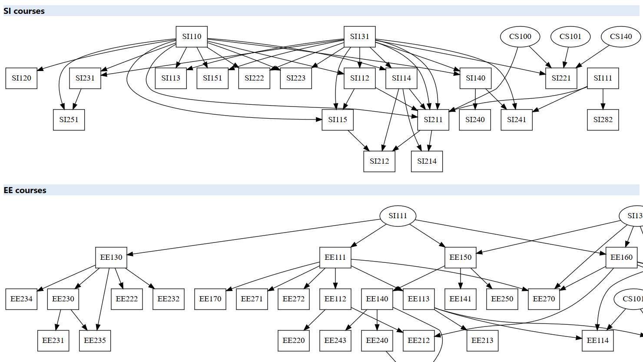
SIST course curriculum

Slide 6
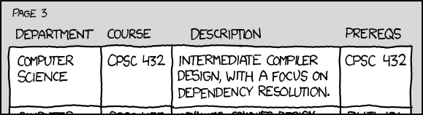
Motivation
http://xkcd.com/754/
Cycles in dependencies can cause issues...

Slide 7
Restriction of paths in DAGs
In a DAG, given two different vertices v_{j} and v_{k}, there cannot both be a path from v_{j} to v_{k} and a path from v_{k} to v_{j}
Proof:
Assume otherwise; thus there exists two paths:
(v_{j}, v_{1,1}, v_{1,2} , v_{1,3} , … , v_{k})
(v_{k}, v_{2,1}, v_{2,2} , v_{2,3} , … , v_{j})
From this, we can construct the path
(v_{j}, v_{1,1}, v_{1,2} , v_{1,3} , … , v_{k}, v_{2,1}, v_{2,2} , v_{2,3} , … , v_{j})
This a path is a cycle, but this is an acyclic graph
∴ contradiction

Slide 8
Topological sorting
Given a set of tasks with dependencies, is there an order in which we can complete the tasks?
A topological sorting of the vertices in a DAG is an ordering
v₁, v₂, v₃, …, v_{|V|}
such that v_{j} appears before v_{k} if there is a path from v_{j} to v_{k}

Slide 9
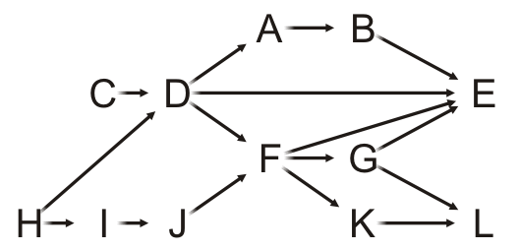
Example
Given this DAG, a topological sort is
H, C, I, D, J, A, F, B, G, K, E, L

Slide 10
Example
For example, there are paths from H, C, I, D and J to F, so all these must come before F in a topological sort
H, C, I, D, J, A, F, B, G, K, E, L
Clearly, this sorting need not be unique

Slide 11
Applications
Taking courses
The courses must be taken in an order such that the prerequisites of a course are taken before that course
Notes:
http://www.idealliance.org/proceedings/xml03/slides/mansfield&otkunc/Paper/03-02-04.html

Slide 12
Applications
Consider you getting ready for a dinner out
You must wear the following:
jacket, shirt, briefs, socks, tie, etc.
There are certain constraints:
the pants really should go on after the briefs,
socks are put on before shoes
Notes:
http://www.idealliance.org/proceedings/xml03/slides/mansfield&otkunc/Paper/03-02-04.html

Slide 13
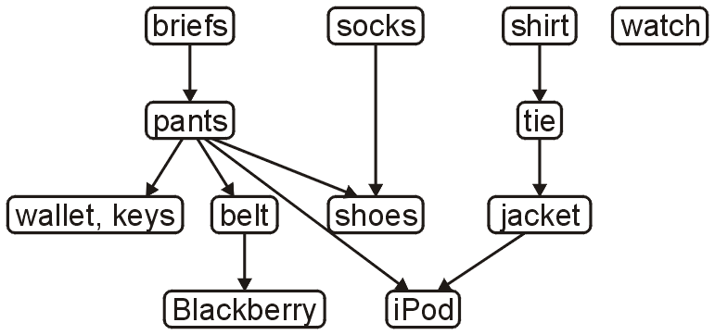
Applications
The following is a task graph for getting dressed:
Many people would go like this (a possible topological sort):
briefs, shirt, socks, pants, belt, tie, jacket, wallet, keys, iPod, watch, shoes
Another topological sort is:
briefs, pants, wallet, keys, belt, socks, shoes, shirt, tie, jacket, iPod, watch

Slide 14
Applications
C++ header and source files have #include statements
A change to an included file requires a recompilation of the current file
On a large project, it is desirable to recompile only those source files that depended on those files which changed
For large software projects, full compilations may take hours

Slide 15
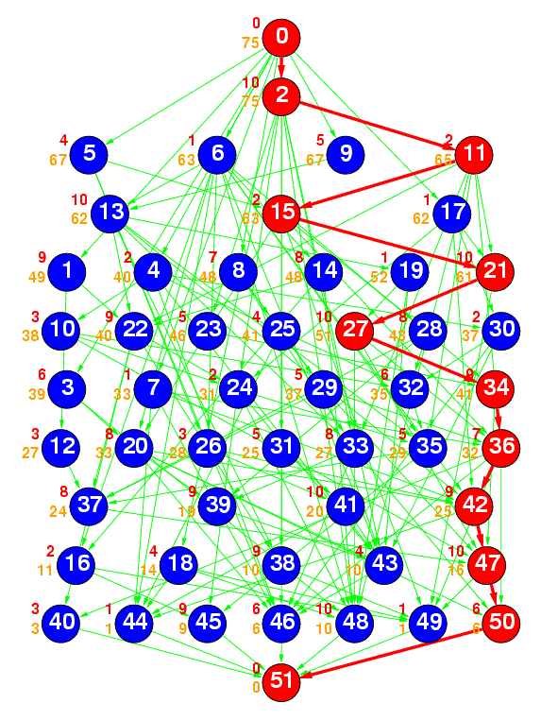
Applications
Ref: The Standard Task Graph
http://www.kasahara.elec.waseda.ac.jp/schedule/
The following is a DAG
representing a number of tasks
The green arrows represent dependencies
The numbering indicates a topological sort of the tasks

Slide 16
Topological Sort
Theorem:
A graph is a DAG if and only if it has a topological sorting
Proof strategy:
Such a statement is of the form a ↔ b and this is equivalent to:
a → b and b → a

Slide 17
Topological Sort
First, we need a two lemmas:
A DAG always has at least one vertex with in-degree zero
That is, it has at least one source
Proof by contradiction:
If we cannot find a vertex with in-degree zero, we will show there must be a cycle
Start with any vertex and define a list L = (v)
Then iterate this loop |V| times:
The first vertex ℓ₁ in the list L does not have in-degree zero
So we can find a vertex w such that (w, ℓ₁) is an edge
Add w to the list: L = (w, ℓ₁, …, ℓ_{k})
By the pigeon-hole principle, at least one vertex must appear twice
This forms a cycle; hence a contradiction, as this is a DAG

Slide 18
Topological Sort
First, we need a two lemmas:
Any sub-graph of a DAG is a DAG
Proof:
If a sub-graph has a cycle, that same cycle must appear in the super-graph
We assumed the super-graph was a DAG
This is a contradiction
∴ the sub-graph must be a DAG

Slide 19
Topological Sort
We will start with showing a → b:
If a graph is a DAG, it has a topological sort
Proof by induction:
A graph with one vertex is a DAG and it has a topological sort
Assume a DAG with n vertices has a topological sort
A DAG with n + 1 vertices must have at least one vertex v of in-degree zero
Removing the vertex v and consider the vertex-induced sub-graph with the remaining n vertices
If this sub-graph has a cycle, so would the original graph—contradiction
Thus, the graph with n vertices is also a DAG, therefore it has a topological sort
Add the vertex v to the start of the topological sort to get one for the graph of size n + 1

Slide 20
Topological Sort
Next, we will show that b → a:
If a graph has a topological ordering, it must be a DAG
We will show this by showing the contrapositive: ¬a → ¬b:
If a graph is not a DAG, it does not have a topological sort
By definition, it has a cycle: (v₁, v₂, v₃, …, v_{k}, v₁)
In any topological sort, v₁ must appear before v₂, because (v₁, v₂) is a path
However, there is also a path from v₂ to v₁: (v₂, v₃, …, v_{k}, v₁)
Therefore, v₂ must appear in the topological sort before v₁
This is a contradiction, therefore the graph cannot have a topological sort
∴ a ↔ b: A graph is a DAG if and only if it has a topological sorting

Slide 21
Outline
Topological sorting
Definitions
Algorithm
Finding the critical path

Slide 22
Topological Sort
Idea:
Given a DAG V, iterate:
Find a vertex v in V with in-degree zero
Let v be the next vertex in the topological sort
Continue iterating with the vertex-induced sub-graph V \ {v}

Slide 23
Example
On this graph, iterate the following |V| = 12 times
Choose a vertex v that has in-degree zero
Let v be the next vertex in our topological sort
Remove v and all edges connected to it

Slide 24
Example
Let’s step through this algorithm with this example
Which task can we start with?

Slide 25
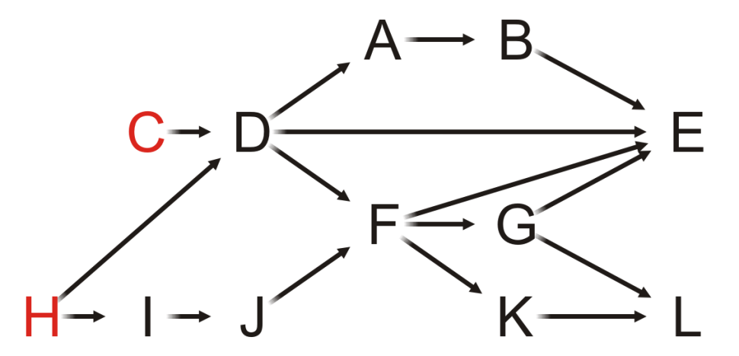
Example
Of Tasks C or H, choose Task C

Slide 26
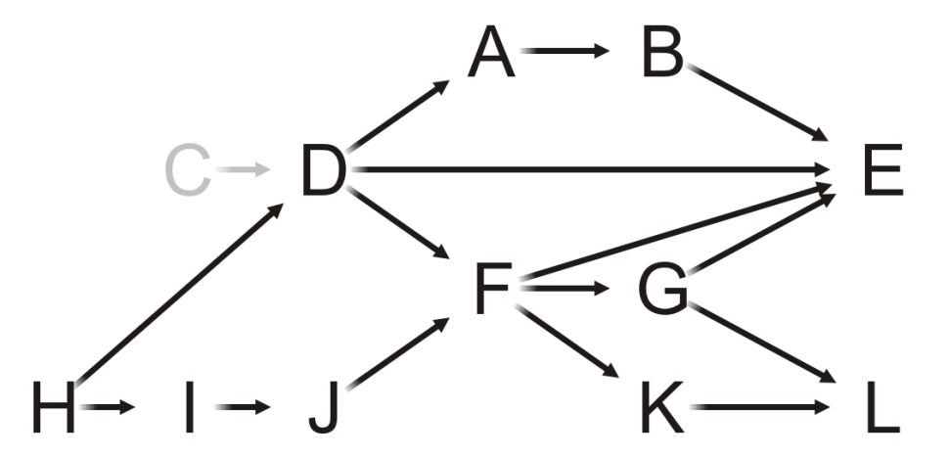
Example
Having completed Task C, which vertices have in-degree zero?
C

Slide 27
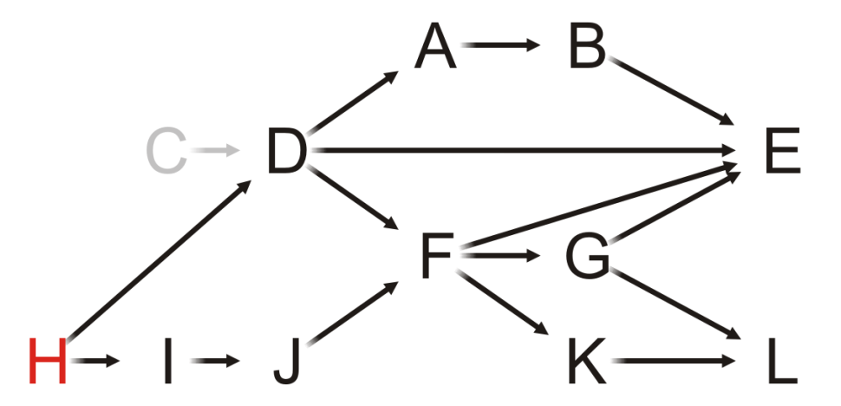
Example
Only Task H can be completed, so we choose it
C

Slide 28
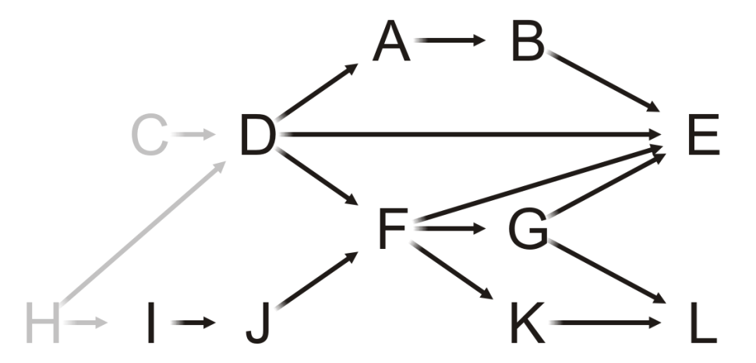
Example
Having removed H, what is next?
C, H

Slide 29
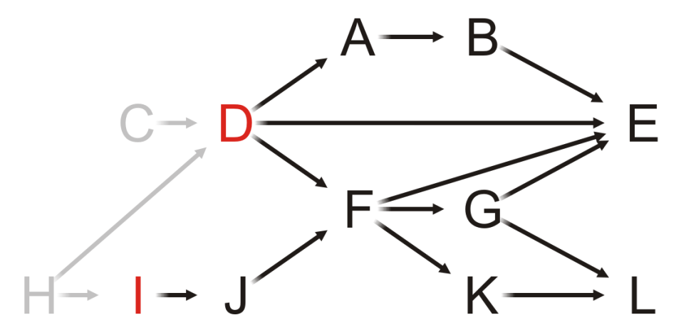
Example
Both Tasks D and I have in-degree zero
Let us choose Task D
C, H

Slide 30
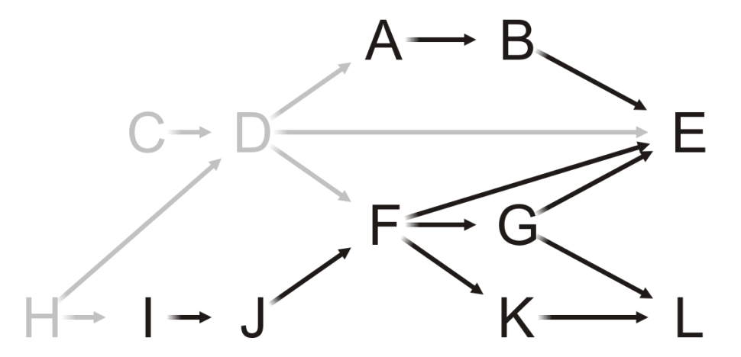
Example
We remove Task D, and now?
C, H, D

Slide 31
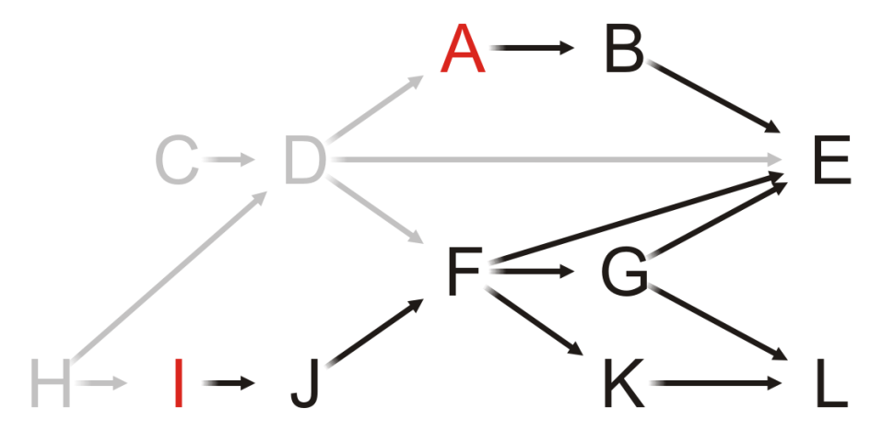
Example
C, H, D
Both Tasks A and I have in-degree zero
Let’s choose Task A

Slide 32
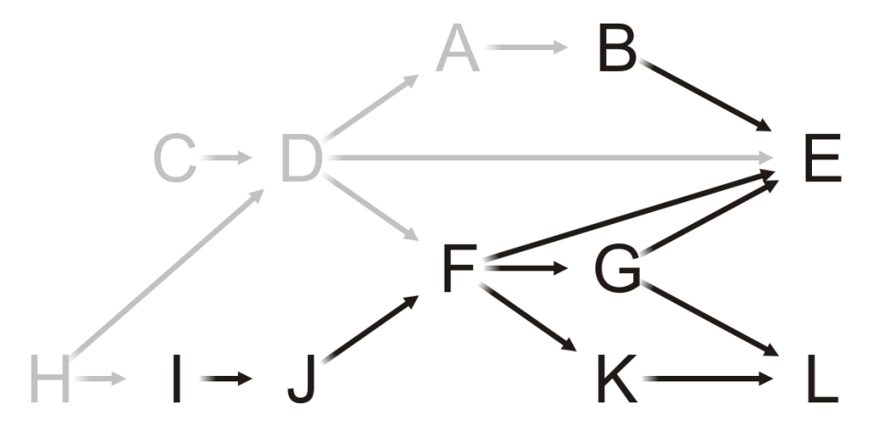
Example
C, H, D, A
Having removed A, what now?

Slide 33
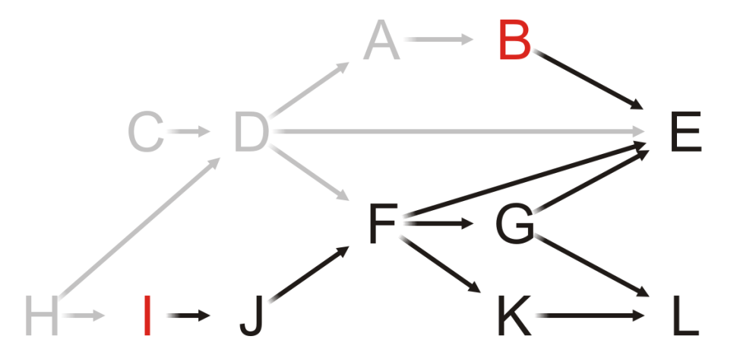
Example
C, H, D, A
Both Tasks B and I have in-degree zero
Choose Task B

Slide 34
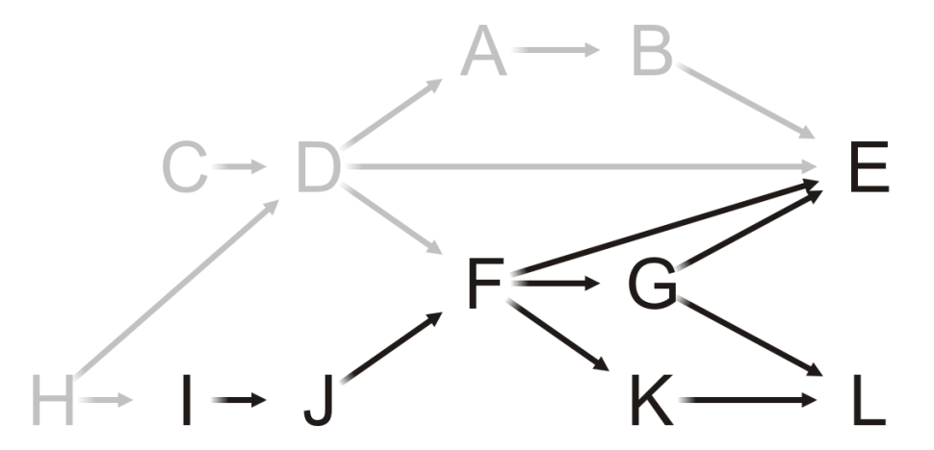
Example
C, H, D, A, B
Removing Task B, we note that Task E still has an in-degree of two
Next?

Slide 35
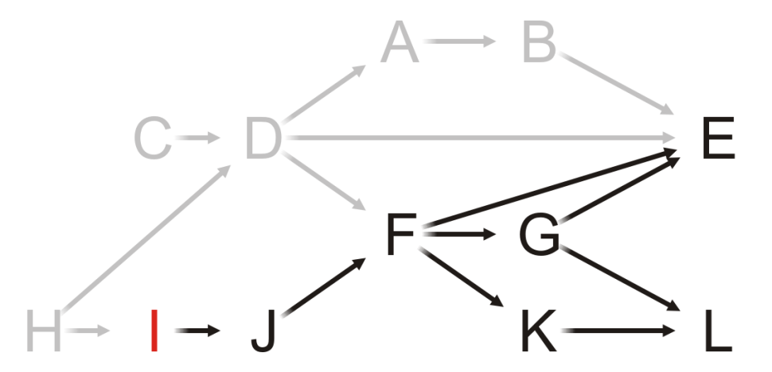
Example
C, H, D, A, B
As only Task I has in-degree zero, we choose it

Slide 36
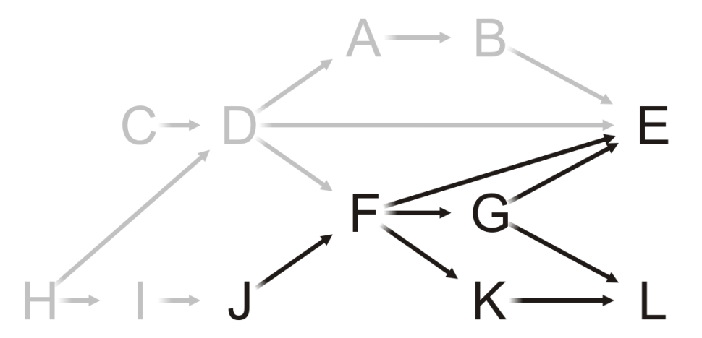
Example
C, H, D, A, B, I
Having completed Task I, what now?

Slide 37
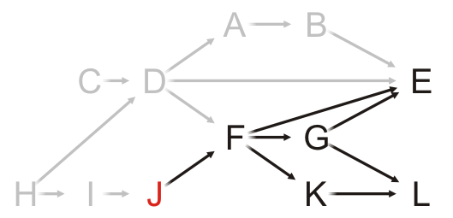
Example
C, H, D, A, B, I
Only Task J has in-degree zero: choose it

Slide 38
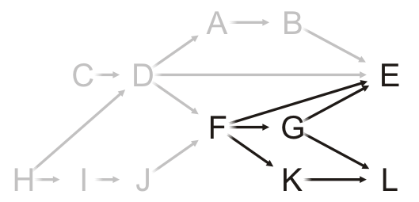
Example
C, H, D, A, B, I, J
Having completed Task J, what now?

Slide 39
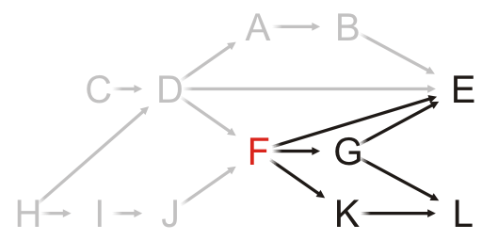
Example
C, H, D, A, B, I, J
Only Task F can be completed, so choose it

Slide 40
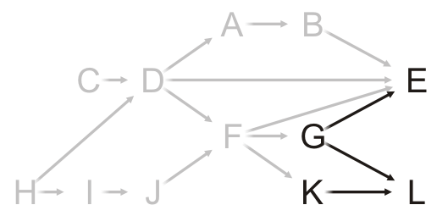
Example
C, H, D, A, B, I, J, F
What choices do we have now?

Slide 41
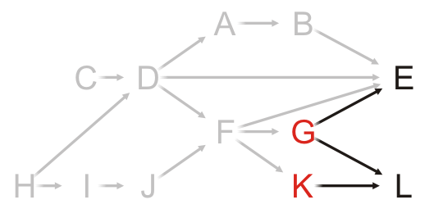
Example
C, H, D, A, B, I, J, F
We can perform Tasks G or K
Choose Task G

Slide 42
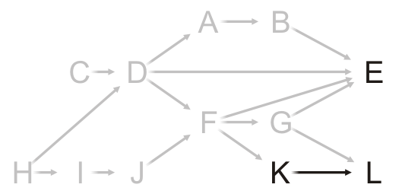
Example
C, H, D, A, B, I, J, F, G
Having removed Task G from the graph, what next?

Slide 43
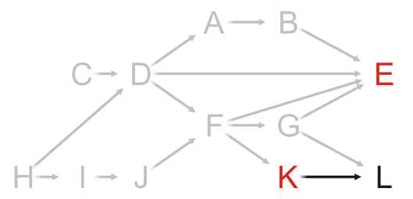
Example
C, H, D, A, B, I, J, F, G
Choosing between Tasks E and K, choose Task E

Slide 44
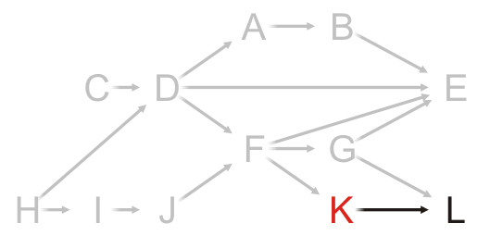
Example
C, H, D, A, B, I, J, F, G, E
At this point, Task K is the only one that can be run

Slide 45
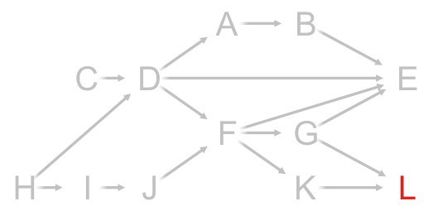
Example
C, H, D, A, B, I, J, F, G, E, K
And now that both Tasks G and K are complete, we can complete Task L

Slide 46
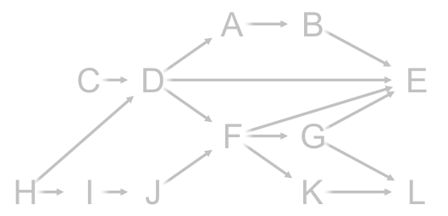
Example
C, H, D, A, B, I, J, F, G, E, K, L
There are no more vertices left

Slide 47
Example
Thus, one possible topological sort would be:
C, H, D, A, B, I, J, F, G, E, K, L

Slide 48
Example
Note that topological sorts need not be unique:
C, H, D, A, B, I, J, F, G, E, K, L
H, I, J, C, D, F, G, K, L, A, B, E

Slide 49
Analysis
What are the tools necessary for a topological sort?
We must know and be able to update the in-degrees of each of the vertices
We could do this with a table of the in-degrees of each of the vertices
This requires Θ(|V|) memory
A | 1
B | 1
C | 0
D | 2
E | 4
F | 2
G | 1
H | 0
I | 1
J | 1
K | 1
L | 2

Slide 50
Analysis
We must iterate at least |V| times, so the run-time must be Ω(|V|)
A | 1
B | 1
C | 0
D | 2
E | 4
F | 2
G | 1
H | 0
I | 1
J | 1
K | 1
L | 2

Slide 51
Analysis
We need to find vertices with in-degree zero
We could loop through the table with each iteration
The run time would be O(|V|²)
A | 1
B | 1
C | 0
D | 2
E | 4
F | 2
G | 1
H | 0
I | 1
J | 1
K | 1
L | 2

Slide 52
Analysis
A better approach
Use a queue (or other container) to temporarily store those vertices with in-degree zero
Each time the in-degree of a vertex is decremented to zero, push it onto the queue
A | 1
B | 1
C | 0
D | 2
E | 4
F | 2
G | 1
H | 0
I | 1
J | 1
K | 1
L | 2

Slide 53
Analysis
What are the run times associated with the queue?
Initially, we must scan through each of the vertices: Θ(|V|)
For each vertex, we will have to push onto and pop off the queue once, also Θ(|V|)
A | 1
B | 1
C | 0
D | 2
E | 4
F | 2
G | 1
H | 0
I | 1
J | 1
K | 1
L | 2

Slide 54
Analysis
Finally, every time we remove a vertex v, all its edges shall also be removed and the in-degree table be updated
The run time of these operations is Ω(|E|)
If we are using an adjacency matrix: Θ(|V|²)
If we are using an adjacency list: Θ(|E|)
A | 1
B | 1
C | 0
D | 2
E | 4
F | 2
G | 1
H | 0
I | 1
J | 1
K | 1
L | 2
+
Here, |E| = 16
16

Slide 55
Analysis
Therefore, the run time of a topological sort is:
Θ(|V| + |E|) if we use an adjacency list
Θ(|V|²) if we use an adjacency matrix
and the memory requirements is Θ(|V|)
A | 1
B | 1
C | 0
D | 2
E | 4
F | 2
G | 1
H | 0
I | 1
J | 1
K | 1
L | 2

Slide 56
Analysis
What happens if at some step, all remaining vertices have an in-degree greater than zero?
There must be at least one cycle within that sub-set of vertices
Consequence: we now have an Θ(|V| + |E|) algorithm for determining if a graph has a cycle
A | 1
B | 1
C | 0
D | 2
E | 4
F | 2
G | 1
H | 0
I | 1
J | 1
K | 1
L | 2

Slide 57
Implementation
Thus, to implement a topological sort:
Allocate memory for and initialize an array of in-degrees
Create a queue and initialize it with all vertices that have in-degree zero
While the queue is not empty:
Pop a vertex from the queue
Decrement the in-degree of each neighbor
Those neighbors whose in-degree was decremented to zero are pushed onto the queue

Slide 58
Implementation
We will use an array implementation of our queue
Because we place each vertex into the queue exactly once
We must never resize the array
We do not have to worry about the queue cycling
Most importantly, however, because of the properties of a queue
When we finish, the underlying array stores the topological sort

Slide 59
Implementation
The operations with our queue
Initialization
Type array[vertex_size()];
int ihead = 0, itail = -1;
Testing if empty:
ihead == itail + 1
For push
++itail;
array[itail] = next vertex;
For pop
Type current_top = array[ihead];
++ihead;

Slide 60
Example
With the previous example, we initialize:
The array of in-degrees
The queue
A | 1
B | 1
C | 0
D | 2
E | 4
F | 2
G | 1
H | 0
I | 1
J | 1
K | 1
L | 2
Queue:
The queue is empty

Slide 61
Example
Stepping through the array, push all source vertices into the queue
A | 1
B | 1
C | 0
D | 2
E | 4
F | 2
G | 1
H | 0
I | 1
J | 1
K | 1
L | 2
Queue:
The queue is empty

Slide 62
Example
Stepping through the table, push all source vertices into the queue
A | 1
B | 1
C | 0
D | 2
E | 4
F | 2
G | 1
H | 0
I | 1
J | 1
K | 1
L | 2
Queue:
C | H
The queue is empty

Slide 63
Example
Pop the front of the queue
A | 1
B | 1
C | 0
D | 2
E | 4
F | 2
G | 1
H | 0
I | 1
J | 1
K | 1
L | 2
Queue:
C | H

Slide 64
Example
Pop the front of the queue
C has one neighbor: D
A | 1
B | 1
C | 0
D | 2
E | 4
F | 2
G | 1
H | 0
I | 1
J | 1
K | 1
L | 2
Queue:
C | H

Slide 65
Example
Pop the front of the queue
C has one neighbor: D
Decrement its in-degree
A | 1
B | 1
C | 0
D | 1
E | 4
F | 2
G | 1
H | 0
I | 1
J | 1
K | 1
L | 2
Queue:
C | H

Slide 66
Example
Pop the front of the queue
A | 1
B | 1
C | 0
D | 1
E | 4
F | 2
G | 1
H | 0
I | 1
J | 1
K | 1
L | 2
Queue:
C | H

Slide 67
Example
Pop the front of the queue
H has two neighbors: D and I
A | 1
B | 1
C | 0
D | 1
E | 4
F | 2
G | 1
H | 0
I | 1
J | 1
K | 1
L | 2
Queue:
C | H

Slide 68
Example
Pop the front of the queue
H has two neighbors: D and I
Decrement their in-degrees
A | 1
B | 1
C | 0
D | 0
E | 4
F | 2
G | 1
H | 0
I | 0
J | 1
K | 1
L | 2
Queue:
C | H

Slide 69
Example
Pop the front of the queue
H has two neighbors: D and I
Decrement their in-degrees
Both are decremented to zero, so push them onto the queue
A | 1
B | 1
C | 0
D | 0
E | 4
F | 2
G | 1
H | 0
I | 0
J | 1
K | 1
L | 2
Queue:
C | H

Slide 70
Example
Pop the front of the queue
H has two neighbors: D and I
Decrement their in-degrees
Both are decremented to zero, so push them onto the queue
A | 1
B | 1
C | 0
D | 0
E | 4
F | 2
G | 1
H | 0
I | 0
J | 1
K | 1
L | 2
Queue:
C | H | D | I

Slide 71
Example
Pop the front of the queue
A | 1
B | 1
C | 0
D | 0
E | 4
F | 2
G | 1
H | 0
I | 0
J | 1
K | 1
L | 2
Queue:
C | H | D | I

Slide 72
Example
Pop the front of the queue
D has three neighbors: A, E and F
A | 1
B | 1
C | 0
D | 0
E | 4
F | 2
G | 1
H | 0
I | 0
J | 1
K | 1
L | 2
Queue:
C | H | D | I

Slide 73
Example
Pop the front of the queue
D has three neighbors: A, E and F
Decrement their in-degrees
A | 0
B | 1
C | 0
D | 0
E | 3
F | 1
G | 1
H | 0
I | 0
J | 1
K | 1
L | 2
Queue:
C | H | D | I

Slide 74
Example
Pop the front of the queue
D has three neighbors: A, E and F
Decrement their in-degrees
A is decremented to zero, so push it onto the queue
A | 0
B | 1
C | 0
D | 0
E | 3
F | 1
G | 1
H | 0
I | 0
J | 1
K | 1
L | 2
Queue:
C | H | D | I | A

Slide 75
Example
Pop the front of the queue
A | 0
B | 1
C | 0
D | 0
E | 3
F | 1
G | 1
H | 0
I | 0
J | 1
K | 1
L | 2
Queue:
C | H | D | I | A

Slide 76
Example
Pop the front of the queue
I has one neighbor: J
A | 0
B | 1
C | 0
D | 0
E | 3
F | 1
G | 1
H | 0
I | 0
J | 1
K | 1
L | 2
Queue:
C | H | D | I | A

Slide 77
Example
Pop the front of the queue
I has one neighbor: J
Decrement its in-degree
A | 0
B | 1
C | 0
D | 0
E | 3
F | 1
G | 1
H | 0
I | 0
J | 0
K | 1
L | 2
Queue:
C | H | D | I | A

Slide 78
Example
Pop the front of the queue
I has one neighbor: J
Decrement its in-degree
J is decremented to zero, so push it onto the queue
A | 0
B | 1
C | 0
D | 0
E | 3
F | 1
G | 1
H | 0
I | 0
J | 0
K | 1
L | 2
Queue:
C | H | D | I | A | J

Slide 79
Example
Pop the front of the queue
A | 0
B | 1
C | 0
D | 0
E | 3
F | 1
G | 1
H | 0
I | 0
J | 0
K | 1
L | 2
Queue:
C | H | D | I | A | J

Slide 80
Example
Pop the front of the queue
A has one neighbor: B
A | 0
B | 1
C | 0
D | 0
E | 3
F | 1
G | 1
H | 0
I | 0
J | 0
K | 1
L | 2
Queue:
C | H | D | I | A | J

Slide 81
Example
Pop the front of the queue
A has one neighbor: B
Decrement its in-degree
A | 0
B | 0
C | 0
D | 0
E | 3
F | 1
G | 1
H | 0
I | 0
J | 0
K | 1
L | 2
Queue:
C | H | D | I | A | J

Slide 82
Example
Pop the front of the queue
A has one neighbor: B
Decrement its in-degree
B is decremented to zero, so push it onto the queue
A | 0
B | 0
C | 0
D | 0
E | 3
F | 1
G | 1
H | 0
I | 0
J | 0
K | 1
L | 2
Queue:
C | H | D | I | A | J | B

Slide 83
Example
Pop the front of the queue
A | 0
B | 0
C | 0
D | 0
E | 3
F | 1
G | 1
H | 0
I | 0
J | 0
K | 1
L | 2
Queue:
C | H | D | I | A | J | B

Slide 84
Example
Pop the front of the queue
J has one neighbor: F
A | 0
B | 0
C | 0
D | 0
E | 3
F | 1
G | 1
H | 0
I | 0
J | 0
K | 1
L | 2
Queue:
C | H | D | I | A | J | B

Slide 85
Example
Pop the front of the queue
J has one neighbor: F
Decrement its in-degree
A | 0
B | 0
C | 0
D | 0
E | 3
F | 0
G | 1
H | 0
I | 0
J | 0
K | 1
L | 2
Queue:
C | H | D | I | A | J | B

Slide 86
Example
Pop the front of the queue
J has one neighbor: F
Decrement its in-degree
F is decremented to zero, so push it onto the queue
A | 0
B | 0
C | 0
D | 0
E | 3
F | 0
G | 1
H | 0
I | 0
J | 0
K | 1
L | 2
Queue:
C | H | D | I | A | J | B | F

Slide 87
Example
Pop the front of the queue
A | 0
B | 0
C | 0
D | 0
E | 3
F | 0
G | 1
H | 0
I | 0
J | 0
K | 1
L | 2
Queue:
C | H | D | I | A | J | B | F

Slide 88
Example
Pop the front of the queue
B has one neighbor: E
A | 0
B | 0
C | 0
D | 0
E | 3
F | 0
G | 1
H | 0
I | 0
J | 0
K | 1
L | 2
Queue:
C | H | D | I | A | J | B | F

Slide 89
Example
Pop the front of the queue
B has one neighbor: E
Decrement its in-degree
A | 0
B | 0
C | 0
D | 0
E | 2
F | 0
G | 1
H | 0
I | 0
J | 0
K | 1
L | 2
Queue:
C | H | D | I | A | J | B | F

Slide 90
Example
Pop the front of the queue
A | 0
B | 0
C | 0
D | 0
E | 2
F | 0
G | 1
H | 0
I | 0
J | 0
K | 1
L | 2
Queue:
C | H | D | I | A | J | B | F

Slide 91
Example
Pop the front of the queue
F has three neighbors: E, G and K
A | 0
B | 0
C | 0
D | 0
E | 2
F | 0
G | 1
H | 0
I | 0
J | 0
K | 1
L | 2
Queue:
C | H | D | I | A | J | B | F

Slide 92
Example
Pop the front of the queue
F has three neighbors: E, G and K
Decrement their in-degrees
A | 0
B | 0
C | 0
D | 0
E | 1
F | 0
G | 0
H | 0
I | 0
J | 0
K | 0
L | 2
Queue:
C | H | D | I | A | J | B | F

Slide 93
Example
Pop the front of the queue
F has three neighbors: E, G and K
Decrement their in-degrees
G and K are decremented to zero, so push them onto the queue
A | 0
B | 0
C | 0
D | 0
E | 1
F | 0
G | 0
H | 0
I | 0
J | 0
K | 0
L | 2
Queue:
C | H | D | I | A | J | B | F | G | K

Slide 94
Example
Pop the front of the queue
A | 0
B | 0
C | 0
D | 0
E | 1
F | 0
G | 0
H | 0
I | 0
J | 0
K | 0
L | 2
Queue:
C | H | D | I | A | J | B | F | G | K

Slide 95
Example
Pop the front of the queue
G has two neighbors: E and L
A | 0
B | 0
C | 0
D | 0
E | 1
F | 0
G | 0
H | 0
I | 0
J | 0
K | 0
L | 2
Queue:
C | H | D | I | A | J | B | F | G | K

Slide 96
Example
Pop the front of the queue
G has two neighbors: E and L
Decrement their in-degrees
A | 0
B | 0
C | 0
D | 0
E | 0
F | 0
G | 0
H | 0
I | 0
J | 0
K | 0
L | 1
Queue:
C | H | D | I | A | J | B | F | G | K

Slide 97
Example
Pop the front of the queue
G has two neighbors: E and L
Decrement their in-degrees
E is decremented to zero, so push it onto the queue
A | 0
B | 0
C | 0
D | 0
E | 0
F | 0
G | 0
H | 0
I | 0
J | 0
K | 0
L | 1
Queue:
C | H | D | I | A | J | B | F | G | K | E

Slide 98
Example
Pop the front of the queue
A | 0
B | 0
C | 0
D | 0
E | 0
F | 0
G | 0
H | 0
I | 0
J | 0
K | 0
L | 1
Queue:
C | H | D | I | A | J | B | F | G | K | E

Slide 99
Example
Pop the front of the queue
K has one neighbors: L
A | 0
B | 0
C | 0
D | 0
E | 0
F | 0
G | 0
H | 0
I | 0
J | 0
K | 0
L | 1
Queue:
C | H | D | I | A | J | B | F | G | K | E

Slide 100
Example
Pop the front of the queue
K has one neighbors: L
Decrement its in-degree
A | 0
B | 0
C | 0
D | 0
E | 0
F | 0
G | 0
H | 0
I | 0
J | 0
K | 0
L | 0
Queue:
C | H | D | I | A | J | B | F | G | K | E

Slide 101
Example
Pop the front of the queue
K has one neighbors: L
Decrement its in-degree
L is decremented to zero, so push it onto the queue
A | 0
B | 0
C | 0
D | 0
E | 0
F | 0
G | 0
H | 0
I | 0
J | 0
K | 0
L | 0
Queue:
C | H | D | I | A | J | B | F | G | K | E | L

Slide 102
Example
Pop the front of the queue
A | 0
B | 0
C | 0
D | 0
E | 0
F | 0
G | 0
H | 0
I | 0
J | 0
K | 0
L | 0
Queue:
C | H | D | I | A | J | B | F | G | K | E | L

Slide 103
Example
Pop the front of the queue
E has no neighbors—it is a sink
A | 0
B | 0
C | 0
D | 0
E | 0
F | 0
G | 0
H | 0
I | 0
J | 0
K | 0
L | 0
Queue:
C | H | D | I | A | J | B | F | G | K | E | L

Slide 104
Example
Pop the front of the queue
A | 0
B | 0
C | 0
D | 0
E | 0
F | 0
G | 0
H | 0
I | 0
J | 0
K | 0
L | 0
Queue:
C | H | D | I | A | J | B | F | G | K | E | L

Slide 105
Example
Pop the front of the queue
L has no neighbors—it is also a sink
A | 0
B | 0
C | 0
D | 0
E | 0
F | 0
G | 0
H | 0
I | 0
J | 0
K | 0
L | 0
Queue:
C | H | D | I | A | J | B | F | G | K | E | L

Slide 106
Example
The queue is empty, so we are done
A | 0
B | 0
C | 0
D | 0
E | 0
F | 0
G | 0
H | 0
I | 0
J | 0
K | 0
L | 0
Queue:
C | H | D | I | A | J | B | F | G | K | E | L

Slide 107
Example
The array used for the queue stores the topological sort
A | 0
B | 0
C | 0
D | 0
E | 0
F | 0
G | 0
H | 0
I | 0
J | 0
K | 0
L | 0
C | H | D | I | A | J | B | F | G | K | E | L

Slide 108
Example
The array used for the queue stores the topological sort
Note the difference in order from our previous sort?
C, H, D, A, B, I, J, F, G, E, K, L
A | 0
B | 0
C | 0
D | 0
E | 0
F | 0
G | 0
H | 0
I | 0
J | 0
K | 0
L | 0
C | H | D | I | A | J | B | F | G | K | E | L

Slide 109
Outline
Topological sorting
Definitions
Algorithm
Finding the critical path

Slide 110
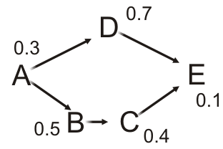
Critical path
Suppose each task has a performance time associated with it
If the tasks are performed serially, the time required to complete the last task equals to the sum of the individual task times
These tasks require 0.3 + 0.7 + 0.5 + 0.4 + 0.1 = 2.0 s to execute serially

Slide 111
Critical path
In many cases, however, we could perform tasks in parallel
Computer tasks can be executed in parallel (multi-processing)
Different tasks can be completed by different teams in a company

Slide 112
Critical path
Suppose Task A completes
We can now execute Tasks B and D in parallel

Slide 113
Critical path
Note that, Task E cannot execute until Task C completes, and Task C cannot execute until Task B completes
The least time in which these five tasks can be completed is 0.3 + 0.5 + 0.4 + 0.1 = 1.3 s
This is called the critical time of all tasks
The path (A, B, C, E) is said to be the critical path

Slide 114
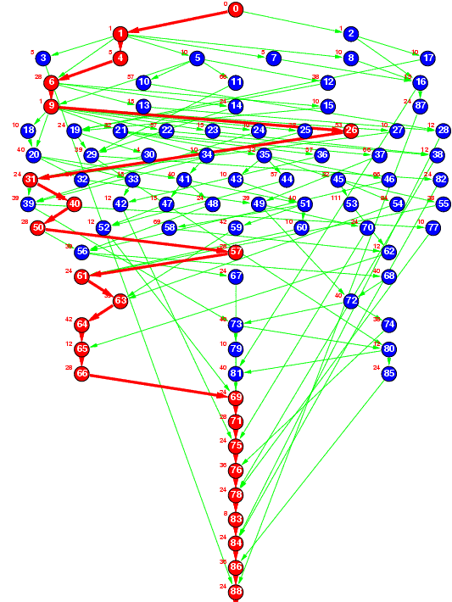
Critical path
The critical time of each task is the earliest time that it could be completed after the start of execution
The critical path is the sequence of tasks determining the minimum time needed to complete the project
If a task on the critical path is delayed, the entire project will be delayed
Ref: The Standard Task Graph
http://www.kasahara.elec.waseda.ac.jp/schedule/

Slide 115
Finding the critical path
Tasks that have no prerequisites have a critical time equal to the time it takes to complete that task
For tasks that depend on others, the critical time will be:
The maximum critical time that it takes to complete a prerequisite
Plus the time it takes to complete this task
In this example, the critical times are:
Task A completes in 0.3 s
Task B must wait for A and completes after 0.8 s
Task D must wait for A and completes after 1.0 s
Task C must wait for B and completes after 1.2 s
Task E must wait for both C and D, and completes after max(1.0, 1.2) + 0.1 = 1.3 s

Slide 116
Finding the critical path
To find the critical time/path, we run topological sorting and require the following additional information:
We must know the execution time of each task
We will have to record the critical time for each task
Initialize these to zero
We will need to know the previous task with the longest critical time to determine the critical path
Set these to null

Slide 117
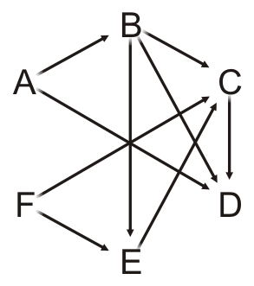
Finding the critical path
Task | In-degree | Task Time | Critical Time | Previous Task
A | 0 | 5.2 | 0.0 | Ø
B | 1 | 6.1 | 0.0 | Ø
C | 3 | 4.7 | 0.0 | Ø
D | 3 | 8.1 | 0.0 | Ø
E | 2 | 9.5 | 0.0 | Ø
F | 0 | 17.1 | 0.0 | Ø
Queue
Suppose we have the following times for the tasks

Slide 118
Finding the critical path
Each time we pop a vertex v, in addition to what we already do:
For v, add the task time onto the critical time for that vertex:
That is the critical time for v
For each adjacent vertex w:
If the critical time for v is greater than the currently stored critical time for w
Update the critical time with the critical time for v
Set the previous pointer to the vertex v

Slide 119
Finding the critical path
Task | In-degree | Task Time | Critical Time | Previous Task
A | 0 | 5.2 | 0.0 | Ø
B | 1 | 6.1 | 0.0 | Ø
C | 3 | 4.7 | 0.0 | Ø
D | 3 | 8.1 | 0.0 | Ø
E | 2 | 9.5 | 0.0 | Ø
F | 0 | 17.1 | 0.0 | Ø
Queue
A | F
So we initialize the queue with those vertices with in-degree zero

Slide 120
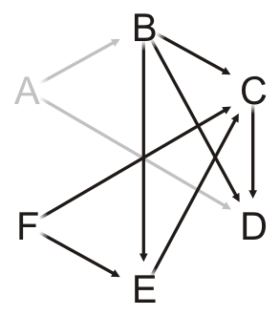
Finding the critical path
Task | In-degree | Task Time | Critical Time | Previous Task
A | 0 | 5.2 | 0.0 | Ø
B | 1 | 6.1 | 0.0 | Ø
C | 3 | 4.7 | 0.0 | Ø
D | 3 | 8.1 | 0.0 | Ø
E | 2 | 9.5 | 0.0 | Ø
F | 0 | 17.1 | 0.0 | Ø
Queue
F
Pop Task A and update its critical time 0.0 + 5.2 = 5.2

Slide 121
Finding the critical path
Task | In-degree | Task Time | Critical Time | Previous Task
A | 0 | 5.2 | 5.2 | Ø
B | 1 | 6.1 | 0.0 | Ø
C | 3 | 4.7 | 0.0 | Ø
D | 3 | 8.1 | 0.0 | Ø
E | 2 | 9.5 | 0.0 | Ø
F | 0 | 17.1 | 0.0 | Ø
Queue
F
Pop Task A and update its critical time 0.0 + 5.2 = 5.2

Slide 122
Finding the critical path
Task | In-degree | Task Time | Critical Time | Previous Task
A | 0 | 5.2 | 5.2 | Ø
B | 1 | 6.1 | 0.0 | Ø
C | 3 | 4.7 | 0.0 | Ø
D | 3 | 8.1 | 0.0 | Ø
E | 2 | 9.5 | 0.0 | Ø
F | 0 | 17.1 | 0.0 | Ø
Queue
F
For each neighbor of Task A:
Decrement the in-degree, push if necessary, and check if we must update the critical time

Slide 123
Finding the critical path
Task | In-degree | Task Time | Critical Time | Previous Task
A | 0 | 5.2 | 5.2 | Ø
B | 0 | 6.1 | 5.2 | A
C | 3 | 4.7 | 0.0 | Ø
D | 2 | 8.1 | 5.2 | A
E | 2 | 9.5 | 0.0 | Ø
F | 0 | 17.1 | 0.0 | Ø
Queue
F | B
For each neighbor of Task A:
Decrement the in-degree, push if necessary, and check if we must update the critical time

Slide 124
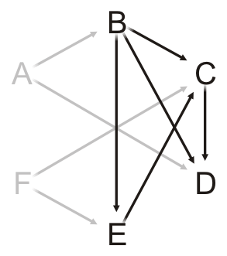
Finding the critical path
Task | In-degree | Task Time | Critical Time | Previous Task
A | 0 | 5.2 | 5.2 | Ø
B | 0 | 6.1 | 5.2 | A
C | 3 | 4.7 | 0.0 | Ø
D | 2 | 8.1 | 5.2 | A
E | 2 | 9.5 | 0.0 | Ø
F | 0 | 17.1 | 0.0 | Ø
Queue
B
Pop Task F and update its critical time 0.0 + 17.1 = 17.1

Slide 125
Finding the critical path
Task | In-degree | Task Time | Critical Time | Previous Task
A | 0 | 5.2 | 5.2 | Ø
B | 0 | 6.1 | 5.2 | A
C | 3 | 4.7 | 0.0 | Ø
D | 2 | 8.1 | 5.2 | A
E | 2 | 9.5 | 0.0 | Ø
F | 0 | 17.1 | 17.1 | Ø
Queue
B
Pop Task F and update its critical time 0.0 + 17.1 = 17.1

Slide 126
Finding the critical path
Task | In-degree | Task Time | Critical Time | Previous Task
A | 0 | 5.2 | 5.2 | Ø
B | 0 | 6.1 | 5.2 | A
C | 3 | 4.7 | 0.0 | Ø
D | 2 | 8.1 | 5.2 | A
E | 2 | 9.5 | 0.0 | Ø
F | 0 | 17.1 | 17.1 | Ø
Queue
B
For each neighbor of Task F:
Decrement the in-degree, push if necessary, and check if we must update the critical time

Slide 127
Finding the critical path
Task | In-degree | Task Time | Critical Time | Previous Task
A | 0 | 5.2 | 5.2 | Ø
B | 0 | 6.1 | 5.2 | A
C | 2 | 4.7 | 17.1 | F
D | 2 | 8.1 | 5.2 | A
E | 1 | 9.5 | 17.1 | F
F | 0 | 17.1 | 17.1 | Ø
Queue
B
For each neighbor of Task F:
Decrement the in-degree, push if necessary, and check if we must update the critical time

Slide 128
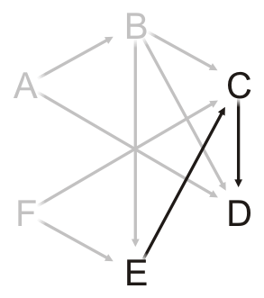
Finding the critical path
Task | In-degree | Task Time | Critical Time | Previous Task
A | 0 | 5.2 | 5.2 | Ø
B | 0 | 6.1 | 5.2 | A
C | 2 | 4.7 | 17.1 | F
D | 2 | 8.1 | 5.2 | A
E | 1 | 9.5 | 17.1 | F
F | 0 | 17.1 | 17.1 | Ø
Queue
Pop Task B and update its critical time 5.2 + 6.1 = 11.3

Slide 129
Finding the critical path
Task | In-degree | Task Time | Critical Time | Previous Task
A | 0 | 5.2 | 5.2 | Ø
B | 0 | 6.1 | 11.3 | A
C | 2 | 4.7 | 17.1 | F
D | 2 | 8.1 | 5.2 | A
E | 1 | 9.5 | 17.1 | F
F | 0 | 17.1 | 17.1 | Ø
Queue
Pop Task B and update its critical time 5.2 + 6.1 = 11.3

Slide 130
Finding the critical path
Task | In-degree | Task Time | Critical Time | Previous Task
A | 0 | 5.2 | 5.2 | Ø
B | 0 | 6.1 | 11.3 | A
C | 2 | 4.7 | 17.1 | F
D | 2 | 8.1 | 5.2 | A
E | 1 | 9.5 | 17.1 | F
F | 0 | 17.1 | 17.1 | Ø
Queue
For each neighbor of Task B:
Decrement the in-degree, push if necessary, and check if we must update the critical time

Slide 131
Finding the critical path
Task | In-degree | Task Time | Critical Time | Previous Task
A | 0 | 5.2 | 5.2 | Ø
B | 0 | 6.1 | 11.3 | A
C | 1 | 4.7 | 17.1 | F
D | 1 | 8.1 | 11.3 | B
E | 0 | 9.5 | 17.1 | F
F | 0 | 17.1 | 17.1 | Ø
Queue
E
For each neighbor of Task F:
Decrement the in-degree, push if necessary, and check if we must update the critical time
Both C and E are waiting on F

Slide 132
Finding the critical path
Task | In-degree | Task Time | Critical Time | Previous Task
A | 0 | 5.2 | 5.2 | Ø
B | 0 | 6.1 | 11.3 | A
C | 1 | 4.7 | 17.1 | F
D | 1 | 8.1 | 11.3 | B
E | 0 | 9.5 | 17.1 | F
F | 0 | 17.1 | 17.1 | Ø
Queue
Pop Task E and update its critical time 17.1 + 9.5 = 26.6

Slide 133
Finding the critical path
Task | In-degree | Task Time | Critical Time | Previous Task
A | 0 | 5.2 | 5.2 | Ø
B | 0 | 6.1 | 11.3 | A
C | 1 | 4.7 | 17.1 | F
D | 1 | 8.1 | 11.3 | B
E | 0 | 9.5 | 26.6 | F
F | 0 | 17.1 | 17.1 | Ø
Queue
Pop Task E and update its critical time 17.1 + 9.5 = 26.6

Slide 134
Finding the critical path
Task | In-degree | Task Time | Critical Time | Previous Task
A | 0 | 5.2 | 5.2 | Ø
B | 0 | 6.1 | 11.3 | A
C | 1 | 4.7 | 17.1 | F
D | 1 | 8.1 | 11.3 | B
E | 0 | 9.5 | 26.6 | F
F | 0 | 17.1 | 17.1 | Ø
Queue
For each neighbor of Task E:
Decrement the in-degree, push if necessary, and check if we must update the critical time

Slide 135
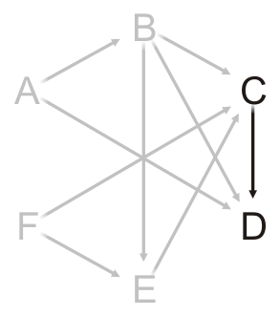
Finding the critical path
Task | In-degree | Task Time | Critical Time | Previous Task
A | 0 | 5.2 | 5.2 | Ø
B | 0 | 6.1 | 11.3 | A
C | 0 | 4.7 | 26.6 | E
D | 1 | 8.1 | 11.3 | B
E | 0 | 9.5 | 26.6 | F
F | 0 | 17.1 | 17.1 | Ø
Queue
C
For each neighbor of Task E:
Decrement the in-degree, push if necessary, and check if we must update the critical time

Slide 136
Finding the critical path
Task | In-degree | Task Time | Critical Time | Previous Task
A | 0 | 5.2 | 5.2 | Ø
B | 0 | 6.1 | 11.3 | A
C | 0 | 4.7 | 26.6 | E
D | 1 | 8.1 | 11.3 | B
E | 0 | 9.5 | 26.6 | F
F | 0 | 17.1 | 17.1 | Ø
Queue
Pop Task C and update its critical time 26.6 + 4.7 = 31.3

Slide 137
Finding the critical path
Task | In-degree | Task Time | Critical Time | Previous Task
A | 0 | 5.2 | 5.2 | Ø
B | 0 | 6.1 | 11.3 | A
C | 0 | 4.7 | 31.3 | E
D | 1 | 8.1 | 11.3 | B
E | 0 | 9.5 | 26.6 | F
F | 0 | 17.1 | 17.1 | Ø
Queue
Pop Task C and update its critical time 26.6 + 4.7 = 31.3

Slide 138
Finding the critical path
Task | In-degree | Task Time | Critical Time | Previous Task
A | 0 | 5.2 | 5.2 | Ø
B | 0 | 6.1 | 11.3 | A
C | 0 | 4.7 | 31.3 | E
D | 1 | 8.1 | 11.3 | B
E | 0 | 9.5 | 26.6 | F
F | 0 | 17.1 | 17.1 | Ø
Queue
For each neighbor of Task C:
Decrement the in-degree, push if necessary, and check if we must update the critical time

Slide 139
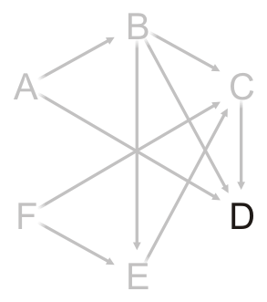
Finding the critical path
Task | In-degree | Task Time | Critical Time | Previous Task
A | 0 | 5.2 | 5.2 | Ø
B | 0 | 6.1 | 11.3 | A
C | 0 | 4.7 | 31.3 | E
D | 0 | 8.1 | 31.3 | C
E | 0 | 9.5 | 26.6 | F
F | 0 | 17.1 | 17.1 | Ø
Queue
D
For each neighbor of Task C:
Decrement the in-degree, push if necessary, and check if we must update the critical time

Slide 140
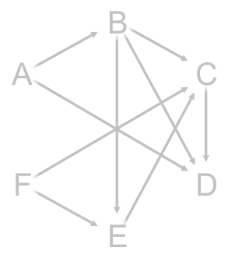
Finding the critical path
Task | In-degree | Task Time | Critical Time | Previous Task
A | 0 | 5.2 | 5.2 | Ø
B | 0 | 6.1 | 11.3 | A
C | 0 | 4.7 | 31.3 | E
D | 0 | 8.1 | 31.3 | C
E | 0 | 9.5 | 26.6 | F
F | 0 | 17.1 | 17.1 | Ø
Queue
Pop Task D and update its critical time 31.3 + 8.1 = 39.4

Slide 141
Finding the critical path
Task | In-degree | Task Time | Critical Time | Previous Task
A | 0 | 5.2 | 5.2 | Ø
B | 0 | 6.1 | 11.3 | A
C | 0 | 4.7 | 31.3 | E
D | 0 | 8.1 | 39.4 | C
E | 0 | 9.5 | 26.6 | F
F | 0 | 17.1 | 17.1 | Ø
Queue
Pop Task D and update its critical time 31.3 + 8.1 = 39.4

Slide 142
Finding the critical path
Task | In-degree | Task Time | Critical Time | Previous Task
A | 0 | 5.2 | 5.2 | Ø
B | 0 | 6.1 | 11.3 | A
C | 0 | 4.7 | 31.3 | E
D | 0 | 8.1 | 39.4 | C
E | 0 | 9.5 | 26.6 | F
F | 0 | 17.1 | 17.1 | Ø
Queue
Task D has no neighbors and the queue is empty
We are done

Slide 143
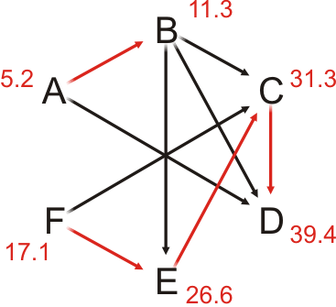
Finding the critical path
Task | In-degree | Task Time | Critical Time | Previous Task
A | 0 | 5.2 | 5.2 | Ø
B | 0 | 6.1 | 11.3 | A
C | 0 | 4.7 | 31.3 | E
D | 0 | 8.1 | 39.4 | C
E | 0 | 9.5 | 26.6 | F
F | 0 | 17.1 | 17.1 | Ø

Slide 144
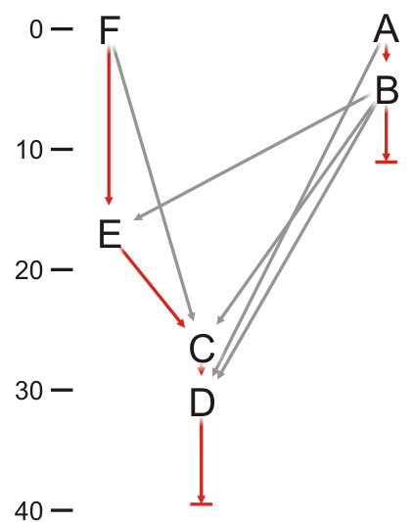
Finding the critical path
Task | In-degree | Task Time | Critical Time | Previous Task
A | 0 | 5.2 | 5.2 | Ø
B | 0 | 6.1 | 11.3 | A
C | 0 | 4.7 | 31.3 | E
D | 0 | 8.1 | 39.4 | C
E | 0 | 9.5 | 26.6 | F
F | 0 | 17.1 | 17.1 | Ø
We can also plot the completing of the tasks in time

Slide 145
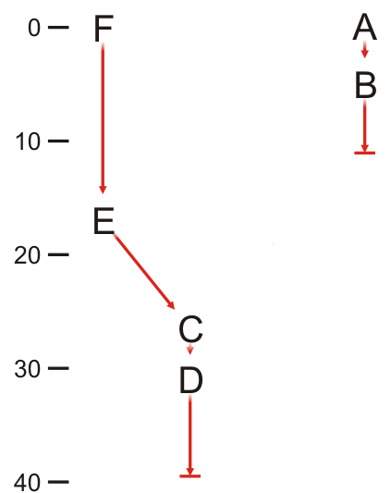
Finding the critical path
Task | Previous Task
A | Ø
B | A
C | E
D | C
E | F
F | Ø
Incidentally, the task and previous task defines a forest using the parental tree data structure

Slide 146
Summary
In this topic, we have discussed topological sorts
Sorting of elements in a DAG
Implementation
A table of in-degrees
Select that vertex which has current in-degree zero
We defined critical paths
The implementation requires only a few more table entries

