Slide 1
CS101 Data Structures
Introduction
Instructor: Dengji Zhao
Notes:
Adapted from slides at https://courses.cs.washington.edu/courses/cse326/03wi/326lecturesb.shtml (by Dan Suciu of U Washington)

Slide 2
What is this Course About?
Clever ways to organize information in order to enable efficient computation
Notes:
clever – range from techniques with which you are already familiar – eg, representing simple lists – to ones that are more complex, such as hash tables or self-balancing trees. Elegant, mathematically deep, non obvious.
making the different meanings of “efficient” precise is much of the work of this course!

Slide 3
Clever ways to organize information
Efficient computation
Lists, Stacks, Queues
Heaps
Binary Search Trees
AVL Trees
Hash Tables
Graphs
Disjoint Sets
Insert
Delete
Find
Merge
Shortest Paths
Union
Data Structures
Algorithms

Slide 4
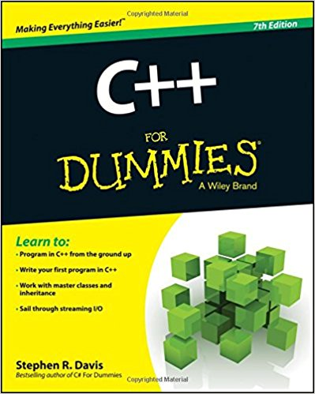
Used Everywhere!
Graphics
Theory
AI
Applications
Systems
Mastery of this material separates you from:
Perhaps the most important course in your CS curriculum!
Guaranteed non-obsolescence!

Slide 5
Example
Array data structure
Algorithm to find the index of element x
    for(int i=0; i<n; i++)
    if(a[i]==x)
    return i;
A₁
A₂
A₃
A₄
A₅

Slide 6
Efficient Computation
Our notion of efficiency:
How the running time of an algorithm scales with the size of its input
  several ways to further refine:
    worst case
    average case
    amortized over a series of runs (平摊分析)

Slide 7
Asymptotic Complexity
Example
  Access the k-th element in an array
    O(1)
  Searching for an element in a sorted array
    Exhaustive search: O(n)
    Binary search: O(log n)
  Sort an array
    Bubble sort: O(n²)
    Quicksort: O(n log n) on average

Slide 8

Asymptotic Complexity
This course is about asymptotic complexity
  Deals with data structures, algorithms, and their analysis
It is not about better coding
  Does not deal with coding details
I don’t need to
take CS101 because:
I can buy a faster laptop
I can write very good code

Slide 9

The Ultimate Laptop
Seth Lloyd (MIT), NATURE, 31 Aug 2000, Ultimate physical limits to computation.
“Using a black hole as a data storage and/or computing device”
5.4258 x 10⁵⁰ operations per second

Slide 10
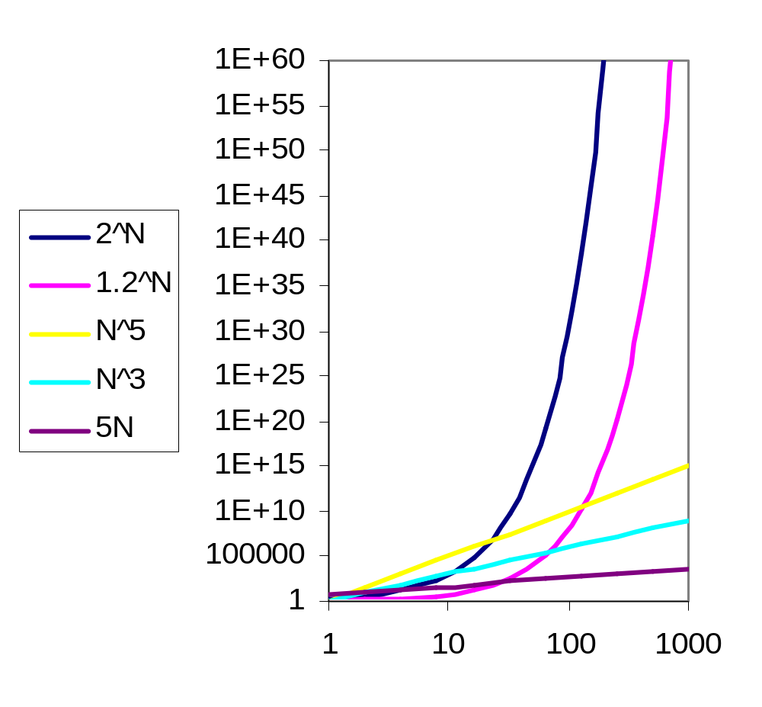
What a Better Laptop Buys You
1 year
1 second
Ultimate
Laptop
Since
Big Bang
Today’s
laptop
(100kMIPS)
1 day
Not much...

Slide 11
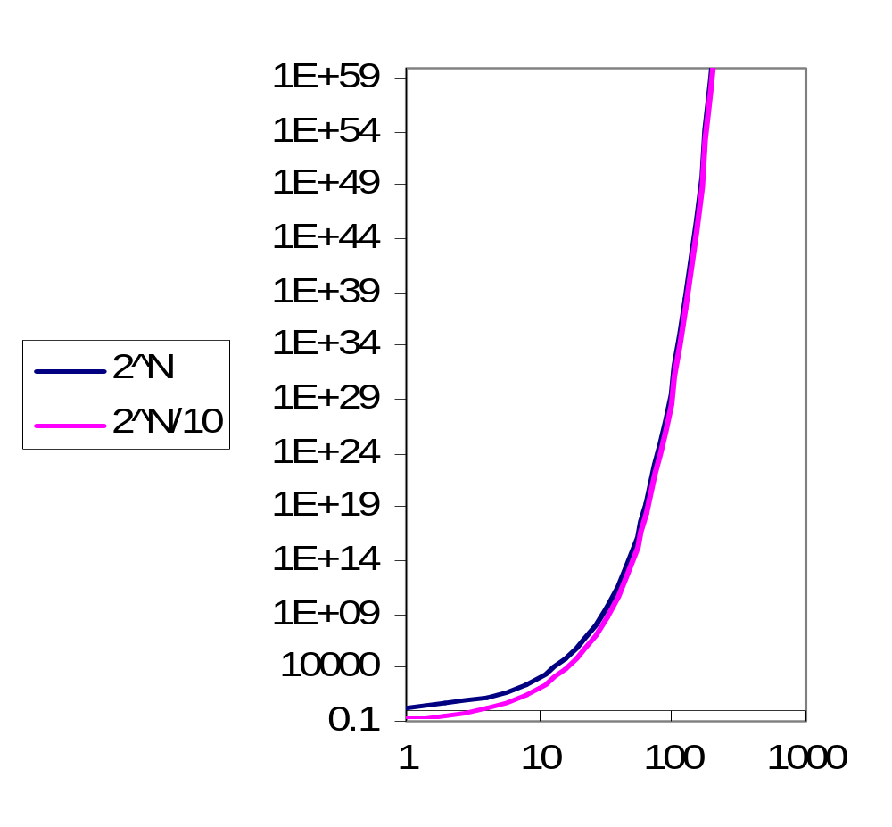
What Better Coding Buys You
1 year
1 second
Ultimate
Laptop,
Since
Big Bang
Today’s
laptop
(1000MIPS)
1 day
Ten times faster buys you…
…nothing

Slide 12
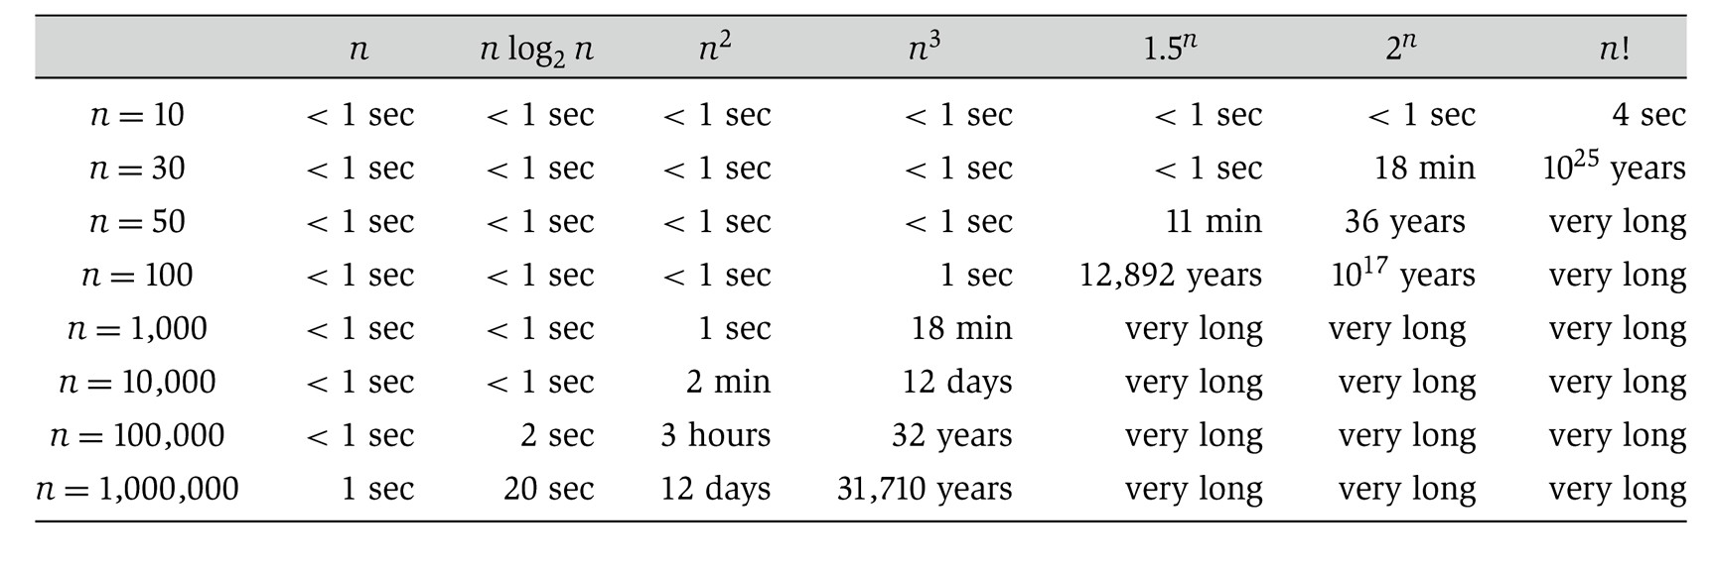
Notes:
table taken from More Programming Pearls, p. 82, 400MhZ Pentium II scaled up
one step takes one nanosecond
msec = millisecond

Slide 13
Specific Goals of the Course
Become familiar with some of the fundamental data structures in computer science
Improve ability to solve problems abstractly
  data structures are the building blocks
Improve ability to analyze your algorithms
  prove correctness
  gauge (and improve) time complexity

Slide 14
Abstract Data Types
Abstract Data Type (ADT)
  Mathematical description of an object and the set of operations on the object, e.g., list
Implement
Concrete Data Type
Specific Data Types or Data Structures, e.g., integer, array, linked list, …

Slide 15
ADT Presentation Algorithm
Present an ADT
Motivate with some applications
Repeat until it’s time to move on:
  develop a data structure and algorithms for the ADT
  analyze its properties
    efficiency
    correctness
    limitations
    ease of programming
Contrast strengths and weaknesses

Slide 16
Example: List ADT
Mathematical description: a sequence of items
  A₁ , A₂ , A₃ , A₄ , … , A_{n}
  A_{i} precedes A_{i+1} for 1 ≤ i < n
Operations
  Length() = integer
  Value(position) = item
  Insert(position)
  Delete(position)
  Set(position, item)

Slide 17
Example: List ADT
Array implementation
Operations
  Length()
  Value(position)
  Insert(position)
  Delete(position)
  Set(position, item)
A₁
A₂
A₃
A₄
A₅
  O(1)
  O(1)
  O(n)
  O(n)
  O(1)

Slide 18
First Example: Queue ADT
Queue operations
  create
  destroy
  enqueue
  dequeue
  is_empty
Queue property: if x is enQed before y is enQed, then x will be deQed before y is deQed
FIFO: First In First Out
F E D C B
G
enqueue
dequeue
A

Slide 19
Applications of the Q
Hold jobs for a printer
Store packets on network routers
Make waitlists fair
Breadth first search

Slide 20
Circular Array Q Data Structure
Q
0
size - 1
b
c
d
e
f
front
back
enqueue(Object x) {
  Q[back] = x ;
  back = (back + 1) % size }
How test for empty list?
How to find K-th element in the queue?
What is complexity of these operations?
Limitations of this structure?
dequeue() {
  x = Q[front] ;
  front = (front + 1) % size;
  return x ; }
Notes:
Here is a data structure implementation of the Q.
The queue is stored as an array, and, to avoid shifting all the elements each time an element is dequeued, we imagine that the array wraps around on itself.
This is an excellent example of how implementation can affect interface: notice the “is_full” function.
There’s also another problem here. What’s wrong with the Enqueue and Dequeue functions?
Your data structures should be robust! Make them robust before you even consider thinking about making them efficient! That is an order!

Slide 21
Linked List Q Data Structure
b
c
d
e
f
front
back
enqueue(Object x) {
back.next = new Node(x);
back = back.next; }
dequeue() {
saved = front.data;
temp = front;
front = front.next;
return saved;}
What are tradeoffs?
simplicity
speed
robustness
memory usage
Notes:
Notice the tricky memory management

