Slide 1
CS101 Data Structures
Hash Table
Textbook Ch 11
Notes:
Adapted from the slides by Douglas Wilhelm Harder of U Waterloo (https://ece.uwaterloo.ca/~dwharder/aads/Lecture_materials/)
May also contain material from the slides at https://courses.cs.washington.edu/courses/cse326/03wi/326lecturesb.shtml (by Dan Suciu of U Washington)

Slide 2
Outline
Introduction
Hash function
Mapping down to 0, ..., M – 1
Dealing with collisions
Chained hash tables
Open addressing

Slide 3
Outline
Discuss storing unrelated/unordered data
IP addresses and domain names
Consider conversions between these two forms
Introduce the idea of hashing:
Reducing O(ln(n)) operations to O(1)
Consider some of the weaknesses

Slide 4
Supporting Example
Suppose we have a system which is associated with approximately 150 error conditions where
Each of which is identified by an 16-bit number from 0 to 65535, and
When an identifier is received, a corresponding error-handling function must be called
We could create an array of 150 function pointers and to then call the appropriate function….

Slide 5
Supporting Example
#include <iostream>
void a() {
std::cout
<< "Calling 'void a()'"
<< std::endl;
}
void b() {
std::cout
<< "Calling 'void b()'"
<< std::endl;
}
int main() {
void (*function_array[150])();
unsigned int error_id[150];
function_array[0] = a;
error_id[0] = 3;
function_array[1] = b;
error_id[1] = 8;
function_array[0]();
function_array[1]();
return 0;
}

Slide 6
Supporting Example
Given an error-condition identifier, e.g., id = 198, how shall we determine which of the 150 slots corresponds to it?
Binary search!
Problems
This is slow: it would require approximately 7 comparisons per error condition
Slow to dynamically add new error conditions or remove defunct conditions

Slide 7
Supporting Example
A better solution:
Create an array of size 65536
Assign those entries corresponding to valid error conditions
Problem: additional memory usage
int main() {
void (*function_array[65536])();
for ( int i = 0; i < 65536; ++i ) {
function_array[i] = nullptr;
}
function_array[3] = a;
function_array[8] = b;
function_array[3]();
function_array[8]();
return 0;
}

Slide 8
IP Addresses
Examples:
Suppose we want to associate IP addresses and any corresponding domain names
Recall that a 32-bit IP address are often written as four byte values from 0 to 255
Consider 10000001 01100001 00001010 10110011₂
This can be written as 129.97.10.179
We use domain names because IP addresses are not human readable

Slide 9
IP Addresses
Given an IP address, sometimes we wanted to quickly find any associated domain name.
We could create an array of size 2³²= 4,294,967,296 of strings!
string domain_name[4294967296];
For example, the IP address of shanghaitech.edu.cn is 10.15.42.202
As 202 + 42×2⁸ + 15×2¹⁶ + 10×2²⁴ = 168766154, it follows that
domain_name[168766154] = "shanghaitech.edu.cn";

Slide 10
IP Addresses
Given an IP address, sometimes we wanted to quickly find any associated domain name.
We could create an array of size 2³²= 4,294,967,296 of strings!
string domain_name[4294967296];
As of 2015, the number of domain names is 299 million.
So most part of the array is empty!

Slide 11
IP Addresses
Under IPv6, IP addresses are 128 bits
It combines what is now implemented as subnets as well as allowing for many more IP addresses
We cannot allocate an array of size 2¹²⁸ !

Slide 12
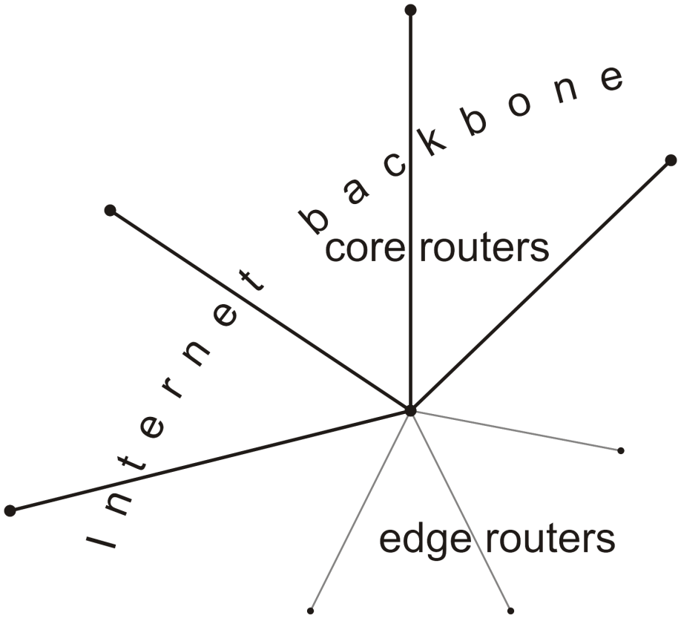
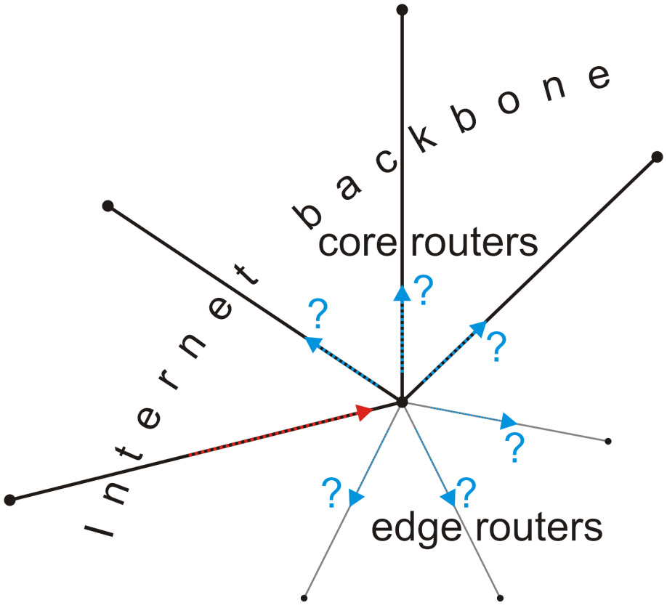
IP Addresses
What if we want to associate domain names with IP addresses?
Which entry in the array should be associated with the domain name churchill.uwaterloo.ca ?
Consider core routers on the Internet:
They must associate each IP address with the next router that address should be passed to

Slide 13
DNS
Given a domain name, we wanted to quickly find the associated IP address.
A domain name can have a maximum of 253 characters!
The number of possible domain names is huge!
Again, we cannot allocate an array for that.

Slide 14
Goal
Our goal:
Store data so that all operations are Θ(1) time
The memory requirement should be Θ(n)
Notes:
In our supporting example, the corresponding function can be called in Θ(1) time and the array is less than twice the optimal size

Slide 15
Keys
In our example, we:
Created an array of size 65536
Store each of 150 objects in one of the 256 entries
The error code indicated which bin the corresponding function pointer was stored
In general, we would like to:
Create an array of size M
Store each of n objects in one of the M bins
Have some means of determining the bin in which an object is stored

Slide 16
Simpler problem
Let’s try a simpler problem
How do I store your examination grades so that I can access your grades in Θ(1) time?
Recall that each student is issued an 8-digit number
How do I store your examination grades so that I can access your grades in Θ(1) time?
Create an array of size 10⁸ ≈ 1.5 × 2²⁶ ?

Slide 17
Simpler problem
I could create an array of size 1000
How could you convert an 8-digit number into a 3-digit number?
Idea: the last three digits, which seem random
Therefore, I could store the examination grade of student “10105456” by:
grade[456] = 86;

Slide 18
Simpler problem
Question:
What is the likelihood that in a class of size 100 no two students have the same last three digits?
Not very high:

Slide 19
Simpler problem
Consequently, I have a function that maps a student onto a 3-digit number
I can store the examination grade in that location
Storing it, accessing it, and erasing it is Θ(1)
Problem: two or more students may map to the same number:
Student A has ID 20173456 and scored 85
Student B has ID 20234456 and scored 87
...
...
454
455
456 | 86
457
458
459
460
461
462
463 | 79
464
465
...
...

Slide 20
The hashing problem
The process of mapping an object or a number onto an integer in a given range is called hashing
Problem: multiple objects may hash to the same value
Such an event is termed a collision
Hash tables use a hash function together with a mechanism for dealing with collisions

Slide 21
IP Addresses
Going back to the problem with IP addresses
We need a hash function to map an IP address to a smaller range
We need a hash function to map a domain name to a smaller range
Mapping 129.97.10.179 onto a smaller range may seem easier, but a mechanism for mapping churchill.uwaterloo.ca onto a small range of integers may be more interesting

Slide 22
The hash process
Object
We will break the process into three independent steps:
We will try to get each of these down to Θ(1)
Techniques vary...
32-bit integer
Modulus, mid-square, multiplicative, Fibonacci
Map to an index 0, ..., M – 1
Deal with collisions
Chained hash tables
Open addressing
Linear probing
Quadratic probing
Double hashing

Slide 23
Summary
Discuss storing unordered data
Discuss IP addresses and domain names
Consider conversions between these two forms
Introduce the idea of using a smaller array
Converted “large” numbers into valid array indices
Reduces O(ln(n)) in arrays and AVL trees to to O(1)
Discussed the issues with collisions

Slide 24
References
Wikipedia, http://en.wikipedia.org/wiki/Hash_table
[1] Cormen, Leiserson, and Rivest, Introduction to Algorithms, McGraw Hill, 1990.
[2] Weiss, Data Structures and Algorithm Analysis in C++, 3rd Ed., Addison Wesley.
These slides are provided for the ECE 250 Algorithms and Data Structures course. The material in it reflects Douglas W. Harder’s best judgment in light of the information available to him at the time of preparation. Any reliance on these course slides by any party for any other purpose are the responsibility of such parties. Douglas W. Harder accepts no responsibility for damages, if any, suffered by any party as a result of decisions made or actions based on these course slides for any other purpose than that for which it was intended.

Slide 25
Outline
Introduction
Hash function
Mapping down to 0, ..., M – 1
Dealing with collisions
Chained hash tables
Open addressing

Slide 26
Outline
In this talk, we will discuss
Finding 32-bit hash values using:
Predetermined hash values
Auto-incremented hash values
Address-based hash values
Arithmetic hash values
Example: strings

Slide 27
Definitions
What is a hash of an object?
From Merriam-Webster:
a restatement of something that is already known
The ultimate goal is to map onto an integer range 0, 1, 2, ..., M – 1

Slide 28
Properties
Necessary properties of such a hash function h are:
1a. Should be fast: ideally Θ(1)
1b. The hash value must be deterministic
It must always return the same 32-bit integer each time
1c. Equal objects hash to equal values
x = y ⇒ h(x) = h(y)
1d. If two objects are randomly chosen, there should be only a one-in- 2³² chance that they have the same hash value

Slide 29
Types of hash functions
We will look at two classes of hash functions
Predetermined hash functions (explicit)
Arithmetic hash functions (implicit)

Slide 30
Predetermined hash functions
The easiest solution is to give each object a unique number
class Class_name {
private:
unsigned int hash_value; // int: –2³¹, ..., 2³¹ – 1
// unsigned int: 0, ..., 2³² – 1
public:
Class_name();
unsigned int hash() const;
};
Class_name::Class_name() {
hash_value = ???;
}
unsigned int Class_name::hash() const {
return hash_value;
}

Slide 31
Predetermined hash functions
For example, an auto-incremented static member variable
class Class_name {
private:
unsigned int hash_value;
static unsigned int hash_count;
public:
Class_name();
unsigned int hash() const;
};
unsigned int Class_name::hash_count = 0;
Class_name::Class_name() {
hash_value = hash_count;
++hash_count;
}
unsigned int Class_name::hash() const {
return hash_value;
}

Slide 32
Predetermined hash functions
Examples
Student ID Number
Personal ID Card Number
Any 9-digit-decimal integer yields a 32-bit integer
lg( 10⁹ ) = 29.897

Slide 33
Predetermined hash functions
If we only need the hash value while the object exists in memory, use the address:
unsigned int Class_name::hash() const {
return reinterpret_cast<unsigned int>( this );
}
This fails if an object may be stored in secondary memory
It will have a different address the next time it is loaded

Slide 34
Predetermined hash functions
Problem with predetermined hash functions?
Strings with the same characters:
string str1 = "Hello world!";
string str2 = "Hello world!";
Objects which are conceptually equal:
Rational x(1, 2);
Rational y(3, 6);
The previous two methods would give them different hash values.
But, a hash function should “hash equal objects to equal values”
These hash values must depend on the member variables
Usually this uses arithmetic functions

Slide 35
Arithmetic Hash Values
An arithmetic hash value is a deterministic function that is calculated from the relevant member variables of an object
We will look at arithmetic hash functions for:
Rational numbers, and
Strings

Slide 36
Rational number class
What if we just add the numerator and denominator?
class Rational {
private:
int numer, denom;
public:
Rational( int, int );
};
unsigned int Rational::hash() const {
return static_cast<unsigned int>( numer ) +
static_cast<unsigned int>( denom );
}
Very likely to collide!

Slide 37
Rational number class
We could improve on this: multiply the denominator by a large prime:
class Rational {
private:
int numer, denom;
public:
Rational( int, int );
};
unsigned int Rational::hash() const {
return static_cast<unsigned int>( numer ) +
429496751*static_cast<unsigned int>( denom );
}

Slide 38
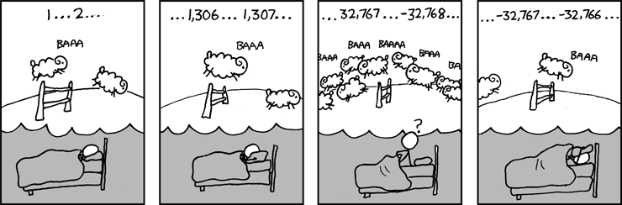
Rational number class
For example, the output of
int main() {
cout << Rational( 0, 1 ).hash() << endl;
cout << Rational( 1, 2 ).hash() << endl;
cout << Rational( 2, 3 ).hash() << endl;
cout << Rational( 99, 100 ).hash() << endl;
return 0;
}
is
429496751
858993503
1288490255
2239
Recall that arithmetic operations wrap on overflow
http://xkcd.com/571/

Slide 39
Rational number class
This hash function does not generate unique values
The following pairs have the same hash values:
0/1 1327433019/800977868
1/2 534326814/1480277007
2/3 820039962/1486995867
Finding rational numbers with matching hash values is very difficult:
Finding these required the generation of 1 500 000 000 random rational numbers
It is fast: Θ(1)
It does produce an even distribution

Slide 40
Rational number class
Problem:
The rational numbers 1/2 and 2/4 have different values
The output of
cout << Rational( 1, 2 ).hash();
cout << Rational( 2, 4 ).hash();
is
858993503
1717987006

Slide 41
Rational number class
Solution: divide through by the greatest common divisor
Rational::Rational( int a, int b ):numer(a), denom(b) {
int divisor = gcd( numer, denom );
numer /= divisor;
denom /= divisor;
}
int gcd( int a, int b) {
while( true ) {
if ( a == 0 ) {
return (b >= 0) ? b : -b;
}
b %= a;
if ( b == 0 ) {
return (a >= 0) ? a : -a;
}
a %= b;
}
}

Slide 42
Rational number class
Problem:
The rational numbers and have different values
The output of
int main() {
cout << Rational( 1, 2 ).hash();
cout << Rational( -1, -2 ).hash();
return 0;
}
is
858993503
3435973793

Slide 43
Rational number class
Solution: define a normal form
Require that the denominator is positive
Rational::Rational( int a, int b ):numer(a), denom(b) {
int divisor = gcd( numer, denom );
divisor = (denom >= 0) ? divisor : -divisor;
numer /= divisor;
denom /= divisor;
}

Slide 44
String class
Two strings are equal if all the characters are equal and in the identical order
A string is simply an array of bytes:
Each byte stores a value from 0 to 255
Any hash function must be a function of these bytes

Slide 45
String class
We could, for example, just add the characters:
unsigned int hash( const string &str ) {
unsigned int hash_value = 0;
for ( int k = 0; k < str.length(); ++k ) {
hash_value += str[k];
}
return hash_value;
}

Slide 46
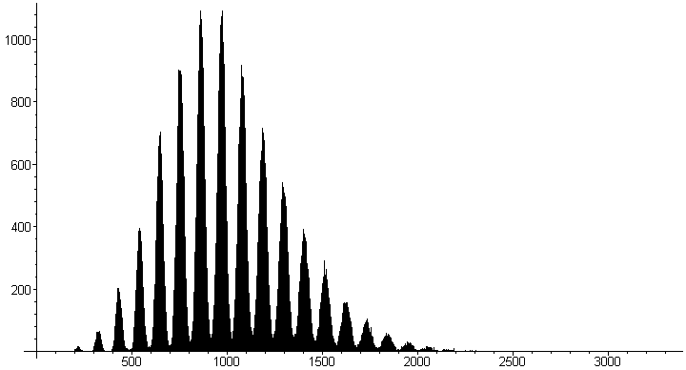
String class
Not very good:
Slow run time: Θ(n)
Words with the same characters hash to the same code:
"form" and "from"
A poor distribution, e.g., all words in MobyTM Words II by Grady Ward:
The distribution peaks about every 109. Why?
Hint: 'a'=97, …, 'z'=122

Slide 47
String class
Let the individual characters represent the coefficients of a polynomial in x:
p(x) = c₀ x^{n – 1} + c₁ x^{n – 2} + ··· + c_{n – 3} x² + c_{n – 2} x + c_{n – 1}
Use Horner’s rule to evaluate this polynomial at a prime number, e.g., x = 12347:
unsigned int hash( string const &str ) {
unsigned int hash_value = 0;
for ( int k = 0; k < str.length(); ++k ) {
hash_value = 12347*hash_value + str[k];
}
return hash_value;
}

Slide 48
String class
Is this hash function actually better?
Suppose I pick n random integers from 1 to L
One would expect each integer to appear λ = n/L times
Some, however, will appear more often, others less often
To test whether or not the integers are random, we will ask:
“How many (what proportion of) integers were chosen k times?”

Slide 49
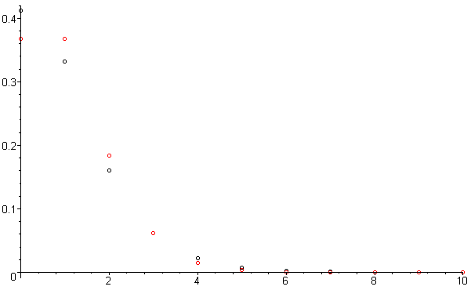
String class
Proportion of intervals with n hash values
Poisson distribution with λ = 1
Consider the hash of each of the 354985 strings in MobyTM Words II to be a random value in 0, 1, 2, 3, …, 2³² – 1
Subdivide the integers into groups of approximately 12099
We expect one hash value per interval
Count the number of these subintervals which contain 0, 1, 2, ... of these hash values
Plotting these proportions and 1/en!, we see they’re very similar

Slide 50
String class
Problem, Horner’s rule runs in Θ(n)
"A Elbereth Gilthoniel,\n
Silivren penna miriel\n
O menal aglar elenath!\n
Na-chaered palan-diriel\n
O galadhremmin ennorath,\n
Fanuilos, le linnathon\n
nef aear, si nef aearon!"
Suggestions?
Notes:
J.R.R. Tolkien

Slide 51
String class
Use characters in locations 2^{k} – 1 for k = 0, 1, 2, ...:
"A_Elbereth Gilthoniel,\n
Silivren_penna miriel\n
O menal aglar elenath!\n
Na-chaered palan-diriel\n
O galadhremmin ennorath,\n
Fanuilos, le linnathon\n
nef aear, si nef aearon!"
J.R.R. Tolkien

Slide 52
String class
The run time is now Θ(ln(n)) :
unsigned int hash( const string &str ) {
unsigned int hash_value = 0;
for ( int k = 1; k <= str.length(); k *= 2 ) {
hash_value = 12347*hash_value + str[k – 1];
}
return hash_value;
}
Notes:
Note: this cannot be used if you require a cryptographic hash function or message digest

Slide 53
Arithmetic hash functions
In general, any member variables that are used to uniquely define an object may be used as coefficients in such a polynomial
class Person {
string surname;
string given_name;
unsigned short birth_year;
unsigned char birth_month;
unsigned char birth_day;
unsigned int salary;
// ...
};
Notes:
The salary hopefully changes over time…

Slide 54
Arithmetic hash functions
In general, any member variables that are used to uniquely define an object may be used as coefficients in such a polynomial
class Person {
string surname;
string given_name;
unsigned short birth_year;
unsigned char birth_month;
unsigned char birth_day;
unsigned int salary;
// ...
};
Notes:
The salary hopefully changes over time…

Slide 55
Summary
We have seen how a number of objects can be mapped onto a 32-bit integer
We considered
Predetermined hash functions
Auto-incremented variables
Addresses
Hash functions calculated using arithmetic
Next: map a 32-bit integer onto a smaller range 0, 1, ..., M – 1

Slide 56
Outline
Introduction
Hash function
Mapping down to 0, ..., M – 1
Dealing with collisions
Chained hash tables
Open addressing

Slide 57
Outline
Previously, we considered means for calculating 32-bit hash values
Explicitly defined hash values
Implicitly calculated hash values
Practically, we will require a hash value on the range 0, ..., M – 1:
The modulus operator %
Review of bitwise operations
The multiplicative method

Slide 58
The hash process
Object
32-bit integer
Modulus, mid-square, multiplicative, Fibonacci
Map to an index 0, ..., M – 1
Deal with collisions
Chained hash tables
Open addressing

Slide 59
Properties
Necessary properties of this mapping function h_{M} are:
2a. Must be fast: Θ(1)
2b. The hash value must be deterministic
Given n and M, h_{M}(n) must always return the same value
2c. If two objects are randomly chosen, there should be only a one-in-M chance that they have the same value from 0 to M – 1

Slide 60
Modulus operator
Easiest method: return the value modulus M
unsigned int hash_M( unsigned int n, unsigned int M ) {
return n % M;
}
Unfortunately, calculating the modulus (or remainder) is expensive
If M = 2^{m}, we can simplify the calculation by bitwise operations
left and right shift and bit-wise and

Slide 61
The bitwise operators: & << >>
Suppose I want to calculate
7985325 % 100
The modulo is a power of ten: 100 = 10²
In this case, take the last two decimal digits: 25
Similarly, 7985325 % 10³ = 325
We set the appropriate digits to 0:
0000025 and 0000325

Slide 62
The bitwise operators: & << >>
The same works in base 2:
100011100101₂ % 10000₂
The modulo is a power of 2: 10000₂ = 2⁴
In this case, take the last four bits: 0101
Similarly, 100011100101₂ % 1000000₂ == 100101,
We set the appropriate digits to 0:
000000000101 and 000000100101

Slide 63
The bitwise operators: & << >>
To zero all but the last n bits, select the last n bits using bitwise and:
1000 1110 0101₂ & 0000 0000 1111₂ → 0000 0000 0101₂
1000 1110 0101₂ & 0000 0011 1111₂ → 0000 0010 0101₂

Slide 64
The bitwise operators: & << >>
Similarly, multiplying or dividing by powers of 10 is easy:
7985325 * 100
The multiplier is a power of ten: 100 = 10²
In this case, add two zeros: 798532500
Similarly, 7985325 / 10³ = 7985
Just add the appropriate number of zeros or remove the appropriate number of digits

Slide 65
The bitwise operators: & << >>
The same works in base 2:
100011100101₂ * 10000₂
The modulo is a power of 2: 10000₂ = 2⁴
In this case, add four zeros: 1000111001010000
Similarly, 100011100101₂ / 1000000₂ == 100011

Slide 66
The bitwise operators: & << >>
This can be done mechanically by shifting the bits appropriately:
1000 1110 0101₂ << 4 == 1000 1110 0101 0000₂
1000 1110 0101₂ >> 6 == 10 0011₂
Powers of 2 are now easy to calculate:
1₂ << 4 == 1 0000₂ // 2⁴ = 16
1₂ << 6 == 100 0000₂ // 2⁶ = 64

Slide 67
Modulo a power of two
The implementation using the modulus/remainder operator:
unsigned int hash_M( unsigned int n, unsigned int m ) {
return n & ((1 << m) – 1);
}

Slide 68
Modulo a power of two
Problem:
Suppose that the hash function h is always even
An even number modulo a power of two is still even
Example: memory allocations are multiples of word size
On a 64-bit computer, addresses returned by new will be multiples of 8
The probability that h_{M}( h(x) ) = h_{M}( h(y) ) is one in M/8
This is not one in M

Slide 69
Modulo a power of two
For some objects, it is worse:
Instance of Single_node<int> on ecelinux always have 10000 as the last five bits
This increases the probability of a collision to one in M/32
Fortunately, the multiplicative method resolves this issue

Slide 70
The multiplicative method
We need to obfuscate the bits
The most common method to obfuscate bits is multiplication
Consider how one bit can affect an entire range of numbers in the result:
10100111
× 11010011
10100111
10100111
10100111
10100111
+ 10100111 .
1000101110100101
The avalanche effect: changing one bits has the potential of affecting all bits in the result:
10100011 × 11010011
= 1000011001011001
Notes:
C++ truncates the product of two n-bit
numbers to n bits

Slide 71
The multiplicative method
Multiplication can be used in encryption as with IDEA:
unsigned short a, b, c, d; // 64 bit number broken into four 16 bits
unsigned short z[9][6]; // 52 numbers based on key (2 unused)
for ( int i = 0; i < 8; ++i ) {
a *= z[i][0]; b += z[i][1]; c += z[i][2]; d *= z[i][3];
e = z[i][4]*(a^c);
f = ( e + (b^d) )*z[i][5];
e += f;
a ^= f; tmp = b; b = c^f; c = tmp^e; d ^= e;
}
a *= z[8][0]; b += z[8][1]; c += z[8][2]; d *= z[8][3];
Xuejia Lai and James Massey

Slide 72
The multiplicative method
Multiplying by a fixed constant is a reasonable method
Take the middle m bits of Cn:
unsigned int const C = 581869333; // some number
unsigned int hash_M( unsigned int n, unsigned int m ) {
unsigned int shift = (32 – m)/2;
return ((C*n) >> shift) & ((1 << m) – 1);
}

Slide 73
The multiplicative method
Suppose that the value m = 10 (M = 1024) and n = 42
const unsigned int C = 581869333; // some number
unsigned int hash_M( unsigned int n, unsigned int m ) {
unsigned int shift = (32 – m)/2;
return ((C*n) >> shift) & ((1 << m) – 1);
}

Slide 74
The multiplicative method
m = 10
n = 42
First calculate the shift
const unsigned int C = 581869333; // some number
unsigned int hash_M( unsigned int n, unsigned int m ) {
unsigned int shift = (32 – m)/2;
return ((C*n) >> shift) & ((1 << m) – 1);
}
shift = 11

Slide 75
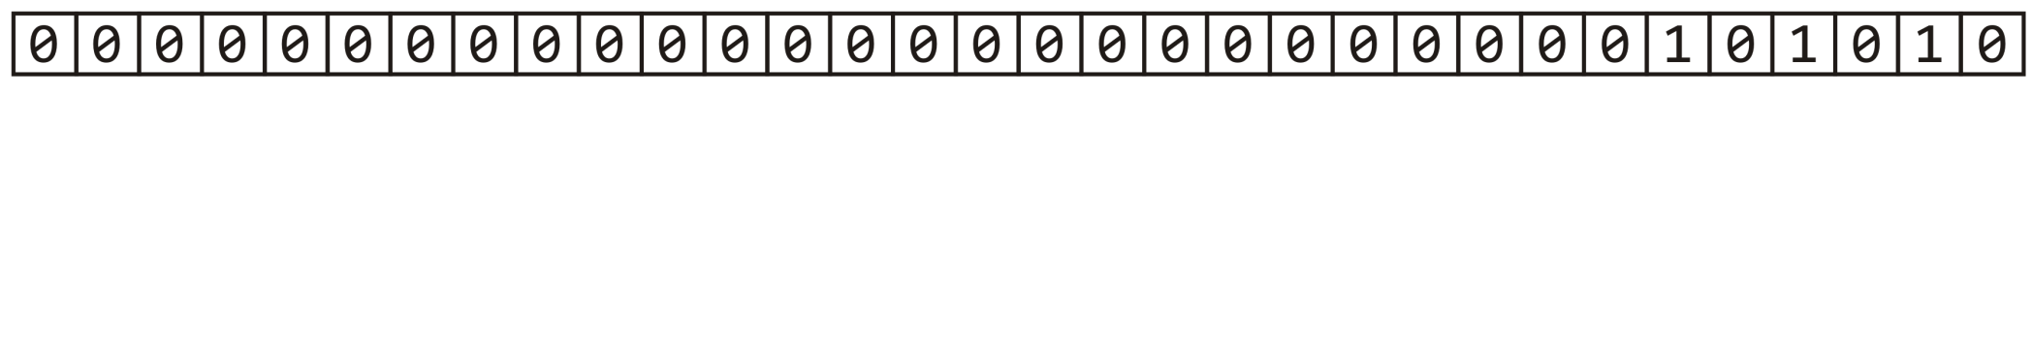
The multiplicative method
m = 10
n = 42
Next, n = 42 or 101010₂
const unsigned int C = 581869333; // some number
unsigned int hash_M( unsigned int n, unsigned int m ) {
unsigned int shift = (32 – m)/2;
return ((C*n) >> shift) & ((1 << m) – 1);
}
shift = 11

Slide 76
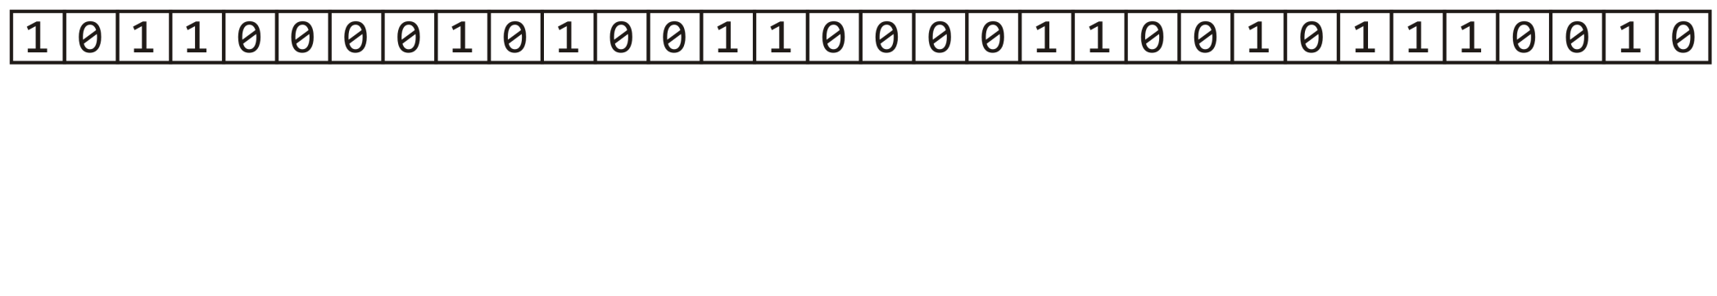
The multiplicative method
m = 10
n = 42
Calculate Cn
const unsigned int C = 581869333; // some number
unsigned int hash_M( unsigned int n, unsigned int m ) {
unsigned int shift = (32 – m)/2;
return ((C*n) >> shift) & ((1 << m) – 1);
}
shift = 11

Slide 77
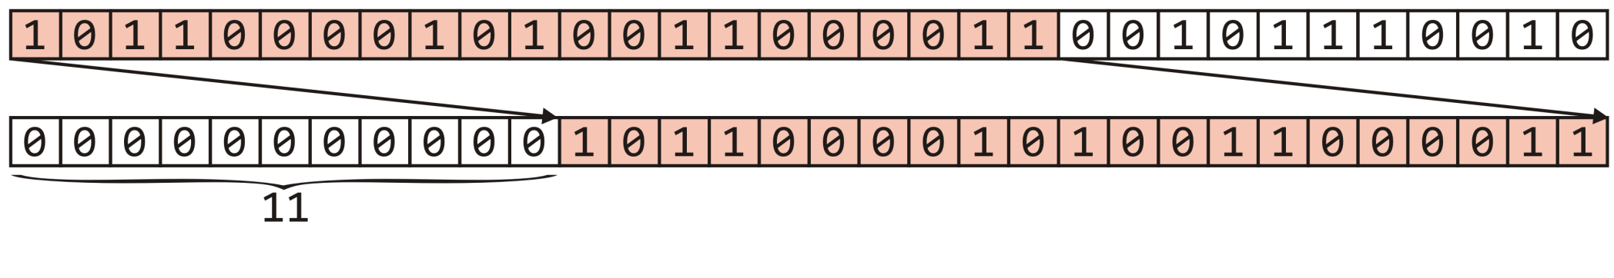
The multiplicative method
m = 10
n = 42
Right shift this value 11 bits—equivalent to dividing by 2¹¹
const unsigned int C = 581869333; // some number
unsigned int hash_M( unsigned int n, unsigned int m ) {
unsigned int shift = (32 – m)/2;
return ((C*n) >> shift) & ((1 << m) – 1);
}
shift = 11

Slide 78
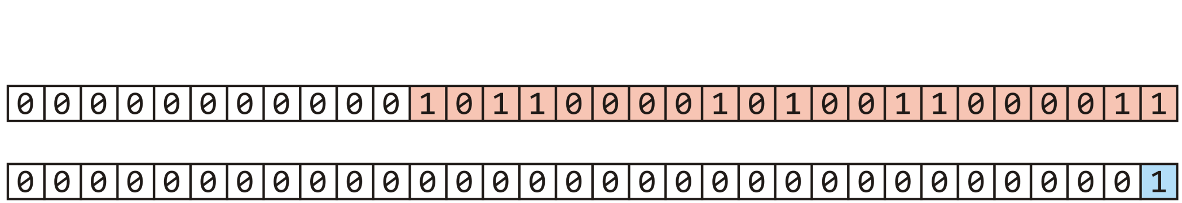
The multiplicative method
m = 10
n = 42
Next, start with 1
const unsigned int C = 581869333; // some number
unsigned int hash_M( unsigned int n, unsigned int m ) {
unsigned int shift = (32 – m)/2;
return ((C*n) >> shift) & ((1 << m) – 1);
}

Slide 79
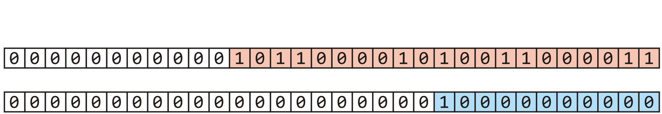

The multiplicative method
m = 10
n = 42
Left shift 1 m = 10 bits yielding 2¹⁰
const unsigned int C = 581869333; // some number
unsigned int hash_M( unsigned int n, unsigned int m ) {
unsigned int shift = (32 – m)/2;
return ((C*n) >> shift) & ((1 << m) – 1);
}

Slide 80
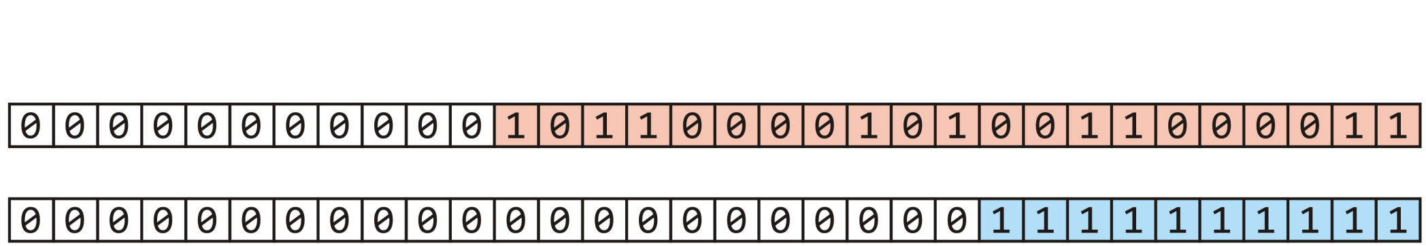
The multiplicative method
m = 10
n = 42
Subtracting 1 yields m = 10 ones
const unsigned int C = 581869333; // some number
unsigned int hash_M( unsigned int n, unsigned int m ) {
unsigned int shift = (32 – m)/2;
return ((C*n) >> shift) & ((1 << m) – 1);
}

Slide 81
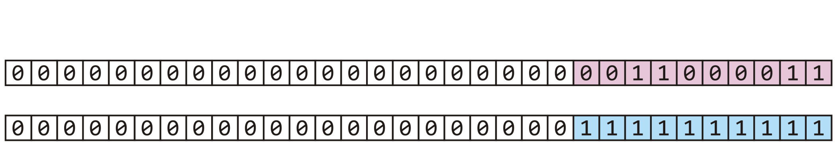
The multiplicative method
m = 10
n = 42
Taken the bitwise to clear all but the last 10 bits
const unsigned int C = 581869333; // some number
unsigned int hash_M( unsigned int n, unsigned int m ) {
unsigned int shift = (32 – m)/2;
return ((C*n) >> shift) & ((1 << m) – 1);
}

Slide 82
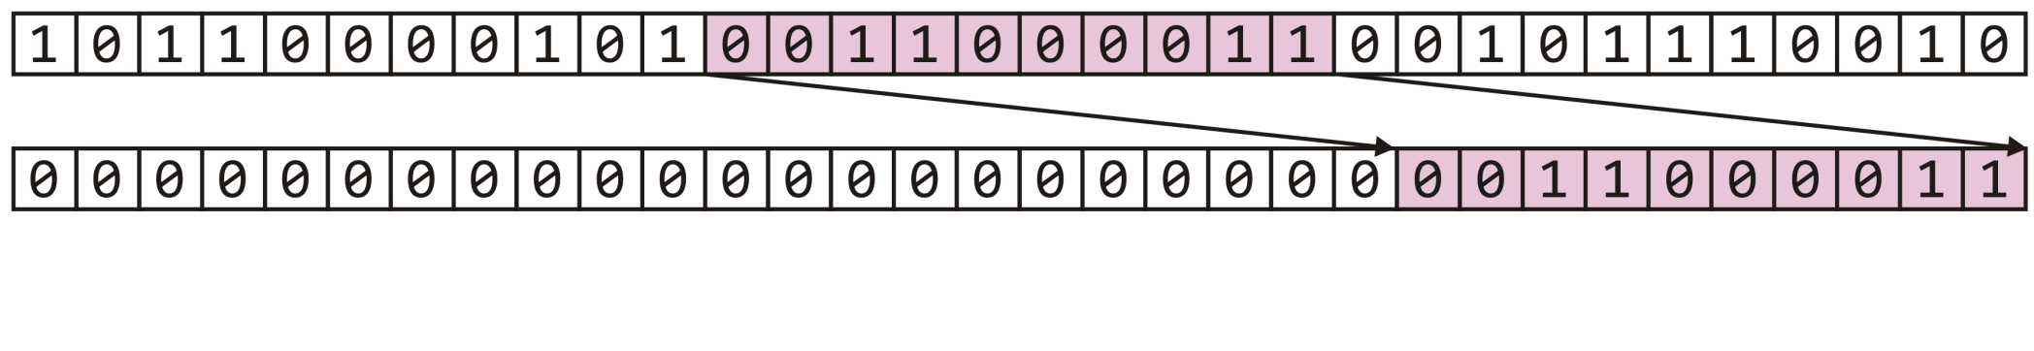
The multiplicative method
We have extracted the middle m = 10 bits—a number in 0, …, 1023
const unsigned int C = 581869333; // some number
unsigned int hash_M( unsigned int n, unsigned int m ) {
unsigned int shift = (32 – m)/2;
return ((C*n) >> shift) & ((1 << m) – 1);
}
h_{M}(42) = 195

Slide 83
Dealing with signed integers
In some cases (Java) unsigned integers are either not available
Our function would be implemented as follows:
int hash_M( int n, int M ) {
return n % M;
}
Is this sufficient to yield a value on 0, ..., M – 1?

Slide 84
Dealing with signed integers
The modulus operator % satisfies the following equality:
n == M*(n/M) + n%M
The division operator n/M truncates any factional part
It rounds towards zero
For positive n and M, this yields positive values:
If n = 13 and M = 8, 13/8 → 1 and 8*1 → 8
∴ 13 % 8 → 5
For a negative value of n:
If n = -11 and M = 8, -11/8 → -1 and 8*(-1) = -8
∴(-11) % 8 → -3

Slide 85
Dealing with signed integers
Our mapping function could be implemented as follows:
int hash_M( int n, int M ) {
int hash_value = n % M;
return (hash_value >= 0) ? hash_value : hash_value + M;
}

Slide 86
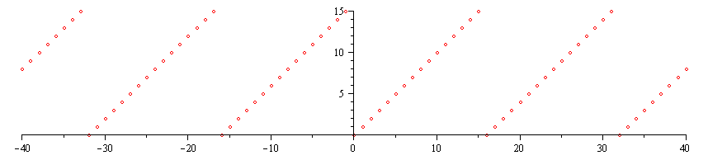
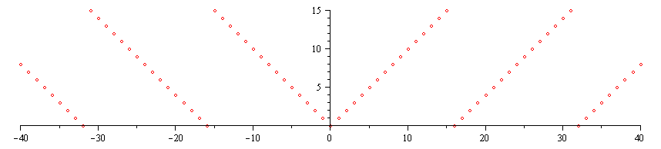
Dealing with signed integers
Why + M and not std::abs( M )?
First, adding results in periodicity:
Using the absolute value is not periodic

Slide 87
Dealing with signed integers
Also, not all integers have absolute values:
int main() {
int n1 = -2147483648; // -2^31
int n2 = -2147483647; // -(2^31 – 1)
cout << std::abs( n1 ) << endl;
cout << std::abs( n2 ) << endl;
return 0;
}
The output is:
-2147483648
2147483647

Slide 88
Summary
This topic covered next step in creating a hash value:
Taking a 32-bit number and mapping it down to 0, …, M – 1
One can use the modulus; however, using the middle m bits of the number times a large prime avoids some weaknesses of the modulus
We must now deal with collisions: the reality that two objects may hash to the same value

Slide 89
Outline
Introduction
Hash function
Mapping down to 0, ..., M – 1
Dealing with collisions
Chained hash tables
Open addressing

Slide 90
Outline
We have:
Discussed techniques for hashing
Discussed mapping down to a given range 0, ..., M – 1
Now we must deal with collisions
Numerous techniques exist
Containers in general
Specifically linked lists

Slide 91
Hashing
First, a review:
We want to store objects in an array of size M
We want to quickly calculate the bin where we want to store the object
We came up with hash functions—hopefully Θ(1)
Perfect hash functions (no collisions) are difficult to design
We will look at some schemes for dealing with collisions

Slide 92
The hash process
Object
32-bit integer
Modulus, mid-square, multiplicative, Fibonacci
Map to an index 0, ..., M – 1
Deal with collisions
Chained hash tables
Open addressing

Slide 93
Chained hash table
Consider associating each bin with a linked list:
template <class Type>
class Chained_hash_table {
private:
int table_capacity;
int table_size;
Single_list<Type> *table;
unsigned int hash( Type const & );
public:
Chained_hash_table( int = 16 );
int count( Type const & ) const;
void insert( Type const & );
int erase( Type const & );
// ...
};

Slide 94
Chained hash table
Associating each bin with a linked list.
For any object assigned to the bin by the hash function, finding, inserting, and erasing the object is done on the linked list.

Slide 95
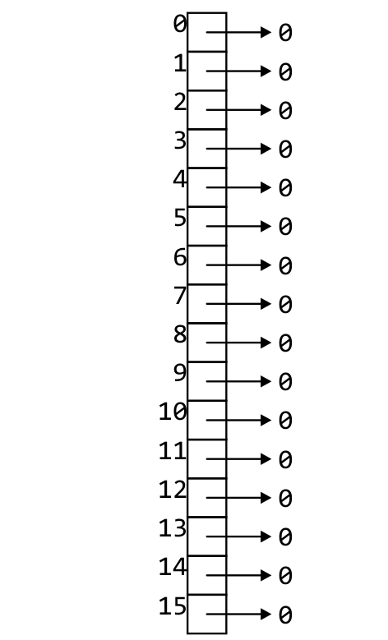
Implementation
The constructor creates an array of n linked lists
template <class Type>
Chained_hash_table::Chained_hash_table( int n ):
table_capacity( std::max( n, 1 ) ),
table_size( 0 ),
table( new Single_list<Type>[table_capacity] ) {
// empty constructor
}

Slide 96
Implementation
The function hash will determine the bin of an object:
template <class Type>
int Chained_hash_table::hash( Type const &obj ) {
return hash_M( obj.hash(), capacity() );
}
Recall:
obj.hash() returns a 32-bit non-negative integer
unsigned int hash_M( obj, M ) returns a value in 0, …, M – 1

Slide 97
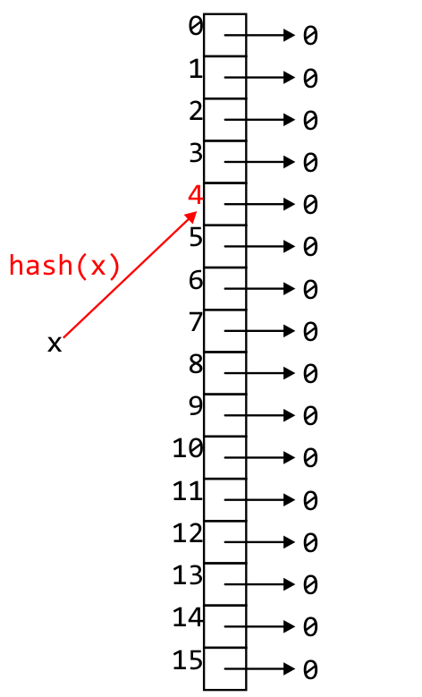
Implementation
template <class Type>
void Chained_hash_table::insert( Type const &obj ) {
unsigned int bin = hash( obj );
if ( table[bin].count( obj ) == 0 ) {
table[bin].push_front( obj );
++table_size;
}
}

Slide 98
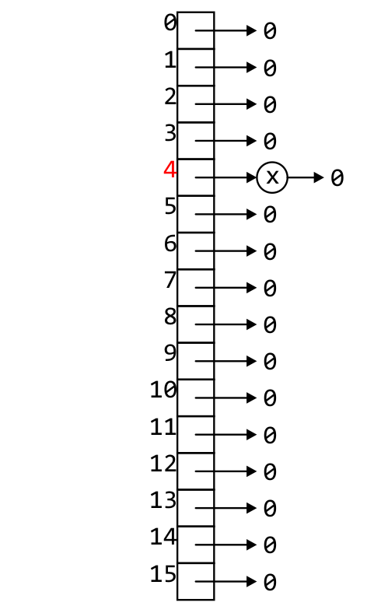
Implementation
template <class Type>
void Chained_hash_table::insert( Type const &obj ) {
unsigned int bin = hash( obj );
if ( table[bin].count( obj ) == 0 ) {
table[bin].push_front( obj );
++table_size;
}
}

Slide 99
Implementation
template <class Type>
int Chained_hash_table::count( Type const &obj ) const {
return table[hash( obj )].count( obj );
}

Slide 100
Implementation
template <class Type>
int Chained_hash_table::erase( Type const &obj ) {
unsigned int bin = hash( obj );
if ( table[bin].erase( obj ) ) {
--table_size;
return 1;
} else {
return 0;
}
}

Slide 101
Example
As an example, let’s store hostnames and allow a fast look-up of the corresponding IP address
We will choose the bin based on the host name
Associated with the name will be the IP address
E.g., ("optimal", 129.97.94.57)

Slide 102
Example
Suppose the hash value of a string is the last 3 bits of the first character in the host name
The hash of "optimal" is based on "o“
a 01100001 n 01101110
b 01100010 o 01101111
c 01100011 p 01110000
d 01100100 q 01110001
e 01100101 r 01110010
f 01100110 s 01110011
g 01100111 t 01110100
h 01101000 u 01110101
i 01101001 v 01110110
j 01101010 w 01110111
k 01101011 x 01111000
l 01101100 y 01111001
m 01101101 z 01111010

Slide 103
Example
Our hash function is
unsigned int hash( string const &str ) {
// the empty string "" is hashed to 0
if str.length() == 0 ) {
return 0;
}
return str[0] & 7;
}

Slide 104
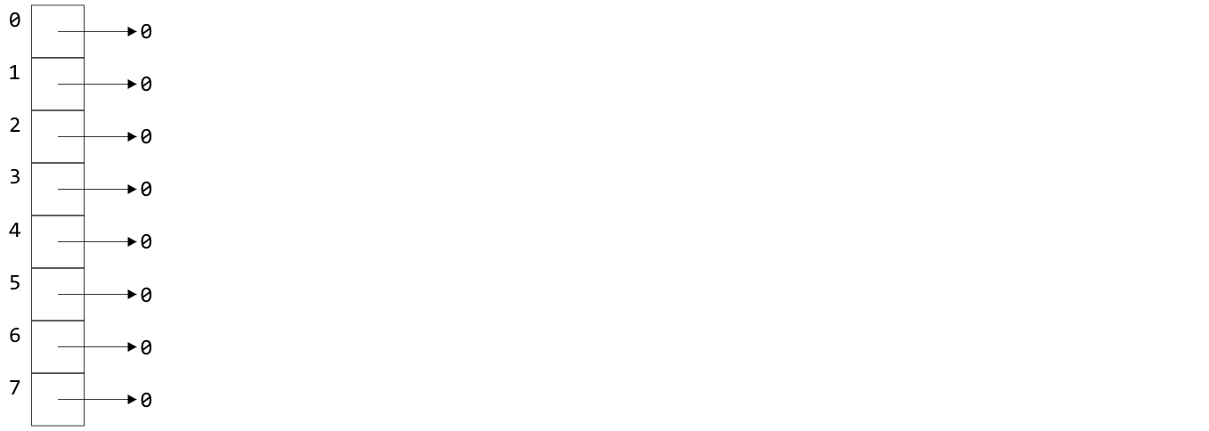
Example
Starting with an array of 8 empty linked lists

Slide 105
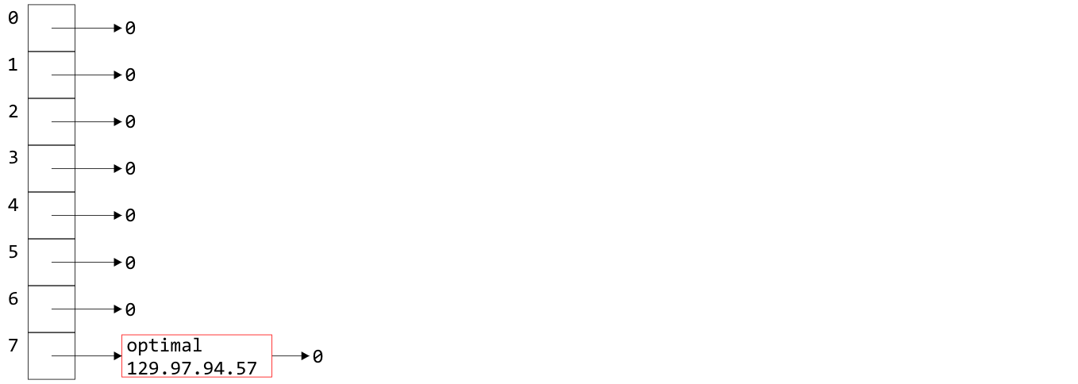
Example
The pair ("optimal", 129.97.94.57) is entered into bin 01101111 = 7

Slide 106
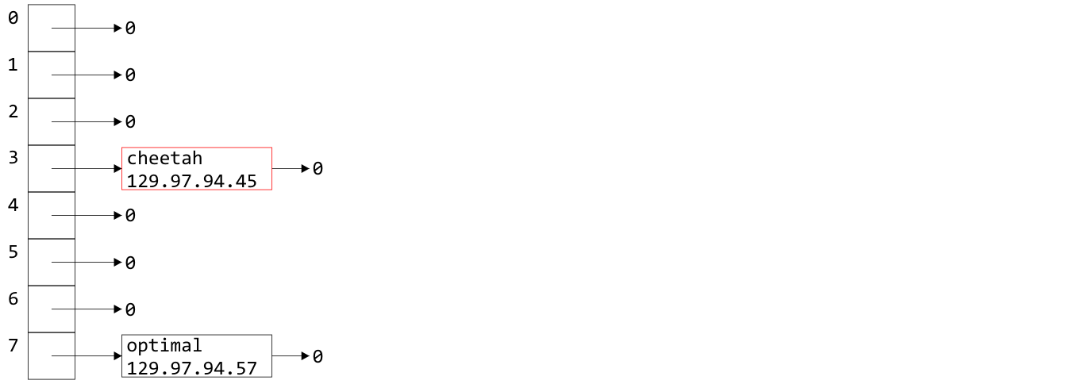
Example
Similarly, as "c" hashes to 3
The pair ("cheetah", 129.97.94.45) is entered into bin 3

Slide 107
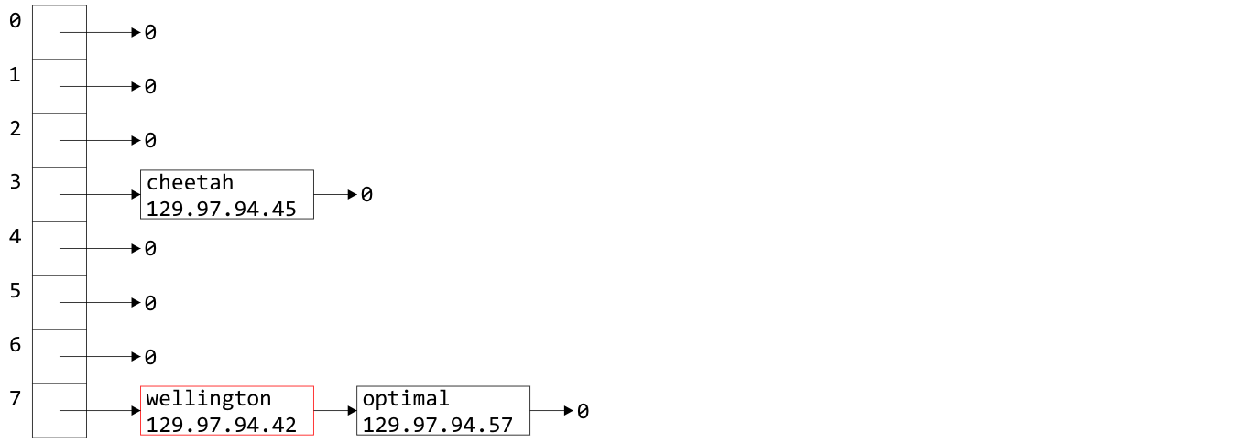
Example
The "w" in Wellington also hashes to 7
("wellington", 129.97.94.42) is entered into bin 7

Slide 108
Example
Why did I use push_front from the linked list?
A good heuristic is
“unless you know otherwise, data which has been
accessed recently will be accessed again in the near future”
It is easiest to access data at the front of a linked list
Heuristics include rules of thumb, educated guesses, and intuition

Slide 109
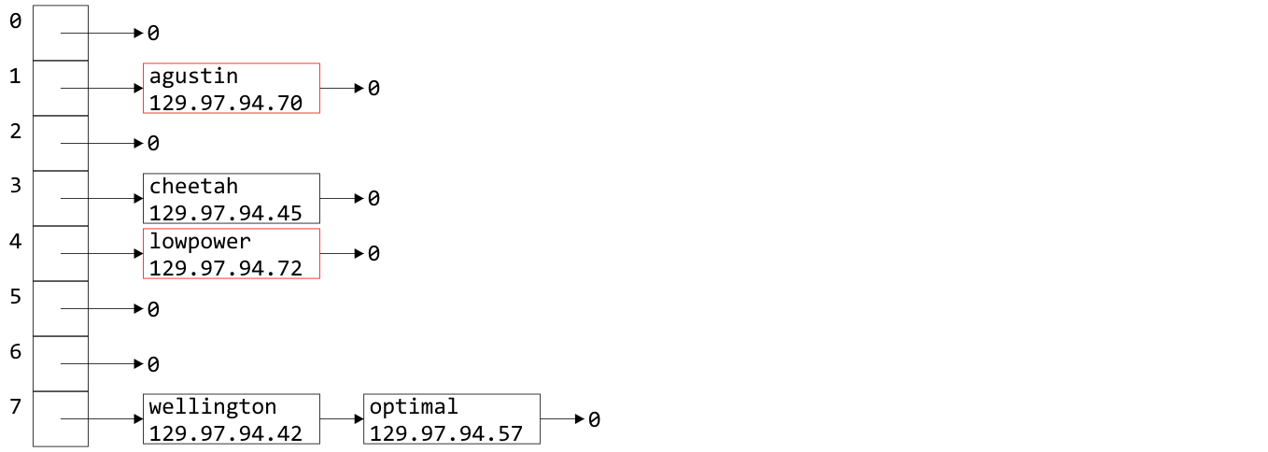
Example
Similarly we can insert the host names "augustin" and "lowpower"

Slide 110
Example
If we now wanted the IP address for "optimal", we would simply hash "optimal" to 7, walk through the linked list, and access 129.97.94.57 when we access the node containing the relevant string

Slide 111
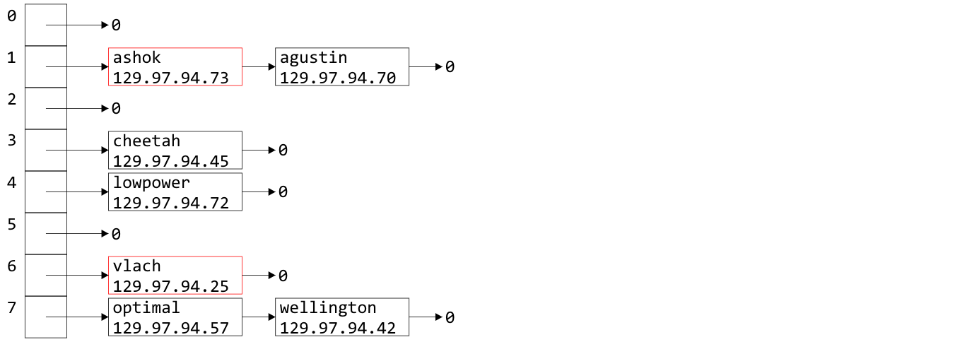
Example
Similarly, "ashok" and "vlach" are entered into bin 1 and 6

Slide 112
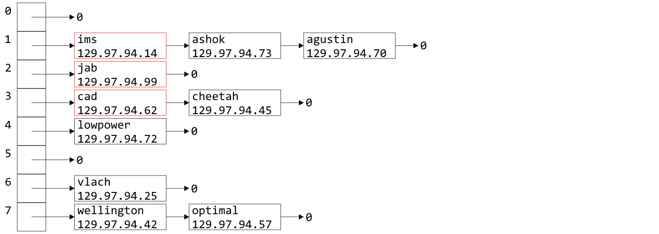
Example
Inserting "ims", "jab", and "cad" doesn’t even out the bins

Slide 113
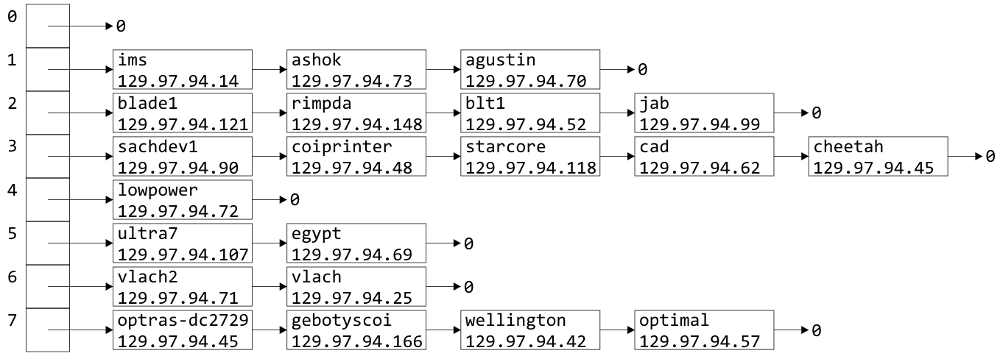
Example
Indeed, after 21 insertions, the linked lists are becoming rather long
We were looking for Θ(1) access time, but accessing something in a linked list with k objects is O(k)

Slide 114
Load Factor
To describe the length of the linked lists, we define the load factor of the hash table:
This is the average number of objects per bin
This assumes an even distribution
Right now, the load factor is λ = 21/8 = 2.625
The average bin has 2.625 objects

Slide 115
Load Factor
If the load factor becomes too large, access times will start to increase: O(λ)
The most obvious solution is to double the size of the hash table and re-insert every object (rehashing)

Slide 116
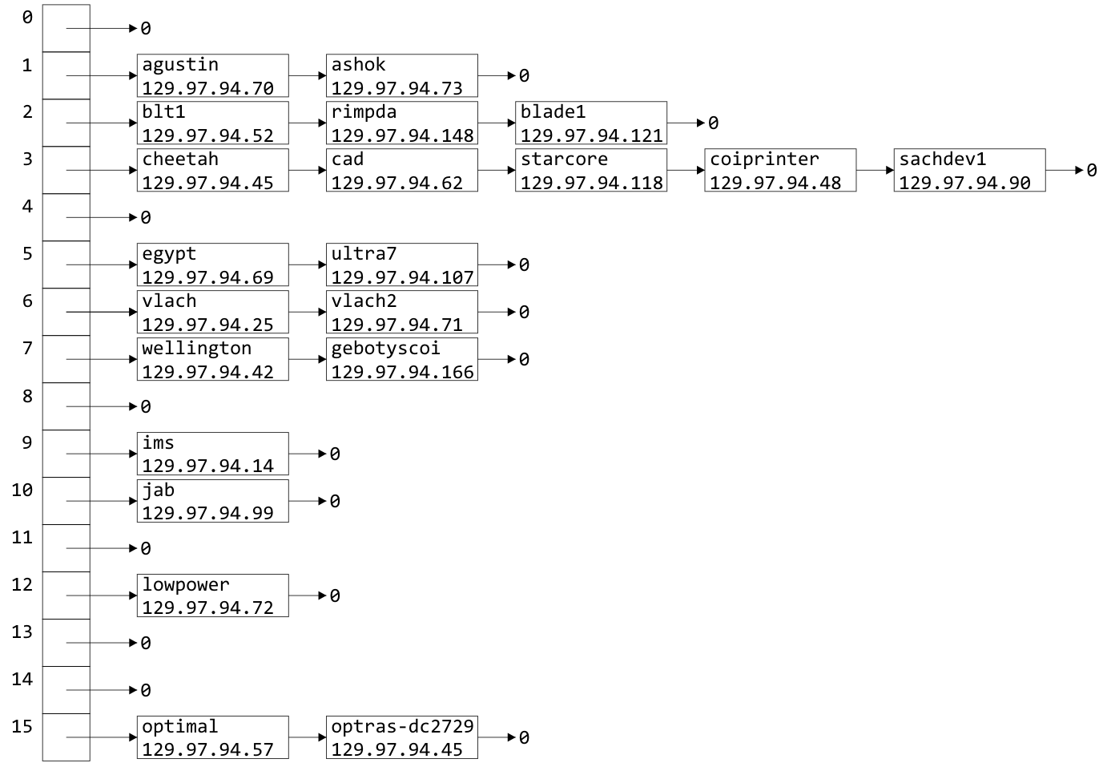
Doubling Size
In our example, suppose we take the last four bits as the hash function after doubling the hash table size

Slide 117
Doubling Size
The load factor is now λ = 1.3125
Unfortunately, the distribution hasn’t improved much

Slide 118
Doubling Size
There is significant clustering in bins 2 and 3 due to the choice of host names

Slide 119
Choosing a Good Hash Function
We choose a very poor hash function:
We looked at the first letter of the host name
Unfortunately, all these are also actual host names:
ultra7 ultra8 ultra9 ultra10 ultra11
ultra12 ultra13 ultra14 ultra15 ultra16 ultra17
blade1 blade2 blade3 blade4 blade5
This will cause clustering in bins 2 and 5
Notes:
Any hash function based on anything other than every letter will cause clustering

Slide 120
Choosing a Good Hash Function
Let’s go back to the hash function defined previously:
unsigned int hash( string const &str ) {
unsigned int hash_value = 0;
for ( int k = 0; k < str.length(); ++k ) {
hash_value = 12347*hash_value + str[k];
}
return hash_value;
}

Slide 121
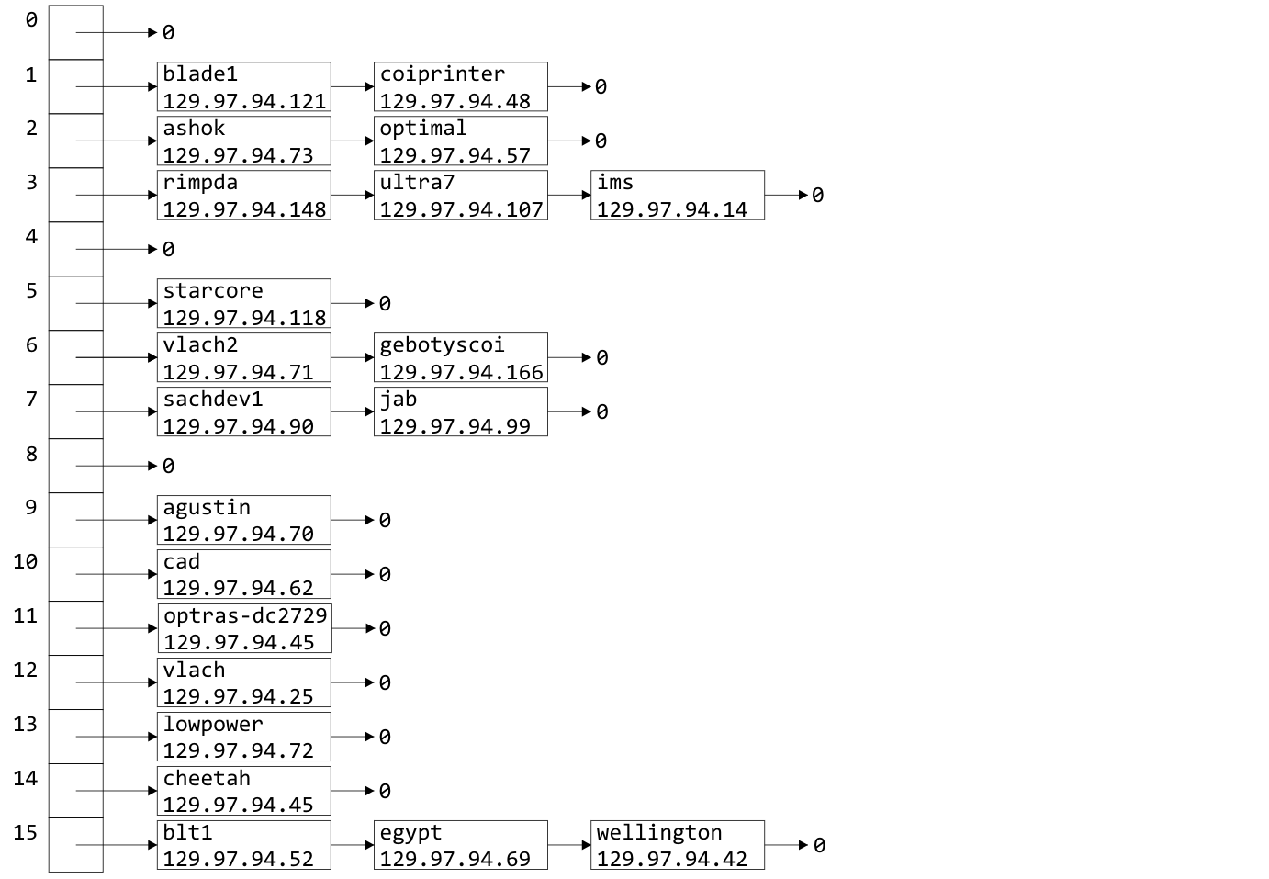
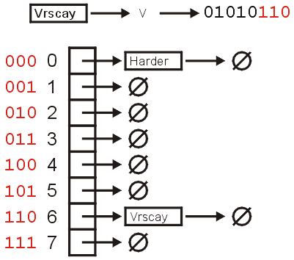
Choosing a Good Hash Function
This hash function yields a much nicer distribution:

Slide 122
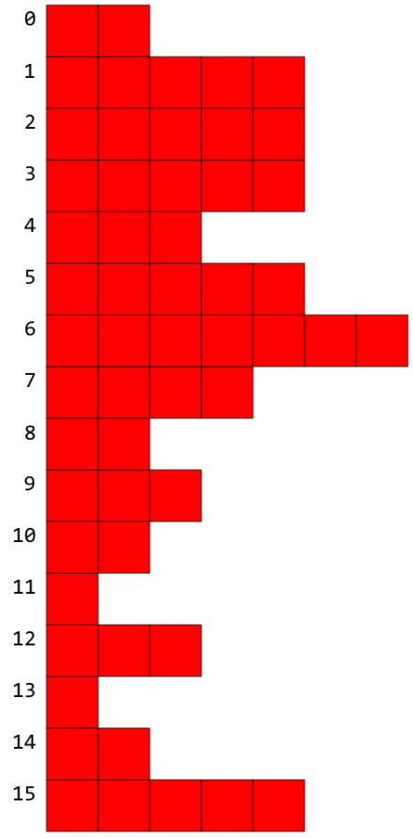
Choosing a Good Hash Function
When we insert 55 names, we would have a load factor λ = 3.4375
Clearly there are not exactly 3.4375 objects per bin
How can we tell if this is a good hash function?
Can we expect exactly 3.4375 objects per bin?
Clearly no…
The answer is with statistics…

Slide 123
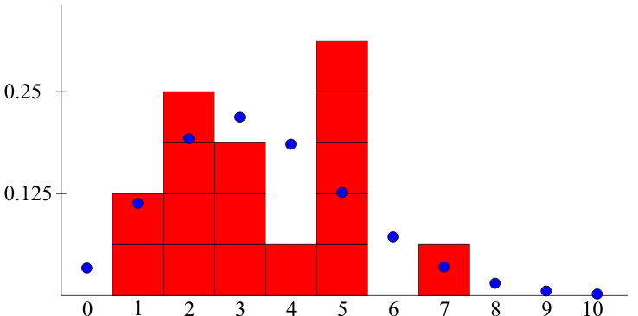
Choosing a Good Hash Function
We would expect the number of bins which hold k objects to approximately follow a Poisson distribution
k

Slide 124
Problems with Linked Lists
One significant issue with chained hash tables using linked lists
It requires extra memory
It uses dynamic memory allocation
Another issue is the O(λ) time complexity
For faster access, we could replace each linked list with an AVL tree (assuming we can order the objects)
The access time drops to O(ln(λ))
The memory requirements are increased by Θ(n), as each node will require two pointers
Notes:
Total memory:
16 bytes
A pointer to an array, initial and current number of bins, and the size
+ 12M bytes (8M if we remove count from Single_list)
+ 8n bytes if each object is 4 bytes

Slide 125
Problems with linked lists
For faster access, we could replace each linked list with an AVL tree (assuming we can order the objects)
The access time drops to O(ln(λ))
The memory requirements are increased by Θ(n), as each node will require two pointers
We could look at other techniques:
Scatter tables: use other bins and link the bins
Use an alternate memory allocation model

Slide 126
Black Board Example
Use the hash function unsigned int hash( unsigned int n ) { return n % 10; }
to enter the following 15 numbers into a hash table with 10 bins:
534, 415, 465, 459, 869, 442, 840, 180, 450, 265, 23, 946, 657, 3, 29

Slide 127
Summary
The easiest way to deal with collisions is to associate each bin with a container
We looked at bins of linked lists
The example used host names and IP addresses
We defined the load factor λ = n/M
Discussed doubling the number of bins
Our goals are to choose a good hash function and to keep the load factor low
We discussed alternatives
Next we will see a different technique using only one array of bins: open addressing

Slide 128
Outline
Introduction
Hash function
Mapping down to 0, ..., M – 1
Dealing with collisions
Chained hash tables
Open addressing

Slide 129
Background
Chained hash tables require special memory allocation
Can we create a hash table without significant memory allocation?
We will deal with collisions by storing collisions elsewhere
We will define an implicit rule which tells us where to look next

Slide 130
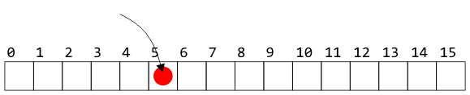
Open Addressing
Suppose an object hashes to bin 5
If bin 5 is empty, we can copy the object into that entry

Slide 131
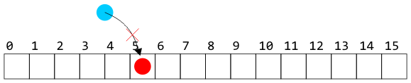
Open Addressing
Suppose, however, another object hashes to bin 5
Without a linked list, we cannot store the object in that bin

Slide 132
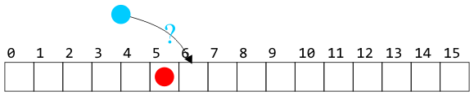
Open Addressing
We need a rule to tells us where to look next
For example, look in the next bin to see if it is occupied
Notes:
Such a rule is implicit—we do not follow an explicit link

Slide 133
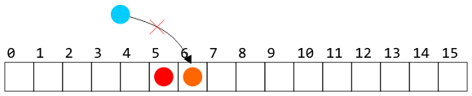
Open Addressing
The rule must be:
simple to follow—i.e., fast
general enough to deal with the fact that the next cell could also be occupied: e.g., continue searching until the first empty bin is found

Slide 134
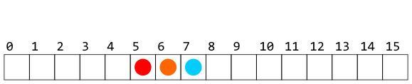
Open Addressing
Of course, whatever rule we use in placing an object must also be used when searching for or removing objects

Slide 135
Open Addressing
Recall, however, that our goal is Θ(1) access times
We cannot, on average, be forced to access too many bins

Slide 136
Open Addressing
There are numerous strategies for defining the order in which the bins should be searched:
Linear probing
Quadratic probing
Double hashing
There are many alternate strategies, as well:
Last come, first served
Always place the object into the bin moving what may be there already
Cuckoo hashing

Slide 137
Summary
This short topic introduces the concept of open addressing
Use a predefined sequence of bins which should be searched
We need a fast rule that can be easily followed
We must ensure that we are not making too many searches
The load factor will never be greater than one

Slide 138
Outline
Introduction
Hash function
Mapping down to 0, ..., M – 1
Dealing with collisions
Chained hash tables
Open addressing
Linear probing
Quadratic probing

Slide 139
Outline
Our first scheme for open addressing:
Linear probing—keep looking ahead one cell at a time
Examples and implementations
Primary clustering
Is it working looking ahead every k entries?

Slide 140
Linear Probing
The easiest method to probe the bins of the hash table is to search forward linearly
Assume we are inserting into bin k:
If bin k is empty, we occupy it
Otherwise, check bin k + 1, k + 2, and so on, until an empty bin is found
If we reach the end of the array, we start at the front (bin 0)

Slide 141
Linear Probing
Consider a hash table with M = 16 bins
Given a 3-digit hexadecimal number:
The least-significant digit is the primary hash function (bin)
Example: for 72A₁₆ , the initial bin is A

Slide 142
Insertion
Insert these numbers into this initially empty hash table:
19A, 207, 3AD, 488, 5BA, 680, 74C, 826, 946, ACD, B32, C8B, DBE, E9C
0 | 1 | 2 | 3 | 4 | 5 | 6 | 7 | 8 | 9 | A | B | C | D | E | F

Slide 143
Example
Start with the first four values:
19A, 207, 3AD, 488
0 | 1 | 2 | 3 | 4 | 5 | 6 | 7 | 8 | 9 | A | B | C | D | E | F

Slide 144
Example
Start with the first four values:
19A, 207, 3AD, 488
0 | 1 | 2 | 3 | 4 | 5 | 6 | 7 | 8 | 9 | A | B | C | D | E | F
 |  |  |  |  |  |  | 207 | 488 |  | 19A |  |  | 3AD

Slide 145
Example
Next we must insert 5BA
0 | 1 | 2 | 3 | 4 | 5 | 6 | 7 | 8 | 9 | A | B | C | D | E | F
 |  |  |  |  |  |  | 207 | 488 |  | 19A |  |  | 3AD

Slide 146
Example
Next we must insert 5BA
Bin A is occupied
We search forward for the next empty bin
0 | 1 | 2 | 3 | 4 | 5 | 6 | 7 | 8 | 9 | A | B | C | D | E | F
 |  |  |  |  |  |  | 207 | 488 |  | 19A | 5BA |  | 3AD

Slide 147
Example
Next we are adding 680, 74C, 826
0 | 1 | 2 | 3 | 4 | 5 | 6 | 7 | 8 | 9 | A | B | C | D | E | F
 |  |  |  |  |  |  | 207 | 488 |  | 19A | 5BA |  | 3AD

Slide 148
Example
Next we are adding 680, 74C, 826
All the bins are empty—simply insert them
0 | 1 | 2 | 3 | 4 | 5 | 6 | 7 | 8 | 9 | A | B | C | D | E | F
680 |  |  |  |  |  | 826 | 207 | 488 |  | 19A | 5BA | 74C | 3AD

Slide 149
Example
Next, we must insert 946
0 | 1 | 2 | 3 | 4 | 5 | 6 | 7 | 8 | 9 | A | B | C | D | E | F
680 |  |  |  |  |  | 826 | 207 | 488 |  | 19A | 5BA | 74C | 3AD

Slide 150
Example
Next, we must insert 946
Bin 6 is occupied
The next empty bin is 9
0 | 1 | 2 | 3 | 4 | 5 | 6 | 7 | 8 | 9 | A | B | C | D | E | F
680 |  |  |  |  |  | 826 | 207 | 488 | 946 | 19A | 5BA | 74C | 3AD

Slide 151
Example
Next, we must insert ACD
0 | 1 | 2 | 3 | 4 | 5 | 6 | 7 | 8 | 9 | A | B | C | D | E | F
680 |  |  |  |  |  | 826 | 207 | 488 | 946 | 19A | 5BA | 74C | 3AD

Slide 152
Example
Next, we must insert ACD
Bin D is occupied
The next empty bin is E
0 | 1 | 2 | 3 | 4 | 5 | 6 | 7 | 8 | 9 | A | B | C | D | E | F
680 |  |  |  |  |  | 826 | 207 | 488 | 946 | 19A | 5BA | 74C | 3AD | ACD

Slide 153
Example
Next, we insert B32
0 | 1 | 2 | 3 | 4 | 5 | 6 | 7 | 8 | 9 | A | B | C | D | E | F
680 |  |  |  |  |  | 826 | 207 | 488 | 946 | 19A | 5BA | 74C | 3AD | ACD

Slide 154
Example
Next, we insert B32
Bin 2 is unoccupied
0 | 1 | 2 | 3 | 4 | 5 | 6 | 7 | 8 | 9 | A | B | C | D | E | F
680 |  | B32 |  |  |  | 826 | 207 | 488 | 946 | 19A | 5BA | 74C | 3AD | ACD

Slide 155
Example
Next, we insert C8B
0 | 1 | 2 | 3 | 4 | 5 | 6 | 7 | 8 | 9 | A | B | C | D | E | F
680 |  | B32 |  |  |  | 826 | 207 | 488 | 946 | 19A | 5BA | 74C | 3AD | ACD

Slide 156
Example
Next, we insert C8B
Bin B is occupied
The next empty bin is F
0 | 1 | 2 | 3 | 4 | 5 | 6 | 7 | 8 | 9 | A | B | C | D | E | F
680 |  | B32 |  |  |  | 826 | 207 | 488 | 946 | 19A | 5BA | 74C | 3AD | ACD | C8B

Slide 157
Example
Next, we insert D59
0 | 1 | 2 | 3 | 4 | 5 | 6 | 7 | 8 | 9 | A | B | C | D | E | F
680 |  | B32 |  |  |  | 826 | 207 | 488 | 946 | 19A | 5BA | 74C | 3AD | ACD | C8B

Slide 158
Example
Next, we insert D59
Bin 9 is occupied
The next empty bin is 1
0 | 1 | 2 | 3 | 4 | 5 | 6 | 7 | 8 | 9 | A | B | C | D | E | F
680 | D59 | B32 |  |  |  | 826 | 207 | 488 | 946 | 19A | 5BA | 74C | 3AD | ACD | C8B

Slide 159
Example
Finally, insert E9C
0 | 1 | 2 | 3 | 4 | 5 | 6 | 7 | 8 | 9 | A | B | C | D | E | F
680 | D59 | B32 |  |  |  | 826 | 207 | 488 | 946 | 19A | 5BA | 74C | 3AD | ACD | C8B

Slide 160
Example
Finally, insert E9C
Bin C is occupied
The next empty bin is 3
0 | 1 | 2 | 3 | 4 | 5 | 6 | 7 | 8 | 9 | A | B | C | D | E | F
680 | D59 | B32 | E9C |  |  | 826 | 207 | 488 | 946 | 19A | 5BA | 74C | 3AD | ACD | C8B

Slide 161
Example
Having completed these insertions:
The load factor is λ = 14/16 = 0.875
The average number of probes is 38/14 ≈ 2.71
0 | 1 | 2 | 3 | 4 | 5 | 6 | 7 | 8 | 9 | A | B | C | D | E | F
680 | D59 | B32 | E93 |  |  | 826 | 207 | 488 | 946 | 19A | 5BA | 74C | 3AD | ACD | C8B
Notes:
38: the number of probes when inserting all these numbers

Slide 162
Resizing the array
To double the capacity of the array, each value must be rehashed
We use the least-significant five bits for the initial bin
680, B32, ACD, 5BA, 826, 207, 488, D59 may be immediately placed
0 | 1 | 2 | 3 | 4 | 5 | 6 | 7 | 8 | 9 | A | B | C | D | E | F | 10 | 11 | 12 | 13 | 14 | 15 | 16 | 17 | 18 | 19 | 1A | 1B | 1C | 1D | 1E | 1F
680 |  |  |  |  |  | 826 | 207 | 488 |  |  |  |  | ACD |  |  |  |  | B32 |  |  |  |  |  |  | D59 | 5BA

Slide 163
Resizing the array
To double the capacity of the array, each value must be rehashed
19A resulted in a collision
0 | 1 | 2 | 3 | 4 | 5 | 6 | 7 | 8 | 9 | A | B | C | D | E | F | 10 | 11 | 12 | 13 | 14 | 15 | 16 | 17 | 18 | 19 | 1A | 1B | 1C | 1D | 1E | 1F
680 |  |  |  |  |  | 826 | 207 | 488 |  |  |  |  | ACD |  |  |  |  | B32 |  |  |  |  |  |  | D59 | 5BA | 19A

Slide 164
Resizing the array
To double the capacity of the array, each value must be rehashed
946 resulted in a collision
0 | 1 | 2 | 3 | 4 | 5 | 6 | 7 | 8 | 9 | A | B | C | D | E | F | 10 | 11 | 12 | 13 | 14 | 15 | 16 | 17 | 18 | 19 | 1A | 1B | 1C | 1D | 1E | 1F
680 |  |  |  |  |  | 826 | 207 | 488 | 946 |  |  |  | ACD |  |  |  |  | B32 |  |  |  |  |  |  | D59 | 5BA | 19A

Slide 165
Resizing the array
To double the capacity of the array, each value must be rehashed
74C fits into its bin
0 | 1 | 2 | 3 | 4 | 5 | 6 | 7 | 8 | 9 | A | B | C | D | E | F | 10 | 11 | 12 | 13 | 14 | 15 | 16 | 17 | 18 | 19 | 1A | 1B | 1C | 1D | 1E | 1F
680 |  |  |  |  |  | 826 | 207 | 488 | 946 |  |  | 74C | ACD |  |  |  | 946 | B32 |  |  |  |  |  |  | D59 | 5BA | 19A

Slide 166
Resizing the array
To double the capacity of the array, each value must be rehashed
3AD resulted in a collision
0 | 1 | 2 | 3 | 4 | 5 | 6 | 7 | 8 | 9 | A | B | C | D | E | F | 10 | 11 | 12 | 13 | 14 | 15 | 16 | 17 | 18 | 19 | 1A | 1B | 1C | 1D | 1E | 1F
680 |  |  |  |  |  | 826 | 207 | 488 | 946 |  |  | 74C | ACD | 3AD |  |  | 946 | B32 |  |  |  |  |  |  | D59 | 5BA | 19A

Slide 167
Resizing the array
To double the capacity of the array, each value must be rehashed
Both E9C and C8B fit without a collision
The load factor is λ = 14/32 = 0.4375
The average number of probes is 18/14 ≈ 1.29
0 | 1 | 2 | 3 | 4 | 5 | 6 | 7 | 8 | 9 | A | B | C | D | E | F | 10 | 11 | 12 | 13 | 14 | 15 | 16 | 17 | 18 | 19 | 1A | 1B | 1C | 1D | 1E | 1F
680 |  |  |  |  |  | 826 | 207 | 488 | 946 |  | C8B | 74C | ACD | 3AD |  |  | 946 | B32 |  |  |  |  |  |  | D59 | 5BA | 19A | E9C

Slide 168
Marking bins occupied
How can we mark a bin as occupied?
Suppose we’re storing arbitrary integers?
Should we store –1938275734 in the hopes that it will never be inserted into the hash table?
In general, magic numbers are bad—they lead to spurious errors
A better solution:
Create a bit vector where the k^{th} entry is marked true if the k^{th} entry of the hash table is occupied
Pointers | nullptr
Positive integers | -1
Floating-point numbers | NaN
Objects | Create a privately stored static object that does not compare to any other instances of that class

Slide 169
Searching
Testing for membership is similar to insertions:
Start at the appropriate bin, and searching forward until
The item is found,
An empty bin is found, or
We have traversed the entire array
The third case will only occur if the hash table is full (load factor of 1)

Slide 170
Searching
Searching for C8B
0 | 1 | 2 | 3 | 4 | 5 | 6 | 7 | 8 | 9 | A | B | C | D | E | F
680 | D59 | B32 | E93 |  |  | 826 | 207 | 488 | 946 | 19A | 5BA | 74C | 3AD | ACD | C8B

Slide 171
Searching
Searching for C8B
Examine bins B, C, D, E, F
The value is found in F
0 | 1 | 2 | 3 | 4 | 5 | 6 | 7 | 8 | 9 | A | B | C | D | E | F
680 | D59 | B32 | E93 |  |  | 826 | 207 | 488 | 946 | 19A | 5BA | 74C | 3AD | ACD | C8B

Slide 172
Searching
Searching for 23E
0 | 1 | 2 | 3 | 4 | 5 | 6 | 7 | 8 | 9 | A | B | C | D | E | F
680 | D59 | B32 | E93 |  |  | 826 | 207 | 488 | 946 | 19A | 5BA | 74C | 3AD | ACD | C8B

Slide 173
Searching
Searching for 23E
Search bins E, F, 0, 1, 2, 3, 4
The last bin is empty; therefore, 23E is not in the table
0 | 1 | 2 | 3 | 4 | 5 | 6 | 7 | 8 | 9 | A | B | C | D | E | F
680 | D59 | B32 | E93 | × |  | 826 | 207 | 488 | 946 | 19A | 5BA | 74C | 3AD | ACD | C8B

Slide 174
Erasing
Can we simply remove elements from the hash table?
0 | 1 | 2 | 3 | 4 | 5 | 6 | 7 | 8 | 9 | A | B | C | D | E | F
680 | D59 | B32 | E93 |  |  | 826 | 207 | 488 | 946 | 19A | 5BA | 74C | 3AD | ACD | C8B

Slide 175
Erasing
We cannot simply remove elements from the hash table
For example, consider erasing 3AD
0 | 1 | 2 | 3 | 4 | 5 | 6 | 7 | 8 | 9 | A | B | C | D | E | F
680 | D59 | B32 | E93 |  |  | 826 | 207 | 488 | 946 | 19A | 5BA | 74C | 3AD | ACD | C8B

Slide 176
Erasing
We cannot simply remove elements from the hash table
For example, consider erasing 3AD
If we just erase it, it is now an empty bin
By our algorithm, we cannot find ACD, C8B and D59
0 | 1 | 2 | 3 | 4 | 5 | 6 | 7 | 8 | 9 | A | B | C | D | E | F
680 | D59 | B32 | E93 |  |  | 826 | 207 | 488 | 946 | 19A | 5BA | 74C |  | ACD | C8B

Slide 177
Erasing
Instead, we must attempt to fill the empty bin
0 | 1 | 2 | 3 | 4 | 5 | 6 | 7 | 8 | 9 | A | B | C | D | E | F
680 | D59 | B32 | E93 |  |  | 826 | 207 | 488 | 946 | 19A | 5BA | 74C |  | ACD | C8B

Slide 178
Erasing
Instead, we must attempt to fill the empty bin
We can move ACD into the location
Are we done?
0 | 1 | 2 | 3 | 4 | 5 | 6 | 7 | 8 | 9 | A | B | C | D | E | F
680 | D59 | B32 | E93 |  |  | 826 | 207 | 488 | 946 | 19A | 5BA | 74C | ACD | ACD | C8B

Slide 179
Erasing
Now we have another bin to fill
0 | 1 | 2 | 3 | 4 | 5 | 6 | 7 | 8 | 9 | A | B | C | D | E | F
680 | D59 | B32 | E93 |  |  | 826 | 207 | 488 | 946 | 19A | 5BA | 74C | ACD |  | C8B

Slide 180
Erasing
Now we have another bin to fill
We can move C8B into the location
0 | 1 | 2 | 3 | 4 | 5 | 6 | 7 | 8 | 9 | A | B | C | D | E | F
680 | D59 | B32 | E93 |  |  | 826 | 207 | 488 | 946 | 19A | 5BA | 74C | ACD | C8B | C8B

Slide 181
Erasing
Now we must attempt to fill the bin at F
We cannot move 680
0 | 1 | 2 | 3 | 4 | 5 | 6 | 7 | 8 | 9 | A | B | C | D | E | F
680 | D59 | B32 | E93 |  |  | 826 | 207 | 488 | 946 | 19A | 5BA | 74C | ACD | C8B

Slide 182
Erasing
Now we must attempt to fill the bin at F
We cannot move 680
We can, however, move D59
0 | 1 | 2 | 3 | 4 | 5 | 6 | 7 | 8 | 9 | A | B | C | D | E | F
680 | D59 | B32 | E93 |  |  | 826 | 207 | 488 | 946 | 19A | 5BA | 74C | ACD | C8B | D59

Slide 183
Erasing
At this point, we cannot move B32 or E93 and the next bin is empty
We are finished
0 | 1 | 2 | 3 | 4 | 5 | 6 | 7 | 8 | 9 | A | B | C | D | E | F
680 |  | B32 | E93 |  |  | 826 | 207 | 488 | 946 | 19A | 5BA | 74C | ACD | C8B | D59

Slide 184
Erasing
Suppose we delete 207
0 | 1 | 2 | 3 | 4 | 5 | 6 | 7 | 8 | 9 | A | B | C | D | E | F
680 |  | B32 | E93 |  |  | 826 | 207 | 488 | 946 | 19A | 5BA | 74C | ACD | C8B | D59

Slide 185
Erasing
Suppose we delete 207
Cannot move 488
0 | 1 | 2 | 3 | 4 | 5 | 6 | 7 | 8 | 9 | A | B | C | D | E | F
680 |  | B32 | E93 |  |  | 826 |  | 488 | 946 | 19A | 5BA | 74C | ACD | C8B | D59

Slide 186
Erasing
Suppose we delete 207
We could move 946 into Bin 7
0 | 1 | 2 | 3 | 4 | 5 | 6 | 7 | 8 | 9 | A | B | C | D | E | F
680 |  | B32 | E93 |  |  | 826 | 946 | 488 | 946 | 19A | 5BA | 74C | ACD | C8B | D59

Slide 187
Erasing
Suppose we delete 207
We cannot move any of the next five entries
0 | 1 | 2 | 3 | 4 | 5 | 6 | 7 | 8 | 9 | A | B | C | D | E | F
680 |  | B32 | E93 |  |  | 826 | 946 | 488 |  | 19A | 5BA | 74C | ACD | C8B | D59

Slide 188
Erasing
Suppose we delete 207
We could move D59
0 | 1 | 2 | 3 | 4 | 5 | 6 | 7 | 8 | 9 | A | B | C | D | E | F
680 |  | B32 | E93 |  |  | 826 | 946 | 488 | D59 | 19A | 5BA | 74C | ACD | C8B | D59

Slide 189
Erasing
Suppose we delete 207
We cannot fill this bin with 680, and the next bin is empty
We are finished
0 | 1 | 2 | 3 | 4 | 5 | 6 | 7 | 8 | 9 | A | B | C | D | E | F
680 |  | B32 | E93 |  |  | 826 | 946 | 488 | D59 | 19A | 5BA | 74C | ACD | C8B

Slide 190
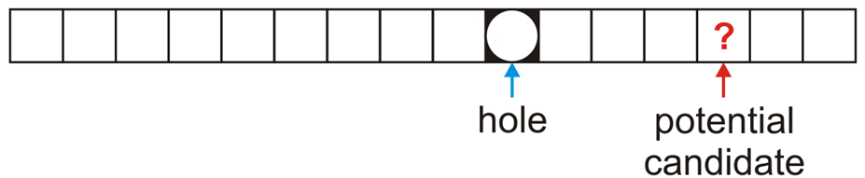
Erasing
In general, assume:
The currently removed object has created a hole at index hole
The object we are checking is located at the position index and has a hash value of hash
Remember: if we are checking the object ? at location index, this means that all entries between hole and index are both occupied and could not have been copied into the hole

Slide 191
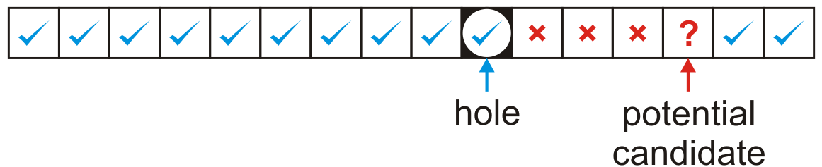
Erasing
The first possibility is that hole < index
In this case, we move the object at index only if its hash value is either
equal to or less than the hole or
greater than the index of the potential candidate

Slide 192
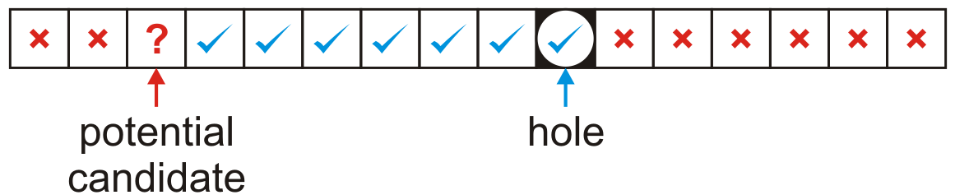
Erasing
The other possibility is we wrapped around the end of the array, that is, hole > index
In this case, we move the object at index only if its hash value is both
greater than the index of the potential candidate and
less than or equal to the hole
In either case, if the move is successful, the ? now becomes the new hole to be filled

Slide 193
Alternative Method: Lazy Erasing
Consider erasing 3AD
0 | 1 | 2 | 3 | 4 | 5 | 6 | 7 | 8 | 9 | A | B | C | D | E | F
680 | D59 | B32 | E93 |  |  | 826 | 207 | 488 | 946 | 19A | 5BA | 74C | 3AD | ACD | C8B

Slide 194
Alternative Method: Lazy Erasing
Consider erasing 3AD
Mark the bin as ERASED
Searching: regard it as occupied
Insertion: regard it as unoccupied
What if we want to insert ACD?
Search before insertion
0 | 1 | 2 | 3 | 4 | 5 | 6 | 7 | 8 | 9 | A | B | C | D | E | F
680 | D59 | B32 | E93 |  |  | 826 | 207 | 488 | 946 | 19A | 5BA | 74C | 3AD | ACD | C8B

Slide 195
Alternative Method: Lazy Erasing
One problem which may occur after multiple insertions and removals is that numerous bins may be marked as ERASED
In calculating the load factor, an ERASED bin is equivalent to an occupied bin
This will increase our run times…
If the load factor λ grows too large, we have two choices:
If the load factor due to occupied bins is too large, double the table size
Otherwise, rehash all of the objects currently in the hash table

Slide 196
Black Board Example
Using the last digit as our hash function—insert these nine numbers into a hash table of size M = 10
31, 15, 79, 55, 42, 99, 60, 80, 23
Then, remove 79, 31, 42, and 60, in that order

Slide 197
Primary Clustering
We have already observed the following phenomenon:
With more insertions, the contiguous regions (or clusters) get larger
The length of these chains will affect the number of probes required to perform insertions, accesses, or removals
0 | 1 | 2 | 3 | 4 | 5 | 6 | 7 | 8 | 9 | A | B | C | D | E | F | 10 | 11 | 12 | 13 | 14 | 15 | 16 | 17 | 18 | 19 | 1A | 1B | 1C | 1D | 1E | 1F
680 |  |  |  |  |  | 826 | 207 | 488 | 946 |  | C8B | 74C | ACD | 3AD |  |  | 946 | B32 |  |  |  |  |  |  | D59 | 5BA | 19A | E9C

Slide 198
Primary Clustering
We currently have three clusters of length four
0 | 1 | 2 | 3 | 4 | 5 | 6 | 7 | 8 | 9 | A | B | C | D | E | F | 10 | 11 | 12 | 13 | 14 | 15 | 16 | 17 | 18 | 19 | 1A | 1B | 1C | 1D | 1E | 1F
680 |  |  |  |  |  | 826 | 207 | 488 | 946 |  | C8B | 74C | ACD | 3AD |  |  | 946 | B32 |  |  |  |  |  |  | D59 | 5BA | 19A | E9C

Slide 199
Primary Clustering
There is a 5/32 ≈ 16 % chance that an insertion will fill A
0 | 1 | 2 | 3 | 4 | 5 | 6 | 7 | 8 | 9 | A | B | C | D | E | F | 10 | 11 | 12 | 13 | 14 | 15 | 16 | 17 | 18 | 19 | 1A | 1B | 1C | 1D | 1E | 1F
680 |  |  |  |  |  | 826 | 207 | 488 | 946 |  | C8B | 74C | ACD | 3AD |  |  | 946 | B32 |  |  |  |  |  |  | D59 | 5BA | 19A | E9C

Slide 200
Primary Clustering
There is a 5/32 ≈ 16 % chance that an insertion will fill A
This causes two clusters to coalesce into one larger cluster of length 9
0 | 1 | 2 | 3 | 4 | 5 | 6 | 7 | 8 | 9 | A | B | C | D | E | F | 10 | 11 | 12 | 13 | 14 | 15 | 16 | 17 | 18 | 19 | 1A | 1B | 1C | 1D | 1E | 1F
680 |  |  |  |  |  | 826 | 207 | 488 | 946 | 747 | C8B | 74C | ACD | 3AD |  |  | 946 | B32 |  |  |  |  |  |  | D59 | 5BA | 19A | E9C

Slide 201
Primary Clustering
There is now a 11/32 ≈ 34 % chance that the next insertion will increase the length of this cluster
0 | 1 | 2 | 3 | 4 | 5 | 6 | 7 | 8 | 9 | A | B | C | D | E | F | 10 | 11 | 12 | 13 | 14 | 15 | 16 | 17 | 18 | 19 | 1A | 1B | 1C | 1D | 1E | 1F
680 |  |  |  |  |  | 826 | 207 | 488 | 946 | 747 | C8B | 74C | ACD | 3AD |  |  | 946 | B32 |  |  |  |  |  |  | D59 | 5BA | 19A | E9C

Slide 202
Primary Clustering
As the cluster length increases, the probability of further increasing the length increases
In general:
Suppose that a cluster is of length ℓ
An insertion either into any bin occupied by the chain or into the locations immediately before or after it will increase the length of the chain
This gives a probability of
0 | 1 | 2 | 3 | 4 | 5 | 6 | 7 | 8 | 9 | A | B | C | D | E | F | 10 | 11 | 12 | 13 | 14 | 15 | 16 | 17 | 18 | 19 | 1A | 1B | 1C | 1D | 1E | 1F
680 |  |  |  |  |  | 826 | 207 | 488 | 946 | 747 | C8B | 74C | ACD | 3AD |  |  | 946 | B32 |  |  |  |  |  |  | D59 | 5BA | 19A | E9C

Slide 203
Run-time analysis
It is possible to estimate the average number of probes for a successful search, where λ is the load factor:
For example: if λ = 0.5, we require 1.5 probes on average
Reference: Knuth, The Art of Computer Programming, Vol. 3, 2nd Ed., Addison Wesley, 1998, p.528.

Slide 204
Run-time analysis
The number of probes for an unsuccessful search or for an insertion is higher:
For 0 ≤ λ ≤ 1, we have (1 – λ)² ≤ 1 – λ, and therefore the reciprocal will be larger
if λ = 0.5 then we require 2.5 probes on average
Reference: Knuth, The Art of Computer Programming, Vol. 3, 2nd Ed., Addison Wesley, 1998, p.528.

Slide 205
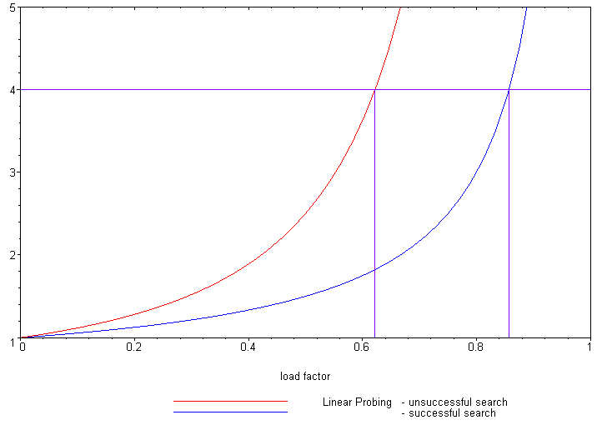
Run-time analysis
The following plot shows how the number of required probes increases

Slide 206
Run-time analysis
Our goal was to keep all operations Θ(1)
Unfortunately, as λ grows, so does the run time
One solution is to keep the load factor under a given bound
If we choose λ = 2/3, then the number of probes for either a successful or unsuccessful search is 2 and 5, respectively

Slide 207
Run-time analysis
Therefore, we have three choices:
Choose M large enough so that we will not pass this load factor
This could waste memory
Double the number of bins if the chosen load factor is reached
Choose a different strategy than linear probing
Two possibilities are quadratic probing and double hashing

Slide 208
Summary
This topic introduced linear problem
Continue looking forward until an empty cell is found
Searching follows the same rule
Removing an object is more difficult
Primary clustering is an issue
Keep the load factor λ ≤ 2/3

Slide 209
Outline
Introduction
Hash function
Mapping down to 0, ..., M – 1
Dealing with collisions
Chained hash tables
Open addressing
Linear probing
Quadratic probing

Slide 210
Outline
This topic covers quadratic probing
Similar to linear probing
Does not step forward one step at a time
Primary clustering no longer occurs
Affected by secondary clustering

Slide 211
Background
Linear probing:
Look at bins k, k + 1, k + 2, k + 3, k + 4, …
Primary clustering

Slide 212
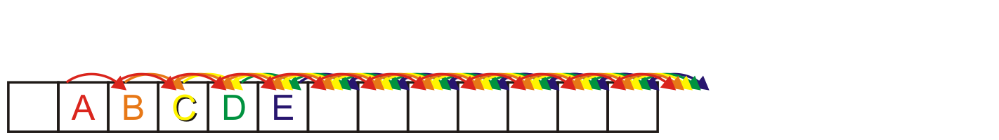
Background
Linear probing causes primary clustering
All entries follow the same search pattern for bins:
int initial = hash_M( x.hash(), M );
for ( int k = 0; k < M; ++k ) {
bin = (initial + k) % M;
// ...
}

Slide 213
Description
Quadratic probing suggests moving forward by different amounts
For example,
int initial = hash_M( x.hash(), M );
for ( int k = 0; k < M; ++k ) {
bin = (initial + k*k) % M;
}

Slide 214
Description
Problem:
Will initial + k*k step through all of the bins?
Here, the array size is 10:
M = 10;
initial = 5
for ( int k = 0; k <= M; ++k ) {
std::cout << (initial + k*k) % M << ' ';
}
The output is
5 6 9 4 1 0 1 4 9 6 5

Slide 215
Description
Problem:
Will initial + k*k step through all of the bins?
Now the array size is 12:
M = 12;
initial = 5
for ( int k = 0; k <= M; ++k ) {
std::cout << (initial + k*k) % M << ' ';
}
The output is now
5 6 9 2 9 6 5 6 9 2 9 6 5

Slide 216
Making M Prime
If we make the table size M = p a prime number, quadratic probing is guaranteed to iterates through entries
Problems:
All operations must be done using %
Cannot use &, <<, or >>
The modulus operator % is relatively slow
Doubling the number of bins is difficult:
What is the next prime after 2 × 263?
Notes:
Warning: most text books stop here!
– Never use a prime table size if at all possible

Slide 217
Generalization
More generally, we could consider an approach like:
int initial = hash_M( x.hash(), M );
for ( int k = 0; k < M; ++k ) {
bin = (initial + c1*k + c2*k*k) % M;
}

Slide 218
Using M = 2^{m}
If we ensure M = 2^{m} then choose
c₁ = c₂ = ½
int initial = hash_M( x.hash(), M );
for ( int k = 0; k < M; ++k ) {
bin = (initial + (k + k*k)/2) % M;
}
Note that k + k*k is always even
The growth is still Θ(k²)
This guarantees that all M entries are visited before the pattern repeats
This only works for powers of two
Notes:
For proof, see solution to textbook problem 11-3

Slide 219
Using M = 2^{m}
For example:
Use an array size of 16:
M = 16;
initial = 5
for ( int k = 0; k <= M; ++k ) {
std::cout << (initial + (k + k*k)/2) % M << ' ';
}
The output is now
5 6 8 11 15 4 10 1 9 2 12 7 3 0 14 13 13

Slide 220
Using M = 2^{m}
There is an even easier means of calculating this approach
int bin = hash_M( x.hash(), M );
for ( int k = 0; k < M; ++k ) {
bin = (bin + k) % M;
}
Recall that , so just keep adding the next highest value

Slide 221
Example
Consider a hash table with M = 16 bins
Given a 2-digit hexadecimal number:
The least-significant digit is the primary hash function (bin)
Example: for 7A₁₆ , the initial bin is A

Slide 222
Example
Insert these numbers into this initially empty hash table
9A, 07, AD, 88, BA, 80, 4C, 26, 46, C9, 32, 7A, BF, 9C
0 | 1 | 2 | 3 | 4 | 5 | 6 | 7 | 8 | 9 | A | B | C | D | E | F

Slide 223
Example
Start with the first four values:
9A, 07, AD, 88
0 | 1 | 2 | 3 | 4 | 5 | 6 | 7 | 8 | 9 | A | B | C | D | E | F

Slide 224
Example
Start with the first four values:
9A, 07, AD, 88
0 | 1 | 2 | 3 | 4 | 5 | 6 | 7 | 8 | 9 | A | B | C | D | E | F
 |  |  |  |  |  |  | 07 | 88 |  | 9A |  |  | AD

Slide 225
Example
Next we must insert BA
0 | 1 | 2 | 3 | 4 | 5 | 6 | 7 | 8 | 9 | A | B | C | D | E | F
 |  |  |  |  |  |  | 07 | 88 |  | 9A |  |  | AD

Slide 226
Example
Next we must insert BA
The next bin is empty
0 | 1 | 2 | 3 | 4 | 5 | 6 | 7 | 8 | 9 | A | B | C | D | E | F
 |  |  |  |  |  |  | 07 | 88 |  | 9A | BA |  | AD

Slide 227
Example
Next we are adding 80, 4C, 26
0 | 1 | 2 | 3 | 4 | 5 | 6 | 7 | 8 | 9 | A | B | C | D | E | F
 |  |  |  |  |  |  | 07 | 88 |  | 9A | BA |  | AD

Slide 228
Example
Next we are adding 80, 4C, 26
All the bins are empty—simply insert them
0 | 1 | 2 | 3 | 4 | 5 | 6 | 7 | 8 | 9 | A | B | C | D | E | F
80 |  |  |  |  |  | 26 | 07 | 88 |  | 9A | BA | 4C | AD

Slide 229
Example
Next, we must insert 46
0 | 1 | 2 | 3 | 4 | 5 | 6 | 7 | 8 | 9 | A | B | C | D | E | F
80 |  |  |  |  |  | 26 | 07 | 88 |  | 9A | BA | 4C | AD

Slide 230
Example
Next, we must insert 46
Bin 6 is occupied
Bin 6 + 1 = 7 is occupied
Bin 7 + 2 = 9 is empty
0 | 1 | 2 | 3 | 4 | 5 | 6 | 7 | 8 | 9 | A | B | C | D | E | F
80 |  |  |  |  |  | 26 | 07 | 88 | 46 | 9A | BA | 4C | AD

Slide 231
Example
Next, we must insert C9
0 | 1 | 2 | 3 | 4 | 5 | 6 | 7 | 8 | 9 | A | B | C | D | E | F
80 |  |  |  |  |  | 26 | 07 | 88 | 46 | 9A | BA | 4C | AD

Slide 232
Example
Next, we must insert C9
Bin 9 is occupied
Bin 9 + 1 = A is occupied
Bin A + 2 = C is occupied
Bin C + 3 = F is empty
0 | 1 | 2 | 3 | 4 | 5 | 6 | 7 | 8 | 9 | A | B | C | D | E | F
80 |  |  |  |  |  | 26 | 07 | 88 | 46 | 9A | BA | 4C | AD |  | C9

Slide 233
Example
Next, we insert 32
Bin 2 is unoccupied
0 | 1 | 2 | 3 | 4 | 5 | 6 | 7 | 8 | 9 | A | B | C | D | E | F
80 |  | 32 |  |  |  | 26 | 07 | 88 | 46 | 9A | BA | 4C | AD |  | C9

Slide 234
Example
Next, we insert 7A
Bin A is occupied
Bins A + 1 = B, B + 2 = D and D + 3 = 0 are occupied
Bin 0 + 4 = 4 is empty
0 | 1 | 2 | 3 | 4 | 5 | 6 | 7 | 8 | 9 | A | B | C | D | E | F
80 |  | 32 |  | 7A |  | 26 | 07 | 88 | 46 | 9A | BA | 4C | AD |  | C9

Slide 235
Example
Next, we insert BF
Bin F is occupied
Bins F + 1 = 0 and 0 + 2 = 2 are occupied
Bin 2 + 3 = 5 is empty
0 | 1 | 2 | 3 | 4 | 5 | 6 | 7 | 8 | 9 | A | B | C | D | E | F
80 |  | 32 |  | 7A | BF | 26 | 07 | 88 | 46 | 9A | BA | 4C | AD |  | C9

Slide 236
Example
Finally, we insert 9C
Bin C is occupied
Bins C + 1 = D, D + 2 = F, F + 3 = 2, 2 + 4 = 6 and 6 + 5 = B are occupied
Bin B + 6 = 1 is empty
0 | 1 | 2 | 3 | 4 | 5 | 6 | 7 | 8 | 9 | A | B | C | D | E | F
80 | 9C | 32 |  | 7A | BF | 26 | 07 | 88 | 46 | 9A | BA | 4C | AD |  | C9

Slide 237
Example
Having completed these insertions:
The load factor is λ = 14/16 = 0.875
The average number of probes is 32/14 ≈ 2.29
0 | 1 | 2 | 3 | 4 | 5 | 6 | 7 | 8 | 9 | A | B | C | D | E | F
80 | 9C | 32 |  | 7A | BF | 26 | 07 | 88 | 46 | 9A | BA | 4C | AD |  | C9

Slide 238
Resizing the array
To double the capacity of the array, each value must be rehashed
80, 9C, 32, 7A, BF, 26, 07, 88 may be immediately placed
We use the least-significant five bits for the initial bin
0 | 1 | 2 | 3 | 4 | 5 | 6 | 7 | 8 | 9 | A | B | C | D | E | F | 10 | 11 | 12 | 13 | 14 | 15 | 16 | 17 | 18 | 19 | 1A | 1B | 1C | 1D | 1E | 1F
80 |  |  |  |  |  | 26 | 07 | 88 |  |  |  |  |  |  |  |  |  | 32 |  |  |  |  |  |  |  | 7A |  | 9C |  |  | BF
Notes:
If the next least-significant digit is
Even, use bins 0 – F
Odd, use bins 10 – 1F

Slide 239
Resizing the array
To double the capacity of the array, each value must be rehashed
46 results in a collision
We place it in bin 9
0 | 1 | 2 | 3 | 4 | 5 | 6 | 7 | 8 | 9 | A | B | C | D | E | F | 10 | 11 | 12 | 13 | 14 | 15 | 16 | 17 | 18 | 19 | 1A | 1B | 1C | 1D | 1E | 1F
80 |  |  |  |  |  | 26 | 07 | 88 | 46 |  |  |  |  |  |  |  |  | 32 |  |  |  |  |  |  |  | 7A |  | 9C |  |  | BF

Slide 240
Resizing the array
To double the capacity of the array, each value must be rehashed
9A results in a collision
We place it in bin 1B
0 | 1 | 2 | 3 | 4 | 5 | 6 | 7 | 8 | 9 | A | B | C | D | E | F | 10 | 11 | 12 | 13 | 14 | 15 | 16 | 17 | 18 | 19 | 1A | 1B | 1C | 1D | 1E | 1F
80 |  |  |  |  |  | 26 | 07 | 88 | 46 |  |  |  |  |  |  |  |  | 32 |  |  |  |  |  |  |  | 7A | 9A | 9C |  |  | BF

Slide 241
Resizing the array
To double the capacity of the array, each value must be rehashed
BA also results in a collision
We place it in bin 1D
0 | 1 | 2 | 3 | 4 | 5 | 6 | 7 | 8 | 9 | A | B | C | D | E | F | 10 | 11 | 12 | 13 | 14 | 15 | 16 | 17 | 18 | 19 | 1A | 1B | 1C | 1D | 1E | 1F
80 |  |  |  |  |  | 26 | 07 | 88 | 46 |  |  |  |  |  |  |  |  | 32 |  |  |  |  |  |  |  | 7A | 9A | 9C | BA |  | BF

Slide 242
Resizing the array
To double the capacity of the array, each value must be rehashed
4C and AD don’t cause collisions
0 | 1 | 2 | 3 | 4 | 5 | 6 | 7 | 8 | 9 | A | B | C | D | E | F | 10 | 11 | 12 | 13 | 14 | 15 | 16 | 17 | 18 | 19 | 1A | 1B | 1C | 1D | 1E | 1F
80 |  |  |  |  |  | 26 | 07 | 88 | 46 |  |  | 4C | AD |  |  |  |  | 32 |  |  |  |  |  |  |  | 7A | 9A | 9C | BA |  | BF

Slide 243
Resizing the array
To double the capacity of the array, each value must be rehashed
Finally, C9 causes a collision
We place it in bin A
0 | 1 | 2 | 3 | 4 | 5 | 6 | 7 | 8 | 9 | A | B | C | D | E | F | 10 | 11 | 12 | 13 | 14 | 15 | 16 | 17 | 18 | 19 | 1A | 1B | 1C | 1D | 1E | 1F
80 |  |  |  |  |  | 26 | 07 | 88 | 46 | C9 |  | 4C | AD |  |  |  |  | 32 |  |  |  |  |  |  |  | 7A | 9A | 9C | BA |  | BF

Slide 244
Resizing the array
To double the capacity of the array, each value must be rehashed
The load factor is λ = 14/32 = 0.4375
The average number of probes is 20/14 ≈ 1.43
0 | 1 | 2 | 3 | 4 | 5 | 6 | 7 | 8 | 9 | A | B | C | D | E | F | 10 | 11 | 12 | 13 | 14 | 15 | 16 | 17 | 18 | 19 | 1A | 1B | 1C | 1D | 1E | 1F
80 |  |  |  |  |  | 26 | 07 | 88 | 46 | C9 |  | 4C | AD |  |  |  |  | 32 |  |  |  |  |  |  |  | 7A | 9A | 9C | BA |  | BF

Slide 245
Erase
Can we erase an object like we did with linear probing?
Consider erasing 9A from this table
There are M – 1 possible locations where an object which could have occupied a position could be located
Instead, we use lazy erasing
Mark a bin as ERASED; however, when searching, treat the bin as occupied and continue
0 | 1 | 2 | 3 | 4 | 5 | 6 | 7 | 8 | 9 | A | B | C | D | E | F
80 | 21 |  | 43 |  |  | 76 |  |  |  | 9A |  |  |  |  | 50
Notes:
We must have a separate ternary-valued flag for each bin

Slide 246
Erase
If we erase AD, we must mark that bin as erased
0 | 1 | 2 | 3 | 4 | 5 | 6 | 7 | 8 | 9 | A | B | C | D | E | F
80 | 9C | 32 |  | 7A | BF | 26 | 07 | 88 | 46 | 9A | BA | 4C | AD |  | C9

Slide 247
Find
When searching, it is necessary to skip over this bin
For example, find AD: D, E
find 5C: C, D, F, 2, 6, B, 1, 8, 0, 9, 3
0 | 1 | 2 | 3 | 4 | 5 | 6 | 7 | 8 | 9 | A | B | C | D | E | F
80 | 9C | 32 |  | 7A | BF | 26 | 07 | 88 | 46 | 9A | BA | 4C | AD |  | C9

Slide 248
Modified insertion
We must modify insert, as we may place new items into either
Unoccupied bins
Erased bins

Slide 249
Implementation
Storing three states can be achieved using an enumerated type:
enum bin_state_t {
UNOCCUPIED,
OCCUPIED,
ERASED
};
Now we can declare and initialize arrays:
bin_state_t state[M];
for ( int i = 0; i < M; ++i ) {
state[i] = UNOCCUPIED;
}

Slide 250
Multiple insertions and erases
One problem which may occur after multiple insertions and removals is that numerous bins may be marked as ERASED
In calculating the load factor, an ERASED bin is equivalent to an OCCUPIED bin
This will increase our run times…
If the load factor λ grows too large, we have two choices:
If the load factor due to occupied bins is too large, double the table size
Otherwise, rehash all of the objects currently in the hash table

Slide 251
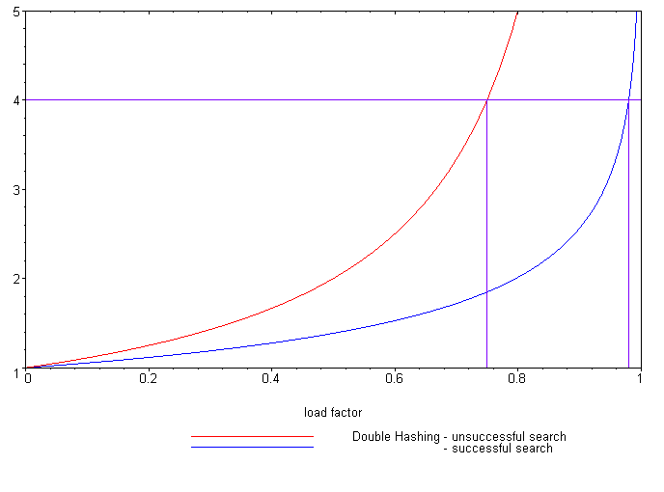
Expected number of probes
Load Factor (λ)
Unsuccessful search
Successful search
Reference: Knuth, The Art of Computer Programming,
Vol. 3, 2nd Ed., 1998, Addison Wesley, p. 530.
It is possible to calculate the expected number of probes for quadratic probing, again, based on the load factor:
Successful searches:
Unsuccessful searches:
When λ = 2/3, we requires 1.65 and 3 probes, respectively
Linear probing required 3 and 5 probes, respectively

Slide 252
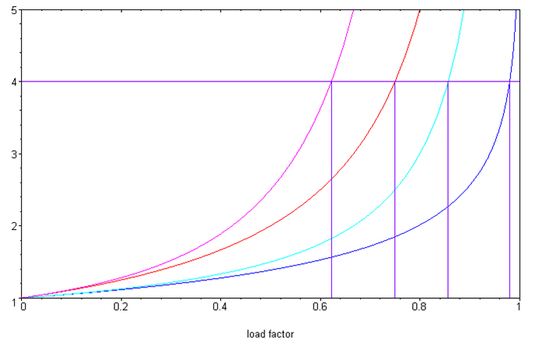
Quadratic probing versus linear probing
Comparing the two:
Linear probing
Unsuccessful search
Successful search
Quadratic probing
Unsuccessful search
Successful search
Examined Bins
Load Factor (λ)

Slide 253
Cache misses
One benefit of quadratic probing:
The first few bins examined are close to the initial bin
It is unlikely to reference a section of the array far from the initial bin
Modern computers use caches
4 KiB pages of main memory are copied into faster caches
Pages are only brought into the cache when referenced
Accesses close to the initial bin are likely to reference the same page

Slide 254
Secondary clustering
Weakness with quadratic problem
Clustering may still occur: objects placed in the same bin will follow the same sequence
Less severe than linear probing

Slide 255
Summary
In this topic, we have looked at quadratic probing:
An open addressing technique
Steps forward by a quadratically growing steps
Insertions and searching are straight forward
Removing objects is more complicated: use lazy deletion
Still subject to secondary probing

Slide 256
Summary
Object
Predetermined hash functions (explicit)
Arithmetic hash functions (implicit)
32-bit integer
Modulus (bitwise operations for M = 2^{m}) Obfuscate via multiplication
Map to an index 0, ..., M – 1
Chained hash tables
Open addressing
Linear probing
Quadratic probing
Deal with collisions

