Slide 1
CS101 Data Structures
Spring 2018
ShanghaiTech University

Slide 2
Course Info
Instructor
Dengji Zhao zhaodj@shanghaitech.edu.cn SIST 1A304E
TAs
Discussions: Dinghong LI (李鼎弘 lidh1@)
Office Hours, Exams: Zhiqiang XIE (谢志强 xiezhq@)
Piazza, Slides: Jie MIN (闵杰 minjie@)
Homework: Jianzhong LIU(刘健中liujzh@), Xiting ZHAO(赵希亭zhaoxt@)
Projects: Bin CHEN (陈彬 chenbin@)

Slide 3
Course Info
Classes
Wed & Fri 10:15-11:55 (Week 1-16)
教学中心101
Discussions
Thu 19:35-21:15 (Week 1-16)
教学中心301
Instructors: all TAs
Optional but highly recommended (C++ will be discussed there only!)

Slide 4
Course Info
Course Forum
http://piazza.com/shanghaitech.edu.cn/spring2018/cs101/home
You are encouraged to ask questions and participate in discussions
Announcements, slides, OH etc. are published on the forum only
Invitation has be sent to your ShanghaiTech email (haven’t received it?)
Office Hours
Location: SIST 1B101
Time: see course forum

Slide 5
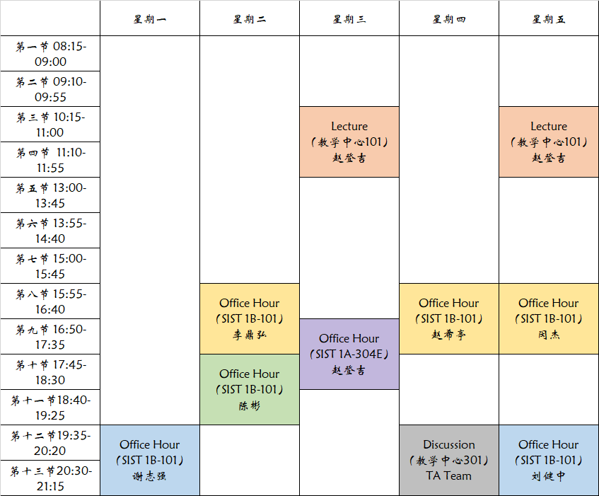
Current Plan

Slide 6
Course Info
Reference Book
Introduction to Algorithms (3rd ed.). Cormen, Thomas H., Leiserson, Charles E., Rivest, Ronald L., Stein, Clifford. MIT Press. ISBN 9780262033848.

Slide 7
Course Policy
Grading
Homework (55%): 5-6 programming assignments (C++)
Midterm Exam (20%): Week 9
Final Exam (25%): Week 17-18
Advanced Project/Bonus (10%): Week 3-16

Slide 8
Course Policy
Plagiarism
All assignments must be done individually
You cannot copy directly from any other source
You cannot share solutions with any other students
Plagiarism detection software will be used on all the programming assignments
Ways of collaboration
You may discuss together or help another student debug his or her code; however, you cannot dictate or give the exact solutions.

Slide 9
Course Policy
Plagiarism
Punishment
When one student copied from another student, both students are responsible
Zero point on the assignment or exam in question
Disqualified from receiving any awards recommended by the school and from any competitive studying opportunities (e.g., international exchange)
Repeated violation will result in a F grade for this course as well as further discipline at the school/university level

Slide 10
Plagiarism: Example 1
Alex and Bob were roommates
Bob let Alex use his laptop to complete an assignment
Alex copied Bob’s solution for the assignment
Adapted from slides by Douglas Wilhelm Harder of U Waterloo

Slide 11
Plagiarism: Example 2
Leslie asked if Morgan could send her his code so that she could look at it (promising, of course, not to copy it)
Morgan sent the code
Leslie copied it and handed it in
Adapted from slides by Douglas Wilhelm Harder of U Waterloo

Slide 12
Plagiarism: Example 3
Garry and Harry worked together on a single source file initially and then worked separately to finish off the details
The result was still noticeably similar with finger-print-like characteristics which left no doubt that some of the code had a common source
Adapted from slides by Douglas Wilhelm Harder of U Waterloo

Slide 13
Plagiarism: Example 4
Jordan uploaded the projects to GITHUB.com without setting appropriate permissions. Kasey found this site, downloaded the projects and submitted them. Both are guilty.
This applies to any public forum, news group, etc., not just gitub.com…
Adapted from slides by Douglas Wilhelm Harder of U Waterloo

