Slide 1
CS101 Data Structures
Mathematical Background
Instructor: Dengji Zhao
Notes:
Adapted from slides by Douglas Wilhelm Harder of U Waterloo (https://ece.uwaterloo.ca/~dwharder/aads/Lecture_materials/)

Slide 2
Outline
This topic reviews the basic mathematics required in this course:
A justification for a mathematical framework
Logarithms
Arithmetic and other polynomial series
Mathematical induction
Geometric series
Recurrence relations
Weighted averages
Combinations

Slide 3
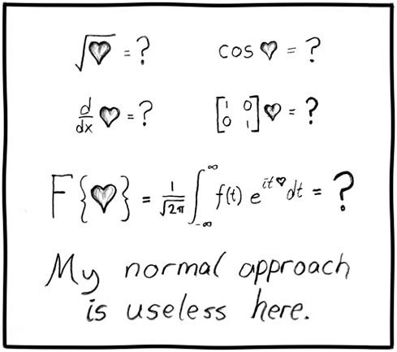
Mathematics and engineering
For engineers, mathematics is a tool:
Of course, that doesn’t mean it always works...
http://xkcd.com/55/

Slide 4
Justification
As engineers, you will not be paid to say:
Method A is better than Method B
or
Algorithm A is faster than Algorithm B
Such comparisons are said to be qualitative:
qualitative, a. Relating to, connected or concerned with, quality or qualities.
Now usually in implied or expressed opposition to quantitative.
OED

Slide 5
Justification
Qualitative statements cannot guide engineering design decisions:
Algorithm A may be “better” only under some circumstances. Such circumstances cannot be qualitatively specified.
The advantage of algorithm A vs. algorithm B may be small, while implementing algorithm A may be very complicated. A tradeoff between benefit vs. cost shall be calculated.

Slide 6
Justification
Thus, we will look at a quantitative means of describing data structures and algorithms:
quantitative, a. Relating to, concerned with, quantity or its measurement; ascertaining or expressing quantity. OED
This will be based on mathematics, and therefore we will look at a number of properties which will be used again and again throughout this course

Slide 7
Floor and ceiling functions
The floor function maps any real number x onto the greatest integer less than or equal to x:
Consider it rounding towards negative infinity
The ceiling function maps x onto the least integer greater than or equal to x:
Consider it rounding towards positive infinity

Slide 8
L’Hôpital’s rule
If you are attempting to determine
but both , it follows
Repeat as necessary…

Slide 9
Logarithms
We will begin with a review of logarithms:
If n = e^{m}, we define
m = ln( n )
It is always true that e^{ln(n)} = n; however, ln(e^{n}) = n requires that n is real

Slide 10
Logarithms
Exponentials grow faster than any non-constant polynomial
for any d > 0
Logarithms grow slower than any polynomial
Notes:
This can be also argued as follows:
The inverse of n^{d} is n^{1/d} and to assume otherwise would suggest that a polynomial grows as fast as an exponential, which is false simply by applying l’Hopital’s rule.

Slide 11
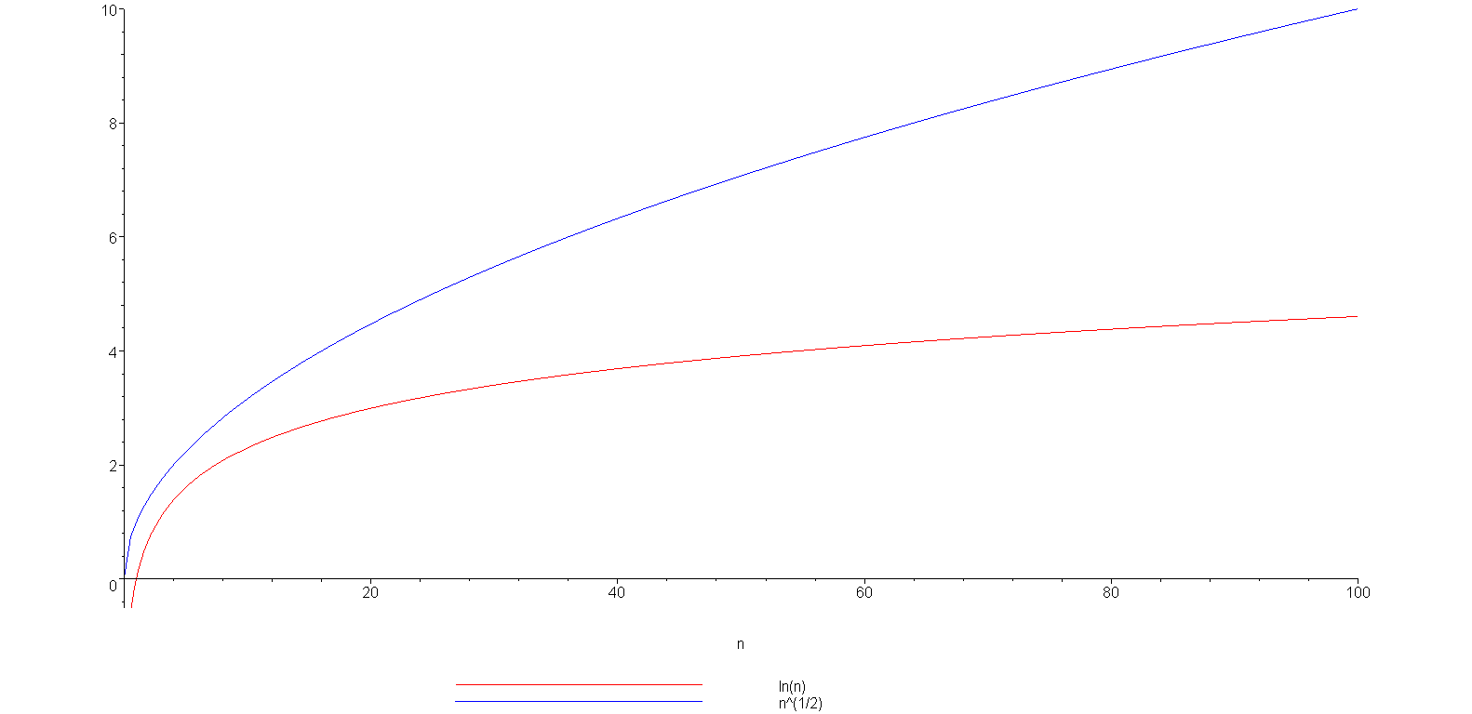
Logarithms
Example: is strictly greater than ln(n)
ln(n)

Slide 12
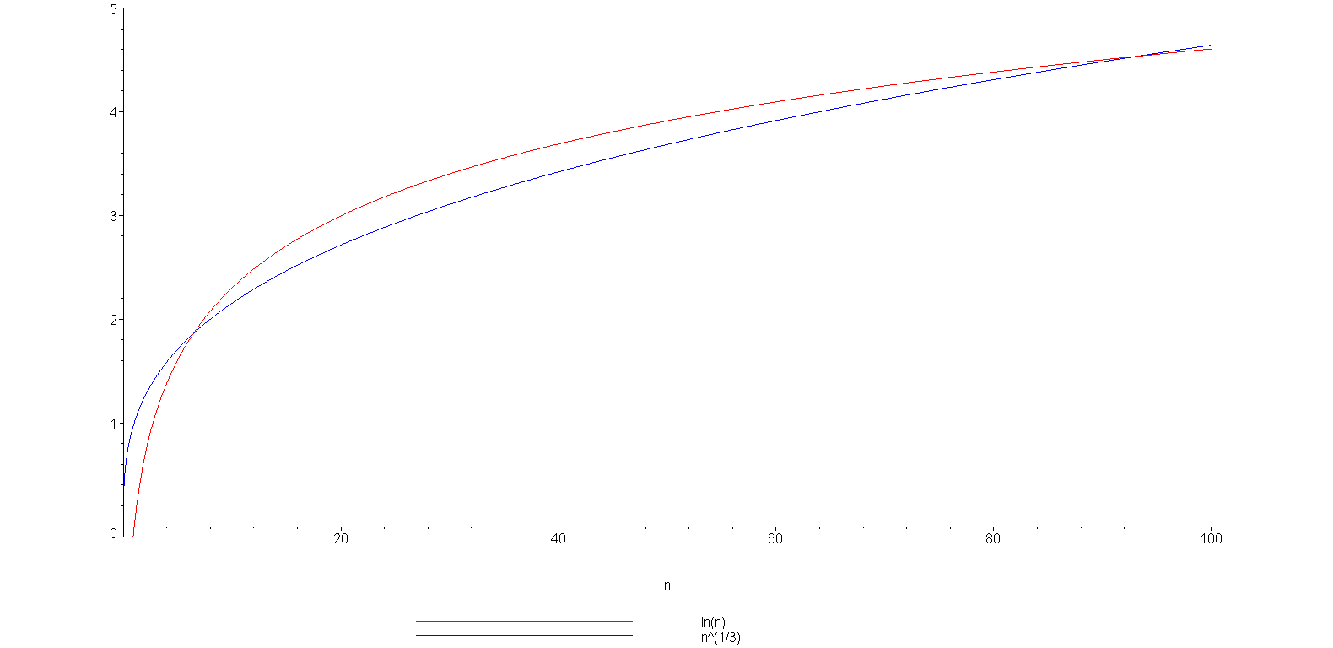
Logarithms
grows slower but only up to n = 93
(93.354, 4.536)
ln(n)

Slide 13
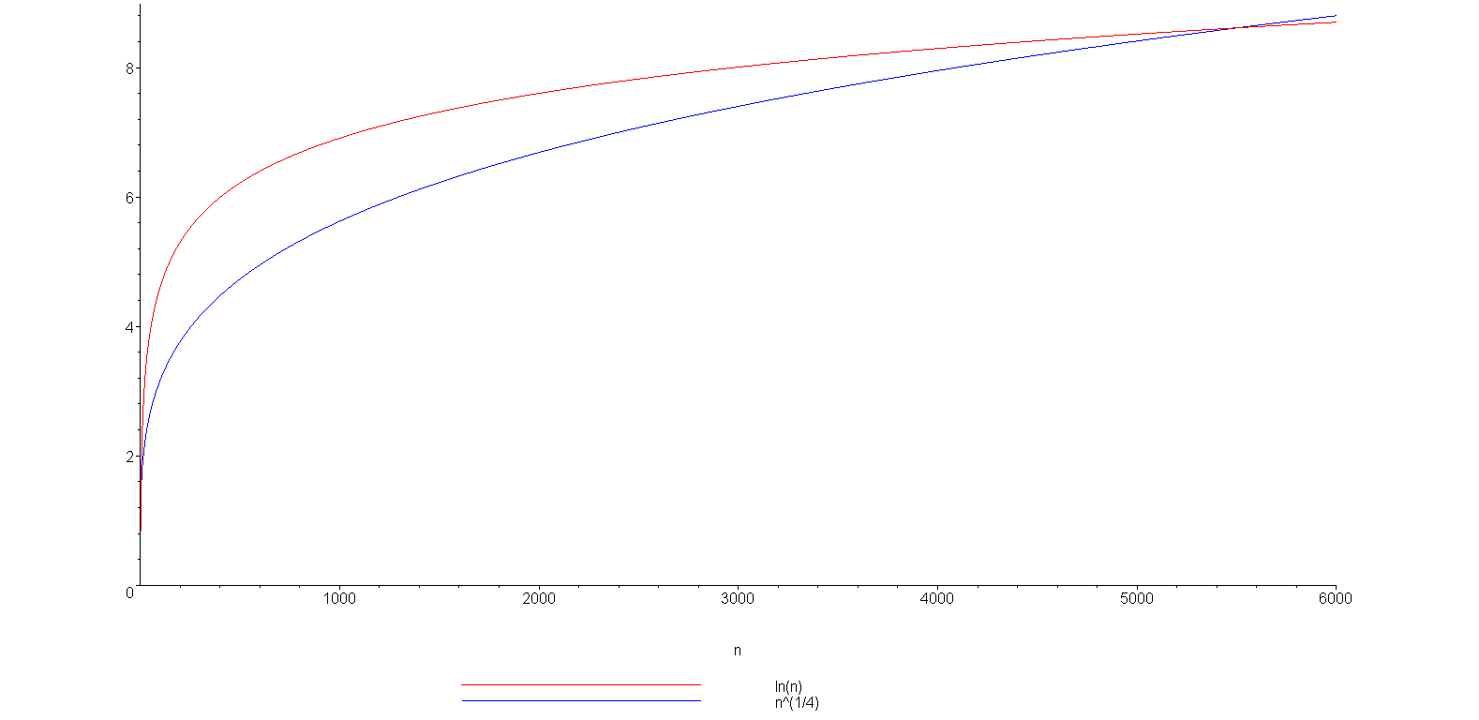
Logarithms
You can view this with any polynomial
ln(n)
(5503.66, 8.61)

Slide 14
Logarithms
We have compared logarithms and polynomials
How about log₂(n) versus ln(n) versus log₁₀(n)
You have seen the formula
All logarithms are scalar multiples of each others
Constant

Slide 15
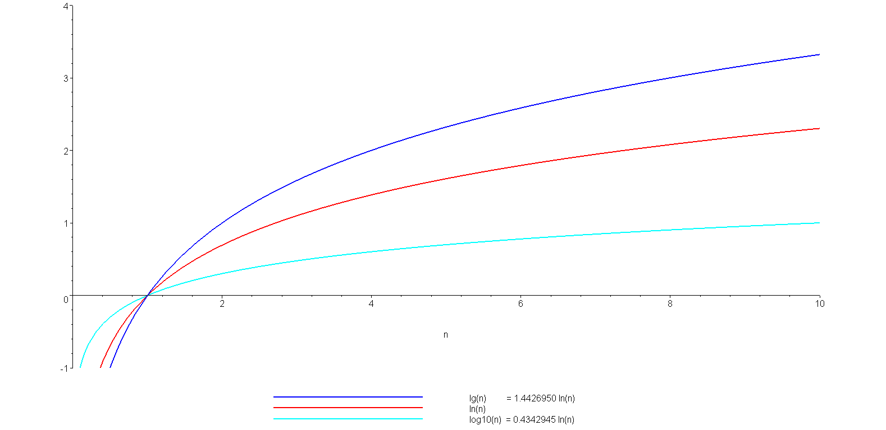
Logarithms
A plot of log₂(n) = lg(n), ln(n), and log₁₀(n)
lg(n)
ln(n)
log₁₀(n)

Slide 16
Logarithms
Note: the base-2 logarithm log₂(n) is written as lg(n)
It is an industry standard to implement the natural logarithm ln(n) as
double log( double );
The common logarithm log₁₀(n) is implemented as
double log10( double );

Slide 17
Logarithms
A more interesting observation we will repeatedly use:
n^{logb (m)} = m^{logb(n)},
a consequence of :
n^{logb (m)} = (b^{logb(n)})^{logb(m)} = b^{logb(n) logb(m)} = (b^{logb(m)})^{logb(n)}
= m^{logb(n)}

Slide 18
Logarithms
You should also, as electrical or computer engineers be aware of the relationship:
lg(2¹⁰) = lg(1024) = 10
lg(2²⁰) = lg(1 048 576) = 20
and consequently:
lg(10³) = lg(1000) ≈ 10 kilo
lg(10⁶) = lg(1 000 000) ≈ 20 mega
lg(10⁹) ≈ 30 giga
lg(10¹²) ≈ 40 tera

Slide 19
Arithmetic series
Next we will look various series
Each term in an arithmetic series is increased by a constant value (usually 1) :

Slide 20
Arithmetic series
Proof 1: write out the series twice and add each column
1 + 2 + 3 + . . . + n – 2 + n – 1 + n
+ n + n – 1 + n – 2 + . . . + 3 + 2 + 1
(n + 1) + (n + 1) + (n + 1) + . . . + (n + 1) + (n + 1) + (n + 1)
= n (n + 1)
Since we added the series twice, we must divide the result by 2

Slide 21
Arithmetic series
Proof 2 (by induction):
The statement is true for n = 0:
Assume that the statement is true for an arbitrary n:

Slide 22
Arithmetic series
Using the assumption that
for n, we must show that

Slide 23
Arithmetic series
Then, for n + 1, we have:
By assumption, the second sum is known:

Slide 24
Arithmetic series
The statement is true for n = 0 and
the truth of the statement for n implies
the truth of the statement for n + 1.
Therefore, by the process of mathematical induction, the statement is true for all values of n ≥ 0.
Notes:
Reference: Mr. Oprendick

Slide 25
Other polynomial series
We could repeat this process, after all:
however, it is easier to see the pattern:

Slide 26
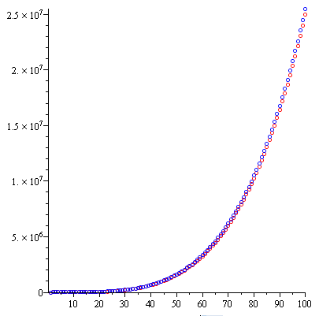
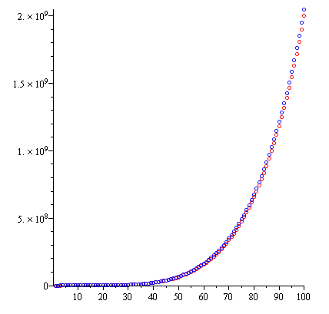
Other polynomial series
We can generalize this formula
Demonstrating with d = 3 and d = 4:

Slide 27
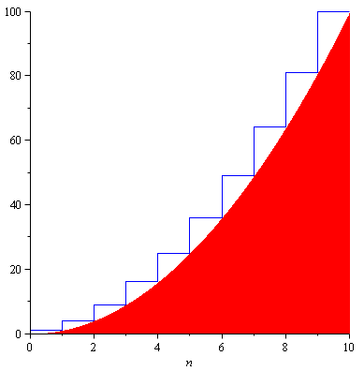
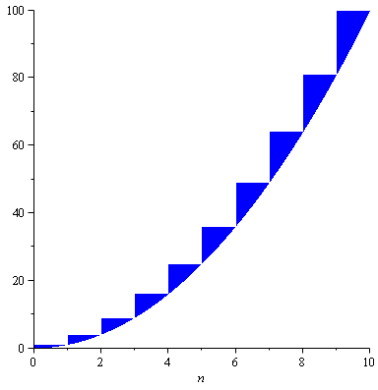
Other polynomial series
The justification for the approximation is that we are approximating the sum with an integral:
However, there is an accumulating error:
n²

Slide 28

Other polynomial series
How large is the error?
Assuming d > 1, shifting the errors, we see that they would be
<<
n² = 100
n = 10

Slide 29

Other polynomial series
In the limit, as n → ∞
The ratio between the error and the approximation goes to 0
Therefore, the ratio between the sum and the approximation goes to 1
$$\lim_{n→∞}{\frac{\sum_{k=0}^{n}{k^{d}}−\frac{n^{d+1}}{d+1}}{\frac{n^{d+1}}{d+1}}}=0$$

Slide 30

Geometric series
The next series we will look at is the geometric series with common ratio r: $1, r, r^{2}, r^{3},⋯,r^{n}$
and if |r| < 1 then it is also true that

Slide 31
Geometric series
Elegant proof: multiply by
Ref: Bret D. Whissel, A Derivation of Amortization
all but the first and last terms cancel

Slide 32
Geometric series
Proof by induction:
The formula is correct for n = 0:
Assume the formula is true for an arbitrary n; then
and therefore, by the process of mathematical induction, the statement is true for all n ≥ 0.

Slide 33
Geometric series
Note that we can use a change-of-index with summations like we do with integration:
Letting j = i – 1:

Slide 34
Geometric series
A common geometric series will involve the ratios r = ½ and r = 2:

Slide 35
Recurrence relations
Finally, we will review recurrence relations:
A recurrence relationship is a means of defining a sequence based on previous values in the sequence
Such definitions of sequences are said to be recursive

Slide 36
Recurrence relations
Define an initial value: e.g., x₁ = 1
Defining x_{n} in terms of previous values:
For example,
x_{n} = x_{n – 1} + 2
x_{n} = 2x_{n – 1} + n
x_{n} = x_{n – 1} + x_{n – 2}

Slide 37
Recurrence relations
Given the two recurrence relations
x_{n} = x_{n – 1} + 2 x_{n} = 2x_{n – 1} + n
and the initial condition x₁ = 1 we would like to find explicit formulae for the sequences
In this case, we have
x_{n} = 2n – 1 x_{n} = 2^{n + 1} – n – 2
respectively

Slide 38
Recurrence relations
We will use a functional form of recurrence relations:
Calculus | Functional form
x₁ = 1............. | f(1) = 1...................
x_{n} = x_{n – 1} + 2.. | f(n) = f(n – 1) + 2...
x_{n} = 2x_{n – 1} + n | f(n) = 2 f(n – 1) + n

Slide 39
Recurrence relations
The previous examples using the functional notation are:
f(n) = f(n – 1) + 2 g(n) = 2 g(n – 1) + n
With the initial conditions f(1) = g(1) = 1, the solutions are:
f(n) = 2n – 1 g(n) = 2^{n + 1} – n – 2

Slide 40
Recurrence relations
In some cases, given the recurrence relation, we can find the explicit formula:
Consider the Fibonacci sequence:
f(n) = f(n – 1) + f(n – 2)
f(0) = f(1) = 1
that has the solution
where φ is the golden ratio:

Slide 41
Weighted averages
Given n objects x₁, x₂, x₃, ..., x_{n}, the average is
Given a sequence of coefficients c₁ , c₂ , c₃ , … , c_{n} where
then we refer to
as a weighted average
For an average,

Slide 42
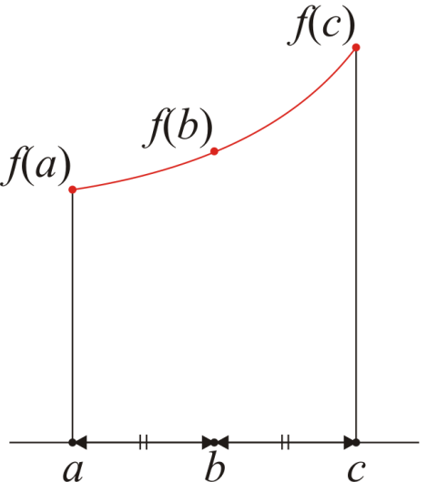
Weighted averages
Examples:
Simpson’s method approximates an integral by sampling the function at three points: f(a), f(b), f(c)
The average value of the function is approximated by
It can be shown that that
is a significant better approximation than

Slide 43
Weighted averages
Examples:
Using the weighted average:
Using a simple average:

Slide 44
Combinations
Given n distinct items, in how many ways can you choose k of these?
I.e., “In how many ways can you combine k items from n?”
For example, given the set {1, 2, 3, 4, 5}, I can choose three of these in any of the following ways:
{1, 2, 3}, {1, 2, 4}, {1, 2, 5}, {1, 3, 4}, {1, 3, 5},
{1, 4, 5}, {2, 3, 4}, {2, 3, 5}, {2, 4, 5}, {3, 4, 5},
The number of ways such items can be chosen is written
where is read as “n choose k”s
There is a recursive definition:

Slide 45
Combinations
The most common question we will ask in this vein:
Given n items, in how many ways can we choose two of them?
In this case, the formula simplifies to:
For example, given {0, 1, 2, 3, 4, 5, 6}, we have the following 21 pairs:
{0, 1}, {0, 2}, {0, 3}, {0, 4}, {0, 5}, {0, 6},
{1, 2}, {1, 3}, {1, 4}, {1, 5}, {1, 6},
{2, 3}, {2, 4}, {2, 5}, {2, 6},
{3, 4}, {3, 5}, {3, 6},
{4, 5}, {4, 6},
{5, 6}

Slide 46
Combinations
You have also seen this in expanding polynomials:
For example,

Slide 47
Combinations
These are also the coefficients of Pascal’s triangle:

Slide 48
Summary
In this topic, we have discussed:
A review of the necessity of quantitative analysis in engineering
We reviewed the following mathematical concepts:
Logarithms
Arithmetic and other polynomial series
Mathematical induction
Geometric series
Recurrence relations
Weighted average
Combinations

Slide 49
Reference
[1] Cormen, Leiserson, and Rivest, Introduction to Algorithms, McGraw Hill, 1990, Chs 2-3, p.42-76.
[2] Weiss, Data Structures and Algorithm Analysis in C++, 3rd Ed., Addison Wesley, §§ 1.2-3, p.2-11.

Slide 50
Usage Notes
These slides are made publicly available on the web for anyone to use
If you choose to use them, or a part thereof, for a course at another institution, I ask only three things:
that you inform me that you are using the slides,
that you acknowledge my work, and
that you alert me of any mistakes which I made or changes which you make, and allow me the option of incorporating such changes (with an acknowledgment) in my set of slides
Sincerely,
Douglas Wilhelm Harder, MMath
dwharder@alumni.uwaterloo.ca

