Slide 1
CS101 Data Structures
Linked List
Instructor: Dengji Zhao
Textbook Ch 10.2
Notes:
Adapted from the slides by Douglas Wilhelm Harder of U Waterloo (https://ece.uwaterloo.ca/~dwharder/aads/Lecture_materials/)
May also contain material from the slides at https://courses.cs.washington.edu/courses/cse326/03wi/326lecturesb.shtml (by Dan Suciu of U Washington)

Slide 2
Outline
List ADT
Linked list
Doubly linked list
Node-based storage with arrays
Application

Slide 3
Outline
We will now look at our first abstract data structure
Relation: explicit linear ordering
Operations
Implementations of an abstract list with:
Linked lists
Arrays
Memory requirements
Strings as a special case
The STL vector class

Slide 4
List ADT
An Abstract List (or List ADT) is linearly ordered data
( A₁ A₂ … A_{n-1} A_{n} )
The same value may occur more than once

Slide 5

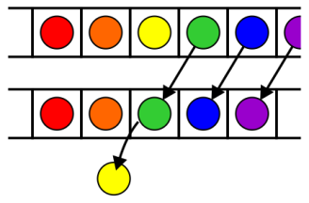
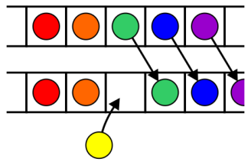
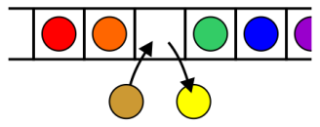
Operations
Operations at the k^{th} entry of the list include:
Access to the object Erasing an object
Insertion of a new object Replacement of the object

Slide 6
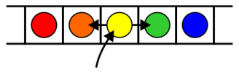
Operations
Given access to the k^{th} object, gain access to either the previous or next object
Given two abstract lists, we may want to
Concatenate the two lists
Determine if one is a sub-list of the other

Slide 7
Abstract Strings
A specialization of an Abstract List is an Abstract String:
The entries are restricted to characters from a finite alphabet
This includes regular strings, e.g., “Hello world!”
The restriction using an alphabet emphasizes specific operations that would seldom be used otherwise
Substrings, matching substrings, string concatenations
It also allows more efficient implementations
String searching/matching algorithms
Regular expressions

Slide 8
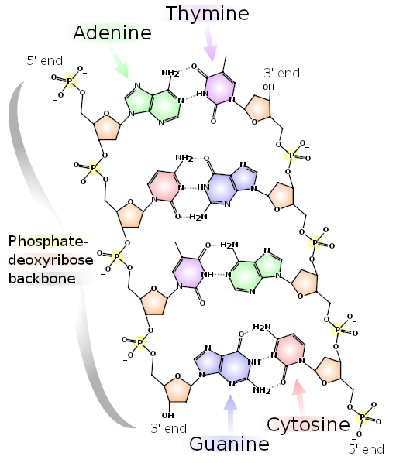
Abstract Strings
Strings also include DNA
The alphabet has 4 characters: A, C, G, and T
These are the nucleobases:
adenine, cytosine, guanine, and thymine
Bioinformatics today uses many of the algorithms traditionally restricted to computer science:
Dan Gusfield, Algorithms on Strings, Trees and Sequences: Computer Science and Computational Biology, Cambridge, 1997
http://books.google.ca/books?id=STGlsyqtjYMC
References:
http://en.wikipedia.org/wiki/DNA
http://en.wikipedia.org/wiki/Bioinformatics

Slide 9

Arrays
 | Accessing the k^{th} entry | Insert or erase at the
 |  | Front | k^{th} entry | Back
Arrays | Θ(1) | Θ(n) | O(n) | Θ(1)

Slide 10
Outline
List ADT
Linked list
Doubly linked list
Node-based storage with arrays
Application

Slide 11
Outline
In this topic, we will look at linked lists
The Node and List classes
Accessors and mutators
The implementation of various member functions
Stepping through a linked list
Defining the copy and assignment operator
Defining move constructors and move assignment operators
Discussed efficiencies

Slide 12
Definition
A linked list is a data structure where each object is stored in a node
As well as storing data, the node must also contains a reference/pointer to the node containing the next item of data
L
42
95
70
81
∅

Slide 13
Node Class
The node must store data and a pointer:
class Node {
private:
int element;
Node *next_node;
public:
Node( int = 0, Node * = nullptr );
int retrieve() const;
Node *next() const;
};

Slide 14
Node Constructor
The constructor assigns the two member variables based on the arguments
Node::Node( int e, Node *n ):
element( e ),
next_node( n ) {
// empty constructor
}
The default values are given in the class definition:
Node( int = 0, Node * = nullptr );

Slide 15
Accessors
The two member functions are accessors which simply return the element and the next_node member variables, respectively
int Node::retrieve() const { return element;
}
Node *Node::next() const {
return next_node;
}
Notes:
Member functions that do not change the object acted upon are variously called accessors, readonly functions, inspectors, and, when it involves simply returning a member variable, getters

Slide 16
Linked List Class
Because each node in a linked lists refers to the next, the linked list class need only link to the first node in the list
The linked list class requires member variable: a pointer to a node
class List {
private:
Node *list_head;
// ...
};

Slide 17
Structure
Let us look at the internal representation of a linked list
Suppose we want a linked list to store the values
42 95 70 81
in this order

Slide 18
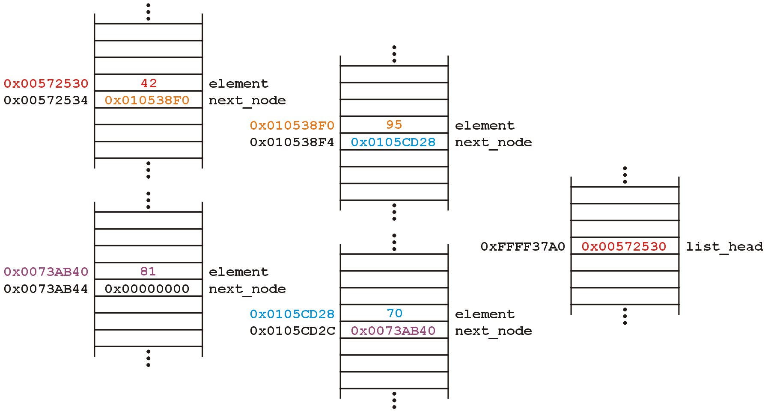
Structure
A linked list uses linked allocation, and therefore each node may appear anywhere in memory:
Linked List Object

Slide 19
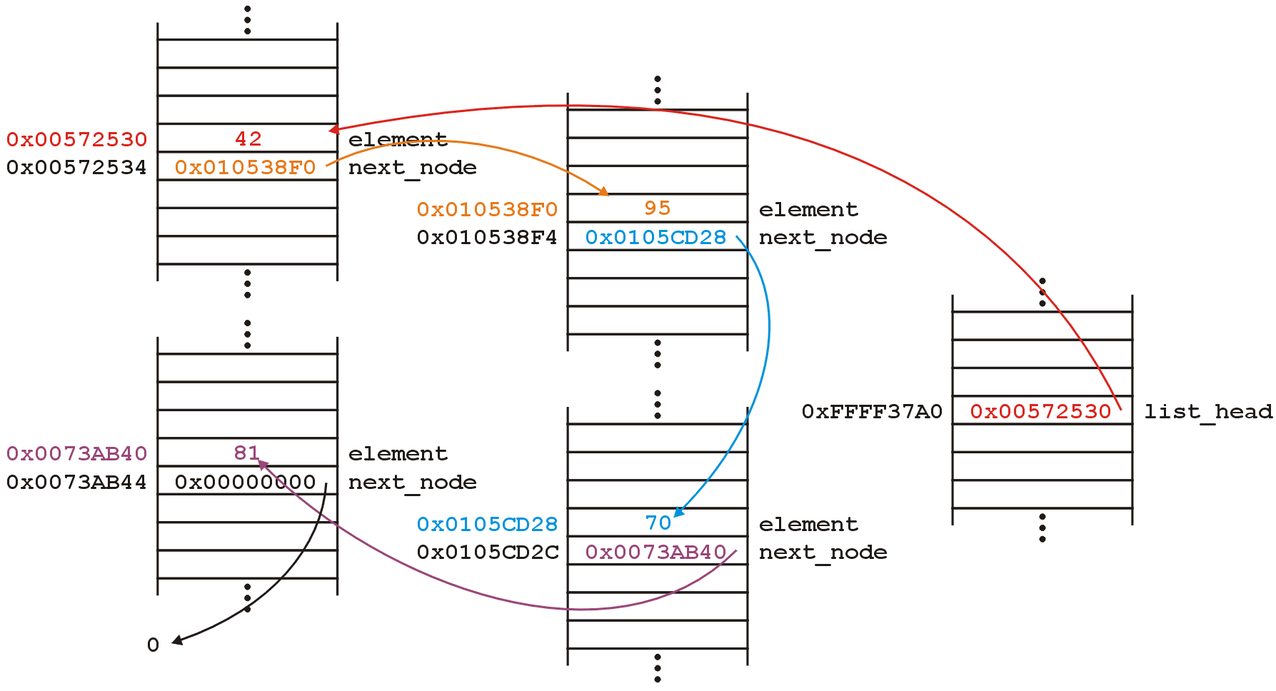
Structure
The next_node pointers store the addresses of the next node in the list

Slide 20
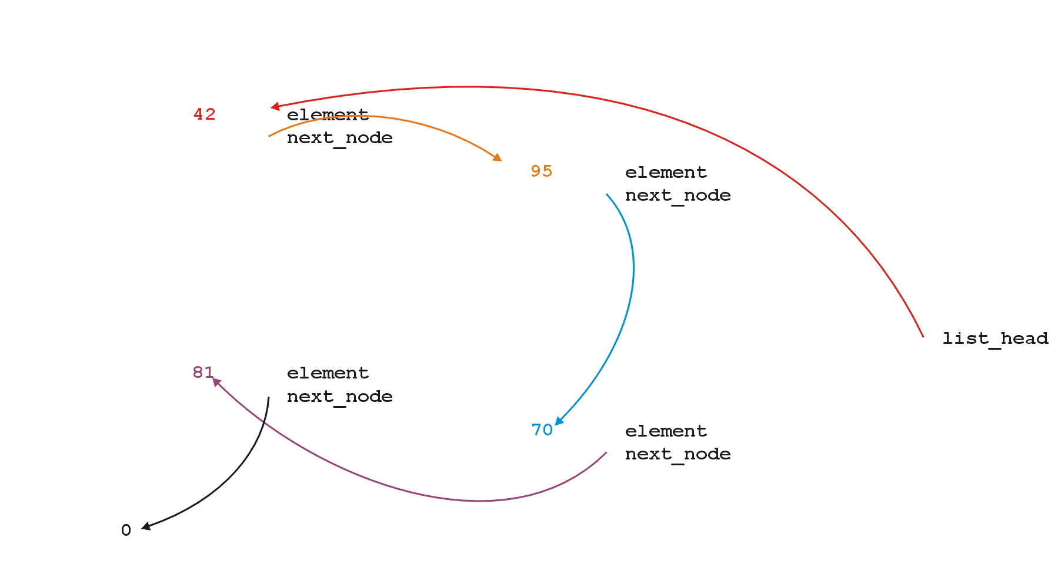
Structure
Because the addresses are arbitrary, we can remove that information:

Slide 21
Structure
We will clean up the representation as follows:
We do not specify the addresses because they are arbitrary and:
The contents of the circle is the element
The next_node pointer is represented by an arrow
list_

Slide 22
Operations
First, we want to create a linked list
We also want to be able to:
insert into,
access, and
erase from
the elements stored in the linked list

Slide 23
Operations
We can do them with the following operations:
Adding, retrieving, or removing the value at the front of the linked list
void push_front( int );
int front() const;
void pop_front();
We may also want to access the head of the linked list
Node *head() const;

Slide 24
Operations
All these operations relate to the first node of the linked list
We may want to perform operations on an arbitrary node of the linked list, for example:
Find the number of instances of an integer in the list:
int count( int ) const;
Remove all instances of an integer from the list:
int erase( int );

Slide 25
Linked Lists
Additionally, we may wish to check the state:
Is the linked list empty?
bool empty() const;
How many objects are in the list?
int size() const;
The list is empty when the list_head pointer is set to nullptr

Slide 26
Linked Lists
Consider this simple (but incomplete) linked list class:
class List {
private:
Node *list_head;
public:
List();
// Accessors
bool empty() const;
int size() const;
int front() const;
Node *head() const;
int count( int ) const;
// Mutators
void push_front( int );
int pop_front();
int erase( int );
};

Slide 27
The Constructor
In the constructor, we assign list_head the value nullptr
List::List():list_head( nullptr ) {
// empty constructor
}
We will always ensure that when a linked list is empty, the list head is assigned nullptr

Slide 28
bool empty() const
Starting with the easier member functions:
bool List::empty() const {
if ( list_head == nullptr ) {
return true;
} else {
return false;
}
}
Better yet:
bool List::empty() const {
return ( list_head == nullptr );
}

Slide 29
Node *head() const
The member function Node *head() const is easy enough to implement:
Node *List::head() const {
return list_head;
}
This will always work: if the list is empty, it will return nullptr

Slide 30
int front() const
To get the first element in the linked list, we must access the node to which the list_head is pointing
Because we have a pointer, we must use the -> operator to call the member function:
int List::front() const {
return head()->retrieve();
}

Slide 31
int front() const
What if the list is empty?
If we tried to access a member function of a pointer set to nullptr, we would access restricted memory and the OS would terminate the running program

Slide 32
int front() const
Instead, we can use an exception handling mechanism where we thrown an exception
We define a class
class underflow {
// emtpy
};
and then we throw an instance of this class:
throw underflow();

Slide 33
int front() const
Thus, the full function is
int List::front() const {
if ( empty() ) {
throw underflow(); }
return head()->retrieve();
}

Slide 34
int front() const
Why is emtpy() better than
int List::front() const {
if ( list_head == nullptr ) {
throw underflow(); }
return list_head->element;
}
Two benefits:
More readable
If the implementation changes we do nothing

Slide 35


void push_front( int )
Next, let us add an element to the list
If it is empty, we start with:
and, if we try to add 81, we should end up with:

Slide 36
void push_front( int )
We must:
create a new node which:
stores the value 81, and
is pointing to 0
assign its address to list_head
We can do this as follows:
list_head = new Node( 81, nullptr );
Notes:
We could also use the default value...

Slide 37
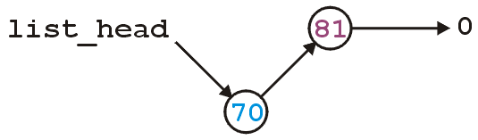
void push_front( int )
Suppose however, we already have a non-empty list
Adding 70, we want:

Slide 38
void push_front( int )
To achieve this, we must we must create a new node which:
stores the value 70, and
is pointing to the current list head
we must then assign its address to list_head
We can do this as follows:
list_head = new Node( 70, list_head );

Slide 39
void push_front( int )
Thus, our implementation could be:
void List::push_front( int n ) {
if ( empty() ) {
list_head = new Node( n, nullptr );
} else {
list_head = new Node( n, head() );
}
}

Slide 40
void push_front( int )
We could, however, note that when the list is empty, list_head == 0, thus we could shorten this to:
void List::push_front( int n ) {
list_head = new Node( n, list_head );
}

Slide 41
void push_front( int )
Are we allowed to do this?
void List::push_front( int n ) {
list_head = new Node( n, head() );
}
Yes: the right-hand side of an assignment is evaluated first
The original value of list_head is accessed first before the function call is made

Slide 42
void push_front( int )
Question: does this work?
void List::push_front( int n ) {
Node new_node( n, head() );
list_head = &new_node;
}
Why or why not? What happens to new_node?
How does this differ from
void List::push_front( int n ) {
Node *new_node = new Node( n, head() );
list_head = new_node;
}

Slide 43

int pop_front()
Erasing from the front of a linked list is even easier:
We assign the list head to the next pointer of the first node
Graphically, given:
we want:

Slide 44
int pop_front()
Easy enough:
int List::pop_front() {
int e = front();
list_head = head()->next();
return e;
}
Unfortunately, we have some problems:
The list may be empty
We still have the memory allocated for the node containing 70

Slide 45
int pop_front()
Does this work?
int List::pop_front() {
if ( empty() ) {
throw underflow();
}
int e = front();
delete head();
list_head = head()->next();
return e;
}

Slide 46
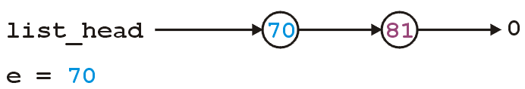
int pop_front()
int List::pop_front() {
if ( empty() ) {
throw underflow();
}
int e = front();
delete head();
list_head = head()->next();
return e;
}

Slide 47
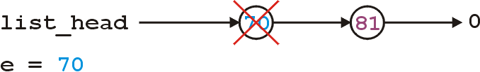
int pop_front()
int List::pop_front() {
if ( empty() ) {
throw underflow();
}
int e = front();
delete head();
list_head = head()->next();
return e;
}

Slide 48
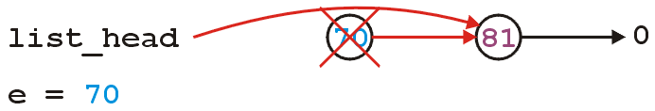
int pop_front()
int List::pop_front() {
if ( empty() ) {
throw underflow();
}
int e = front();
delete head();
list_head = head()->next();
return e;
}
Any problem with the above code?

Slide 49

int pop_front()
The problem is, we are accessing a node which we have just deleted
Unfortunately, this will work more than 99% of the time:
The running program (process) may still own the memory
Once in a while it will fail ...
... and it will be almost impossible to debug
http://xkcd.com/379/

Slide 50
int pop_front()
The correct implementation assigns a temporary pointer to point to the node being deleted:
int List::pop_front() {
if ( empty() ) {
throw underflow();
}
int e = front();
Node *ptr = list_head;
list_head = list_head->next();
delete ptr;
return e;
}

Slide 51
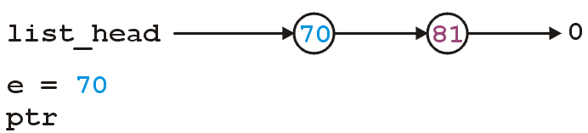
int pop_front()
int List::pop_front() {
if ( empty() ) {
throw underflow();
}
int e = front();
Node *ptr = head();
list_head = head()->next();
delete ptr;
return e;
}

Slide 52
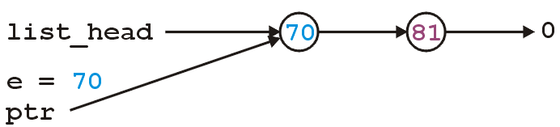
int pop_front()
int List::pop_front() {
if ( empty() ) {
throw underflow();
}
int e = front();
Node *ptr = head();
list_head = head()->next();
delete ptr;
return e;
}

Slide 53
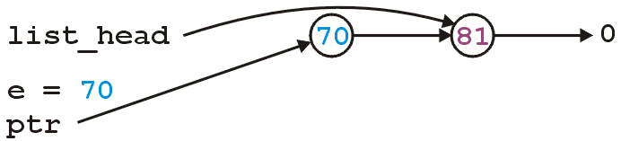
int pop_front()
int List::pop_front() {
if ( empty() ) {
throw underflow();
}
int e = front();
Node *ptr = head();
list_head = head()->next();
delete ptr;
return e;
}

Slide 54
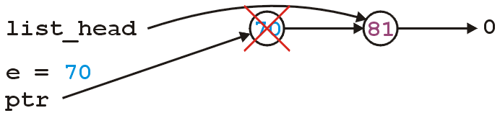
int pop_front()
int List::pop_front() {
if ( empty() ) {
throw underflow();
}
int e = front();
Node *ptr = head();
list_head = head()->next();
delete ptr;
return e;
}

Slide 55
Stepping through a Linked List
The next step is to look at member functions which potentially require us to step through the entire list:
int size() const;
int count( int ) const;
int erase( int );
The second counts the number of instances of an integer, and the last removes the nodes containing that integer

Slide 56
Stepping through a Linked List
The process of stepping through a linked list can be thought of as being analogous to a for-loop:
We initialize a temporary pointer with the list head
We continue iterating until the pointer equals nullptr
With each step, we set the pointer to point to the next object

Slide 57
Stepping through a Linked List
Thus, we have:
for ( Node *ptr = head(); ptr != nullptr; ptr = ptr->next() ) {
// do something
// use ptr->fn() to call member functions
// use ptr->var to assign/access member variables
}

Slide 58
Stepping through a Linked List
Analogously:
for ( Node *ptr = head(); ptr != nullptr; ptr = ptr->next() )
for ( int i = 0; i != N; ++i )

Slide 59
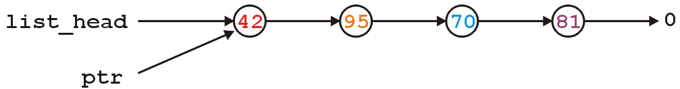
Stepping through a Linked List
With the initialization and first iteration of the loop, we have:
ptr != nullptr and thus we evaluate the body of the loop and then set ptr to the next pointer of the node it is pointing to

Slide 60
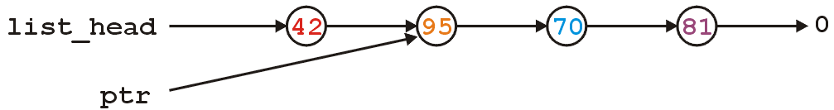
Stepping through a Linked List
ptr != nullptr and thus we evaluate the loop and increment the pointer

Slide 61
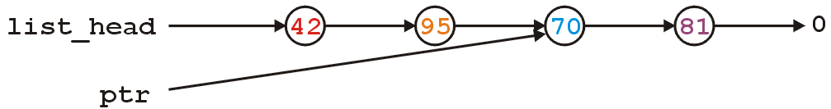
Stepping through a Linked List
ptr != nullptr and thus we evaluate the loop and increment the
pointer

Slide 62
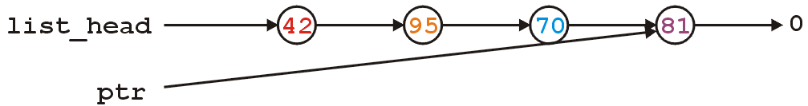
Stepping through a Linked List
ptr != nullptr and thus we evaluate the loop and increment the
pointer

Slide 63
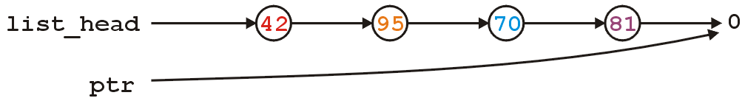
Stepping through a Linked List
Here, we check and find ptr != nullptr is false, and thus we exit
the loop

Slide 64
int count( int ) const
To implement int count(int) const, we simply check if the argument matches the element with each step
Each time we find a match, we increment the count
When the loop is finished, we return the count
The size function is simplification of count

Slide 65
int count( int ) const
The implementation:
int List::count( int n ) const {
int node_count = 0;
for ( Node *ptr = list(); ptr != nullptr; ptr = ptr->next() ) {
if ( ptr->retrieve() == n ) {
++node_count;
}
}
return node_count;
}

Slide 66
int erase( int )
To remove an arbitrary element, i.e., to implement int erase( int ), we must update the previous node
For example, given
if we delete 70, we want to end up with

Slide 67
Accessing Private Member Variables
Notice that the erase function must modify the member variables of the node prior to the node being removed
Thus, it must have access to the member variable next_node
We could supply the member function
void set_next( Node * );
however, this would be globally accessible
Possible solutions:
Friends
Nested classes
Inner classes (Java/C#)

Slide 68
C++ Friends
In C++, you explicitly break encapsulation by declaring the class List to be a friend of the class Node:
class Node {
Node *next() const;
// ... declaration ...
friend class List;
};
Now, inside erase (a member function of List), you can modify all the member variables of any instance of the Node class

Slide 69
C++ Friends
For example, the erase member function could be implemented using the following code:
int List::erase( int n ) {
int node_count = 0;
// ...
for ( Node *ptr = head(); ptr != nullptr; ptr = ptr->next() ) {
// ...
if ( some condition ) {
ptr->next_node = ptr->next()->next();
// ...
++node_count;
}
}
return node_count;
}

Slide 70
Nested Classes
In C++, you can nest one class inside another
class Outer {
private:
class Nested {
private:
int element;
public:
int get() const;
void set( int );
};
Nested stored;
public:
int get() const;
void set( int );
};

Slide 71
Nested Classes
The function definitions are as one would expect:
int Outer::Nested::get() const {
return element;
}
void Outer::Nested::set( int n ) {
element = n;
}
int Outer::get() const {
return stored.get();
}
void Outer::set( int n ) {
// Not allowed, as element is private
// stored.element = n;
stored.set( n );
}

Slide 72
Inner Classes
In Java/C#, there is also the notion of an inner class
This is an elegant object-oriented solution
Any instance of the inner class is linked to the instance of the outer class that created it
That inner class can access the member variables of the outer class
If Node was an inner class of List, the node could determine its position with the list (not possible in C++):
int List::Node::position() const {
int posn = 1;
for ( Node *ptr = list_head; ptr != this; ptr = ptr->next() ) {
} // empty loop body
return posn;
}

Slide 73
Destructor
We dynamically allocated memory each time we added a new int into this list
Suppose we delete a list before we remove everything from it
This would leave the memory allocated with no reference to it

Slide 74
Destructor
Thus, we need a destructor:
class List {
private:
Node *list_head;
public:
List();
~List();
// ...etc...
};

Slide 75
Destructor
The destructor has to delete any memory which had been allocated but has not yet been deallocated
This is straight-forward enough:
while ( !empty() ) {
pop_front();
}

Slide 76
Destructor
Is this efficient?
It runs in O(n) time, where n is the number of objects in the linked list
Given that delete is approximately 100× slower than most other instructions (it does call the OS), the extra overhead is negligible...

Slide 77
Making Copies
Is this sufficient for a linked list class?
Initially, it may appear yes, but we now have to look at how C++ copies objects during:
Passing by value (making a copy), and
Assignment

Slide 78
Pass by Value
Recall that when you pass an integer to a function, a copy is made, so any changes to that parameter does not affect the original:
#include <iostream>
void increment( int n ) {
++n;
}
int main() {
int counter = 0;
increment( counter );
std::cout << counter << std::endl; // counter is still 0
}

Slide 79
Pass by Reference
If you want to change the value, you can pass by reference:
#include <iostream>
void increment( int &n ) {
++n;
}
int main() {
int counter = 0;
increment( counter );
std::cout << counter << std::endl; // counter is now 1
}

Slide 80
Pass by Pointer (C)
In C, you would pass the address of the object to change it:
#include <stdio.h>
void increment( int *pn ) {
++(*pn);
}
int main() {
int counter = 0;
increment( &counter );
printf( "%d", counter ); // counter is now 1
}

Slide 81
Modifying Arguments
Pass by reference could be used to modify a list
void reverse( List &list ) {
List tmp;
while ( !list.empty() ) {
tmp.push_front( ls.pop_front() );
}
// All the member variables of 'list' and 'tmp' are swapped
std::swap( list, tmp );
// The memory for 'tmp' will be cleaned up
}

Slide 82
Modifying Arguments
If you wanted to prevent the argument from being modified, you could declare it const:
double average( List const &ls, int min, int max ) {
double sum = 0, count = 0;
for ( Node *ptr = head(); ptr != nullptr; ptr = ptr->next() ) {
sum += ptr->retrieve();
++count;
}
return sum/count;
}
Note: this reveals a weakness in our model—we will discuss iterators later…

Slide 83
Modifying Arguments
You want to pass a copy of a linked list to a function—where the function may modify the copy, but the original list shall be unchanged.
void func( List ls ) {
// The compiler creates a new instance and copies the values
// The function does something with 'ls'
// The compiler ensures the destructor is called on 'ls'
}
With the default copy constructor, all the member variables are simply copied over into the new instance of the class

Slide 84
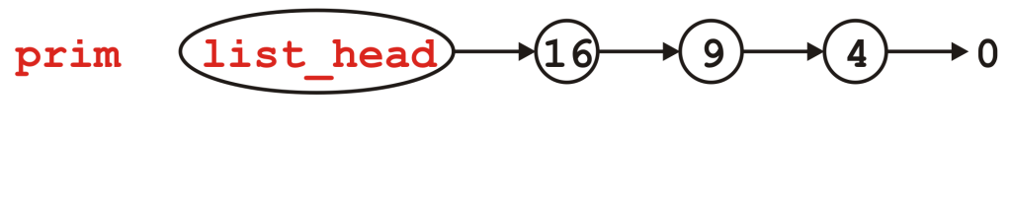
Modifying Arguments
void send_copy( List ls ) {
// The compiler creates a new instance and copies the values
// The function does something with 'ls'
// The compiler ensures the destructor is called on 'ls'
}
int main() {
List prim;
for ( int i = 2; i <= 4; ++i ) {
prim.push_front( i*i );
}
send_copy( prim );
std::cout << prim.empty() << std::endl;
return 0;
}
First, the list prim is created and three elements are pushed onto it

Slide 85
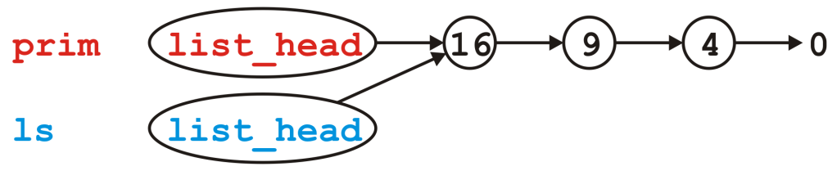
Modifying Arguments
void send_copy( List ls ) {
// The compiler creates a new instance and copies the values
// The function does something with 'ls'
// The compiler ensures the destructor is called on 'ls'
}
int main() {
List prim;
for ( int i = 2; i <= 4; ++i ) {
prim.push_front( i*i );
}
send_copy( prim );
std::cout << prim.empty() << std::endl;
return 0;
}
Next, we call send_copy and assigns a copy of prim to ls. The default is to copy member variables:
ls.list_head = prim.list_head

Slide 86
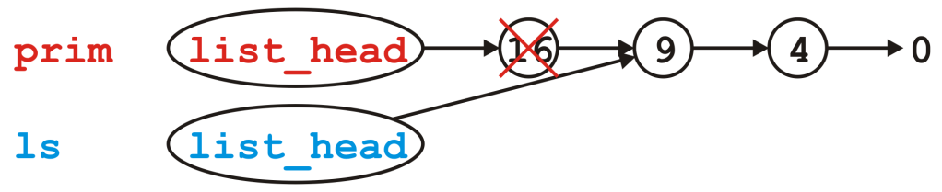
Modifying Arguments
void send_copy( List ls ) {
// The compiler creates a new instance and copies the values
// The function does something with 'ls'
// The compiler ensures the destructor is called on 'ls'
}
int main() {
List prim;
for ( int i = 2; i <= 4; ++i ) {
prim.push_front( i*i );
}
send_copy( prim );
std::cout << prim.empty() << std::endl;
return 0;
}
When send_copy returns, the destructor is called on ls

Slide 87
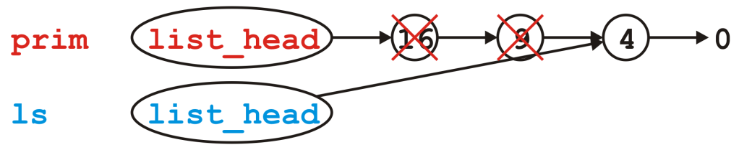
Modifying Arguments
void send_copy( List ls ) {
// The compiler creates a new instance and copies the values
// The function does something with 'ls'
// The compiler ensures the destructor is called on 'ls'
}
int main() {
List prim;
for ( int i = 2; i <= 4; ++i ) {
prim.push_front( i*i );
}
send_copy( prim );
std::cout << prim.empty() << std::endl;
return 0;
}
When send_copy returns, the destructor is called on ls

Slide 88
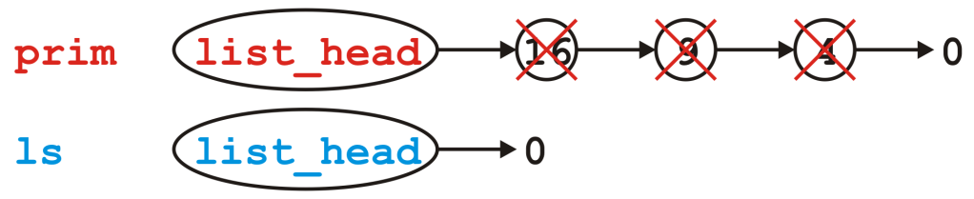
Modifying Arguments
void send_copy( List ls ) {
// The compiler creates a new instance and copies the values
// The function does something with 'ls'
// The compiler ensures the destructor is called on 'ls'
}
int main() {
List prim;
for ( int i = 2; i <= 4; ++i ) {
prim.push_front( i*i );
}
send_copy( prim );
std::cout << prim.empty() << std::endl;
return 0;
}
When send_copy returns, the destructor is called on ls

Slide 89
Modifying Arguments
void send_copy( List ls ) {
// The compiler creates a new instance and copies the values
// The function does something with 'ls'
// The compiler ensures the destructor is called on 'ls'
}
int main() {
List prim;
for ( int i = 2; i <= 4; ++i ) {
prim.push_front( i*i );
}
send_copy( prim );
std::cout << prim.empty() << std::endl;
return 0;
}
Back in main(), prim.list_head still stores the address of the Node containing 16, memory that has since been returned to the OS

Slide 90
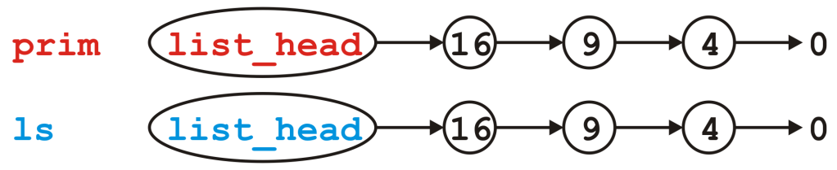
Modifying Arguments
What do we really want?
We really want a copy of the linked list
If this copy is modified, it leaves the original unchanged

Slide 91
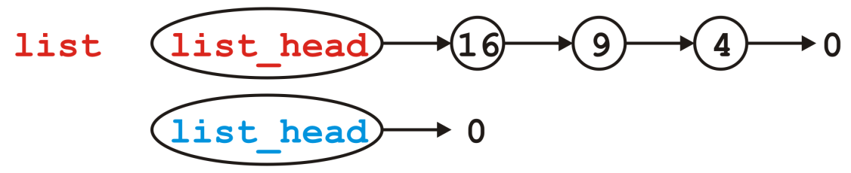
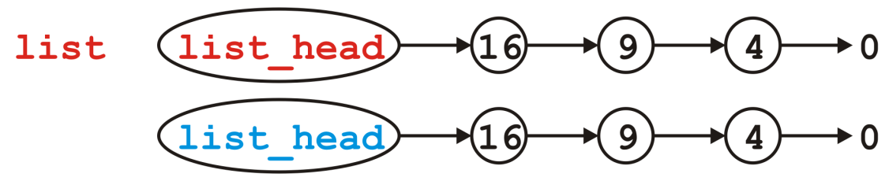
Copy Constructor
You can modify how copies are made by defining a copy constructor
List::List( List const &list ):list_head( nullptr ) {
// Make a copy of list
}
We now want to go from
to

Slide 92
Copy Constructor
Naïvely, we step through list and call push_front( int ):
List::List( List const &list ):list_head( nullptr ) {
for ( Node *ptr = list.head(); ptr != nullptr; ptr = ptr->next() ) {
push_front( ptr->retrieve() );
}
}
Does this work?
How could we make this work?
We need a push_back( int ) member function:
List::List( List const &list ):list_head( nullptr ) {
for ( Node *ptr = list.head(); ptr != nullptr; ptr = ptr->next() ) {
push_back( ptr->retrieve() );
}
}

Slide 93
Copy Constructor
Unfortunately, to make push_back( int ) more efficient, we need a pointer to the last node in the linked list
We require a list_tail member variable
Otherwise, push_back( int ) becomes a Θ(n) function
This would make the copy constructor Θ(n²)
In Project 1, you will define and use the member variable list_tail

Slide 94
Copy Constructor
First, make life simple: if list is empty, we are finished, so return
List::List( List const &list ):list_head( nullptr ) {
if ( list.empty() ) {
return;
}
}

Slide 95
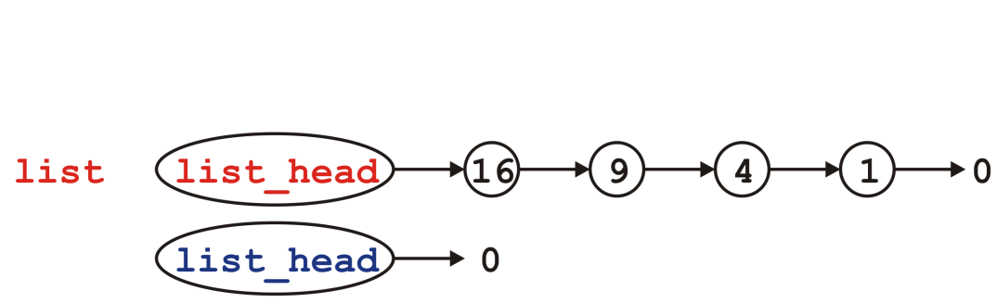
Copy Constructor
Otherwise, the list being copied is not empty…
List::List( List const &list ):list_head( nullptr ) {
if ( list.empty() ) {
return;
}
}

Slide 96
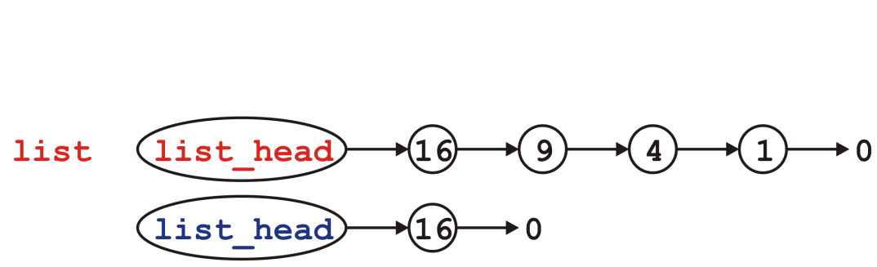
Copy Constructor
Copy the first node—we no longer modifying list_head
List::List( List const &list ):list_head( nullptr ) {
if ( list.empty() ) {
return;
}
push_front( list.front() );
}

Slide 97
Copy Constructor
We will need to loop through the list… How about a for loop?
List::List( List const &list ):list_head( nullptr ) {
if ( list.empty() ) {
return;
}
push_front( list.front() );
}

Slide 98
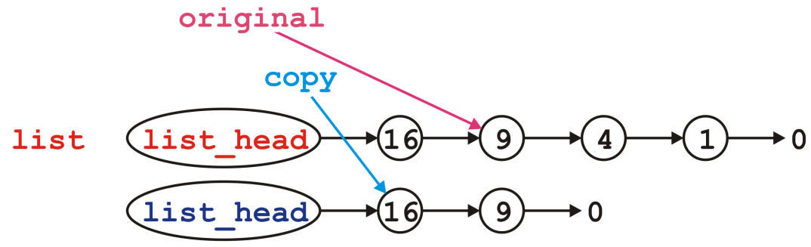
Copy Constructor
We modify the next pointer of the node pointed to by copy
List::List( List const &list ):list_head( nullptr ) {
if ( list.empty() ) {
return;
}
push_front( list.front() );
for (
Node *original = list.head()->next(), *copy = head();
original != nullptr;
original = original->next(), copy = copy->next()
) {
copy->next_node = new Node( original->retrieve(), nullptr );
}
}

Slide 99
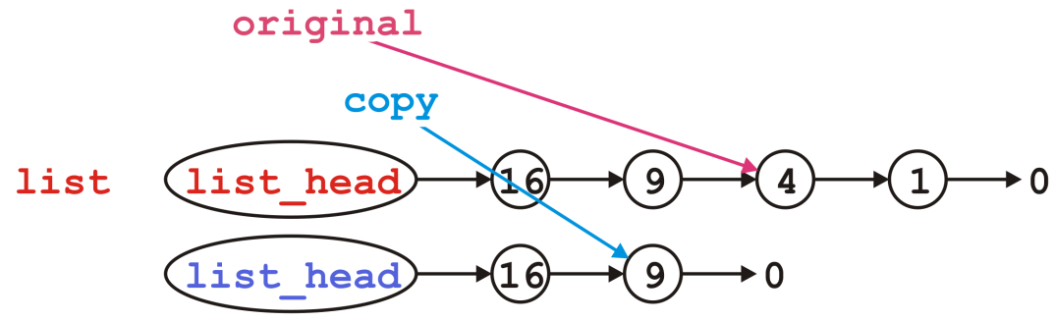
Copy Constructor
Then we move each pointer forward:
List::List( List const &list ):list_head( nullptr ) {
if ( list.empty() ) {
return;
}
push_front( list.front() );
for (
Node *original = list.head()->next(), *copy = head();
original != nullptr;
original = original->next(), copy = copy->next()
) {
copy->next_node = new Node( original->retrieve(), nullptr );
}
}

Slide 100
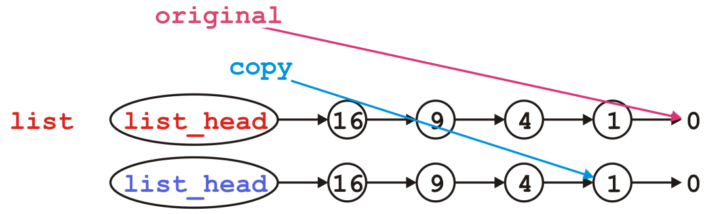
Copy Constructor
We’d continue copying until we reach the end
List::List( List const &list ):list_head( nullptr ) {
if ( list.empty() ) {
return;
}
push_front( list.front() );
for (
Node *original = list.head()->next(), *copy = head();
original != nullptr;
original = original->next(), copy = copy->next()
) {
copy->next_node = new Node( original->retrieve(), nullptr );
}
}

Slide 101
Assignment
What about assignment?
Suppose you have linked lists:
List lst1, lst2;
lst1.push_front( 35 );
lst1.push_front( 18 );
lst2.push_front( 94 );
lst2.push_front( 72 );

Slide 102
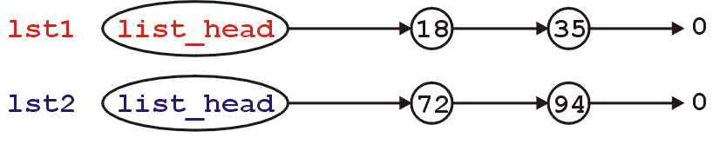
Assignment
This is the current state:
Consider an assignment:
lst2 = lst1;
What do we want? What do we actually do?

Slide 103
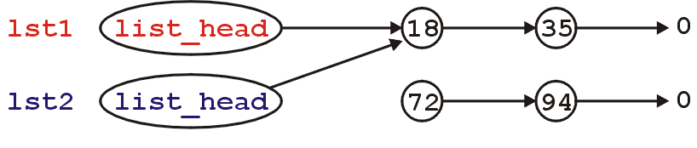
Assignment
The default behavior: the member variables of this class are copied over
It is equivalent to writing:
lst2.list_head = lst1.list_head;
Graphically:

Slide 104
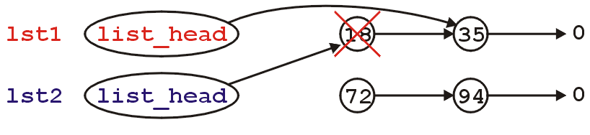
Assignment
What’s wrong with this picture?
We no longer have links to either of the nodes storing 72 or 94 (memory leak)
Also, suppose we call the member function
lst1.pop_front();
lst2 is now invalid

Slide 105
Assignment
Now, the second list lst2 is pointing to memory which has been deallocated...
What is the behavior if we make this call?
lst2.pop_front();
The behaviour is undefined, however, soon this will probably lead to an access violation

Slide 106
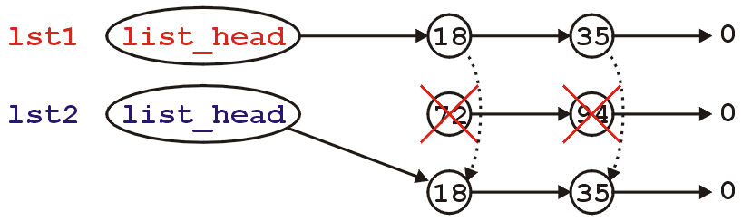
Assignment
Like making copies, we must have a reasonable means of assigning
Starting with
We need to erase the content of lst2 and copy over the nodes in lst1

Slide 107
Assignment
First, to overload the assignment operator, we must overload the function named operator =
This is a how you indicate to the compiler that you are overloading the assignment (=) operator
The signature is:
List &operator = ( List );

Slide 108
Return by Value
Now, suppose you create the following function:
List initialize( int a, int b ) {
List ls;
for ( int i = b; i >= a; --i ) {
ls.push_front( i );
}
return ls;
}
and call
List vec = initialize( 3, 6 );

Slide 109
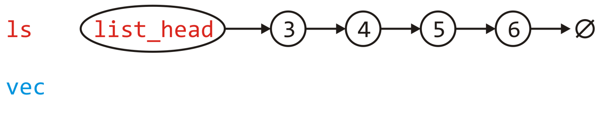
Return by Value
Because ls is a local variable, it will be garbage collected once the function returns—thus, we would normally make a copy
List initialize( int a, int b ) {
List ls;
for ( int i = b; i >= a; --i ) {
ls.push_front( i );
}
return ls;
}

Slide 110
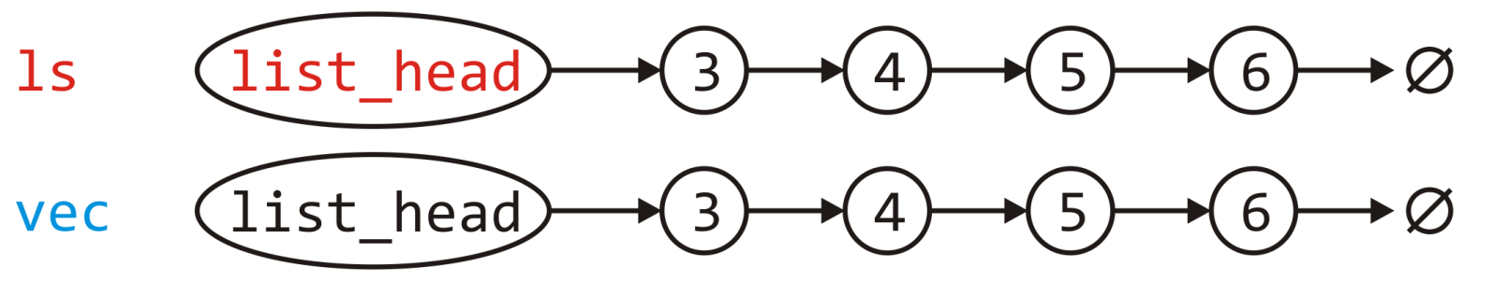
Return by Value
Because ls is a local variable, it will be garbage collected once the function returns—thus, we would normally make a copy
Create a copy
List initialize( int a, int b ) {
List ls;
for ( int i = b; i >= a; --i ) {
ls.push_front( i );
}
return ls;
}

Slide 111
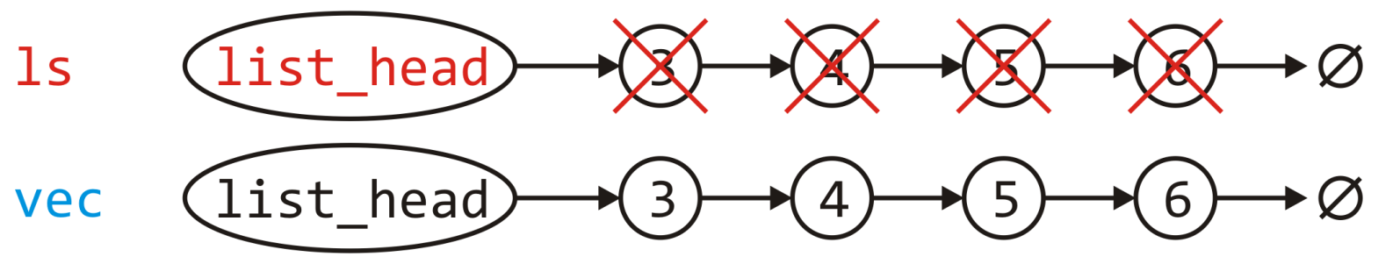
Return by Value
Because ls is a local variable, it will be garbage collected once the function returns—thus, we would normally make a copy
Create a copy
Call the destructor on ls
List initialize( int a, int b ) {
List ls;
for ( int i = b; i >= a; --i ) {
ls.push_front( i );
}
return ls;
}

Slide 112
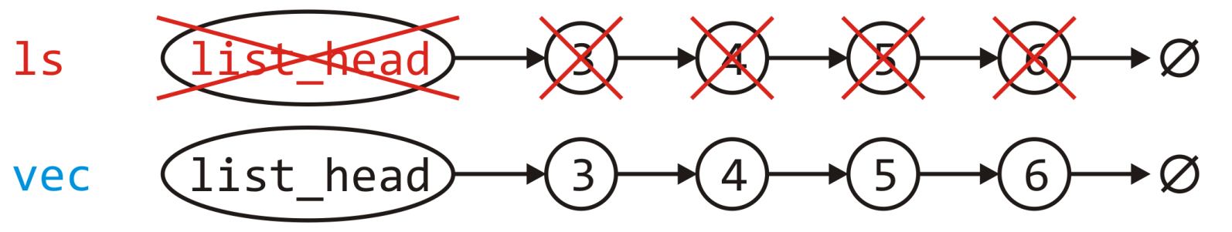
Return by Value
Because ls is a local variable, it will be garbage collected once the function returns—thus, we would normally make a copy
Create a copy
Call the destructor on ls
Remove the memory for ls from the stack
List initialize( int a, int b ) {
List ls;
for ( int i = b; i >= a; --i ) {
ls.push_front( i );
}
return ls;
}

Slide 113
Return by Value
Why are we allocating and deallocating so much memory?
Until C++-11, this was the only way
List initialize( int a, int b ) {
List ls;
for ( int i = b; i >= a; --i ) {
ls.push_front( i );
}
return ls;
}

Slide 114
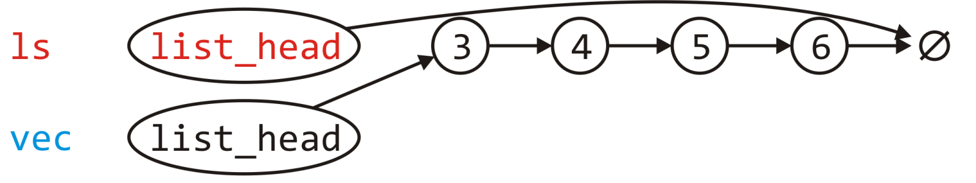
Return by Value
Wouldn’t it be easier to link vec.list_head to the first node in ls and then set ls.list_head = nullptr?
List initialize( int a, int b ) {
List ls;
for ( int i = b; i >= a; --i ) {
ls.push_front( i );
}
return ls;
}

Slide 115
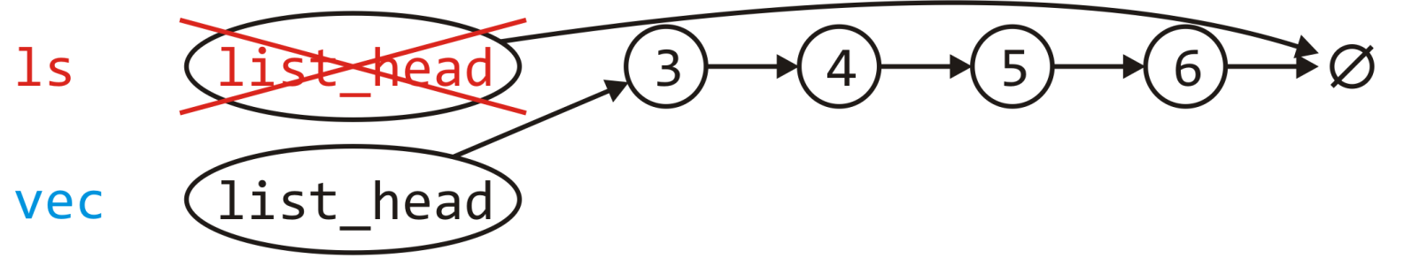
Return by Value
Wouldn’t it be easier to link vec.list_head to the first node in ls and then set ls.list_head = nullptr?
The destructor called on ls does nothing and the memory for it is popped from the stack
List initialize( int a, int b ) {
List ls;
for ( int i = b; i >= a; --i ) {
ls.push_front( i );
}
return ls;
}

Slide 116
Move Constructors
The move constructor was added to the C++-11 standard
It is called when an rvalue is being assigned—as an rvalue, it will be deleted anyway
The instance ls is being deleted as soon as it is copied
If a move constructor is defined, it will be called instead of a copy constructor
List( List &&list ):list_head( list.list_head ) {
// make 'list' empty so that nothing is
// done when it is passed to the destructor
list.list_head = nullptr;
}

Slide 117
Assignment
The right-hand side is passed by value (a copy is made) The return value is passed by reference
List &operator = ( List rhs );
Note that rhs is a copy of the list, it is not a pointer to a list
Use rhs.head() or rhs.list_head

Slide 118
Assignment
We will swap all the values of the member variables between the left- and right-hand sides
rhs is already a copy, so we swap all member variables of it and *this
List &operator = ( List rhs ) {
// 'rhs' is passed by value--it is a copy of the
// right-hand side of the assignment
// Swap all the entries of the copy with this
return *this;
}

Slide 119
Assignment
Under C++-11, the following is the appropriate implementation:
List &List::operator = ( List rhs ) {
std::swap( *this, rhs );
// Memory for rhs was allocated on the stack
// and the destructor will delete it
return *this;
}

Slide 120
Assignment
Until compilers are C++-11 compliant, this may be necessary:
List &List::operator = ( List rhs ) {
swap( rhs );
// Memory for rhs was allocated on the stack
// and the destructor will delete it
return *this;
}
void List::swap( List &list ) {
std::swap( list_head, list.list_head );
}

Slide 121
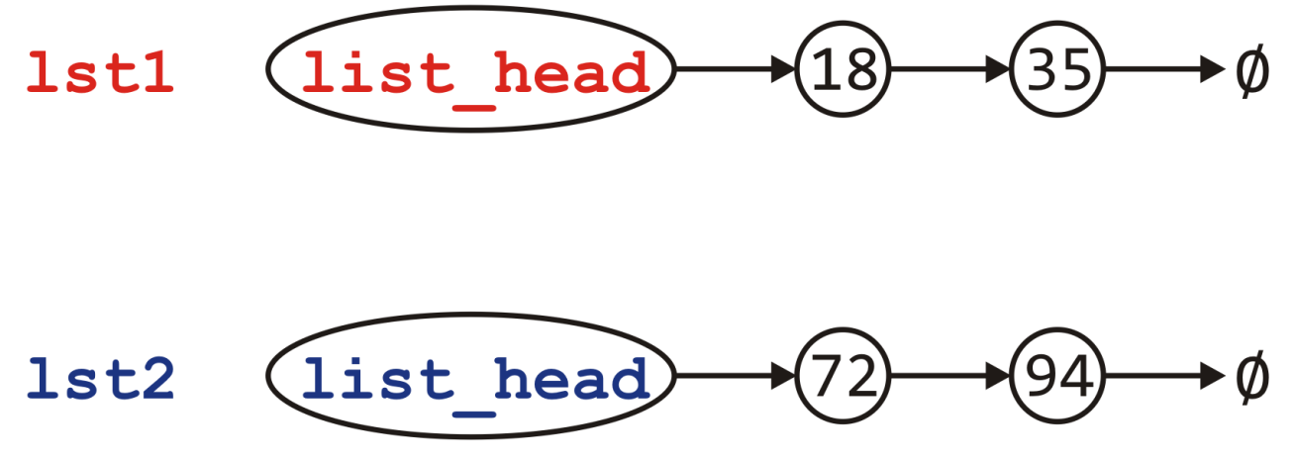
Assignment
Visually, we are doing the following:

Slide 122
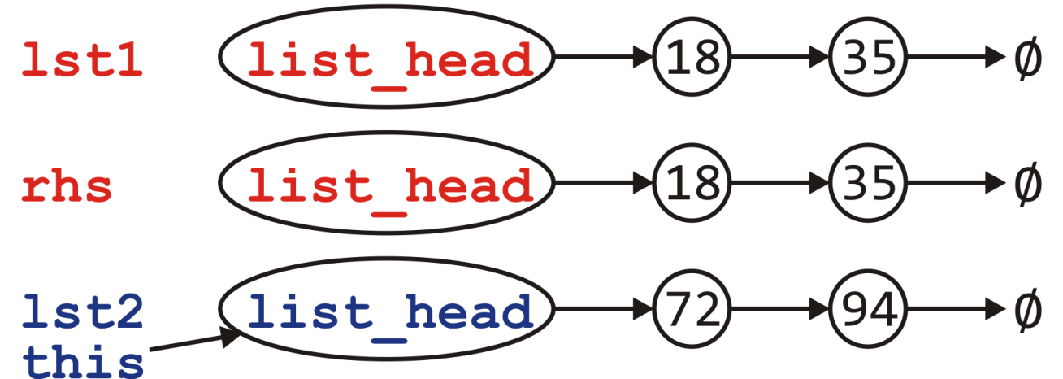
Assignment
Visually, we are doing the following:
Call the copy constructor to create rhs

Slide 123
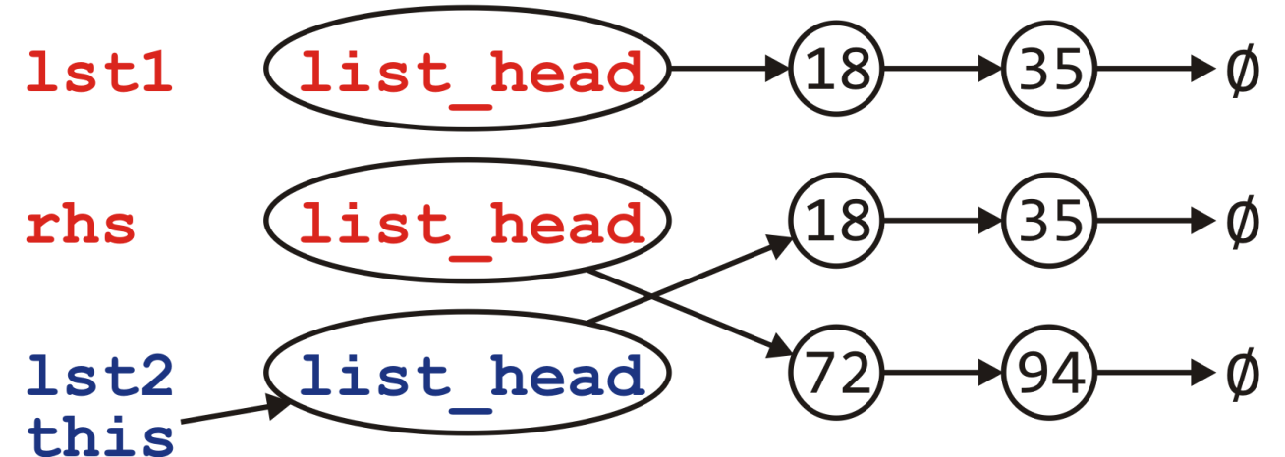
Assignment
Visually, we are doing the following:
Call the copy constructor to create rhs
Swapping the member variables of *this and rhs

Slide 124
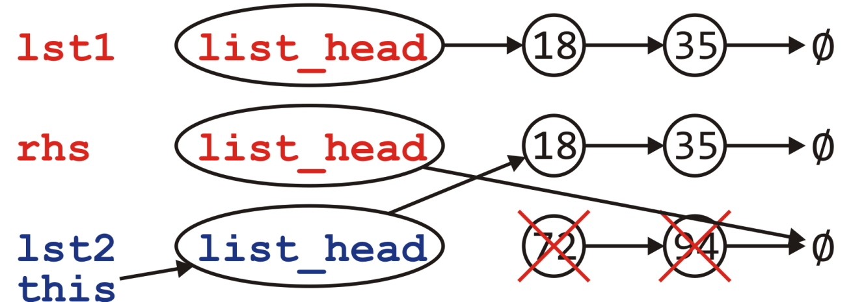
Assignment
Visually, we are doing the following:
Call the copy constructor to create rhs
Swapping the member variables of *this and rhs
The destructor is called on rhs

Slide 125
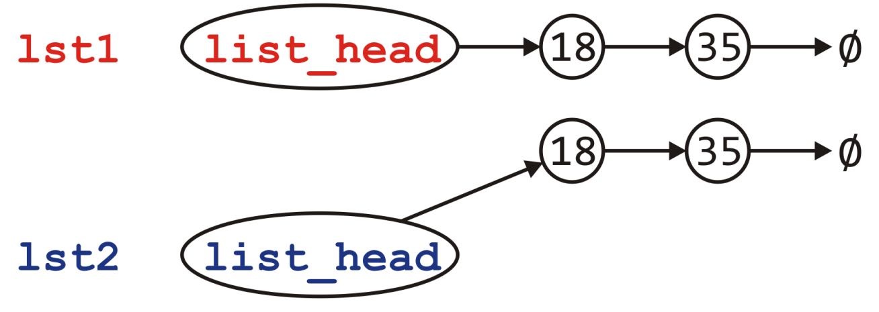
Assignment
Visually, we are doing the following:
Call the copy constructor to create rhs
Swapping the member variables of *this and rhs
The destructor is called on rhs

Slide 126
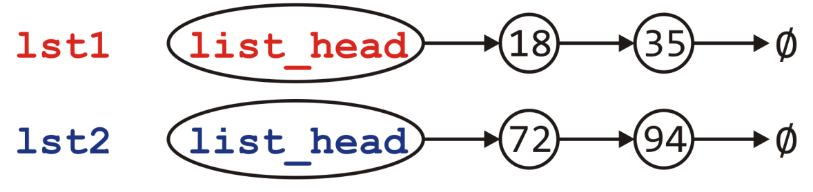
Assignment
Can we do better?
Consider the calls to new and delete
Each of these is very expensive…
Would it not be better to reuse the nodes if possible?
Notes:
Reference: Howard Hinnant

Slide 127

Assignment
Can we do better?
Consider the calls to new and delete
Each of these is very expensive…
Would it not be better to reuse the nodes if possible?
No calls to new or delete
Notes:
Reference: Howard Hinnant

Slide 128
Assignment
What is the plan?
If the right-hand side is empty, it’s straight-forward:
Just empty this list
Otherwise, step through the right-hand side list and for each node there
If there is a corresponding node in this, copy over the value, else
There is no corresponding node; create a new node and append it
If there are any nodes remaining in this, delete them

Slide 129
Assignment
The implementation must be more carefully written
List &List::operator = ( List const &rhs ) {
if ( this == &rhs ) {
return *this;
}
if ( rhs.empty() ) {
while ( !empty() ) {
pop_front();
}
return *this;
}

Slide 130
Assignment
if ( empty() ) {
list_head = new Node( rhs.front() );
} else {
head()->element = rhs.front();
}
Node *this_node = list_head,
*rhs_node = rhs.head()->next();
while ( rhs_node != 0 ) {
if ( this_node->next() == 0 ) {
this_node->next_node = new Node( rhs_node->retrieve() );
this_node = this_node->next();
} else {
this_node->next();
this_node->element = rhs_node->retrive();
}
rhs_node = rhs_node->next();
}

Slide 131
Assignment
while ( this_node->next() != 0 ) {
Node *tmp = this_node->next();
this_node->next_node = this_node->next()->next();
delete tmp;
}
return *this;
}

Slide 132
Move Assignment
Similarly, we need a move assignment:
List &List::operator = ( List &&rhs ) {
while ( !empty() ) {
pop_front();
}
list_head = rhs.head();
rhs.list_head = 0;
return *this;
}

Slide 133
Linked Lists
Thus, the complete class is:
class List {
private:
Node *list_head;
void swap( List & );
public:
// Constructors and destructors
List();
List( List const & );
List( List && );
~List();
// Assignment operators
List &operator = ( List const & );
List &operator = ( List && );
// Accessors
bool empty() const;
int size() const;
int front() const;
Node *head() const;
int count( int ) const;
// Mutators
void push_front( int );
int pop_front();
int erase( int );
};

Slide 134
Linked Lists
With asymptotic analysis of linked lists, we can now make the following statements:
* these become Θ(1) if we have a tail pointer
 | front | arbitrary | back
insert | Θ(1) | O(n) | Θ(n) *
access | Θ(1) | O(n) | Θ(n) *
erase | Θ(1) | O(n) | Θ(n)

Slide 135
Summary
We have considered the implementation of linked lists in C++
Aspects of the Node class
Accessors and mutators
The implementation of various member functions
Stepping through a linked list
Defining the copy and assignment operator
Defining move constructors and move assignment operators
Discussed efficiencies

Slide 136
References
Donald E. Knuth, The Art of Computer Programming, Volume 3: Sorting and Searching, 2nd Ed., Addison Wesley, 1998, §5.4, pp.248-379.
Wikipedia, https://en.wikipedia.org/wiki/Linked_list
http://stackoverflow.com/error?aspxerrorpath=/questions/8848363/rvalue-reference-with-assignement-operator
These slides are provided for the ECE 250 Algorithms and Data Structures course. The material in it reflects Douglas W. Harder’s best judgment in light of the information available to him at the time of preparation. Any reliance on these course slides by any party for any other purpose are the responsibility of such parties. Douglas W. Harder accepts no responsibility for damages, if any, suffered by any party as a result of decisions made or actions based on these course slides for any other purpose than that for which it was intended.

Slide 137

Linked list
 | Front/1st node | k^{th} node | Back/n^{th} node
Find | Θ(1) | Ο(n)* | Θ(1)
Insert Before | Θ(1) | Ο(n)* | Θ(n)
Insert After | Θ(1) | Θ(1)* | Θ(1)
Replace | Θ(1) | Θ(1)* | Θ(1)
Erase | Θ(1) | Ο(n)* | Θ(n)
Next | Θ(1) | Θ(1)* | n/a
Previous | n/a | Ο(n)* | Θ(n)
* These assume we have already accessed the k^{th} entry—an O(n) operation
Assume we have a tail pointer

Slide 138
Linked list
 | Front/1st node | k^{th} node | Back/n^{th} node
Find | Θ(1) | Ο(n)* | Θ(1)
Insert Before | Θ(1) | Θ(1)* | Θ(1)
Insert After | Θ(1) | Θ(1)* | Θ(1)
Replace | Θ(1) | Θ(1)* | Θ(1)
Erase | Θ(1) | Θ(1)* | Θ(n)
Next | Θ(1) | Θ(1)* | n/a
Previous | n/a | Ο(n)* | Θ(n)
By replacing the value in the node in question, we can speed things up
Assume we have a tail pointer

Slide 139
Other operations on linked lists
Other operations on linked lists include:
Allocation and deallocating the memory requires Θ(n) time
Concatenating two linked lists can be done in Θ(1)
This requires a tail pointer

Slide 140
Outline
List ADT
Linked list
Doubly linked list
Node-based storage with arrays
Application

Slide 141

Doubly linked lists
 | Front/1st node | k^{th} node | Back/n^{th} node
Find | Θ(1) | Ο(n)* | Θ(1)
Insert Before | Θ(1) | Θ(1)* | Θ(1)
Insert After | Θ(1) | Θ(1)* | Θ(1)
Replace | Θ(1) | Θ(1)* | Θ(1)
Erase | Θ(1) | Θ(1)* | Θ(1)
Next | Θ(1) | Θ(1)* | n/a
Previous | n/a | Θ(1)* | Θ(1)
* These assume we have already accessed the k^{th} entry—an O(n) operation

Slide 142
Doubly linked lists
Accessing the k^{th} entry is O(n)
 | k^{th} node
Insert Before | Θ(1)
Insert After | Θ(1)
Replace | Θ(1)
Erase | Θ(1)
Next | Θ(1)
Previous | Θ(1)

Slide 143
Data Structures
In general, we will only use these basic data structures if we can restrict ourselves to operations that execute in Θ(1) time, as the only alternative is O(n) or Θ(n)
Interview question: in a singly linked list, can you speed up the two O(n) operations of
Inserting before an arbitrary node?
Erasing any node that is not the last node?
If you can replace the contents of a node, the answer is “yes”
Replace the contents of the current node with the new entry and insert after the current node
Copy the contents of the next node into the current node and erase the next node

Slide 144
Memory usage versus run times
Using a doubly linked list requires Θ(n) additional memory, but it speeds up many operations

Slide 145

Memory usage versus run times
In general, there is an interesting relationship between memory and time efficiency
For a data structure/algorithm:
Improving the run time usually requires more memory
Reducing the required memory usually requires more run time
Notes:
As well as determining run times, we are also interested in memory usage

Slide 146
Memory usage versus run times
Warning: programmers often mistake this to suggest that given any solution to a problem, any solution which may be faster must require more memory
This guideline not true in general: there may be different data structures and/or algorithms which are both faster and require less memory
This requires thought and research

Slide 147
The sizeof Operator
In order to determine memory usage, we must know the memory usage of the various built-in data types and classes
The sizeof operator in C++ returns the number of bytes occupied by a data type
This value is determined at compile time
It is not a function

Slide 148
The sizeof Operator
#include <iostream>
using namespace std;
int main() {
cout << "bool " << sizeof( bool ) << endl;
cout << "char " << sizeof( char ) << endl;
cout << "short " << sizeof( short ) << endl;
cout << "int " << sizeof( int ) << endl;
cout << "char * " << sizeof( char * ) << endl; cout << "int * " << sizeof( int * ) << endl;
cout << "double " << sizeof( double ) << endl;
cout << "int[10] " << sizeof( int[10] ) << endl;
return 0;
}
{eceunix:1} ./a.out # output
bool 1
char 1
short 2
int 4
char * 4
int * 4
double 8
int[10] 40
{eceunix:2}

Slide 149
Standard Template Library
In this course, you must understand each data structure and their associated algorithms
In industry, you will use other implementations of these structures
The C++ Standard Template Library (STL) has an implementation of the vector data structure
Excellent reference:
http://www.cplusplus.com/reference/stl/vector/

Slide 150
Standard Template Library
#include <iostream>
#include <vector>
using namespace std;
int main() {
vector<int> v( 10, 0 );
cout << "Is the vector empty? " << v.empty() << endl;
cout << "Size of vector: " << v.size() << endl;
v[0] = 42;
v[9] = 91;
for ( int k = 0; k < 10; ++k ) {
cout << "v[" << k << "] = " << v[k] << endl;
}
return 0;
}
$ g++ vec.cpp
$ ./a.out
Is the vector empty? 0
Size of vector: 10
v[0] = 42
v[1] = 0
v[2] = 0
v[3] = 0
v[4] = 0
v[5] = 0
v[6] = 0
v[7] = 0
v[8] = 0
v[9] = 91
$

Slide 151
References
[1] Donald E. Knuth, The Art of Computer Programming, Volume 1: Fundamental Algorithms, 3rd Ed., Addison Wesley, 1997, §2.2.1, p.238.
[2] Weiss, Data Structures and Algorithm Analysis in C++, 3rd Ed., Addison Wesley, §3.3.1, p.75.

Slide 152
Outline
List ADT
Linked list
Doubly linked list
Node-based storage with arrays
Application

Slide 153
Outline
In this presentation, we will cover:
The costs of node-based storage
Using an array for node-based storage
Having multiple linked lists within a single structure
Reallocation of memory

Slide 154
The issue
A significant issue with linked lists: node-based data structures require Θ(n) calls to new
Each new operation requires a call to the operating system requesting a memory allocation

Slide 155

Using an array?
Suppose we store this linked list in an array?
list_head = 5;
list_tail = 2;
0 | 1 | 2 | 3 | 4 | 5 | 6 | 7
A |  | E | P |  | S | C
6 |  | -1 | 0 |  | 3 | 2

Slide 156
Using an array?
Rather than using, -1, use a constant assigned that value
This makes reading your code easier
list_head = 5;
list_tail = 2;
0 | 1 | 2 | 3 | 4 | 5 | 6 | 7
A |  | E | P |  | S | C
6 |  | NULLPTR | 0 |  | 3 | 2

Slide 157
A solution
To achieve this, we must create an array of objects that:
Store the value
Store the array index where the next entry is stored
template <typename Type>
class Single_node {
private:
Type element;
int next_node;
public:
Type retrieve() const;
int next() const;
};

Slide 158
A solution
Now, memory allocation is done once in the constructor:
template <typename Type>
class Single_list {
private:
int list_capacity;
int list_head;
int list_tail;
int list_size;
Single_node<Type> *node_pool;
static const int NULL;
public:
Single_list( int = 16 );
// member functions
};
const int Single_list::NULLPTR = -1;
template <typename Type>
Single_list<Type>::Single_list( int n ):
list_capacity( n ),
list_head( NULLPTR ),
list_tail( NULLPTR ),
list_size( 0 ),
node_pool( new Single_node<Type>[n] ) {
// Empty constructor
}

Slide 159
A solution
Problem: when inserting a new element…
how do you know which cell to use?
Solution: keep a container (a stack) of the indices of unused nodes
list_head = 5;
list_tail = 2;
0 | 1 | 2 | 3 | 4 | 5 | 6 | 7
A |  | E | P |  | S | C
6 |  | NULLPTR | 0 |  | 3 | 2
stack_size = 3;
0 | 1 | 2 | 3 | 4 | 5 | 6 | 7
7 | 1 | 4

Slide 160
A solution
The stack would be initialized with all the entries
list_head = NULLPTR;
list_tail = NULLPTR;
0 | 1 | 2 | 3 | 4 | 5 | 6 | 7
stack_size = 8;
0 | 1 | 2 | 3 | 4 | 5 | 6 | 7
0 | 1 | 2 | 3 | 4 | 5 | 6 | 7

Slide 161
A solution
When pushing onto the list, the entry at the top of the stack is used
list_head = NULLPTR;
list_tail = NULLPTR;
0 | 1 | 2 | 3 | 4 | 5 | 6 | 7
stack_size = 8;
0 | 1 | 2 | 3 | 4 | 5 | 6 | 7
0 | 1 | 2 | 3 | 4 | 5 | 6 | 7

Slide 162
A solution
Now, push_front( 'O' ) would result in
list_head = 7;
list_tail = 7;
0 | 1 | 2 | 3 | 4 | 5 | 6 | 7
 |  |  |  |  |  |  | O
 |  |  |  |  |  |  | NULLPTR
stack_size = 7;
0 | 1 | 2 | 3 | 4 | 5 | 6 | 7
0 | 1 | 2 | 3 | 4 | 5 | 6 | 7

Slide 163
A solution
Suppose we call push_front( 'N' )
list_head = 7;
list_tail = 7;
0 | 1 | 2 | 3 | 4 | 5 | 6 | 7
 |  |  |  |  |  |  | O
 |  |  |  |  |  |  | NULLPTR
stack_size = 7;
0 | 1 | 2 | 3 | 4 | 5 | 6 | 7
0 | 1 | 2 | 3 | 4 | 5 | 6 | 7

Slide 164
A solution
Suppose we call push_front( 'N' )
The next node is at index 6
list_head = 6;
list_tail = 7;
0 | 1 | 2 | 3 | 4 | 5 | 6 | 7
 |  |  |  |  |  | N | O
 |  |  |  |  |  | 7 | NULLPTR
stack_size = 6;
0 | 1 | 2 | 3 | 4 | 5 | 6 | 7
0 | 1 | 2 | 3 | 4 | 5 | 6 | 7

Slide 165
A solution
Suppose we call push_back( 'R' )
list_head = 6;
list_tail = 7;
0 | 1 | 2 | 3 | 4 | 5 | 6 | 7
 |  |  |  |  |  | N | O
 |  |  |  |  |  | 7 | NULLPTR
stack_size = 6;
0 | 1 | 2 | 3 | 4 | 5 | 6 | 7
0 | 1 | 2 | 3 | 4 | 5 | 6 | 7

Slide 166
A solution
Suppose we call push_back( 'R' )
The next node is at index 5
list_head = 6;
list_tail = 5;
0 | 1 | 2 | 3 | 4 | 5 | 6 | 7
 |  |  |  |  | R | N | O
 |  |  |  |  | NULLPTR | 7 | 5
stack_size = 5;
0 | 1 | 2 | 3 | 4 | 5 | 6 | 7
0 | 1 | 2 | 3 | 4 | 5 | 6 | 7

Slide 167
A solution
Finally, suppose we call pop_front()
list_head = 6;
list_tail = 5;
0 | 1 | 2 | 3 | 4 | 5 | 6 | 7
 |  |  |  |  | R | N | O
 |  |  |  |  | NULLPTR | 7 | 5
stack_size = 5;
0 | 1 | 2 | 3 | 4 | 5 | 6 | 7
0 | 1 | 2 | 3 | 4 | 5 | 6 | 7

Slide 168
A solution
Finally, suppose we call pop_front()
The popped node is placed back into the stack
list_head = 7;
list_tail = 5;
0 | 1 | 2 | 3 | 4 | 5 | 6 | 7
 |  |  |  |  | R | N | O
 |  |  |  |  | NULLPTR | 7 | 5
stack_size = 6;
0 | 1 | 2 | 3 | 4 | 5 | 6 | 7
0 | 1 | 2 | 3 | 4 | 6 | 6 | 7

Slide 169
A better solution
Problem:
Our solution requires Θ(N) additional memory
In our initial example, the unused nodes are 1, 4 and 7
How about using these to define a second stack-as-linked-list?
list_head = 5;
list_tail = 2;
0 | 1 | 2 | 3 | 4 | 5 | 6 | 7
A |  | E | P |  | S | C
6 |  | NULLPTR | 0 |  | 3 | 2

Slide 170
A better solution
Problem:
Our solution requires Θ(N) additional memory
In our initial example, the unused nodes are 1, 4 and 7
How about using these to define a second stack-as-linked-list?
We only need a head pointer for the stack-as-linked-list
list_head = 5;
list_tail = 2;
stack_top = 1;
0 | 1 | 2 | 3 | 4 | 5 | 6 | 7
A |  | E | P |  | S | C
6 | 4 | NULLPTR | 0 | 7 | 3 | 2 | NULLPTR

Slide 171
A better solution
Suppose we call pop_front()
list_head = 5;
list_tail = 2;
stack_top = 1;
0 | 1 | 2 | 3 | 4 | 5 | 6 | 7
A |  | E | P |  | S | C
6 | 4 | NULLPTR | 0 | 7 | 3 | 2 | NULLPTR

Slide 172
A better solution
Suppose we call pop_front()
The extra node is placed onto the stack
list_head = 3;
list_tail = 2;
stack_top = 5;
0 | 1 | 2 | 3 | 4 | 5 | 6 | 7
A |  | E | P |  | S | C
6 | 4 | NULLPTR | 0 | 7 | 1 | 2 | NULLPTR

Slide 173
A better solution
Suppose we now call push_back( 'D' )
list_head = 3;
list_tail = 2;
stack_top = 5;
0 | 1 | 2 | 3 | 4 | 5 | 6 | 7
A |  | E | P |  | S | C
6 | 4 | NULLPTR | 0 | 7 | 1 | 2 | NULLPTR

Slide 174
A better solution
Suppose we now call push_back( 'D' )
We pop the node off of the top of the stack
list_head = 3;
list_tail = 5;
stack_top = 1;
0 | 1 | 2 | 3 | 4 | 5 | 6 | 7
A |  | E | P |  | D | C
6 | 4 | 5 | 0 | 7 | NULLPTR | 2 | NULLPTR

Slide 175
A better solution
Suppose we finally call pop_front() again
list_head = 3;
list_tail = 5;
stack_top = 1;
0 | 1 | 2 | 3 | 4 | 5 | 6 | 7
A |  | E | P |  | D | C
6 | 4 | 5 | 0 | 7 | NULLPTR | 2 | NULLPTR

Slide 176
A better solution
Suppose we finally call pop_front() again
The node containing 'P' is pushed back onto the stack
list_head = 0;
list_tail = 5;
stack_top = 3;
0 | 1 | 2 | 3 | 4 | 5 | 6 | 7
A |  | E | P |  | D | C
6 | 4 | 5 | 1 | 7 | NULLPTR | 2 | NULLPTR

Slide 177
A better solution
In this case, our data structure would be initialized to:
list_head = NULLPTR;
list_tail = NULLPTR;
stack_top = 0;
0 | 1 | 2 | 3 | 4 | 5 | 6 | 7
1 | 2 | 3 | 4 | 5 | 6 | 7 | NULLPTR

Slide 178
A solution
Our class would look something like:
template <typename Type>
class Single_list {
private:
int list_head;
int list_tail;
int list_size;
int list_capacity;
Single_node<Type> *node_pool;
int stack_top;
static const int NULL;
public:
Single_list( int = 16 );
// member functions
};
const int Single_list::NULLPTR = -1;
template <typename Type>
Single_list<Type>::Single_list( int n ):
list_head( NULLPTR ),
list_tail( NULLPTR ),
list_size( 0 ),
list_capacity( n ),
node_pool( new Single_node<Type>[n] ),
stack_top( 0 ) {
for ( int i = 1; i < n; ++i ) {
node_pool[i - 1].next = i;
}
node_pool[n - 1] = NULLPTR;
}

Slide 179
Analysis
This solution:
Requires only three more member variable than our linked list class
It still requires O(N) additional memory over an array
All the run-times are identical to that of a linked list
Only one call to new, as opposed to Θ(n)
There is a potential for up to O(N) wasted memory
Question: What happens if we run out of memory?

Slide 180
Reallocation of memory
Suppose we start with a capacity N but after a while, all the entries have been allocated
We can double the size of the array and copy the entries over
list_head = 6;
list_tail = 4;
list_size = 8;
list_capacity = 8;
stack_top = NULLPTR;
0 | 1 | 2 | 3 | 4 | 5 | 6 | 7
C | R | U | T | R | U | S | T
7 | 2 | 0 | 1 | NULLPTR | 4 | 3 | 5

Slide 181
Reallocation of memory
Suppose we start with a capacity N but after a while, all the entries have been allocated
We can double the size of the array and copy the entries over
Only the stack needs to be updated and the old array deleted
list_head = 6;
list_tail = 4;
list_size = 8;
list_capacity = 16;
stack_top = 8;
0 | 1 | 2 | 3 | 4 | 5 | 6 | 7
C | R | U | T | R | U | S | T
7 | 2 | 0 | 1 | NULLPTR | 4 | 3 | 5
0 | 1 | 2 | 3 | 4 | 5 | 6 | 7 | 8 | 9 | 10 | 11 | 12 | 13 | 14 | 15
C | R | U | T | R | U | S | T
7 | 2 | 0 | 1 | NULLPTR | 4 | 3 | 5 | 9 | 10 | 11 | 12 | 13 | 14 | 15 | NULLPTR

Slide 182
Reallocation of memory
Now push_back( 'E' ) would use the next location
list_head = 6;
list_tail = 4;
list_size = 8;
list_capacity = 16;
stack_top = 8;
0 | 1 | 2 | 3 | 4 | 5 | 6 | 7 | 8 | 9 | 10 | 11 | 12 | 13 | 14 | 15
C | R | U | T | R | U | S | T
7 | 2 | 0 | 1 | NULLPTR | 4 | 3 | 5 | 9 | 10 | 11 | 12 | 13 | 14 | 15 | NULLPTR

Slide 183
Reallocation of memory
Now push_back( 'E' ) would use the next location
list_head = 6;
list_tail = 8;
list_size = 9;
list_capacity = 16;
stack_top = 9;
0 | 1 | 2 | 3 | 4 | 5 | 6 | 7 | 8 | 9 | 10 | 11 | 12 | 13 | 14 | 15
C | R | U | T | R | U | S | T | E
7 | 2 | 0 | 1 | 8 | 4 | 3 | 5 | NULLPTR | 10 | 11 | 12 | 13 | 14 | 15 | NULLPTR

Slide 184
Reallocation of memory
If at some point, we decide it is desirable to reduce the memory allocated, it might be easier to just insert the entries into a newer and smaller table
list_head = 4;
list_tail = 5;
list_size = 4;
list_capacity = 16;
stack_top = 7;
0 | 1 | 2 | 3 | 4 | 5 | 6 | 7 | 8 | 9 | 10 | 11 | 12 | 13 | 14 | 15
 |  | T |  | D | A |  |  |  |  | A
14 | 9 | 5 | 0 | 10 | NULLPTR | 8 | 12 | NULLPTR | 3 | 2 | 13 | 1 | 15 | 11 | 6

Slide 185
Reallocation of memory
If at some point, we decide it is desirable to reduce the memory allocated, it might be easier to just insert the entries into a newer and smaller table
list_head = 4;
list_tail = 5;
list_size = 4;
list_capacity = 16;
stack_top = 7;
0 | 1 | 2 | 3 | 4 | 5 | 6 | 7 | 8 | 9 | 10 | 11 | 12 | 13 | 14 | 15
 |  | T |  | D | A |  |  |  |  | A
14 | 9 | 5 | 0 | 10 | NULLPTR | 8 | 12 | NULLPTR | 3 | 2 | 13 | 1 | 15 | 11 | 6
0 | 1 | 2 | 3 | 4 | 5 | 6 | 7
D | A | T | A
1 | 2 | 3 | NULLPTR | 5 | 6 | 7 | NULLPTR

Slide 186
Reallocation of memory
If at some point, we decide it is desirable to reduce the memory allocated, it might be easier to just insert the entries into a newer, and smaller table
Now, delete the old array and update the member variables
list_head = 0;
list_tail = 3;
list_size = 4;
list_capacity = 8;
stack_top = 4;
0 | 1 | 2 | 3 | 4 | 5 | 6 | 7
D | A | T | A
1 | 2 | 3 | NULLPTR | 5 | 6 | 7 | NULLPTR

Slide 187
Summary
In this presentation, we covered
Dealing with node-based allocation with arrays
Internally, it is still a linked list, only the nodes are contiguous in memory
It is no longer necessary to call the operating system for each new node
Doubling the memory used is straight-forward
To halve the memory used, we just follow the linked list
All of this will transfer seamlessly

Slide 188
References
Wikipedia, http://en.wikipedia.org/wiki/Search_algorithm
These slides are provided for the ECE 250 Algorithms and Data Structures course. The material in it reflects Douglas W. Harder’s best judgment in light of the information available to him at the time of preparation. Any reliance on these course slides by any party for any other purpose are the responsibility of such parties. Douglas W. Harder accepts no responsibility for damages, if any, suffered by any party as a result of decisions made or actions based on these course slides for any other purpose than that for which it was intended.

Slide 189
Outline
List ADT
Linked list
Doubly linked list
Node-based storage with arrays
Application

Slide 190
Polynomial
Possible linked list implementation
A_{i} is the coefficient of the x^{i-1} term
5 + 2x + 3x²
( 5 2 3 )
7 + 8x
( 7 8 )
3 + x²
( 3 0 2 )
Problem?

Slide 191
4 + 3x²⁰⁰¹
( 4 0 0 0 0 0 0 0 0 0 0 0 0 0 0 0 0 0 0 0 0 0 0 0 0 0 0 0 0 0 0 0 0 0 0 0 0 0 0 0 0 0 0 0 0 0 0 0 0 0 0 0 0 0 0 0 0 0 0 0 0 0 0 0 0 0 0 0 0 0 0 0 0 0 0 0 0 0 0 0 0 0 0 0 0 0 0 0 0 0 0 0 0 0 0 0 0 0 0 0 0 0 0 0 0 0 0 0 0 0 0 0 0 0 0 0 0 0 0 0 0 0 0 0 0 0 0 0 0 0 0 0 0 0 0 0 0 0 0 0 0 0 0 0 0 0 0 0 0 0 0 0 0 0 0 0 0 0 0 0 0 0 0 0 0 0 0 0 0 0 0 0 0 0 0 0 0 0 0 0 0 0 0 0 0 0 0 0 0 0 0 0 0 0 0 0 0 0 0 0 0 0 0 0 0 0 0 0 0 0 0 0 0 0 0 0 0 0 0 0 0 0 0 0 0 0 0 0 0 0 0 0 0 0 0 0 0 0 0 0 0 0 0 0 0 0 0 0 0 0 0 0 0 0 0 0 0 0 0 0 0 0 0 0 0 0 0 0 0 0 0 0 0 0 0 0 0 0 0 0 0 0 0 0 0 0 0 0 0 0 0 0 0 0 0 0 0 0 0 0 0 0 0 0 0 0 0 0 0 0 0 0 0 0 0 0 0 0 0 0 0 0 0 0 0 0 0 0 0 0 0 0 0 0 0 0 0 0 0 0 0 0 0 0 0 0 0 0 0 0 0 0 0 0 0 0 0 0 0 0 0 0 0 0 0 0 0 0 0 0 0 0 0 0 0 0 0 0 0 0 0 0 0 0 0 0 0 0 0 0 0 0 0 0 0 0 0 0 0 0 0 0 0 0 0 0 0 0 0 0 0 0 0 0 0 0 0 0 0 0 0 0 0 0 0 0 0 0 0 0 0 0 0 0 0 0 0 0 0 0 0 0 0 0 0 0 0 0 0 0 0 0 0 0 0 0 0 0 0 0 0 0 0 0 0 0 0 0 0 0 0 0 0 0 0 0 0 0 0 0 0 0 0 0 0 0 0 0 0 0 0 0 0 0 0 0 0 0 0 0 0 0 0 0 0 0 0 0 0 0 0 0 0 0 0 0 0 0 0 0 0 0 0 0 0 0 0 0 0 0 0 0 0 0 0 0 0 0 0 0 0 0 0 0 0 0 0 0 0 0 0 0 0 0 0 0 0 0 0 0 0 0 0 0 0 0 0 0 0 0 0 0 0 0 0 0 0 0 0 0 0 0 0 0 0 0 0 0 0 0 0 0 0 0 0 0 0 0 0 0 0 0 0 0 0 0 0 0 0 0 0 0 0 0 0 0 0 0 0 0 0 0 0 0 0 0 0 0 0 0 0 0 0 0 0 0 0 0 0 0 0 0 0 0 0 0 0 0 0 0 0 0 0 0 0 0 0 0 0 0 0 0 0 0 0 0 0 0 0 0 0 0 0 0 0 0 0 0 0 0 0 0 0 0 0 0 0 0 0 0 0 0 0 0 0 0 0 0 0 0 0 0 0 0 0 0 0 0 0 0 0 0 0 0 0 0 0 0 0 0 0 0 0 0 0 0 0 0 0 0 0 0 0 0 0 0 0 0 0 0 0 0 0 0 0 0 0 0 0 0 0 0 0 0 0 0 0 0 0 0 0 0 0 0 0 0 0 0 0 0 0 0 0 0 0 0 0 0 0 0 0 0 0 0 0 0 0 0 0 0 0 0 0 0 0 0 0 0 0 0 0 0 0 0 0 0 0 0 0 0 0 0 0 0 0 0 0 0 0 0 0 0 0 0 0 0 0 0 0 0 0 0 0 0 0 0 0 0 0 0 0 0 0 0 0 0 0 0 0 0 0 0 0 0 0 0 0 0 0 0 0 0 0 0 0 0 0 0 0 0 0 0 0 0 0 0 0 0 0 0 0 0 0 0 0 0 0 0 0 0 0 0 0 0 0 0 0 0 0 0 0 0 0 0 0 0 0 0 0 0 0 0 0 0 0 0 0 0 0 0 0 0 0 0 0 0 0 0 0 0 0 0 0 0 0 0 0 0 0 0 0 0 0 0 0 0 0 0 0 0 0 0 0 0 0 0 0 0 0 0 0 0 0 0 0 0 0 0 0 0 0 0 0 0 0 0 0 0 0 0 0 0 0 0 0 0 0 0 0 0 0 0 0 0 0 0 0 0 0 0 0 0 0 0 0 0 0 0 0 0 0 0 0 0 0 0 0 0 0 0 0 0 0 0 0 0 0 0 0 0 0 0 0 0 0 0 0 0 0 0 0 0 0 0 0 0 0 0 0 0 0 0 0 0 0 0 0 0 0 0 0 0 0 0 0 0 0 0 0 0 0 0 0 0 0 0 0 0 0 0 0 0 0 0 0 0 0 0 0 0 0 0 0 0 0 0 0 0 0 0 0 0 0 0 0 0 0 0 0 0 0 0 0 0 0 0 0 0 0 0 0 0 0 0 0 0 0 0 0 0 0 0 0 0 0 0 0 0 0 0 0 0 0 0 0 0 0 0 0 0 0 0 0 0 0 0 0 0 0 0 0 0 0 0 0 0 0 0 0 0 0 0 0 0 0 0 0 0 0 0 0 0 0 0 0 0 0 0 0 0 0 0 0 0 0 0 0 0 0 0 0 0 0 0 0 0 0 0 0 0 0 0 0 0 0 0 0 0 0 0 0 0 0 0 0 0 0 0 0 0 0 0 0 0 0 0 0 0 0 0 0 0 0 0 0 0 0 0 0 0 0 0 0 0 0 0 0 0 0 0 0 0 0 0 0 0 0 0 0 0 0 0 0 0 0 0 0 0 0 0 0 0 0 0 0 0 0 0 0 0 0 0 0 0 0 0 0 0 0 0 0 0 0 0 0 0 0 0 0 0 0 0 0 0 0 0 0 0 0 0 0 0 0 0 0 0 0 0 0 0 0 0 0 0 0 0 0 0 0 0 0 0 0 0 0 0 0 0 0 0 0 0 0 0 0 0 0 0 0 0 0 0 0 0 0 0 0 0 0 0 0 0 0 0 0 0 0 0 0 0 0 0 0 0 0 0 0 0 0 0 0 0 0 0 0 0 0 0 0 0 0 0 0 0 0 0 0 0 0 0 0 0 0 0 0 0 0 0 0 0 0 0 0 0 0 0 0 0 0 0 0 0 0 0 0 0 0 0 0 0 0 0 0 0 0 0 0 0 0 0 0 0 0 0 0 0 0 0 0 0 0 0 0 0 0 0 0 0 0 0 0 0 0 0 0 0 0 0 0 0 0 0 0 0 0 0 0 0 0 0 0 0 0 0 0 0 0 0 0 0 0 0 0 0 0 0 0 0 0 0 0 0 0 0 0 0 0 0 0 0 0 0 0 0 0 0 0 0 0 0 0 0 0 0 0 0 0 0 0 0 0 0 0 0 0 0 0 0 0 0 0 0 0 0 0 0 0 0 0 0 0 0 0 0 0 0 0 0 0 0 0 0 0 0 0 0 0 0 0 0 0 0 0 0 0 0 0 0 0 0 0 0 0 0 0 0 0 0 0 0 0 0 0 0 0 0 0 0 0 0 0 0 0 0 0 0 0 0 0 0 0 0 0 0 0 0 0 0 0 0 0 0 0 0 0 0 0 0 0 0 0 0 0 0 0 0 0 0 0 0 0 0 0 0 0 0 0 0 0 0 0 0 0 0 0 0 0 0 0 0 0 0 0 0 0 0 0 0 0 0 0 0 0 0 0 0 0 0 0 0 0 0 0 0 0 0 0 0 0 0 0 0 0 0 0 0 0 0 0 0 0 0 0 0 0 0 0 0 0 0 0 0 0 0 0 0 0 0 0 0 0 0 0 0 0 0 0 0 0 0 0 0 0 0 0 0 0 0 0 0 0 0 0 0 0 0 0 0 0 0 0 0 0 0 0 0 0 0 0 0 0 0 0 0 0 0 0 0 0 0 0 0 0 0 0 0 0 0 0 0 0 0 0 0 0 0 0 0 0 0 0 0 0 0 0 0 0 0 0 0 0 0 0 0 0 0 0 0 0 0 0 0 0 0 0 0 0 0 0 0 0 0 0 0 0 0 0 0 0 0 0 0 0 0 0 0 0 0 0 0 0 0 0 0 0 0 0 0 0 0 0 0 0 0 0 0 0 0 0 0 0 0 0 0 0 0 0 0 0 0 0 0 0 0 0 0 0 0 0 0 0 0 0 0 0 0 0 0 0 0 0 0 0 0 0 0 0 0 0 0 0 0 0 0 0 0 0 0 0 0 0 0 0 0 0 0 0 0 0 0 0 0 0 0 0 0 0 0 0 0 0 0 0 0 0 0 0 0 0 0 0 0 0 0 0 0 0 0 0 0 0 0 0 0 0 0 0 0 0 0 0 0 0 0 0 0 0 0 0 0 0 0 0 0 0 0 0 0 0 0 0 0 0 0 0 0 0 0 0 0 0 0 0 0 0 0 0 0 0 0 0 0 0 0 0 0 0 0 0 0 0 0 0 0 0 3 )

Slide 192
Sparse Vector Data Structure:
4 + 3x²⁰⁰¹
(<4 0> <2001 3>)
4
0
3
2001

Slide 193
Addition of Two Polynomials?
15+10x⁵⁰+3x¹⁰⁰
p
15
0
10
50
3
100
5+30x⁶⁰+4x¹⁰⁰
q
5
0
30
60
4
100

Slide 194
Addition of Two Polynomials
15+10x⁵⁰+3x¹⁰⁰
p
15
0
10
50
3
100
5+30x⁶⁰+4x¹⁰⁰
q
5
0
30
60
4
100
r
20
0

Slide 195
Addition of Two Polynomials
15+10x⁵⁰+3x¹⁰⁰
p
15
0
10
50
3
100
5+30x⁶⁰+4x¹⁰⁰
q
5
0
30
60
4
100
r
20
0
10
50

Slide 196
Addition of Two Polynomials
15+10x⁵⁰+3x¹⁰⁰
p
15
0
10
50
3
100
5+30x⁶⁰+4x¹⁰⁰
q
5
0
30
60
4
100
r
20
0
10
50
30
60

Slide 197

Addition of Two Polynomials
One pass down each list: $Θ(n+m)$
15+10x⁵⁰+3x¹⁰⁰
p
15
0
10
50
3
100
5+30x⁶⁰+4x¹⁰⁰
q
5
0
30
60
4
100
r
20
0
10
50
30
60
7
100

Slide 198
Sparse Matrices
m
1
1
18
3
33
4
4
99
6
6
27

Slide 199
Summary
List ADT
A sequence of elements (special case: string)
Array
Linked list
Accessors and mutators
Stepping through a linked list
Copy and assignment operator
Doubly linked list
Memory usage versus run times
Node-based storage with arrays
No longer need to call new for each new node
Application
Polynomial, sparse matrix

Slide 200
Efficient Allocation
In all our examples, we use new and delete to allocate and deallocate nodes
This is exceptionally inefficient
It requires the operating system to allocate and deallocate memory with each node
Could we pre-allocate memory for a number of nodes and use them?
Suggestions?

Slide 201
Efficient Allocation
Consider the following strategy:
Allocate an array of N nodes
The address of the node is the index in the array
Therefore, next_node is an integer
Each time we require a new node, use one of these
If all the nodes in the block are used, we double the size of the array of the allocated nodes and move the objects over
To track which nodes are being used, we could use a stack
Initially, the stack would contain the values from 0 to N – 1
If we need an unused entry in the array, pop the next index from the top of the stack
If we no longer are using a node, push its index onto the stack

Slide 202

Efficient Allocation
We would use -1 to represent the end of the list
More intelligently, we would define a constant:
int const NULL = -1;

Slide 203

Efficient Allocation
After a few calls to push_front and erase, we could end up with an allocation as follows:

Slide 204
Efficient Allocation
If we wanted to call pop_front, we would:
Push 4 onto the stack
Updated list_head to be 7

Slide 205

Efficient Allocation
If we wanted to call pop_front, we would:
Push 4 onto the stack
Updated list_head to be 7
The result:

Slide 206
Efficient Allocation
If we wanted to push 99 onto the front of this list, we would:
Get to top of the stack, 6
At this location, place 99 and the current value of list_head
Update list_head = 6

Slide 207

Efficient Allocation
This results in:

Slide 208
Efficient Allocation
Originally, we would require n calls to new() to insert n objects into the linked list
This updated allocation strategy requires lg(n) calls to new and n copies

