Slide 1
CS101 Data Structures
Stack
Textbook Ch 10.1
Notes:
Adapted from the slides by Douglas Wilhelm Harder of U Waterloo (https://ece.uwaterloo.ca/~dwharder/aads/Lecture_materials/)
May also contain material from the slides at https://courses.cs.washington.edu/courses/cse326/03wi/326lecturesb.shtml (by Dan Suciu of U Washington)

Slide 2
Outline
Stack ADT
Implementation
Example applications

Slide 3
Stack ADT
Uses an explicit linear ordering
Two principal operations
Push: insert an object onto the top of the stack
Pop: erase the object on the top of the stack

Slide 4
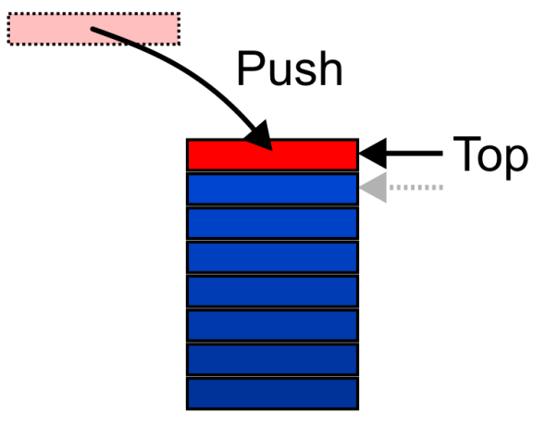
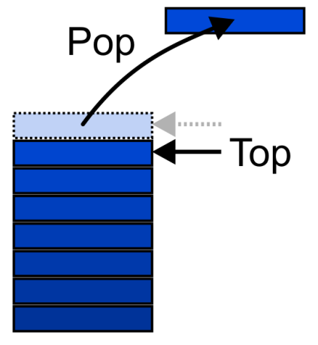
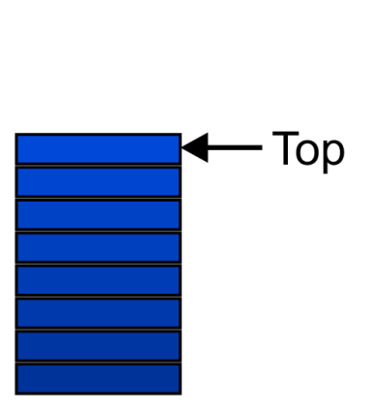
Stack ADT
Also called a last-in–first-out (LIFO) behaviour
Graphically, we may view these operations as follows:
Notes:
There are two exceptions associated with abstract stacks:
It is an undefined operation to call either pop or top on an empty stack

Slide 5
Applications
Numerous applications:
Parsing code:
Matching parenthesis
XML (e.g., XHTML)
Tracking function calls
Dealing with undo/redo operations
Reverse-Polish calculators
Assembly language

Slide 6
Applications
Problem solving:
Solving one problem may lead to subsequent problems
These problems may result in further problems
As problems are solved, your focus shifts back to the problem which lead to the solved problem
Notice that function calls behave similarly:
A function is a collection of code which solves a problem

Slide 7
Outline
Stack ADT
Implementation
Example applications

Slide 8
Implementations
We will look at two implementations of stacks:
Singly linked lists
One-ended arrays
The optimal asymptotic run time of any algorithm is Θ(1)
The run time of the algorithm is independent of the number of objects being stored in the container

Slide 9
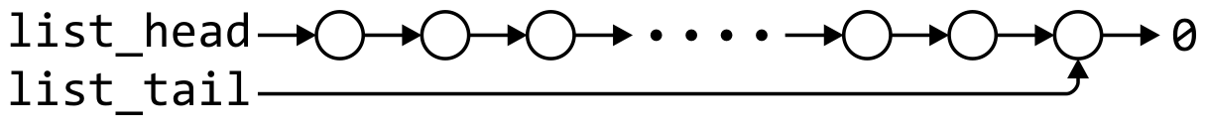
Linked-List Implementation
Operations at the front of a singly linked list are all Θ(1)
The desired behaviour of an Abstract Stack may be reproduced by performing all operations at the front
 | Front/1st | Back/n^{th}
Find | Θ(1) | Θ(1)
Insert | Θ(1) | Θ(1)
Erase | Θ(1) | Θ(n)

Slide 10
Single_list Definition
The definition of single list class:
template <typename Type>
class Single_list {
public:
Single_list();
~Single_list();
int size() const;
bool empty() const;
Type front() const;
Type back() const;
Single_node<Type> *head() const;
Single_node<Type> *tail() const;
int count( Type const & ) const;
void push_front( Type const & );
void push_back( Type const & );
Type pop_front();
int erase( Type const & );
};

Slide 11
Stack-as-List Class
The stack class using a singly linked list has a single private member variable:
template <typename Type>
class Stack {
private:
Single_list<Type> list;
public:
bool empty() const;
Type top() const;
void push( Type const & );
Type pop();
};

Slide 12
Stack-as-List Class
The empty and push functions just call the appropriate functions of the Single_list class
template <typename Type>
bool Stack<Type>::empty() const {
return list.empty();
}
template <typename Type>
void Stack<Type>::push( Type const &obj ) {
list.push_front( obj );
}
Notes:
12

Slide 13
Stack-as-List Class
The top and pop functions, however, must check the boundary case:
template <typename Type>
Type Stack<Type>::top() const {
if ( empty() ) {
throw underflow();
}
return list.front();
}
template <typename Type>
Type Stack<Type>::pop() {
if ( empty() ) {
throw underflow();
}
return list.pop_front();
}

Slide 14
Stack-as-List Class
A constructor and destructor is not needed
Because list is declared, the compiler will call the constructor of the Single_list class when the Stack is constructed
Notes:
14

Slide 15

Array Implementation
For one-ended arrays, all operations at the back are Θ(1)
 | Front/1st | Back/n^{th}
Find | Θ(1) | Θ(1)
Insert | Θ(n) | Θ(1)
Erase | Θ(n) | Θ(1)

Slide 16
Stack-as-Array Class
template <typename Type>
class Stack {
private:
int stack_size; //number of objects in the stack
int array_capacity; //capacity of the array
Type *array;
public:
Stack( int = 10 );
~Stack();
bool empty() const;
Type top() const;
void push( Type const & );
Type pop();
};

Slide 17
Constructor
The class is only storing the address of the array
We must allocate memory for the array and initialize the member variables
#include <algorithm>
// ...
template <typename Type>
Stack<Type>::Stack( int n ):
stack_size( 0 ),
array_capacity( std::max( 1, n ) ),
array( new Type[array_capacity] ) {
// Empty constructor
}

Slide 18
Constructor
template <typename Type>
class Stack {
private:
int stack_size;
int array_capacity;
Type *array;
public:
Stack( int = 10 );
~Stack();
bool empty() const;
Type top() const;
void push( Type const & );
Type pop();
};
template <typename Type>
Stack<Type>::Stack( int n ):
stack_size( 0 ),
array_capacity( std::max( 1, n ) ),
array( new Type[array_capacity] ) {
// Empty constructor
}
Warning: in C++, the variables are initialized in the order in which they are defined:
Notes:
18

Slide 19
Destructor
The destructor must release the memory for the array
template <typename Type>
Stack<Type>::~Stack() {
delete [] array;
}

Slide 20
Empty
The stack is empty if the stack size is zero:
template <typename Type>
bool Stack<Type>::empty() const {
return ( stack_size == 0 );
}

Slide 21
Top
If there are n objects in the stack, the last is located at index n – 1
template <typename Type>
Type Stack<Type>::top() const {
if ( empty() ) {
throw underflow();
}
return array[stack_size - 1];
}
Notes:
21

Slide 22
Pop
Removing an object simply involves reducing the size
By decreasing the size, the previous top of the stack is now at the location stack_size
template <typename Type>
Type Stack<Type>::pop() {
if ( empty() ) {
throw underflow();
}
--stack_size;
return array[stack_size];
}
Notes:
22

Slide 23
Push
Pushing an object onto the stack can only be performed if the array is not full
template <typename Type>
void Stack<Type>::push( Type const &obj ) {
if ( stack_size == array_capacity ) {
throw overflow();
}
array[stack_size] = obj;
++stack_size;
}
Best solution?????

Slide 24
Exceptions
The case where the array is full is not an exception defined in the Abstract Stack
If the array is filled, we have five options:
Increase the size of the array
Throw an exception
Ignore the element being pushed
Replace the current top of the stack
Put the pushing process to “sleep” until something else removes the top of the stack
Include a member function bool full() const;

Slide 25
Array Capacity
The best option is to increase the array capacity
If we increase the array capacity, the question is:
How much?
By a constant? array_capacity += c;
By a multiple? array_capacity *= c;

Slide 26
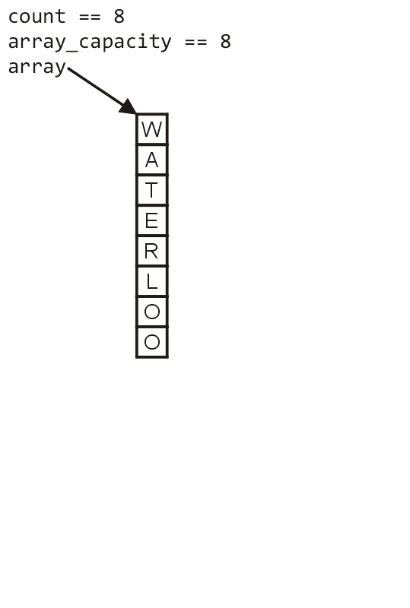
Array Capacity
First, let us visualize what must occur to allocate new memory

Slide 27
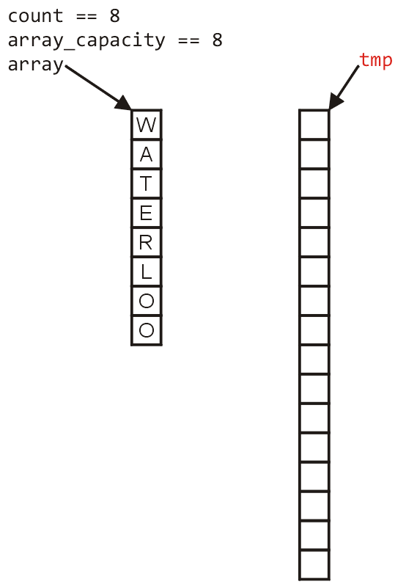
Array Capacity
First, this requires a call to new Type[N] where N is the new capacity
We must have access to this so we must store the address returned by new in a local variable, say tmp

Slide 28
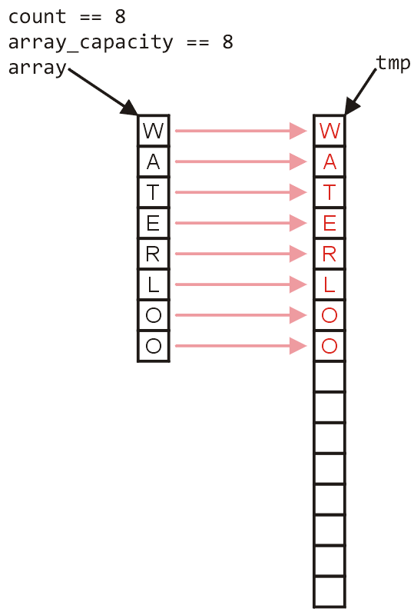
Array Capacity
Next, the values must be copied over

Slide 29
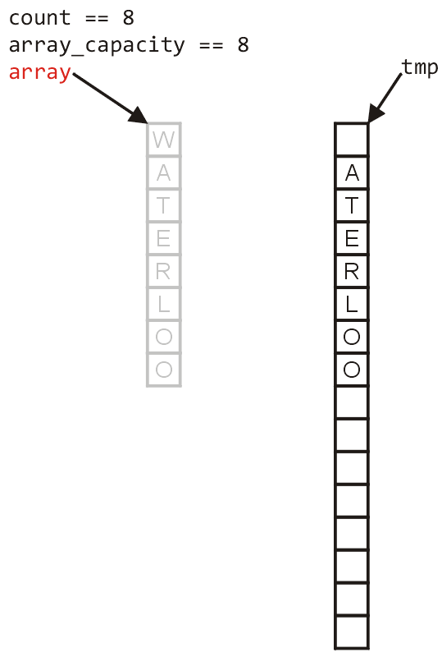
Array Capacity
W
The memory for the original array must be deallocated

Slide 30
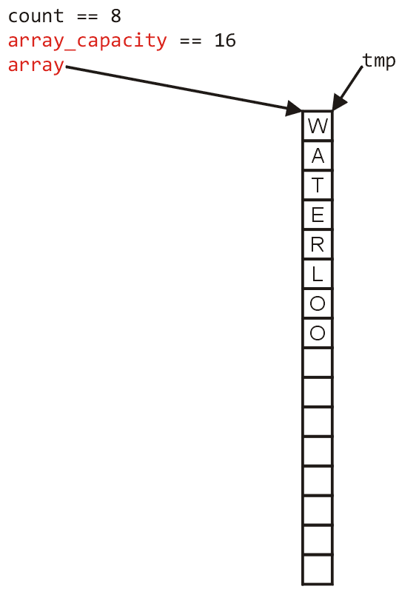
Array Capacity
Finally, the appropriate member variables must be reassigned

Slide 31
Array Capacity
The implementation:
void double_capacity() {
}

Slide 32
Array Capacity
tmp_array
The implementation:
void double_capacity() {
Type *tmp_array = new Type[2*array_capacity];
}

Slide 33
Array Capacity
tmp_array
The implementation:
void double_capacity() {
Type *tmp_array = new Type[2*array_capacity];
for ( int i = 0; i < array_capacity; ++i ) {
tmp_array[i] = array[i];
}
}

Slide 34
Array Capacity
tmp_array
W
The implementation:
void double_capacity() {
Type *tmp_array = new Type[2*array_capacity];
for ( int i = 0; i < array_capacity; ++i ) {
tmp_array[i] = array[i];
}
delete [] array;
}

Slide 35
Array Capacity
tmp_array
The implementation:
void double_capacity() {
Type *tmp_array = new Type[2*array_capacity];
for ( int i = 0; i < array_capacity; ++i ) {
tmp_array[i] = array[i];
}
delete [] array;
array = tmp_array;
}

Slide 36
Array Capacity
tmp_array
The implementation:
void double_capacity() {
Type *tmp_array = new Type[2*array_capacity];
for ( int i = 0; i < array_capacity; ++i ) {
tmp_array[i] = array[i];
}
delete [] array;
array = tmp_array;
array_capacity *= 2;
}

Slide 37
Array Capacity
Back to the original question:
How much do we change the capacity?
Add a constant?
Multiply by a constant?
First, we recognize that any time that we push onto a full stack, this requires n copies and the run time is Θ(n)
Therefore, push is usually Θ(1) except when new memory is required

Slide 38
Array Capacity
To state the average run time, we will introduce the concept of amortized time:
If n operations requires Θ(f(n)), we will say that an individual operation has an amortized run time of Θ(f(n)/n)
Therefore, if inserting n objects requires:
Θ(n²) copies, the amortized time is Θ(n)
Θ(n) copies, the amortized time is Θ(1)

Slide 39
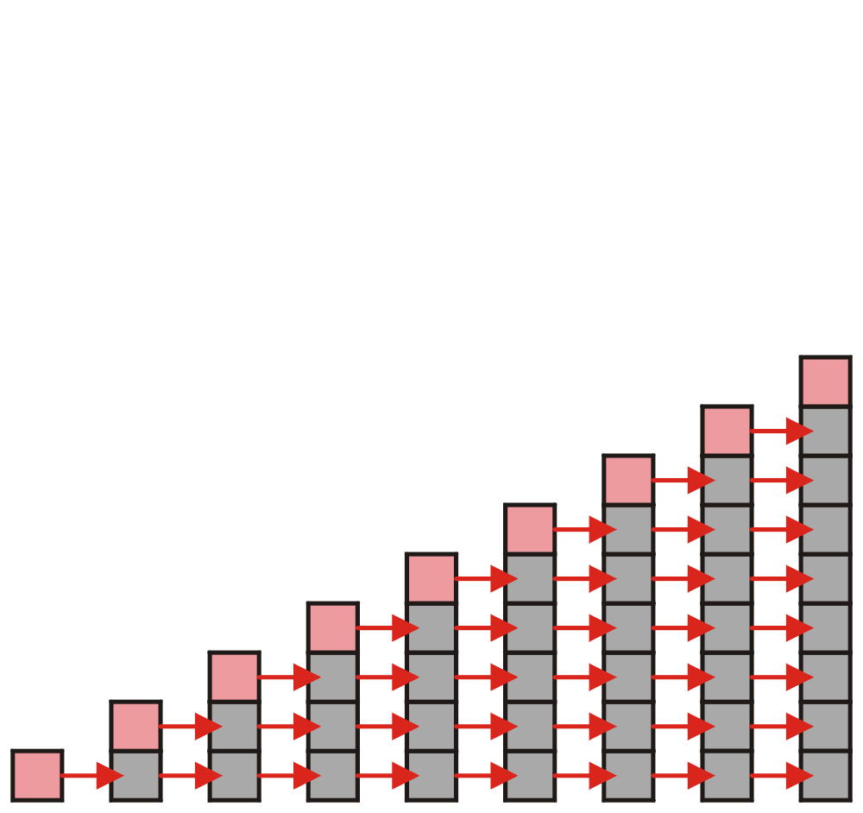
Array Capacity
Let us consider the case of increasing the capacity by 1 each time the array is full
With each insertion when the array is full, this requires all entries to be copied

Slide 40
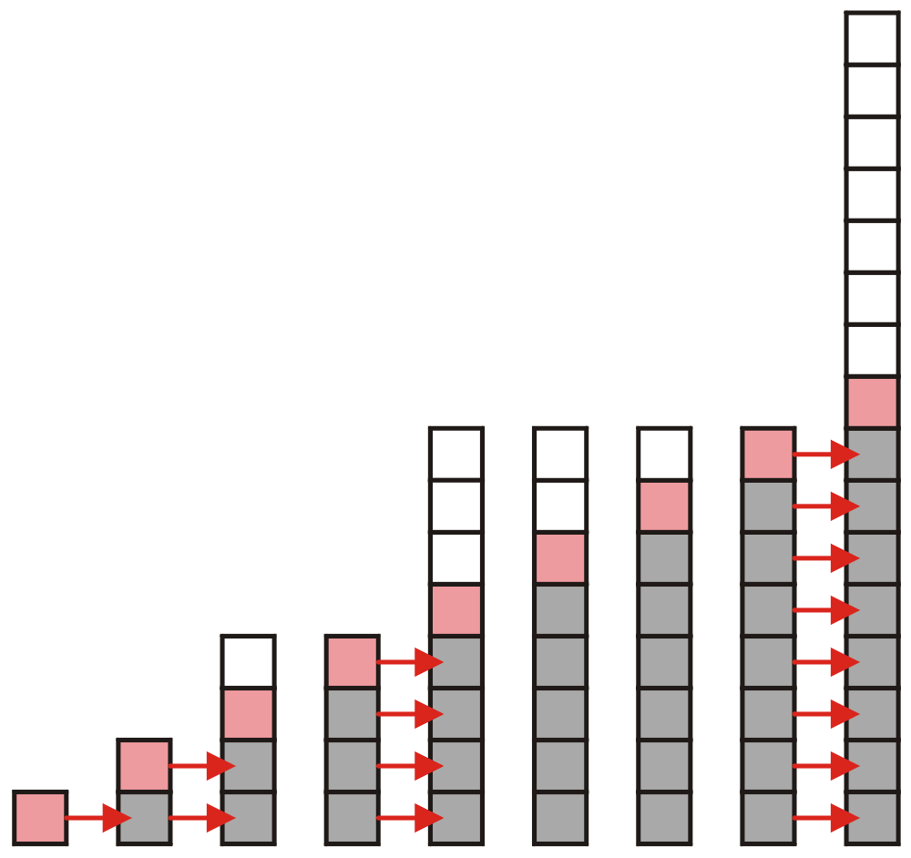
Array Capacity
Suppose we double the number of entries each time the array is full
Now the number of copies appears to be significantly fewer

Slide 41
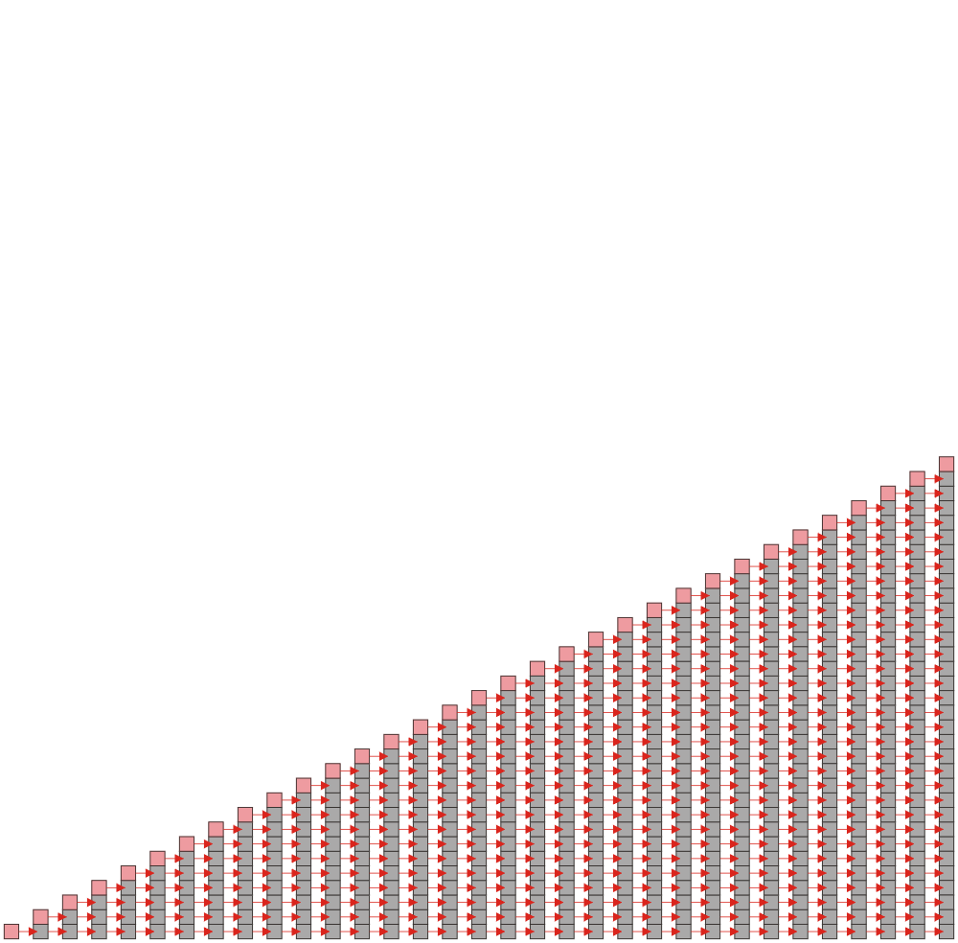
Array Capacity
Suppose we insert k objects
The pushing of the k^{th} object on the stack requires k-1 copies
The total number of copies is now given by:
Therefore, the amortized number of copies is given by
Therefore each push must run in Θ(n) time
The wasted space, however is Θ(1)

Slide 42
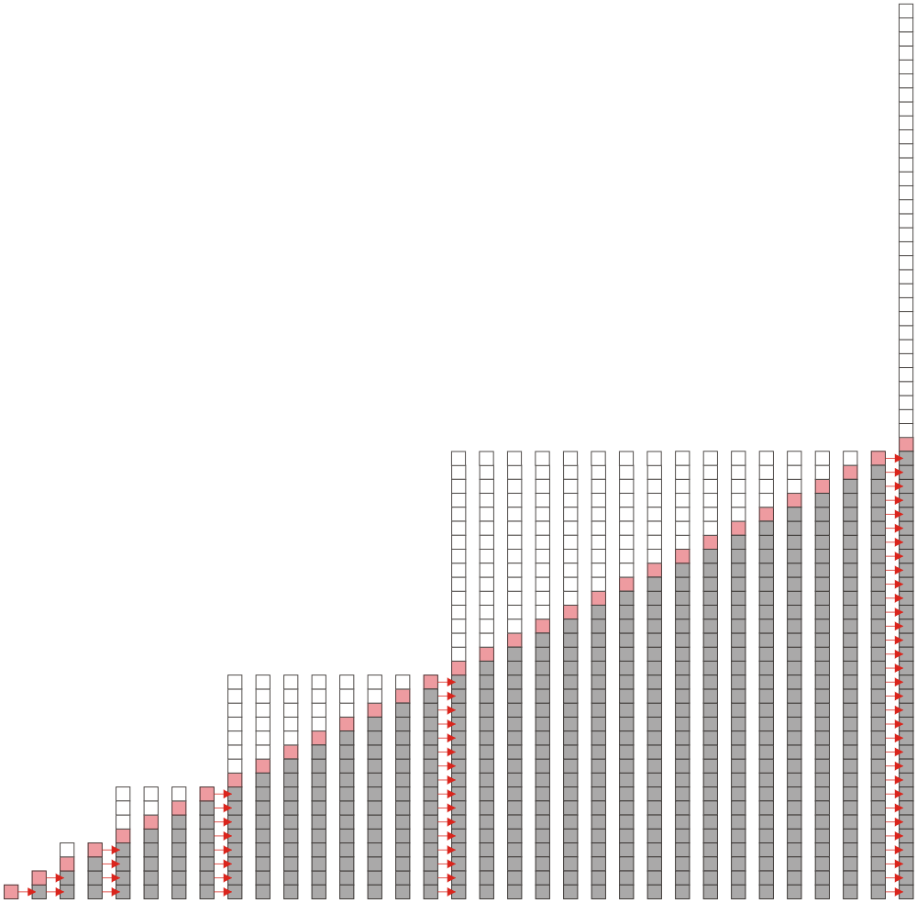
Array Capacity
Suppose we double the array size each time it is full:
Inserting n objects would require 1, 2, 4, 8, ..., all the way up to the largest 2^{k} < n or
Therefore the amortized number of copies per insertion is Θ(1)
The wasted space, however is O(n)

Slide 43
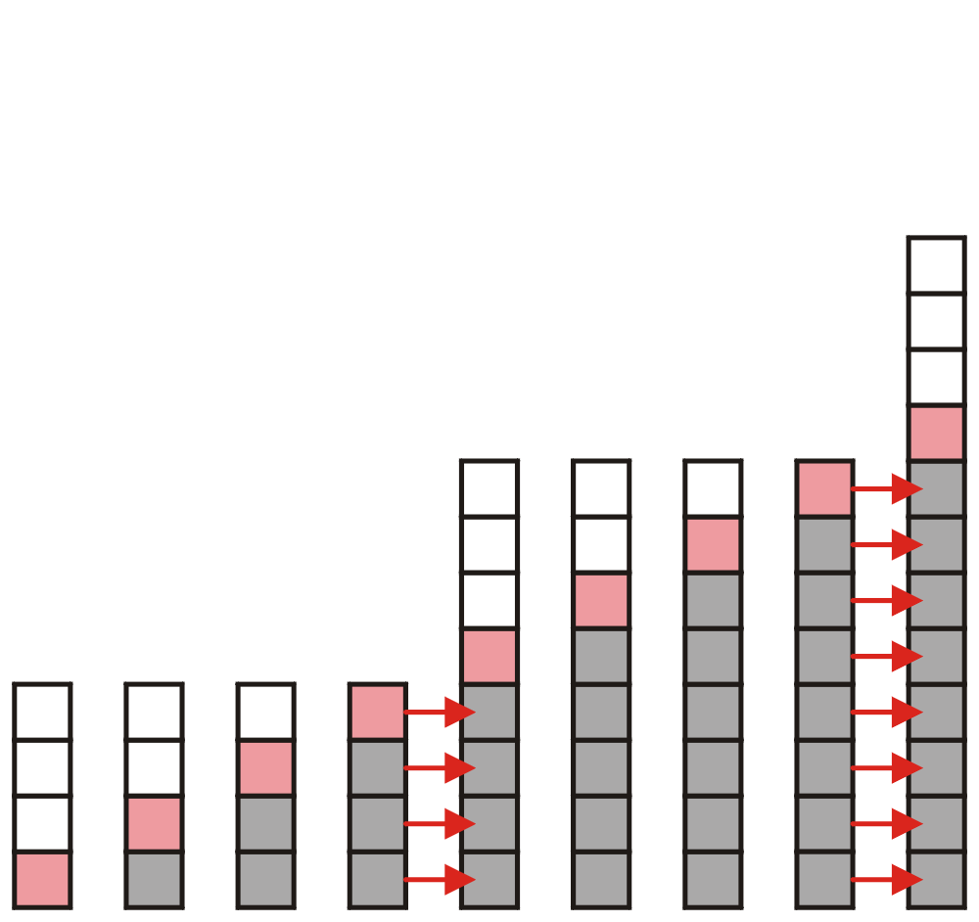
Array Capacity
What if we increase the array size by a larger constant?
For example, increase the array size by 4, 8, 100?

Slide 44
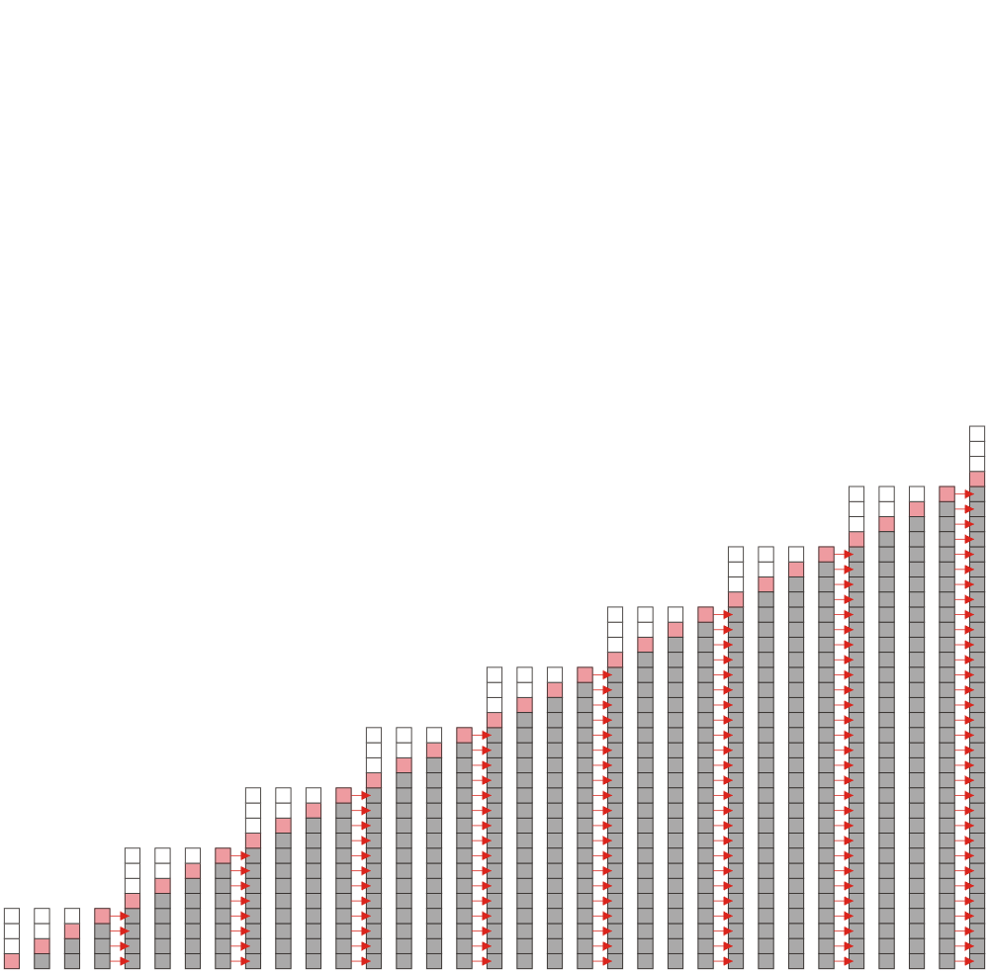
Array Capacity
Suppose we increase it by a constant value m
Therefore, the amortized run time per insertion is Θ(n)

Slide 45
Array Capacity
 | Copies per Insertion | Unused Memory
Increase by 1 | n – 1 | 0
Increase by m | n/m | m – 1
Increase by a factor of 2 | 1 | n
Increase by a factor of r > 1 | 1/(r – 1) | (r – 1)n
Note the difference in worst-case amortized scenarios:

Slide 46
Outline
Stack ADT
Implementation
Example applications

Slide 47
Application: Parsing
Most parsing uses stacks
Examples includes:
Matching tags in XHTML
In C++, matching
parentheses ( ... )
brackets, and [ ... ]
braces { ... }

Slide 48
Parsing XHTML
The first example will demonstrate parsing XHTML
We will show how stacks may be used to parse an XHTML document
You will use XHTML (and more generally XML and other markup languages) in the workplace

Slide 49
Parsing XHTML
A markup language is a means of annotating a document to given context to the text
The annotations give information about the structure or presentation of the text
The best known example is HTML, or HyperText Markup Language
We will look at XHTML

Slide 50
Parsing XHTML
XHTML is made of nested
opening tags, e.g., <some_identifier>, and
matching closing tags, e.g., </some_identifier>
<html>
<head><title>Hello</title></head>
<body><p>This appears in the <i>browser</i>.</p></body>
</html>
Nesting indicates that any closing tag must match the most recent opening tag

Slide 51
Parsing XHTML
Strategy for parsing XHTML:
read though the XHTML linearly
place the opening tags in a stack
when a closing tag is encountered, check that it matches what is on top of the stack

Slide 52
Parsing XHTML
<html>
<head><title>Hello</title></head>
<body><p>This appears in the <i>browser</i>.</p></body>
</html>
<html>

Slide 53
Parsing XHTML
<html>
<head><title>Hello</title></head>
<body><p>This appears in the <i>browser</i>.</p></body>
</html>
<html> | <head>

Slide 54
Parsing XHTML
<html>
<head><title>Hello</title></head>
<body><p>This appears in the <i>browser</i>.</p></body>
</html>
<html> | <head> | <title>

Slide 55
Parsing XHTML
<html>
<head><title>Hello</title></head>
<body><p>This appears in the <i>browser</i>.</p></body>
</html>
<html> | <head> | <title>

Slide 56
Parsing XHTML
<html>
<head><title>Hello</title></head>
<body><p>This appears in the <i>browser</i>.</p></body>
</html>
<html> | <head>

Slide 57
Parsing XHTML
<html>
<head><title>Hello</title></head>
<body><p>This appears in the <i>browser</i>.</p></body>
</html>
<html> | <body>

Slide 58
Parsing XHTML
<html>
<head><title>Hello</title></head>
<body><p>This appears in the <i>browser</i>.</p></body>
</html>
<html> | <body> | <p>

Slide 59
Parsing XHTML
<html>
<head><title>Hello</title></head>
<body><p>This appears in the <i>browser</i>.</p></body>
</html>
<html> | <body> | <p> | <i>

Slide 60
Parsing XHTML
<html>
<head><title>Hello</title></head>
<body><p>This appears in the <i>browser</i>.</p></body>
</html>
<html> | <body> | <p> | <i>

Slide 61
Parsing XHTML
<html>
<head><title>Hello</title></head>
<body><p>This appears in the <i>browser</i>.</p></body>
</html>
<html> | <body> | <p>

Slide 62
Parsing XHTML
<html>
<head><title>Hello</title></head>
<body><p>This appears in the <i>browser</i>.</p></body>
</html>
<html> | <body>

Slide 63
Parsing XHTML
<html>
<head><title>Hello</title></head>
<body><p>This appears in the <i>browser</i>.</p></body>
</html>
<html>

Slide 64
Parsing XHTML
We are finished parsing, and the stack is empty
Possible errors:
a closing tag which does not match the opening tag on top of the stack
a closing tag when the stack is empty
the stack is not empty at the end of the document

Slide 65
HTML
Old HTML required neither closing tags nor nesting
<html>
<head><title>Hello</title></head>
<body><p>This is a list of topics:
<ol> <!-- para ends with start of list -->
<li><i>veni <!-- implied </li> -->
<li>vidi <!-- italics continues -->
<li>vici</i>
</ol> <!-- end-of-file implies </body></html> -->
Parsers were therefore specific to HTML
Results: ambiguities and inconsistencies

Slide 66
XML
XHTML is an implementation of XML
XML defines a class of general-purpose eXtensible Markup Languages designed for sharing information between systems
The same rules apply for any flavour of XML:
opening and closing tags must match and be nested

Slide 67
Parsing C++
The next example shows how stacks may be used in parsing C++
Those taking ECE 351 Compilers will use this
For other students, it should help understand, in part:
how a compiler works, and
why programming languages have the structure they do

Slide 68

Parsing C++
Like opening and closing tags, C++ parentheses, brackets, and braces must be similarly nested:
void initialize( int *array, int n ) {
for ( int i = 0; i < n; ++i ) {
array[i] = 0;
}
}
http://xkcd.com/859/

Slide 69
Parsing C++
For C++, the errors are similar to that for XHTML, however:
many XHTML parsers usually attempt to “correct” errors (e.g., insert missing tags)
C++ compilers will simply issue a parse error:
{eceunix:1} cat example1.cpp
#include <vector>
int main() {
std::vector<int> v(100];
return 0;
}
{eceunix:2} g++ example1.cpp
example1.cpp: In function 'int main()':
example1.cpp:3: error: expected ')' before ']' token

Slide 70
Parsing C++
For C++, the errors are similar to that for XHTML, however:
many XHTML parsers usually attempt to “correct” errors (e.g., insert missing tags)
C++ compilers will simply issue a parse error:
{eceunix:1} cat example2.cpp
#include <vector>
int main() {
std::vector<int> v(100);
v[0] = 3];
return 0;
}
{eceunix:2} g++ example2.cpp
example2.cpp: In function 'int main()':
example2.cpp:4: error: expected ';' before ']' token

Slide 71
Function calls
int a(){
b();
c();
return 0;
}
int b(){ return 0; }
int c(){ return 0; }
int main(){
a();
return 0;
}

Slide 72
Function calls
main
main() calls a()
main | a
a() calls b()
main | a | b
b() returns
main | a
a() calls c()
main | a | c
c() returns
main | a
a() returns
main

Slide 73
Function calls
int a(){
return a();
}

Slide 74
Function calls
calls a()
a
a() calls a()
a | a
a() calls a()
a | a | a
a() calls a()
a | a | a | a
a | a | a | a
a() calls a()
?
Stack Overflow!

Slide 75
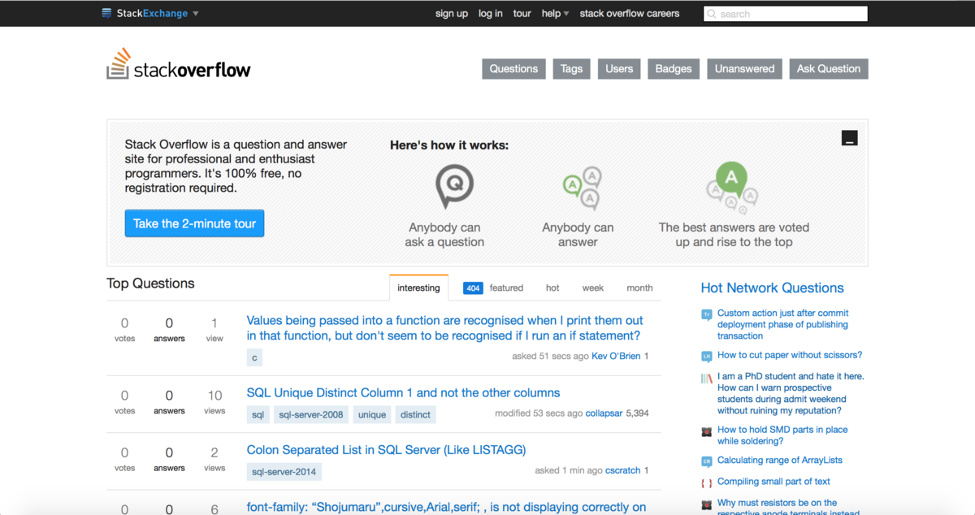
Stack Overflow

Slide 76
Reverse-Polish Notation
Normally, mathematics is written using what we call in-fix notation:
(3 + 4) × 5 – 6
The operator is placed between to operands
One weakness: parentheses are required
(3 + 4) × 5 – 6 = 29
3 + 4 × 5 – 6 = 17
3 + 4 × (5 – 6) = –1
(3 + 4) × (5 – 6) = –7

Slide 77
Reverse-Polish Notation
Alternatively, we can place the operands first, followed by the operator:
(3 + 4) × 5 – 6
3 4 + 5 × 6 –
Parsing reads left-to-right and performs any operation on the last two operands:
3 4 + 5 × 6 –
7 5 × 6 –
35 6 –
29

Slide 78
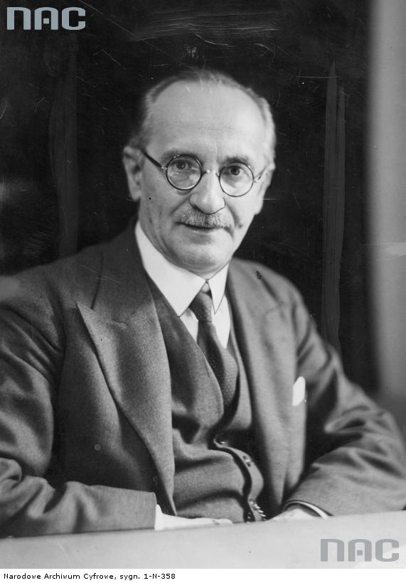
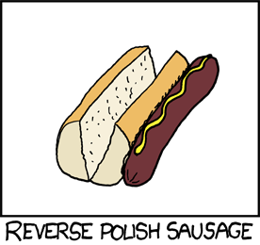
Reverse-Polish Notation
This is called reverse-Polish notation after the mathematician Jan Łukasiewicz
http://xkcd.com/645/
http://www.audiovis.nac.gov.pl/

Slide 79
Reverse-Polish Notation
Other examples:
3 4 5 × + 6 –
3 20 + 6 –
23 6 –
17
3 4 5 6 – × +
3 4 –1 × +
3 –4 +
–1

Slide 80
Reverse-Polish Notation
Benefits:
No ambiguity and no brackets are required
It is the same process used by a computer to perform computations:
operands must be loaded into registers before operations can be performed on them
Notes:
Reverse-Polish can be processed using stacks

Slide 81
Reverse-Polish Notation
The easiest way to parse reverse-Polish notation is to use an operand stack:
operands are processed by pushing them onto the stack
when processing an operator:
pop the last two items off the operand stack,
perform the operation, and
push the result back onto the stack

Slide 82
Reverse-Polish Notation
Evaluate the following reverse-Polish expression using a stack:
1 2 3 + 4 5 6 × – 7 × + – 8 9 × +

Slide 83
Reverse-Polish Notation
Push 1 onto the stack
1 2 3 + 4 5 6 × – 7 × + – 8 9 × +
1

Slide 84
Reverse-Polish Notation
Push 1 onto the stack
1 2 3 + 4 5 6 × – 7 × + – 8 9 × +
2
1

Slide 85
Reverse-Polish Notation
Push 3 onto the stack
1 2 3 + 4 5 6 × – 7 × + – 8 9 × +
3
2
1

Slide 86
Reverse-Polish Notation
Pop 3 and 2 and push 2 + 3 = 5
1 2 3 + 4 5 6 × – 7 × + – 8 9 × +
5
1

Slide 87
Reverse-Polish Notation
Push 4 onto the stack
1 2 3 + 4 5 6 × – 7 × + – 8 9 × +
4
5
1

Slide 88
Reverse-Polish Notation
Push 5 onto the stack
1 2 3 + 4 5 6 × – 7 × + – 8 9 × +
5
4
5
1

Slide 89
Reverse-Polish Notation
Push 6 onto the stack
1 2 3 + 4 5 6 × – 7 × + – 8 9 × +
6
5
4
5
1

Slide 90
Reverse-Polish Notation
Pop 6 and 5 and push 5 × 6 = 30
1 2 3 + 4 5 6 × – 7 × + – 8 9 × +
30
4
5
1

Slide 91
Reverse-Polish Notation
Pop 30 and 4 and push 4 – 30 = –26
1 2 3 + 4 5 6 × – 7 × + – 8 9 × +
–26
5
1

Slide 92
Reverse-Polish Notation
Push 7 onto the stack
1 2 3 + 4 5 6 × – 7 × + – 8 9 × +
7
–26
5
1

Slide 93
Reverse-Polish Notation
Pop 7 and –26 and push –26 × 7 = –182
1 2 3 + 4 5 6 × – 7 × + – 8 9 × +
–182
5
1

Slide 94
Reverse-Polish Notation
Pop –182 and 5 and push –182 + 5 = –177
1 2 3 + 4 5 6 × – 7 × + – 8 9 × +
–177
1

Slide 95
Reverse-Polish Notation
Pop –177 and 1 and push 1 – (–177) = 178
1 2 3 + 4 5 6 × – 7 × + – 8 9 × +
178

Slide 96
Reverse-Polish Notation
Push 8 onto the stack
1 2 3 + 4 5 6 × – 7 × + – 8 9 × +
8
178

Slide 97
Reverse-Polish Notation
Push 1 onto the stack
1 2 3 + 4 5 6 × – 7 × + – 8 9 × +
9
8
178

Slide 98
Reverse-Polish Notation
Pop 9 and 8 and push 8 × 9 = 72
1 2 3 + 4 5 6 × – 7 × + – 8 9 × +
72
178

Slide 99
Reverse-Polish Notation
Pop 72 and 178 and push 178 + 72 = 250
1 2 3 + 4 5 6 × – 7 × + – 8 9 × +
250

Slide 100
Reverse-Polish Notation
Thus
1 2 3 + 4 5 6 × – 7 × + – 8 9 × +
evaluates to the value on the top: 250
The equivalent in-fix notation is
((1 – ((2 + 3) + ((4 – (5 × 6)) × 7))) + (8 × 9))
We reduce the parentheses using order-of-operations:
1 – (2 + 3 + (4 – 5 × 6) × 7) + 8 × 9

Slide 101
Reverse-Polish Notation
Incidentally,
1 – 2 + 3 + 4 – 5 × 6 × 7 + 8 × 9 = – 132
which has the reverse-Polish notation of
1 2 – 3 + 4 + 5 6 7 × × – 8 9 × +
For comparison, the calculated expression was
1 2 3 + 4 5 6 × – 7 × + – 8 9 × +

Slide 102
Summary
Stack ADT
Push, pop, LIFO
Implementation
Linked list
Array
How to increase the array capacity
Applications
Parsing XHTML
Function calls
Reverse-Polish Notation

Slide 103

Standard Template Library
The Standard Template Library (STL) has a wrapper class stack with the following declaration:
template <typename T>
class stack {
public:
stack(); // not quite true...
bool empty() const;
int size() const;
const T & top() const;
void push( const T & );
void pop();
};

Slide 104
Standard Template Library
#include <iostream>
#include <stack>
using namespace std;
int main() {
stack<int> istack;
istack.push( 13 );
istack.push( 42 );
cout << "Top: " << istack.top() << endl;
istack.pop(); // no return value
cout << "Top: " << istack.top() << endl;
cout << "Size: " << istack.size() << endl;
return 0;
}

Slide 105
Standard Template Library
The reason that the stack class is termed a wrapper is because it uses a different container class to actually store the elements
The stack class simply presents the stack interface with appropriately named member functions:
push, pop , and top

Slide 106
References
Donald E. Knuth, The Art of Computer Programming, Volume 1: Fundamental Algorithms, 3rd Ed., Addison Wesley, 1997, §2.2.1, p.238.
Cormen, Leiserson, and Rivest, Introduction to Algorithms, McGraw Hill, 1990, §11.1, p.200.
Weiss, Data Structures and Algorithm Analysis in C++, 3rd Ed., Addison Wesley, §3.6, p.94.
Koffman and Wolfgang, “Objects, Abstraction, Data Strucutes and Design using C++”, John Wiley & Sons, Inc., Ch. 5.
Wikipedia, http://en.wikipedia.org/wiki/Stack_(abstract_data_type)
These slides are provided for the ECE 250 Algorithms and Data Structures course. The material in it reflects Douglas W. Harder’s best judgment in light of the information available to him at the time of preparation. Any reliance on these course slides by any party for any other purpose are the responsibility of such parties. Douglas W. Harder accepts no responsibility for damages, if any, suffered by any party as a result of decisions made or actions based on these course slides for any other purpose than that for which it was intended.

