Slide 1
CS101 Data Structures
Queue
Textbook Ch 10.1
Notes:
Adapted from the slides by Douglas Wilhelm Harder of U Waterloo (https://ece.uwaterloo.ca/~dwharder/aads/Lecture_materials/)
May also contain material from the slides at https://courses.cs.washington.edu/courses/cse326/03wi/326lecturesb.shtml (by Dan Suciu of U Washington)

Slide 2
Outline
Queue ADT
Implementation
Deque

Slide 3
Queue ADT
Uses an explicit linear ordering
Two principal operations
Push: insert an object at the back of the queue
Pop: remove the object from the front of the queue

Slide 4
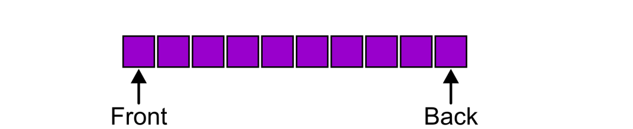
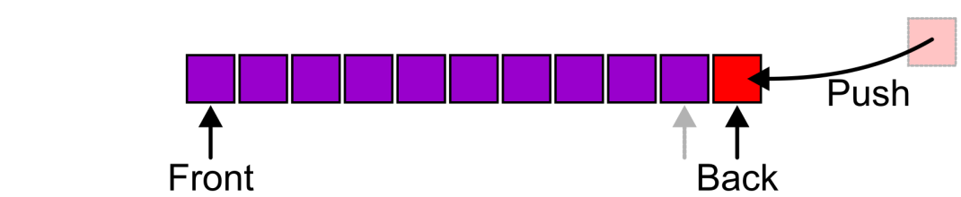
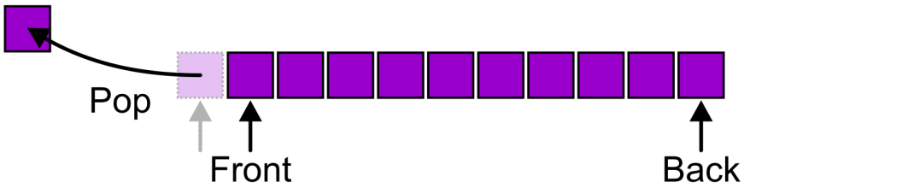
Queue ADT
Also called a first-in–first-out (FIFO) data structure
Graphically, we may view these operations as follows:

Slide 5
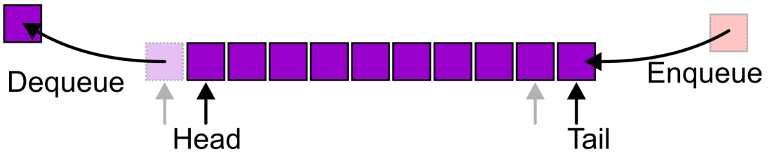
Queue ADT
Alternative terms may be used for the four operations on a queue, including:
Notes:
There are two exceptions associated with this abstract data structure:
It is an undefined operation to call either pop or front on an empty queue

Slide 6

Applications
Grocery stores, banks, airport security…

Slide 7
Applications
Tree traversals, graph traversals
Will see in coming lectures
The most common application is in client-server models (web, file, ftp, database, mail, printers, etc.)
Multiple clients may be requesting services from one or more servers
Some clients may have to wait while the servers are busy
Those clients are placed in a queue and serviced in the order of arrival

Slide 8
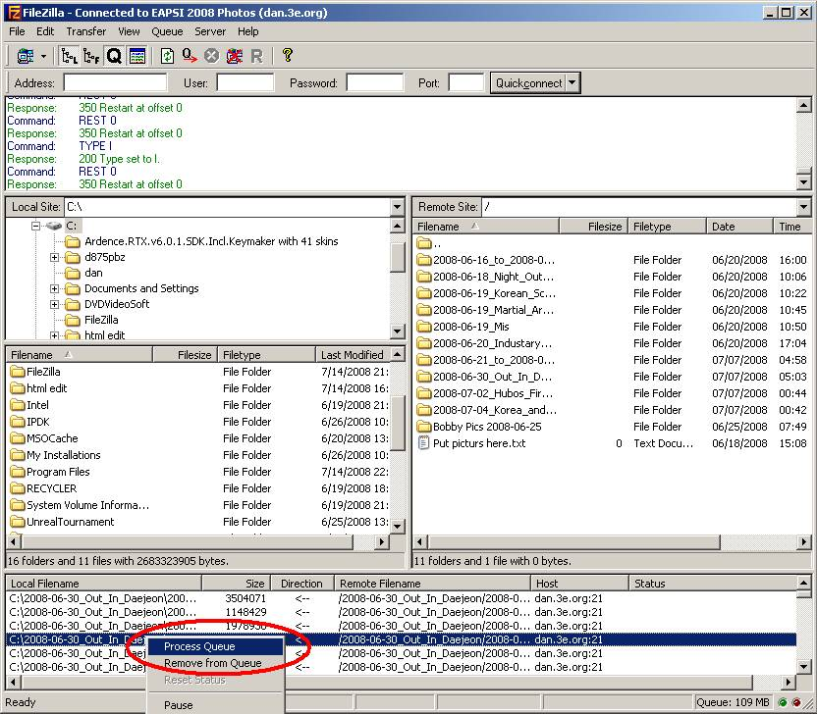
Applications
Example: When downloading files from a web server, the requests not currently being downloaded are marked as “Queued”

Slide 9
Outline
Queue ADT
Implementation
Deque

Slide 10
Implementations
We will look at two implementations of queues:
Singly linked lists
Circular arrays
All queue operations run in Θ(1) time

Slide 11
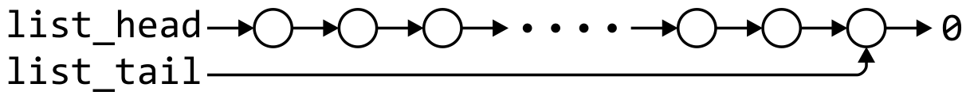
Linked-List Implementation
List head/tail → Queue front/back?
Removal is only possible at the front with Θ(1) run time
The desired behavior of an Abstract Queue may be produced by performing insertions at the back and removal at the front
 | Front/1st | Back/n^{th}
Find | Θ(1) | Θ(1)
Insert | Θ(1) | Θ(1)
Erase | Θ(1) | Θ(n)

Slide 12
Single_list Definition
The definition of single list class:
template <typename Type>
class Single_list {
public:
int size() const;
bool empty() const;
Type front() const;
Type back() const;
Single_node<Type> *head() const;
Single_node<Type> *tail() const;
int count( Type const & ) const;
void push_front( Type const & );
void push_back( Type const & );
Type pop_front();
int erase( Type const & );
};

Slide 13
Queue-as-List Class
The queue class using a singly linked list has a single private member variable: a singly linked list
template <typename Type>
class Queue{
private:
Single_list<Type> list;
public:
bool empty() const;
Type front() const;
void push( Type const & );
Type pop();
};

Slide 14
Queue-as-List Class
The implementation is similar to that of a Stack-as-List
template <typename Type>
bool Queue<Type>::empty() const {
return list.empty();
}
template <typename Type>
void Queue<Type>::push( Type const &obj ) {
list.push_back( obj );
}
template <typename Type>
Type Queue<Type>::front() const {
if ( empty() ) {
throw underflow();
}
return list.front();
}
template <typename Type>
Type Queue<Type>::pop() {
if ( empty() ) {
throw underflow();
}
return list.pop_front();
}
Notes:
14

Slide 15

Array Implementation
A one-ended array does not allow all operations to occur in Θ(1) time
 | Front/1st | Back/n^{th}
Find | Θ(1) | Θ(1)
Insert | Θ(n) | Θ(1)
Remove | Θ(n) | Θ(1)

Slide 16
Array Implementation
Using a two-ended array, Θ(1) are possible by pushing at the back and popping from the front
 | Front/1st | Back/n^{th}
Find | Θ(1) | Θ(1)
Insert | Θ(1) | Θ(1)
Remove | Θ(1) | Θ(1)

Slide 17
Array Implementation
We need to store an array:
Type *array;
We need additional information, including:
The number of objects currently in the queue and the front and back indices
int queue_size;
int ifront; // index of the front entry
int iback; // index of the back entry
The capacity of the array
int array_capacity;
Notes:
17

Slide 18
Queue-as-Array Class
The class definition is similar to that of the Stack:
template <typename Type>
class Queue{
private:
int queue_size;
int ifront;
int iback;
int array_capacity;
Type *array;
public:
Queue( int = 10 );
~Queue();
bool empty() const;
Type front() const;
void push( Type const & );
Type pop();
};

Slide 19
Constructor
We must initialize the values
Allocate memory for the array
Initialize the member variables
iback is initialized to -1
template <typename Type>
Queue<Type>::Queue( int n ):
queue_size( 0 ),
iback( -1 ),
ifront( 0 ),
array_capacity( std::max(1, n) ),
array( new Type[array_capacity] ) {
// Empty constructor
}

Slide 20
Constructor
template <typename Type>
class Queue {
private:
int queue_size;
int iback;
int ifront;
int array_capacity;
Type *array;
public:
Queue( int = 10 );
~Queue();
bool empty() const;
Type top() const;
void push( Type const & );
Type pop();
};
template <typename Type>
Queue<Type>::Queue( int n ):
queue_size( 0 ),
iback( -1 ),
ifront( 0 ),
array_capacity( std::max(1, n) ),
array( new Type[array_capacity] )
{
// Empty constructor
}
Reminder:
Initialization is performed in the order specified in the class declaration
Notes:
20

Slide 21
Destructor
template <typename Type>
Queue<Type>::~Queue() {
delete [] array;
}

Slide 22
Member Functions
template <typename Type>
bool Queue<Type>::empty() const {
return ( queue_size == 0 );
}
template <typename Type>
Type Queue<Type>::front() const {
if ( empty() ) {
throw underflow();
}
return array[ifront];
}

Slide 23
Member Functions
A naïve implementation of push and pop:
template <typename Type>
void Queue<Type>::push( Type const &obj ) {
if ( queue_size == array_capacity ) {
throw overflow();
}
++iback;
array[iback] = obj;
++queue_size;
}
Notes:
23

Slide 24
Member Functions
A naïve implementation of push and pop:
template <typename Type>
Type Queue<Type>::pop() {
if ( empty() ) {
throw underflow();
}
--queue_size;
++ifront;
return array[ifront - 1];
}
Problem?
Notes:
24

Slide 25
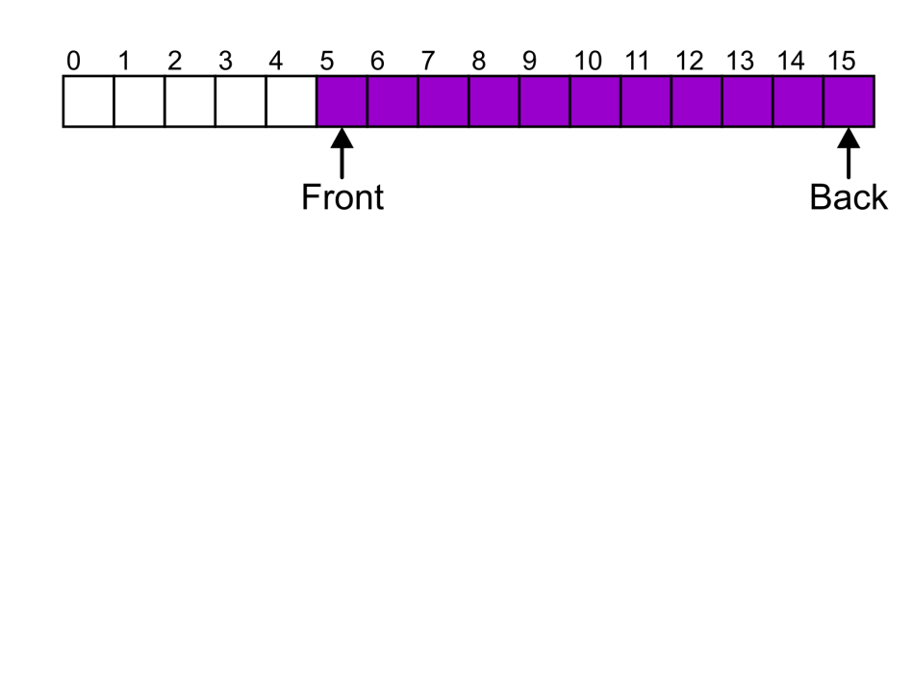
Member Functions
Suppose that:
The array capacity is 16
We have performed 16 pushes
We have performed 5 pops
The queue size is now 11
We perform one further push
In this case, the array is not full and yet we cannot place any more objects in to the array
Notes:
25

Slide 26
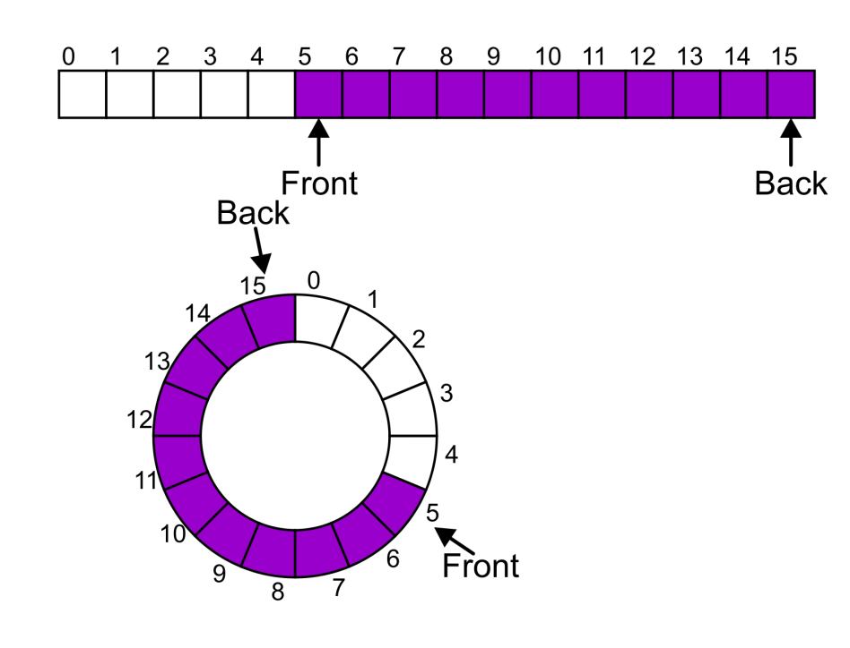
Member Functions
Instead of viewing the array on the range 0, …, 15, consider the indices being cyclic:
…, 15, 0, 1, …, 15, 0, 1, …, 15, 0, 1, …
This is referred to as a circular array
Notes:
26

Slide 27
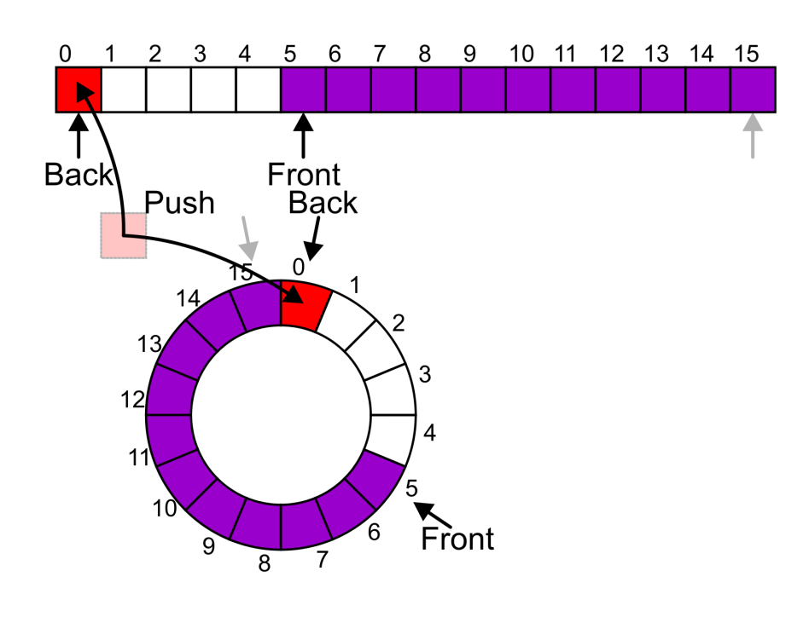
Member Functions
Now, the next push may be performed in the next available location of the circular array:
++iback;
if ( iback == capacity() ) {
iback = 0;
}
Notes:
27

Slide 28
Exceptions
As with a stack, there are a number of options which can be used if the array is filled
If the array is filled, we have five options:
Increase the size of the array
Throw an exception
Ignore the element being pushed
Put the pushing process to “sleep” until something else pops the front of the queue
Include a member function bool full()

Slide 29
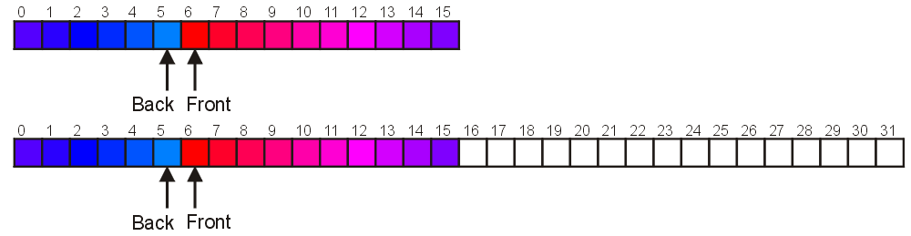
Increasing Capacity
When the array is full, increasing the capacity is slightly more complex than in the case of stack:
A direct copy does not work:

Slide 30
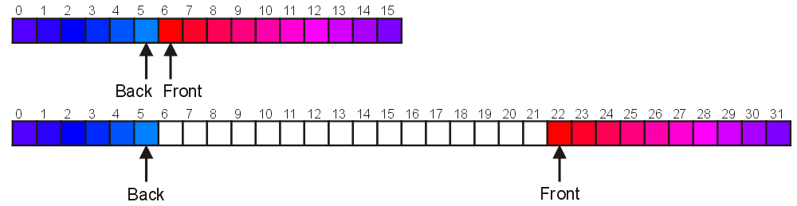
Increasing Capacity
One solution:
Move those beyond the front to the end of the array
The next push would then occur in position 6
Notes:
30

Slide 31
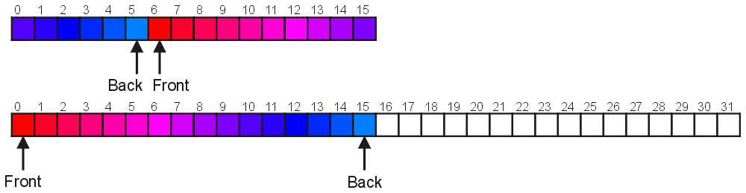
Increasing Capacity
An alternate solution is normalization:
Map the front at position 0
The next push would then occur in position 16
Notes:
31

Slide 32
Outline
Queue ADT
Implementation
Deque

Slide 33
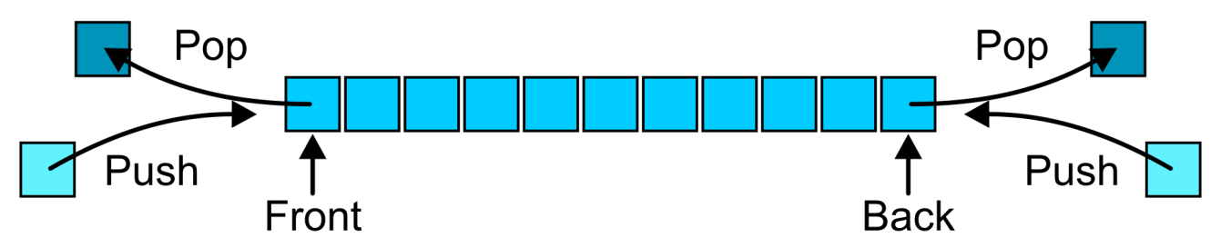
Deque ADT
Deque = Double-ended queue
pronounced like "deck"
Uses an explicit linear ordering
Allows insertion/removal at both the front and the back of the deque

Slide 34
Abstract Deque
The operations will be called
front back
push_front push_back
pop_front pop_back
There are four errors associated with this abstract data type:
It is an undefined operation to access or pop from an empty deque

Slide 35
Applications
Useful as a general-purpose tool:
Can be used as either a queue or a stack
Can be used in certain job scheduling algorithms for parallel programming

Slide 36
Implementations
Can we use linked list?
Pop_back requires Θ(n)
Two efficient implementations:
Doubly linked list
Circular array
Notes:
36

Slide 37
Summary
Queue ADT
Push, pop, FIFO
Implementation
Singly linked lists
Circular arrays
Deque

Slide 38
Standard Template Library
An example of a queue in the STL is:
#include <iostream>
#include <queue>
using namespace std;
int main() {
queue <int> iqueue;
iqueue.push( 13 );
iqueue.push( 42 );
cout << "Head: " << iqueue.front() << endl;
iqueue.pop(); // no return value
cout << "Head: " << iqueue.front() << endl;
cout << "Size: " << iqueue.size() << endl;
return 0;
}

Slide 39
References
Donald E. Knuth, The Art of Computer Programming, Volume 1: Fundamental Algorithms, 3rd Ed., Addison Wesley, 1997, §2.2.1, p.238.
Cormen, Leiserson, and Rivest, Introduction to Algorithms, McGraw Hill, 1990, §11.1, p.200.
Weiss, Data Structures and Algorithm Analysis in C++, 3rd Ed., Addison Wesley, §3.6, p.94.
Koffman and Wolfgang, “Objects, Abstraction, Data Strucutes and Design using C++”, John Wiley & Sons, Inc., Ch. 6.
Wikipedia, http://en.wikipedia.org/wiki/Queue_(abstract_data_type)
These slides are provided for the ECE 250 Algorithms and Data Structures course. The material in it reflects Douglas W. Harder’s best judgment in light of the information available to him at the time of preparation. Any reliance on these course slides by any party for any other purpose are the responsibility of such parties. Douglas W. Harder accepts no responsibility for damages, if any, suffered by any party as a result of decisions made or actions based on these course slides for any other purpose than that for which it was intended.

