Slide 1
CSCI 3150 Introduction to Operating Systems
Tutorial: Understanding inode and directory mapping
TA: YU Chengye
cyyu23@cse.cuhk.edu.hk

Slide 2
Goal
In the Assignment 2, you will be asked to do some exercises related to inode and directory mapping.
This tutorial will help you understand Assignment 2.

Slide 3
Inode
In the simple file system (SFS), an inode is defined based on the following structure:
/* The structure of inode, each file has only one inode */
typedef struct _inode_
{
int i_number; /* The inode number */
time_t c_time; /* Creation time of the file (use int in your code) */
int f_type; /* 0 for regular file, 1 for directory */
int f_size; /* The size of the file (bytes)*/
int blk_number; /* The number of data blocks occupied by this file */
int direct_blk[2]; /* Two direct data block pointers */
int indirect_blk; /* One indirect data block pointer */
int sub_f_num; /* Number of files under a directory (0 for regular file)*/
} inode;

Slide 4
read_t()
The prototype of read_t() is:
int read_t(int i_number, int offset, void *buf, int count);
Description: read_t() attempts to read up to count bytes from the file with the inode number i_number, starting at offset, into the buffer buf. On success, the number of bytes read is returned (zero indicates end of file). Otherwise, -1 is returned.

Slide 5
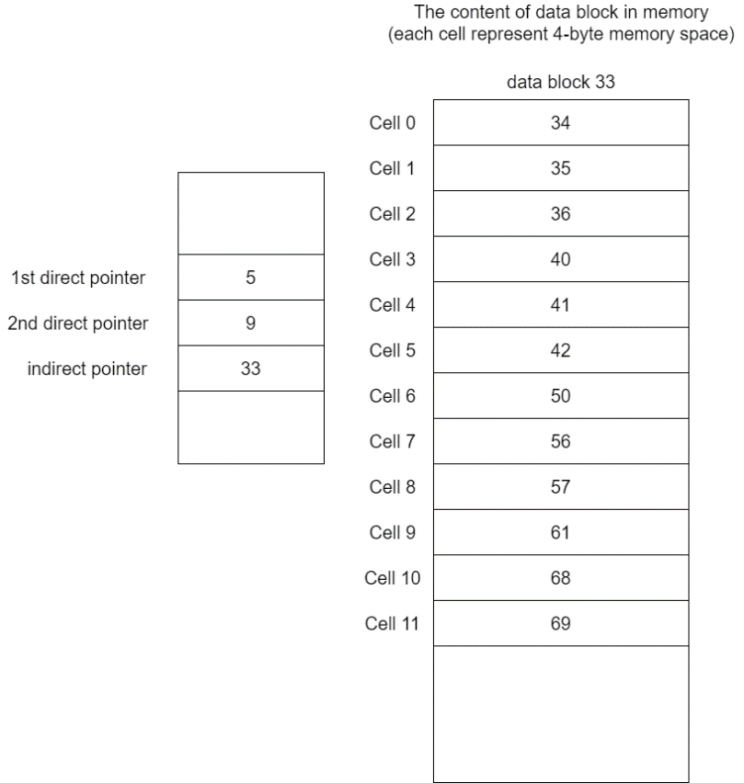
Question
Here is an example on reading a file. (Maybe helpful for your assignment 2)

Slide 6
Logical view of the file:
…
0
4K
8K
12K
16K

Slide 7
Logical view of the file:
DataBlock 5
…
0
4K
8K
12K
16K

Slide 8
Logical view of the file:
DataBlock 5
DataBlock 9
…
0
4K
8K
12K
16K

Slide 9
Logical view of the file:
DataBlock 5
DataBlock 9
DataBlock 34
…
0
4K
8K
12K
16K

Slide 10
Logical view of the file:
DataBlock 5
DataBlock 9
DataBlock 34
DataBlock 35
…
0
4K
8K
12K
16K

Slide 11
 | read_t(i_number, offset, buf, count) | Data blocks that will be read
Example 1 | read_t(inum,130,buf,400) | ?
Example 2 | read_t(inum,130,buf,9000) | ?
Logical view of the file:
DataBlock 5
DataBlock 9
DataBlock 34
DataBlock 35
…
0
4K
8K
12K
16K

Slide 12
 | read_t(i_number, offset, buf, count) | Data blocks that will be read
Example 1 | read_t(inum,130,buf,400) | ?
Example 2 | read_t(inum,130,buf,9000) | ?
Logical view of the file:
DataBlock 5
DataBlock 9
DataBlock 34
DataBlock 35
…
0
4K
8K
12K
16K

Slide 13
 | read_t(i_number, offset, buf, count) | Data blocks that will be read
Example 1 | read_t(inum,130,buf,400) | 5
Example 2 | read_t(inum,130,buf,9000) | ?
Logical view of the file:
DataBlock 5
DataBlock 9
DataBlock 34
DataBlock 35
…
0
4K
8K
12K
16K
130
530

Slide 14
 | read_t(i_number, offset, buf, count) | Data blocks that will be read
Example 1 | read_t(inum,130,buf,400) | 5
Example 2 | read_t(inum,130,buf,9000) | ?
Logical view of the file:
DataBlock 5
DataBlock 9
DataBlock 34
DataBlock 35
…
0
4K
8K
12K
16K

Slide 15
 | read_t(i_number, offset, buf, count) | Data blocks that will be read
Example 1 | read_t(inum,130,buf,400) | 5
Example 2 | read_t(inum,130,buf,9000) | 5,9,34
Logical view of the file:
DataBlock 5
DataBlock 9
DataBlock 34
DataBlock 35
…
0
4K
8K
12K
16K
130
9130

Slide 16
Directory
The directory is a special type of file. It also has the inode and data blocks.
The only difference is that the data blocks of a directory do not store file data, instead they store a list of special metadata called dir_mapping, which is the mapping of file name to inode number.
An example structure of dir_mapping:
/* Record file information in directory file */
typedef struct dir_mapping
{
char f_name[20]; /* The file name of the file */
int i_number; /* The inode number of the file */
} DIR_NODE;

Slide 17
Traverse the directory
Each directory should at least contain two special dir_mapping items, “.” and “..”, the current directory and the parent directory. (note: the parent of the root directory is itself).
When we look for a specific file under a directory, actually we are traversing these dir_mappings one by one, comparing f_names with that of the specific file.
Once the f_name matches the specific file, the corresponding i_number will be returned.

Slide 18
Example of path traveling: find “/dir1/file1”
For example, there is a simple directory below:
/
dir1
dir2
file1
“/” is the root directory. “dir1” and “dir2” are subdirectories. “file1” is a regular file under directory “dir1”.
Assume the inode numbers of “/”, “dir1”, “dir2”, “file1” are 0, 1, 2 and 3, respectively. Each directory only occupies one data block (as said in Lab4), and the data block numbers allocated to “/”, “dir1” and “dir2” are 0, 1 and 2, respectively.

Slide 19
“/” - the root directory
The root directory’s inode number is 0, and from inode 0, we can find that its data block number is 0.
From data block 0, we can read out the list of dir_mappings of root directory:
f_name i_number
. 0
.. 0
dir1 1
dir2 2
/
dir1
dir2
file1

Slide 20
“/” - the root directory
The root directory’s inode number is 0, and from inode 0, we can find that its data block number is 0.
From data block 0, we can read out the list of dir_mappings of root directory:
f_name i_number
. 0
.. 0
dir1 1
dir2 2
/
The next directory to go through
dir1
dir2
file1

Slide 21
dir1
The inode number of “dir1” is 1. And from inode 1, we know the data block of “dir1” is 1. From data block 1, we can read out the list of dir_mappings of “dir1”:
f_name i_nubmer
. 1
.. 0
file1 3
/
dir1
dir2
file1

Slide 22
dir1
The inode number of “dir1” is 1. And from inode 1, we know the data block of “dir1” is 1. From data block 1, we can read out the list of dir_mappings of “dir1”:
f_name i_nubmer
. 1
.. 0
file1 3
/
dir1
dir2
what we want
file1

