Slide 1
Lecture 1: Course Overview: Introduction to OS

Slide 2
The Course Organization (Bottom-up)
Race Conditions, Lock/Semaphore
Concurrency
Thread
Memory Management
HW#4
Virtualization
Process and CPU Scheduling
HW#3
IO Devices and Storage
HW#2
&
Project
Persistence
File System
System Calls (User-level Programming)
HW#1

Slide 3
What happens when a program runs?
CPU
Memory
Fetches an instruction from the memory.
Decode: which instruction this is
Execute: e.g arithmetic, logic, memory, control,
Repeat the above
code
static data
heap
stack
Process
Bus
Loading:
Takes on-disk program
and reads it into the address space of process
code
static data
Von Neumann architecture
Program
Disk

Slide 4
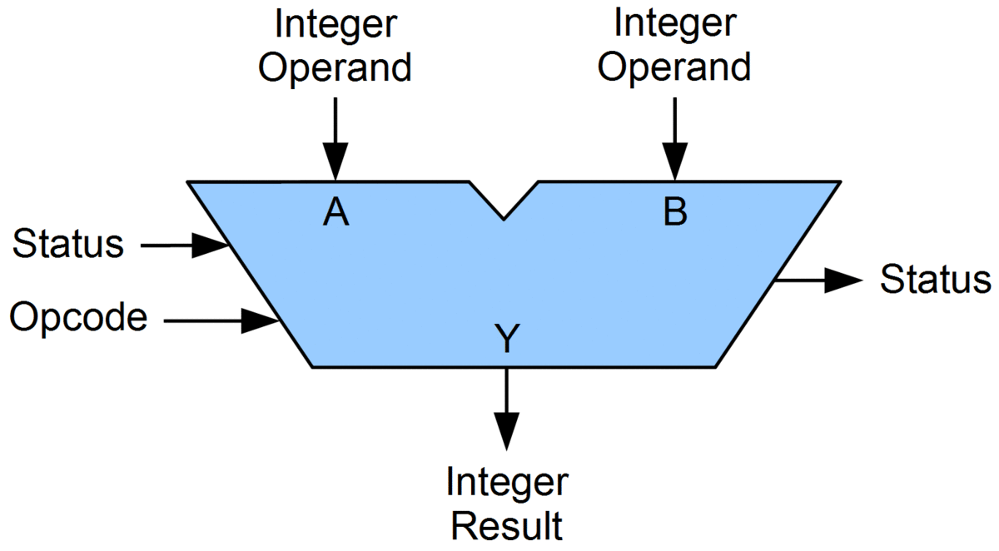

How CPU works?
CPU
Memory
mov 1, eax
Control Unit
mov 1, eax
0
1
2
3
50
0
PC (Program Counter)
50
ALU
IR (Instruction Register)
PSR
(Processor Status Register)
General Purpose Registers
eax
Bus
Fetch an instruction from memory.
Decode: Figure out which instruction this is
Execute: i.e., arithmetic/logic operations (e.g. add/and), memory, condition, branch, etc.
Repeat the above steps

Slide 5
Operating System (OS)
CPU
Memory
OS’s major functions
Manage Resources (virtualization)
CPU, Memory, Disk, etc.
Provide Services (system call)
Process (running program): Easily run programs
Memory: Share memory among processes
IO devices: Enable processes to interact with or operate/utilize devices
Fetches an instruction from the memory.
Decode: which instruction this is
Execute: e.g arithmetic, logic, memory, control,
Repeat the above
code
static data
heap
stack
Process
Bus
code
static data
Program
Disk

Slide 6
OS – Resource management via virtualization
The OS manages resources such as CPU, memory and disk.
many programs to run (processes) → Sharing the CPU
many processes to concurrently access their own instructions and data → Sharing memory
many processes to access devices → Sharing disks
etc.
How to achieve this – Virtualization
OS takes a physical resource and transforms it into a virtual form of itself.
Physical resource: Processor, Memory, Disk …
The virtual form is more general, powerful and easy-to-use.
We can refer to the OS as a “virtual” machine.

Slide 7
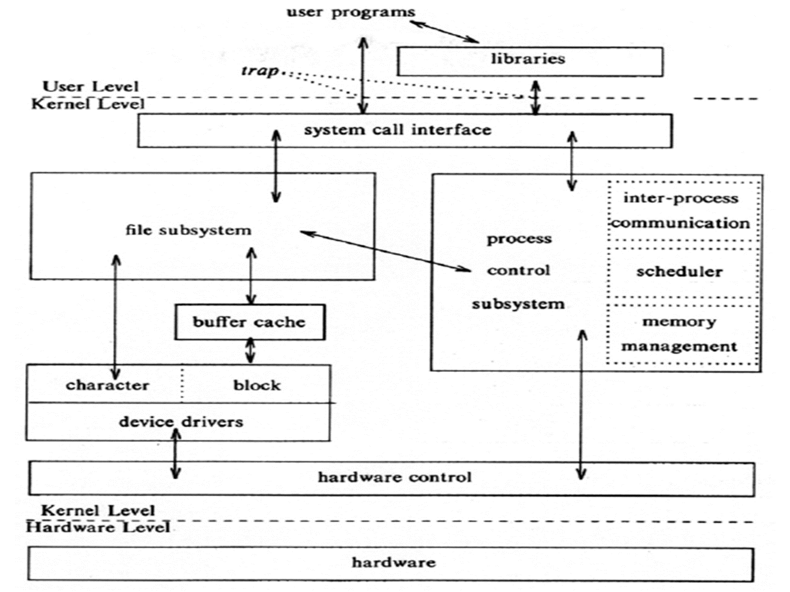
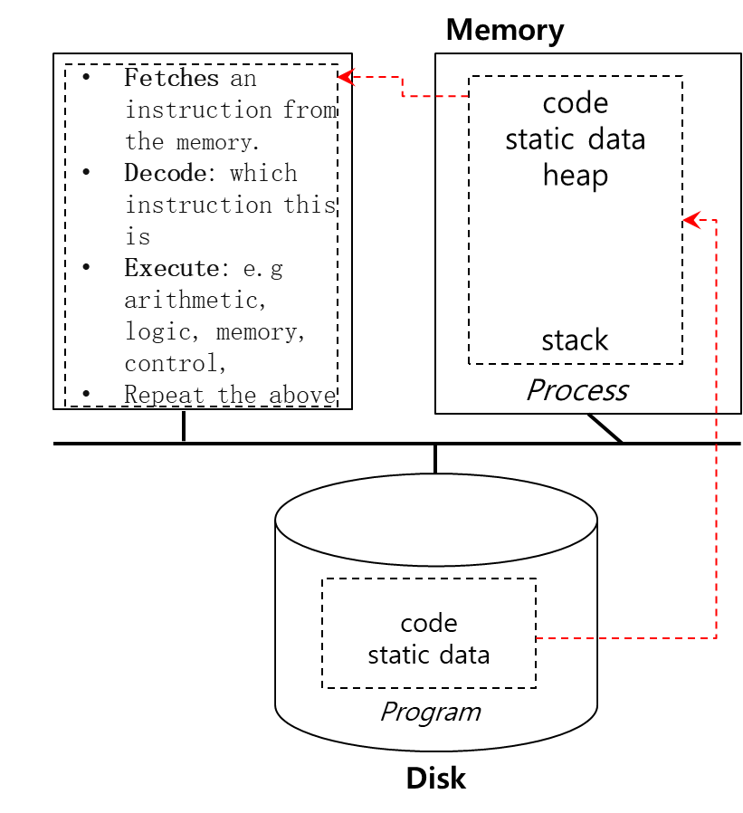
System call
OS provides services (to utilize resources) via System Call (typically a few hundred) to run process, access memory/devices, etc.
The Design Of The Unix Operating System (Maurice Bach, 1986)

Slide 8
Virtualizing the CPU
The system has a very large number of virtual CPUs.
Turn a single CPU into a seemingly infinite number of CPUs.
Allow many processes to seemingly run at the same time → Virtualizing the CPU

Slide 9
Virtualizing the CPU (Cont.)
1 #include <stdio.h>
2 #include <stdlib.h>
3 #include <sys/time.h>
4 #include <assert.h>
5 #include <unistd.h>
6
7 int main(int argc, char *argv[])
8 {
9 if (argc != 2) {
10 fprintf(stderr, "usage: cpu <string>\n");
11 exit(1);
12 }
13
14 char *str = argv[1];
15 int i=0;
16
17 while (i<100) {
18 sleep(1);
19 i++;
20 printf("%s\n", str);
21 }
22 return 0;
23 }
24
Simple Example(cpu.c): Code that loops and prints

Slide 10
Virtualizing the CPU (Cont.)
Execution result 1.
prompt> gcc -o cpu cpu.c -Wall
prompt> ./cpu A
A
A
A
ˆC
prompt>
Pressing “Ctrl-c” to halt the program

Slide 11
Virtualizing the CPU (Cont.)
Execution result 2.
prompt> ./cpu A & ./cpu B & ./cpu C & ./cpu D &
[1] 7353
[2] 7354
[3] 7355
[4] 7356
A
B
D
C
A
B
D
C
A
C
B
D
...
Even though we have only one CPU, the four processes seem to be running at the same time!

Slide 12
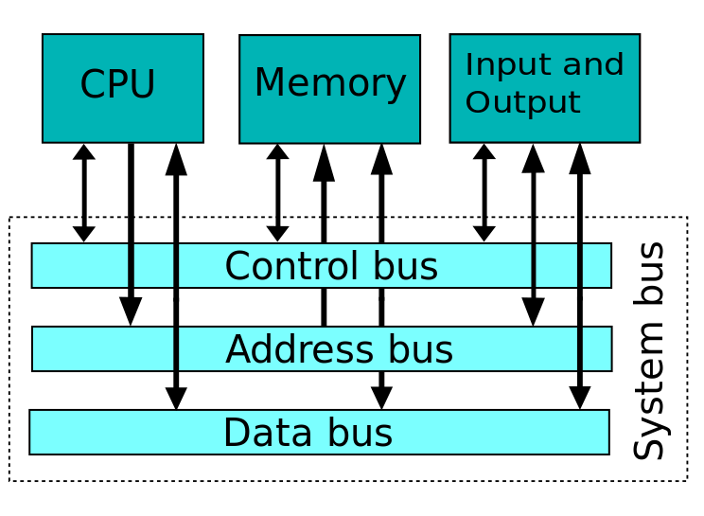
Virtualizing Memory
The physical memory is an array of bytes.
A program keeps all of its data structures in memory.
Read memory (load):
Specify an address to be able to access the data
Write memory (store):
Specify the data to be written to the given address

Slide 13
Virtualizing Memory (Cont.)
A program that Accesses Memory (mem.c)
1 #include <unistd.h>
2 #include <stdio.h>
3 #include <stdlib.h>
4 #include <assert.h>
5 #define MAX 100000000
6 int
7 main(int argc, char *argv[])
8 {
9 int *p = malloc(MAX*sizeof(int)); // a1: allocate memory
10 assert(p != NULL);
11 printf("(%d) Address Range: %p - %p\n",getpid(),
p, (p+MAX-1));
*p = 0; // a3: put zero into the first slot of the memory
13 int i=0;
14 while (i<10) {
15 sleep(1);
16 *p = *p + 1; i=i+1;
17 printf("(%d) p: %d\n", getpid(), *p);
18 }
19 return 0;
}

Slide 14
Virtualizing Memory (Cont.)
The output of the program mem.c
The newly allocated memory range is at Address Range: 0x7fca105ba010 - 0x7fca2833240c
It updates the value and prints out the results.
prompt> ./mem
(25187) Address Range: Address Range: 0x7fca105ba010 - 0x7fca2833240c
(25187) p: 1
(25187) p: 2
(25187) p: 3
(25187) p: 4
(25187) p: 5
(25187) p: 6
(25187) p: 7
(25187) p: 8
(25187) p: 9
(25187) p: 10

Slide 15
Virtualizing Memory (Cont.)
Running mem.c multiple times
The memory ranges from two processes are overlapped – Each process has its own private memory.
Each running program has allocated memory at its own address space.
Each seems to be updating the value independently.
prompt> ./mem & ./mem &
(25274) Address Range: 0x7fb44a50d010 - 0x7fb46228540c
(25275) Address Range: 0x7fb44a50d010 - 0x7fb46228540c
(25274) p: 1
(25275) p: 1
(25274) p: 2
(25275) p: 2
(25274) p: 3
(25275) p: 3
(25274) p: 4
(25275) p: 4
...

Slide 16
Virtualizing Memory (Cont.)
Each process accesses its own private virtual address space.
The OS maps address space onto the physical memory.
A memory reference within one running program does not affect the address space of other processes.
Physical memory is a shared resource, managed by the OS.

Slide 17
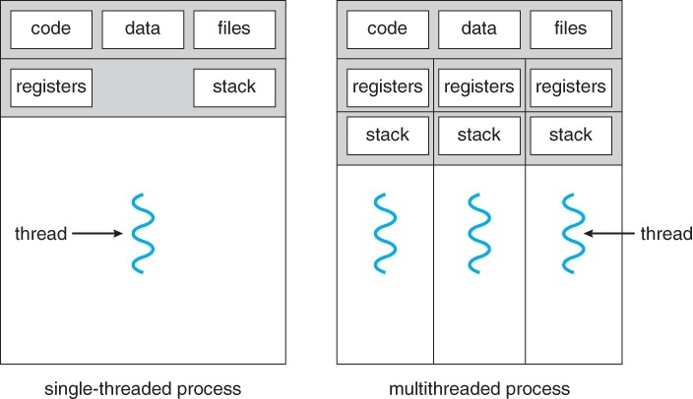
Concurrency Problem
The OS is juggling many things at once, first running one process, then another, and so forth.
Modern multi-threaded programs also exhibit the concurrency problem.

Slide 18
Concurrency Example
A Multi-threaded Program (thread.c)
1 #include <stdio.h>
2 #include <stdlib.h>
3 #include <pthread.h>
4
5 volatile int counter = 0;
6 int loops;
7
8 void *worker(void *arg) {
9 int i;
10 for (i = 0; i < loops; i++) {
11 counter++;
12 }
13 return NULL;
}

Slide 19
Concurrency Example (Cont.)
16 int
17 main(int argc, char *argv[])
18 {
19 if (argc != 2) {
20 fprintf(stderr, "usage: threads <value>\n");
21 exit(1);
22 }
23 loops = atoi(argv[1]);
24 pthread_t p1, p2;
25 printf("Initial value : %d\n", counter);
26
27 pthread_create(&p1, NULL, worker, NULL);
28 pthread_create(&p2, NULL, worker, NULL);
29 pthread_join(p1, NULL);
30 pthread_join(p2, NULL);
31 printf("Final value : %d\n", counter);
32 return 0;
33 }
The main program creates two threads.
Thread: a function running within the same memory space. Each thread starts running in a routine called worker().
worker(): increments a counter

Slide 20
Concurrency Example (Cont.)
loops determines how many times each of the two workers will increment the shared counter in a loop.
loops: 1000.
loops: 1000000000
.
prompt> gcc -o thread thread.c -Wall -pthread
prompt> ./thread 1000
Initial value : 0
Final value : 2000
prompt> ./thread 1000000000
Initial value : 0
Final value : 1997974414 // huh??
prompt> ./thread 1000000000
Initial value : 0
Final value : 1997940107 // what the??

Slide 21

Why is this happening?
Increment a shared counter → take three instructions.
Load the value of the counter from the memory into a register.
Increment it
Store it back into the memory
These three instructions do not execute atomically. → The problem of concurrency happens.

Slide 22
What happened?
Example with two threads
counter = counter + 1 (initial value: 50)
We expect the result is 52. However,
(after instruction)
OS
Thread1
Thread2
PC
%eax
counter
Initial value
mov 0x8049a1c, %eax
add $0x1, %eax
100
105
108
0
50
51
50
50
50
interrupt
save T1’s state
restore T2’s state
100
105
108
113
0
50
51
51
50
50
50
51
mov 0x8049a1c, %eax
add $0x1, %eax
mov %eax, 0x8049a1c
interrupt
save T2’s state
restore T1’s state
108
113
51
51
51
51
mov %eax, 0x8049a1c

Slide 23
Step 0: Initial Value (PC=100)
CPU
Memory
Control Unit
100
PC
ALU
IR
PSR
mov 0x8049a1c, %eax
100
105
108
0x 0x8049a1c (counter)
Thread 2’s local copy of %eax in memory
Thread 1’s local copy of %eax in memory
add $0x1, %eax
General Purpose Registers
mov %eax, 0x8049a1c
%eax
0
50
50
100
Thread 2’s local copy of PC in memory
Thread 1’s local copy of PC in memory
0

Slide 24
Step 1: Fetch instruction from the memory (PC->Address=100)
CPU
Memory
Control Unit
100
PC
ALU
mov 0x8049a1c, %eax
IR
PSR
mov 0x8049a1c, %eax
100
105
108
0x 0x8049a1c (counter)
Thread 2’s local copy of %eax in memory
Thread 1’s local copy of %eax in memory
add $0x1, %eax
General Purpose Registers
mov %eax, 0x8049a1c
%eax
0
50
50
100
Thread 2’s local copy of PC in memory
Thread 1’s local copy of PC in memory
0

Slide 25
Steps 2 & 3: Decode & Execution
CPU
Memory
Control Unit
100
PC
ALU
mov 0x8049a1c, %eax
IR
PSR
mov 0x8049a1c, %eax
100
105
108
0x 0x8049a1c (counter)
Thread 2’s local copy of %eax in memory
Thread 1’s local copy of %eax in memory
add $0x1, %eax
General Purpose Registers
mov %eax, 0x8049a1c
%eax
50
50
50
100
Thread 2’s local copy of PC in memory
Thread 1’s local copy of PC in memory
0

Slide 26
Step 4: Increase PC (pointed to the next instruction in the memory)
CPU
Memory
Control Unit
105
PC
ALU
mov 0x8049a1c, %eax
IR
PSR
mov 0x8049a1c, %eax
100
105
108
0x 0x8049a1c (counter)
Thread 2’s local copy of %eax in memory
Thread 1’s local copy of %eax in memory
add $0x1, %eax
General Purpose Registers
mov %eax, 0x8049a1c
%eax
50
50
50
100
Thread 2’s local copy of PC in memory
Thread 1’s local copy of PC in memory
0

Slide 27
Step 1: Fetch instruction from the memory (PC->Address=105)
CPU
Memory
Control Unit
105
PC
ALU
add $0x1, %eax
IR
PSR
mov 0x8049a1c, %eax
100
105
108
0x 0x8049a1c (counter)
Thread 2’s local copy of %eax in memory
Thread 1’s local copy of %eax in memory
add $0x1, %eax
General Purpose Registers
mov %eax, 0x8049a1c
%eax
50
50
50
100
Thread 2’s local copy of PC in memory
Thread 1’s local copy of PC in memory
0

Slide 28
Steps 2 & 3: Decode & Execution
CPU
Memory
Control Unit
105
PC
ALU
add $0x1, %eax
IR
PSR
mov 0x8049a1c, %eax
100
105
108
0x 0x8049a1c (counter)
Thread 2’s local copy of %eax in memory
Thread 1’s local copy of %eax in memory
add $0x1, %eax
General Purpose Registers
mov %eax, 0x8049a1c
%eax
51
50
50
100
Thread 2’s local copy of PC in memory
Thread 1’s local copy of PC in memory
0

Slide 29
Step 3: Increase PC (pointed to the next instruction in the memory)
CPU
Memory
Control Unit
108
PC
ALU
add $0x1, %eax
IR
PSR
mov 0x8049a1c, %eax
100
105
108
0x 0x8049a1c (counter)
Thread 2’s local copy of %eax in memory
Thread 1’s local copy of %eax in memory
add $0x1, %eax
General Purpose Registers
mov %eax, 0x8049a1c
%eax
51
50
50
100
Thread 2’s local copy of PC in memory
Thread 1’s local copy of PC in memory
0

Slide 30
Interrupt occurred; Save Thread 1’s state
CPU
Memory
Control Unit
108
PC
ALU
add $0x1, %eax
IR
PSR
mov 0x8049a1c, %eax
100
105
108
0x 0x8049a1c (counter)
Thread 2’s local copy of %eax in memory
Thread 1’s local copy of %eax in memory
add $0x1, %eax
General Purpose Registers
mov %eax, 0x8049a1c
%eax
51
50
50
100
Thread 2’s local copy of PC in memory
Thread 1’s local copy of PC in memory
0
108
51

Slide 31
Restore Thread 2’s state
CPU
Memory
Control Unit
100
PC
ALU
add $0x1, %eax
IR
PSR
mov 0x8049a1c, %eax
100
105
108
0x 0x8049a1c (counter)
Thread 2’s local copy of %eax in memory
Thread 1’s local copy of %eax in memory
add $0x1, %eax
General Purpose Registers
mov %eax, 0x8049a1c
%eax
0
50
50
100
Thread 2’s local copy of PC in memory
Thread 1’s local copy of PC in memory
0
108
51

Slide 32
Step 1: Fetch instruction from the memory (PC->Address=100)
CPU
Memory
Control Unit
100
PC
ALU
mov 0x8049a1c, %eax
IR
PSR
mov 0x8049a1c, %eax
100
105
108
0x 0x8049a1c (counter)
Thread 2’s local copy of %eax in memory
Thread 1’s local copy of %eax in memory
add $0x1, %eax
General Purpose Registers
mov %eax, 0x8049a1c
%eax
0
50
50
100
Thread 2’s local copy of PC in memory
Thread 1’s local copy of PC in memory
0
108
51

Slide 33
Steps 2 & 3: Decode & Execution
CPU
Memory
Control Unit
100
PC
ALU
mov 0x8049a1c, %eax
IR
PSR
mov 0x8049a1c, %eax
100
105
108
0x 0x8049a1c (counter)
Thread 2’s local copy of %eax in memory
Thread 1’s local copy of %eax in memory
add $0x1, %eax
General Purpose Registers
mov %eax, 0x8049a1c
%eax
50
50
50
100
Thread 2’s local copy of PC in memory
Thread 1’s local copy of PC in memory
0
108
51

Slide 34
Step 4: Increase PC (pointed to the next instruction in the memory)
CPU
Memory
Control Unit
105
PC
ALU
mov 0x8049a1c, %eax
IR
PSR
mov 0x8049a1c, %eax
100
105
108
0x 0x8049a1c (counter)
Thread 2’s local copy of %eax in memory
Thread 1’s local copy of %eax in memory
add $0x1, %eax
General Purpose Registers
mov %eax, 0x8049a1c
%eax
50
50
50
100
Thread 2’s local copy of PC in memory
Thread 1’s local copy of PC in memory
0
108
51

Slide 35
Step 1: Fetch instruction from the memory (PC->Address=105)
CPU
Memory
Control Unit
105
PC
ALU
add $0x1, %eax
IR
PSR
mov 0x8049a1c, %eax
100
105
108
0x 0x8049a1c (counter)
Thread 2’s local copy of %eax in memory
Thread 1’s local copy of %eax in memory
add $0x1, %eax
General Purpose Registers
mov %eax, 0x8049a1c
%eax
50
50
50
100
Thread 2’s local copy of PC in memory
Thread 1’s local copy of PC in memory
0
108
51

Slide 36
Steps 2 & 3: Decode & Execution
CPU
Memory
Control Unit
105
PC
ALU
add $0x1, %eax
IR
PSR
mov 0x8049a1c, %eax
100
105
108
0x 0x8049a1c (counter)
Thread 2’s local copy of %eax in memory
Thread 1’s local copy of %eax in memory
add $0x1, %eax
General Purpose Registers
mov %eax, 0x8049a1c
%eax
51
50
50
100
Thread 2’s local copy of PC in memory
Thread 1’s local copy of PC in memory
0
108
51

Slide 37
Step 4: Increase PC (pointed to the next instruction in the memory)
CPU
Memory
Control Unit
108
PC
ALU
add $0x1, %eax
IR
PSR
mov 0x8049a1c, %eax
100
105
108
0x 0x8049a1c (counter)
Thread 2’s local copy of %eax in memory
Thread 1’s local copy of %eax in memory
add $0x1, %eax
General Purpose Registers
mov %eax, 0x8049a1c
%eax
51
50
50
100
Thread 2’s local copy of PC in memory
Thread 1’s local copy of PC in memory
0
108
51

Slide 38
Step 1: Fetch instruction from the memory (PC->Address=108)
CPU
Memory
Control Unit
108
PC
ALU
mov %eax, 0x8049a1c
IR
PSR
mov 0x8049a1c, %eax
100
105
108
0x 0x8049a1c (counter)
Thread 2’s local copy of %eax in memory
Thread 1’s local copy of %eax in memory
add $0x1, %eax
General Purpose Registers
mov %eax, 0x8049a1c
%eax
51
50
50
100
Thread 2’s local copy of PC in memory
Thread 1’s local copy of PC in memory
0
108
51

Slide 39
Steps 2 & 3: Decode & Execution
CPU
Memory
Control Unit
108
PC
ALU
mov %eax, 0x8049a1c
IR
PSR
mov 0x8049a1c, %eax
100
105
108
0x 0x8049a1c (counter)
Thread 2’s local copy of %eax in memory
Thread 1’s local copy of %eax in memory
add $0x1, %eax
General Purpose Registers
mov %eax, 0x8049a1c
%eax
51
51
100
Thread 2’s local copy of PC in memory
Thread 1’s local copy of PC in memory
0
108
51

Slide 40
Step 4: Increase PC (pointed to the next instruction in the memory)
CPU
Memory
Control Unit
113
PC
ALU
mov %eax, 0x8049a1c
IR
PSR
mov 0x8049a1c, %eax
100
105
108
113
0x 0x8049a1c (counter)
Thread 2’s local copy of %eax in memory
Thread 1’s local copy of %eax in memory
add $0x1, %eax
General Purpose Registers
mov %eax, 0x8049a1c
%eax
51
51
100
Thread 2’s local copy of PC in memory
Thread 1’s local copy of PC in memory
0
108
51

Slide 41
Interrupt occurred; Save Thread 2’s state
CPU
Memory
Control Unit
113
PC
ALU
mov %eax, 0x8049a1c
IR
PSR
mov 0x8049a1c, %eax
100
105
108
113
0x 0x8049a1c (counter)
Thread 2’s local copy of %eax in memory
Thread 1’s local copy of %eax in memory
add $0x1, %eax
General Purpose Registers
mov %eax, 0x8049a1c
%eax
51
51
113
Thread 2’s local copy of PC in memory
Thread 1’s local copy of PC in memory
51
108
51

Slide 42
Restore Thread 1’s state
CPU
Memory
Control Unit
108
PC
ALU
mov %eax, 0x8049a1c
IR
PSR
mov 0x8049a1c, %eax
100
105
108
113
0x 0x8049a1c (counter)
Thread 2’s local copy of %eax in memory
Thread 1’s local copy of %eax in memory
add $0x1, %eax
General Purpose Registers
mov %eax, 0x8049a1c
%eax
51
51
113
Thread 2’s local copy of PC in memory
Thread 1’s local copy of PC in memory
51
108
51

Slide 43
Step 1: Fetch instruction from the memory (PC->Address=108)
CPU
Memory
Control Unit
108
PC
ALU
mov %eax, 0x8049a1c
IR
PSR
mov 0x8049a1c, %eax
100
105
108
113
0x 0x8049a1c (counter)
Thread 2’s local copy of %eax in memory
Thread 1’s local copy of %eax in memory
add $0x1, %eax
General Purpose Registers
mov %eax, 0x8049a1c
%eax
51
51
100
Thread 2’s local copy of PC in memory
Thread 1’s local copy of PC in memory
0
108
51

Slide 44
Step 2 & 3: Decode & Execution
CPU
Memory
Control Unit
108
PC
ALU
mov %eax, 0x8049a1c
IR
PSR
mov 0x8049a1c, %eax
100
105
108
113
0x 0x8049a1c (counter)
Thread 2’s local copy of %eax in memory
Thread 1’s local copy of %eax in memory
add $0x1, %eax
General Purpose Registers
mov %eax, 0x8049a1c
%eax
51
51
100
Thread 2’s local copy of PC in memory
Thread 1’s local copy of PC in memory
0
108
51

Slide 45
Step 4: Increase PC (pointed to the next instruction in the memory)
CPU
Memory
Control Unit
113
PC
ALU
mov %eax, 0x8049a1c
IR
PSR
mov 0x8049a1c, %eax
100
105
108
113
0x 0x8049a1c (counter)
Thread 2’s local copy of %eax in memory
Thread 1’s local copy of %eax in memory
add $0x1, %eax
General Purpose Registers
mov %eax, 0x8049a1c
%eax
51
51
100
Thread 2’s local copy of PC in memory
Thread 1’s local copy of PC in memory
0
108
51

Slide 46
Persistence
Devices such as DRAM store values in a volatile manner.
Hardware and software are needed to store data persistently.
Hardware: I/O device such as a hard drive, solid-state drives(SSDs)
Software:
File system manages storage devices (hard drives, SSDs, etc.).
File system is responsible for storing files that users create.
Regular files
Directory files
Special files (e.g. devices – keyboards, monitors, etc.)
etc.

Slide 47
Persistence (Cont.)
Create a file (myfile) that contains the string “hello world” (fs.c)
1 #include <stdio.h>
2 #include <unistd.h>
3 #include <assert.h>
4 #include <fcntl.h>
5 #include <sys/types.h>
6
7 int
8 main(int argc, char *argv[])
9 {
10 int fd = open("myfile", O_WRONLY | O_CREAT | O_TRUNC, S_IRWXU);
11 assert(fd > -1);
12 int rc = write(fd, "hello world\n", 13);
13 assert(rc == 13);
14 close(fd);
15 return 0;
16 }
open(), write(), and close() system calls are routed to the part of OS called the file system, which handles the requests

Slide 48
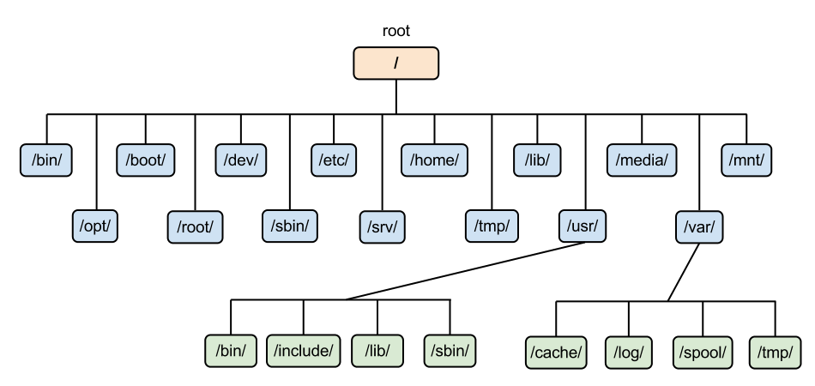

Persistence (Cont.)
What OS does in order to write data to the disk?
Store file meta data in the disk (file name, creation time, etc.)
Figure out where on the disk this new data will reside
Issue I/O requests to the underlying storage device
File system handles system crashes during write.
Journaling or copy-on-write
Carefully order writes to disk

Slide 49
Design Goals
Build up abstraction
Make the system convenient and easy to use.
Provide high performance
Minimize the overhead of the OS.
OS must strive to provide virtualization without excessive overhead.
Protection between applications
Isolation: Bad behavior of one does not harm others and the OS itself.
High degree of reliability
It is desirable for OS to run non-stop.
Other issues: Energy-efficiency, Security, Mobility

Slide 50
Summary
Computer architecture (Von Neumann): CPU, Memory, and IO devices
OS main functions
Manage resources via virtualization
CPU, Memory, IO devices (e.g. storage (e.g. hard drives), keyboard, etc.)
Provide services via system calls
Process (run programs), memory management, file, etc.
Design goals
Abstraction, high performance, protection, reliability etc.
Related Chapter: Chapter 2 (2.1 – 2.5)
Next: User-level programming using system calls (process, memory, file)
Chapter 5 (Process) , Chapter 14 (Memory) , Chapter 39 (Files)
Self study: Lab tutorial

