Slide 1
Lecture 2: User-level Programming via System Calls (Process)

Slide 2
The Course Organization (Bottom-up)
Race Conditions, Lock/Semaphore
Concurrency
Thread
Memory Management
HW#4
Virtualization
Process and CPU Scheduling
HW#3
IO Devices and Storage
HW#2
&
Project
Persistence
File System
System Calls (User-level Programming)
HW#1

Slide 3
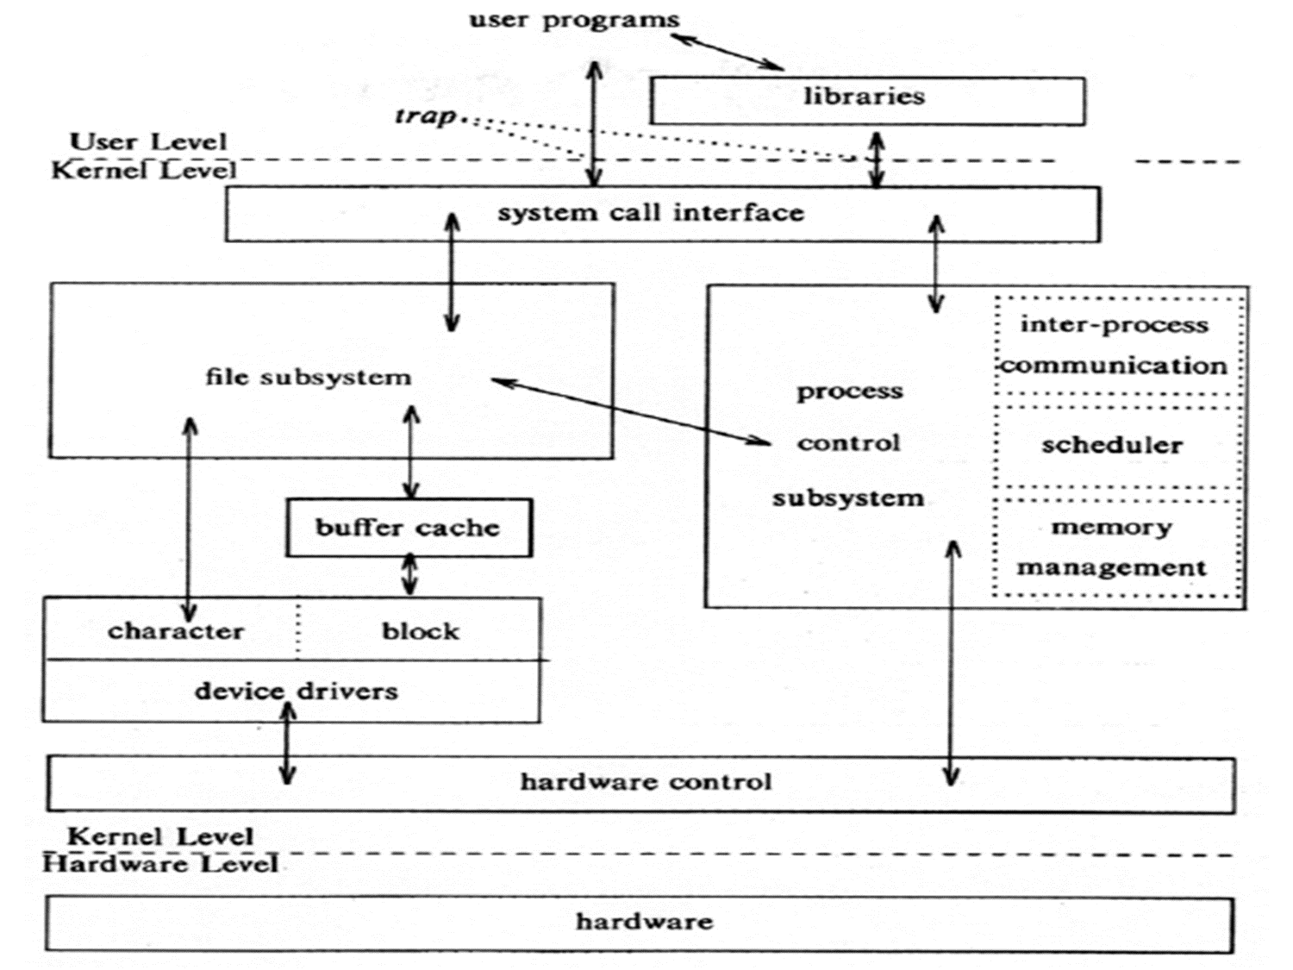
System call
OS provides services via System Call (typically a few hundred) to run process, access memory/devices/files, etc.
The Design Of The Unix Operating System (Maurice Bach, 1986)

Slide 4
Process
A process is an instance of a program in execution (running program)
process is dynamic while program is static.
A process is the basic unit for competing the resources and CPU scheduling.
What happens when a program become a process?
The program is read into memory,
A unique process ID is assigned,
Appropriate information is added to the OS kernel structure,
Necessary resources (e.g. registers) to run the program code is allocated, and
Have a thread of execution – a stream of instructions and a program counter.

Slide 5
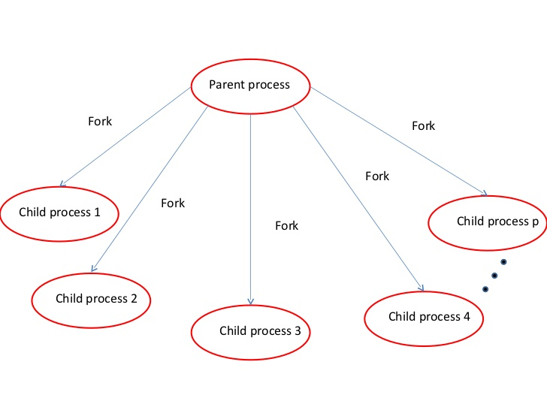
Process characteristics
A process has
a unique ID,
a thread of control, and
some private data
A hierarchy of processes by parent-child links
The process that executes the request for creation of a process is called the parent of that process, and the created process is called the child.
A child process inherits all the properties of its parent when it is created

Slide 6
Process ID
How can we identify processes from one to another?
Each process is given an unique ID number, and is called the process ID, or PID.
The system call, getpid(), prints the PID of the calling process.
UID: Each user has a unique user ID
Each process is associated with a particular user called the owner of the process
The owner has certain privileges with respect to the process.
Use getpid, getppid and getuid to obtain the ID of the child, the parent, and the owner.
#include <stdio.h> // printf()
#include <unistd.h> // getpid()
int main(void) {
printf("My PID is %d\n", getpid() );
return 0;
}
$ ./getpid
My PID is 1234
$ ./getpid
My PID is 1235
$ ./getpid
My PID is 1237

Slide 7

Process ID: using Command ps
ps is the short for process status.
“ps” lists your current processes
“ps -a ” lists more processes, including ones being run by other users and at other terminals (but not include the shells)
“ps -l ” prints longer, more information lines, including UID, PID, PPID, process status, etc.

Slide 8
Process creation
To create a process, we use the system call fork().
Not this
Original execution flow
of a process
Child process
The process
invokes fork().
Flow of original process
Flow of newly-created process

Slide 9
Example for fork()
1 #include <stdio.h>
2 #include <sys/types.h>
3 #include <unistd.h>
4
5 int main(void)
6 {
7 int ret_from_fork;
8
9 printf("Before: my pid is %d\n", getpid());
10
11 ret_from_fork = fork();
12
13 sleep(1);
14
15 printf("After: my pid is %d, return value from fork():%d\n",
16 getpid(), ret_from_fork);
17
18 return 0;
19 }
Simple Example(fork.c): The code that creates a child process

Slide 10
Values returned by fork()
The value returned by fork() allows the parent and the child to execute different part of the code.
The fork returns 0 to the child and returns the child’s PID to the parent:
1 int main(void) {
2 int result;
3 printf("before fork ...\n");
4 result = fork();
5 printf("result = %d.\n", result);
6
7 if(result == 0) {
8 printf("I'm the child.\n");
9 printf("My PID is %d\n", getpid());
10 }
11 else {
12 printf("I'm the parent.\n");
13 printf("My PID is %d\n", getpid());
14 }
15
printf("program terminated.\n");
return 0;
17 }

Slide 11
Create Child Processes
Create a chain of processes
Create a fan of processes
How many?
fork();
fork();
fork();
1
1
2
2
3
4
3
4

Slide 12
wait( )
After fork, both parent and child proceed independently. If a parent wants to wait until the child finishes, it executes wait or waitpid.
pid_t wait(int *stat);
In general, the wait system call
Cause the caller process to pause until a child terminates or stops or until the caller receives a signal.
However, it returns right away
if the process has no children or
if a child has already terminated or stopped but has not yet been waited for
Return value: If wait returns because a child terminated, the return value is positive and is the PID of that child; otherwise, wait returns -1 and sets errno.
What happen if the parent terminates first without waiting for its children? (the children are still running) - Orphan
The stat is a pointer to an integer variable that stores the exit status of the child.

Slide 13
Example for wait()
1 #include <stdio.h>
2 #include <sys/types.h>
3 #include <sys/wait.h>
4 #include <unistd.h>
5 #include <errno.h>
6
7 int main(void)
8 {
9 int i;
10 int n=5;
11 pid_t childpid;
12 int status;
13 pid_t waitreturn;
14
15 for (i = 1; i < n; ++i)
16 if ( (childpid = fork()) >0 )
17 break;
18
19 if((waitreturn = wait(&status))<0)
20 printf("wait(): Return <0 - %d.\n", waitreturn);
21
22
23 printf("My PID:%d, Parent PID: %d\n", getpid(), getppid());
24
25 return 0;
26 }

Slide 14
The exec system call
The fork system call creates a copy of the calling process. However, many applications require the child process to execute code different from the parent’s.
The exec() family of system calls provides a facility for overlaying the calling process with a new executable module
exec loads a new executable into the process image, copies arguments into the process, and calls main(argc, argv).
If successful, exec never returns; the calling process is completely overlaid by the new program and is started from its beginning
The traditional way to use the fork-exec combination is to have the child execute the new program while the parent continues to execute the original code

Slide 15
Example for exec()
1 #include <sys/types.h>
2 #include <sys/wait.h>
3 #include <unistd.h>
4 #include <stdio.h>
5 #include <stdlib.h>
6
7 int main(void)
8 {
9 pid_t childpid;
10 int status;
11
12 char *cmd = "ls";
13 char *argv[2];
14 argv[0] = "ls";
15 argv[1] = NULL;
16
17 if ((childpid = fork()) == -1){
18 printf("Error: fork()\n");
19 return -1;
20 } else if (childpid == 0) {
21 /*child code*/
22 if (execvp(cmd, argv) < 0) {
23 printf("Error: execvp()\n");
24 return -1;
25 }
26 }else if (childpid != wait(&status)){
27 /* parent code */
28 printf("Error: wait()");
29 return -1;
30 }
31
32 return 0;
33 }

Slide 16
execvp()
Example #1: run the command ls (Use whereis to find where a command locates)
char *cmd = "ls";
char *argv[2];
argv[0] = "ls";
argv[1] = NULL;
execvp(cmd, argv);
int execvp(const char *file, char *const argv[]);
Description:
The exec() family of functions replaces the current process image with a new process image.
The execvp() function provides an array of pointers to null-terminated strings that represent the argument list available to the new program.
The first argument, by convention, should point to the filename associated with the file being executed (The search path is the path specified in the environment by PATH variable).
The array of pointers must be terminated by a NULL pointer.

Slide 17
Variations of exec system call
Six variations of the exec system call, which can be distinguished by
the way command-line arguments and environment are passed, and
whether a pathname has to be given for the executable.
The execl calls (execl, execlp, and execle)
pass the command-line arguments as a list of pointers
The execv calls (execv, execvp, execve)
pass the command-line arguments in an argument array
In all calls, in addition to the pathname, name of the executable must also be provided, either as a separate parameter or as the first element of the argument array.

Slide 18
Process termination
Upon termination of a process, the OS de-allocates the resources held by the process, updates the appropriate statistics, and notifies other processes:
Canceling pending timers and signals,
Releasing virtual memory spaces,
Releasing locks, closing open files
Notifying the parent in response to a wait system call
What happened if the parent of the terminating process is not currently executing a wait()? – Zombie
A zombie process is not an orphan process – an orphan process is a process that is still executing, but whose parent has died.
All orphan processes are adopted by init (process ID 1)
A process can terminate either normally or abnormally.

Slide 19
Normal process termination
A normal termination occurs if there was
a return from main,
an implicit return from main,
a call to the _exit system call.
a call to the C function exit, or
exit calls user-defined exit handlers and may provide additional cleanup before it invokes the _exit system call.
exit takes a single, integer argument, called exit status, which will be made available to the parent process (which may be waiting). By convention, a zero means success, some non-zero value means something has gone wrong.

Slide 20
Abnormal process termination
A process can terminate abnormally by
calling abort, causing the SIGABRT signal to be sent to the calling process, or
processing a signal that causes termination.
A code dump may be produced.
User-installed exit handlers will not be called upon abnormal termination.

Slide 21
Background processes
The shell is a command interpreter which
prompts for commands,
reads the commands from standard input, forks children to execute the commands, and waits for the children to finish.
A user can terminate execution of a command by ctrl-c.
Most shells interpret a command line ending with & as one that should be executed by a background process
When a shell creates a background process, it does not wait for the process to complete before issuing a prompt and accepting additional commands
ctrl-c does not terminate a background process.

Slide 22
Summary
System calls related to process
Creation: fork()
Wait: wait()
Change: exec()
Terminate: _exit()
Next: User-level programming using system calls (process, memory, file)
Chapter 14 (Memory) , Chapter 39 (Files)

