Slide 1
Lecture 3: User-level Programming via System Calls (Memory)

Slide 2
The Course Organization (Bottom-up)
Race Conditions, Lock/Semaphore
Concurrency
Thread
Memory Management
HW#4
Virtualization
Process and CPU Scheduling
HW#3
IO Devices and Storage
HW#2
&
Project
Persistence
File System
System Calls (User-level Programming)
HW#1

Slide 3
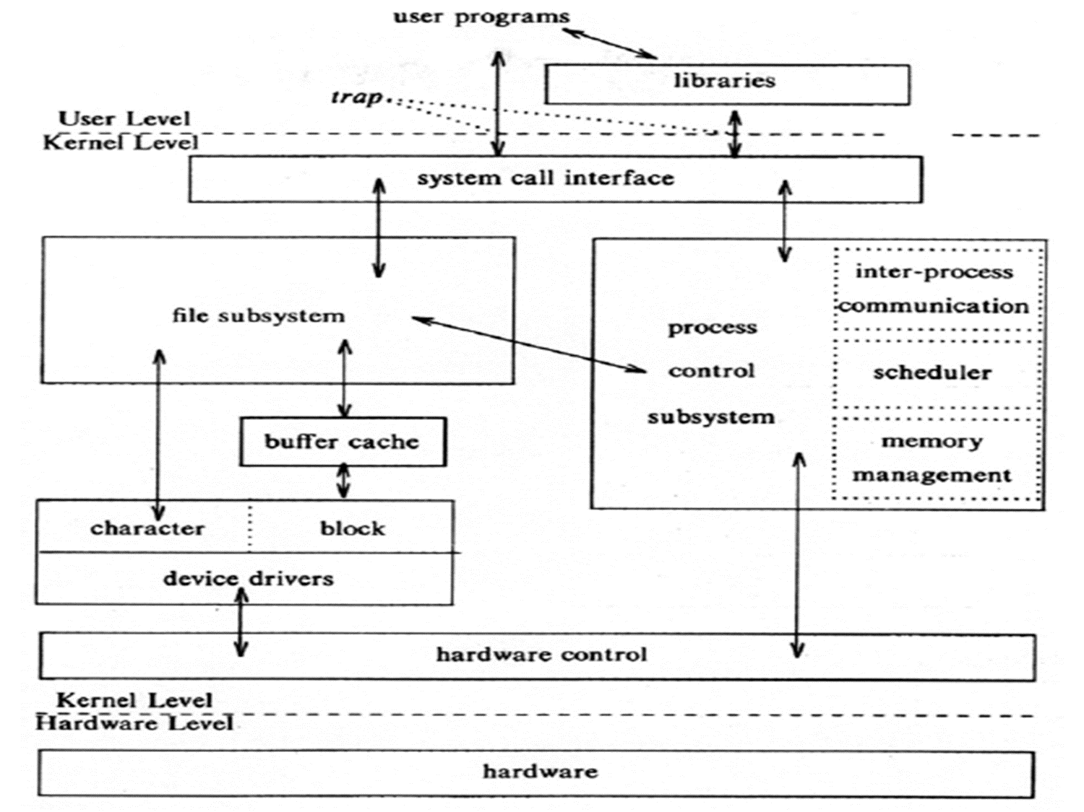
System call
OS provides services via System Call (typically a few hundred) to run process, access memory/devices/files, etc.
The Design Of The Unix Operating System (Maurice Bach, 1986)

Slide 4
System Calls Related to Memory Allocation
Several system calls
User programming should not directly call them but use memory API (library functions).
#include <unistd.h>
int brk(void *addr)
void *sbrk(intptr_t increment);
#include <sys/mman.h>
void *mmap(void *ptr, size_t length, int port, int flags, int fd, off_t offset)

Slide 5
Memory API: malloc()
Allocate a memory region on the heap.
Argument
size_t size : size of the memory block(in bytes)
size_t is an unsigned integer type.
Return
Success : a void type pointer to the memory block allocated by malloc
Fail : a null pointer
#include <stdlib.h>
void* malloc(size_t size)

Slide 6
sizeof()
Routines and macros utilize sizeof in malloc instead typing in a number directly.
Two types of results of sizeof with variables
The actual size of ‘x’ is known at run-time.
The actual size of ‘x’ is known at compile-time.
int *x = malloc(10 * sizeof(int));
printf(“%d\n”, sizeof(x));
4 (for 32-bit CPU) or 8 (for 64-bit CPU)
int x[10];
printf(“%d\n”, sizeof(x));
40

Slide 7
Memory API: free()
Free a memory region allocated by a call to malloc.
Argument
void *ptr : a pointer to a memory block allocated with malloc
Return
none
#include <stdlib.h>
void free(void* ptr)

Slide 8
Common Error: Forgetting To Allocate Memory
Incorrect code
char *src = “hello”; //character string constant
char *dst; //unallocated
strcpy(dst, src); //segfault and die
hello
(free)
heap
strcpy(dst, src);
unallocated
stack
*dst
*src
Address Space

Slide 9
Common Error: Forgetting To Allocate Memory(Cont.)
Correct code
char *src = “hello”; //character string constant
char *dst (char *)malloc(strlen(src) + 1 ); // allocated
strcpy(dst, src); //work properly
hello
hello
allocated
hello
(free)
(free)
strcpy(dst, src);
heap
heap
stack
stack
*dst
*dst
*src
*src
Address Space
Address Space

Slide 10
Common Error: Not Allocating Enough Memory
Incorrect code, but work properly
char *src = “hello”; //character string constant
char *dst (char *)malloc(strlen(src)); // too small
strcpy(dst, src); //work properly
h
6 bytes
strlen
e
l
l
o
\0
hello
‘\0’ is omitted
5 bytes
(free)
strcpy(dst, src);
heap
stack
*dst
*src
Address Space

Slide 11
Common Error: Forgetting to Initialize
Encounter an uninitialized read
int *x = (int *)malloc(sizeof(int)); // allocated
printf(“*x = %d\n”, *x); // uninitialized memory access
value used before
(free)
allocated
with value used before
(free)
(free)
heap
heap
stack
stack
*x
*x
Address Space
Address Space

Slide 12
Common Error: Memory Leak
A program runs out of memory and eventually dies.
unused
: unused, but not freed
allocated
unused
unused
(free)
allocated
unused
(free)
unused
heap
heap
heap
allocated
stack
(free)
stack
*d
*c
*b
*b
*a
*a
*a
Address Space
Address Space
Address Space
run out of memory

Slide 13
Common Error: Dangling Pointer
Freeing memory before it is finished using
A program accesses to memory with an invalid pointer
*b
*b
free()
unreachable
*a
*a
dangling pointer
2KB
3KB
2KB
3KB
3KB
4KB
3KB
free(b)
freed
4KB
4KB
NULL
NULL
(free)
Heap
Heap
(free)
Stack
Stack
*b
3KB
*b
3KB
*a
2KB
*a
2KB
Address Space
Address Space

Slide 14
Common Error: Double Free
Free memory that was freed already.
int *x = (int *)malloc(sizeof(int)); // allocated
free(x); // free memory
free(x); // free repeatedly
2KB
allocated
2KB
freed
(free)
(free)
Heap
Heap
free(x)
free(x)
Undefined Error
Stack
Stack
16KB
2KB
*x
16KB
2KB(invalid)
*x
Address Space
Address Space
Address Space

Slide 15
Other Memory APIs: calloc()
Allocate memory on the heap and set with zero before returning.
Argument
size_t num : number of blocks to allocate
size_t size : size of each block(in bytes)
Return
Success : a void type pointer to the memory block allocated by calloc
Fail : a null pointer
#include <stdlib.h>
void *calloc(size_t num, size_t size)

Slide 16
Other Memory APIs: realloc()
Change the size of memory block.
A pointer returned by realloc may be either the same as ptr or a new.
Argument
void *ptr: Pointer to memory block allocated with malloc, calloc or realloc
size_t size: New size for the memory block(in bytes)
Return
Success: Void type pointer to the memory block
Fail : Null pointer
#include <stdlib.h>
void *realloc(void *ptr, size_t size)

Slide 17
Summary
Functions related to memory allocation
Allocation: malloc()
Free: free()
Allocation & Initialization: calloc()
Re-allocation: realloc()
Next: User-level programming using system calls (file & Directory)
Chapter 39 (Files)

