Slide 1
Lecture 4: User-level Programming via System Calls (File & Directory)

Slide 2
The Course Organization (Bottom-up)
Race Conditions, Lock/Semaphore
Concurrency
Thread
Memory Management
HW#4
Virtualization
Process and CPU Scheduling
HW#3
IO Devices and Storage
HW#2
&
Project
Persistence
File System
System Calls (User-level Programming)
HW#1

Slide 3
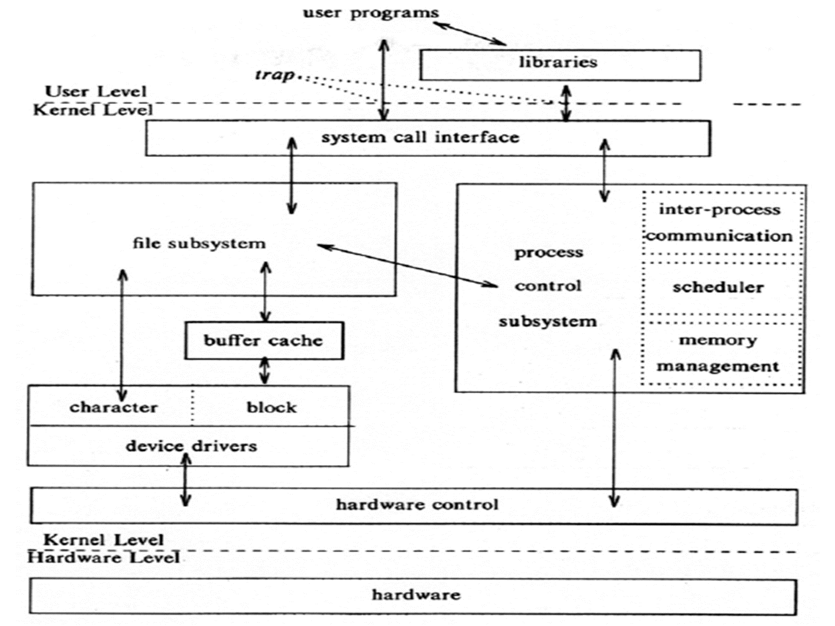
System call
OS provides services via System Call (typically a few hundred) to run process, access memory/devices/files, etc.
The Design Of The Unix Operating System (Maurice Bach, 1986)

Slide 4
Persistent Storage
Keep a data intact even if there is a power loss.
Hard disk drive
Solid-state storage device
Two key abstractions in the virtualization of storage
File
Directory

Slide 5
File and Directory
File – A container to contain data of a file (a linear array of bytes)
Each file has low-level name (inode number)
Directory – Implement directory tree (directory hierarchy)
Like a file, it also has a low-level name (inode number).
It contains a list of (file name, inode number) pairs.
Each entry in a directory refers to either files or other directories.
/
root
dirC
dirA
My3.dat
dirB
My1.dat
My2.dat
My1.dat
inode number file name
123 | .
247 | . .
220 | dirB
230 | My1.dat
230 | My2.dat

Slide 6
Creating Files
Use open() system call with O_CREAT flag.
O_CREAT : create file.
O_WRONLY : only write to that file while opened.
O_TRUNC : make the file size zero (remove any existing content).
open() system call returns file descriptor.
File descriptor is an integer, and is used to access files.
read(file descriptor, buffer pointer, the number of bytes to read from)
Return the number of bytes it read
write(file descriptor, buffer pointer, the number of bytes to write to)
Return the number of bytes it write
int myfd = open(“/home/ann/my.dat”, O_CREAT | O_WRONLY | O_TRUNC);

Slide 7
The Story behind open() (Unix System V)
int myfd = open(“/home/ann/my.dat”, O_CREAT | O_WRONLY | O_TRUNC);
A file descriptor specifies the index into file descriptor table (FDT) of the process.
Entries of FDT contain pointers to entries in system file table (SFT).
When a file is opened, an entry is created in both FDT and SFT.
SFT entry contains information about whether a file is open for read or write, protection, and lock, the file offset, where the next data is read from or written to in the file, etc.
Several entries in SFT may point to the same physical file
myfd (the file descriptor for the newly-created file) is 3
When a process is created, file descriptor 0, 1, 2, are opened by default for standard input/ output/ error.

Slide 8
Current Offset of an Open File
An open file has a current offset.
Determine where the next read or write will begin reading from or writing to within the file.
Update the current offset
Implicitly: A read or write of N bytes takes place, N is added to the current offset.
Explicitly: lseek()

Slide 9
lseek() for Changing “Current Offset”
fd : File descriptor
offset : Position the file offset to a particular location within the file
whence : Determine how the seek is performed
off_t lseek(int fd, off_t offset, int whence);
From the man page:
If whence is SEEK_SET, the offset is set to offset bytes.
If whence is SEEK_CUR, the offset is set to its current location plus offset bytes.
If whence is SEEK_END, the offset is set to the size of the file plus offset bytes.

Slide 10
I/O redirection
To access a file, a process uses a file descriptor, which is an index into the process file descriptor table, which in turn points to an entry in the system file table.
Redirection means that the process modifies its file descriptor table entry so that it points to a different entry in the system file table.
Consider the command cat, which reads from a file and echoes to standard output. The following command redirects standard output to my.file
cat myfile1 > my.file

Slide 11
Use “dup()” to implement “redirection”
int dup(int fd);
DESCRIPTION
dup() is a “smart” function that can duplicate the file descriptor, “fd”, to the lowest-numbered unused file descriptor in the file descriptor table.
RETURN VALUE:
On success, return the new file descriptor.
On error, -1 is returned, and errno is set to indicate the error.

Slide 12
Use “dup()” to implement “redirection”
int dup(int fd)
dup() is a “smart” function that can duplicate the file descriptor, “fd”, to the lowest-numbered unused file descriptor in the file descriptor table.
#include <sys/types.h>
#include <sys/wait.h>
#include <unistd.h>
#include <stdio.h>
#include <stdlib.h>
#include <sys/stat.h>
#include <fcntl.h>
int main(void)
{
int fd;
fd = open("my.file", O_CREAT | O_TRUNC | O_WRONLY, S_IRUSR| S_IWUSR );
close(1);
dup(fd);
close(fd);
char *cmd = "ls";
char *argv[3];
argv[0] = "ls"; argv[1] = "-l"; argv[2] = NULL;
execvp(cmd, argv);
}

Slide 13
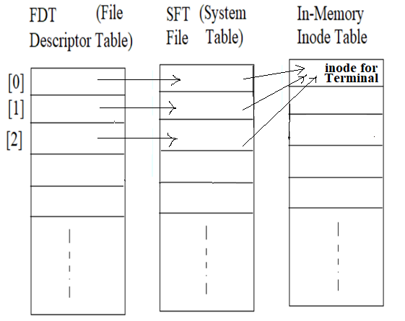
I/O redirection
stdin
stdout
stderr
fd = open(“my.file”, O_CREAT, S_IRUSR| S_IWUSR); /* Create the file – my.file */
close(1); /* Close 1 (Standard output)*/
dup(fd); /* Duplicate fd */
execvp(cmd, argv); /* Execute the command ls -l */

Slide 14
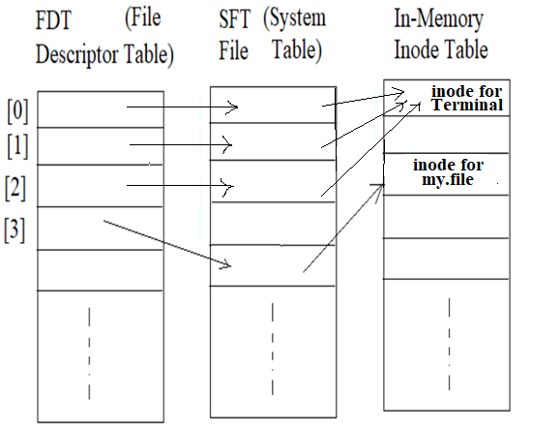
I/O redirection (continue)
stdin
stdout
stderr
fd
fd = open(“my.file”, O_CREAT, S_IRUSR| S_IWUSR); /* Create the file – my.file */
close(1); /* Close 1 (Standard output)*/
dup(fd); /* Duplicate fd */
execvp(cmd, argv); /* Execute the command ls -l */

Slide 15
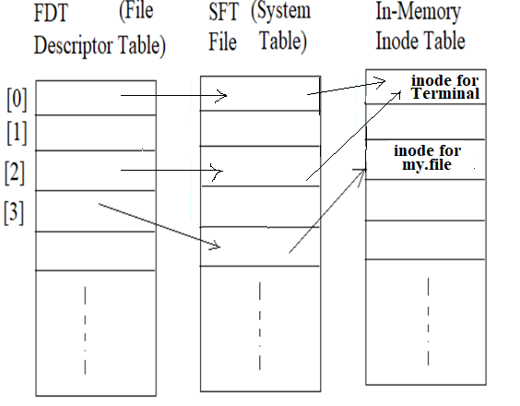
I/O redirection (continue)
stdin
stdout
stderr
fd
fd = open(“my.file”, O_CREAT, S_IRUSR| S_IWUSR); /* Create the file – my.file */
close(1); /* Close 1 (Standard output)*/
dup(fd); /* Duplicate fd */
execvp(cmd, argv); /* Execute the command ls -l */

Slide 16
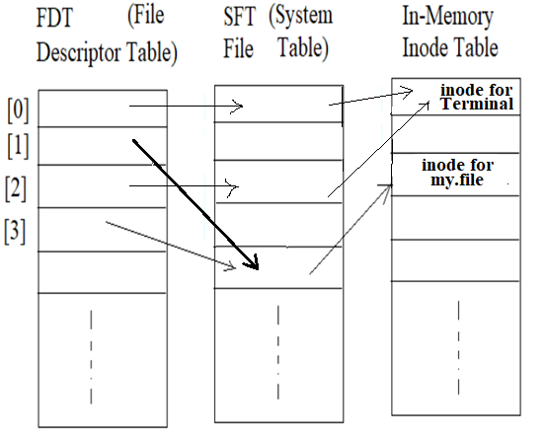
I/O redirection (continue)
stdin
stdout
stderr
fd
fd = open(“my.file”, O_CREAT, S_IRUSR| S_IWUSR); /* Create the file – my.file */
close(1); /* Close 1 (Standard output)*/
dup(fd); /* Duplicate fd */
execvp(cmd, argv); /* Execute the command ls -l */

Slide 17
I/O redirection (continue; before execvp(…) )
Process
for a.out
stdin
stdout
stderr
fd
execvp(….)
fd = open(“my.file”, O_CREAT, S_IRUSR| S_IWUSR); /* Create the file – my.file */
close(1); /* Close 1 (Standard output)*/
dup(fd); /* Duplicate fd */
execvp(cmd, argv); /* Execute the command ls -l */

Slide 18
I/O redirection (continue; executing execvp(…) )
Process
for a.out
stdin
stdout
stderr
fd
execvp(….)
fd = open(“my.file”, O_CREAT, S_IRUSR| S_IWUSR); /* Create the file – my.file */
close(1); /* Close 1 (Standard output)*/
dup(fd); /* Duplicate fd */
execvp(cmd, argv); /* Execute the command ls –l */

Slide 19
I/O redirection (continue; after execvp(…) )
Process for “ls -l”
(totally replace the
body for Process a.out)
stdin
stdout
stderr
Note that stdout of Process
for “ls -l” has been redirected to my.file
fd
fd = open(“my.file”, O_CREAT, S_IRUSR| S_IWUSR); /* Create the file – my.file */
close(1); /* Close 1 (Standard output)*/
dup(fd); /* Duplicate fd */
execvp(cmd, argv); /* Execute the command ls –l */

Slide 20
Communication between parent/child processes via pipe
System call pipe() returns two file descriptors by which we can access the input/output of a pipe (an I/O mechanism)
int fd[2];
int pipe(int fd[2]);
return: 0 success; -1 error
fd[1] for writing
fd[0] for reading
pipe
Question: How to implement “ls –l | wc -l”?

Slide 21
Implement “ls –l | wc –l”
#include <sys/types.h>
#include <sys/wait.h>
#include <unistd.h>
#include <stdio.h>
#include <stdlib.h>
#include <sys/stat.h>
#include <fcntl.h>
main()
{
int fd[2];
int ret;
char *cmd;
char *argv[3];
pipe(fd);
if ( (ret=fork()) > 0 ){
/* Parent process*/
close(1);
dup(fd[1]); close(fd[0]); close(fd[1]);
cmd = "ls"; argv[0] = "ls"; argv[1] = "-l"; argv[2] = NULL;
execvp(cmd, argv);
}else if (ret == 0 ){
/* Child process*/
close(0);
dup( fd[0]); close( fd[0]); close ( fd[1]);
cmd = "wc"; argv[0] = "wc"; argv[1] = "-l"; argv[2] = NULL;
execvp(cmd, argv);
} else{
/* Error in fork()*/
printf("Error occurs when executing fork().\n");
exit(-1);
}
}
Parent Process
for a.out
fork()
execvp(“ls”)

Slide 22
Implement “ls –l | wc –l”
#include <sys/types.h>
#include <sys/wait.h>
#include <unistd.h>
#include <stdio.h>
#include <stdlib.h>
#include <sys/stat.h>
#include <fcntl.h>
main()
{
int fd[2];
int ret;
char *cmd;
char *argv[3];
pipe(fd);
if ( (ret=fork()) > 0 ){
/* Parent process*/
close(1);
dup(fd[1]); close(fd[0]); close(fd[1]);
cmd = "ls"; argv[0] = "ls"; argv[1] = "-l"; argv[2] = NULL;
execvp(cmd, argv);
}else if (ret == 0 ){
/* Child process*/
close(0);
dup( fd[0]); close( fd[0]); close ( fd[1]);
cmd = "wc"; argv[0] = "wc"; argv[1] = "-l"; argv[2] = NULL;
execvp(cmd, argv);
} else{
/* Error in fork()*/
printf("Error occurs when executing fork().\n");
exit(-1);
}
}
Parent Process
for a.out
fork()
execvp(“ls”)

Slide 23
Implement “ls –l | wc –l”
#include <sys/types.h>
#include <sys/wait.h>
#include <unistd.h>
#include <stdio.h>
#include <stdlib.h>
#include <sys/stat.h>
#include <fcntl.h>
main()
{
int fd[2];
int ret;
char *cmd;
char *argv[3];
pipe(fd);
if ( (ret=fork()) > 0 ){
/* Parent process*/
close(1);
dup(fd[1]); close(fd[0]); close(fd[1]);
cmd = "ls"; argv[0] = "ls"; argv[1] = "-l"; argv[2] = NULL;
execvp(cmd, argv);
}else if (ret == 0 ){
/* Child process*/
close(0);
dup( fd[0]); close( fd[0]); close ( fd[1]);
cmd = "wc"; argv[0] = "wc"; argv[1] = "-l"; argv[2] = NULL;
execvp(cmd, argv);
} else{
/* Error in fork()*/
printf("Error occurs when executing fork().\n");
exit(-1);
}
}
Parent Process
for a.out
Child Process
for a.out
fork()
fork()
execvp(“ls”)
execvp(“wc”)

Slide 24
Implement “ls –l | wc –l”
#include <sys/types.h>
#include <sys/wait.h>
#include <unistd.h>
#include <stdio.h>
#include <stdlib.h>
#include <sys/stat.h>
#include <fcntl.h>
main()
{
int fd[2];
int ret;
char *cmd;
char *argv[3];
pipe(fd);
if ( (ret=fork()) > 0 ){
/* Parent process*/
close(1);
dup(fd[1]); close(fd[0]); close(fd[1]);
cmd = "ls"; argv[0] = "ls"; argv[1] = "-l"; argv[2] = NULL;
execvp(cmd, argv);
}else if (ret == 0 ){
/* Child process*/
close(0);
dup( fd[0]); close( fd[0]); close ( fd[1]);
cmd = "wc"; argv[0] = "wc"; argv[1] = "-l"; argv[2] = NULL;
execvp(cmd, argv);
} else{
/* Error in fork()*/
printf("Error occurs when executing fork().\n");
exit(-1);
}
}
Parent Process
for a.out
Child Process
for a.out
fork()
fork()
execvp(“ls”)
execvp(“wc”)

Slide 25
Implement “ls –l | wc –l”
#include <sys/types.h>
#include <sys/wait.h>
#include <unistd.h>
#include <stdio.h>
#include <stdlib.h>
#include <sys/stat.h>
#include <fcntl.h>
main()
{
int fd[2];
int ret;
char *cmd;
char *argv[3];
pipe(fd);
if ( (ret=fork()) > 0 ){
/* Parent process*/
close(1);
dup(fd[1]); close(fd[0]); close(fd[1]);
cmd = "ls"; argv[0] = "ls"; argv[1] = "-l"; argv[2] = NULL;
execvp(cmd, argv);
}else if (ret == 0 ){
/* Child process*/
close(0);
dup( fd[0]); close( fd[0]); close ( fd[1]);
cmd = "wc"; argv[0] = "wc"; argv[1] = "-l"; argv[2] = NULL;
execvp(cmd, argv);
} else{
/* Error in fork()*/
printf("Error occurs when executing fork().\n");
exit(-1);
}
}
Parent Process
for ls
Child Process
for wc

Slide 26
Implement “ls –l | wc –l”
#include <sys/types.h>
#include <sys/wait.h>
#include <unistd.h>
#include <stdio.h>
#include <stdlib.h>
#include <sys/stat.h>
#include <fcntl.h>
main()
{
int fd[2];
int ret;
char *cmd;
char *argv[3];
pipe(fd);
if ( (ret=fork()) > 0 ){
/* Parent process*/
close(1);
dup(fd[1]); close(fd[0]); close(fd[1]);
cmd = "ls"; argv[0] = "ls"; argv[1] = "-l"; argv[2] = NULL;
execvp(cmd, argv);
}else if (ret == 0 ){
/* Child process*/
close(0);
dup( fd[0]); close( fd[0]); close ( fd[1]);
cmd = "wc"; argv[0] = "wc"; argv[1] = "-l"; argv[2] = NULL;
execvp(cmd, argv);
} else{
/* Error in fork()*/
printf("Error occurs when executing fork().\n");
exit(-1);
}
}
Parent
Process
for ls
Child
Process
for wc
fd[1]
writing
pipe
fd[0]
reading

Slide 27
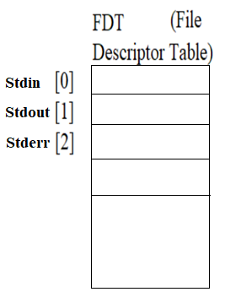
Implement “ls –l | wc –l”
#include <sys/types.h>
#include <sys/wait.h>
#include <unistd.h>
#include <stdio.h>
#include <stdlib.h>
#include <sys/stat.h>
#include <fcntl.h>
main()
{
int fd[2];
int ret;
char *cmd;
char *argv[3];
pipe(fd);
if ( (ret=fork()) > 0 ){
/* Parent process*/
close(1);
dup(fd[1]); close(fd[0]); close(fd[1]);
cmd = "ls"; argv[0] = "ls"; argv[1] = "-l"; argv[2] = NULL;
execvp(cmd, argv);
}else if (ret == 0 ){
/* Child process*/
close(0);
dup( fd[0]); close( fd[0]); close ( fd[1]);
cmd = "wc"; argv[0] = "wc"; argv[1] = "-l"; argv[2] = NULL;
execvp(cmd, argv);
} else{
/* Error in fork()*/
printf("Error occurs when executing fork().\n");
exit(-1);
}
}
Parent
Process
for ls
Child
Process
for wc
fd[1]
writing
pipe
fd[0]
reading

Slide 28
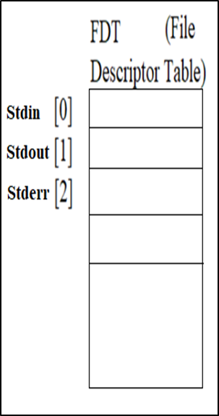
Implement “ls –l | wc –l”
#include <sys/types.h>
#include <sys/wait.h>
#include <unistd.h>
#include <stdio.h>
#include <stdlib.h>
#include <sys/stat.h>
#include <fcntl.h>
main()
{
int fd[2];
int ret;
char *cmd;
char *argv[3];
pipe(fd);
if ( (ret=fork()) > 0 ){
/* Parent process*/
close(1);
dup(fd[1]); close(fd[0]); close(fd[1]);
cmd = "ls"; argv[0] = "ls"; argv[1] = "-l"; argv[2] = NULL;
execvp(cmd, argv);
}else if (ret == 0 ){
/* Child process*/
close(0);
dup( fd[0]); close( fd[0]); close ( fd[1]);
cmd = "wc"; argv[0] = "wc"; argv[1] = "-l"; argv[2] = NULL;
execvp(cmd, argv);
} else{
/* Error in fork()*/
printf("Error occurs when executing fork().\n");
exit(-1);
}
}
Parent
Process
for ls
Child
Process
for wc
fd[1]
writing
pipe
fd[0]
reading

Slide 29
More about Pipe (https://man7.org/linux/man-pages/man7/pipe.7.html)
Pipes provide a unidirectional interprocess communication channel. A pipe has a read end and a write end. Data written to the write end of a pipe can be read from the read end of the pipe.
If a process attempts to read from an empty pipe, then read() will block until data is available.
The communication channel provided by a pipe is a byte stream: there is no concept of message boundaries.
If all file descriptors referring to the write end of a pipe have been closed, then an attempt to read() from the pipe will see end-of-file (read() will return 0). If all file descriptors referring to the read end of a pipe have been closed, then a write() will cause a SIGPIPE signal to be generated for the calling process. If the calling process is ignoring this signal, then write() fails with the error EPIPE.

Slide 30
Writing Immediately with fsync()
The file system will buffer writes in memory for some time (for performance reasons), e.g. 5 or 30 seconds.
At that later point in time, the write(s) will actually be issued and written to the storage device.
Writes seem to complete quickly; but data can be lost (e.g., machine crashes).
However, some applications require persistence guarantee, e.g. DBMS requires force writes to disk from time to time (your bank transactions).
int fsync(int fd)
force all dirty (i.e., not yet written) data written to disk
fsync() returns once all of theses writes are complete.

Slide 31
Writing Immediately with fsync() (Cont.)
An Example of fsync().
In some cases, this code needs to fsync() the directory that contains the file foo.
#include <unistd.h>
int fsync(int fd)
On success, these system calls return zero. On error, -1 is returned, and errno is set appropriately.
int fd = open("foo", O_CREAT | O_WRONLY | O_TRUNC);
assert (fd > -1)
int rc = write(fd, buffer, size);
assert (rc == size);
rc = fsync(fd);
assert (rc == 0);

Slide 32
Renaming Files
rename(char* old, char *new)
Rename a file to different name.
It implemented as an atomic call.
e.g. Change from foo to bar:
How to update a file atomically:
prompt> mv foo bar // mv uses the system call rename()
int fd = open("foo.txt.tmp", O_WRONLY|O_CREAT|O_TRUNC, S_IRWXU);
char buffer[20]= "hello";
write(fd, buffer, sizeof(buffer)); // write out new version of file
fsync(fd);
close(fd);
rename("foo.txt.tmp", "foo.txt");

Slide 33
Getting Information About Files
stat(), fstat(): Show the file metadata
Each file has its metadata information.
Size, inode, permission, …
stat structure is below:
struct stat {
dev_t st_dev; /* ID of device containing file */
ino_t st_ino; /* inode number */
mode_t st_mode; /* protection */
nlink_t st_nlink; /* number of hard links */
uid_t st_uid; /* user ID of owner */
gid_t st_gid; /* group ID of owner */
dev_t st_rdev; /* device ID (if special file) */
off_t st_size; /* total size, in bytes */
blksize_t st_blksize; /* blocksize for filesystem I/O */
blkcnt_t st_blocks; /* number of blocks allocated */
time_t st_atime; /* time of last access */
time_t st_mtime; /* time of last modification */
time_t st_ctime; /* time of last status change */
};

Slide 34
Getting Information About Files (Cont.)
To see stat information, you can use the command line tool stat.
File system keeps this type of information in an inode structure.
prompt> echo hello > file
prompt> stat file
File: ‘file’
Size: 6 Blocks: 8 IO Block: 4096 regular file
Device: 811h/2065d Inode: 67158084 Links: 1
Access: (0640/-rw-r-----) Uid: (30686/ root) Gid: (30686/ remzi)
Access: 2011-05-03 15:50:20.157594748 -0500
Modify: 2011-05-03 15:50:20.157594748 -0500
Change: 2011-05-03 15:50:20.157594748 -0500

Slide 35
Removing Files
rm is a Linux command to remove a file
rm call unlink() to remove a file.
prompt> strace rm foo
…
unlink(“foo”) = 0 // return 0 upon success
…
prompt>
Why it calls unlink() not “remove or delete”?
We can get the answer later.

Slide 36
Making Directories
mkdir(): Make a directory
When a directory is created, it is empty.
Empty directory have two entries: . (itself), .. (parent)
prompt> strace mkdir foo
…
mkdir("foo", 0777) = 0
prompt>
prompt> ls –a
./ ../
prompt> ls -al
total 8
drwxr-x--- 2 remzi remzi 6 Apr 30 16:17 ./
drwxr-x--- 26 remzi remzi 4096 Apr 30 16:17 ../

Slide 37
Reading Directories
The information available within struct dirent
A sample code to read directory entries (like ls).
#include <sys/stat.h>
#include <assert.h>
#include <stdio.h>
#include <dirent.h>
int main(int argc, char *argv[]) {
DIR *dp = opendir("."); // open current directory
assert(dp != NULL);
struct dirent *d;
while ((d = readdir(dp)) != NULL) // read one directory entry
{
// print outthe name and inode number of each file
printf("%d %s\n", (int) d->d_ino, d->d_name);
}
closedir(dp); // close current directory
return 0;
}
struct dirent {
char d_name[256]; /* filename */
ino_t d_ino; /* inode number */
off_t d_off; /* offset to the next direct */
unsigned short d_reclen; /* length of this record */
unsigned char d_type; /* type of file */
}

Slide 38
Deleting Directories
rmdir(): Delete a directory.
Require that the target directory should be empty
i.e. Only has “.” and “..” entries.
If you call rmdir()to a non-empty directory, it will fail.

Slide 39
Hard Links
link(old pathname, new one)
Link a new file name to an old one
Create another way to refer to the same file
The command-line link program : ln
prompt> echo hello > file
prompt> cat file
hello
prompt> ln file file2 // create a hard link, link file to file2
prompt> cat file2
hello

Slide 40
Hard Links (Cont.)
The way link works:
Create another name in the directory.
Refer it to the same inode number of the original file.
The file is not copied.
Then, we have two human names (file and file2) that both refer to the same file.

Slide 41
Hard Links (Cont.)
The result of link()
Two files have same inode number, but two file name (file, file2).
There is no difference between file and file2.
Both just link to the underlying metadata about the file.
prompt> ls -i file file2
67158084 file /* inode value is 67158084 */
67158084 file2 /* inode value is 67158084 */
prompt>

Slide 42
Hard Links (Cont.)
Thus, to remove a file, we call unlink().
reference count
Track how many different file names have been linked to this inode.
When unlink() is called, the reference count decrements.
If the reference count reaches zero, the files system free the inode and related data blocks. → truly “delete” the file
prompt> rm file
removed ‘file’
prompt> cat file2 // Still access the file
hello

Slide 43
Hard Links (Cont.)
The result of unlink()
stat() shows the reference count of a file.
prompt> echo hello > file /* create file*/
prompt> stat file
... Inode: 67158084 Links: 1 ... /* Link count is 1 */
prompt> ln file file2 /* hard link file2 */
prompt> stat file
... Inode: 67158084 Links: 2 ... /* Link count is 2 */
prompt> stat file2
... Inode: 67158084 Links: 2 ... /* Link count is 2 */
prompt> ln file2 file3 /* hard link file3 */
prompt> stat file
... Inode: 67158084 Links: 3 ... /* Link count is 3 */
prompt> rm file /* remove file */
prompt> stat file2
... Inode: 67158084 Links: 2 ... /* Link count is 2 */
prompt> rm file2 /* remove file2 */
prompt> stat file3
... Inode: 67158084 Links: 1 ... /* Link count is 1 */
prompt> rm file3

Slide 44
Symbolic Links (Soft Link)
Symbolic link is more useful than Hard link.
Hard Link cannot be created for a directory.
Hard Link cannot be created for a file in other partition.
Because inode numbers are only unique within a file system.
Create a symbolic link: ln -s
prompt> echo hello > file
prompt> ln –s file file2 /* option –s : create a symbolic link, */
prompt> cat file2
hello

Slide 45
Symbolic Links (Cont.)
What is different between Symbolic link and Hard Link?
Symbolic links are a third type the file system knows about.
The size of symbolic link (file2) is 4 bytes.
A symbolic link holds the pathname of the linked-to file as the data of the link file.
prompt> stat file
... regular file ...
prompt> stat file2
... symbolic link ... // Actually a file itself of a different type
prompt> ls -al
drwxr-x--- 2 remzi remzi 29 May 3 19:10 ./
drwxr-x--- 27 remzi remzi 4096 May 3 15:14 ../ // directory
-rw-r----- 1 remzi remzi 6 May 3 19:10 file // regular file
lrwxrwxrwx 1 remzi remzi 4 May 3 19:10 file2 -> file // symbolic link

Slide 46
Symbolic Links (Cont.)
If we link to a longer pathname, our link file will be bigger.
prompt> echo hello > alongerfilename
prompt> ln -s alongerfilename file3
prompt> ls -al alongerfilename file3
-rw-r----- 1 remzi remzi 6 May 3 19:17 alongerfilename
lrwxrwxrwx 1 remzi remzi 15 May 3 19:17 file3 -> alongerfilename

Slide 47
Symbolic Links (Cont.)
Dangling reference
When remove an original file, symbolic link points nothing.
prompt> echo hello > file
prompt> ln -s file file2
prompt> cat file2
hello
prompt> rm file // remove the original file
prompt> cat file2
cat: file2: No such file or directory

Slide 48
Summary
System calls related to file & directory
open(), read(), write(), lseek()
dup(), pipe(), fsync(), rename(), stat()
mkdir(), rmdir(), opendir(), readdir()
unlink(), hard/symbolic link
Next: File System Implementation
Chapter 40

