Slide 1
Lecture 7: Virtualizing CPU – Process

Slide 2
The Course Organization (Bottom-up)
Race Conditions, Lock/Semaphore
Concurrency
Thread
Memory Management
HW#4
Virtualization
Process and CPU Scheduling
HW#3
IO Devices and Storage
HW#2
&
Project
Persistence
File System
System Calls (User-level Programming)
HW#1

Slide 3
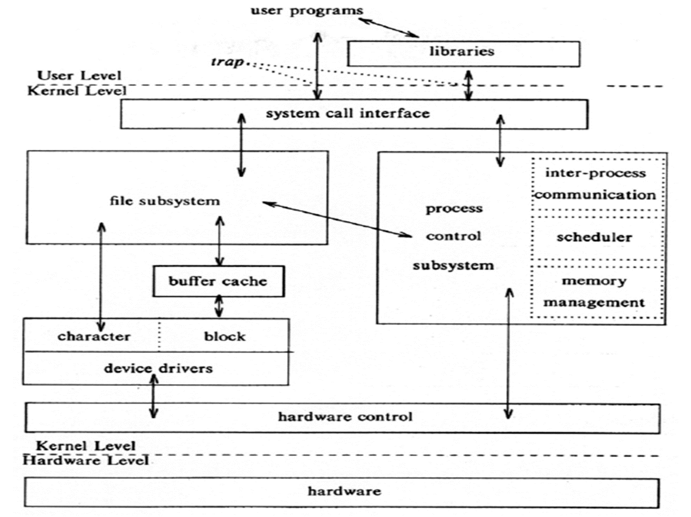
OS – Resource management via virtualization
OS provides services via System Call (typically a few hundred) to run process, access memory/devices/files, etc.
The OS manages resources such as CPU, memory and disk via virtualization.
many programs to run (processes) → Sharing the CPU
many processes to concurrently access their own instructions and data → Sharing memory
many processes to access devices → Sharing disks
The Design Of The Unix Operating System (Maurice Bach, 1986)

Slide 4
Part I. The Abstraction: The Process

Slide 5
Virtualizing CPUs
The OS can provide the illusion that many virtual CPUs exist.
Time sharing: Running one process, then stopping it and running another
The potential cost is performance.

Slide 6
A Process
Comprising of a process:
Memory (address space)
Instructions
Data section
Registers
Program counter
Stack pointer
A process is a running program.

Slide 7
Process API
These APIs are available on any modern OS.
Create
Create a new process to run a program
Destroy
Halt a runaway process
Wait
Wait for a process to stop running
Miscellaneous Control
For example, the methods to suspend a process and then resume it
Status
Get some status info about a process

Slide 8
Process Creation
Load a program code into memory, i.e., into the address space of the process.
Programs initially reside on disk in executable format.
OS perform the loading process lazily.
Loading pieces of code or data only as they are needed during program execution.
The program’s run-time stack is allocated.
Use the stack for local variables, function parameters, and return address.
Initialize the stack with arguments → argc and the argv array of main() function

Slide 9
Process Creation (Cont.)
The program’s heap is created.
Used for explicitly requested dynamically allocated data.
Program request such space by calling malloc() and free it by calling free().
The OS does some other initialization tasks.
Input/output (I/O) setup
Each process by default has three open file descriptors.
Standard input, output and error
Start the program running at the entry point, namely main().
The OS transfers control of the CPU to the newly-created process.

Slide 10
Loading: From Program To Process
CPU
Memory
code
static data
heap
stack
Process
Loading:
Takes on-disk program
and reads it into the address space of the process
code
static data
heap
Program
Disk

Slide 11
Process States
A process can be in one of three states.
Running
A process is running on a processor.
Ready
A process is ready to run but for some reason the OS has chosen not to run it at this given moment.
Blocked
A process has performed some kind of operations.
For example, when a process initiates an I/O request to a disk, it becomes blocked and thus some other process can use the processor.

Slide 12
Process State Transition
Running
Ready
Descheduled
Scheduled
I/O: initiate
I/O: done
Blocked

Slide 13
Data structures
The OS has some key data structures that track various relevant pieces of information.
Process list
Ready processes
Blocked processes
Current running process
PCB (Process Control Block)
An in-memory data structure that contains information about each process.

Slide 14
Example: The xv6 kernel Proc Structure (proc.h)
// proc.h in xv6
// the registers xv6 will save and restore
// to stop and subsequently restart a process
struct context {
uint edi;
uint esi;
uint ebx;
uint ebp;
uint eip;
};
// the different states a process can be in
enum proc_state { UNUSED, EMBRYO, SLEEPING,
RUNNABLE, RUNNING, ZOMBIE };
https://github.com/mit-pdos/xv6-public
xv6 is a re-implementation of Dennis Ritchie's and Ken Thompson's Unix Version 6 (v6). xv6 loosely follows the structure and style of v6, but is implemented for a modern x86-based multiprocessor using ANSI C.

Slide 15
Example: The xv6 kernel Proc Structure (Cont.)
// the information xv6 tracks about each process
// including its register context and state
struct proc {
char *mem; // Start of process memory
uint sz; // Size of process memory
char *kstack; // Bottom of kernel stack
// for this process
enum proc_state state; // Process state
int pid; // Process ID
struct proc *parent; // Parent process
void *chan; // If non-zero, sleeping on chan
int killed; // If non-zero, have been killed
struct file *ofile[NOFILE]; // Open files
struct inode *cwd; // Current directory
struct context context; // Switch here to run process
struct trapframe *tf; // Trap frame for the
// current interrupt
};

Slide 16
Part II: Limited Direct Execution Mechanism

Slide 17
How to efficiently virtualize the CPU with control?
The OS needs to share the physical CPU by time sharing.
Issue
Performance: How can we implement virtualization without adding excessive overhead to the system?
Control: How can we run processes efficiently while retaining control over the CPU?

Slide 18
Direct Execution
Just run the program directly on the CPU.
OS | Program
1. Create entry for process list 2. Allocate memory for program 3. Load program into memory 4. Set up stack with argc / argv 5. Clear registers 6. Execute call main() 9. Free memory of process 10. Remove from process list | 7. Run main() 8. Execute return from main()
Without limits on running programs,
the OS wouldn’t be in control of anything and
thus would be “just a library”

Slide 19
Problem 1: Restricted Operation
What if a process wishes to perform some kind of restricted operation such as …
Issuing an I/O request to a disk
Gaining access to more system resources such as CPU or memory
Solution: Using protected control transfer
User mode: Applications do not have full access to hardware resources.
Kernel mode: The OS has access to the full resources of the machine

Slide 20
System Call
Allow the kernel to carefully expose certain key pieces of functionality to user program, such as …
Accessing the file system
Creating and destroying processes
Communicating with other processes
Allocating more memory

Slide 21
System Call (Cont.)
Trap instruction
Jump into the kernel
Raise the privilege level to the kernel mode
Return-from-trap instruction
Return into the calling user program
Reduce the privilege level back to user mode

Slide 22
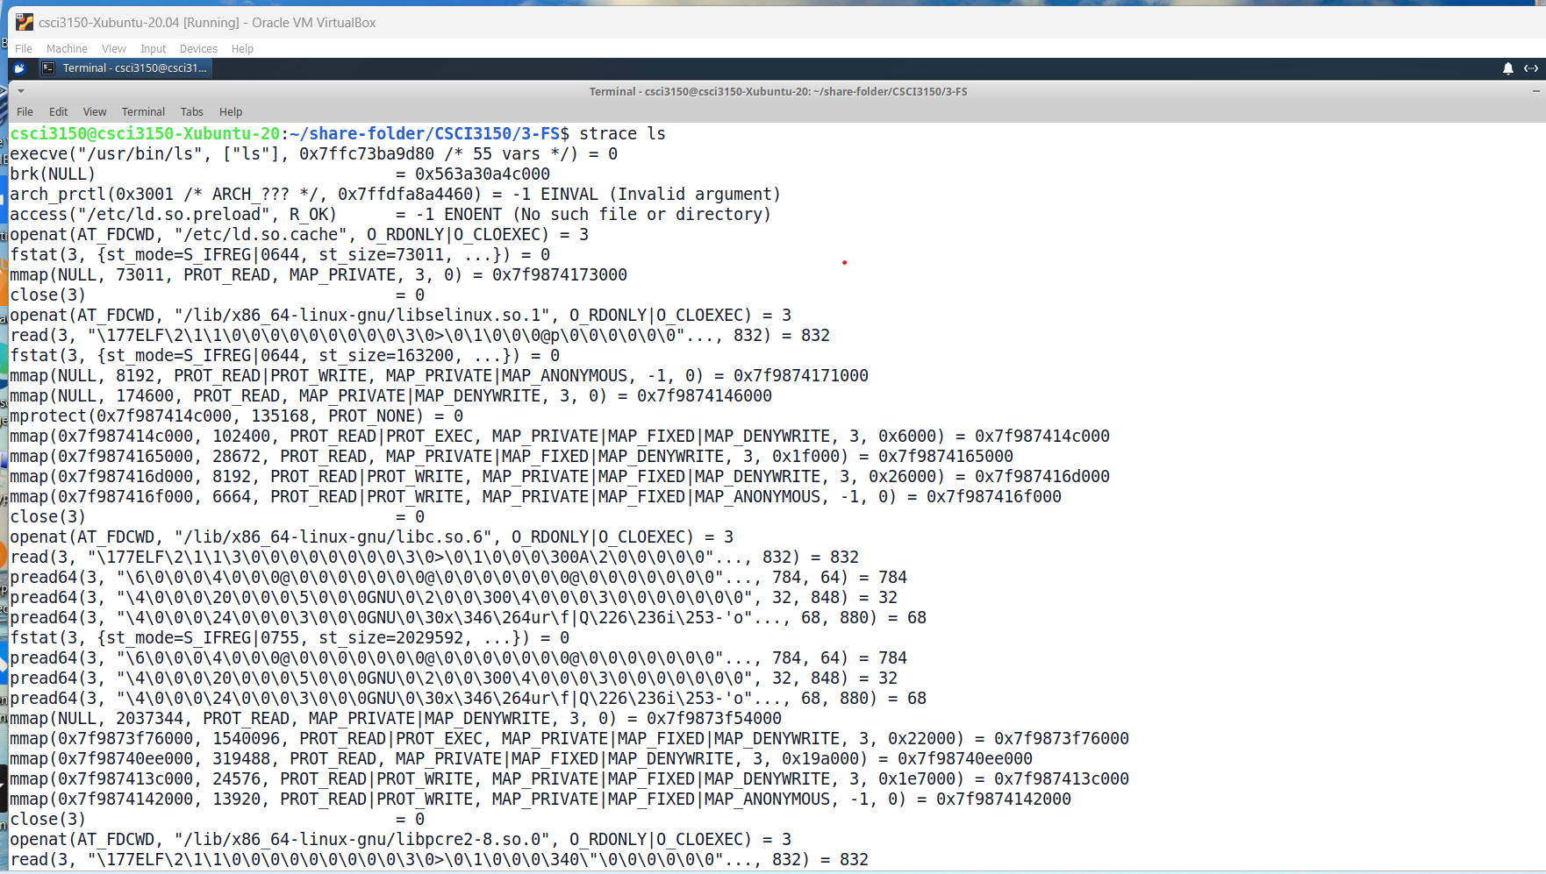
Example: Use “strace” to trace system calls and signals

Slide 23
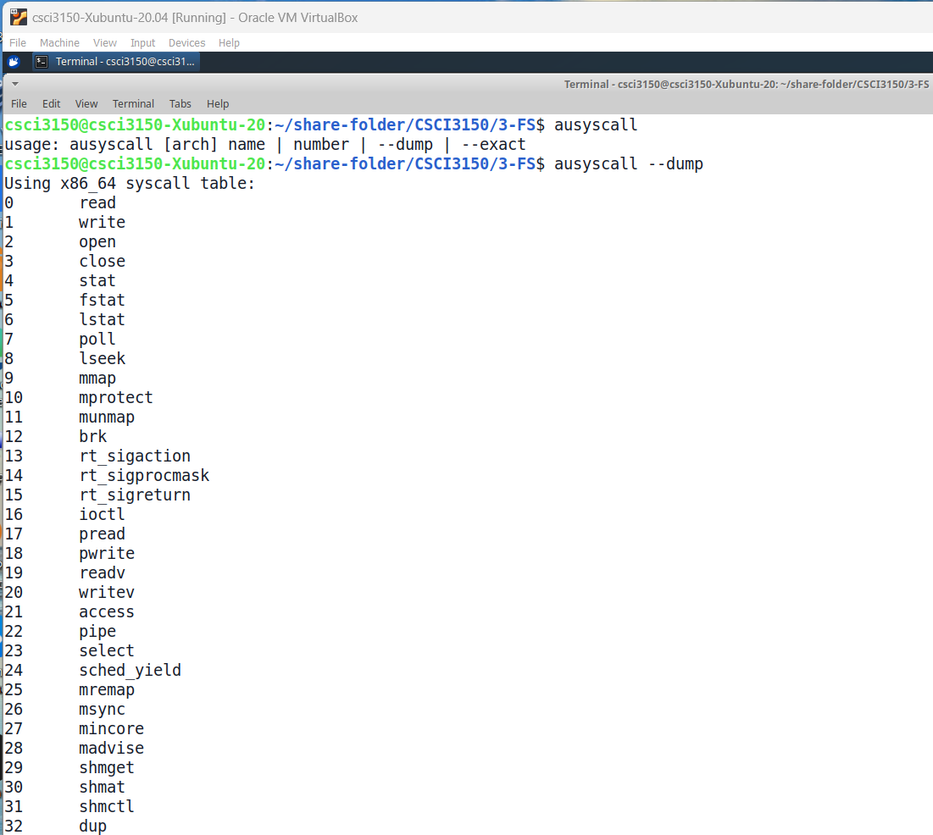
Example: Use command “ausyscall” to see the system call list

Slide 24
Limited Direction Execution Protocol
OS @ boot
(kernel mode)
Hardware
initialize trap table
remember address of …
syscall handler
OS @ run
(kernel mode)
Hardware
Program
(user mode)
Create entry for process list
Allocate memory for program
Load program into memory
Setup user stack with argv
Fill kernel stack with reg/PC
return-from -trap
restore regs from kernel stack
move to user mode
jump to main
Run main()
…
Call system
trap into OS

Slide 25
Limited Direction Execution Protocol (Cont.)
OS @ run
(kernel mode)
Hardware
Program
(user mode)
(Cont.)
save regs to kernel stack
move to kernel mode
jump to trap handler
Handle trap
Do work of syscall
return-from-trap
restore regs from kernel stack
move to user mode
jump to PC after trap
…
return from main
trap (via exit())
Free memory of process
Remove from process list

Slide 26
Problem 2: Switching Between Processes
How can the OS regain control of the CPU so that it can switch between processes?
A cooperative Approach: Wait for system calls
A Non-Cooperative Approach: The OS takes control

Slide 27
A cooperative Approach: Wait for system calls
Processes periodically give up the CPU by making system calls such as yield.
The OS decides to run some other task.
Application also transfer control to the OS when they do something illegal.
Divide by zero
Try to access memory that it shouldn’t be able to access
e.g Early versions of the Macintosh OS, The old Xerox Alto system
A process gets stuck in an infinite loop.
→ Reboot the machine

Slide 28
A Non-Cooperative Approach: OS Takes Control
A timer interrupt
During the booting, the OS start the timer.
The timer raises an interrupt every so many milliseconds.
When the interrupt is raised :
The currently running process is halted.
Save enough of the states of the program
A pre-configured interrupt handler in the OS runs.
A timer interrupt gives OS the ability to
run again on a CPU.

Slide 29
Saving and Restoring Context
Scheduler makes a decision:
Whether to continue running the current process, or switch to a different one.
If the decision is made to switch, the OS executes context switch.

Slide 30
Context Switch
A low-level piece of assembly code
Save the values of necessary registers for the current process onto its kernel stack
General purpose registers
PC
kernel stack pointer
Restore the register values for the soon-to-be-executing process from its kernel stack
Switch to the kernel stack for the soon-to-be-executing process

Slide 31
Limited Direction Execution Protocol (Timer interrupt)
OS @ boot
(kernel mode)
Hardware
initialize trap table
remember address of …
syscall handler
timer handler
start interrupt timer
start timer
interrupt CPU in X ms
OS @ run
(kernel mode)
Hardware
Program
(user mode)
Process A
…
timer interrupt
save regs(A) to k-stack(A)
move to kernel mode
jump to trap handler

Slide 32
Limited Direction Execution Protocol (Timer interrupt)
OS @ run
(kernel mode)
Hardware
Program
(user mode)
(Cont.)
Handle the trap
Call switch() routine
save regs(A) to proc-struct(A)
restore regs(B) from proc-struct(B)
switch to k-stack(B)
return-from-trap (into B)
restore regs(B) from k-stack(B)
move to user mode
jump to B’s PC
Process B
…

Slide 33
The xv6 Context Switch Code (swtch.S)
# Context switch (swtch.S)
#
# void swtch(struct context **old, struct context *new);
#
# Save the current registers on the stack, creating
# a struct context, and save its address in *old.
# Switch stacks to new and pop previously-saved registers.
.globl swtch
swtch:
movl 4(%esp), %eax // Set %eax to contain the old context
movl 8(%esp), %edx // Set %edx to contain the new context
# Save old callee-saved registers
pushl %ebp // Save %ebp onto the old stack
pushl %ebx // Save %ebx onto the old stack
pushl %esi // Save %esi onto the old stack
pushl %edi // Save %edi onto the old stack
# Switch stacks
movl %esp, (%eax) // Copy %esp to the old context
movl %edx, %esp // Set the next context to %esp
# Load new callee-saved registers
popl %edi // Set %edi with the new stack (pop)
popl %esi // Set %esi with the new stack (pop)
popl %ebx // Set %ebx with the new stack (pop)
popl %ebp // Set %ebp with the new stack (pop)
ret // Set %eip with the new stack (ret)

Slide 34
Concurrency Problems?
What happens if, during interrupt or trap handling, another interrupt occurs?
OS handles these situations:
Disable interrupts during interrupt processing
Use a number of sophisticate locking schemes to protect concurrent access to internal data structures.

Slide 35
Summary
Virtualize CPU
The abstraction of process – Process in OS kernel
Process creation process, Process state, Process data structure in OS kernel
Limited Direct Execution
User/kernel mode, System call (the interface between user/kernel), System call working process, and Process switch
Next: CPU Scheduling
Chapter 7 (Scheduling), Chapter 8 (Multi-level Feedback Queue), Chapter 9 (Proportional Share), Chapter 10 (Multi-CPU Scheduling)

