Slide 1
Lecture 8: Virtualizing CPU - Scheduling

Slide 2
The Course Organization (Bottom-up)
Race Conditions, Lock/Semaphore
Concurrency
Thread
Memory Management
HW#4
Virtualization
Process and CPU Scheduling
HW#3
IO Devices and Storage
HW#2
&
Project
Persistence
File System
System Calls (User-level Programming)
HW#1

Slide 3
Part I. Scheduling: Introduction

Slide 4
Scheduling: Introduction
Workload assumptions:
Each job runs for the same amount of time.
All jobs arrive at the same time.
All jobs only use the CPU (i.e., they perform no I/O).
The run-time of each job is known.

Slide 5

Scheduling Metrics
Performance metric: Turnaround time
The time at which the job completes minus the time at which the job arrived in the system.
Another metric is fairness.
Performance and fairness are often at odds in scheduling.
$$T_{turnaround}=T_{completion}−T_{arrival}$$

Slide 6

First In, First Out (FIFO)
First Come, First Served (FCFS)
Very simple and easy to implement
Example:
A arrived just before B which arrived just before C.
Each job runs for 10 seconds.
A
B
C
0
20
40
60
80
100
120
Time (Second)
$$Average turnaround time=\frac{10+20+30}{3}=20 sec$$

Slide 7
Why FIFO is not that great? – Convoy effect
Let’s relax assumption 1: Each job no longer runs for the same amount of time.
Example:
A arrived just before B which arrived just before C.
A runs for 100 seconds, B and C run for 10 each.
A
B
C
0
20
40
60
80
100
120
Time (Second)
$$Average turnaround time=\frac{100+110+120}{3}=110 sec$$

Slide 8

Shortest Job First (SJF)
Run the shortest job first, then the next shortest, and so on
Non-preemptive scheduler
Example:
A arrived just before B which arrived just before C.
A runs for 100 seconds, B and C run for 10 each.
B
C
A
0
20
40
60
80
100
120
Time (Second)
$$Average turnaround time=\frac{10+20+120}{3}=50 sec$$

Slide 9
SJF with Late Arrivals from B and C
Let’s relax assumption 2: Jobs can arrive at any time.
Example:
A arrives at t=0 and needs to run for 100 seconds.
B and C arrive at t=10 and each need to run for 10 seconds
[B,C arrive]
A
B
C
0
20
40
60
80
100
120
Time (Second)
$$Average turnaround time=\frac{100+\left(110−10\right)+(120−10)}{3}=103.33 sec$$

Slide 10
Shortest Time-to-Completion First (STCF)
Add preemption to SJF
Also knows as Preemptive Shortest Job First (PSJF)
A new job enters the system:
Determine of the remaining jobs and new job
Schedule the job which has the least time left

Slide 11
Shortest Time-to-Completion First (STCF)
Example:
A arrives at t=0 and needs to run for 100 seconds.
B and C arrive at t=10 and each needs to run for 10 seconds
[B,C arrive]
A
B
C
A
0
20
40
60
80
100
120
Time (Second)
$$Average turnaround time=\frac{(120−0)+\left(20−10\right)+(30−10)}{3}=50 sec$$

Slide 12

New scheduling metric: Response time
The time from when the job arrives to the first time it is scheduled.
STCF and related disciplines are not particularly good for response time.
$$T_{response}=T_{firstrun}−T_{arrival}$$
How can we build a scheduler that is
sensitive to response time?

Slide 13
Round Robin (RR) Scheduling
Time slicing Scheduling
Run a job for a time slice and then switch to the next job in the run queue until the jobs are finished.
Time slice is sometimes called a scheduling quantum.
It repeatedly does so until the jobs are finished.
The length of a time slice must be a multiple of the timer-interrupt period.
RR is fair, but performs poorly on metrics
such as turnaround time

Slide 14


RR Scheduling Example
A, B and C arrive at the same time.
They each wish to run for 5 seconds.
A
B
C
$$T_{average response}=\frac{0+5+10}{3}=5sec$$
0
5
10
15
20
25
30
Time (Second)
SJF (Bad for Response Time)
A
B
A
B
A
B
A
B
A
C
C
C
C
B
C
$$T_{average response}=\frac{0+1+2}{3}=1sec$$
0
5
10
15
20
25
30
Time (Second)
RR with a time-slice of 1sec (Good for Response Time)

Slide 15
The length of the time slice is critical.
The shorter time slice
Better response time
The cost of context switching will dominate overall performance.
The longer time slice
Amortize the cost of switching
Worse response time
Deciding on the length of the time slice presents
a trade-off to a system designer

Slide 16
Incorporating I/O
Let’s relax assumption 3: All programs perform I/O
Example:
A and B need 50ms of CPU time each.
A runs for 10ms and then issues an I/O request
Each I/O takes 10ms
B simply uses the CPU for 50ms and performs no I/O
The scheduler runs A first, then B after

Slide 17
Incorporating I/O (Cont.)
A
A
A
A
A
B
B
B
B
B
0
20
40
60
80
100
120
140
Time (msec)
Poor Use of Resources
A
B
A
B
A
B
A
B
A
B
Maximize the
CPU utilization
0
20
40
60
80
100
120
140
Time (msec)
Overlap Allows Better Use of Resources

Slide 18
Incorporating I/O (Cont.)
When a job initiates an I/O request.
The job is blocked waiting for I/O completion.
The scheduler should schedule another job on the CPU.
When the I/O completes
An interrupt is raised.
The OS moves the process from blocked back to the ready state.

Slide 19
Part II: Scheduling: The Multi-Level Feedback Queue

Slide 20
Multi-Level Feedback Queue (MLFQ)
A Scheduler that learns from the past to predict the future.
Objective:
Optimize turnaround time → Run shorter jobs first
Minimize response time without a priori knowledge of job length.

Slide 21
MLFQ: Basic Rules
MLFQ has a number of distinct queues.
Each queues is assigned a different priority level.
A job that is ready to run is on a single queue.
A job on a higher queue is chosen to run.
Use round-robin scheduling among jobs in the same queue
Rule 1: If Priority(A) > Priority(B), A runs (B doesn’t).
Rule 2: If Priority(A) = Priority(B), A & B run in RR.

Slide 22
MLFQ: Basic Rules (Cont.)
MLFQ varies the priority of a job based on its observed behavior.
Example:
A job repeatedly relinquishes the CPU while waiting IOs → Keep its priority high
A job uses the CPU intensively for long periods of time → Reduce its priority.

Slide 23
MLFQ Example
[High Priority]
Q8
Q7
Q6
Q5
Q4
Q3
Q2
Q1
A
B
C
[Low Priority]
D

Slide 24
MLFQ: How to Change Priority
MLFQ priority adjustment algorithm:
Rule 3: When a job enters the system, it is placed at the highest priority
Rule 4a: If a job uses up an entire time slice while running, its priority is reduced (i.e., it moves down on queue).
Rule 4b: If a job gives up the CPU before the time slice is up, it stays at the same priority level
In this manner, MLFQ approximates SJF

Slide 25
Example 1: A Single Long-Running Job
A three-queue scheduler with time slice 10ms
Q2
Q1
Q0
0
50
100
150
200
Long-running Job Over Time (msec)

Slide 26
Example 2: Along Came a Short Job
Assumption:
Job A: A long-running CPU-intensive job
Job B: A short-running interactive job (20ms runtime)
A has been running for some time, and then B arrives at time T=100.
Q2
A:
Q1
B:
Q0
0
50
100
150
200
Along Came An Interactive Job (msec)

Slide 27
Example 3: What About I/O?
Assumption:
Job A: A long-running CPU-intensive job
Job B: An interactive job that need the CPU only for 1ms before performing an I/O
Q2
A:
Q1
B:
Q0
0
50
100
150
200
A Mixed I/O-intensive and CPU-intensive Workload (msec)
The MLFQ approach keeps an interactive job at the highest priority

Slide 28
Problems with the Basic MLFQ
Starvation
If there are “too many” interactive jobs in the system.
Long-running jobs will never receive any CPU time.
Game the scheduler
After running 99% of a time slice, issue an I/O operation.
The job gains a higher percentage of CPU time.
A program may change its behavior over time.
CPU bound process → I/O bound process

Slide 29
The Priority Boost
Rule 5: After some time period S, move all the jobs in the system to the topmost queue.
Example:
A long-running job(A) with two short-running interactive job(B, C)
Q2
Q2
Q1
Q1
Q0
Q0
0
50
100
150
200
0
50
100
150
200
A:
B:
C:
Without(Left) and With(Right) Priority Boost

Slide 30
Better Accounting
How to prevent gaming of our scheduler?
Solution:
Rule 4 (Rewrite Rules 4a and 4b): Once a job uses up its time allotment at a given level (regardless of how many times it has given up the CPU), its priority is reduced(i.e., it moves down on queue).
Q2
Q2
Q1
Q1
Q0
Q0
0
50
100
150
200
0
50
100
150
200
Without(Left) and With(Right) Gaming Tolerance

Slide 31
Tuning MLFQ And Other Issues
The high-priority queues → Short time slices
E.g., 10 or fewer milliseconds
The Low-priority queue → Longer time slices
E.g., 100 milliseconds
Lower Priority, Longer Quantum
Q2
Q1
Q0
0
50
100
150
200
Example) 10ms for the highest queue, 20ms for the middle,
40ms for the lowest

Slide 32
The Solaris MLFQ implementation
For the Time-Sharing scheduling class (TS)
60 Queues
Slowly increasing time-slice length
The highest priority: 20msec
The lowest priority: A few hundred milliseconds
Priorities boosted around every 1 second or so.

Slide 33
MLFQ: Summary
The refined set of MLFQ rules:
Rule 1: If Priority(A) > Priority(B), A runs (B doesn’t).
Rule 2: If Priority(A) = Priority(B), A & B run in RR.
Rule 3: When a job enters the system, it is placed at the highest priority.
Rule 4: Once a job uses up its time allotment at a given level (regardless of how many times it has given up the CPU), its priority is reduced(i.e., it moves down on queue).
Rule 5: After some time period S, move all the jobs in the system to the topmost queue.

Slide 34
Part III: Scheduling: Proportional Share

Slide 35
Proportional Share Scheduler
Fair-share scheduler
Guarantee that each job obtain a certain percentage of CPU time.
Not optimized for turnaround or response time

Slide 36
Basic Concept
Tickets
Represent the share of a resource that a process should receive
The percent of tickets represents its share of the system resource in question.
Example
There are two processes, A and B.
Process A has 75 tickets → receive 75% of the CPU
Process B has 25 tickets → receive 25% of the CPU

Slide 37
Lottery scheduling
The scheduler picks a winning ticket.
Load the state of that winning process and runs it.
Example
There are 100 tickets
Process A has 75 tickets: 0 ~ 74
Process B has 25 tickets: 75 ~ 99
Scheduler’s winning tickets:
63 85 70 39 76 17 29 41 36 39 10 99 68 83 63
Resulting scheduler:
A
B
A
A
B
A
A
A
A
A
A
B
A
B
A
The longer these two jobs compete,
The more likely they are to achieve the desired percentages.

Slide 38
Ticket Mechanisms
Ticket currency
A user allocates tickets among their own jobs in whatever currency they would like.
The system converts the currency into the correct global value.
Example
There are 200 tickets (Global currency)
Process A has 100 tickets
Process B has 100 tickets
User A → 500 (A’s currency) to A1 → 50 (global currency)
→ 500 (A’s currency) to A2 → 50 (global currency)
User B → 10 (B’s currency) to B1 → 100 (global currency)

Slide 39
Ticket Mechanisms (Cont.)
Ticket transfer
A process can temporarily hand off its tickets to another process.
Ticket inflation
A process can temporarily raise or lower the number of tickets it owns.
If any one process needs more CPU time, it can boost its tickets.

Slide 40
Implementation
Example: There are three processes, A, B, and C.
Keep the processes in a list:
Job:A
Tix:100
Job:B
Tix:50
Job:C
Tix:250
head
NULL
1 // counter: used to track if we’ve found the winner yet
2 int counter = 0;
3
4 // winner: use some call to a random number generator to
5 // get a value, between 0 and the total # of tickets
6 int winner = getrandom(0, totaltickets);
7
8 // current: use this to walk through the list of jobs
9 node_t *current = head;
10
11 // loop until the sum of ticket values is > the winner
12 while (current) {
13 counter = counter + current->tickets;
14 if (counter > winner)
15 break; // found the winner
16 current = current->next;
17 }
18 // ’current’ is the winner: schedule it...

Slide 41
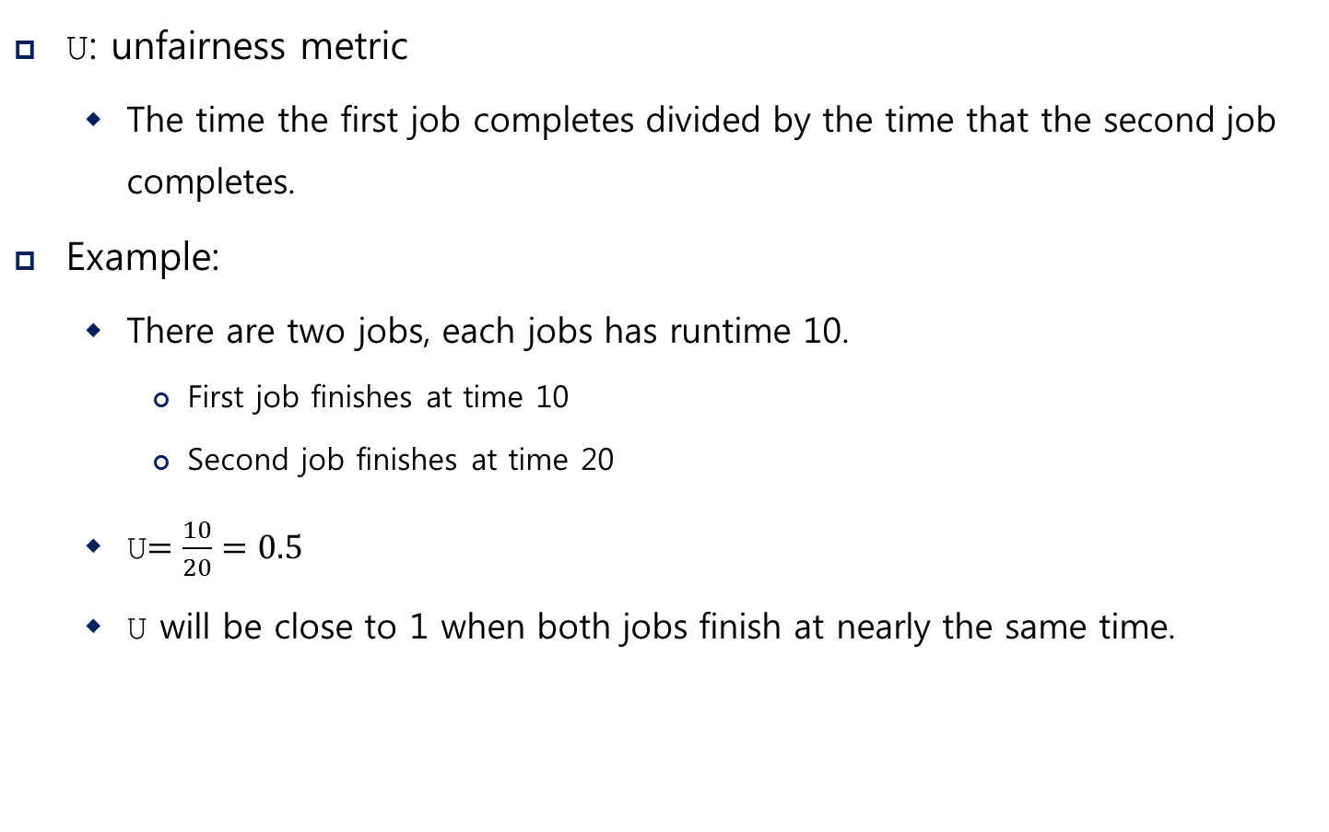
Implementation (Cont.)
U: unfairness metric
The time the first job completes divided by the time that the second job completes.
Example:
There are two jobs, each jobs has runtime 10.
First job finishes at time 10
Second job finishes at time 20
U$=\frac{10}{20}=0.5$
U will be close to 1 when both jobs finish at nearly the same time.

Slide 42
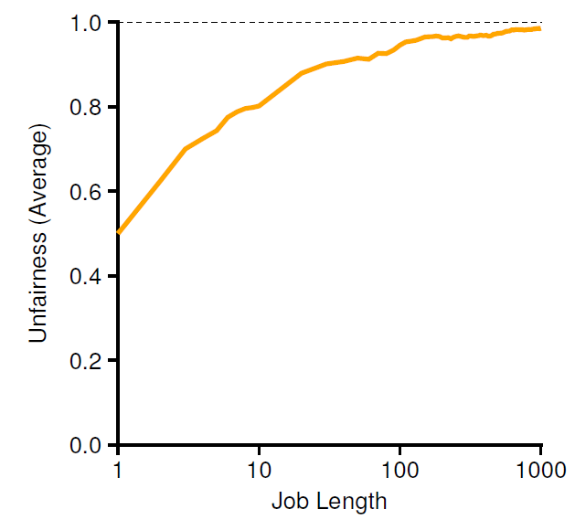
Lottery Fairness Study
There are two jobs.
Each jobs has the same number of tickets (100).
When the job length is not very long,
average unfairness can be quite severe.

Slide 43
Stride Scheduling
Stride of each process
(A large number) / (the number of tickets of the process)
Example: A large number = 10,000
Process A has 100 tickets → stride of A is 100
Process B has 50 tickets → stride of B is 200
A process runs, increment a counter(=pass value) for it by its stride.
Pick the process to run that has the lowest pass value
current = remove_min(queue); // pick client with minimum pass
schedule(current); // use resource for quantum
current->pass += current->stride; // compute next pass using stride
insert(queue, current); // put back into the queue
A pseudo code implementation

Slide 44
Stride Scheduling Example
Pass(A)
(stride=100)
Pass(B)
(stride=200)
Pass(C)
(stride=40)
Who Runs?
0
100
100
100
100
100
200
200
200
0
0
200
200
200
200
200
200
200
0
0
0
40
80
120
120
160
200
A
B
C
C
C
A
C
C
…
If new job enters with pass value 0,
It will monopolize the CPU!

Slide 45
Part IV. Multiprocessor Scheduling

Slide 46
Multiprocessor Scheduling
The rise of the multicore processor is the source of multiprocessor-scheduling proliferation.
Multicore: Multiple CPU cores are packed onto a single chip.
Adding more CPUs does not make that single application run faster. → You’ll have to rewrite application to run in parallel, using threads.
How to schedule jobs on Multiple CPUs?

Slide 47
Single CPU with cache
CPU
Cache
Small, fast memories
Hold copies of popular data that is found in the main memory.
Utilize temporal and spatial locality
Cache
Memory
Main Memory
Holds all of the data
Access to main memory is slower than cache.
By keeping data in cache, the system can make slow memory appear to be a fast one

Slide 48



Cache coherence
Consistency of shared resource data stored in multiple caches.
0. Two CPUs with caches sharing memory
1. CPU0 reads a data at address 1.
CPU 0
CPU 1
CPU 0
CPU 1
Cache
Cache
Cache
$$D$$
Cache
Bus
Bus
 | $$D$$
Memory
 | $$D$$
Memory
0
1
2
3
0
1
2
3

Slide 49





Cache coherence (Cont.)
2. $D$ is updated and CPU1 is scheduled.
3. CPU1 re-reads the value at address A
CPU 0
CPU 1
CPU 0
CPU 1
Cache
$$D′$$
Cache
Cache
$$D′$$
Cache
$$D$$
Bus
Bus
 | $$D$$
Memory
 | $$D$$
Memory
0
1
2
3
0
1
2
3
CPU1 gets the old value $D$
instead of the correct value $D′$.

Slide 50
Cache coherence solution
Bus snooping
Each cache pays attention to memory updates by observing the bus.
When a CPU sees an update for a data item it holds in its cache, it will notice the change and either invalidate its copy or update it.

Slide 51
Don’t forget synchronization
When accessing shared data across CPUs, mutual exclusion primitives should likely be used to guarantee correctness.
1 typedef struct __Node_t {
2 int value;
3 struct __Node_t *next;
4 } Node_t;
5
6 int List_Pop() {
7 Node_t *tmp = head; // remember old head ...
8 int value = head->value; // ... and its value
9 head = head->next; // advance head to next pointer
10 free(tmp); // free old head
11 return value; // return value at head
12 }
Simple List Delete Code

Slide 52
Don’t forget synchronization (Cont.)
Solution
1 pthread_mtuex_t m;
2 typedef struct __Node_t {
3 int value;
4 struct __Node_t *next;
5 } Node_t;
6
7 int List_Pop() {
8 lock(&m)
9 Node_t *tmp = head; // remember old head ...
10 int value = head->value; // ... and its value
11 head = head->next; // advance head to next pointer
12 free(tmp); // free old head
13 unlock(&m)
14 return value; // return value at head
15 }
Simple List Delete Code with lock

Slide 53
Cache Affinity
Keep a process on the same CPU if at all possible
A process builds up a fair bit of state in the cache of a CPU.
The next time the process run, it will run faster if some of its state is already present in the cache on that CPU.
A multiprocessor scheduler should consider cache affinity
when making its scheduling decision.

Slide 54
Single queue Multiprocessor Scheduling (SQMS)
Put all jobs that need to be scheduled into a single queue.
Each CPU simply picks the next job from the globally shared queue.
Cons:
Some form of locking have to be inserted → Lack of scalability
Cache affinity
Example:
Possible job scheduler across CPUs:
Queue
A
B
C
D
E
NULL
CPU0
A | E | D | C | B
… (repeat) …
CPU1
B | A | E | D | C
… (repeat) …
CPU2
C | B | A | E | D
… (repeat) …
CPU3
D | C | B | A | E
… (repeat) …

Slide 55
Scheduling Example with Cache affinity
Preserving affinity for most
Jobs A through D are not moved across processors.
Only job e Migrating from CPU to CPU.
Implementing such a scheme can be complex.
Queue
A
B
C
D
E
NULL
CPU0
A | E | A | A | A
… (repeat) …
CPU1
B | B | E | B | B
… (repeat) …
CPU2
C | C | C | E | C
… (repeat) …
CPU3
D | D | D | D | E
… (repeat) …

Slide 56
Multi-queue Multiprocessor Scheduling (MQMS)
MQMS consists of multiple scheduling queues.
Each queue will follow a particular scheduling discipline.
When a job enters the system, it is placed on exactly one scheduling queue.
Avoid the problems of information sharing and synchronization.

Slide 57
MQMS Example
With round robin, the system might produce a schedule that looks like this:
Q0
A
C
Q1
B
D
CPU0
A | A | C | C | A | A | C | C | A | A | C | C
…
CPU1
B | B | D | D | B | B | D | D | B | B | D | D
…
MQMS provides more scalability and cache affinity.

Slide 58
Load Imbalance issue of MQMS
After job C in Q0 finishes:
After job A in Q0 finishes:
Q0
A
Q1
B
D
CPU0
A | A | A | A | A | A | A | A | A | A | A | A
…
CPU1
B | B | D | D | B | B | D | D | B | B | D | D
…
A gets twice as much CPU as B and D.
Q0
Q1
B
D
CPU0
…
CPU1
B | B | D | D | B | B | D | D | B | B | D | D
…
CPU0 will be left idle!

Slide 59
How to deal with load imbalance?
The answer is to move jobs (Migration).
Example:
Q0
Q1
B
D
The OS moves one of B or D to CPU 0
Q0
D
Q1
B
Or
Q0
B
Q1
D

Slide 60
How to deal with load imbalance? (Cont.)
A more tricky case:
A possible migration pattern:
Keep switching jobs
Q0
A
Q1
B
D
CPU0
A | A | A | A | B | A | B | A | B | B | B | B
…
CPU1
B | D | B | D | D | D | D | D | A | D | A | D
…
Migrate B to CPU0
Migrate A to CPU1

Slide 61
Work Stealing
Move jobs between queues
Implementation:
A source queue that is low on jobs is picked.
The source queue occasionally peeks at another target queue.
If the target queue is more full than the source queue, the source will “steal” one or more jobs from the target queue.
Cons:
High overhead and trouble scaling

Slide 62
Linux Multiprocessor Schedulers
O(1)
A Priority-based scheduler
Use Multiple queues
Change a process’s priority over time
Schedule those with highest priority
Interactivity is a particular focus
Completely Fair Scheduler (CFS)
Deterministic proportional-share approach
Multiple queues

Slide 63
Linux Multiprocessor Schedulers (Cont.)
BF Scheduler (BFS)
A single queue approach
Proportional-share
Based on Earliest Eligible Virtual Deadline First(EEVDF)

Slide 64
Summary
CPU Scheduling
Scheduling metrics: Turnaround time, Response time; Fairness
Scheduling Strategy: FIFO, SJF, PSJF, RR, MLFQ
Simple: FIFO, SJF, PSJF, RR
MLFQ
Proportional Share
Multiprocessor scheduling
Cache coherence
Cache affinity
SQMS, MQMS, Load balance
Next: Memory (Chapters 13, 15, 16, 17, 18, 19, 20, 21, 22, 23)

