Slide 1
Online Restaurant reservation
XI NAN

Slide 2
Introduction
An online reservation website
It designs for a restaurant
The service is intuitive and convenient for customers
The company will expand their business
I will learn …
The management of database and website
The E-commerce
The methods of investigation, analysis, design and development

Slide 3
Investigation
Methods-
interview
questionnaire (will be taken later)
User group-
Potential customers
A restaurant host

Slide 4
Basic Requirements
Reservation system
-User interface- PHP for dynamic pages
-Manager interface- manage reservations
-Database- concurrency
Payment system
-Card- redirect to the online bank website
-Cash- pay in person

Slide 5
Required Functions
For an easy search
Keyword search
Popular menu
User history
Web navigation

Slide 6
Required Functions
Customer care
Cooking reading
Bonus
News publishing
Manual

Slide 7
Problems
User group
Database- proper roles and system privileges
Website- Present different interfaces
Concurrency
-abundant potential customers
-Example: order the seat at the same time
Account safety
-User information store in the database
-The external link to bank will be made use of phishing

Slide 8
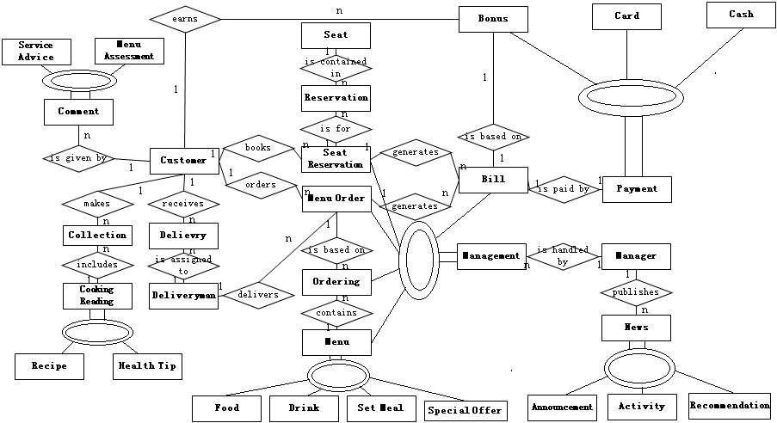
Entity Relationship Diagram
Add the membership class, attributions and turn the diagram to the skeleton table later.

Slide 9
Development
Database
Database: MySQL
Languages: SQL
Website
Edit: Dreamweaver
Language: HTML, JAVASCRIPT, CSS
Connect the database with web server
Web server: Apache
Database: MySQL
Language: PHP

Slide 10
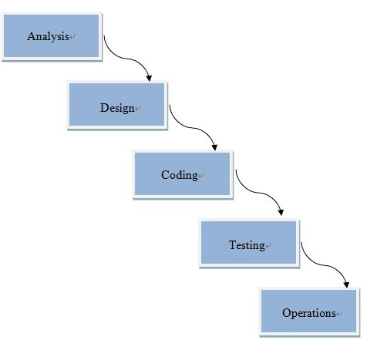
Plan
Water fall

Slide 11
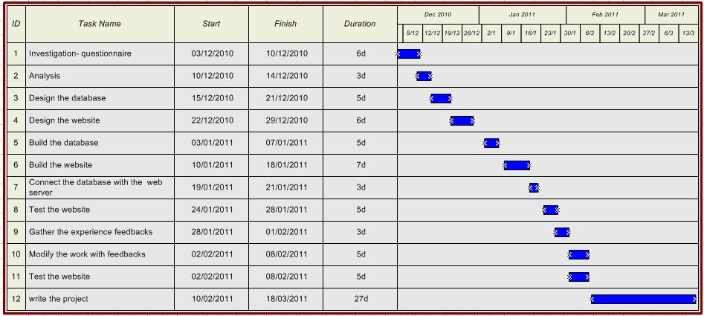
Plan
Gantt diagram

Slide 12
Thank you for listening.

