Slide 1
UM-SJTU Joint Institute
Steganography and Cryptography
Members:
Xuanjin Jin
Ying Huai
Zhihao Song
Ziying An
2021 July 22
Date:
Prof. _______
Instructor:
presentor: Ying Huai
Ve475 Project 1 Presentation

Slide 2
UM-SJTU Joint Institute
Steganography and Cryptography
Members:
Xuanjin Jin
Ying Huai
Zhihao Song
Ziying An
2021 July 22
Date:
Manuel
Prof. _______
Instructor:
presentor: Ying Huai
Ve475 Project 1 Presentation

Slide 3
Introduction
Steganography is a technique of
hiding secret data within an ordinary, non-secret, file or message in order to avoid detection
Secret data
Stegonagraphic Algorithm
Stego-object
Stego-medium
1

Slide 4
Introduction
Digital Stego-medium
Text
Image (our focus)
Audio
Video
Metrics of Steganographic Algorithm
Security (difficulty of the stego-object to be detected)
Capacity (rate of secret data that can be stored)
Robustness (resistance over attack or transmission errors)
2

Slide 5
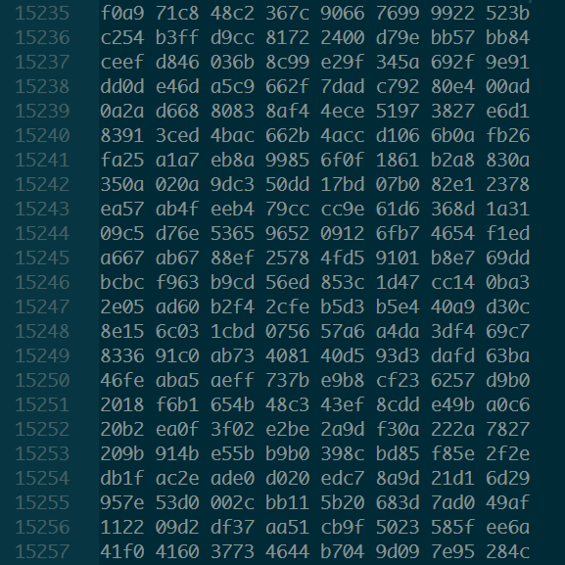


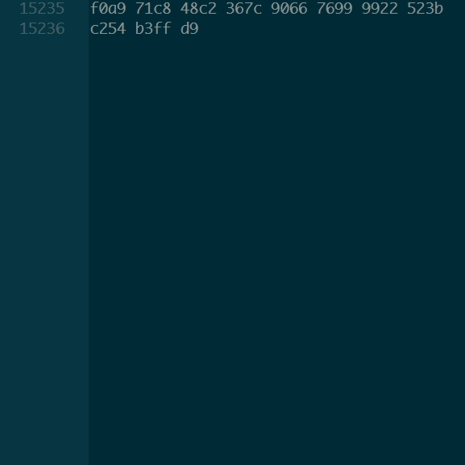
File-Based Algorithm
EOI Injection
append secret data after EOI identifier the image decoder ignores everything after EOI
append data
stego-image
raw data
the same as the original
3
https://img3.gelbooru.com/images/96/11/9611236348815eb79b53c7398aa3272e.jpg

Slide 6
File-Based Algorithm
EOI Injection
append secret data after EOI identifier the image decoder ignores everything after EOI
Security: low
Capacity: not limited
Robustness: relatively high
4

Slide 7




Spatial Domain Algorithm
Least Significant Bits (LSB)
for each 8-bit pixel block change last n bits to the secret data
n-bit
LSB
n = 2
n = 4
original (n = 0)
n = 8
n = 6
5

Slide 8




Spatial Domain Algorithm
Pixel Value Differencing (PVD)
an advanced LSB technique wisely choose n for each pixel by value difference
smooth
small n
n = 2
n = 4
rough
large n
original (n = 0)
n = 2
n = 4
6

Slide 9
Spatial Domain Algorithm
Pixel Value Differencing (PVD)
an advanced LSB technique wisely choose n for each pixel by value difference
Security: high
Capacity: higher than secure LSB
Robustness: low
7

Slide 10
Transform Domain Algorithm
Discrete Cosine Transform (DCT) convert the image into transform domain by DCT insert secret data and transform it back
Spatial Domain
Transform Domain
DCT
Raw Image
Transformed Image
Spatial Domain Algorithm
Secret Data
IDCT
Stego-object
Stego-image
8

Slide 11
Transform Domain Algorithm
Discrete Cosine Transform (DCT) convert the image into transform domain by DCT insert secret data and transform it back
Security: high
Capacity: medium
Robustness: relatively high
9

Slide 12
Steganographic Elimination
Eliminate the steganographic secret data
without knowing its contents
or even without knowing its existence
Destroy Everything
Compression
Reformat
Random noise
…
10

Slide 13

With Cryptography
No protection method
extremely vulnerable
11
https://www.primeinspiration.com/joom/media/files/photos/1341281758890aff_l.jpg

Slide 14
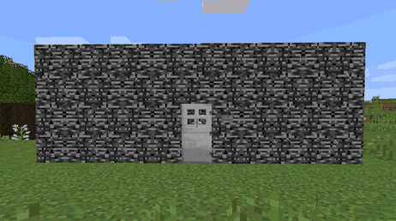
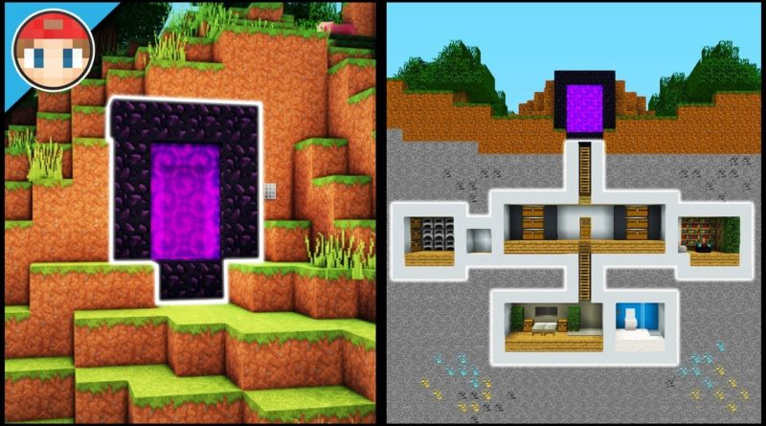
With Cryptography
Cryptography
Steganography
invincible
known to everyone
undetectable
lack of protection
12
http://razorxgamer.com/wp-content/uploads/2019/01/1546779275_maxresdefault-800x445.jpg
https://www.digminecraft.com/getting_started/images/how_to_make_indestructible_shelter7.png

Slide 15

With Cryptography
Cryptography
Steganography
undetectable
even detected, hard to intrude
13

Slide 16
References
Documents
McKay, B. and McKay K., “Man Knowledge: The History of Invisible Ink”. AoM Newsletter, 2011. https://www.artofmanliness.com/articles/man-knowledge-the-history-of-invisible-ink.
Kessler, G. C. and Hosmer, C., “Chapter 2 - An Overview of Steganography”, Advances in Computers, Elsevier, 83: 51-107ff 2011. https://doi.org/10.1016/B978-0-12-385510-7.00002-3.
Images
https://img3.gelbooru.com/images/96/11/9611236348815eb79b53c7398aa3272e.jpg
https://www.primeinspiration.com/joom/media/files/photos/1341281758890aff_l.jpg
http://razorxgamer.com/wp-content/uploads/2019/01/1546779275_maxresdefault-800x445.jpg
https://www.digminecraft.com/getting_started/images/how_to_make_indestructible_shelter7.png
14

Slide 17
https://www.ji.sjtu.edu.cn/

