Slide 1

Message Authentication Code (MAC)
Group 1
Xiner Shen, Sheng Qiao, Yichun Hou, Hsiang-Yu Chu

Slide 2

Content
1
MAC
2
Block Cipher-Based MAC
3
Hash Function-Based MAC
4
Universal Hash Function-
Based MAC
5
Discussion

Slide 3
1
MAC

Slide 4




Message Authentication Code (MAC)
MAC
+
Message
Alice
Bob
Masquerade as Alice
Message is sent by Alice.
The message hasn’t been modified.
Eve

Slide 5
MAC — Working Principle
SENDER
RECEIVER
Message_Sent
Message_Received
MAC Generation
Secret Key
Secret Key
MAC Generation
MAC_Sender
==?
MAC_Receiver
Yes
The integrity and authenticity of message received is verified.

Slide 6
MAC — Common Approaches
Block Cipher-
Based MAC
Universal Hash Function-
Based MAC
Hash Function-Based MAC

Slide 7
2
Block Cipher-Based MAC

Slide 8
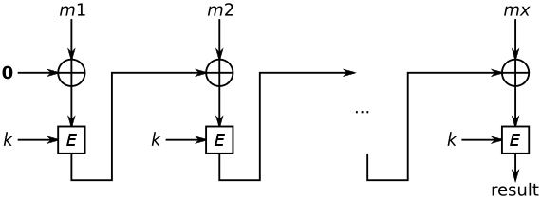
Block Cipher-Based MAC — Cipher Block Chaining MAC (CBC-MAC)
EMAC
CBC-MAC
Constrained message length
Require two keys
Dependent on the message up till current block
OMAC
Use one key
Secure use of arbitrary message lengths
Dependent on the message up till current block
Fixed length of each block of message (Otherwise, not secure)
Dependent on the message up till current block
PMAC
Use one key
Same message length for all blocks
Fully parallelizability
Notes:
each block of ciphertext is dependent on all blocks of plaintext up till the current encryption.
This method is secure as long as the message length m = kn, where k is an integer and n is the length of block cipher E
(sequentially may become a bottleneck in advanced systems)

Slide 9
CBC-MAC — Security & Application
Security
Application
Mobile devices based control systems
Asserting authentic information by sharing the CBC-MAC key between the transmitter and receiver
Protects information against malicious attacks
Provides a secure communication link of the data in mobile devices based control system
Not secure for variable length message
Prone to chosen-plaintext attack

Slide 10
3
Hash Function-Based MAC

Slide 11



Hash Function-Based MAC (HMAC) — Background
Demand
Main goals behind
HMAC construction
Widely available
Simple
Efficient
Can directly put the available hash functions into use without any modifications
Replacement of underlying hash function should be easy and simple
The performance of hash functions should be preserved
The strength of HMAC can be deduced according to the strength of the underlying hash functions
Secret keys should be used and handled in a common and simple way
Hash function
Faster execution speed
Hash functions available worldwide
Software implementation readily available for free

Slide 12
HMAC — Definition
Message m
Secret Key K
1
Block-sized Key K’
1
Generating block-sized Key K’
Hash down K using H
Yes
K is larger than block size B?
No
Append 0 to the end of K / H(K) up to block size B
Secret Key K
Block-sized Key K’
Notes:
H - cryptographic hash function that hashing data by compressing blocks of data using a function iteratively
B - byte-length of the block for the hash function H
L - byte-length of the output of the hash function H
m - message to be authenticated
K - secret key
K’ - block-sized key generated based on secret key K
ipad - block-sized inner padding, byte 0x36 repeated B times
opad - block-sized outer padding, byte 0x5c repeated B times
XOR - XOR operation
|| - concatenation which means appending the latter one to the previous one

Slide 13



HMAC — Definition
Message m
Secret Key K
1
Block-sized Key K’
Block-sized Inner Padding ipad
1
Generating block-sized Key K’
3
2
ipadkey
Concatenation
2
XOR block-sized key K’ with ipad
ipadkey_m
4
Hashing
(Hash Function H)
3
Concatenate ipadkey with message m
h
4
Apply hash function H to ipadkey_m
Notes:
H - cryptographic hash function that hashing data by compressing blocks of data using a function iteratively
B - byte-length of the block for the hash function H
L - byte-length of the output of the hash function H
m - message to be authenticated
K - secret key
K’ - block-sized key generated based on secret key K
ipad - block-sized inner padding, byte 0x36 repeated B times
opad - block-sized outer padding, byte 0x5c repeated B times
XOR - XOR operation
|| - concatenation which means appending the latter one to the previous one

Slide 14



HMAC — Definition
Message m
Secret Key K
1
Block-sized Key K’
Block-sized Inner Padding ipad
3
5
2
ipadkey
Concatenation
XOR block-sized key K’ with opad
ipadkey_m
4
Hashing
(Hash Function H)
6
Concatenate opadkey with h
Block-sized Outer Padding opad
h
6
5
opadkey
Concatenation
7
Apply hash function H to h_opadkey
h_opadkey
7
Hashing
(Hash Function H)
MAC
HMAC(K, m)
Notes:
H - cryptographic hash function that hashing data by compressing blocks of data using a function iteratively
B - byte-length of the block for the hash function H
L - byte-length of the output of the hash function H
m - message to be authenticated
K - secret key
K’ - block-sized key generated based on secret key K
ipad - block-sized inner padding, byte 0x36 repeated B times
opad - block-sized outer padding, byte 0x5c repeated B times
XOR - XOR operation
|| - concatenation which means appending the latter one to the previous one

Slide 15
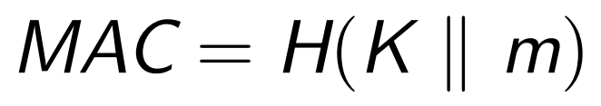

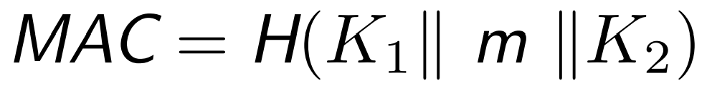
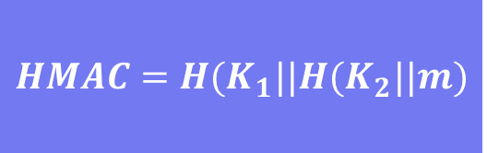
Hash Function-Based MAC (HMAC) — Design Principle
01
“Pretend-only” construction:
extension attack
02
“Append-only” construction:
$$HMAC=H(K_{1}||H(K_{2}||m)$$
collision attack
03
“Envelop” construction:
divide and conquer attack
Notes:
Easy to append extra message or data and get another valid MAC without key.
the collision in the hash function result in the collision in the MAC；finding collision in hash functions is much easier than that in MAC
no extra security is increased as the strength of MAC is based on the length of individual keys

Slide 16
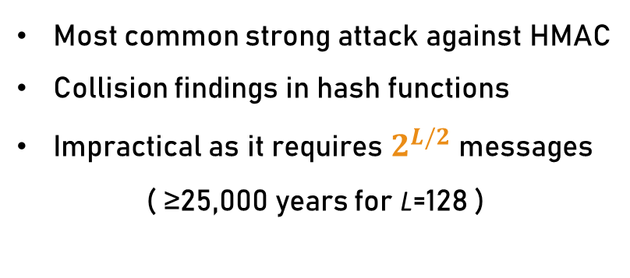
Hash Function-Based MAC (HMAC) — Security
Requirement for Keys
Birthday attack
Be at least L bytes long
Be chosen randomly and refreshed regularly
Most common strong attack against HMAC
Collision findings in hash functions
Impractical as it requires $2^{L/2}$ messages
( ≥25,000 years for L=128 )
Strength of HMAC
Underlying hash functions H with strong cryptographic properties
Compression function of the hash function H required to powerful
HMAC is still of high security
Notes:
L - byte-length of the output of the hash function H

Slide 17

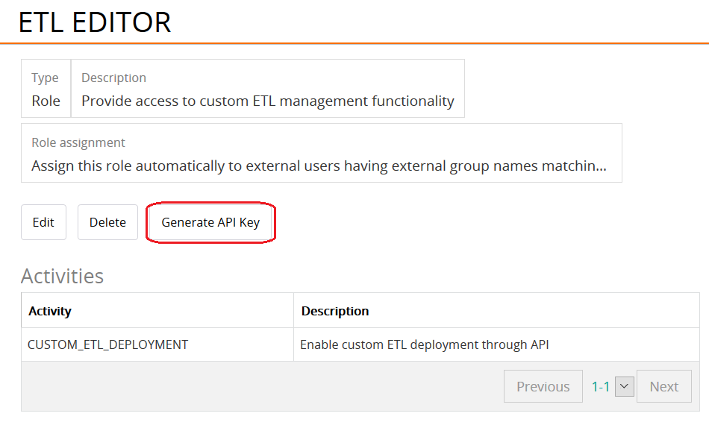

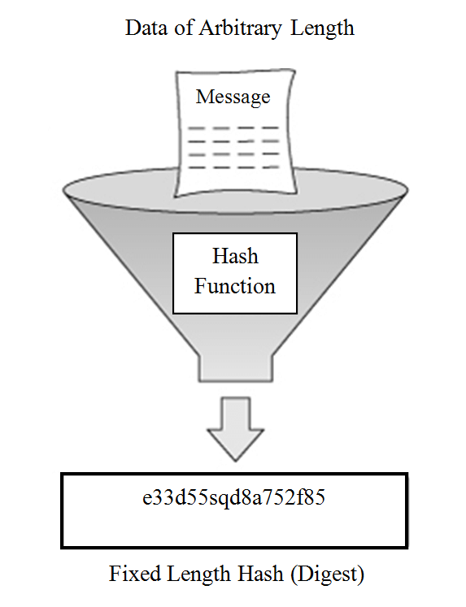
Hash Function-Based MAC (HMAC) — Application
Two-party authenticated communication
Password reset e-mail
Account activation e-mail
Message digest
Notes:
Password reset e-mail: When a user log in a site using their e-mail address, a password reset link can be sent to the users if they forget their password. The link is required to be valid for a certain period of time and can be used only once. A HMAC will be computed on the message m containing the user’s e-mail address, the server’s current time and the hash of current password. A URL is constructed based on the user’s e-mail address, current time and HMAC generated before. The URL which is the path to the password reset page will be sent to the user.
Account activation e-mail: When a user want to create an account on a site, an account activation e-mail will be sent to the user. The verification process and generation of URL is quite similar as that of password reset e-mail.
Two-party authenticated communication: A online service shares ”API key”, a randomly generated key, with users to allow users to report data. HMAC is suitable for the authentication of Internet of Things (IoT) thanks to its low cost.
Message digest: Using HMAC, any message can be converted into a message of fixedlength which can permit maximizing bandwidth.

Slide 18
Universal Hash Function-Based MAC
4

Slide 19
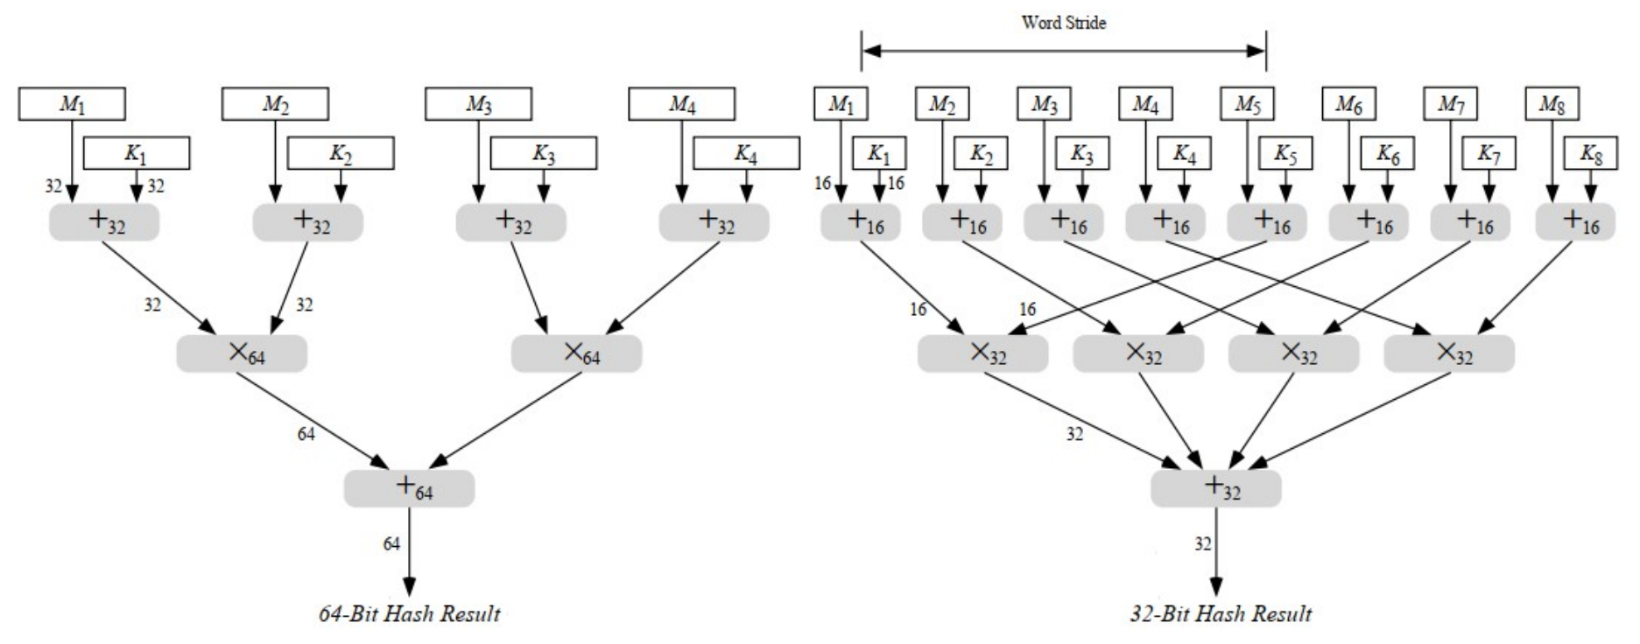
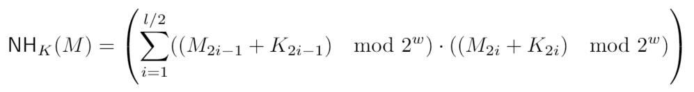

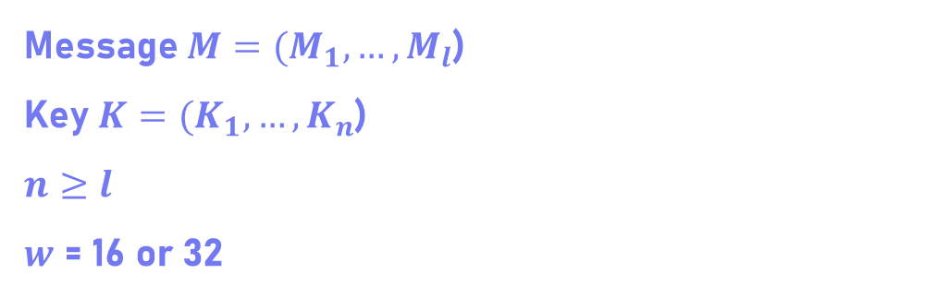
Universal Hash Function-Based MAC (UMAC)
NH function
Message $M=(M_{1}, …,M_{l}$)
Key $K=(K_{1}, …,K_{n}$)
$$n≥l$$
$w$ = 16 or 32
UMAC
Notes:
Secret random keys which are known to both sender and receiver are denoted as K1 and K2
Nonce is a value changing according to each tag that is generated
Meanwhile, a keyed function, namely UHash, is used in UMAC.
In UHash, the pseudorandom function F applies Advanced Encryption Standard (AES) algorithm in its default implementation.

Slide 20
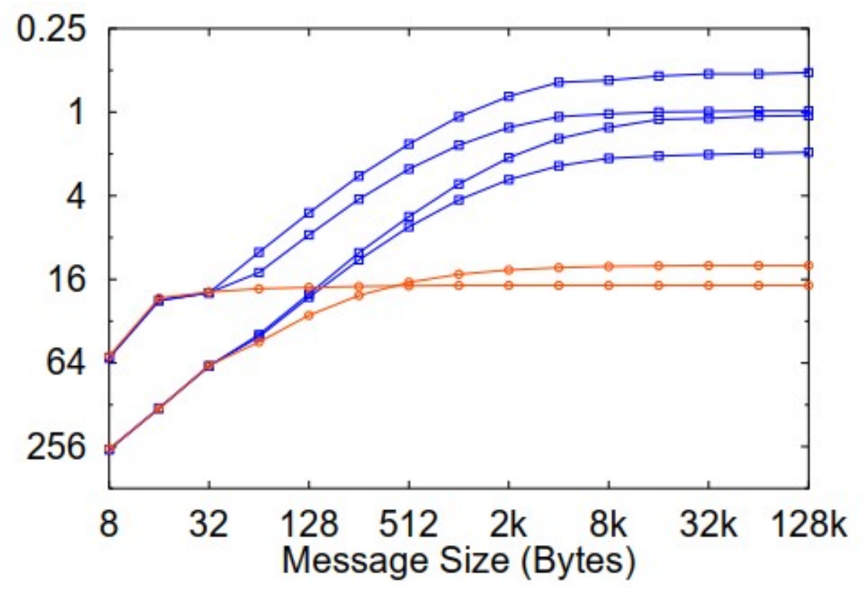
UMAC — Performance & Security
Performance
Performance of different kinds of MACs
UMAC-MMX-30
UMAC-MMX-60
UMAC-STD-30
UMAC-STD-60
HMAC-SHA1
CBC-MAC-RC6
Security
Depend on the cryptographic functions
Higher security thanks to the universal hash function than normal HMAC
Outstanding performance when the message size is large.

Slide 21
5
Discussion

Slide 22
Discussion
Cryptographic strategy advances quickly
Keep updating MAC from time to time
Attacker is also becoming increasingly smarter

Slide 23
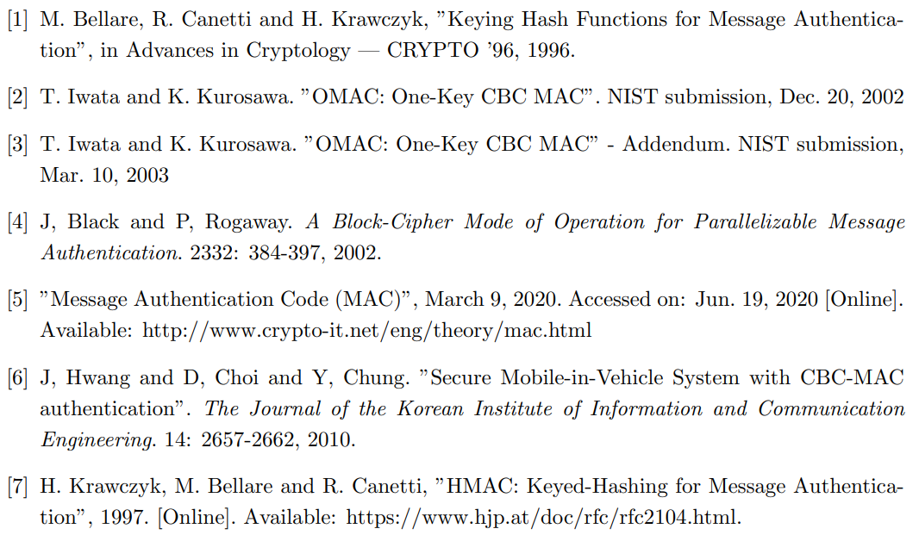
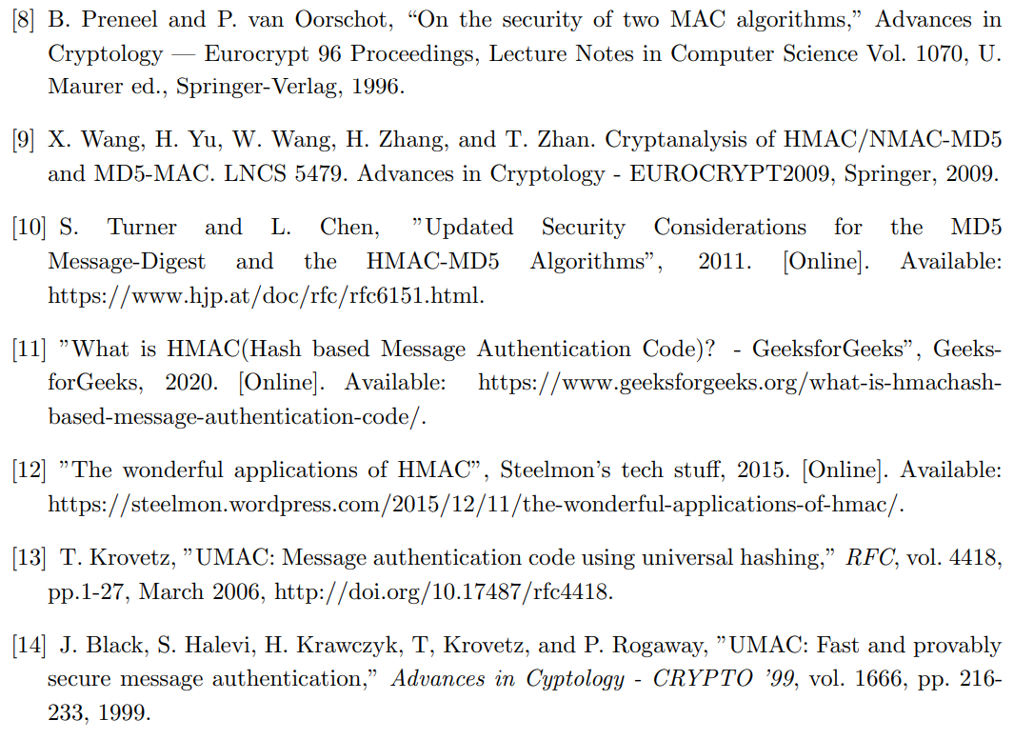
Reference

Slide 24
Thanks!

