Slide 1
Message Authentication Code
VE475 pgroup 3
Chang Yiding
Dong Yier
Xing Yidan
Xu Yuchen

Slide 2
Introduction

Slide 3
Primitive Security Goals:
Integrity: judge whether the message has been modified
Authentication: judge whether the message originated from the sender through cryptographic proof
Non-repudiation: if the message passes the cryptographic proof, whether the receiver is confident that the message originated from the sender

Slide 4
Techniques to Achieve Security
Security Goal | Hash | MAC | Digital Signature
Integrity | Yes | Yes | Yes
Authentication | No | Yes | Yes
Non-repudiation | No | No | Yes
Kind of Keys | None | Symmetric Keys | Asymmetric Keys

Slide 5
Working Principles of MAC

Slide 6
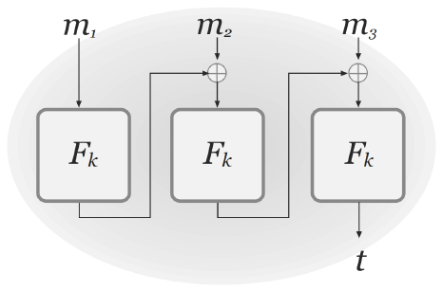
CBC-MAC (fixed-length)
CBC mode for authentication instead of encryption
To ensure security, length known by both sides
Compare the calculated result with the received MAC

Slide 7
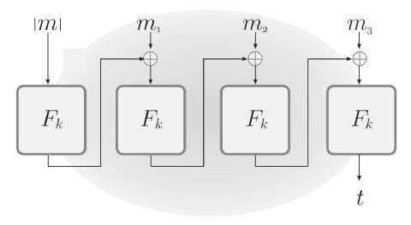
CBC-MAC (arbitrary length)
Add the length of message |m| in front of message
Another way is to use two keys and do CBC-MAC twice, but expensive in computing

Slide 8
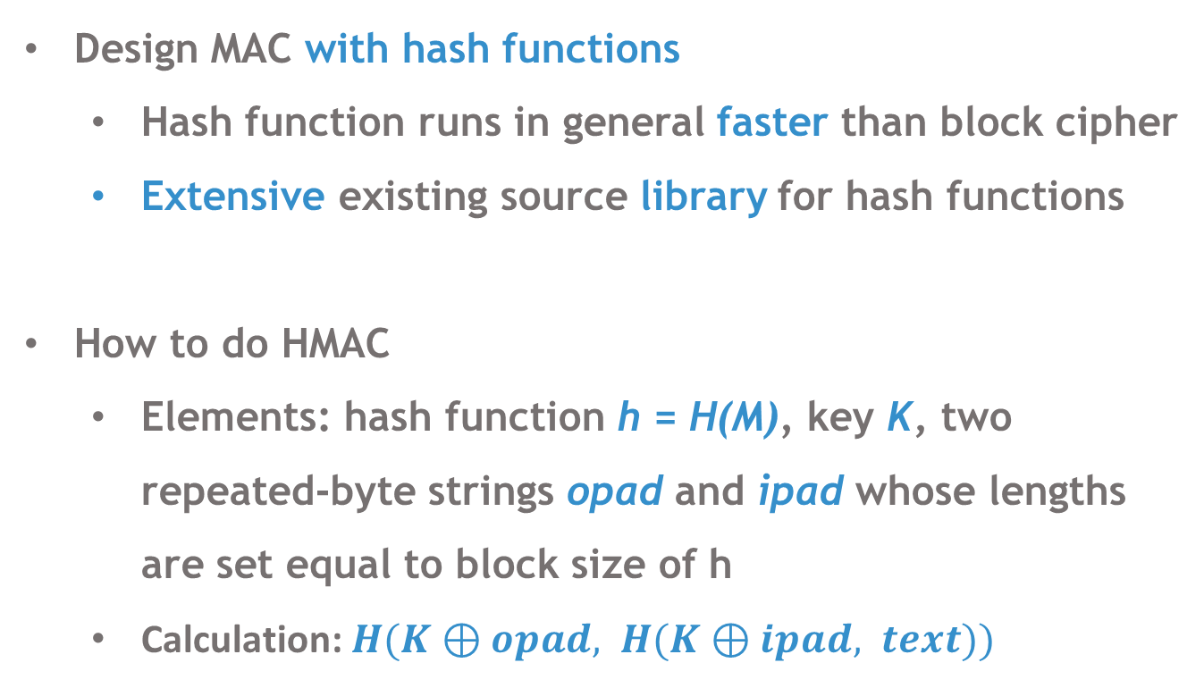
HMAC
Design MAC with hash functions
Hash function runs in general faster than block cipher
Extensive existing source library for hash functions
How to do HMAC
Elements: hash function h = H(M), key K, two repeated-byte strings opad and ipad whose lengths are set equal to block size of h
Calculation: $H(K⊕opad, H(K⊕ipad, text))$

Slide 9
Authenticated Encryption (AE)

Slide 10
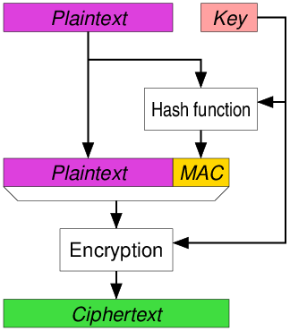
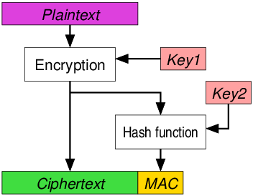
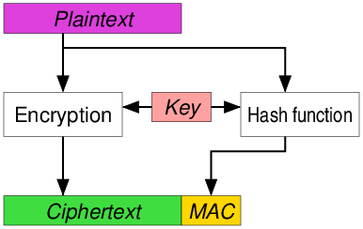
Order of Authentication and Encryption
Encrypt-then-MAC (EtM)
MAC-then-Encrypt (MtE)
Each approach has its own applications
EtM is in general the most secure one
Encrypt-and-MAC (EaM)

Slide 11
Galois Counter Mode (GCM)
Previously, integrity check only for plaintext or ciphertext
To check both, use Authenticated Encryption with Associated Data (AEAD)
Galois Counter Mode (GCM) – one of AEAD approach
GHASH for MAC
128-bit CTR block cipher for encryption
Closely combined instead of directly cascade

Slide 12
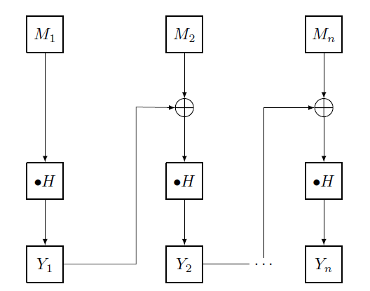
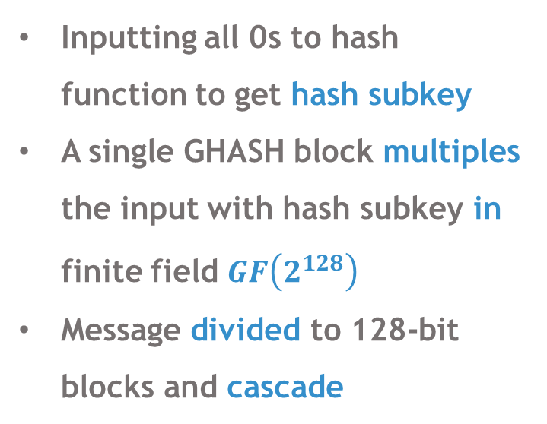
GHASH Function (for MAC)
Inputting all 0s to hash function to get hash subkey
A single GHASH block multiples the input with hash subkey in finite field $GF\left(2^{128}\right)$
Message divided to 128-bit blocks and cascade
output

Slide 13
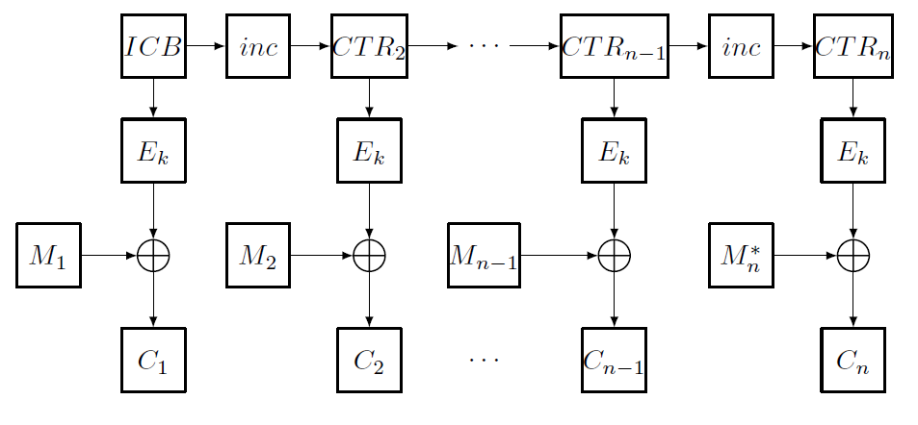
GCTR Function (for encryption)
concentrate and output
Work in a standard way of CTR mode except:
First encrypt counter value before XOR

Slide 14
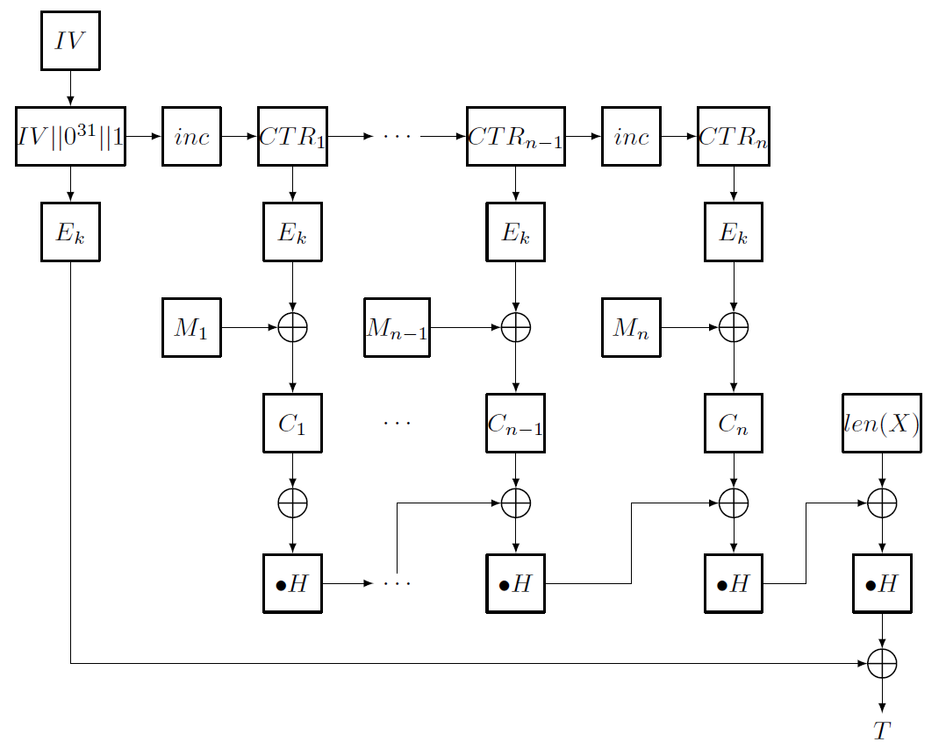
The Complete GCM
Decryption and Verification:
Create the encrypted counter value
XOR with ciphertext => Get the message
Apply GHASH and verify the receiver tag
Initialization vector
GCTR part
Ciphertext as input to GHASH
GHASH part
authentication tag

Slide 15
Security Assessments

Slide 16
Non-repudiation Issues
MAC cannot help "authenticate" the actual sender.
MAC uses the same key for generation and verification
Can deny having created a MAC-authorized message
claiming others with access to the same key generated it
Does not provide non-repudiation.

Slide 17
Brute-force Attacks
Attacking the key (with length k)
Acquire a valid message-tag pair
Find a key to reproduce this pair
Might exist multiple candidates, must choose one
Complexity: O(2^{k}).
Attacking the MAC tag (with length n)
Amounts to finding a hash collision
Complexity: O(2^{n})
Overall complexity: O(min(2^{k}; 2^{n})).
Should choose large k and n.

Slide 18
Multiple Forgery Attacks
Locate a pair of distinct prefixes which can generate a common internal state
Request the tag for the message, which is different in content but have the same tag
The measurement of the effectiveness of a MAC when facing multiple forgery attacks is based on the expectation of the number of forgeries

Slide 19

Multiple Forgery Attacks Against Various MAC
--Universal Hashing
The expected number of forgeries after q queries is calculated by:
Suppose the first successful forgery is the fth trial
Calculate the probability that the first successful forgery will occur on the fth trial times the probability that the next attempt will succeed
Using the geometric series and expanding the binomial, we finally have:

Slide 20
Multiple Forgery Attacks Against Various MAC
--Chained MACs
For any chained MACs, E(F) can be obtained by viewing the number of queries in the first phase of the attack
We then have three cases:
We had a collision pair in the previous step
We had the first collision pair when we arrived at this step
We have never found a collision pair so far

Slide 21

Multiple Forgery Attacks Against Various MAC
--Chained MACs
For the first two cases, we have located the necessary information to forge the information.
Then we need to calculate the probability of the first two cases, then calculate the total of P[F>f] over all values of f in the q queries
Introduce Stirling’s approximation and Taylor’s expansion, we finally have

Slide 22
Applications of MAC

Slide 23
Ciphertext Indistinguishability
Whether two arbitrary ciphertexts are indistinguishable
Experiment between Eve and Charlie:
Eve gives two plaintexts to Charlie
Charlie randomly chooses one, sends the corresponding ciphertext back
Eve has a decryption oracle
Eve needs to guess which plaintext was chosen.
If correct, Eve wins.
If winning probability ≈ 50%, then the cryptosystem is called IND-CCA2 secure.

Slide 24
Improving Ciphertext Indistinguishability
Take block ciphers for example
Without MAC:
Append a random block
Submit it to the oracle
Ditch the last block of the returned plaintext
Eve always wins
With MAC, this will fail
Last block contains MAC tag
Appended random block becomes MAC tag
Oracle finds mismatch on the MAC and rejects

Slide 25
Against Padding Oracle Attacks
Padding oracle: checks if a ciphertext is correctly padded
Padding oracle attacks:
Recover the plaintext byte by byte
Message receivers = padding oracles
Try all (256) possibilities of a byte, ask oracle if the padding matches to deduce the byte
With MAC:
Check MAC tags first before checking the padding
Message receivers = MAC tag verification oracles
Leak no information about the padding

Slide 26
An Application in Real Life
We now introduce how MAC is applied in telemedicince
To conceal patients’ sensitive information and to ensure the correctness of information, two fundamental objectives need to be realized: integrity and authentication

Slide 27
The working principle
For the Hospital Sever: generating HMAC from the message to get the Message Digest, adding message and message digest, using SHA-2 algorithm to encrypt them, sending them to the patients.
For the patients(clients): receiving the ciphertext, applying SHA-2 algorithm to get message and message digest, using HMAC on the message to generate message digest, comparing the generated message digest and original message digest, verifying the information.

Slide 28
Conclusion

Slide 29
Conclusion
MAC is a broad topic
Concept and importance of MAC
Explained CBC-MAC and HMAC
Combining MAC with encryption
Assessed the security of MACs
Discussed possible application scenarios

Slide 30
THANKS FOR WATCHING

