Slide 1

Lattice-Based Cryptography
Group 7

Slide 2
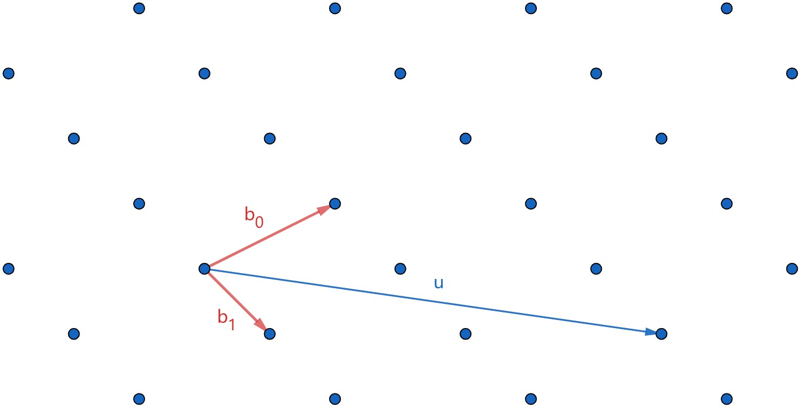
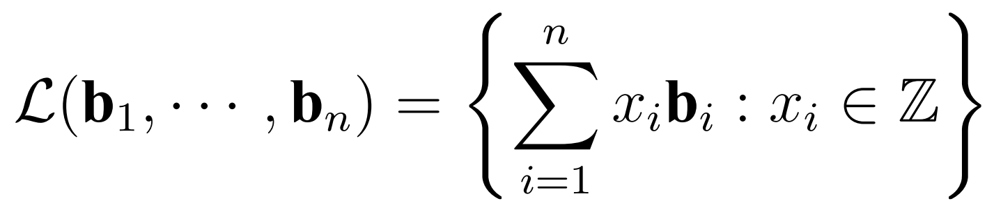
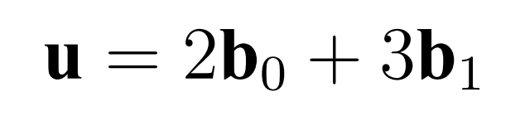
Lattice
Basis:

Slide 3
Hard Lattice Problems

Slide 4
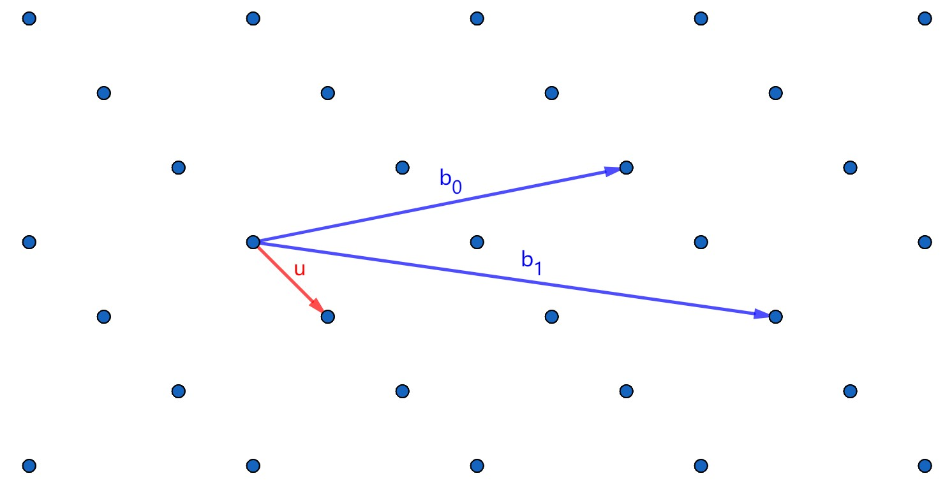
Shortest Vector Problem (SVP)

Slide 5
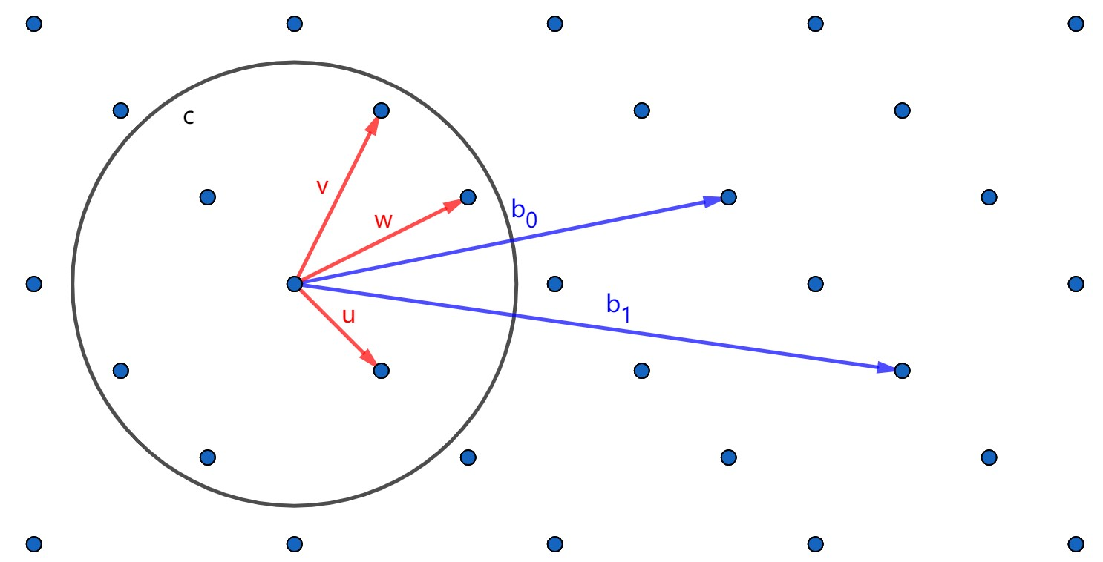
Shortest Independent Vectors Problem (SIVP)

Slide 6
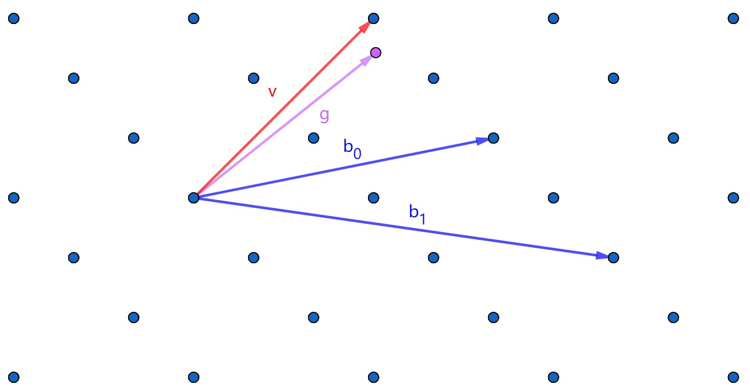
Closest Vector Problem (CVP)

Slide 7
Cryptographic Hard Problems

Slide 8
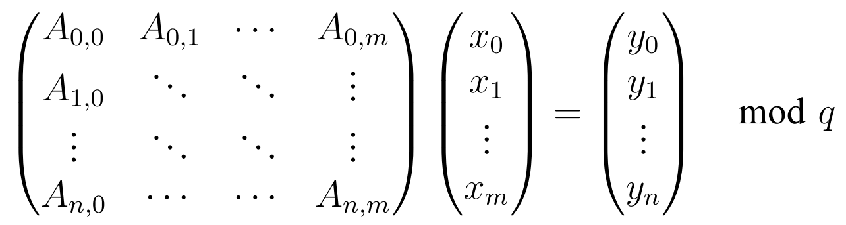
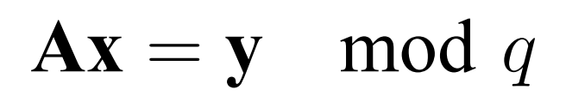
Short Integer Solution Problem (SIS)

Slide 9
GGH/HNF Cryptosystem

Slide 10
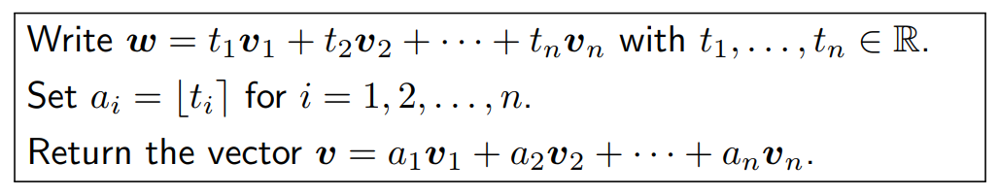
Babai’s Algorithm
Prerequisite: The bases is “good” enough
Short, approximately orthonormal

Slide 11
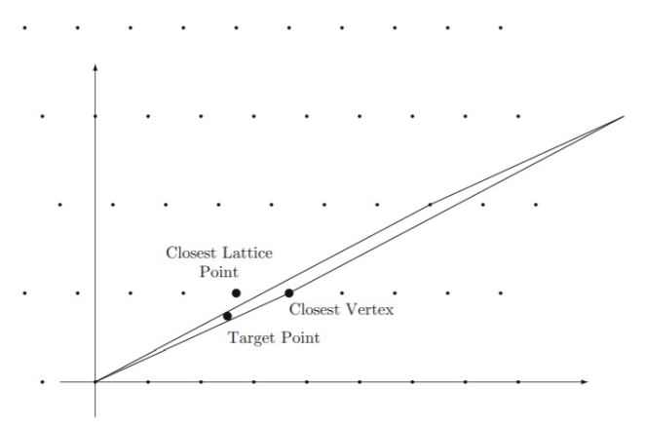
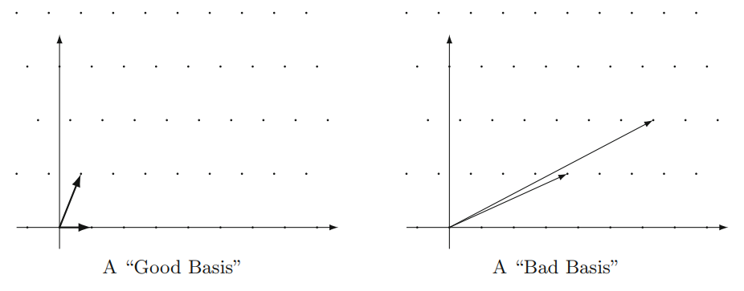
Babai’s Algorithm

Slide 12
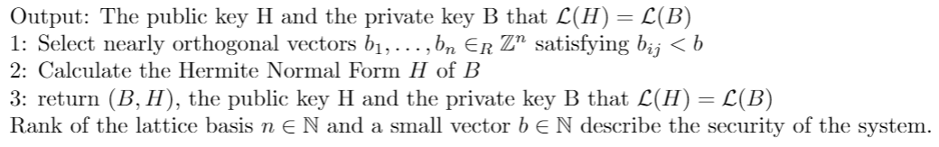
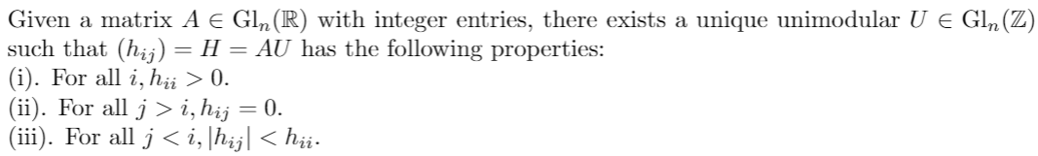
Key Generation
Choose a “good” bases as the private key
Calculate a “bad” bases which has the same lattice space as the public key.
Hermite Normal From
Theorem

Slide 13
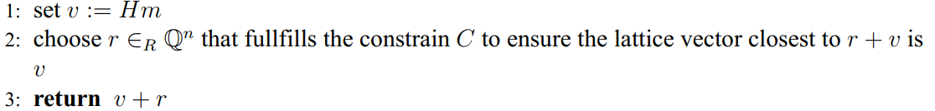
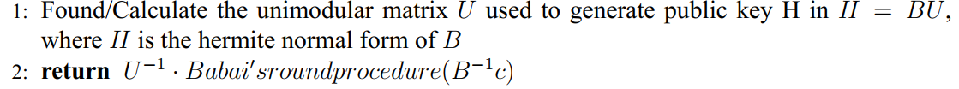
Encryption & Decryption
Encryption:
Decryption:
Prove:

Slide 14
LWE-based Cryptosystem

Slide 15
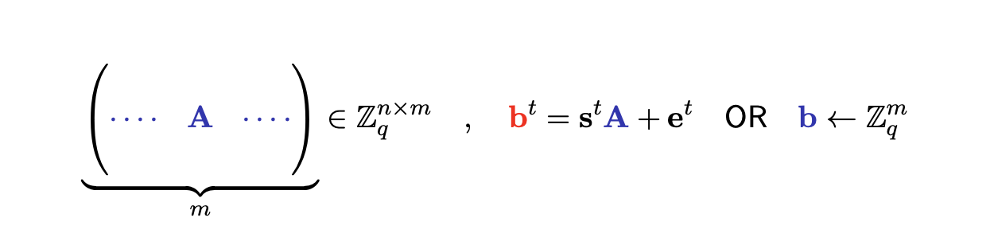
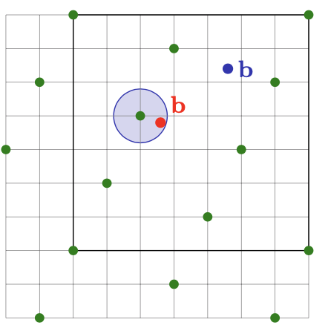
LWE Problem

Slide 16
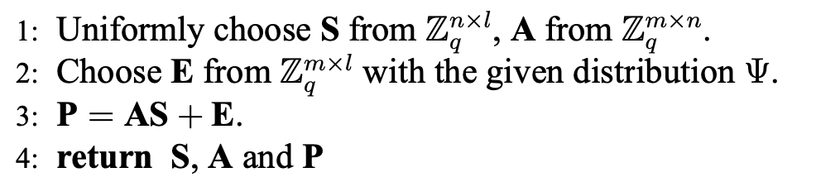
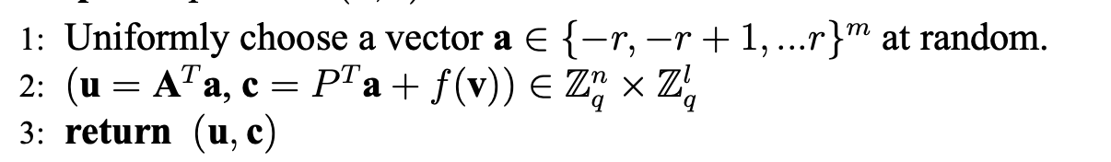

LWE cryptosystem
Key Generation:
Encryption:
Decryption:

Slide 17
Simple Example
Key Generation:
S = 2, E = 1, A = [3, 5, 4, 8], m = 1
P = AS + E = [7, 11, 9, 17]
Encryption:
Let a = [0, 1, 1, 0], then P^{T}a = 11 + 9 = 20
u = A^{T}a = 5 + 4 = 9
c = 20 + 1 = 21
Decryption:
m = c - S^{T}u = 21 - 2 * 9 = 3 = 1 mod 2

Slide 18
NTRU Cryptosystem

Slide 19

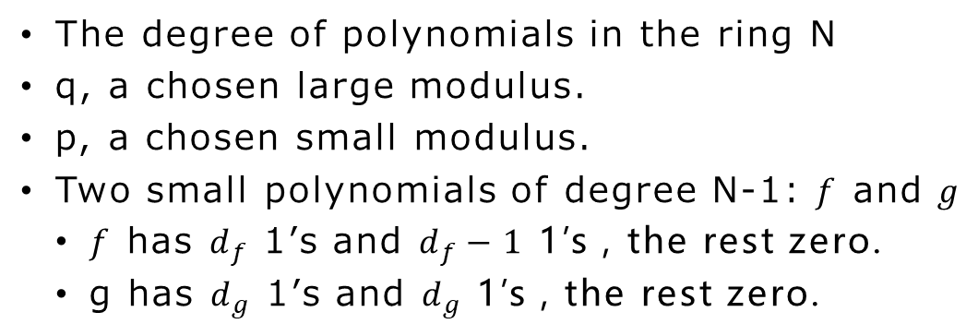
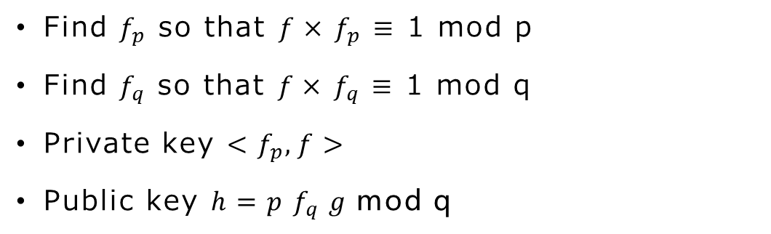
Key Generation
Parameter Choosing
The degree of polynomials in the ring N
q, a chosen large modulus.
p, a chosen small modulus.
Two small polynomials of degree N-1: $f$ and $g$
$f$ has $d_{f}$ 1’s and $d_{f}−1$ 1’s , the rest zero.
g has $d_{g}$ 1’s and $d_{g}$ 1’s , the rest zero.
Generating Keys
Find $f_{p}$ so that $f×$ $f_{p}$ $≡$ 1 mod p
Find $f_{q}$ so that $f×$ $f_{q}$ $≡$ 1 mod q
Private key $<f_{p},f>$
Public key $h=p f_{q} g$mod q

Slide 20


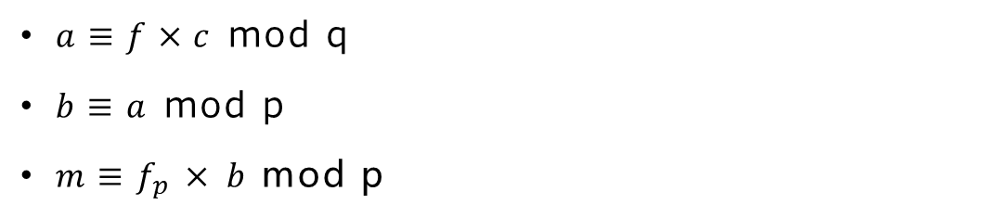
Encryption and Decryption
Encryption
A message m
A random polynomial r
Compute $c≡r×h+m$ mod q
Decryption
$a≡f×c$ mod q
$b≡a$ mod p
$m≡f_{p}$ $×$ $b$ mod p

Slide 21
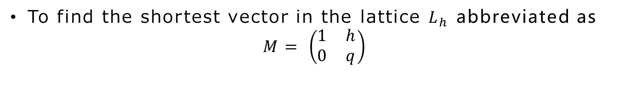
Security
Parameter Choosing
Parameters | N | q | p
Moderate Security | 167 | 128 | 3
Standard Security | 251 | 128 | 3
High Security | 347 | 128 | 3
Highest Security | 503 | 256 | 3
Hard Problem
To find the shortest vector in the lattice $L_{h}$ abbreviated as
$$M= \left(\begin{matrix}1 & h \\ 0 & q\end{matrix}\right)$$

Slide 22
Advantages
Faster key generation (Extended Euclidean Algorithm)
Much efficient encryption and decryption
Low memory use

Slide 23
Reference
Micciancio, D., & Regev, O. (2009). Lattice­-based Cryptography. In D. J. Bernstein, J. Buchmann, & E. Dahmen (Eds.), Post-­Quantum Cryptography , (pp. 147­191).
Wikipedia - the free encyclopedia “NTRU Cryptosystems Inc.”
Hoffstein, J., Pipher, J., & Silverman, J. H. (1998, June).NTRU: A ringbased public key cryptosystem. In International Algorithmic Number Theory Symposium (pp. 267288).

Slide 24
Thanks for your attention!

