Slide 1
VE475 Project1 Shannon’s Theory and cryptography
Kaibin Wang,
Taoyue Xia,
Wenjie Xianyu,
Yichen Hong

Slide 2
Contents
Properties:
Secrecy systems
Perfect secrecy
Entropy and equivocation
Redundancy and Unicity distance
Applications
Conclusion

Slide 3
Secrecy systems
Concealment systems
Physical approaches
Privacy systems
Technical issue
“true” secrecy systems
Kerckhoff’s principle

Slide 4
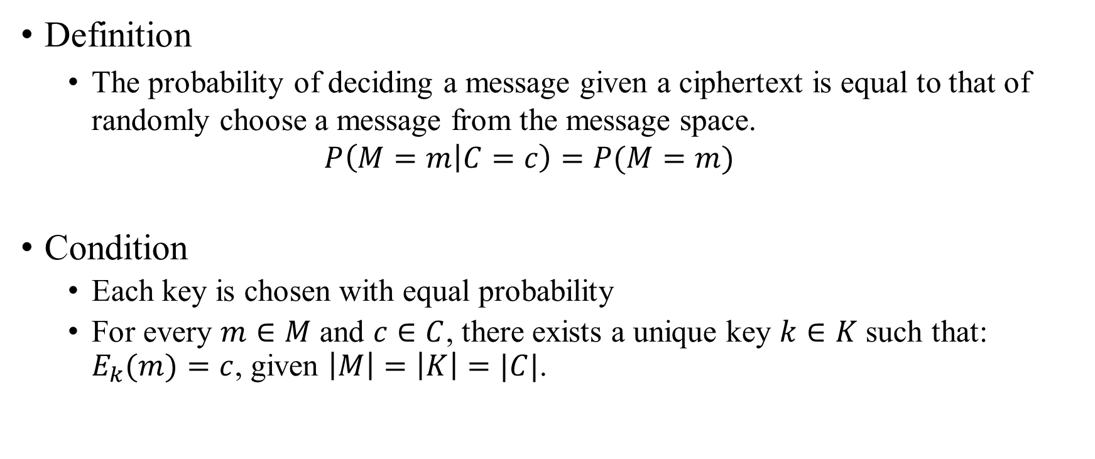
Perfect secrecy
Definition
The probability of deciding a message given a ciphertext is equal to that of randomly choose a message from the message space.
$$P\left(M=m | C=c\right)=P(M=m)$$
Condition
Each key is chosen with equal probability
For every $m∈M$ and $c∈C$, there exists a unique key $k∈K$ such that: $E_{k}(m)=c$, given $\left|M\right|=\left|K\right|=|C|$.

Slide 5
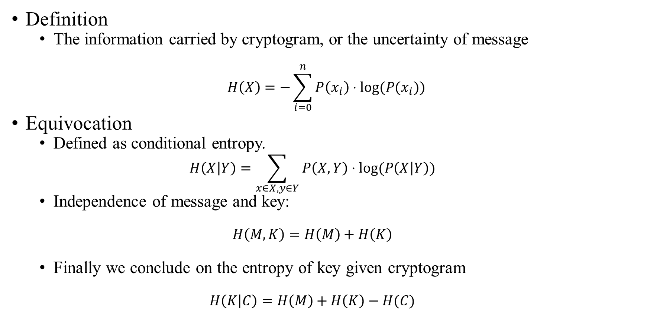
Entropy
Definition
The information carried by cryptogram, or the uncertainty of message
$$H\left(X\right)=−\sum_{i=0}^{n}{P\left(x_{i}\right)⋅log(P(x_{i}))}$$
Equivocation
Defined as conditional entropy.
$$H\left(X | Y\right)=\sum_{x∈X, y∈Y}{P\left(X, Y\right)⋅log(P\left(X | Y\right))}$$
Independence of message and key:
$$H\left(M,K\right)=H\left(M\right)+H\left(K\right)$$
Finally we conclude on the entropy of key given cryptogram
$$H\left(K | C\right)=H\left(M\right)+H\left(K\right)−H(C)$$

Slide 6
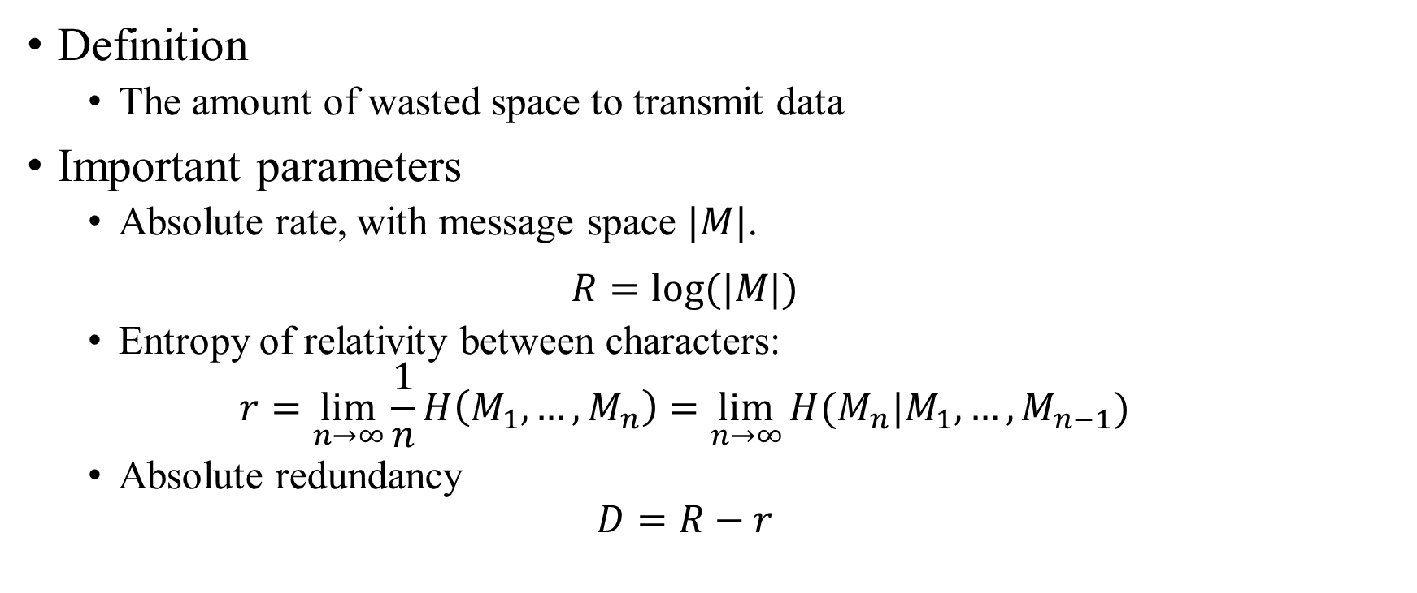
Redundancy
Definition
The amount of wasted space to transmit data
Important parameters
Absolute rate, with message space $|M|$.
$$R=log(|M|)$$
Entropy of relativity between characters:
$$r=\lim_{n→∞}{\frac{1}{n}H\left(M_{1},…,M_{n}\right)=\lim_{n→∞}{H(M_{n}|M_{1},…,M_{n−1})}}$$
Absolute redundancy
$$D=R−r$$

Slide 7
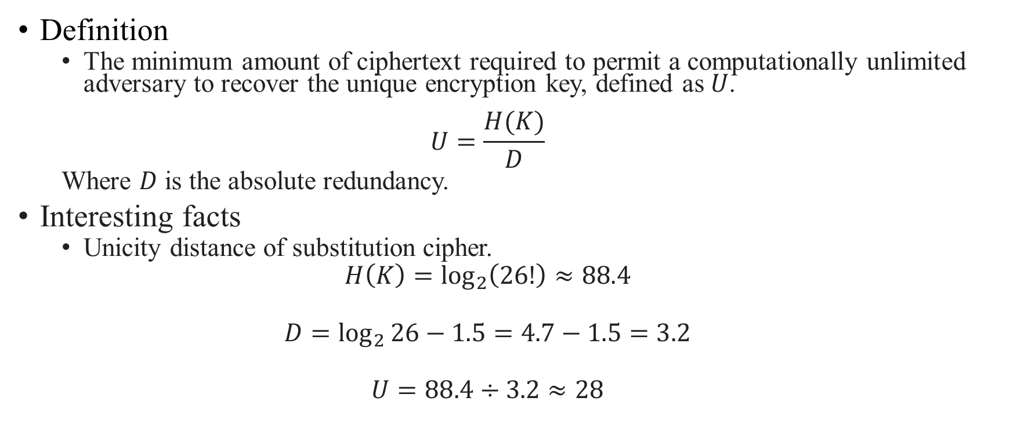
Unicity distance
Definition
The minimum amount of ciphertext required to permit a computationally unlimited adversary to recover the unique encryption key, defined as $U$.
$$U=\frac{H(K)}{D}$$
Where $D$ is the absolute redundancy.
Interesting facts
Unicity distance of substitution cipher.
$$H\left(K\right)=\log_{2}\left(26!\right)≈88.4$$
$$D=\log_{2}{26}−1.5=4.7−1.5=3.2$$
$$U=88.4÷3.2≈28$$

Slide 8
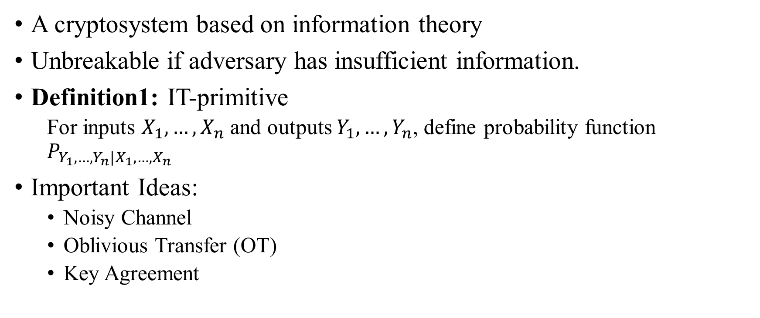
Information-theoretic Cryptography
A cryptosystem based on information theory
Unbreakable if adversary has insufficient information.
Definition1: IT-primitive
For inputs $X_{1},…,X_{n}$ and outputs $Y_{1},…,Y_{n}$, define probability function $P_{Y_{1},…,Y_{n}|X_{1},…,X_{n}}$
Important Ideas:
Noisy Channel
Oblivious Transfer (OT)
Key Agreement

Slide 9
Information-theory Cryptography
Reduction of IT-primitive
Definition 2:
Reduction problem of IT-primitive is the construction of primitive given a specific tolerance of cheating.
Cheating Levels:
Active
Passive
Fail-corrupted

Slide 10
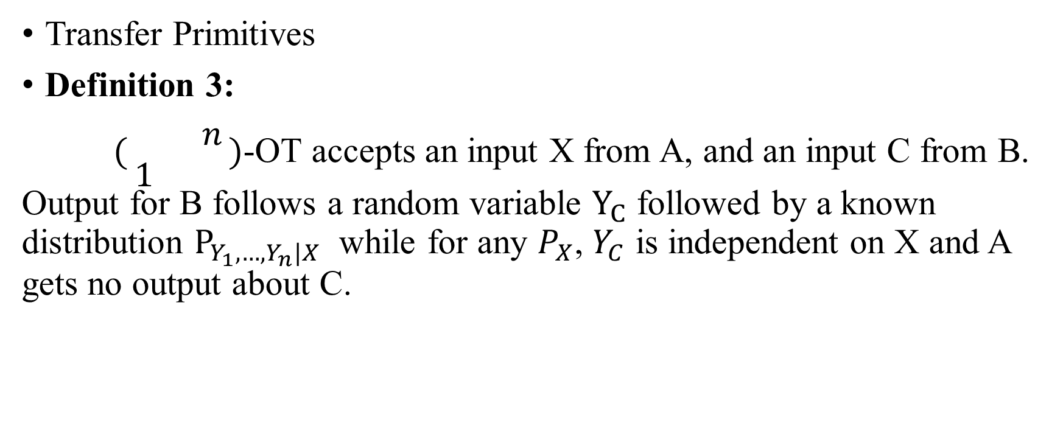
Information-theoretic Cryptography
Transfer Primitives
Definition 3:
$(\begin{matrix} & n \\ 1 & \end{matrix})$-OT accepts an input X from A, and an input C from B. Output for B follows a random variable $Y_{C}$ followed by a known distribution $P_{Y_{1},…,Y_{n}|X}$ while for any $P_{X}$, $Y_{C}$ is independent on X and A gets no output about C.

Slide 11
Hellman’s Extension of the Shannon Theory Approach to Cryptography
Was published in 1977 by Martin Hellman.
Talked about how these properties of Shannon Theory can be applied on cryptography.
Offered some general methods to enhance the safety of the cryptosystem
For substitution cipher, we may improve it by keeping the frequency of the letters or by doing substitution on pair or on words.
A better method is to use numbers instead of letters. If we can uniformly distribute the letters to different numbers, the redundancy will be 0 and it will be very safe.

Slide 12
Generalized Random Oracles
A great example of applications of Shannon Theory. Gain security by setting the redundancy equals to 0.
A generalized random oracle (GRO) is characterized by 1) a set of query operations, each of which takes as input an argument from a certain domain and outputs a corresponding value in a certain range, and 2) a random experiment for which each elementary event in the sample space is a complete set of answers to all possible queries, with some probability distribution over the sample space.

Slide 13
Conclusion
Our study:
Properties of Shannon Theory
Proof of perfect secrecy
Some applications: IT-primitive, Random Oracles…
Limitations:
Further improvement?

Slide 14
Thank you!

